Slide 1
AutoContent Wizard

Slide 2
Introduction
What is the AutoContent Wizard?
Four easy steps to success
Launch your new Presentation

Slide 3
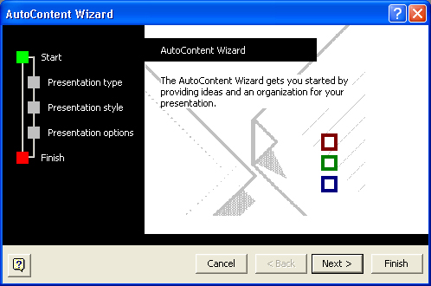
AutoContent Wizard – Step One
The Start of the AutoContent Wizard
Notes:
There’s nothing to do on the first screen. But notice the green dot next to the word Start on the left hand side. The green dot tells you where you are in the Wizard.

Slide 4
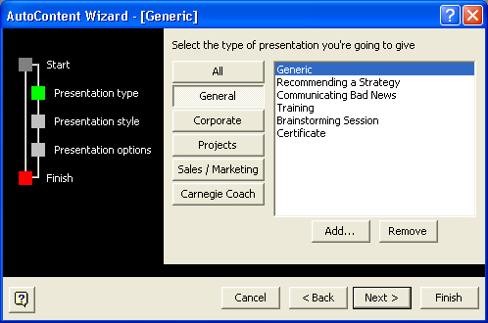
AutoContent wizard – Step Two
Choose a presentation type
Notes:
This step of the Wizard will determine what content the default slides will contain. It will also determine what the background of each slide looks like. Note where the green square is now.

Slide 5
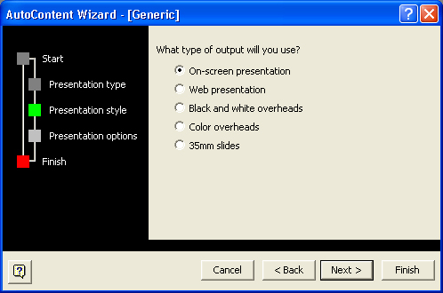
AutoContent wizard – Step Three
How will the presentation be viewed?
Notes:
Discuss the various ways that a PowerPoint presentation can be viewed.

Slide 6
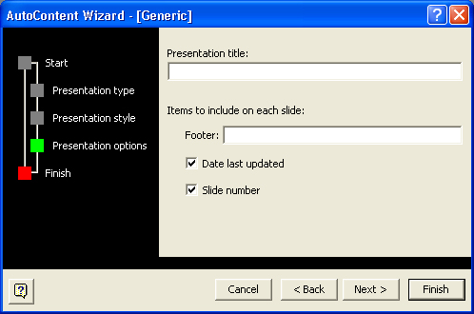
AutoContent wizard – Step Four
Set up a default title and Footer
Notes:
Discuss Slide titles, and the various Footer options.

Slide 7
Conclusion
The AutoContent Wizard is an easy way to start a Presentation
Four easy steps
Finish, and view the results

