Slide 1
Productivity Report
Are we getting the most out of our employees?

Slide 2
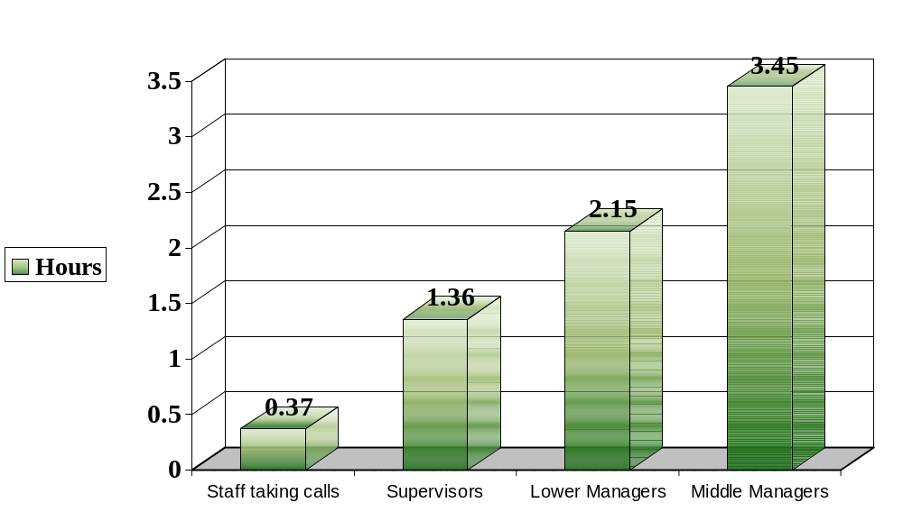
How many hours surfing the internet per day?

Slide 3
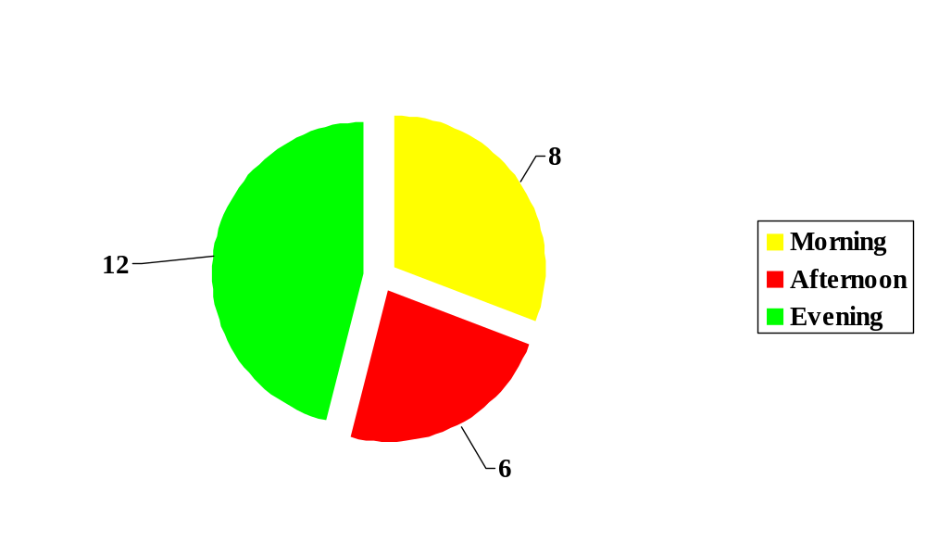
Average Call Handling Time
(in minutes)

Slide 4
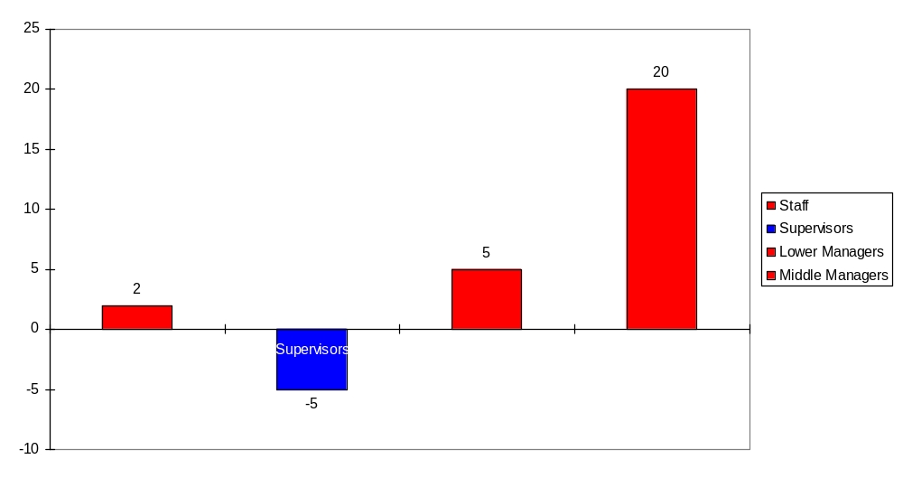
Average time spent on breaks
(Minutes under/over 1 hour)

Slide 5
Call-Structure Discussion Meetings
Supervisor
meets with
Lower Manager
Lower Manager
meets with
Middle Manager
Middle Manager
meets with
Upper Manager
How do we Save Time?
Notes:
Consider having the three boxes move in from the left at each mouse click. Group Box and arrow. Copy and paste boxes after formatting them. Animation effect just for this slide. Custom animation > Order and Timing.

Slide 6
Call-Structure Discussion Meeting
Supervisors
Lower Managers
One Meeting!
Middle Managers
Upper Managers
Notes:
AutoShapes. Copy and Paste other three boxes after formatting first. Start with circle. Guides to position everything. Hold down CTRL on one guide and drag. This will add a another guide.

Slide 7
How happy are you in your job?
 | Overall | With Managers | Pay | Holidays
Middle management | 8 | 7 | 6 | 7
Lower management | 7 | 4 | 3 | 6
Supervisors | 7 | 4 | 5 | 5
Staff taking calls | 2 | 2 | 1 | 4

Slide 8
Conclusion
Managers are spending too much on the Internet
Managers are spending too much time on breaks
Too many meetings!
Warning! Staff taking calls are not happy

