Slide 1

How Setup a Wireless Internet Connection

Slide 2
Introduction
The Basics of connecting a PC to an ADSL router
The difference between Wired and Wireless
What a Wired connection looks like
The Wireless connection

Slide 3
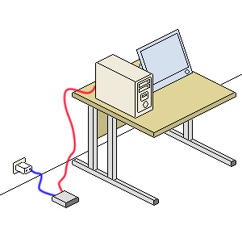
A Basic Wired Setup
An ADSL modem connected to a PC and Phone line
Notes:
Point out the modem, the ADSL filter, the red and blue wires. Discuss what happens when a web page is requested from the internet. Point out that the signals go down the red wire, through the modem, the blue wires, the filter, then the phone line.

Slide 4

A Request for a Web Page
A signal from the PC to the phone line
Notes:
This slide just illustrates the previous one. The only difference between the two images is the moving yellow signal. Use PowerPoint pen to follow the signal.

Slide 5
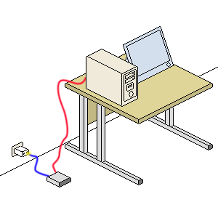
Web Page is sent back to PC
A signal from the phone line to the PC
Notes:
The signal is now reversed – from the phone line to the PC. No need to spend a lot of time on this slide

Slide 6
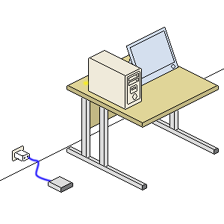
A Wireless Connection
Which wire is missing?
Notes:
Point out that the red wire is missing, and that the signal is now travelling through the air to the ADSL router. The PC needs a wireless card or adapter. The modem is capable of picking up the wireless signal from the PC, and transmitting it down the phone line. Again, use the PowerPoint Pen tool to trace the moving yellow signal.

Slide 7

From the Phone line to the PC
Watch the signal!
Notes:
Signal is now reversed – from the phone line to the PC. Point out that the wireless router is capable of transmitting a signal as well as receiving one.

Slide 8
Conclusion
A Wireless connection can be a handy way to connect a PC to the internet. Especially if the computer is not in the same room as the phone line!
Notes:
Point out that this is just an introduction to the subject. The next presentation will take a closer look at the hardware. Break for lunch!

