Slide 1
William Stallings
Computer Organization and Architecture
7th Edition
Chapter 15
IA-64 Architecture

Slide 2
Background to IA-64
Pentium 4 appears to be last in x86 line
Intel & Hewlett-Packard (HP) jointly developed
New architecture
  64 bit architecture
  Not extension of x86
  Not adaptation of HP 64bit RISC architecture
Exploits vast circuitry and high speeds
Systematic use of parallelism
Departure from superscalar

Slide 3
Motivation
Instruction level parallelism
  Implicit in machine instruction
  Not determined at run time by processor
Long or very long instruction words (LIW/VLIW)
Branch predication (not the same as branch prediction)
Speculative loading
Intel & HP call this Explicit Parallel Instruction Computing (EPIC)
IA-64 is an instruction set architecture intended for implementation on EPIC
Itanium is first Intel product

Slide 4
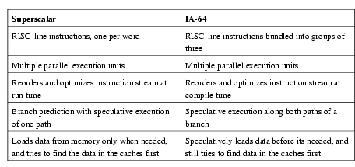
Superscalar v IA-64

Slide 5
Why New Architecture?
Not hardware compatible with x86
Now have tens of millions of transistors available on chip
Could build bigger cache
  Diminishing returns
Add more execution units
  Increase superscaling
  “Complexity wall”
  More units makes processor “wider”
  More logic needed to orchestrate
  Improved branch prediction required
  Longer pipelines required
  Greater penalty for misprediction
  Larger number of renaming registers required
  At most six instructions per cycle

Slide 6
Explicit Parallelism
Instruction parallelism scheduled at compile time
  Included with machine instruction
Processor uses this info to perform parallel execution
Requires less complex circuitry
Compiler has much more time to determine possible parallel operations
Compiler sees whole program

Slide 7
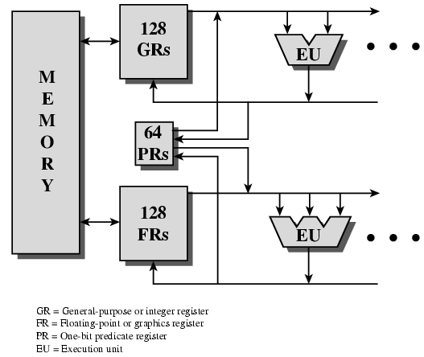
General Organization

Slide 8
Key Features
Large number of registers
  IA-64 instruction format assumes 256
    128 * 64 bit integer, logical & general purpose
    128 * 82 bit floating point and graphic
  64 * 1 bit predicated execution registers (see later)
  To support high degree of parallelism
Multiple execution units
  Expected to be 8 or more
  Depends on number of transistors available
  Execution of parallel instructions depends on hardware available
    8 parallel instructions may be spilt into two lots of four if only four execution units are available

Slide 9
IA-64 Execution Units
I-Unit
  Integer arithmetic
  Shift and add
  Logical
  Compare
  Integer multimedia ops
M-Unit
  Load and store
    Between register and memory
  Some integer ALU
B-Unit
  Branch instructions
F-Unit
  Floating point instructions

Slide 10
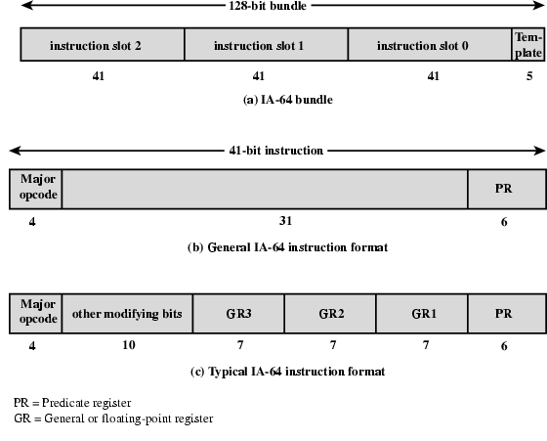
Instruction Format Diagram

Slide 11
Instruction Format
128 bit bundle
  Holds three instructions (syllables) plus template
  Can fetch one or more bundles at a time
  Template contains info on which instructions can be executed in parallel
    Not confined to single bundle
    e.g. a stream of 8 instructions may be executed in parallel
    Compiler will have re-ordered instructions to form contiguous bundles
    Can mix dependent and independent instructions in same bundle
  Instruction is 41 bit long
    More registers than usual RISC
    Predicated execution registers (see later)

Slide 12
Assembly Language Format
[qp] mnemonic [.comp] dest = srcs //
qp - predicate register
  1 at execution then execute and commit result to hardware
  0 result is discarded
mnemonic - name of instruction
comp – one or more instruction completers used to qualify mnemonic
dest – one or more destination operands
srcs – one or more source operands
// - comment
Instruction groups and stops indicated by ;;
  Sequence without read after write or write after write
  Do not need hardware register dependency checks

Slide 13
Assembly Examples
ld8 r1 = [r5] ;; //first group
add r3 = r1, r4 //second group
Second instruction depends on value in r1
  Changed by first instruction
  Can not be in same group for parallel execution

Slide 14
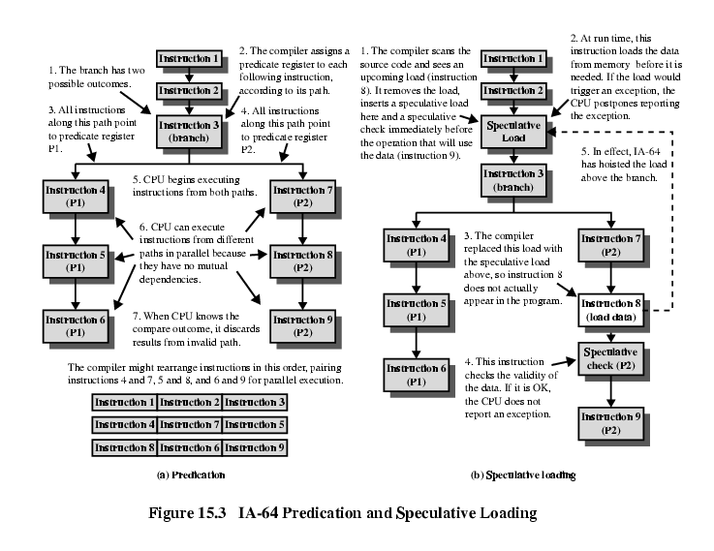
Predication

Slide 15
Speculative
Loading

Slide 16
Control & Data Speculation
Control
  AKA Speculative loading
  Load data from memory before needed
Data
  Load moved before store that might alter memory location
  Subsequent check in value

Slide 17
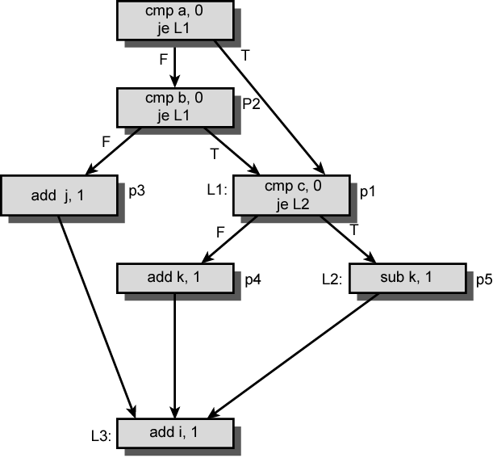
Example of Prediction

Slide 18
Software Pipelining
L1: ld4 r4=[r5],4 ;; //cycle 0 load postinc 4
add r7=r4,r9 ;; //cycle 2
st4 [r6]=r7,4 //cycle 3 store postinc 4
br.cloop L1 ;; //cycle 3
Adds constant to one vector and stores result in another
No opportunity for instruction level parallelism
Instruction in iteration x all executed before iteration x+1 begins
If no address conflicts between loads and stores can move independent instructions from loop x+1 to loop x

Slide 19
Unrolled Loop
ld4 r32=[r5],4;; //cycle 0
ld4 r33=[r5],4;; //cycle 1
ld4 r34=[r5],4 //cycle 2
add r36=r32,r9;; //cycle 2
ld4 r35=[r5],4 //cycle 3
add r37=r33,r9 //cycle 3
st4 [r6]=r36,4;; //cycle 3
ld4 r36=[r5],4 //cycle 3
add r38=r34,r9 //cycle 4
st4 [r6]=r37,4;; //cycle 4
add r39=r35,r9 //cycle 5
st4 [r6]=r38,4;; //cycle 5
add r40=r36,r9 //cycle 6
st4 [r6]=r39,4;; //cycle 6
st4 [r6]=r40,4;; //cycle 7

Slide 20
Unrolled Loop Detail
Completes 5 iterations in 7 cycles
  Compared with 20 cycles in original code
Assumes two memory ports
  Load and store can be done in parallel

Slide 21
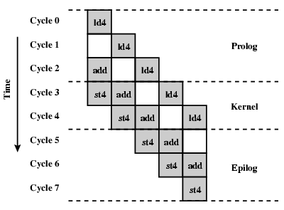
Software Pipeline Example Diagram

Slide 22
Support For Software Pipelining
Automatic register renaming
  Fixed size are of predicate and fp register file (p16-P32, fr32-fr127) and programmable size area of gp register file (max r32-r127) capable of rotation
  Loop using r32 on first iteration automatically uses r33 on second
Predication
  Each instruction in loop predicated on rotating predicate register
    Determines whether pipeline is in prolog, kernel or epilog
Special loop termination instructions
  Branch instructions that cause registers to rotate and loop counter to decrement

Slide 23
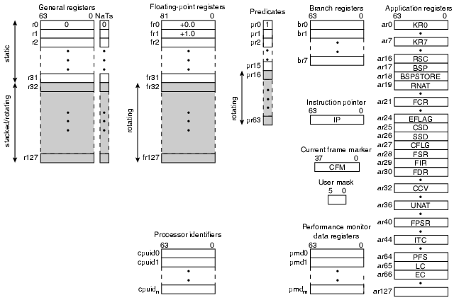
IA-64 Register Set

Slide 24
IA-64 Registers (1)
General Registers
  128 gp 64 bit registers
  r0-r31 static
    references interpreted literally
  r32-r127 can be used as rotating registers for software pipeline or register stack
    References are virtual
    Hardware may rename dynamically
Floating Point Registers
  128 fp 82 bit registers
  Will hold IEEE 745 double extended format
  fr0-fr31 static, fr32-fr127 can be rotated for pipeline
Predicate registers
  64 1 bit registers used as predicates
  pr0 always 1 to allow unpredicated instructions
  pr1-pr15 static, pr16-pr63 can be rotated

Slide 25
IA-64 Registers (2)
Branch registers
  8 64 bit registers
Instruction pointer
  Bundle address of currently executing instruction
Current frame marker
  State info relating to current general register stack frame
  Rotation info for fr and pr
  User mask
    Set of single bit values
    Allignment traps, performance monitors, fp register usage monitoring
Performance monitoring data registers
  Support performance monitoring hardware
Application registers
  Special purpose registers

Slide 26
Register Stack
Avoids unnecessary movement of data at procedure call & return
Provides procedure with new frame up to 96 registers on entry
  r32-r127
Compiler specifies required number
  Local
  output
Registers renamed so local registers from previous frame hidden
Output registers from calling procedure now have numbers starting r32
Physical registers r32-r127 allocated in circular buffer to virtual registers
Hardware moves register contents between registers and memory if more registers needed

Slide 27
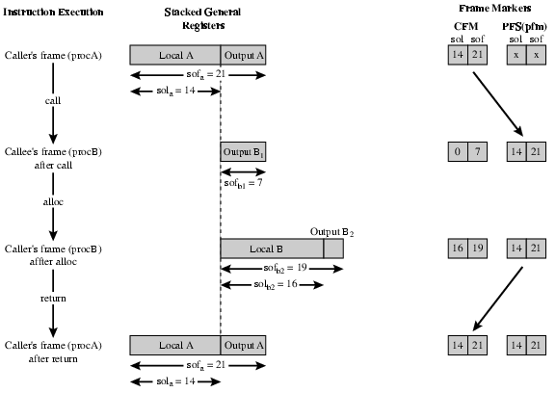
Register Stack Behaviour

Slide 28
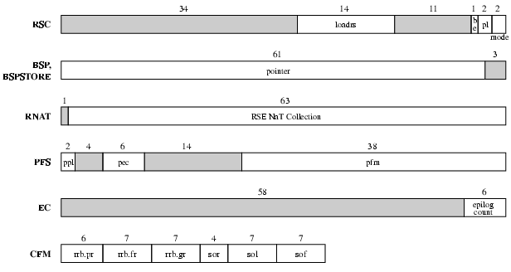
Register Formats

Slide 29
Itanium Organization
Superscalar features
  Six wide, ten stage deep hardware pipeline
  Dynamic prefetch
  branch prediction
  register scoreboard to optimise for compile time nondeterminism
EPIC features
  Hardware support for predicated execution
  Control and data speculation
  Software pipelining

Slide 30
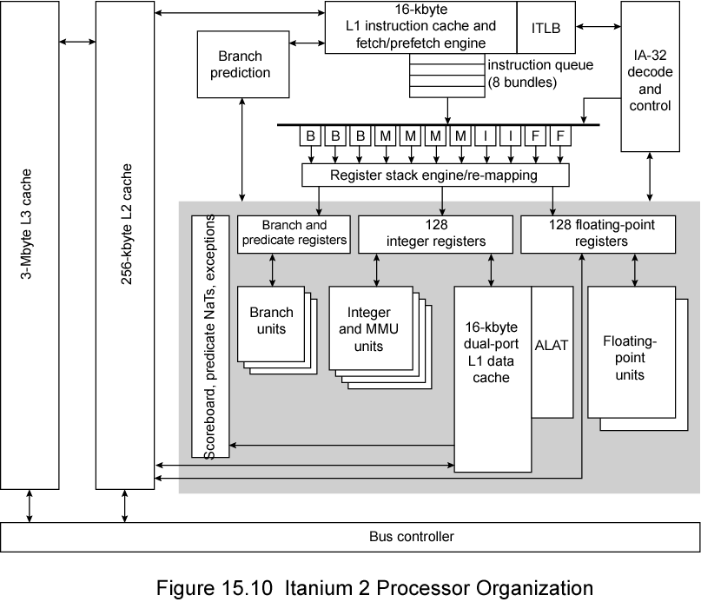
Itanium 2 Processor Diagram

Slide 31
Itanium 2 (1)
8-stage pipeline
  All but floating-point instructions
Pipeline stages
  Instruction pointer generation (IPG)
    Delivers and instruction pointer to L1I cache
  Instruction rotation (ROT)
    Fetch instructions and rotate into position
    Bundle 0 contains first instruction to be executed
  Instruction template decode, expand and disperse (EXP)
    Decode instruction templates
    Disperse up to 6 instructions through 11 ports in conjunction with opcode information for execution units
  Rename and decode (REN)
    Rename (remap) registers for register stack engine
    Decode instructions
  Register file read (REG)
    Delivers operands to execution units

Slide 32
Itanium 2 (2)
  ALU execution (EXE)
    Execute operations
  Last stage for exception detection (DET)
    Detect exceptions
    Abandon result if instruction predicate not true
    Resteer mispredicted branches
  Write back (WRB)
    Write results back to register file
Floating-point instructions
  First five stages same
  Followed by four floating-point pipeline stages
  Followed by write-back stage

Slide 33
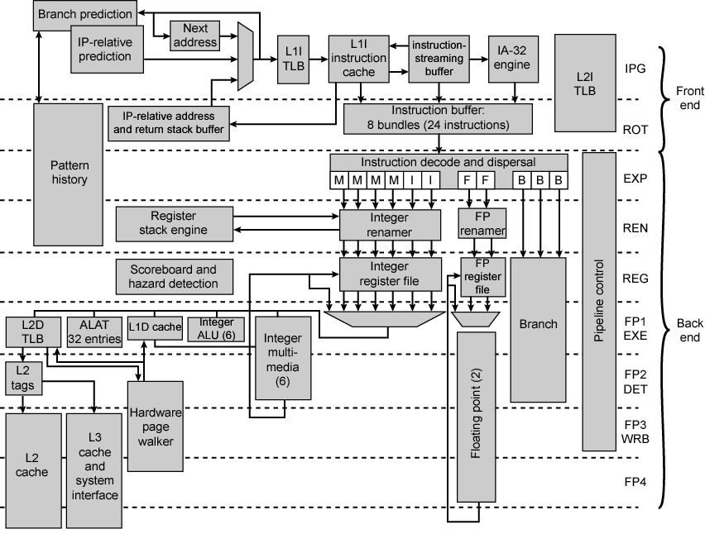
Itanium 2 Processor Pipeline

Slide 34
Required Reading
Stallings chapter 15
Intel web site
IMPACT
  University of Illinois

