Slide 1
Main Memory
Additional slide courtesy: Prof. Mandar Mitra

Slide 2
Contiguous Allocation
Main memory must support both OS and user processes
Contiguous allocation is one early method
Main memory usually into two variable-sized partitions:
Resident operating system, usually held in low memory with interrupt vector
User processes then held in high memory
Each process contained in single contiguous section of memory

Slide 3
Contiguous Allocation
Multiple-partition allocation
OS maintains a list of allocated / free partitions (holes)
Hole – block of available memory; holes of various size are scattered throughout memory
When a process arrives, it is allocated memory from a hole large enough to accommodate it
Memory is allocated to processes until requirements of next process in queue cannot be met
OS may skip down the queue to allocate memory to a smaller process that fits in available memory
Process exiting frees its partition, adjacent free partitions combined

Slide 4
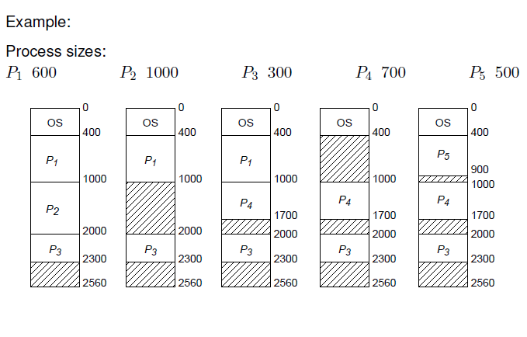
Contiguous Allocation

Slide 5
Dynamic Storage-Allocation Problem
How to satisfy a request of size n from a list of free holes?
First-fit: Allocate the first hole that is big enough
Best-fit: Allocate the smallest hole that is big enough; must search entire list, unless ordered by size
Produces the smallest leftover hole
Worst-fit: Allocate the largest hole; must also search entire list
Produces the largest leftover hole
First-fit and best-fit better than worst-fit in terms of speed and storage utilization
-- depends on the implementation

Slide 6
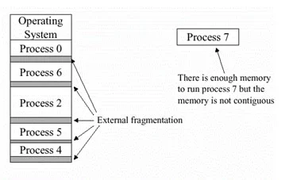
Fragmentation
External Fragmentation – total memory space exists to satisfy a request, but it is not contiguous
May be reduced slightly by allocating from appropriate end (top / bottom) of hole

Slide 7
Compaction
Reduce external fragmentation by compaction
Shuffle memory contents to place all free memory together in one large block
Compaction is possible only if relocation is dynamic, and is done at execution time
I/O problem
Latch job in memory while it is involved in I/O
Do I/O only into OS buffers

Slide 8
Paging
Physical address space of a process can be noncontiguous; process is allocated physical memory whenever the latter is available
Avoids external fragmentation
Avoids problem of varying sized memory chunks
Divide physical memory into fixed-sized blocks called frames
Size defined by hardware
Size is power of 2, between 512 bytes and 16 Mbytes
Divide logical memory into blocks of same size called pages
Kernel to keep track of all free frames

Slide 9
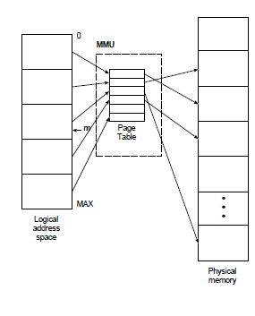
Paging
To run a program of size N pages, need to find N free frames and load program
Set up a page table to translate logical to physical addresses
Still have Internal fragmentation

Slide 10
Address Translation Scheme
Address generated by CPU is divided into:
Page number (p) – used as an index into a page table which contains base address of each page in physical memory
Page offset (d) – combined with base address to define the physical memory address that is sent to the memory unit
For given logical address space 2^{m} and page size 2^{n}

Slide 11

Paging Hardware

Slide 12

Paging Model of Logical and Physical Memory

Slide 13

Paging Example
Logical address: n = 2 and m = 4. Using a page size of 4 bytes and a physical memory of 32 bytes (8 pages)

Slide 14

Free Frames
Before allocation
After allocation

Slide 15
Paging -- Calculating internal fragmentation
Page size = 2,048 bytes, Process size = 72,766 bytes
35 pages + 1,086 bytes
Internal fragmentation of 2,048 - 1,086 = 962 bytes

Slide 16
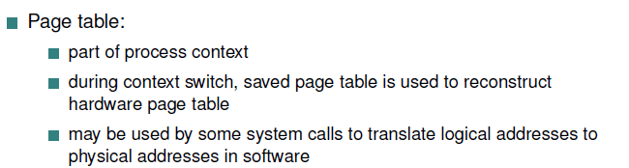
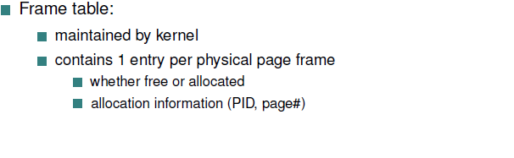
Paging

Slide 17
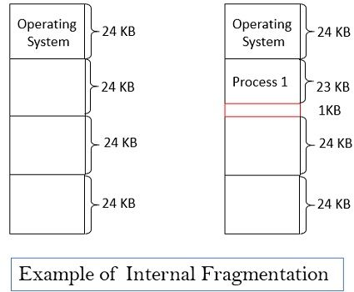
Internal Fragmentation
Internal Fragmentation – allocated memory may be slightly larger than requested memory;
Memory within a partition may be left unused

Slide 18
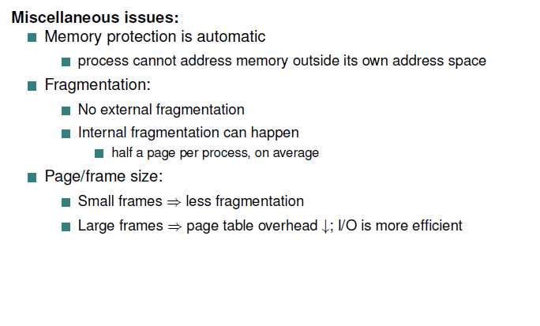
Paging

Slide 19
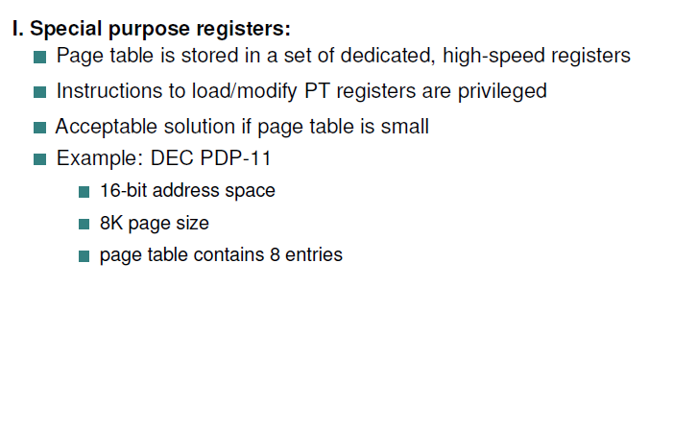
Implementation of Page Table

Slide 20
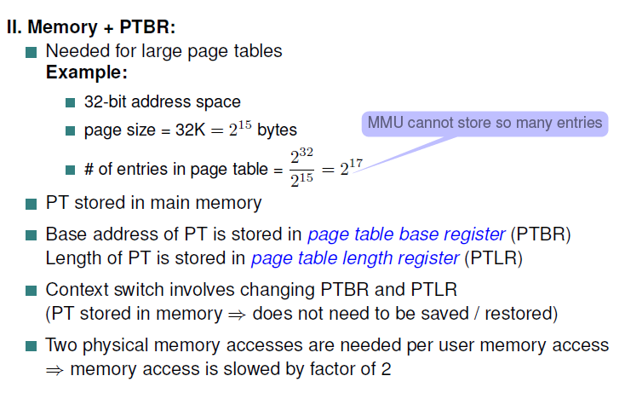
Implementation of Page Table
One for the page table and one for the data / instruction

Slide 21
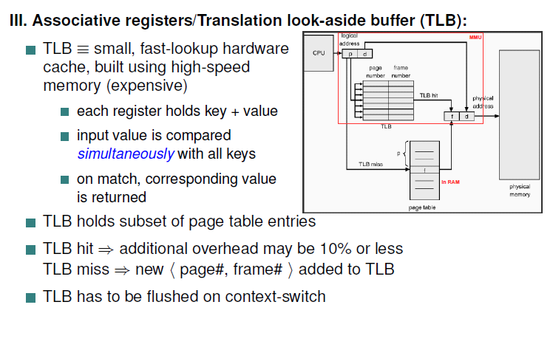
Implementation of Page Table

Slide 22
Translation Look-Aside Buffer
TLBs typically small (64 to 1,024 entries)
On a TLB miss, value is loaded into the TLB for faster access next time
Replacement policies must be considered

Slide 23
Effective Access Time
Hit ratio – percentage of times that a page number is found in the TLB
An 80% hit ratio means that we find the desired page number in the TLB 80% of the time.
Suppose that 10 nanoseconds to access memory.
If we find the page in TLB then a mapped-memory access take 10 ns
Otherwise we need two memory access so it is 20 ns
Effective Access Time (EAT): average time for memory access (including TLB lookup)
EAT = 0.80 x 10 + 0.20 x 20 = 12 nanoseconds
implying 20% slowdown in access time
Consider a more realistic hit ratio of 99%,
EAT = 0.99 x 10 + 0.01 x 20 = 10.1ns
implying only 1% slowdown in access time.

Slide 24
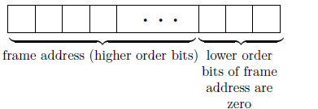
Memory Protection
Memory protection implemented by associating protection bit with each frame to indicate if read-only or read-write access is allowed
Can also add more bits to indicate page execute-only, and so on
protection bit checked in parallel with address computation
Valid-invalid bit attached to each entry in the page table:
“valid” indicates that the associated page is in the process’ logical address space, and is thus a legal page
“invalid” indicates that the page is not in the process’ logical address space
protection violation (e.g. writing to read-only page) causes hardware trap to kernel

Slide 25

Valid (v) or Invalid (i) Bit In A Page Table

Slide 26
Shared Pages
Shared code
One copy of read-only code shared among processes (i.e., text editors, compilers, window systems)
Also useful for interprocess communication if sharing of read-write pages is allowed
Private code and data
Each process keeps a separate copy of the code and data
The pages for the private code and data can appear anywhere in the logical address space

Slide 27

Shared Pages Example

Slide 28
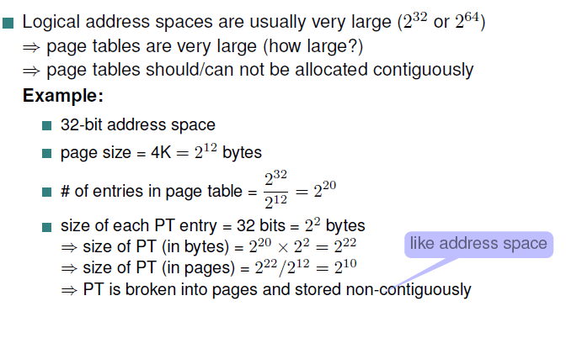
Structure of the Page Table
Multi-level paging I

Slide 29
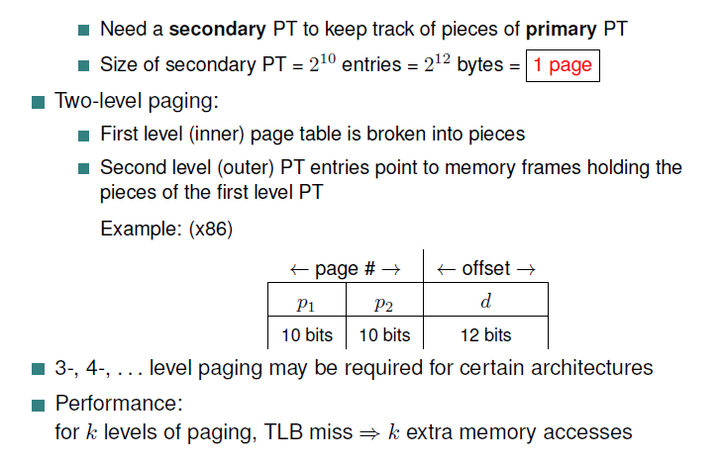
Multi-level paging II / Hierarchical PT
where p₁ is an index into the outer page table, and p₂ is the displacement within the page of the inner page table

Slide 30

2-level Page Table example
Break up the logical address space into multiple page tables
We then page the page table
Known as forward-mapped page table

Slide 31

Address-Translation Scheme

Slide 32
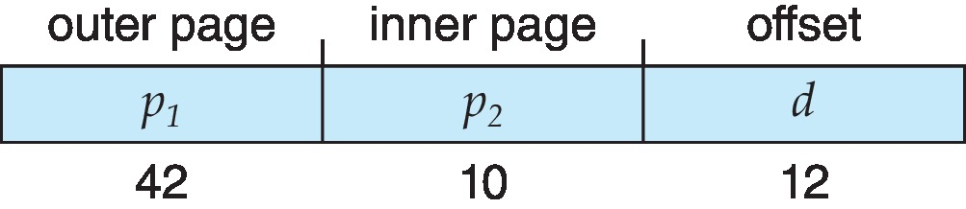
64-bit Logical Address Space
Even two-level paging scheme not sufficient
If page size is 4 KB (2¹²)
Then page table has 2⁵² entries
If two level scheme, inner page tables could be 2¹⁰ 4-byte entries
Address would look like
Outer page table has 2⁴² entries or 2⁴⁴ bytes
One solution is to add a 2nd outer page table
But in the following example the 2nd outer page table is still 2³⁴ bytes in size
And possibly 4 memory access to get to one physical memory location

Slide 33


Three-level Paging Scheme

