Slide 1
Tree-based Classifiers and Ensemble Methods
By
Swagatam Das
Electronics and Communication Sciences Unit,
Indian Statistical Institute, Kolkata – 700 108, India.
E-mail:swagatam.das@isical.ac.in
WSDL 2025

Slide 2
Introduction
Decision tree learning is one of the most widely used techniques for classification.
Its classification accuracy is competitive with other methods, and
it is very efficient.
The classification model is a tree, called decision tree.
C4.5 by Ross Quinlan is perhaps the best-known system, and the codes are freely available from the internet.

Slide 3
A toy data of loan applicants
Approved or not
ID | Age | Has_Job | Own_House | Credit_Rating | Class
1 | Young | false | false | fair | No
2 | Young | false | false | good | No
3 | Young | true | false | good | Yes
4 | Young | true | true | fair | Yes
5 | Young | false | false | fair | No
6 | Middle | false | false | fair | No
7 | Middle | false | false | good | No
8 | Middle | true | true | good | Yes
9 | Middle | false | true | excellent | Yes
10 | Middle | false | true | excellent | Yes
11 | Old | false | true | excellent | Yes
12 | Old | false | true | good | Yes
13 | Old | true | false | good | Yes
14 | Old | true | false | excellent | Yes
15 | Old | false | false | fair | No

Slide 4
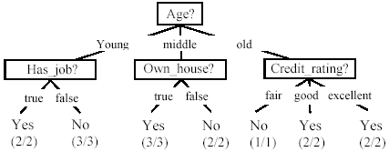
A decision tree from the loan data
Decision nodes and leaf nodes (classes)

Slide 5

Use the decision tree
No

Slide 6
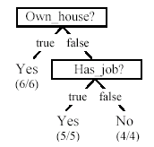
Is the decision tree unique?
No. Here is a simpler tree.
We want a smaller tree and an accurate tree.
Easy to understand and perform better.
Finding the best tree is NP-hard.
All current tree-building algorithms are heuristic algorithms

Slide 7


From a decision tree to a set of rules
A decision tree can be converted to a set of rules
Each path from the root to a leaf is a rule.

Slide 8
Algorithm for decision tree learning
Basic algorithm (a greedy divide-and-conquer algorithm)
Assume attributes are categorical now (continuous attributes can be handled too)
Tree is constructed in a top-down recursive manner
At start, all the training examples are at the root
Examples are partitioned recursively based on selected attributes
Attributes are selected on the basis of an impurity function (e.g., information gain)
Conditions for stopping partitioning
All examples for a given node belong to the same class
There are no remaining attributes for further partitioning – majority class is the leaf
There are no examples left

Slide 9
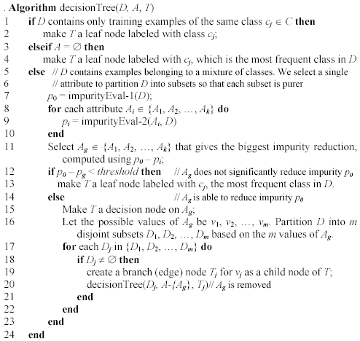
Decision tree learning algorithm

Slide 10
Choose an attribute to partition data
The key to building a decision tree - which attribute to choose in order to branch.
The objective is to reduce impurity or uncertainty in data as much as possible.
A subset of data is pure if all instances belong to the same class.
The heuristic in C4.5 is to choose the attribute with the maximum Information Gain or Gain Ratio based on information theory.

Slide 11
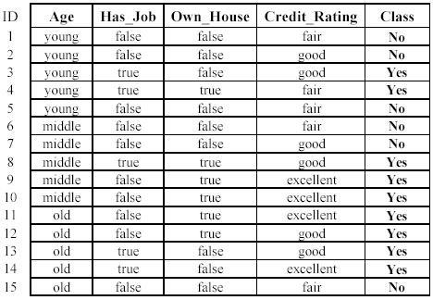
The loan data (reproduced)
Approved or not

Slide 12
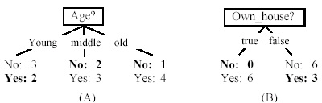
Two possible roots, which is better?
Fig. (B) seems to be better.

Slide 13
Information theory
Information theory provides a mathematical basis for measuring the information content.
To understand the notion of information, think about it as providing the answer to a question, for example, whether a coin will come up heads.
If one already has a good guess about the answer, then the actual answer is less informative.
If one already knows that the coin is rigged so that it will come with heads with a probability of 0.99, then a message (advanced information) about the actual outcome of a flip is worth less than it would be for an honest coin (50-50).

Slide 14
Information theory (cont …)
For a fair (honest) coin, you have no information, and you are willing to pay more (say in terms of $) for advanced information - less you know, the more valuable the information.
Information theory uses this same intuition, but instead of measuring the value for information in dollars, it measures information contents in bits.
One bit of information is enough to answer a yes/no question about which one has no idea, such as the flip of a fair coin

Slide 15
Information theory: Entropy measure
The entropy formula,
Pr(c_{j}) is the probability of class c_{j} in data set D
We use entropy as a measure of impurity or disorder of data set D. (Or, a measure of information in a tree)

Slide 16
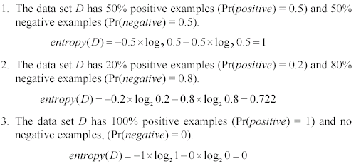
Entropy measure: let us get a feeling
As the data become purer and purer, the entropy value becomes smaller and smaller. This is useful to us!

Slide 17

Information gain
Given a set of examples D, we first compute its entropy:
If we make attribute A_{i}, with v values, the root of the current tree, this will partition D into v subsets D₁, D₂ …, D_{v} . The expected entropy if A_{i} is used as the current root:

Slide 18
Information gain (cont …)
Information gained by selecting attribute A_{i} to branch or to partition the data is
We choose the attribute with the highest gain to branch/split the current tree.

Slide 19
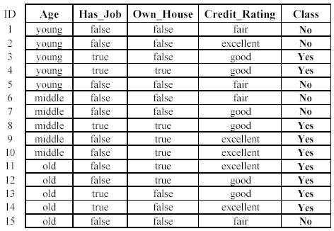

An example
Own_house is the best choice for the root.

Slide 20
We build the final tree
We can use information gain ratio to evaluate the impurity as well

Slide 21
Handling continuous attributes
Handle continuous attribute by splitting into two intervals (can be more) at each node.
How to find the best threshold to divide?
Use information gain or gain ratio again
Sort all the values of an continuous attribute in increasing order {v₁, v₂, …, v_{r}},
One possible threshold between two adjacent values v_{i} and v_{i+1}. Try all possible thresholds and find the one that maximizes the gain (or gain ratio).

Slide 22
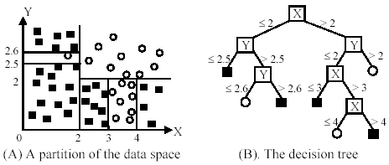
An example in a continuous space

Slide 23
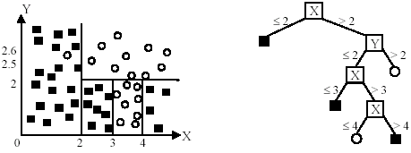
An example
Likely to overfit the data

Slide 24
Ensemble
Applications: classification, clustering, collaborative filtering, anomaly detection……
http://ews.uiuc.edu/~jinggao3/sdm10ensemble.htm

Slide 25
Motivations
Motivations of ensemble methods
Ensemble model improves accuracy and robustness over single model methods
Applications:
distributed computing
privacy-preserving applications
large-scale data with reusable models
multiple sources of data
Efficiency: a complex problem can be decomposed into multiple sub-problems that are easier to understand and solve (divide-and-conquer approach)

Slide 26
from T. Holloway, Introduction to Ensemble Learning, 2007.

Slide 27
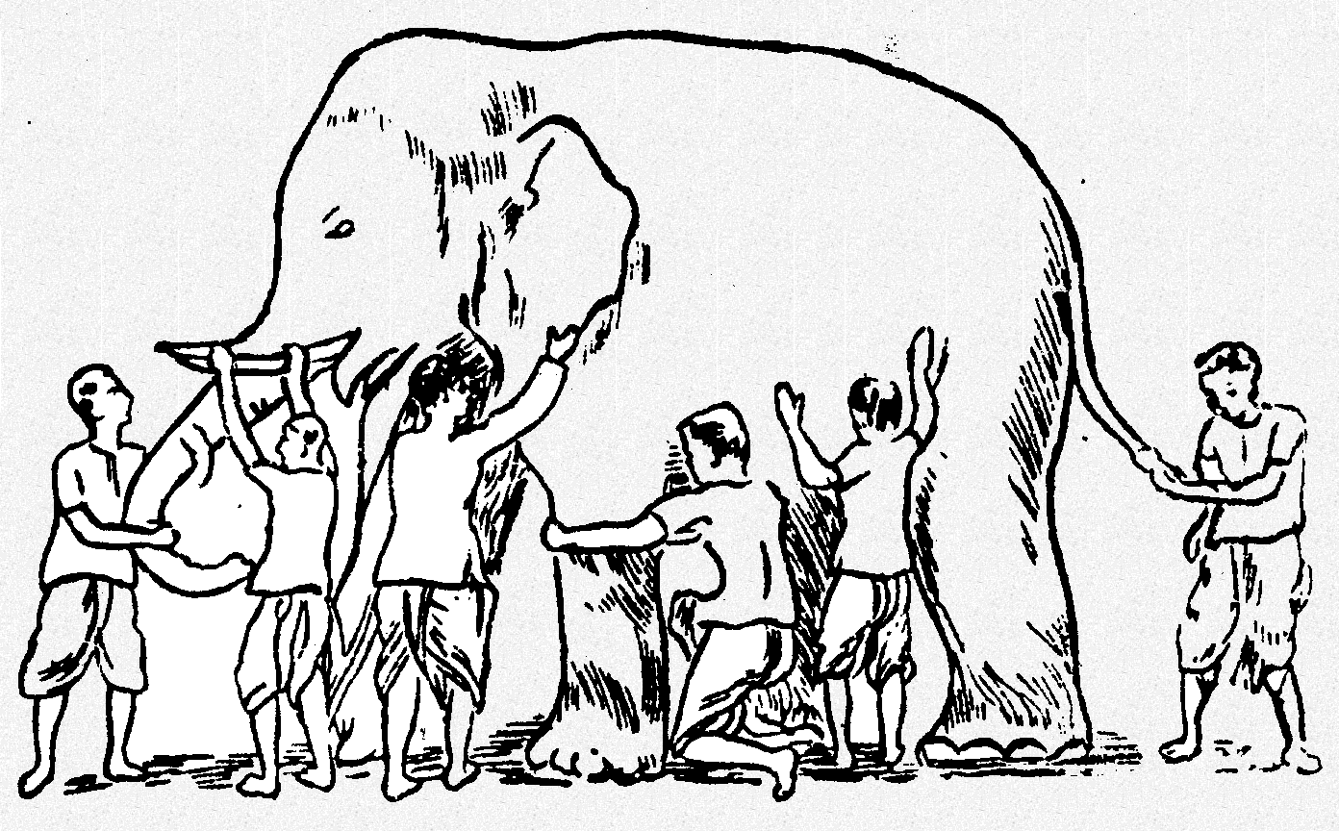
Why Ensemble Works? (2)
Some unknown distribution
Model 1
Model 6
Model 3
Model 5
Model 2
Model 4
Ensemble gives the global picture!

Slide 28
Ensemble of Classifiers—Learn to Combine
training
test
classifier 1
Ensemble model
labeled
data
unlabeled
data
classifier 2
……
classifier k
final
predictions
learn the combination from labeled data
Algorithms: boosting, stacked generalization, rule ensemble, Bayesian model averaging……

Slide 29
Ensemble of Classifiers—Consensus
training
test
classifier 1
labeled
data
unlabeled
data
combine the predictions by majority voting
classifier 2
……
classifier k
final
predictions
Algorithms: bagging, random forest, random decision tree, model averaging of probabilities……

Slide 30
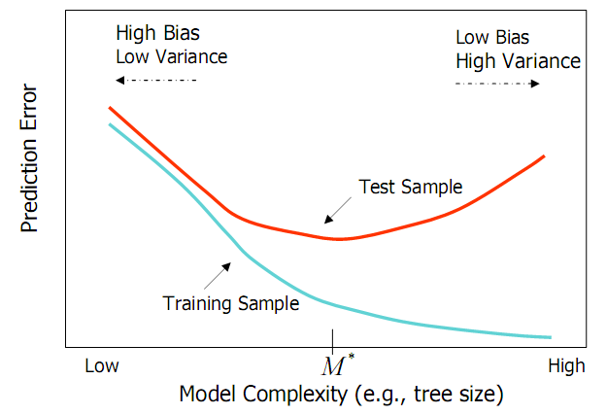
Bias and Variance
Ensemble methods
Combine learners to reduce variance
from Elder, John. From Trees to Forests and Rule Sets - A Unified Overview of Ensemble Methods. 2007.

Slide 31
Generating Base Classifiers
Sampling training examples
Train k classifiers on k subsets drawn from the training set
Using different learning models
Use all the training examples, but apply different learning algorithms
Sampling features
Train k classifiers on k subsets of features drawn from the feature space
Learning “randomly”
Introduce randomness into learning procedures

Slide 35
Random forest classifier
Random forest classifier, an extension to bagging which uses de-correlated trees.

Slide 36
Random Forest Classifier
Training Data
M features
N examples
Notes:
As the classifier of choice we adopt Random Forest Classifier, due to its robustness to heterogenous and noisy feature.
Random Forest is an ensemble classifier. Briefly, given N data and M features, bootsrap samples are created from the traning data

Slide 37
Random Forest Classifier
Create bootstrap samples
from the training data
M features
N examples
....…

Slide 38
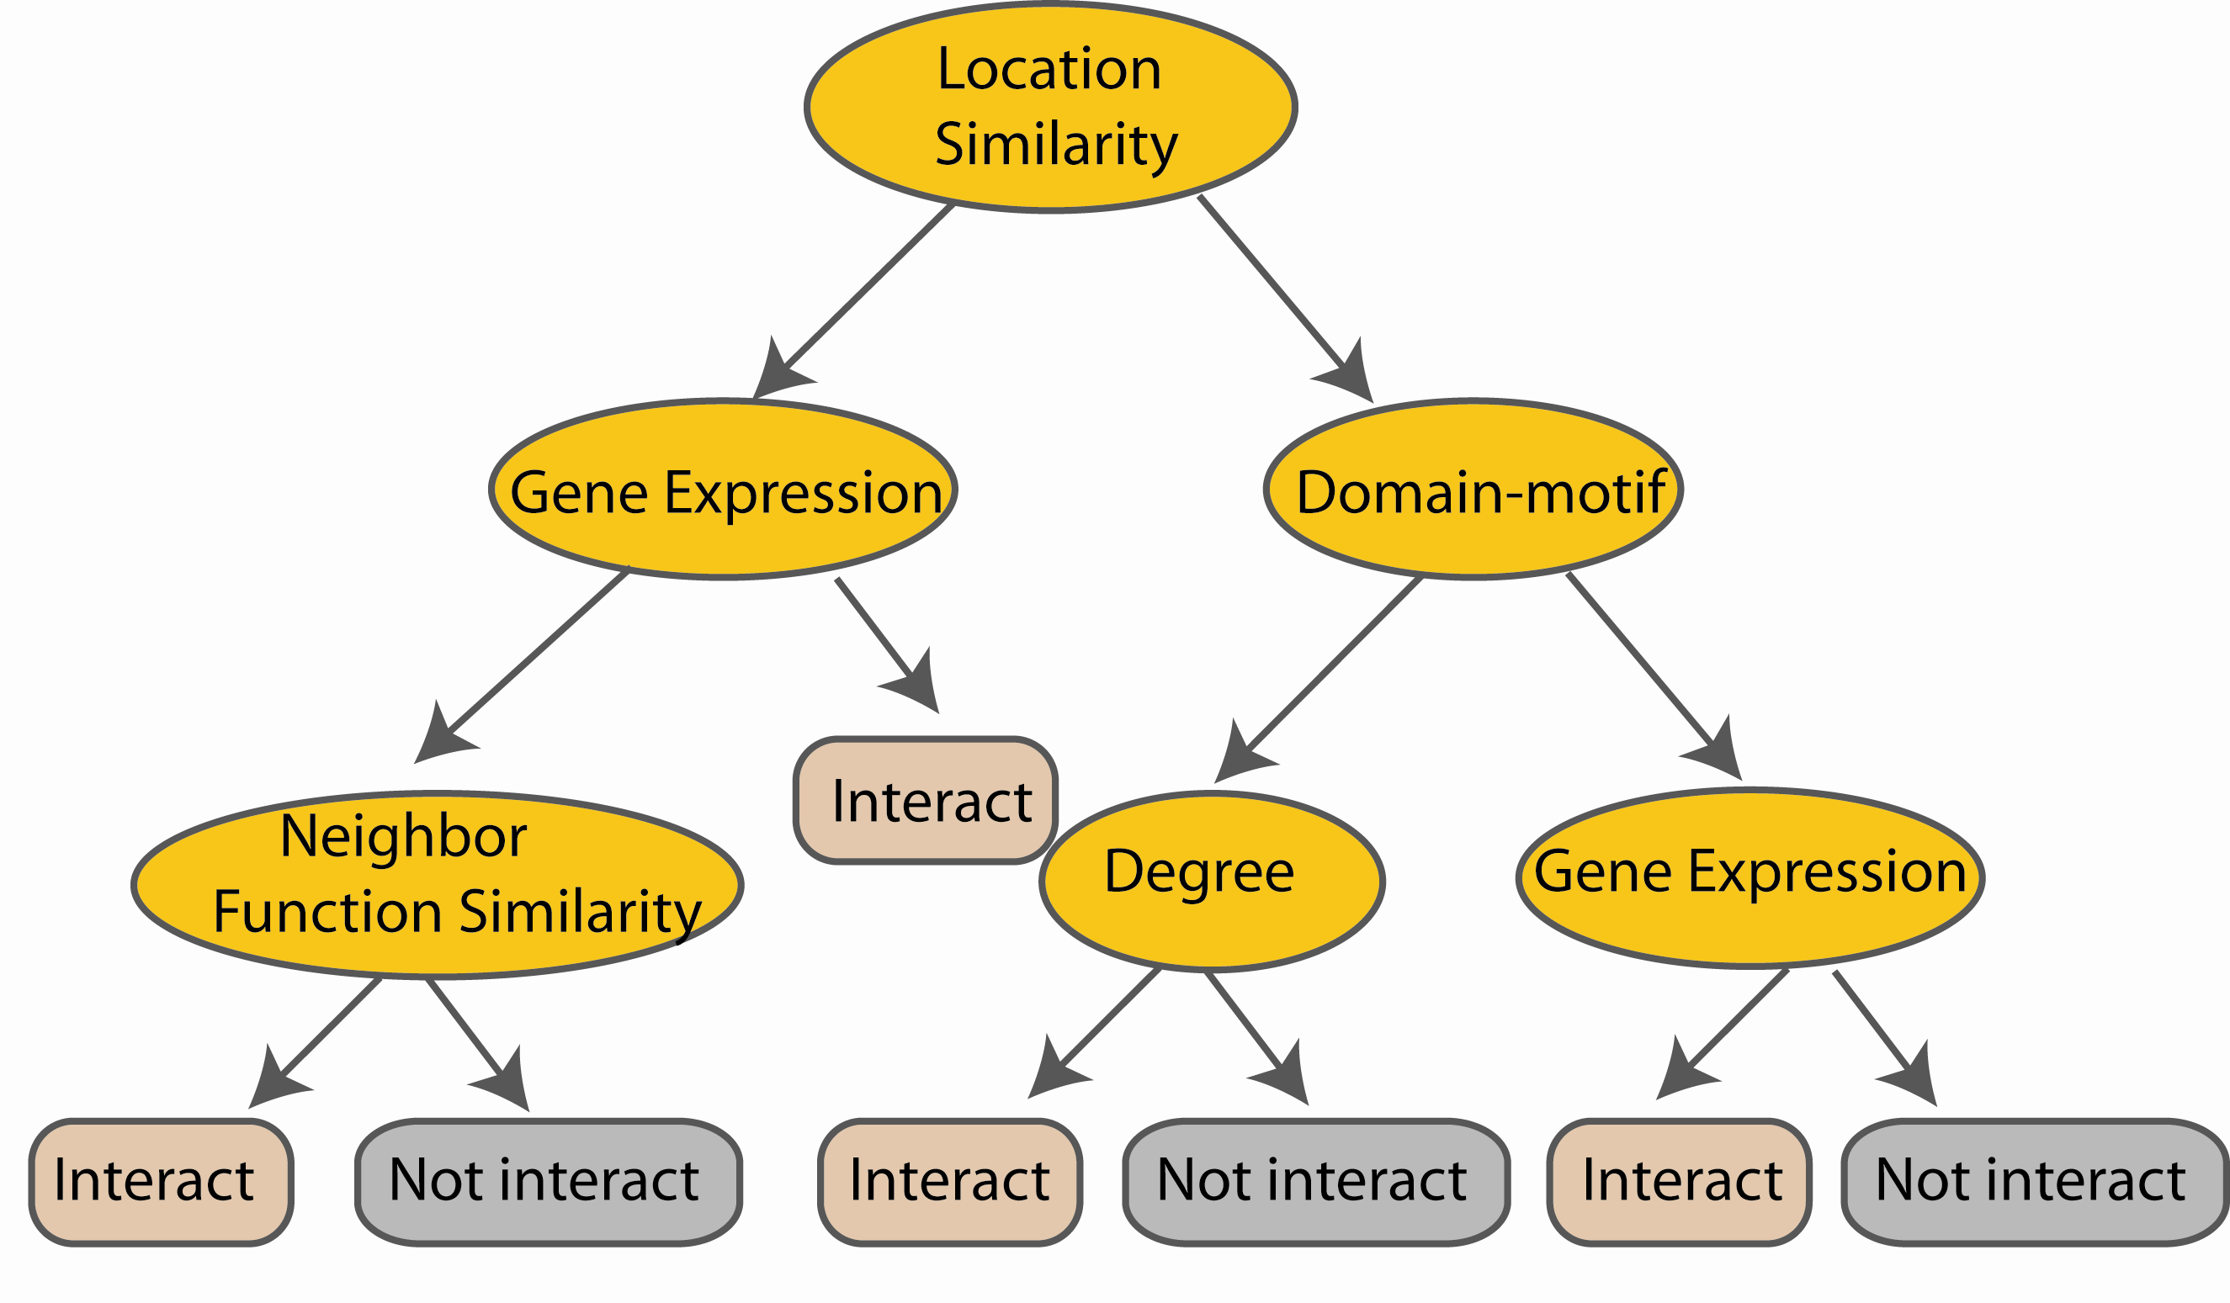
Random Forest Classifier
Construct a decision tree
M features
N examples
....…
Notes:
From eachd descision tree .. In spliting the nodes, the Gini Gain is employed

Slide 39

Random Forest Classifier
At each node in choosing the split feature
choose only among m<M features
M features
N examples
....…
Notes:
Different from the regular decision trees in random forest, when the splitting feature is chosen from only a subset of allf eatures.
The robostness of the classifier arises from
bootsraping of the training data and the random selection of features, the the random choose of features.

Slide 40

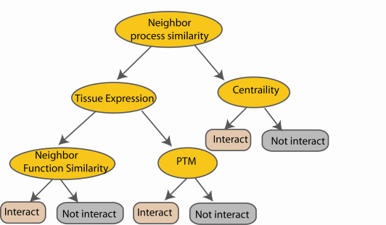
Random Forest Classifier
Create decision tree
from each bootstrap sample
M features
N examples
....…
....…

Slide 41
Random Forest Classifier
M features
N examples
Take the majority vote
....…
....…
Notes:
Finally the given an input data the decision is made as follows given an input data,

Slide 42
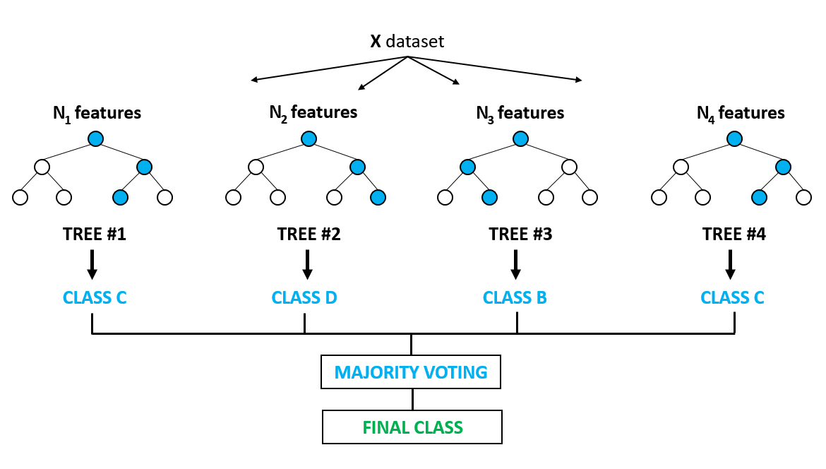
Thus,…..

Slide 43
Random Forests: Pros and Cons
Very popular in practice, probably the most popular classifier for dense data (<= a few thousand features)
Easy to implement (train a lot of trees). Good match for MapReduce.
Parallelizes easily (but not necessarily efficiently).
Inherently immune to missing variables.
Not quite state-of-the-art accuracy – DNNs generally do better, and sometimes gradient boosted trees.
Needs many passes over the data – at least the max depth of the trees. (<< boosted trees though)
Easy to overfit – hard to balance accuracy/fit tradeoff.

Slide 44
Random forest
Available package:
http://www.stat.berkeley.edu/~breiman/RandomForests/cc_home.htm
To read more:
http://www-stat.stanford.edu/~hastie/Papers/ESLII.pdf

Slide 48
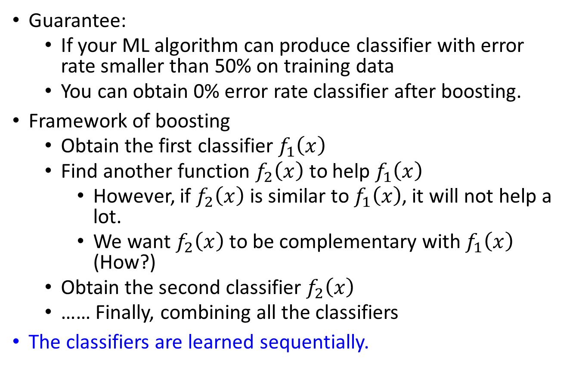
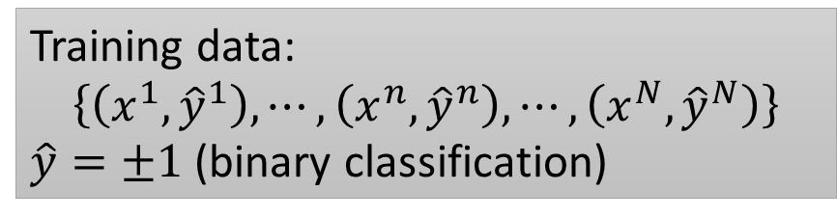
Boosting
Training data:
$$\left\{\left(x^{1},{\hat{y}}^{1}\right),⋯,\left(x^{n},{\hat{y}}^{n}\right),⋯,\left(x^{N},{\hat{y}}^{N}\right)\right\}$$
$\hat{y}=±1$ (binary classification)
Guarantee:
If your ML algorithm can produce classifier with error rate smaller than 50% on training data
You can obtain 0% error rate classifier after boosting.
Framework of boosting
Obtain the first classifier $f_{1}\left(x\right)$
Find another function $f_{2}\left(x\right)$ to help $f_{1}\left(x\right)$
However, if $f_{2}\left(x\right)$ is similar to $f_{1}\left(x\right)$, it will not help a lot.
We want $f_{2}\left(x\right)$ to be complementary with $f_{1}\left(x\right)$ (How?)
Obtain the second classifier $f_{2}\left(x\right)$
…… Finally, combining all the classifiers
The classifiers are learned sequentially.
Slides courtesy: Dr. Hung-yi Lee, NTU, Taiwan
Notes:
We use an ML algorithm to obtain a function $f_{1}\left(x\right)$
If $f_{1}\left(x\right)$ is weak, i.e. bad performance on training data, what can we do?

Slide 49





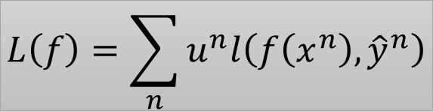

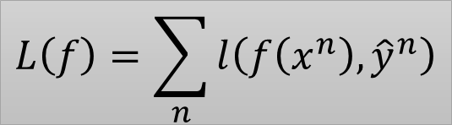
How to obtain different classifiers?
Training on different training data sets
How to have different training data sets
Re-sampling your training data to form a new set
Re-weighting your training data to form a new set
In real implementation, you only have to change the cost/objective function
$$L\left(f\right)=\sum_{n}{l\left(f\left(x^{n}\right),{\hat{y}}^{n}\right)}$$
$$\left(x^{1},{\hat{y}}^{1},u^{1}\right)$$
$$u^{1}=1$$
0.4
$$\left(x^{2},{\hat{y}}^{2},u^{2}\right)$$
$$u^{2}=1$$
2.1
$$L\left(f\right)=\sum_{n}{u^{n}l\left(f\left(x^{n}\right),{\hat{y}}^{n}\right)}$$
$$\left(x^{3},{\hat{y}}^{3},u^{3}\right)$$
$$u^{3}=1$$
0.7

Slide 50
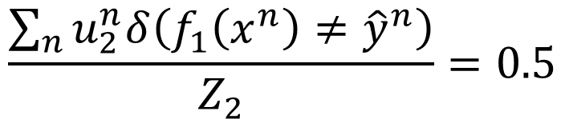

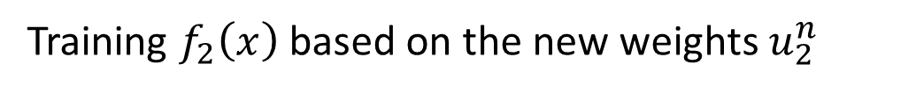

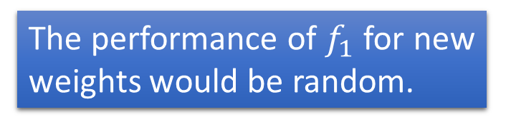
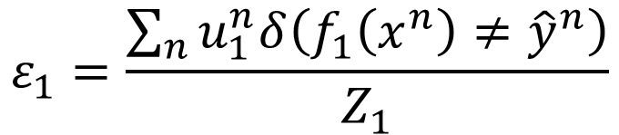

Idea of Adaboost
Idea: training $f_{2}\left(x\right)$ on the new training set that fails $f_{1}\left(x\right)$
How to find a new training set that fails $f_{1}\left(x\right)$?
$ε_{1}$: the error rate of $f_{1}\left(x\right)$ on its training data
$$ε_{1}=\frac{\sum_{n}{u_{1}^{n}δ\left(f_{1}\left(x^{n}\right)≠{\hat{y}}^{n}\right)}}{Z_{1}}$$
$$Z_{1}=\sum_{n}{u_{1}^{n}}$$
$$ε_{1}<0.5$$
Changing the example weights from $u_{1}^{n}$ to $u_{2}^{n}$ such that
$$\frac{\sum_{n}{u_{2}^{n}δ\left(f_{1}\left(x^{n}\right)≠{\hat{y}}^{n}\right)}}{Z_{2}}=0.5$$
The performance of $f_{1}$ for new weights would be random.
Training $f_{2}\left(x\right)$ based on the new weights $u_{2}^{n}$
Notes:
$$ε^{1}>0.5$$

Slide 51








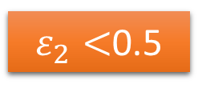









Re-weighting Training Data
Idea: training $f_{2}\left(x\right)$ on the new training set that fails $f_{1}\left(x\right)$
How to find a new training set that fails $f_{1}\left(x\right)$?
$$\left(x^{1},{\hat{y}}^{1},u^{1}\right)$$
$$u^{1}=1$$
$$u^{1}=1/\sqrt{3}$$
$$\left(x^{2},{\hat{y}}^{2},u^{2}\right)$$
$$u^{2}=1$$
$$u^{2}=\sqrt{3}$$
$$u^{3}=1$$
$$u^{3}=1/\sqrt{3}$$
$$\left(x^{3},{\hat{y}}^{3},u^{3}\right)$$
$$\left(x^{4},{\hat{y}}^{4},u^{4}\right)$$
$$u^{4}=1$$
$$u^{4}=1/\sqrt{3}$$
$ε_{2}<$0.5
$ε_{1}=$0.25
0.5
$$f_{1}\left(x\right)$$
$$f_{2}\left(x\right)$$

Slide 52
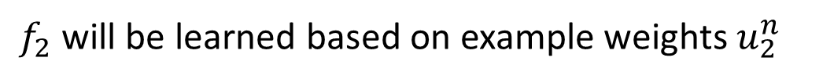
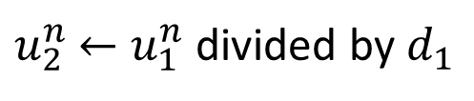
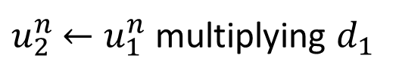
Re-weighting Training Data
Idea: training $f_{2}\left(x\right)$ on the new training set that fails $f_{1}\left(x\right)$
How to find a new training set that fails $f_{1}\left(x\right)$?
If $x^{n}$ misclassified by $f_{1}$ ($f_{1}\left(x^{n}\right)≠{\hat{y}}^{n}$)
$u_{2}^{n}$ $←u_{1}^{n}$ multiplying $d_{1}$
increase
If $x^{n}$ correctly classified by $f_{1}$ ($f_{1}\left(x^{n}\right)={\hat{y}}^{n}$)
$u_{2}^{n}$ $←u_{1}^{n}$ divided by $d_{1}$
decrease
$f_{2}$ will be learned based on example weights $u_{2}^{n}$
What is the value of $d_{1}$?
Notes:
Intuitive reason:

Slide 53

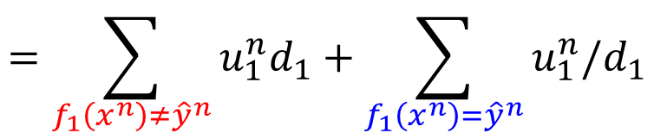
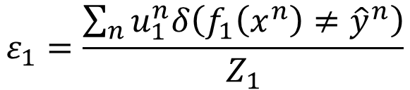
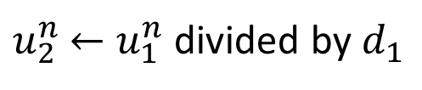
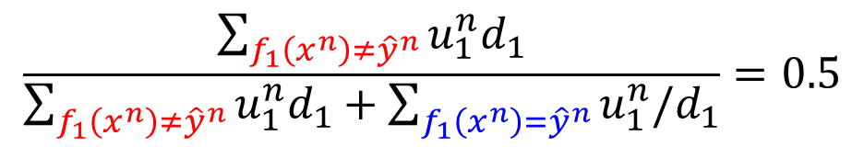

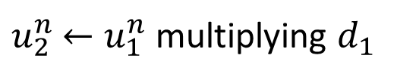

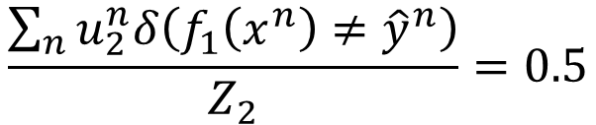

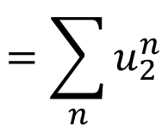
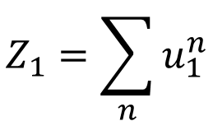
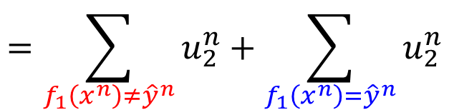
Re-weighting Training Data
$$ε_{1}=\frac{\sum_{n}{u_{1}^{n}δ\left(f_{1}\left(x^{n}\right)≠{\hat{y}}^{n}\right)}}{Z_{1}}$$
$$Z_{1}=\sum_{n}{u_{1}^{n}}$$
$$\frac{\sum_{n}{u_{2}^{n}δ\left(f_{1}\left(x^{n}\right)≠{\hat{y}}^{n}\right)}}{Z_{2}}=0.5$$
$$f_{1}\left(x^{n}\right)≠{\hat{y}}^{n}$$
$u_{2}^{n}$ $←u_{1}^{n}$ multiplying $d_{1}$
$$f_{1}\left(x^{n}\right)={\hat{y}}^{n}$$
$u_{2}^{n}$ $←u_{1}^{n}$ divided by $d_{1}$
$$=\sum_{f_{1}\left(x^{n}\right)≠{\hat{y}}^{n}}{u_{1}^{n}d_{1}}$$
$$=\sum_{f_{1}\left(x^{n}\right)≠{\hat{y}}^{n}}{u_{2}^{n}}+\sum_{f_{1}\left(x^{n}\right)={\hat{y}}^{n}}{u_{2}^{n}}$$
$$=\sum_{n}{u_{2}^{n}}$$
$$=\sum_{f_{1}\left(x^{n}\right)≠{\hat{y}}^{n}}{u_{1}^{n}d_{1}}+\sum_{f_{1}\left(x^{n}\right)={\hat{y}}^{n}}{u_{1}^{n}/d_{1}}$$
$$\frac{\sum_{f_{1}\left(x^{n}\right)≠{\hat{y}}^{n}}{u_{1}^{n}d_{1}}}{\sum_{f_{1}\left(x^{n}\right)≠{\hat{y}}^{n}}{u_{1}^{n}d_{1}}+\sum_{f_{1}\left(x^{n}\right)={\hat{y}}^{n}}{u_{1}^{n}/d_{1}}}=0.5$$
2

Slide 54
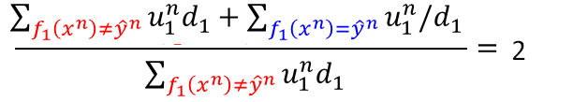





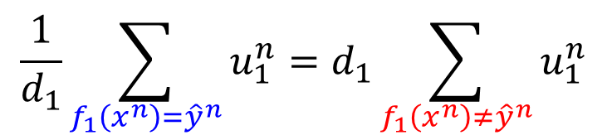
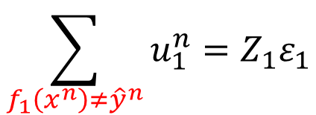
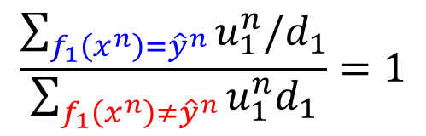
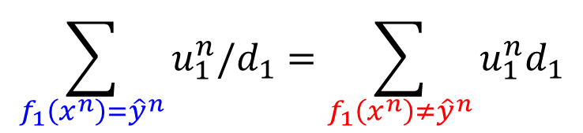
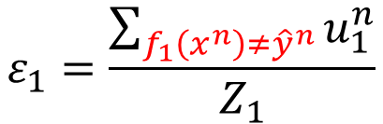
Re-weighting Training Data
$$ε_{1}=\frac{\sum_{n}{u_{1}^{n}δ\left(f_{1}\left(x^{n}\right)≠{\hat{y}}^{n}\right)}}{Z_{1}}$$
$$Z_{1}=\sum_{n}{u_{1}^{n}}$$
$$\frac{\sum_{n}{u_{2}^{n}δ\left(f_{1}\left(x^{n}\right)≠{\hat{y}}^{n}\right)}}{Z_{2}}=0.5$$
$$f_{1}\left(x^{n}\right)≠{\hat{y}}^{n}$$
$u_{2}^{n}$ $←u_{1}^{n}$ multiplying $d_{1}$
$$f_{1}\left(x^{n}\right)={\hat{y}}^{n}$$
$u_{2}^{n}$ $←u_{1}^{n}$ divided by $d_{1}$
$$\frac{\sum_{f_{1}\left(x^{n}\right)={\hat{y}}^{n}}{u_{1}^{n}/d_{1}}}{\sum_{f_{1}\left(x^{n}\right)≠{\hat{y}}^{n}}{u_{1}^{n}d_{1}}}=1$$
$$\sum_{f_{1}\left(x^{n}\right)={\hat{y}}^{n}}{u_{1}^{n}/d_{1}}=\sum_{f_{1}\left(x^{n}\right)≠{\hat{y}}^{n}}{u_{1}^{n}d_{1}}$$
$$\frac{1}{d_{1}}\sum_{f_{1}\left(x^{n}\right)={\hat{y}}^{n}}{u_{1}^{n}}=d_{1}\sum_{f_{1}\left(x^{n}\right)≠{\hat{y}}^{n}}{u_{1}^{n}}$$
$$ε_{1}=\frac{\sum_{f_{1}\left(x^{n}\right)≠{\hat{y}}^{n}}{u_{1}^{n}}}{Z_{1}}$$
$$Z_{1}\left(1−ε_{1}\right)$$
$$Z_{1}ε_{1}$$
$$Z_{1}\left(1−ε_{1}\right)/d_{1}=Z_{1}ε_{1}d_{1}$$
$$\sum_{f_{1}\left(x^{n}\right)≠{\hat{y}}^{n}}{u_{1}^{n}}=Z_{1}ε_{1}$$
$$d_{1}=\sqrt{{\left(1−ε_{1}\right)}/{ε_{1}}}$$
$$>1$$

Slide 55






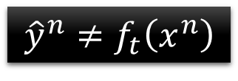
Algorithm for AdaBoost
Giving training data $\left\{\left(x^{1},{\hat{y}}^{1},u_{1}^{1} \right),⋯,\left(x^{n},{\hat{y}}^{n},u_{1}^{n}\right),⋯,\left(x^{N},{\hat{y}}^{N},u_{1}^{N}\right)\right\}$
$\hat{y}=±1$ (Binary classification), $u_{1}^{n}=1$ (equal weights)
For t = 1, …, T:
Training weak classifier $f_{t}\left(x\right)$ with weights $\left\{u_{t}^{1},⋯,u_{t}^{N}\right\}$
$ε_{t}$ is the error rate of $f_{t}\left(x\right)$ with weights $\left\{u_{t}^{1},⋯,u_{t}^{N}\right\}$
For n = 1, …, N:
If $x^{n}$ is misclassified by $f_{t}\left(x\right)$:
$u_{t+1}^{n}=u_{t}^{n}×d_{t}$
Else:
$u_{t+1}^{n}=u_{t}^{n}/d_{t}$
$${\hat{y}}^{n}≠f_{t}\left(x^{n}\right)$$
$$=u_{t}^{n}×exp\left(α_{t}\right)$$
$$d_{t}=\sqrt{{\left(1−ε_{t}\right)}/{ε_{t}}}$$
$$α_{t}=ln\sqrt{{\left(1−ε_{t}\right)}/{ε_{t}}}$$
$$=u_{t}^{n}×exp\left(−α_{t}\right)$$
$$u_{t+1}^{n}←u_{t}^{n}×exp\left(−{\hat{y}}^{n}f_{t}\left(x^{n}\right)α_{t}\right)$$
Notes:
(output is $±1$)

Slide 56

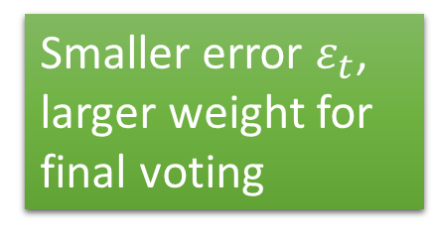
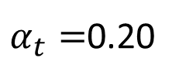
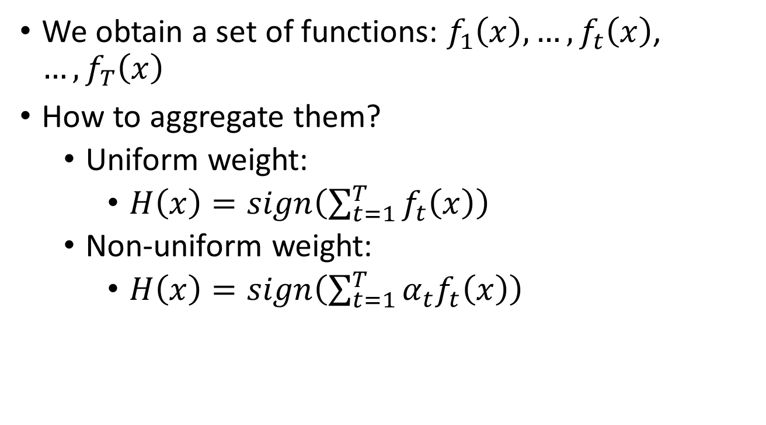




Algorithm for AdaBoost
We obtain a set of functions: $f_{1}\left(x\right),…,f_{t}\left(x\right)$, $…,f_{T}\left(x\right)$
How to aggregate them?
Uniform weight:
$H\left(x\right)=sign\left(\sum_{t=1}^{T}{f_{t}\left(x\right)}\right)$
Non-uniform weight:
$H\left(x\right)=sign\left(\sum_{t=1}^{T}{α_{t}f_{t}\left(x\right)}\right)$
Smaller error $ε_{t}$, larger weight for final voting
$$α_{t}=ln\sqrt{{\left(1−ε_{t}\right)}/{ε_{t}}}$$
$$ε_{t}=0.1$$
$$ε_{t}=0.4$$
$$u_{t+1}^{n}=u_{t}^{n}×exp\left(−{\hat{y}}^{n}f_{t}\left(x^{n}\right)α_{t}\right)$$
$α_{t}=$1.10
$α_{t}=$0.20

Slide 57




Toy Example
T=3, weak classifier = decision stump
t=1
+
+
1.0
1.53
1.0
+
0.65
+
-
-
1.0
1.53
+
+
1.0
1.53
+
-
-
-
1.0
0.65
+
-
1.0
1.0
0.65
0.65
$$ε_{1}=0.30$$
+
-
1.0
1.0
0.65
0.65
+
-
-
1.0
0.65
$$d_{1}=1.53$$
-
$$α_{1}=0.42$$
$$f_{1}\left(x\right)$$

Slide 58







Toy Example
T=3, weak classifier = decision stump
$f_{1}\left(x\right)$:
t=2
$$α_{1}=0.42$$
+
+
1.53
0.78
+
0.65
0.33
-
+
-
1.53
+
0.78
+
1.53
0.78
0.33
-
-
0.65
+
-
-
+
0.65
0.65
1.26
1.26
$$ε_{2}=0.21$$
0.65
0.33
0.33
0.65
-
+
-
+
-
0.65
$$d_{2}=1.94$$
1.26
-
$$α_{2}=0.66$$
$$f_{2}\left(x\right)$$

Slide 59












Toy Example
T=3, weak classifier = decision stump
$f_{1}\left(x\right)$:
$f_{2}\left(x\right)$:
t=3
$$α_{1}=0.42$$
$$α_{2}=0.66$$
+
0.78
$f_{3}\left(x\right)$:
0.33
+
-
0.78
+
0.78
$$α_{3}=0.95$$
$$f_{3}\left(x\right)$$
0.33
-
-
+
1.26
1.26
$$ε_{3}=0.13$$
0.33
0.33
$$d_{3}=2.59$$
+
-
1.26
-
$$α_{3}=0.95$$

Slide 60






Toy Example
Final Classifier: $H\left(x\right)=sign\left(\sum_{t=1}^{T}{α_{t}f_{t}\left(x\right)}\right)$
$$sign($$
$$0.42$$
+
$$0.66$$
+
$$0.95$$
$$)$$
+
+
-
+
+
-
-
+
-
-

Slide 64

Thank You

