Slide 1

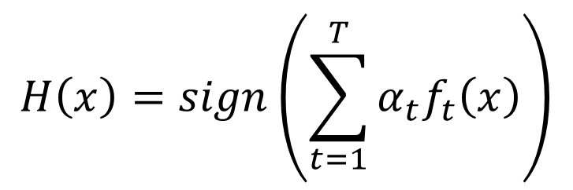

Mathematics of Boosting
$$H\left(x\right)=sign\left(\sum_{t=1}^{T}{α_{t}f_{t}\left(x\right)}\right)$$
$$α_{t}=ln\sqrt{{\left(1−ε_{t}\right)}/{ε_{t}}}$$
As we have more and more $f_{t}$ (T increases), $H\left(x\right)$ achieves smaller and smaller error rate on training data.

Slide 2
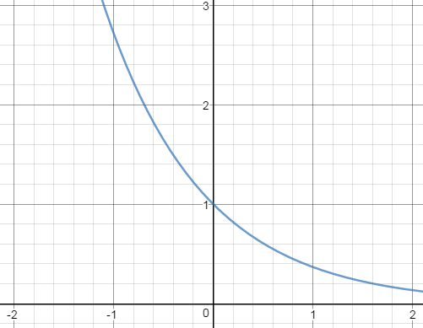

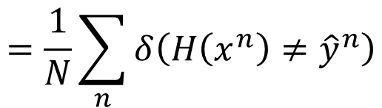

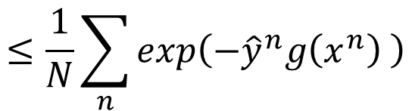

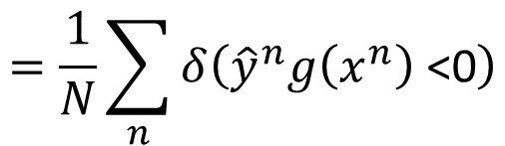
Error Rate of Final Classifier
Final classifier: $H\left(x\right)=sign\left(\sum_{t=1}^{T}{α_{t}f_{t}\left(x\right)}\right)$
$α_{t}=ln\sqrt{{\left(1−ε_{t}\right)}/{ε_{t}}}$
$$g\left(x\right)$$
Training Data Error Rate
$$=\frac{1}{N}\sum_{n}{δ\left(H\left(x^{n}\right)≠{\hat{y}}^{n}\right)}$$
$$=\frac{1}{N}\sum_{n}{δ\left({\hat{y}}^{n}g\left(x^{n}\right) \text{<0}\right)}$$
$$≤\frac{1}{N}\sum_{n}{exp\left(−{\hat{y}}^{n}g\left(x^{n}\right) \right)}$$
$${\hat{y}}^{n}g\left(x^{n}\right)$$

Slide 3
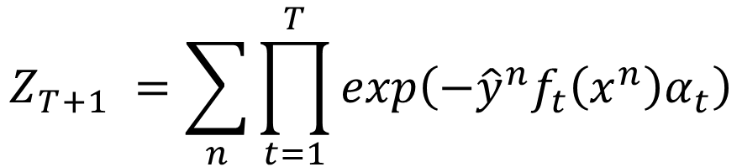

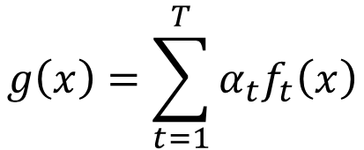

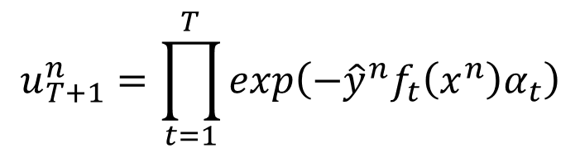
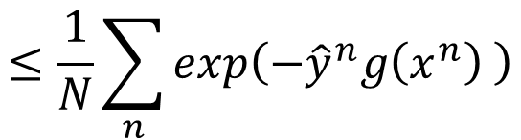


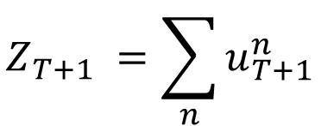
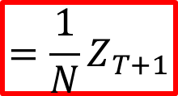
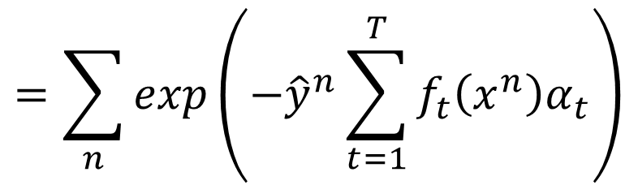

$$g\left(x\right)=\sum_{t=1}^{T}{α_{t}f_{t}\left(x\right)}$$
Training Data Error Rate
$$≤\frac{1}{N}\sum_{n}{exp\left(−{\hat{y}}^{n}g\left(x^{n}\right) \right)}$$
$$=\frac{1}{N}Z_{T+1}$$
$$α_{t}=ln\sqrt{{\left(1−ε_{t}\right)}/{ε_{t}}}$$
$Z_{t}$: the summation of the weights of training data for training $f_{t}$
What is $Z_{T+1}=?$
$$Z_{T+1} =\sum_{n}{u_{T+1}^{n}}$$
$$u_{1}^{n}=1$$
$$u_{T+1}^{n}=\prod_{t=1}^{T}{exp\left(−{\hat{y}}^{n}f_{t}\left(x^{n}\right)α_{t}\right)}$$
$$u_{t+1}^{n}=u_{t}^{n}×exp\left(−{\hat{y}}^{n}f_{t}\left(x^{n}\right)α_{t}\right)$$
$$Z_{T+1} =\sum_{n}{\prod_{t=1}^{T}{exp\left(−{\hat{y}}^{n}f_{t}\left(x^{n}\right)α_{t}\right)}}$$
$$g\left(x\right)$$
$$=\sum_{n}{exp\left(−{\hat{y}}^{n}\sum_{t=1}^{T}{f_{t}\left(x^{n}\right)α_{t}}\right)}$$

Slide 4
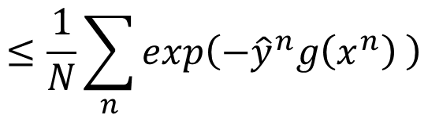
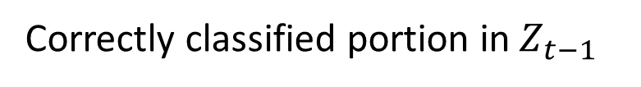

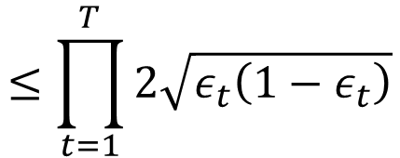
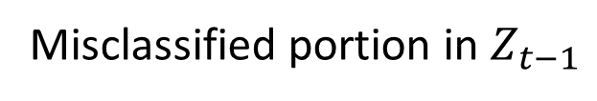

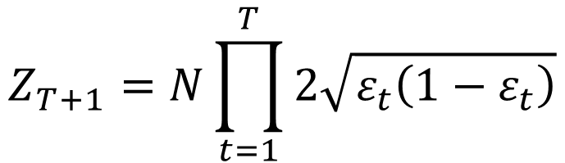
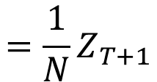
$$g\left(x\right)=\sum_{t=1}^{T}{α_{t}f_{t}\left(x\right)}$$
Training Data Error Rate
$$≤\frac{1}{N}\sum_{n}{exp\left(−{\hat{y}}^{n}g\left(x^{n}\right) \right)}$$
$$=\frac{1}{N}Z_{T+1}$$
$$α_{t}=ln\sqrt{{\left(1−ε_{t}\right)}/{ε_{t}}}$$
$$Z_{1}=N$$
(equal weights)
$$Z_{t}=Z_{t−1}ε_{t}exp\left(α_{t}\right)+Z_{t−1}\left(1−ε_{t}\right)exp\left(−α_{t}\right)$$
Misclassified portion in $Z_{t−1}$
Correctly classified portion in $Z_{t−1}$
$$=Z_{t−1}ε_{t}\sqrt{{\left(1−ε_{t}\right)}/{ε_{t}}}+Z_{t−1}\left(1−ε_{t}\right)\sqrt{{ε_{t}}/{\left(1−ε_{t}\right)}}$$
$$=Z_{t−1}×2\sqrt{ε_{t}\left(1−ε_{t}\right)}$$
$$Z_{T+1}=N\prod_{t=1}^{T}{2\sqrt{ε_{t}\left(1−ε_{t}\right)}}$$
$$≤\prod_{t=1}^{T}{2\sqrt{ε_{t}\left(1−ε_{t}\right)}}$$
Training Data Error Rate
Smaller and smaller
<1

Slide 5
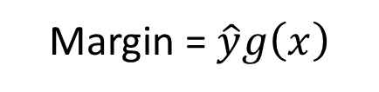


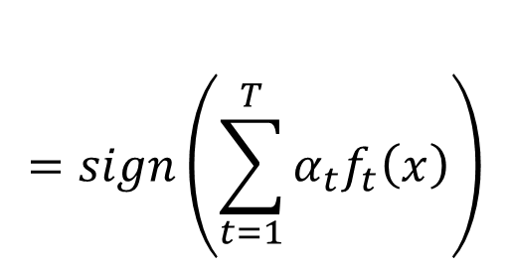
Even though the training error is 0, the testing error still decreases?
$$=sign\left(\sum_{t=1}^{T}{α_{t}f_{t}\left(x\right)}\right)$$
$$H\left(x\right)$$
$$g\left(x\right)$$
Margin = $\hat{y}g\left(x\right)$

Slide 6
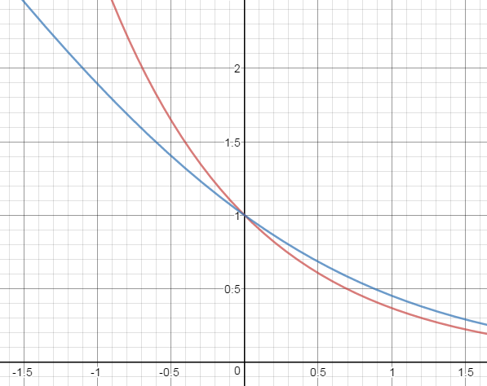

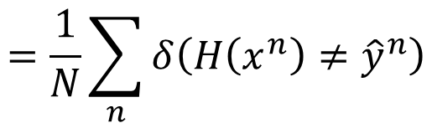



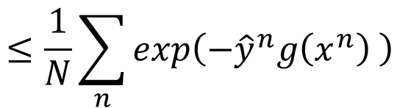
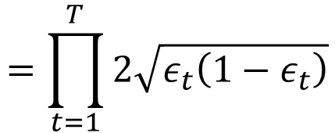
Large Margin?
$$=sign\left(\sum_{t=1}^{T}{α_{t}f_{t}\left(x\right)}\right)$$
$$H\left(x\right)$$
$$g\left(x\right)$$
Training Data Error Rate =
$$=\frac{1}{N}\sum_{n}{δ\left(H\left(x^{n}\right)≠{\hat{y}}^{n}\right)}$$
Adaboost
$$≤\frac{1}{N}\sum_{n}{exp\left(−{\hat{y}}^{n}g\left(x^{n}\right) \right)}$$
Logistic regression
$$=\prod_{t=1}^{T}{2\sqrt{ε_{t}\left(1−ε_{t}\right)}}$$
SVM
Getting smaller and smaller as T increase
$${\hat{y}}^{n}g\left(x^{n}\right)$$

Slide 7
To learn more …
Introduction of Adaboost:
Freund; Schapire (1999). "A Short Introduction to Boosting“
Multiclass/Regression
Y. Freund, R. Schapire, “A Decision-Theoretic Generalization of on-Line Learning and an Application to Boosting”, 1995.
Robert E. Schapire and Yoram Singer. Improved boosting algorithms using confidence-rated predictions. In Proceedings of the Eleventh Annual Conference on Computational Learning Theory, pages 80–91, 1998.
Gentle Boost
Schapire, Robert; Singer, Yoram (1999). "Improved Boosting Algorithms Using Confidence-rated Predictions".

Slide 8

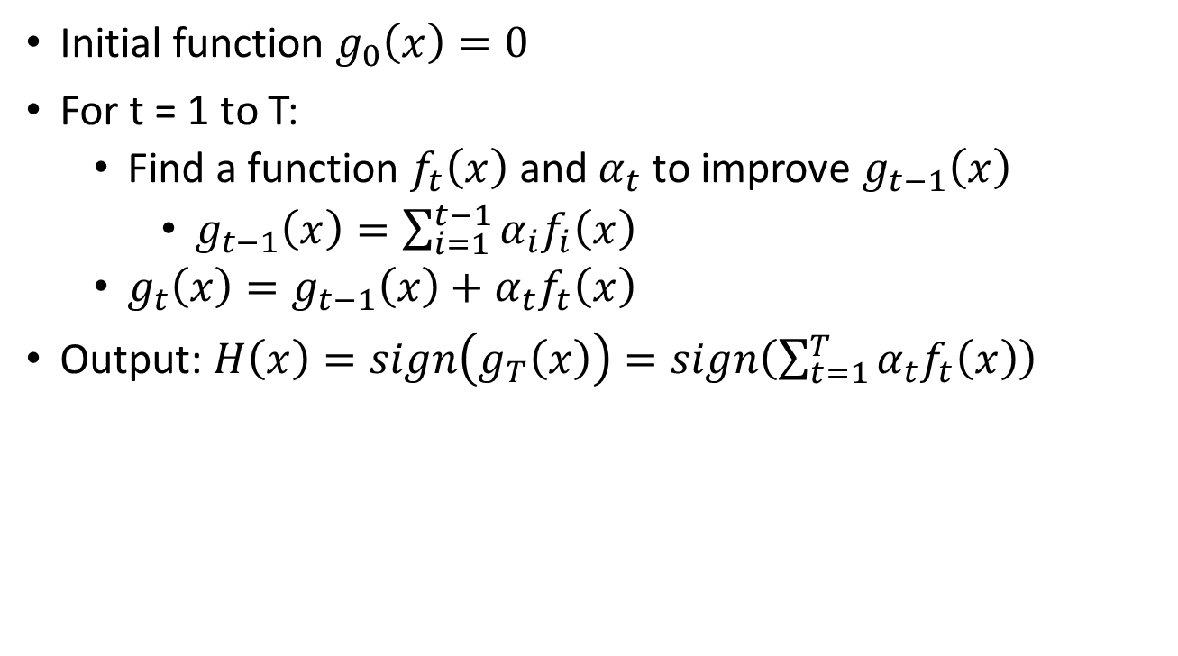
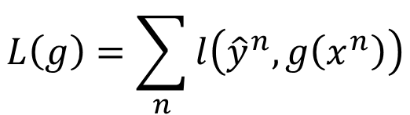
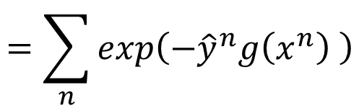
General Formulation of Boosting
Initial function $g_{0}\left(x\right)=0$
For t = 1 to T:
Find a function $f_{t}\left(x\right)$ and $α_{t}$ to improve $g_{t−1}\left(x\right)$
$g_{t−1}\left(x\right)=\sum_{i=1}^{t−1}{α_{i}f_{i}\left(x\right)}$
$g_{t}\left(x\right)=g_{t−1}\left(x\right)+α_{t}f_{t}\left(x\right)$
Output: $H\left(x\right)=sign\left(g_{T}\left(x\right)\right)=sign\left(\sum_{t=1}^{T}{α_{t}f_{t}\left(x\right)}\right)$
What is the learning target of $g\left(x\right)$?
$$L\left(g\right)=\sum_{n}{l\left({\hat{y}}^{n},g\left(x^{n}\right)\right)}$$
$$=\sum_{n}{exp\left(−{\hat{y}}^{n}g\left(x^{n}\right) \right)}$$
Minimize

Slide 9
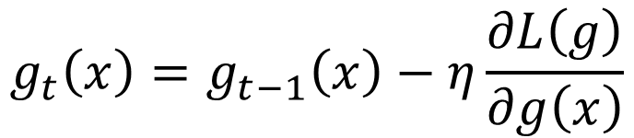
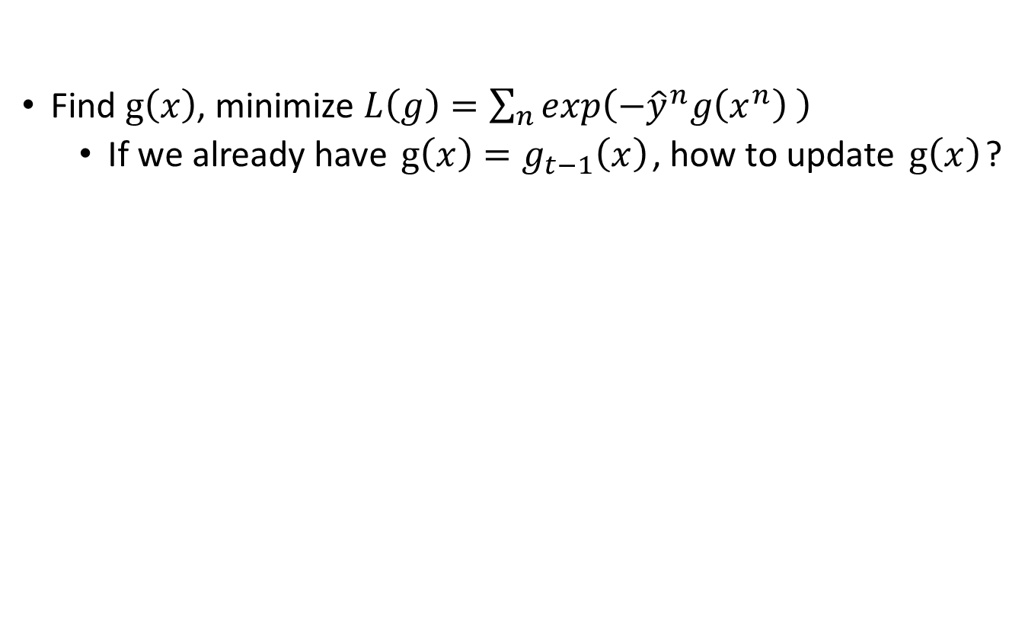

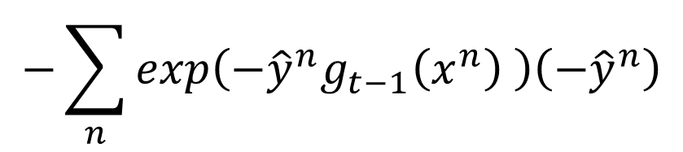

Gradient Boosting
Find $g\left(x\right)$, minimize $L\left(g\right)=\sum_{n}{exp\left(−{\hat{y}}^{n}g\left(x^{n}\right) \right)}$
If we already have $g\left(x\right)=g_{t−1}\left(x\right)$, how to update $g\left(x\right)$?
Gradient Descent:
$$g_{t}\left(x\right)=g_{t−1}\left(x\right)−η\frac{∂L\left(g\right)}{∂g\left(x\right)}$$
$$g\left(x\right)=g_{t−1}\left(x\right)$$
$$−\sum_{n}{exp\left(−{\hat{y}}^{n}g_{t−1}\left(x^{n}\right) \right)\left(−{\hat{y}}^{n}\right)}$$
Same direction
$$g_{t}\left(x\right)=g_{t−1}\left(x\right)+α_{t}f_{t}\left(x\right)$$

Slide 10
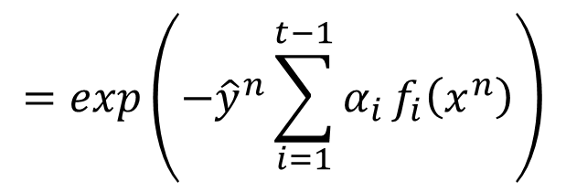


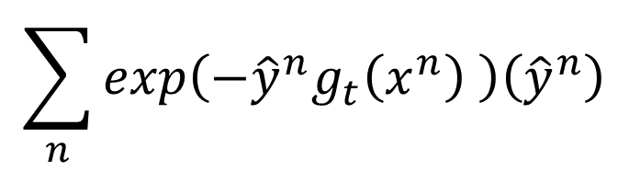
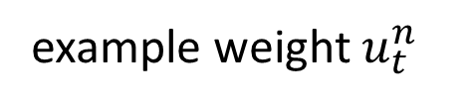
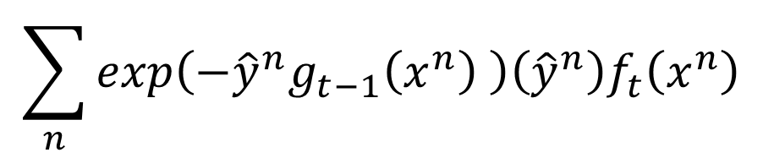

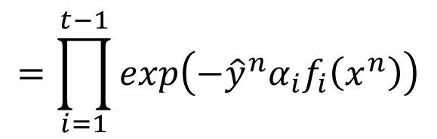
Gradient Boosting
$$\sum_{n}{exp\left(−{\hat{y}}^{n}g_{t}\left(x^{n}\right) \right)\left({\hat{y}}^{n}\right)}$$
$$f_{t}\left(x\right)$$
Same direction
We want to find $f_{t}\left(x\right)$ maximizing
Minimize Error
$$\sum_{n}{exp\left(−{\hat{y}}^{n}g_{t−1}\left(x^{n}\right) \right)\left({\hat{y}}^{n}\right)f_{t}\left(x^{n}\right)}$$
example weight $u_{t}^{n}$
Same sign
$$=exp\left(−{\hat{y}}^{n}\sum_{i=1}^{t−1}{α_{i}}f_{i}\left(x^{n}\right)\right)$$
$$u_{t}^{n}=exp\left(−{\hat{y}}^{n}g_{t−1}\left(x^{n}\right)\right)$$
$$=\prod_{i=1}^{t−1}{exp\left(−{\hat{y}}^{n}α_{i}f_{i}\left(x^{n}\right)\right)}$$
Exactly the weights we obtain in Adaboost

Slide 11



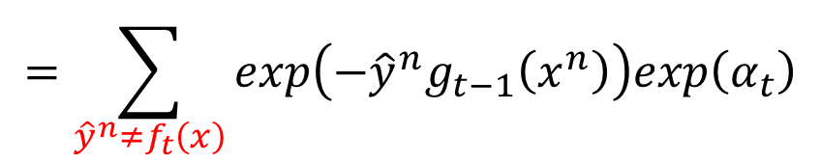

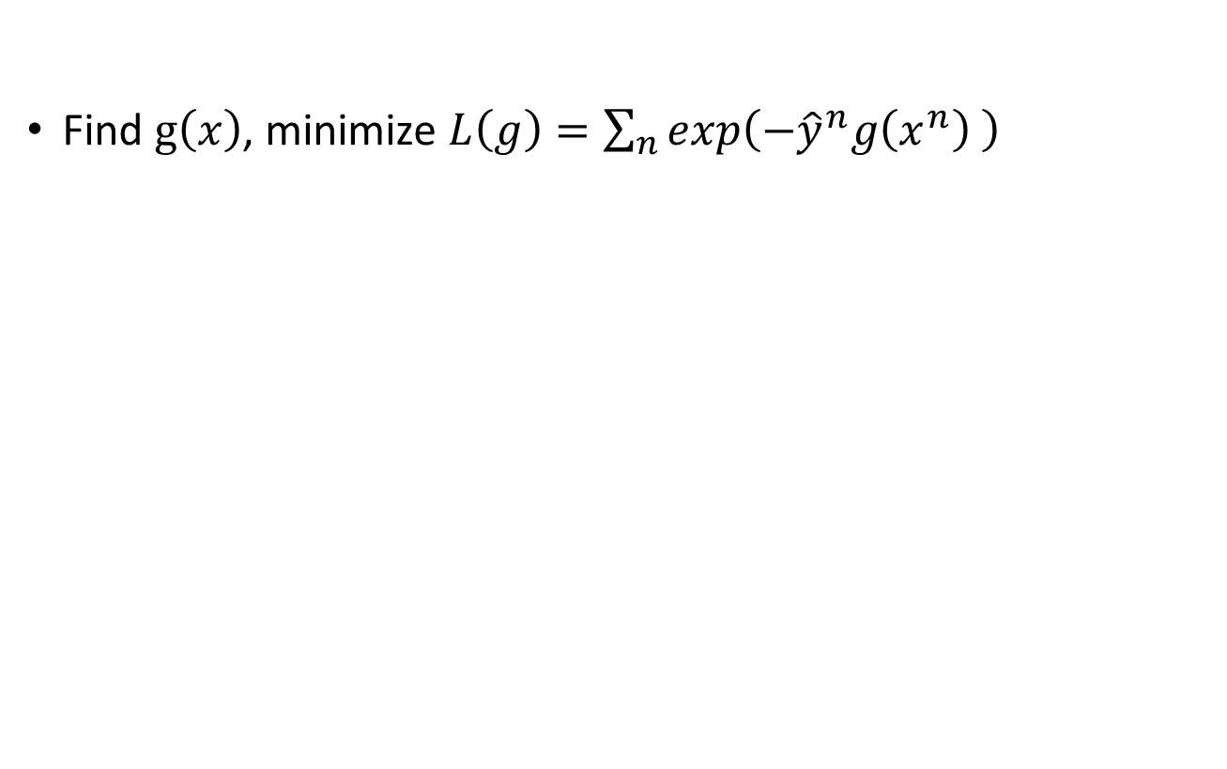
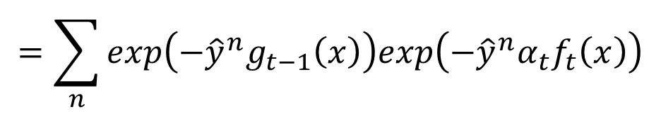

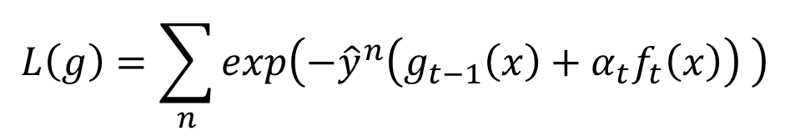
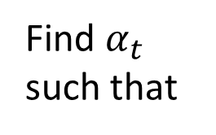
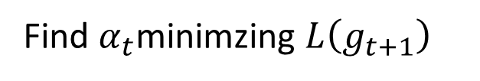
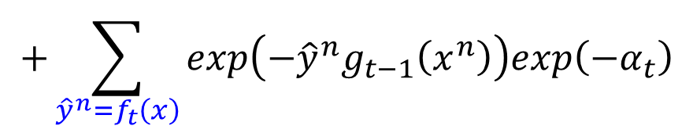
Gradient Boosting
Find $g\left(x\right)$, minimize $L\left(g\right)=\sum_{n}{exp\left(−{\hat{y}}^{n}g\left(x^{n}\right) \right)}$
$α_{t}$ is something like learning rate
$$g_{t}\left(x\right)=g_{t−1}\left(x\right)+α_{t}f_{t}\left(x\right)$$
Find $α_{t}$minimzing $L\left(g_{t+1}\right)$
$$L\left(g\right)=\sum_{n}{exp\left(−{\hat{y}}^{n}\left(g_{t−1}\left(x\right)+α_{t}f_{t}\left(x\right)\right) \right)}$$
Find $α_{t}$ such that
$$=\sum_{n}{exp\left(−{\hat{y}}^{n}g_{t−1}\left(x\right)\right)exp\left(−{\hat{y}}^{n}α_{t}f_{t}\left(x\right)\right)}$$
$$\frac{∂L\left(g\right)}{∂α_{t}}=0$$
$$=\sum_{{\hat{y}}^{n}≠f_{t}\left(x\right)}{exp\left(−{\hat{y}}^{n}g_{t−1}\left(x^{n}\right)\right)exp\left(α_{t}\right)}$$
$$α_{t}=$$
$$ln\sqrt{{\left(1−ε_{t}\right)}/{ε_{t}}}$$
$$+\sum_{{\hat{y}}^{n}=f_{t}\left(x\right)}{exp\left(−{\hat{y}}^{n}g_{t−1}\left(x^{n}\right)\right)exp\left(−α_{t}\right)}$$
Adaboost!

Slide 12
Ensemble: Stacking

Slide 13
Voting
Ram’s system
y
Shyam’s system
y
Majority
Vote
x
Jodu’s system
y
Modhu’s system
y
Notes:
You can ask machine to output confidence

Slide 14
Stacking
Training
Data
Training
Data
Val
Data
Testing
Data
Ram’s system
y
Shyam’s system
y
x
Final
Classifier
Jodu’s system
y
Modhu’s system
y
as new feature

