Slide 1
Linear Algebra: Review Lecture 1 M. Tech(CS) 2024 - 25

Slide 2
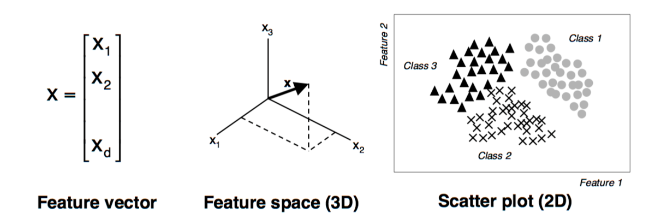
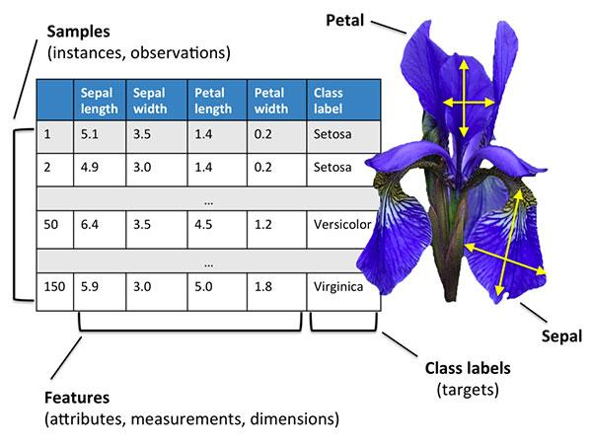
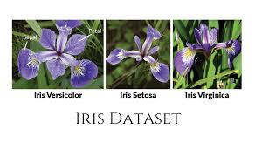
“Data” as scalar, vector, matrix, and tensor?

Slide 3
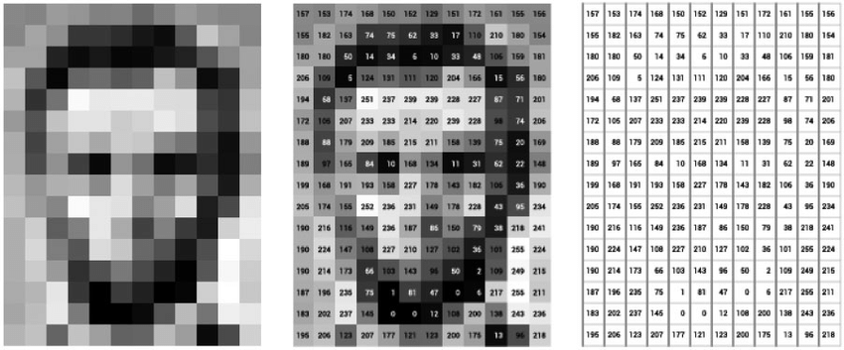
“Data” as scalar, vector, matrix, and tensor?
Source: Melvin Wevers, Thomas Smits, The visual digital turn: Using neural networks to study historical images, Digital Scholarship in the Humanities, Volume 35, Issue 1, April 2020

Slide 4
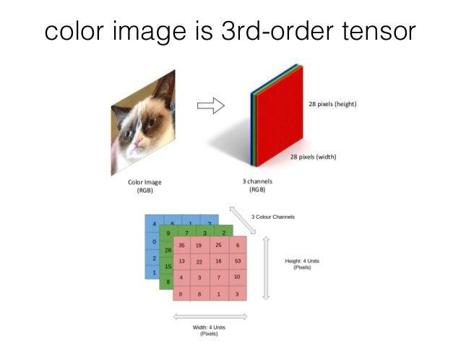

Slide 5
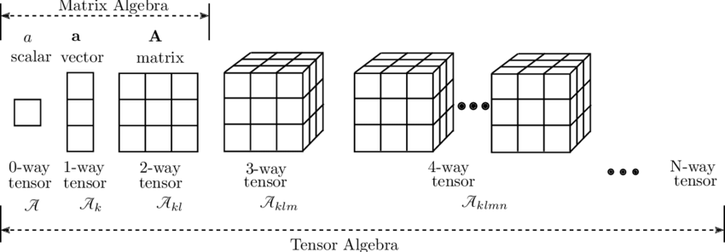
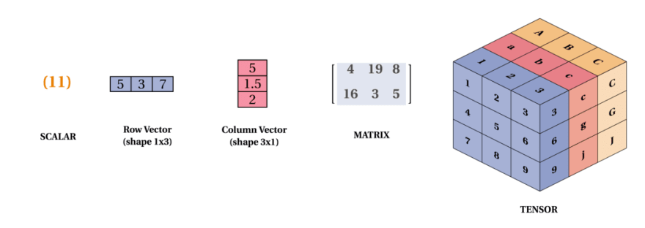
“Data” as scalar, vector, matrix, and tensor?

Slide 6
Reference
Matrix calculus, Wiki http://en.wikipedia.org/wiki/Matrix_calculus
The Matrix Cookbook http://www.imm.dtu.dk/pubdb/views/edoc_download.php/3274/pdf/imm3274.pdf
Video lectures on Linear Algebra by Prof. Gilbert Strang, MIT https://ocw.mit.edu/courses/mathematics/18-06-linear-algebra-spring-2010/video-lectures/
Linear Algebra course by Dr. Hung-yi Lee, Nat. Taiwan Univ.

Slide 7
What are we going to learn?

Slide 8

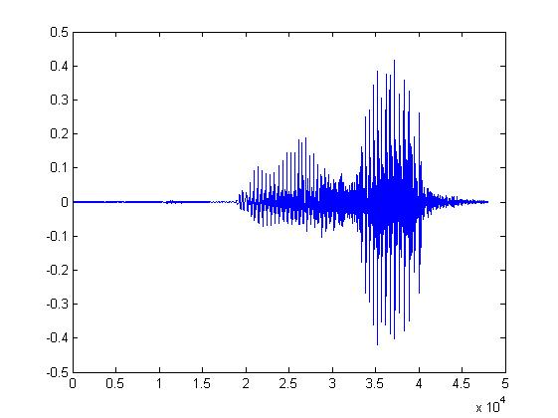


System
A system has input and output (function, transformation, operator)
Speech Recognition System
“How are you”
Dialogue System
(e.g. Siri, Alexa)
“How are you”
“I am fine”
Communication System
“Hello”
“Hello”
Notes:
Can have multiple inputs and outputs

Slide 9
Linear System
Linear system have two properties
1. Persevering Multiplication
2. Persevering Addition
Linear
System
Linear
System
x
y
kx
ky
x₁
Linear
System
y₁
x₁+x₂
Linear
System
y₁+y₂
x₂
Linear
System
y₂

Slide 10






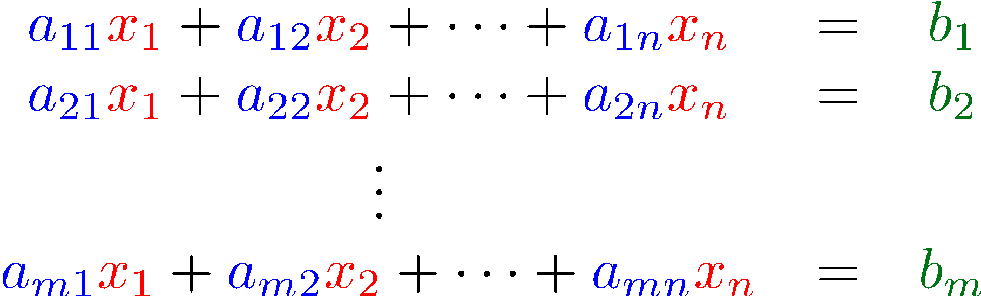
Linear System v.s. System of Linear Equations
Linear
System
……
……
?
trivial
k
k
k
k

Slide 11





























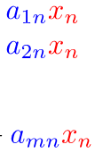









Linear
System
Linear
System
Linear
System
……
……
……
……
……
……
……
……
……
……
……
……
……
……
Linear
System
……
A linear system is described by a system of linear equations

Slide 12
What are we going to learn?
?
Linear
System
3
?
6
vector
vector
……
……
?
9
Does it have solution?
Does it have unique solution?
How to find the solution?
Determinants
Beyond 3 X 3
Different view from high school
Notes:
Higher dimension
Solving a system of linear equations
Approximate Solution

Slide 13

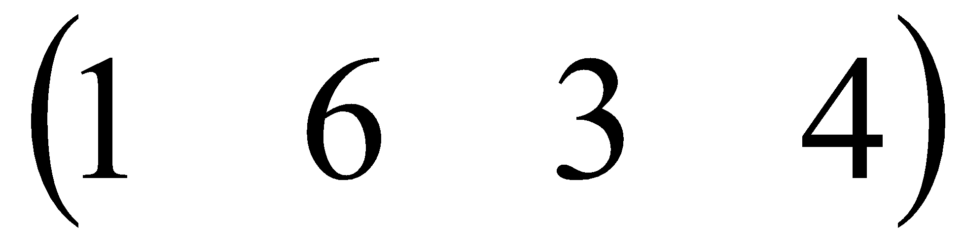
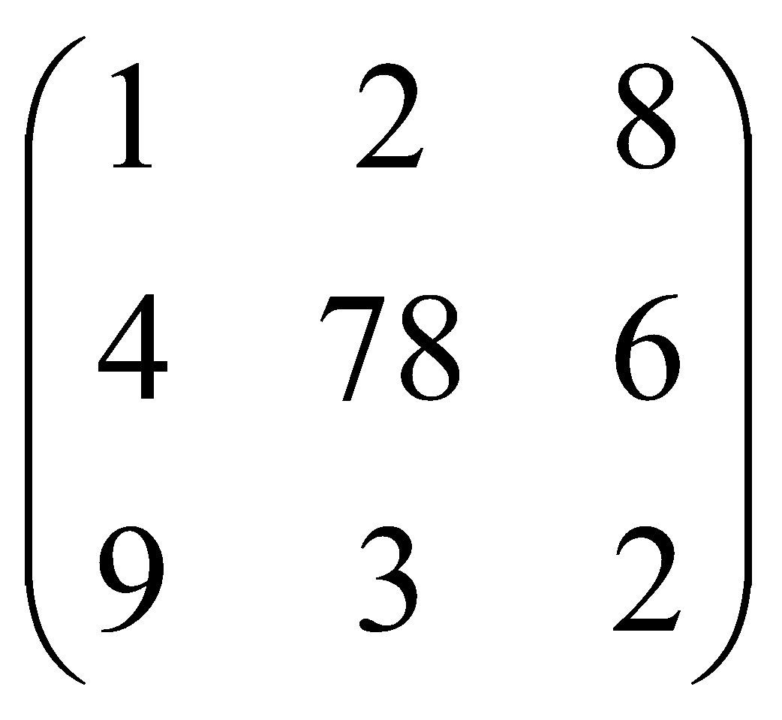
Basic concepts
Vector in R^{n} is an ordered set of n real numbers.
e.g. v = (1,6,3,4) is in R⁴
A column vector:
A row vector:
m-by-n matrix is an object in R^{mxn} with m rows and n columns, each entry filled with a (typically) real number:

Slide 14
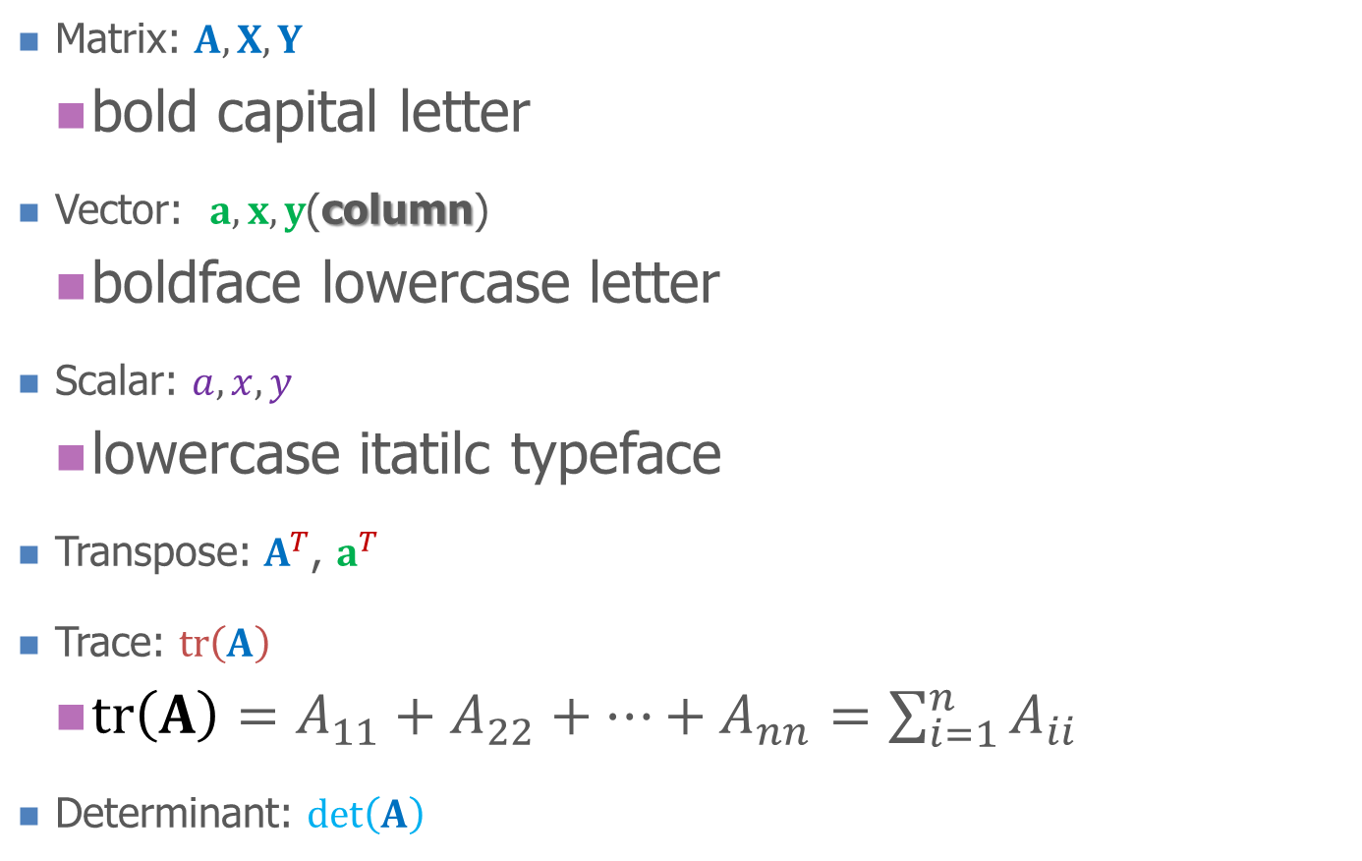

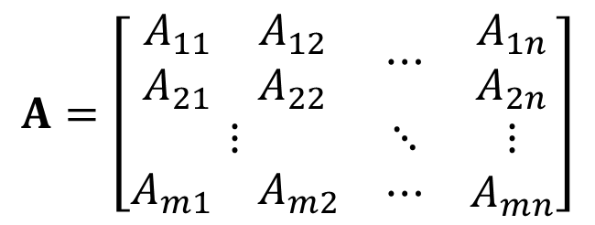




Notation

Slide 15
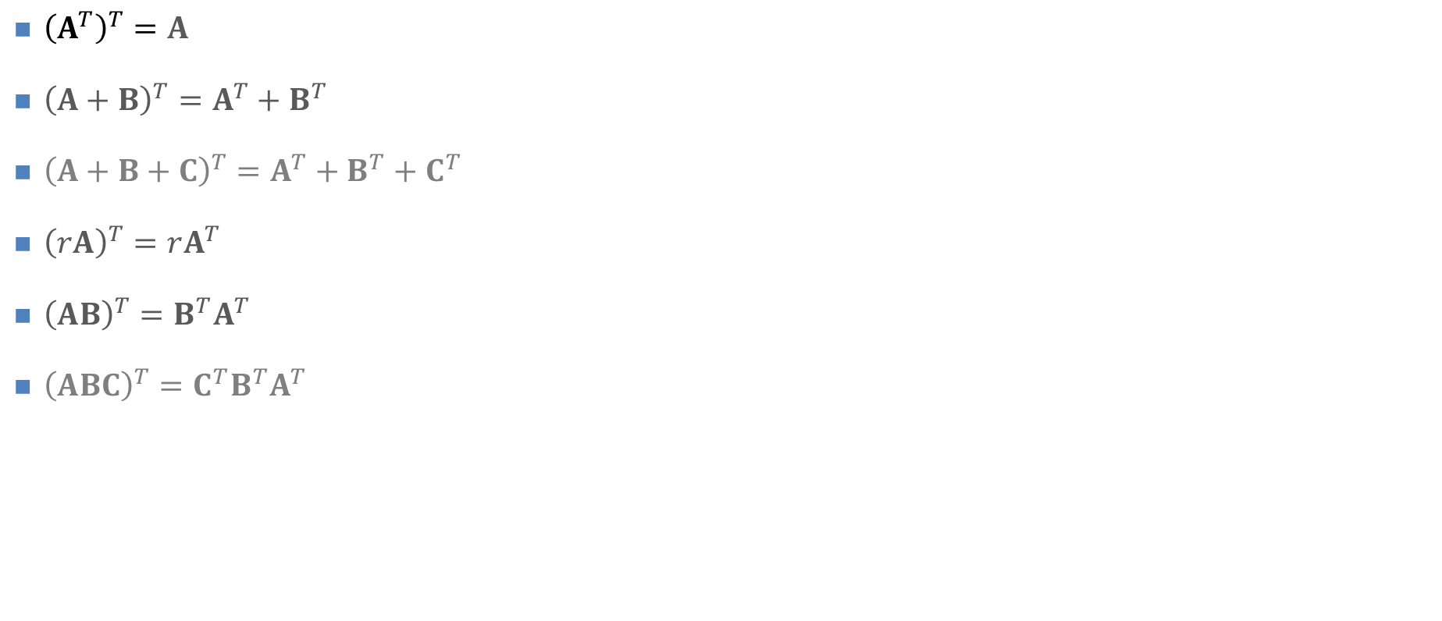
Properties of Transpose

Slide 16
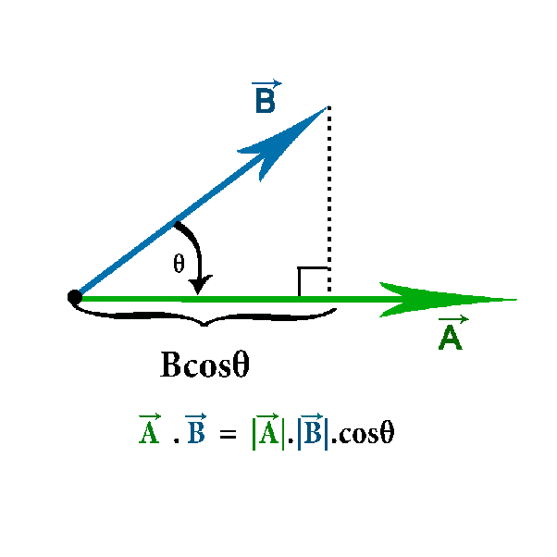
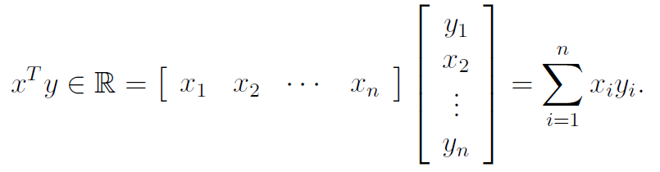
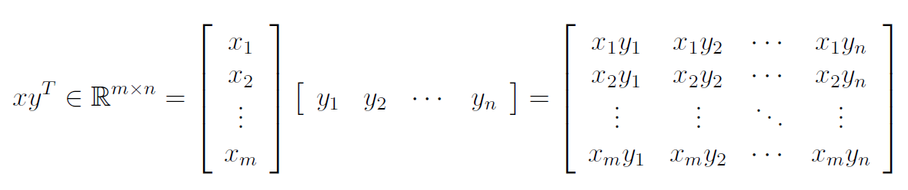
Basic concepts
We will use lower case letters for vectors The elements are referred by x_{i}.
Vector dot (inner) product:
Vector outer product:
If u•v=0, ||u||₂ != 0, ||v||₂ != 0 🡪 u and v are orthogonal
If u•v=0, ||u||₂ = 1, ||v||₂ = 1 🡪 u and v are orthonormal

Slide 17
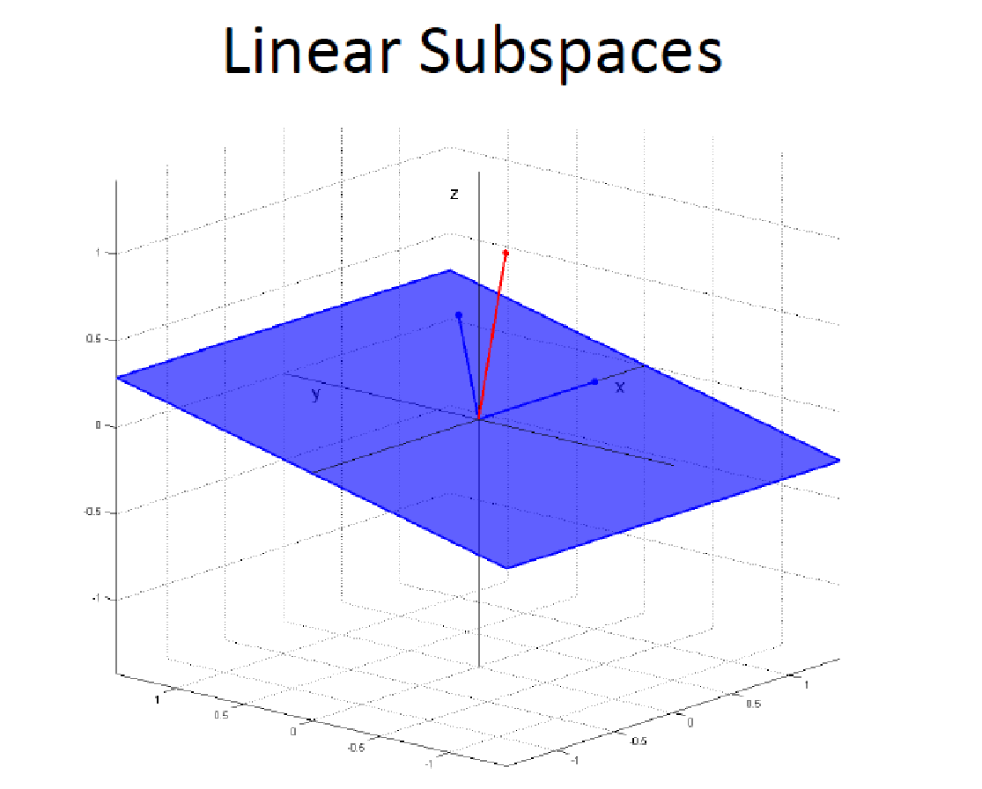
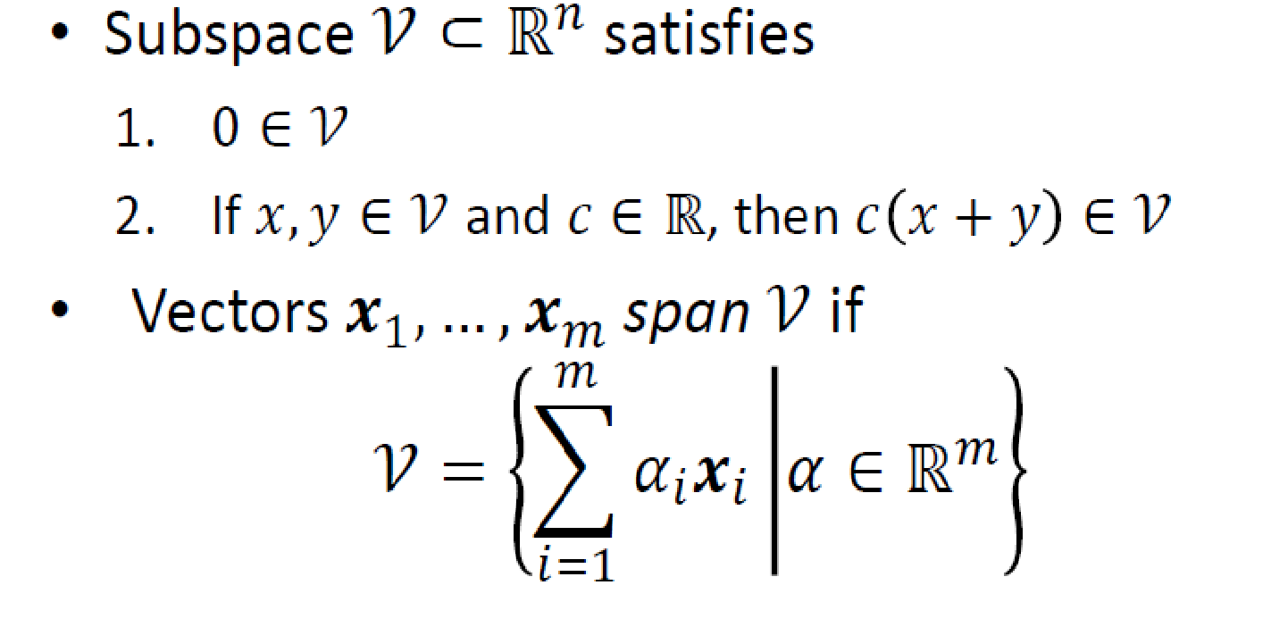
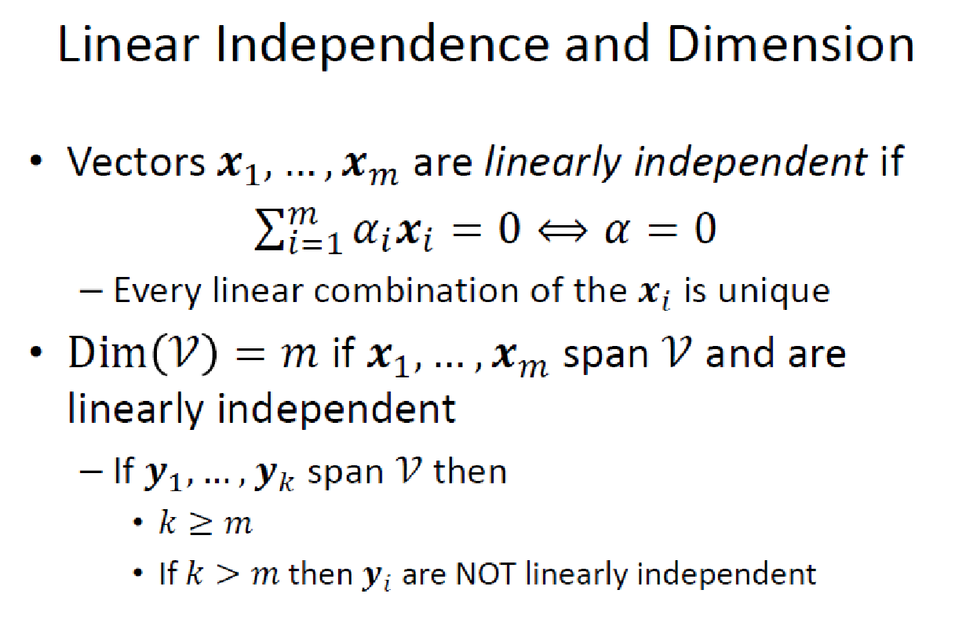

Slide 18
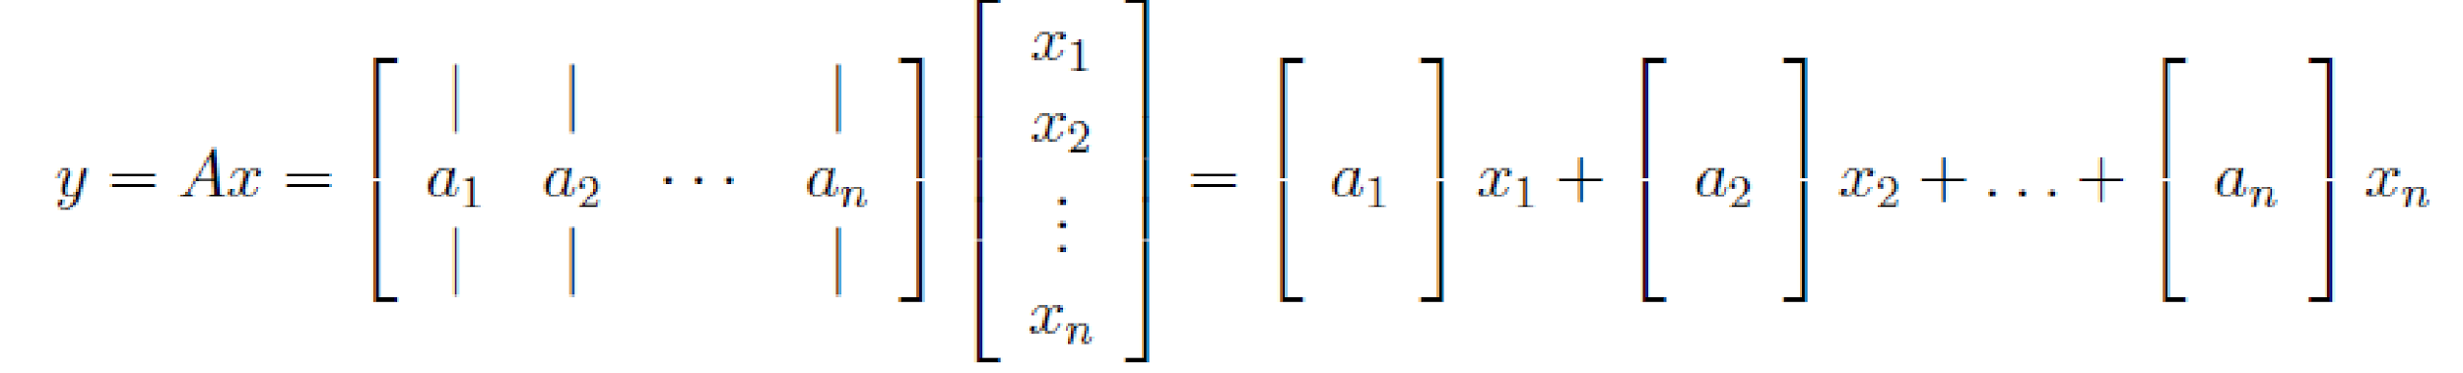
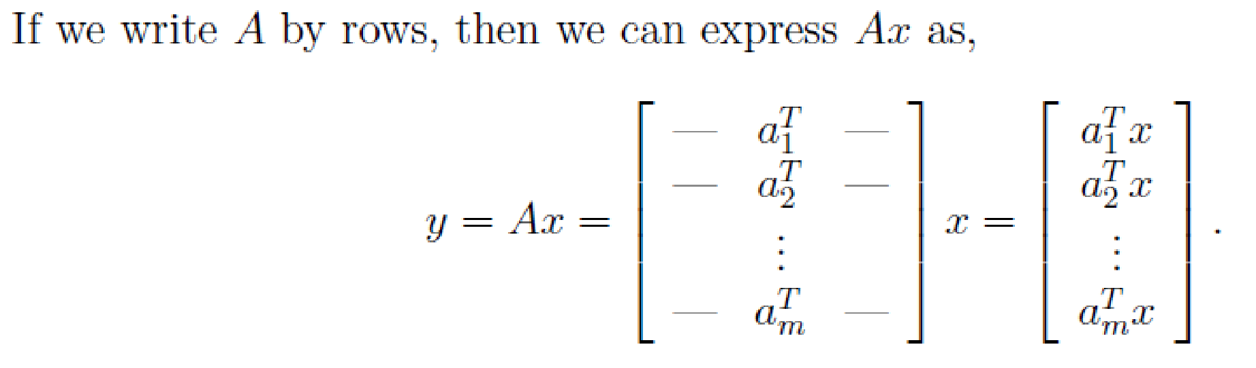

Slide 19
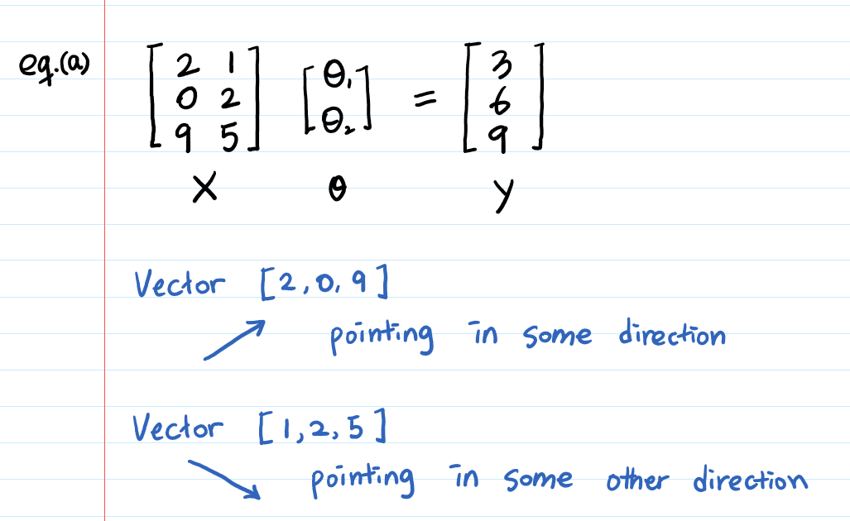
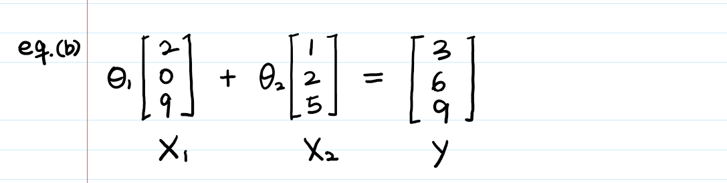
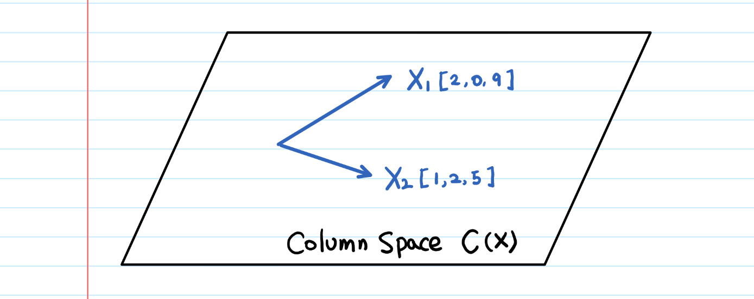
Now can we visualize the column space of a matrix?

Slide 20
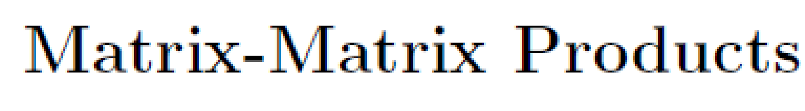
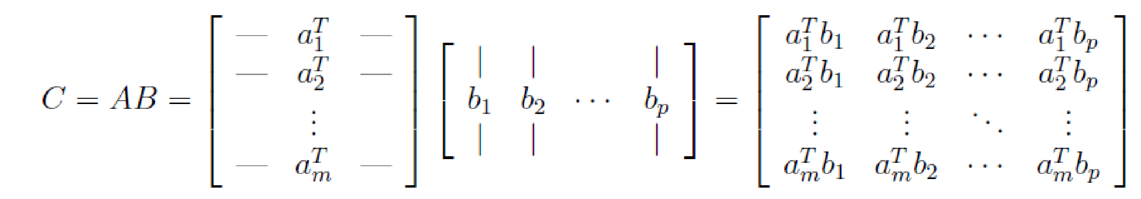
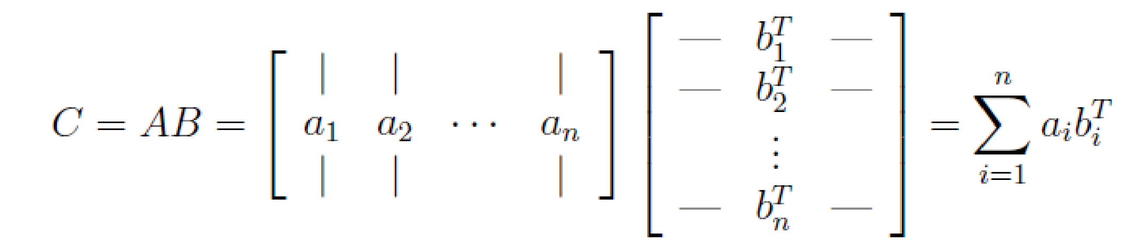
A much trickier representation:

Slide 21
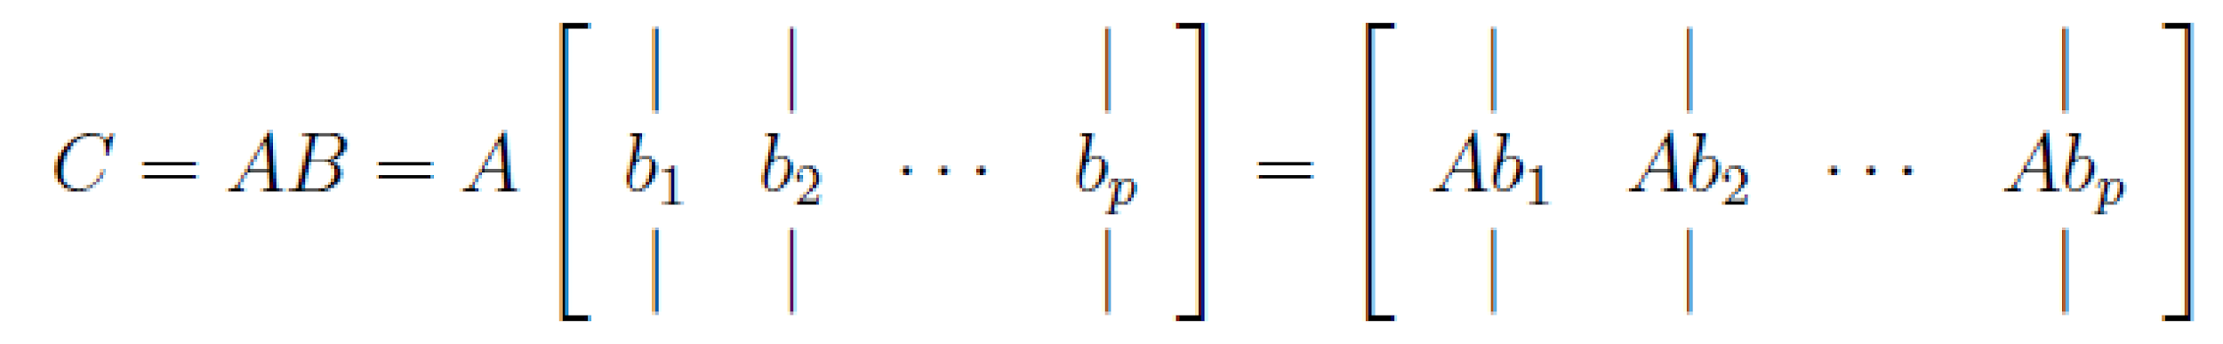
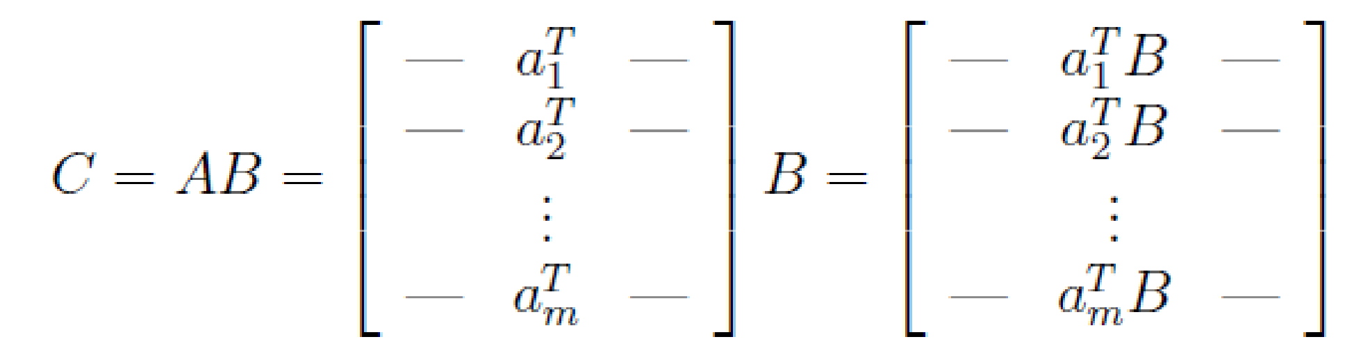
Viewing Matrix-Matrix Product in terms of Vector Matrix Product:
And

Slide 22
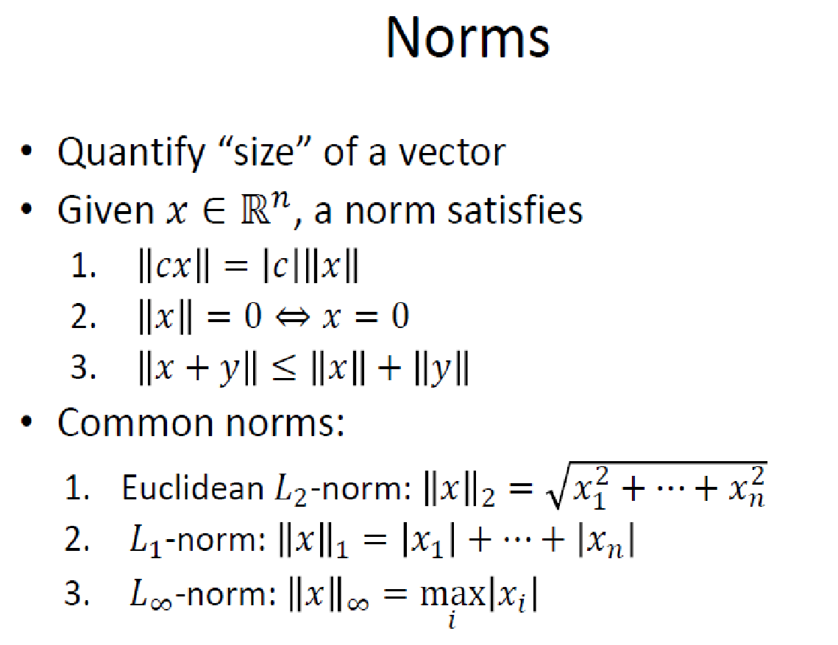
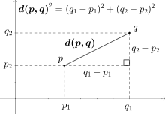
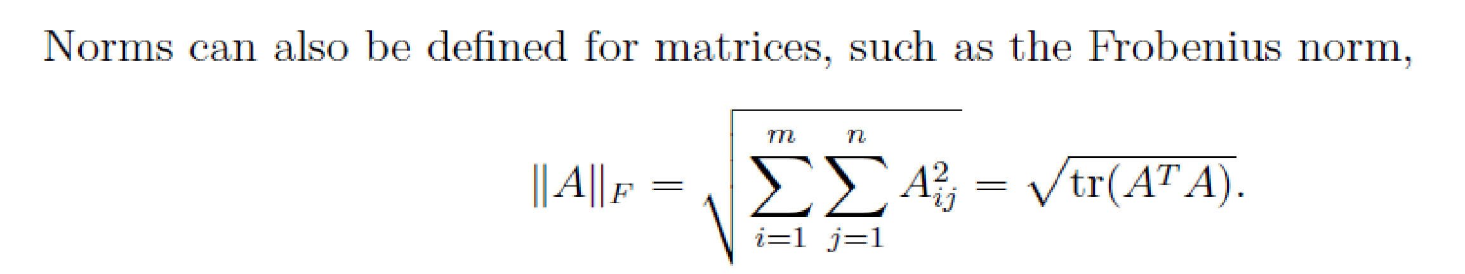
Basic concepts
Remember the good, old Euclidean distance?

Slide 23
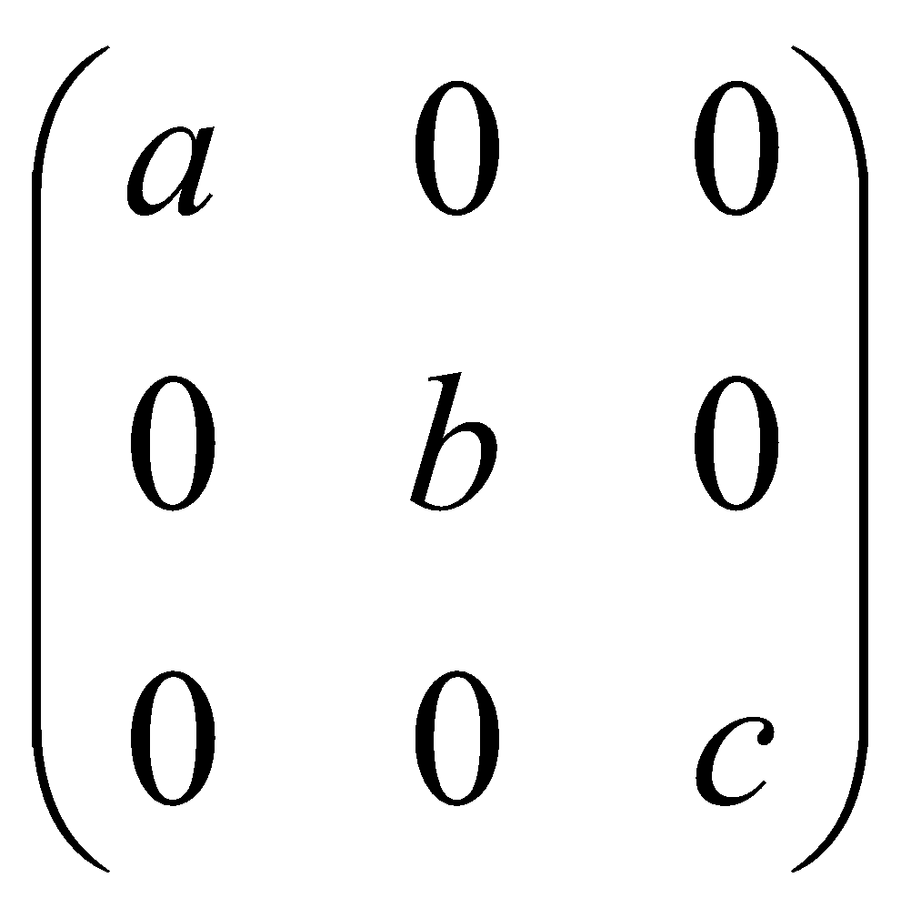
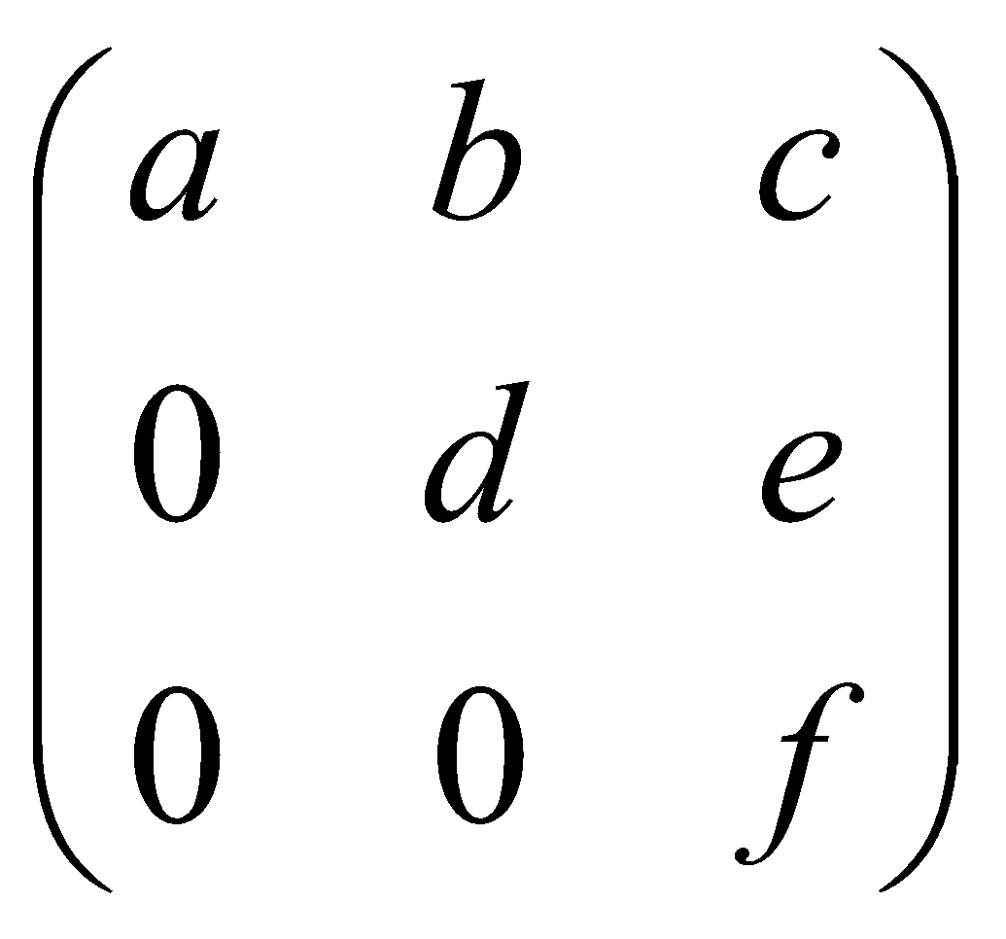
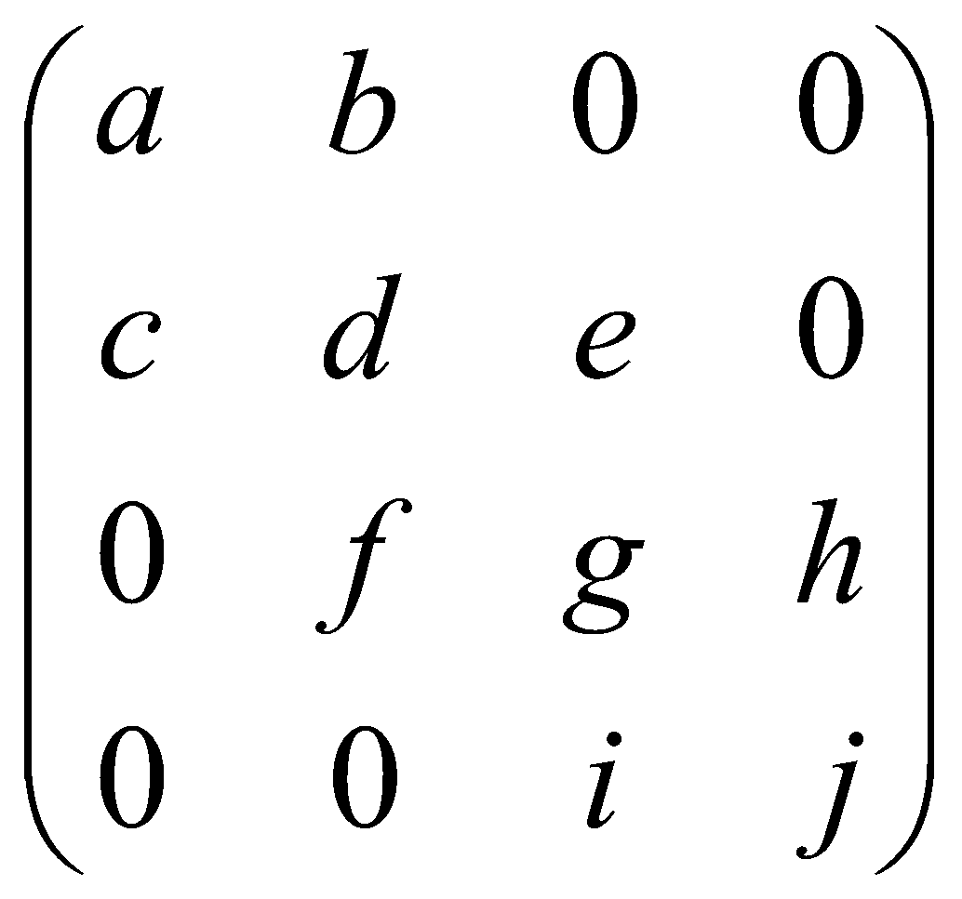
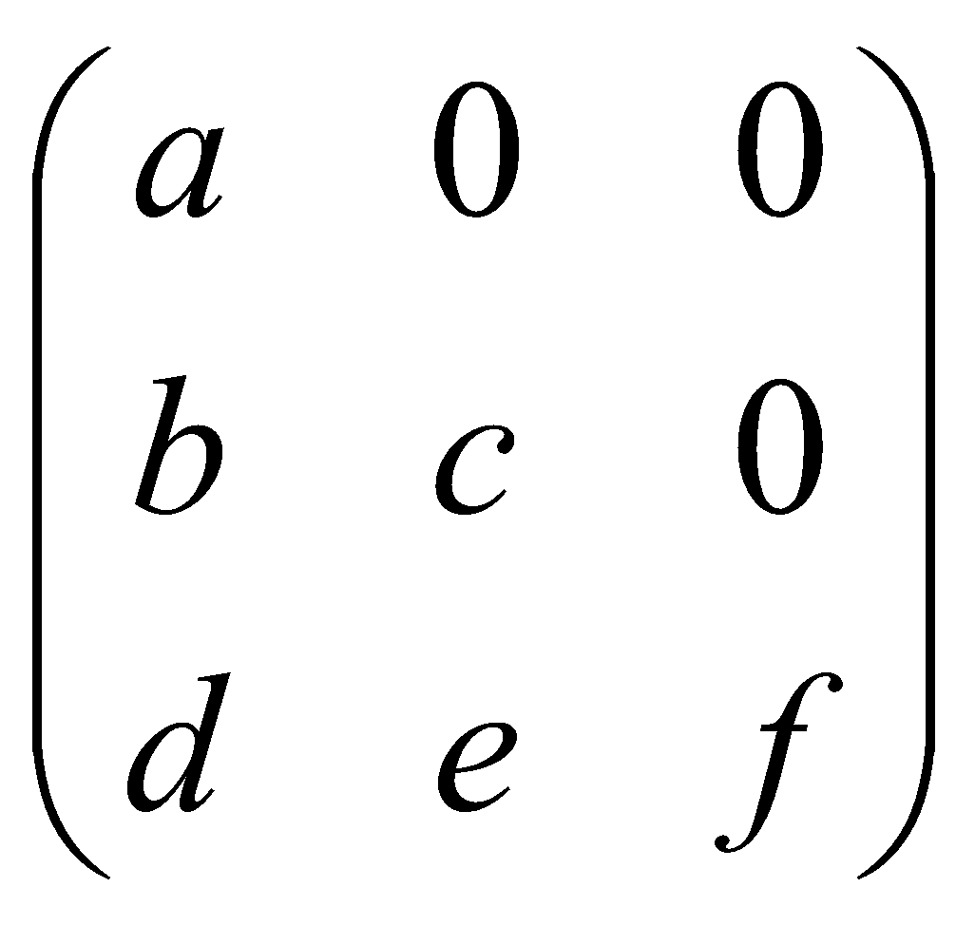
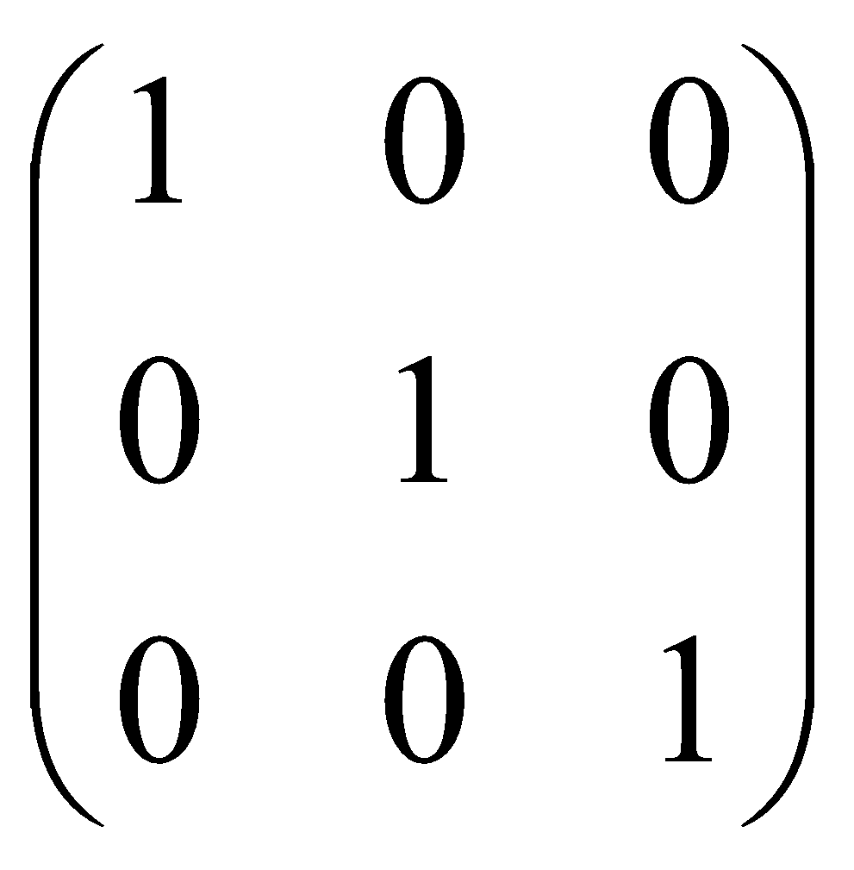
Special matrices
diagonal
upper-triangular
tri-diagonal
lower-triangular
I (identity matrix)

Slide 24
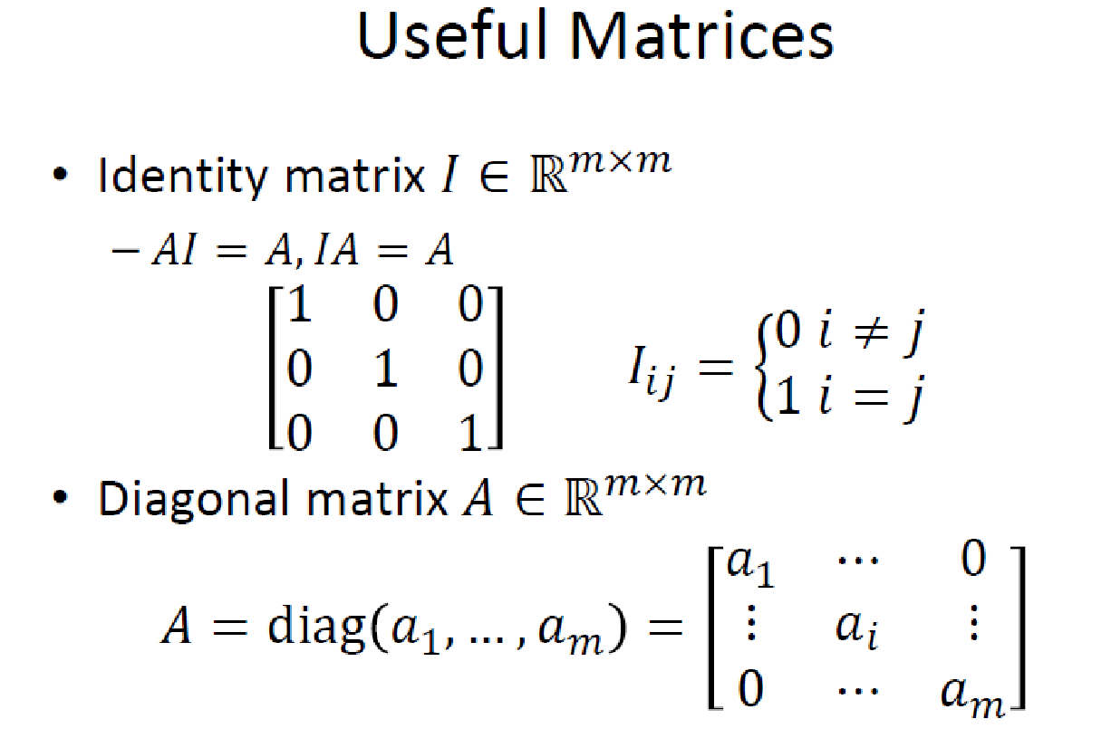

Slide 25
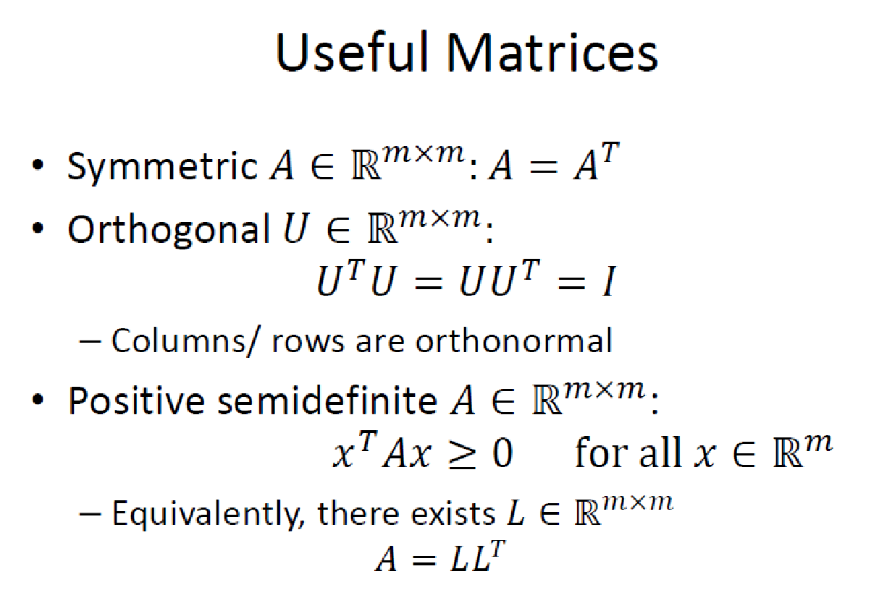

Slide 26
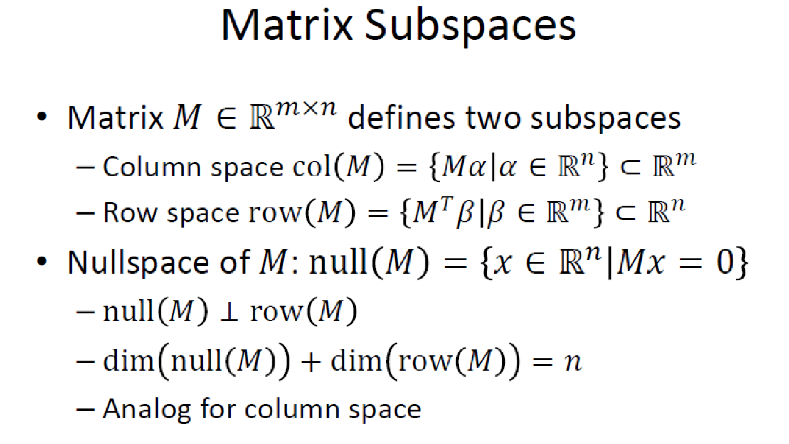

Slide 27
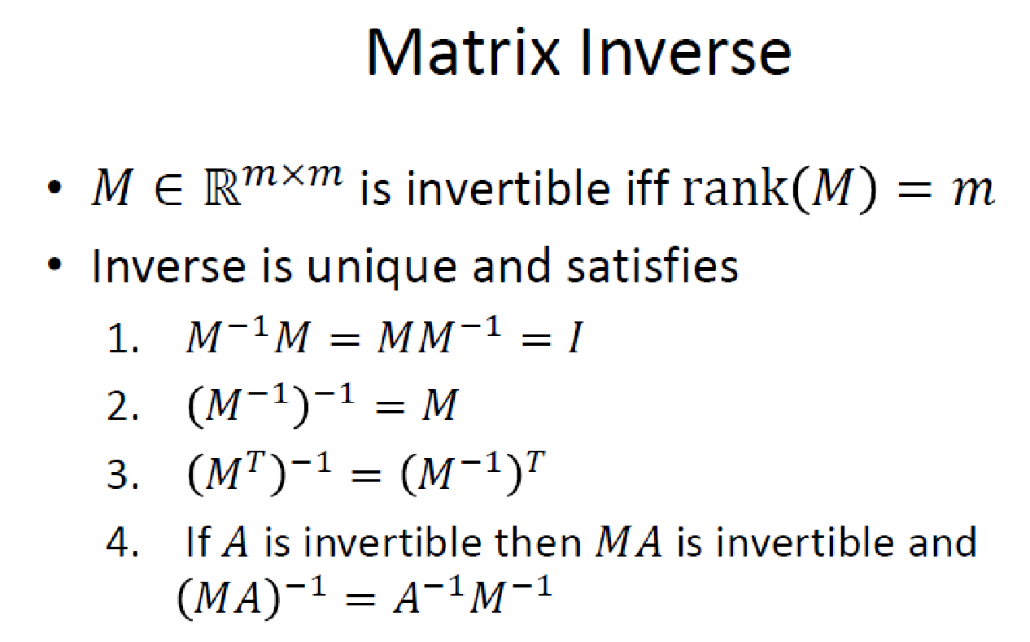
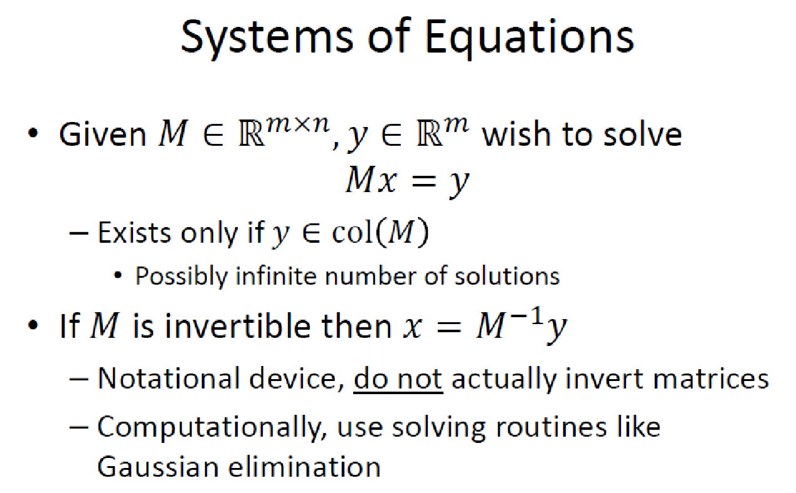

Slide 28
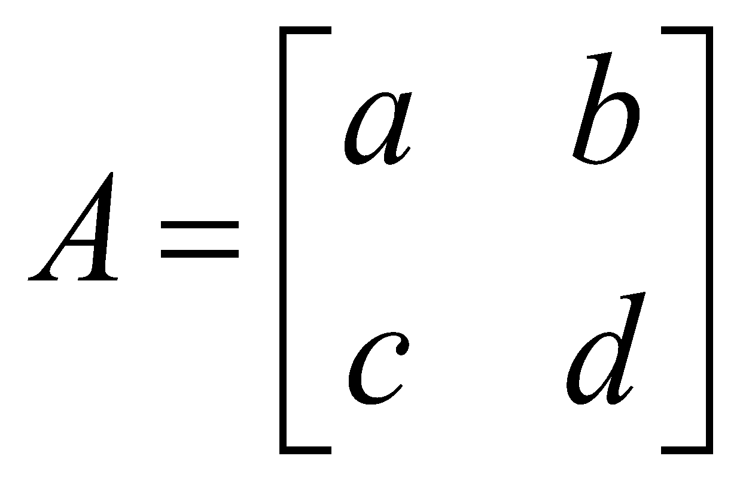
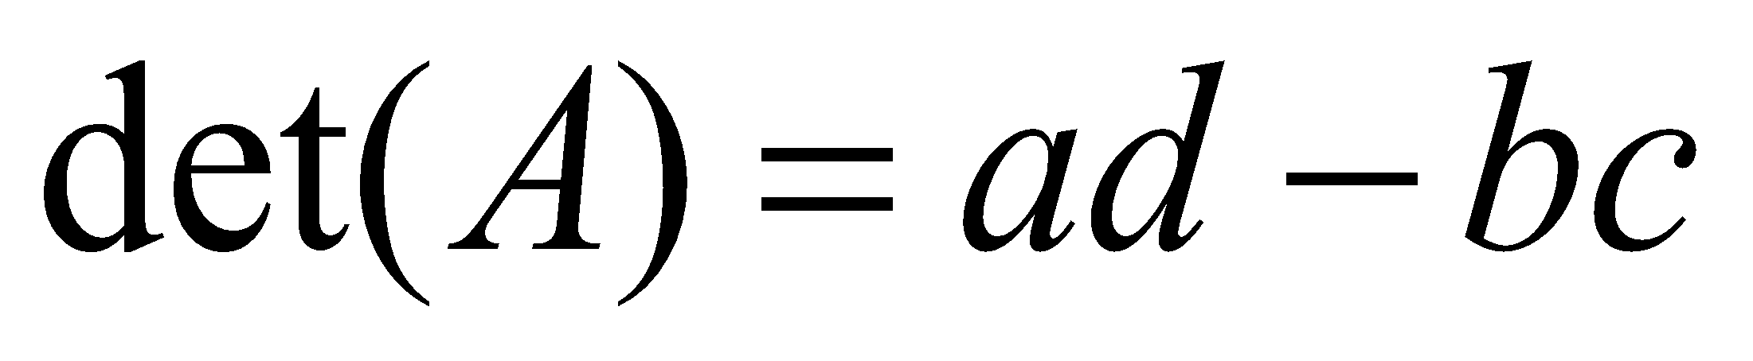
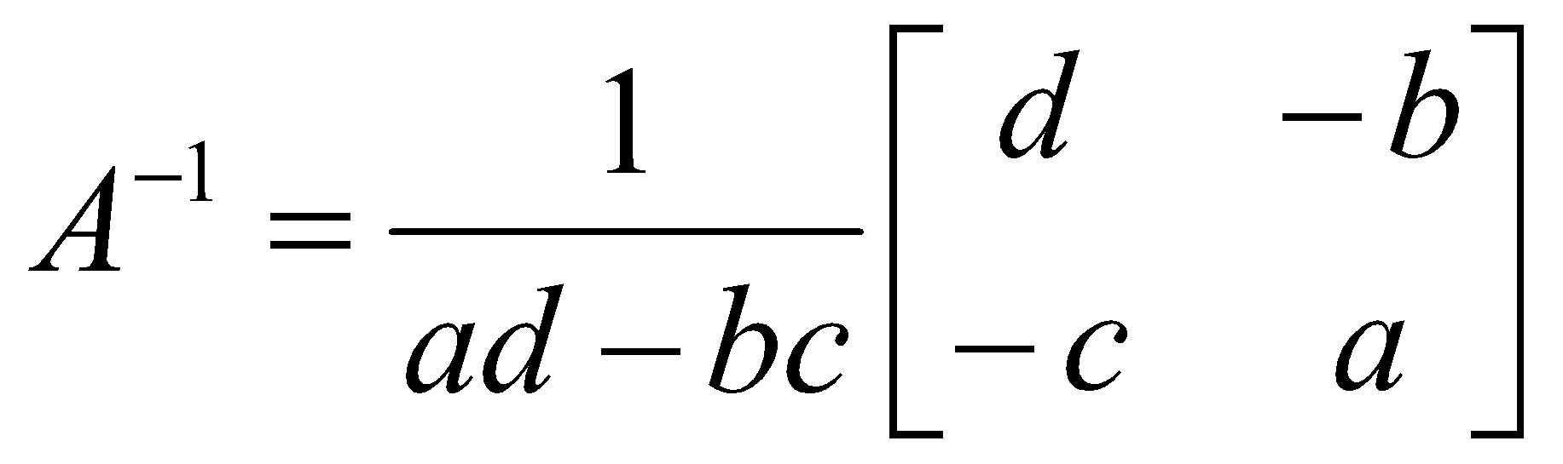
Determinant of a Matrix
Used for inversion
If det(A) = 0, then A has no inverse
http://www.euclideanspace.com/maths/algebra/matrix/functions/inverse/threeD/index.htm

Slide 29
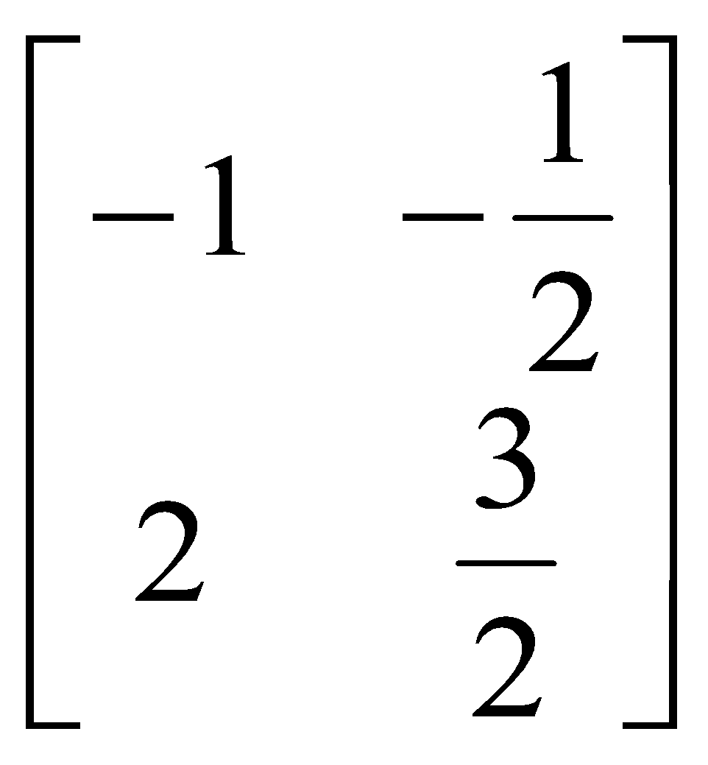
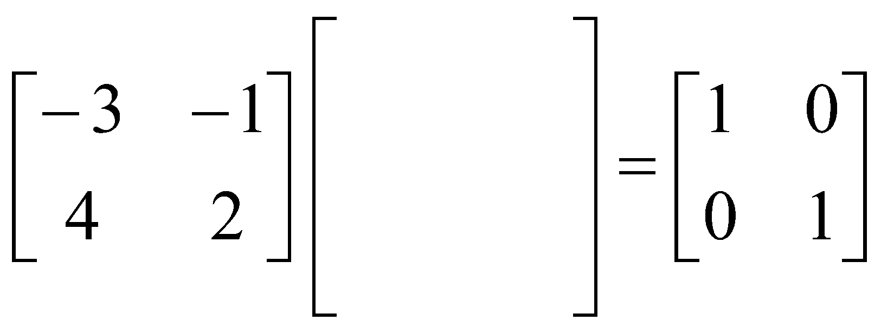
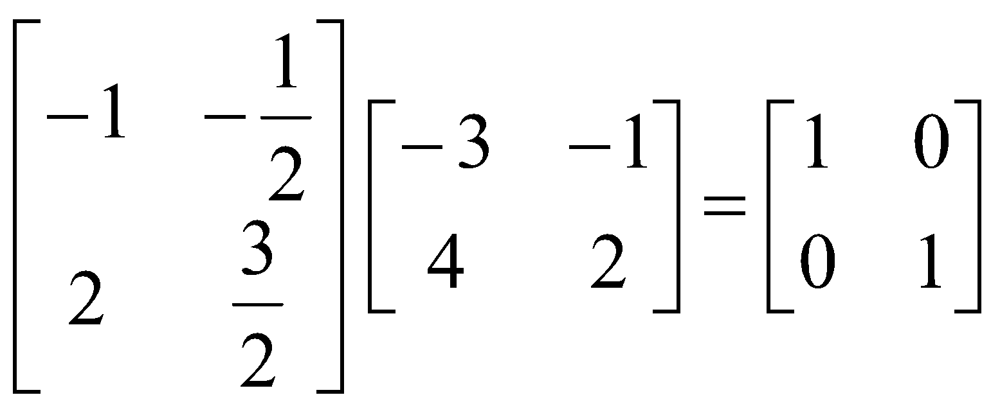
Can we find a matrix to multiply the first matrix by to get the identity?
?
Let A be an n× n matrix. If there exists a matrix B such that AB = BA = I then we call this matrix the inverse of A and denote it A⁻¹.

Slide 30





If A has an inverse we say that A is nonsingular. If A⁻¹ does not exist we say A is singular.
To find the inverse of a matrix we put the matrix A, a line and then the identity matrix. We then perform row operations on matrix A to turn it into the identity. We carry the row operations across and the right hand side will turn into the inverse.
To find the inverse of a matrix we put the matrix A, a line and then the identity matrix. We then perform row operations on matrix A to turn it into the identity. We carry the row operations across and the right hand side will turn into the inverse.
−r₂
r₁ − r₂
2r₁+r₂

Slide 31


Check this answer by multiplying. We should get the identity matrix if we’ve found the inverse.

Slide 32





We can use A⁻¹ to solve a system of equations
To see how, we can re-write a system of equations as matrices.
coefficient matrix
variable matrix
constant matrix

Slide 33



left multiply both sides by the inverse of A
This is just the identity
but the identity times a matrix just gives us back the matrix so we have:
This then gives us a formula for finding the variable matrix: Multiply A inverse by the constants.

Slide 34






find the inverse
-2r₁+r₂
r₁-3r₂
-r₂
x
This is the answer to the system
y

Slide 35
Rank and Nullity
The rank of a matrix is defined as the maximum number of linearly independent columns in the matrix.
Nullity = Number of columns - rank
If A is a mxn matrix:
Rank A = n
Columns of A are independent
Nullity A = 0
Notes:
(b) the maximum number of linearly independent row vectors in the matrix. Both definitions are equivalent.
The rank of a matrix would be zero only if the matrix had no non-zero elements. If a matrix had even one non-zero element, its minimum rank would be one.

Slide 36








Conclusion
NO
YES
No solution
Rank A = n
Rank A < n
Nullity A = 0
Nullity A > 0
Unique solution
Infinite solution
Notes:
Check existence first
One or infinite soluiton

Slide 37








Conclusion
Rank A = n
Nullity A = 0
NO
YES
NO
YES
NO
YES
No solution
Infinite
solution
No solution
Unique solution

Slide 38


Visualizing System of Linear Equations…(every eqn. is a line, plane, or hyperplane)
Source: Linear Algebra, Geometry, and Computation, Mark Crovella

Slide 39



When you will obtain no unique solution….
Source: Linear Algebra, Geometry, and Computation, Mark Crovella

Slide 40


Slide 41


Slide 42

Matrix factorization: a key method for designing recommender systems

Slide 43


Eigenvalues and Eigenvectors
Eigenvalue problem (one of the most important problems in the linear algebra):
If A is an n×n matrix, do there exist nonzero vectors x in R^{n} such that Ax is a scalar multiple of x?
(The term eigenvalue is from the German word Eigenwert, meaning “proper value”)
Eigenvalue and Eigenvector :
A: an n×n matrix
λ: a scalar (could be zero)
x: a nonzero vector in R^{n}
※ Geometric Interpretation
Eigenvalue
Eigenvector

Slide 44





Eigenvalues and Eigenvectors
excluding zero vector
A must be square
Eigen value
Eigen vector
Notes:
𝐴 must be n x n

Slide 45




Looking for Eigenvalues
Example 1: Find the eigenvalues of
=0
t = -3 or 5
The eigenvalues of A are -3 or 5.
Notes:
-3 + 5 = -4 + 6
Det = -4*6 – (-3) * 3 = -15
-3 * 5 = -15

Slide 46




Looking for Eigenvalues
Example 1: Find the eigenvalues of
The eigenvalues of A are -3 or 5.
Eigenspace of -3
find the solution
Eigenspace of 5
find the solution
Notes:
[-3 1]^T
[1 -3]^T or [-1 3]
They are independent

Slide 47


Trace & Determinant

Slide 48


The Eigen-decompostion

Slide 49


Matrix calculus is a specialized notation for doing multivariable calculus, especially over spaces of matrices.
Slides from: Fin500J Mathematical Foundations in Finance, Philip H. Dybvig

Slide 50

1.1 Derivative of Vector with Respect to Vector
This is the tangent matrix or often referred as the Jacobian matrix.

Slide 51



1.2 Derivative of a Scalar with Respect to Vector
If y is a scalar
It is also called the gradient of y with respect to a vector variable x, denoted by
1.3 Derivative of Vector with Respect to Scalar

Slide 52

Can we “see” the gradients?
Nice Youtube video is here:
https://www.youtube.com/watch?v=W6aDzrrLAzQ

Slide 53



Slide 54



Example 1
Given
and

Slide 55



Some useful vector derivative formulas
Homework

Slide 56



Important Property of Quadratic Form x^{T}Cx
Proof:
If C is symmetric,

Slide 57



2 The Chain Rule for Vector Functions
Let
where z is a function of y, which is in turn a function of x, we can write
Each entry of this matrix may be expanded as

Slide 58


The Chain Rule for Vector Functions (Cont.)
Then
On transposing both sides, we finally obtain
This is the chain rule for vectors (different from the conventional chain rule of calculus, the chain of matrices builds toward the left)

Slide 59

Example 2
x, y are as in Example 1 and z is a function of y defined as

Slide 60
List of Differentiation
Result of differentiating various kinds of aggregates with other kinds of aggregates.
 | Notation | Type | Notation | Type | Notation | Type
 |  | scalar

Slide 61

Derivative Formulas

