Slide 1
Regression Analysis: Part 2

Slide 2
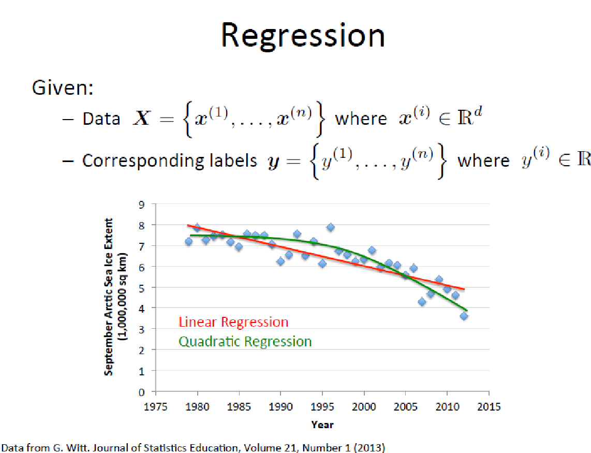

Slide 3
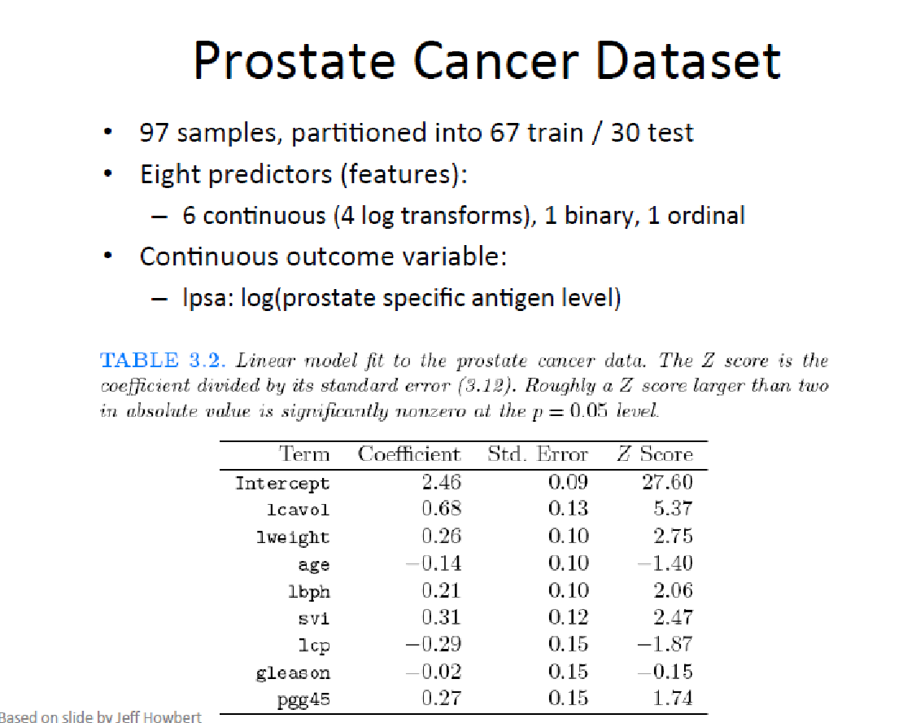

Slide 4
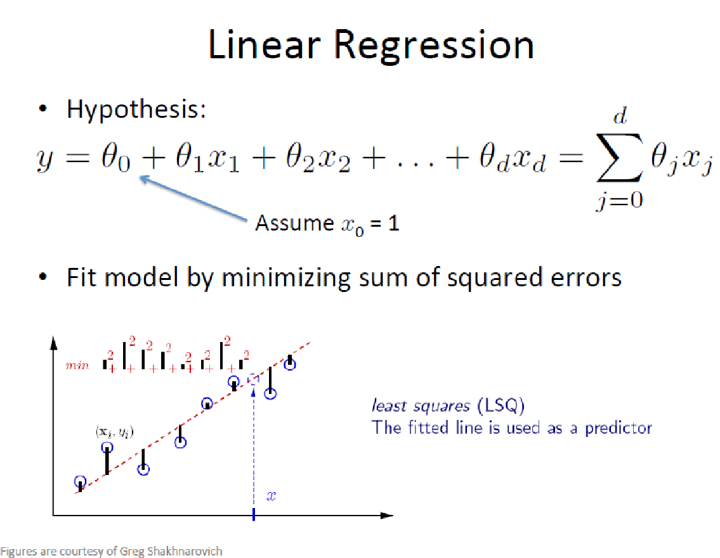

Slide 5
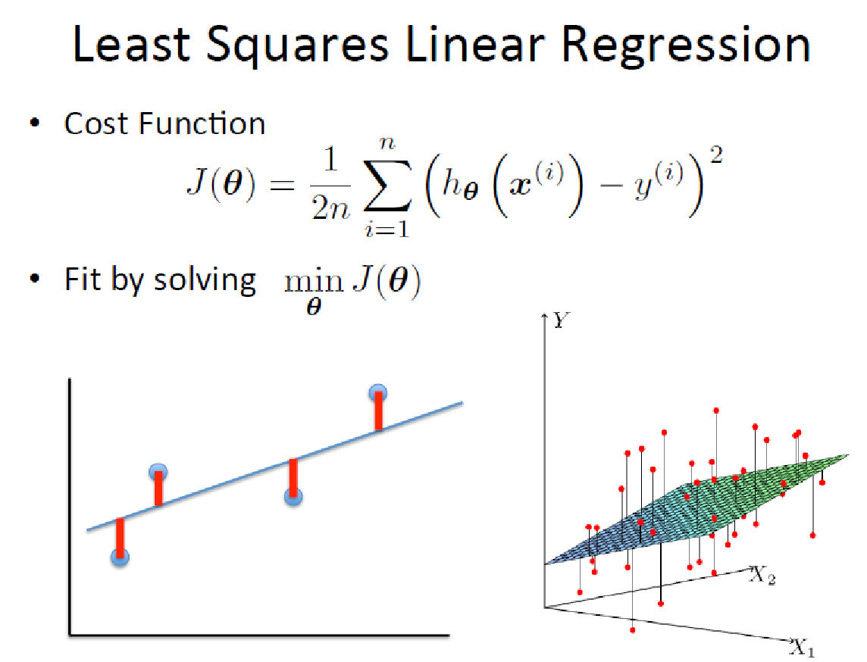

Slide 6
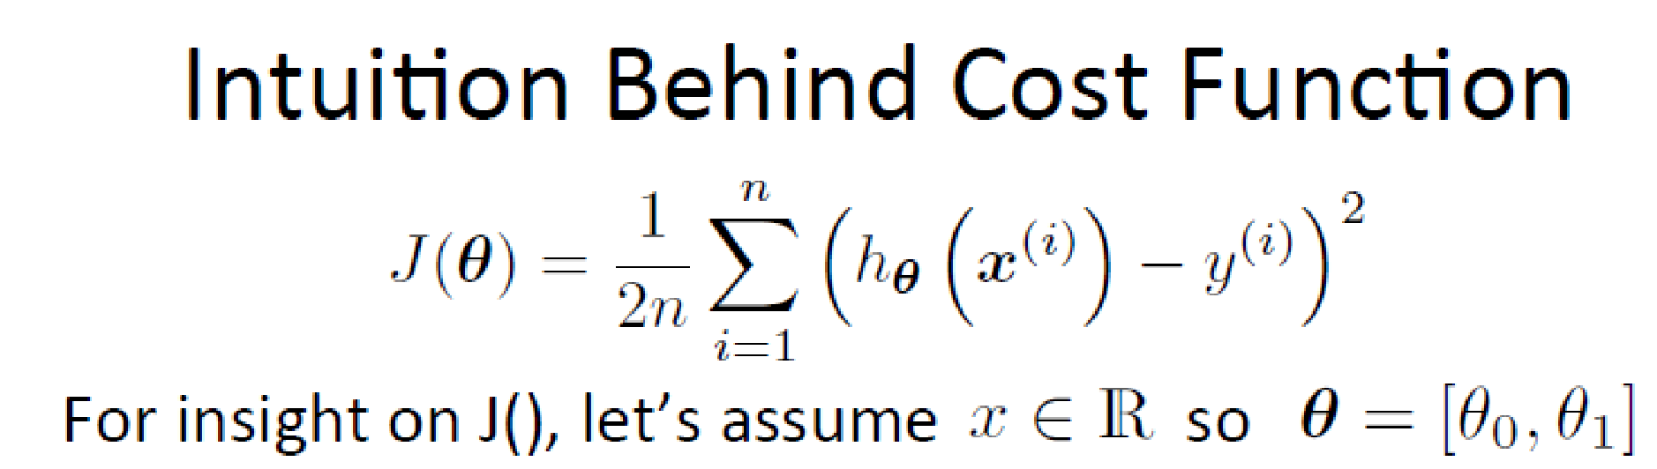
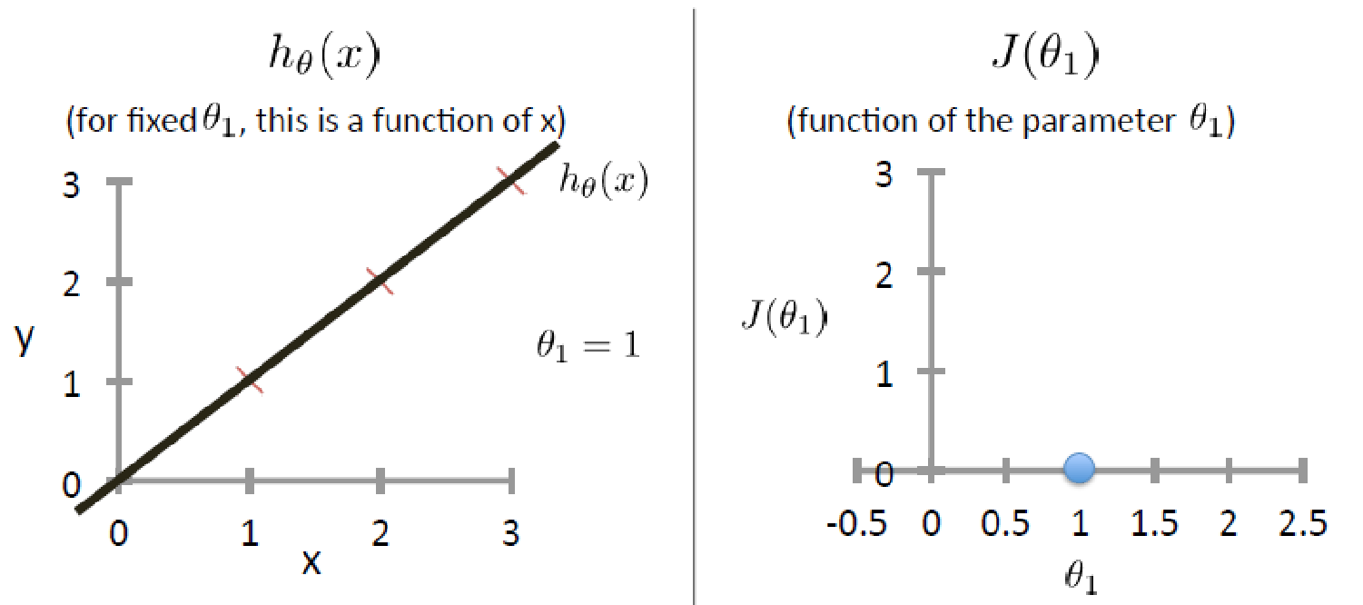
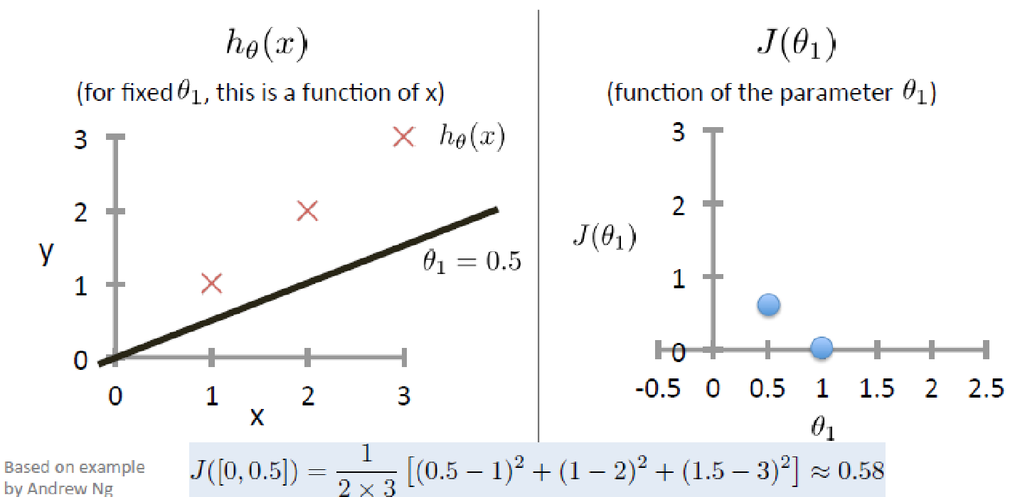
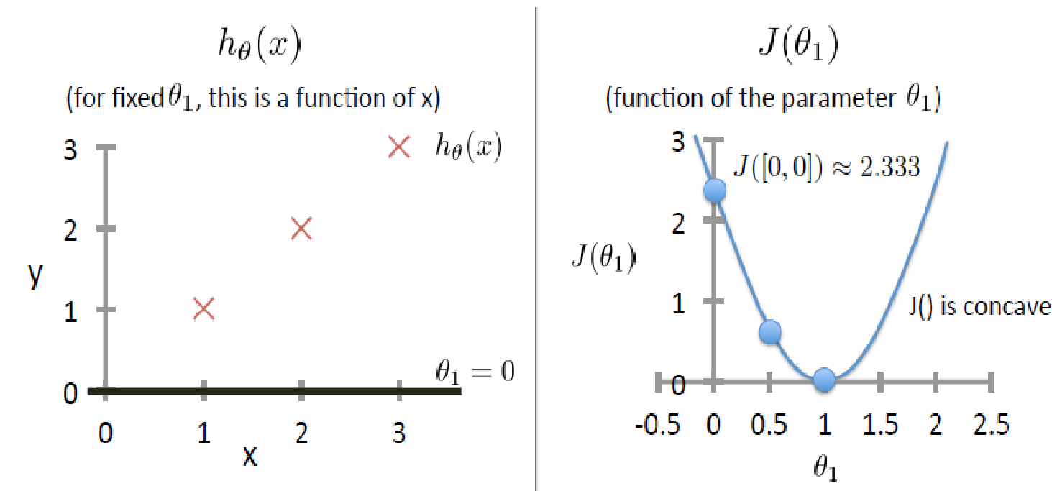

Slide 7
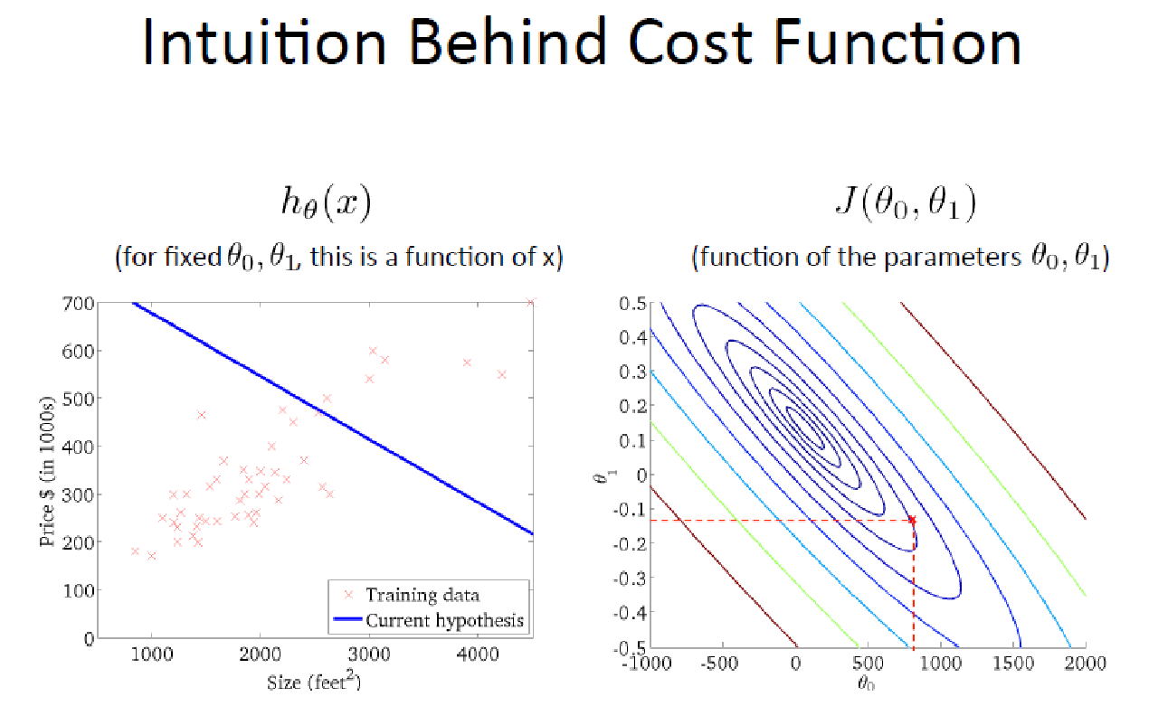
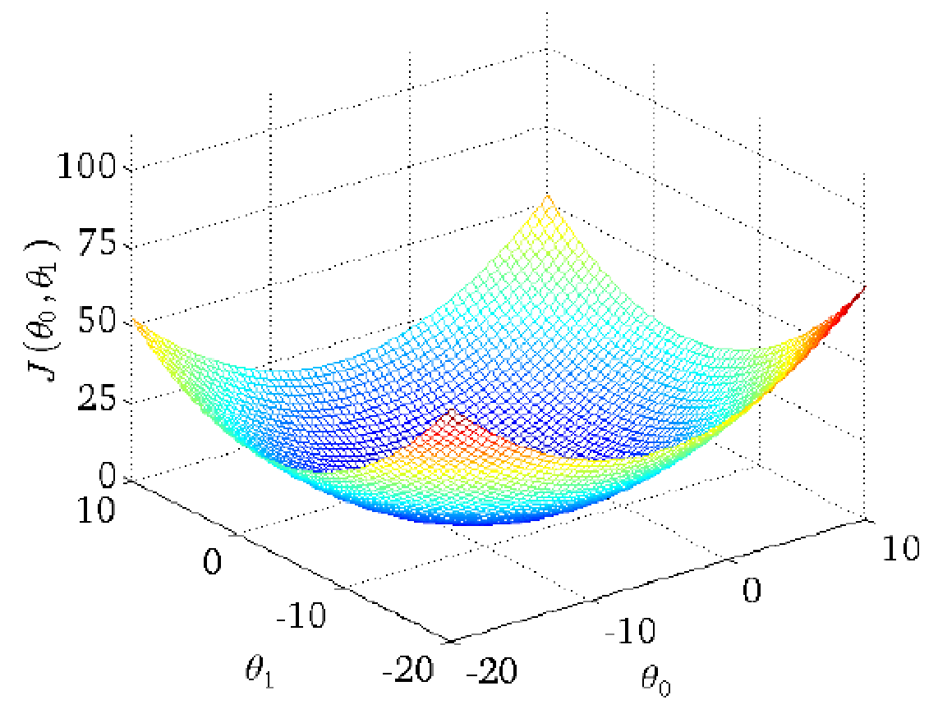

Slide 8
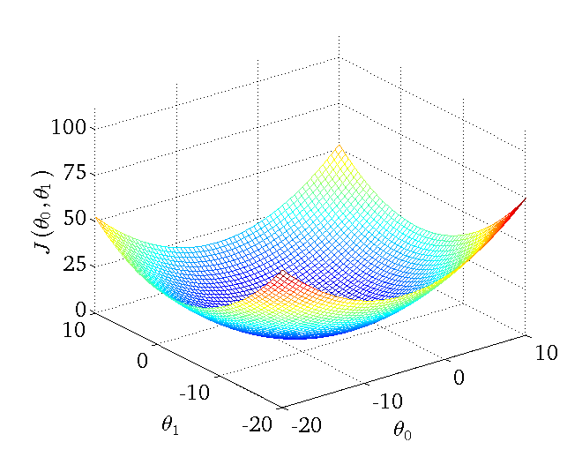
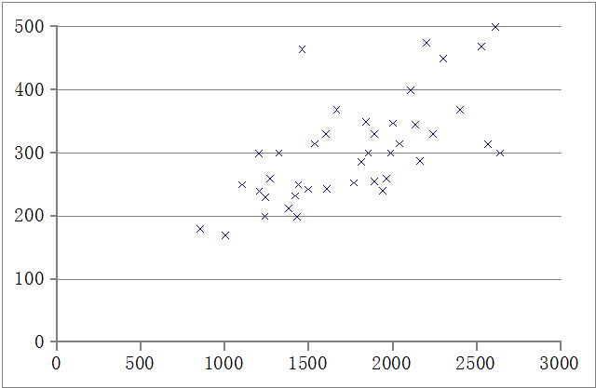
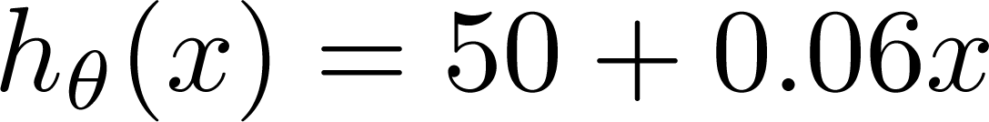
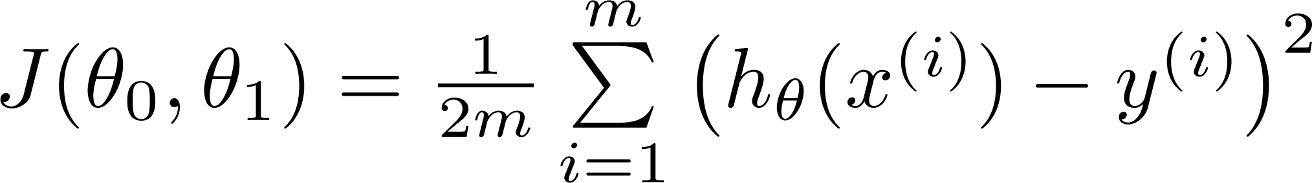
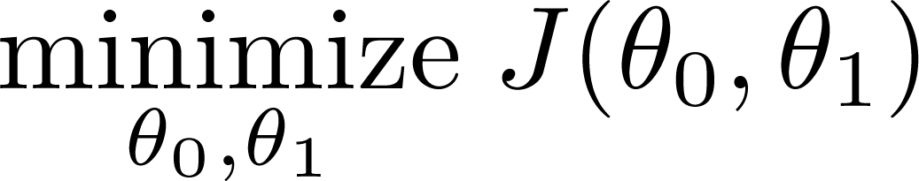
Price ($)
in 1000’s
Size in feet² (x)
Question:How to minimize J?

Slide 9
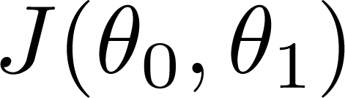
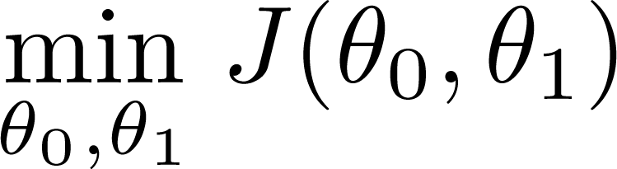
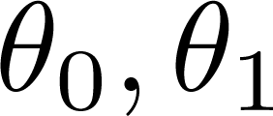
Gradient Descent
Have some function
Want
Outline:
Start with some
Keep changing to reduce until we hopefully end up at a minimum

Slide 10
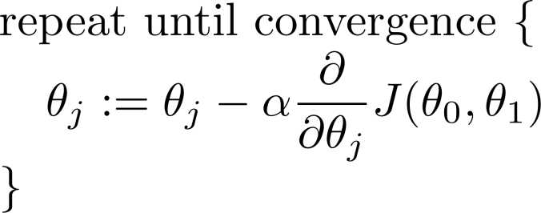
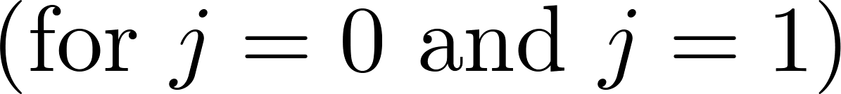
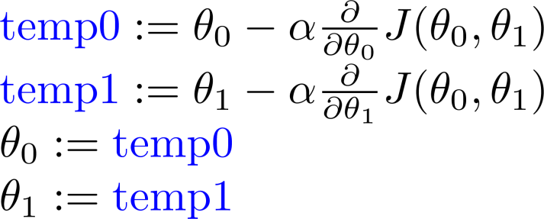
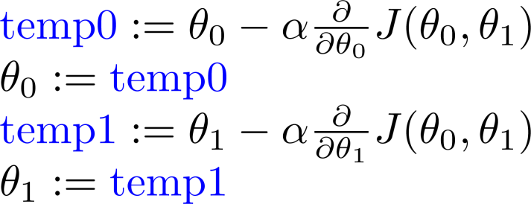
Gradient descent algorithm
Correct: Simultaneous update
Incorrect:

Slide 11
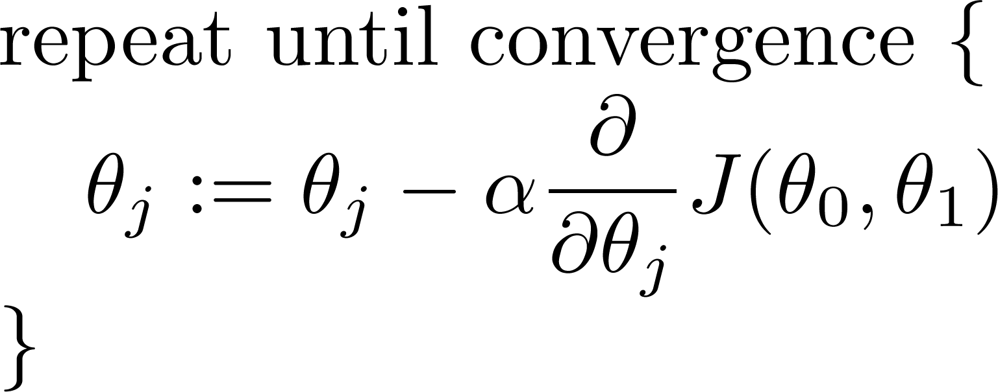
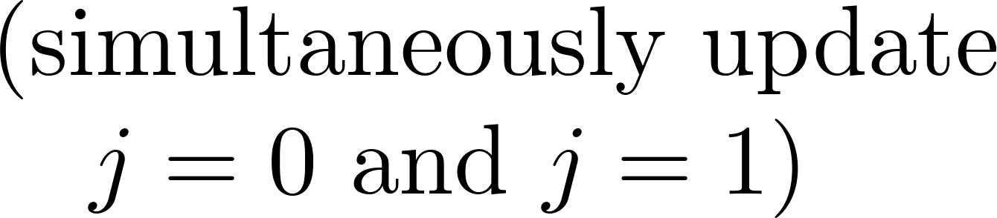

Gradient descent algorithm
Notice : α is the learning rate.

Slide 12
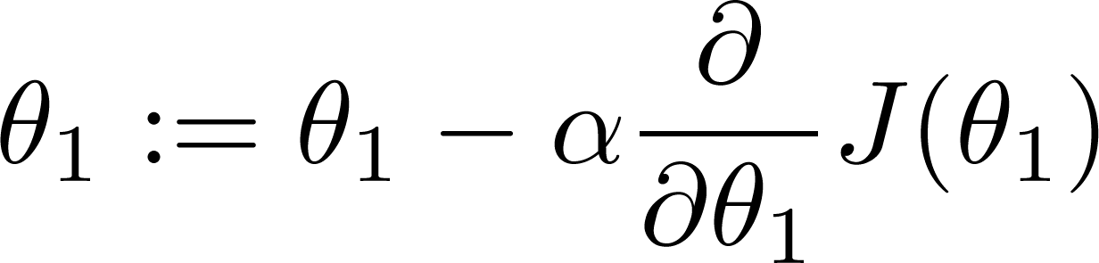

If α is too small, gradient descent can be slow.
If α is too large, gradient descent can overshoot the minimum. It may fail to converge, or even diverge.

Slide 13

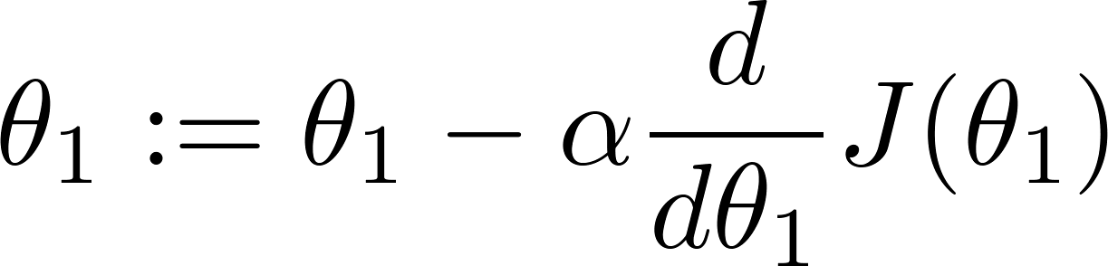
at local optima
Current value of
Unchange
Gradient descent can converge to a local minimum, even with the learning rate α fixed.
As we approach a local minimum, gradient descent will automatically take smaller steps. So, no need to decrease α over time.

Slide 14
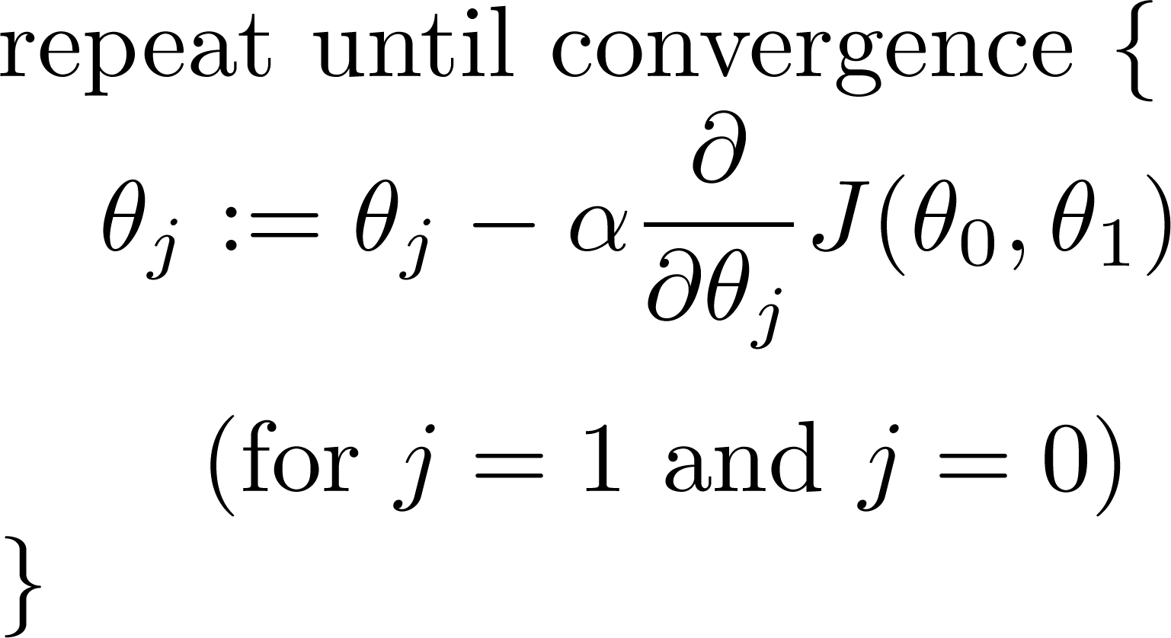
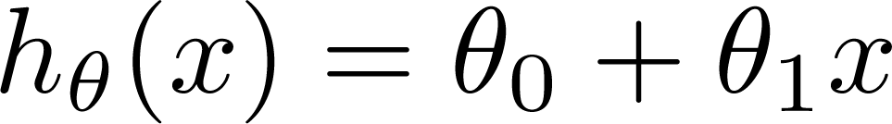
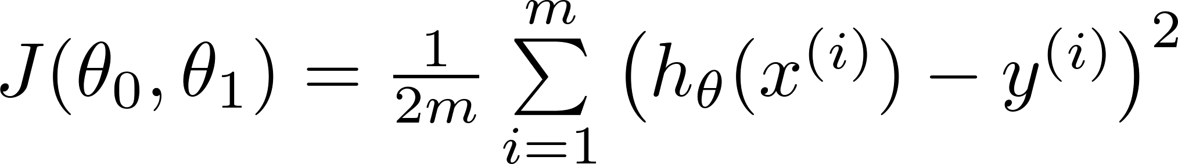
Gradient Descent for Linear Regression
Gradient descent algorithm
Linear Regression Model

Slide 15
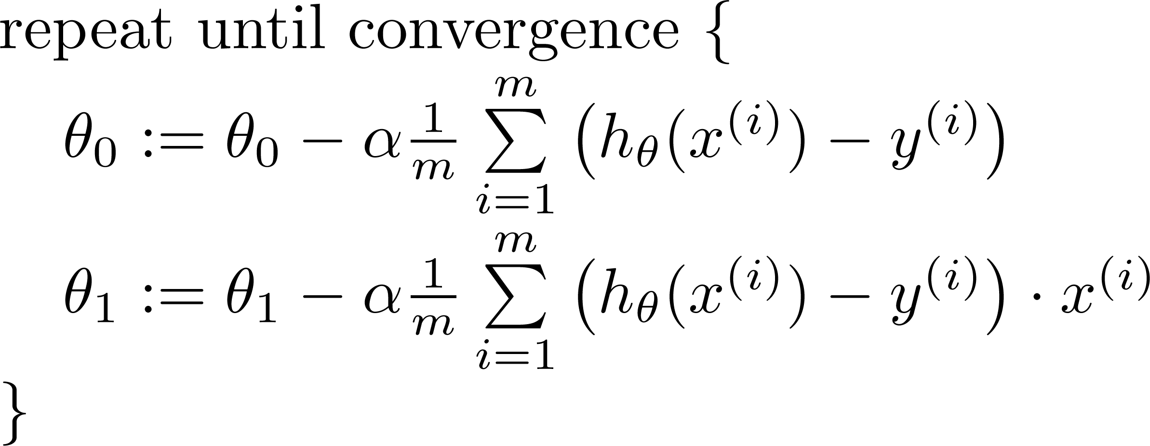

Gradient descent algorithm
update
and
simultaneously

Slide 16
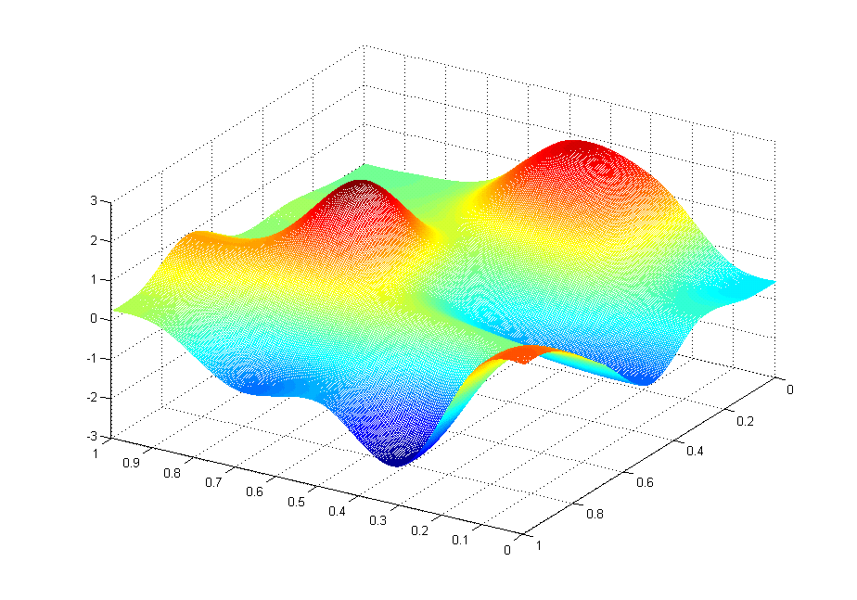
J(θ₀,θ₁)
θ₁
θ₀

Slide 17



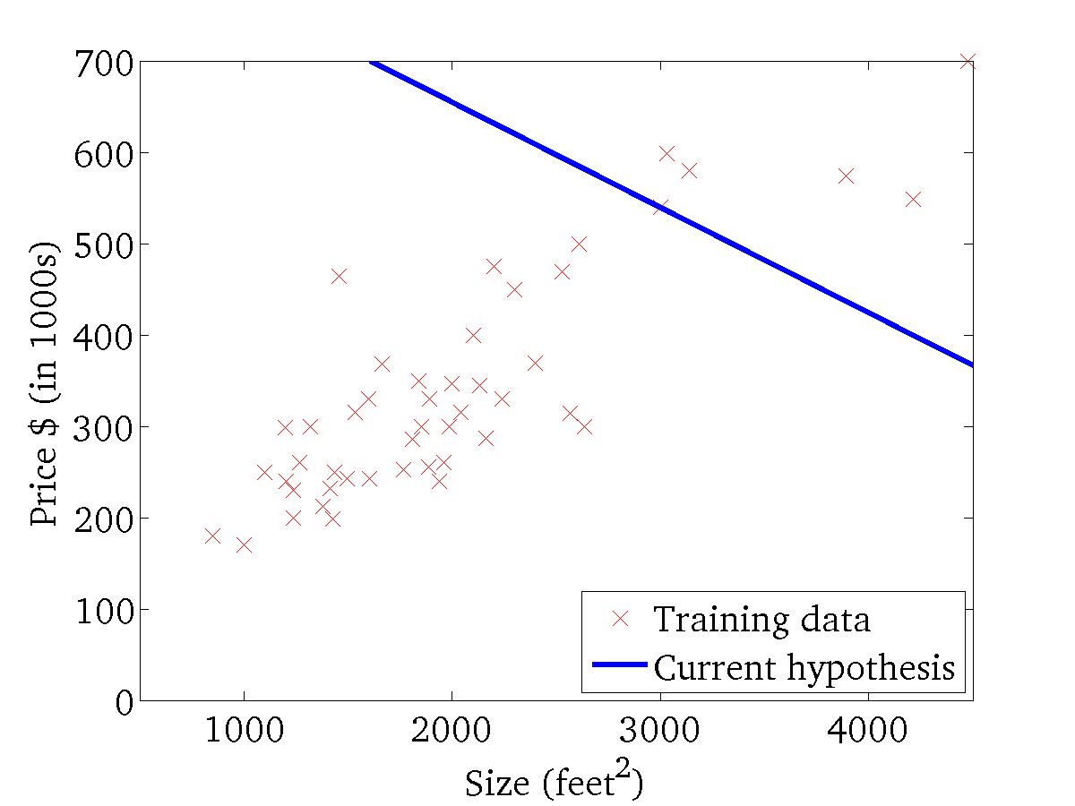
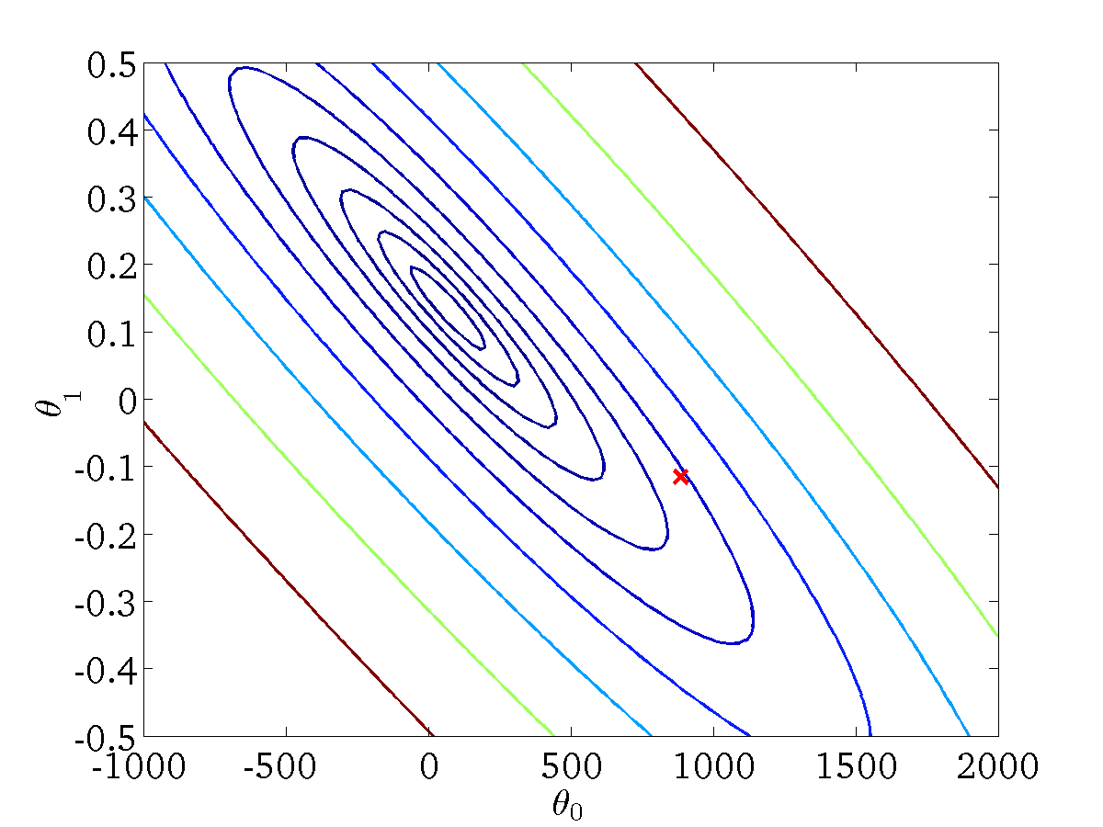
(for fixed , this is a function of x)
(function of the parameters )

Slide 18
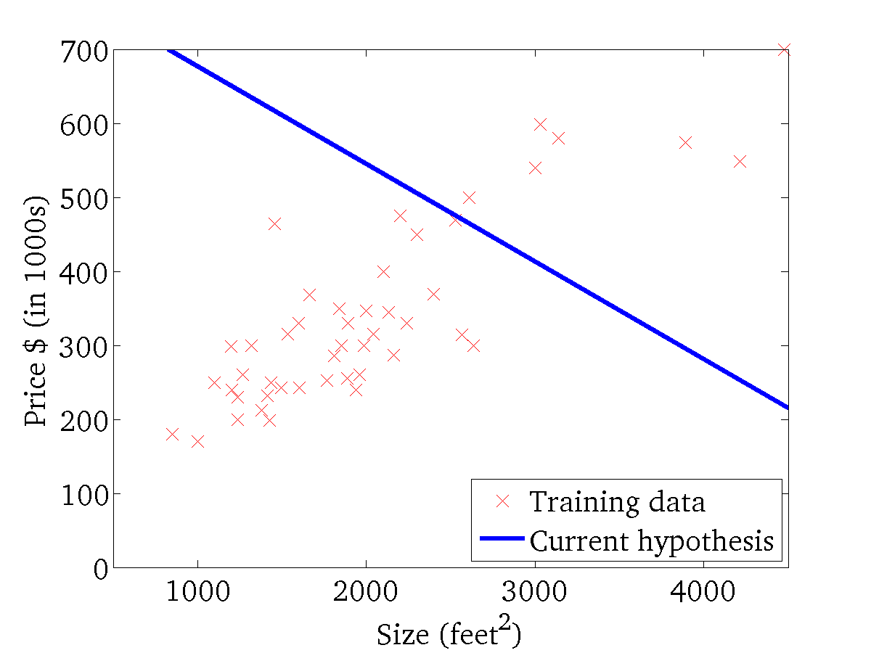

(for fixed , this is a function of x)
(function of the parameters )

Slide 19
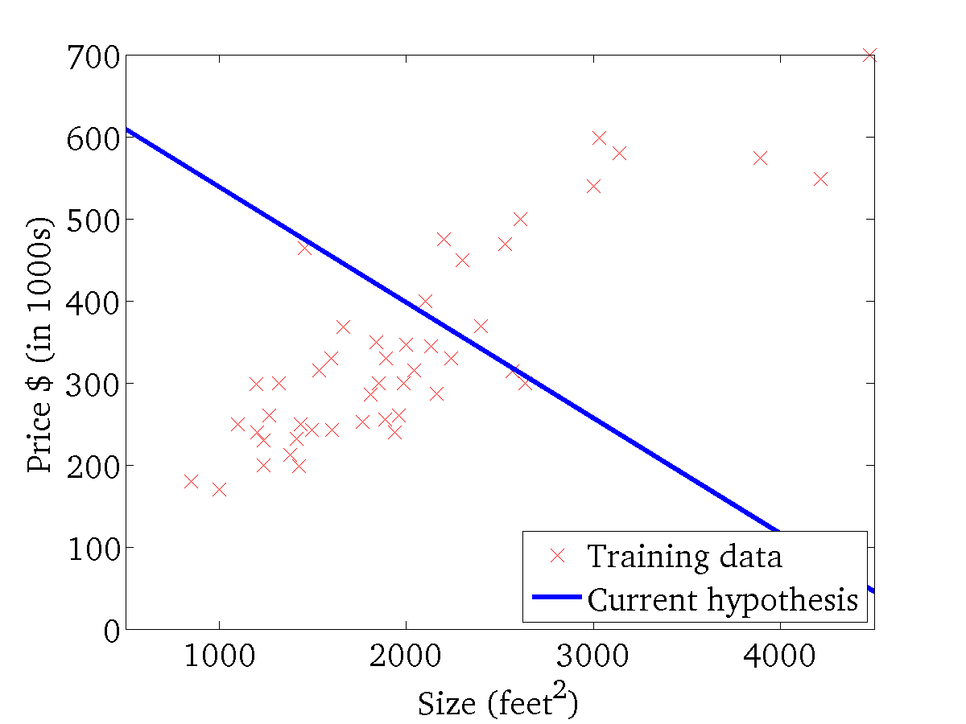
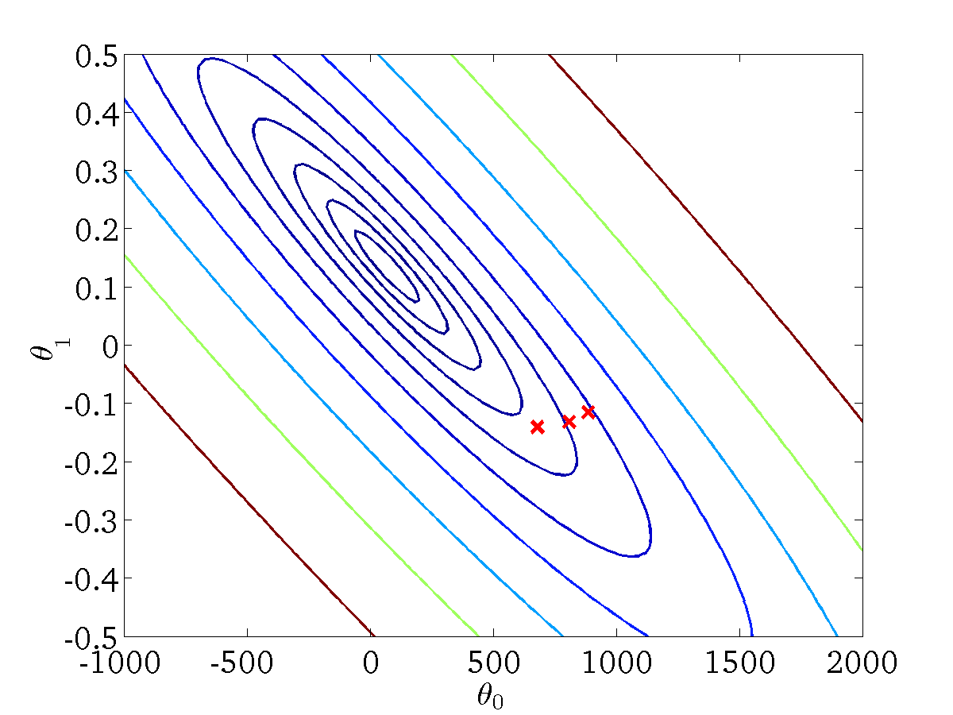
(for fixed , this is a function of x)
(function of the parameters )

Slide 20
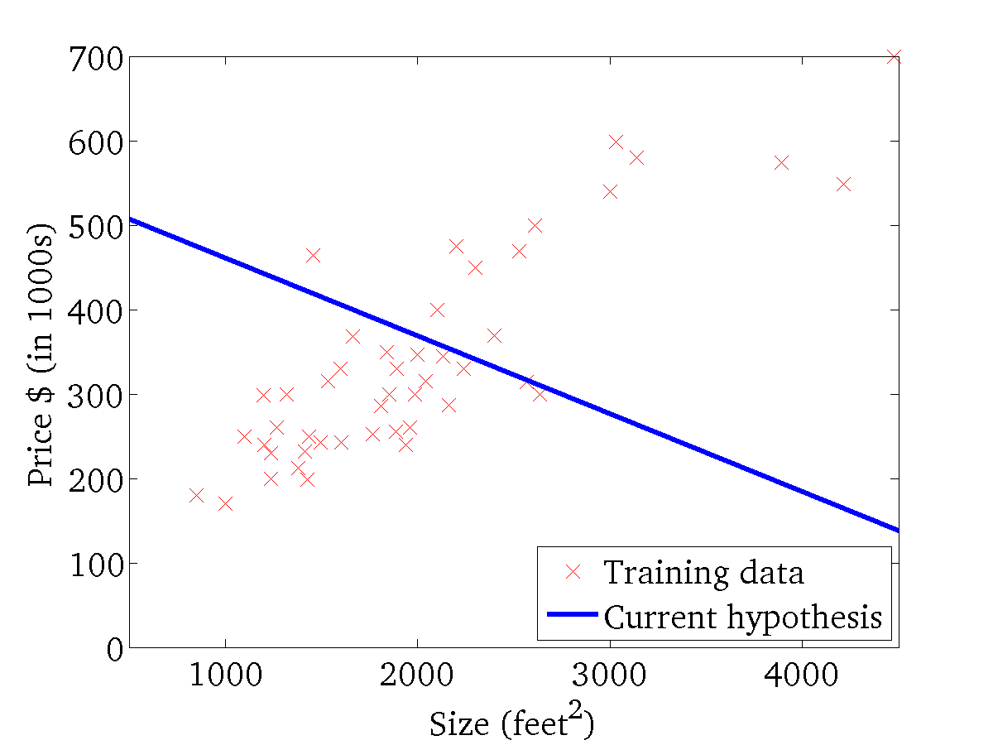

(for fixed , this is a function of x)
(function of the parameters )

Slide 21
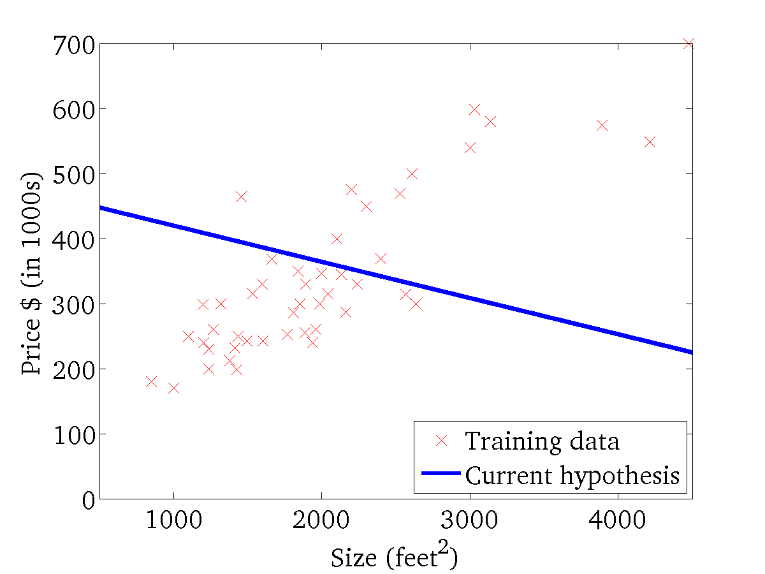
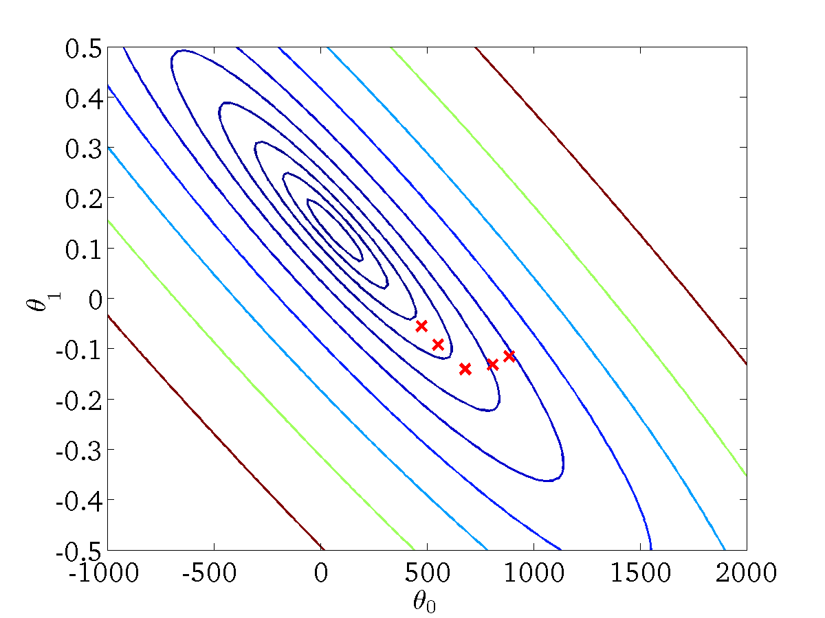
(for fixed , this is a function of x)
(function of the parameters )

Slide 22
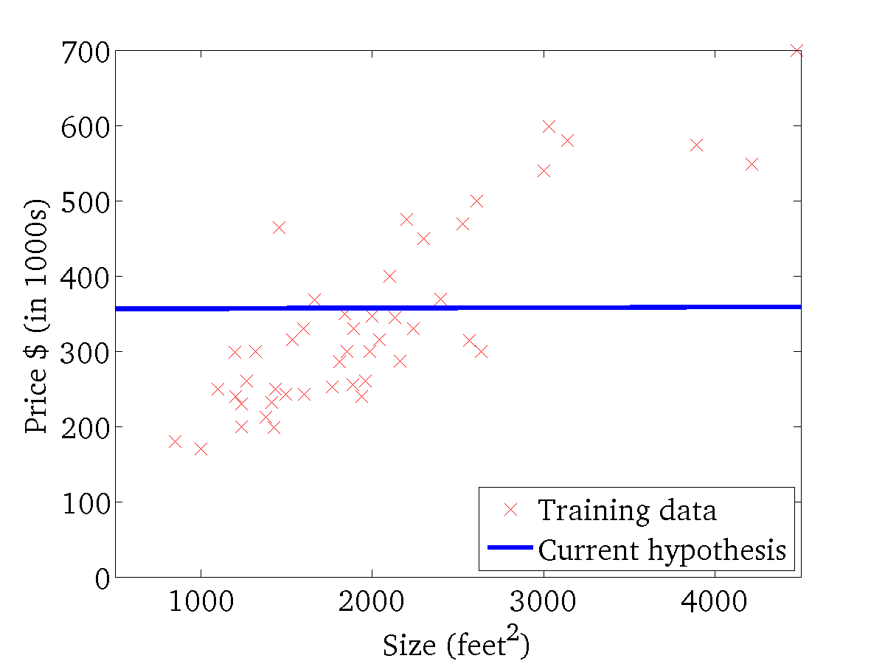

(for fixed , this is a function of x)
(function of the parameters )

Slide 23
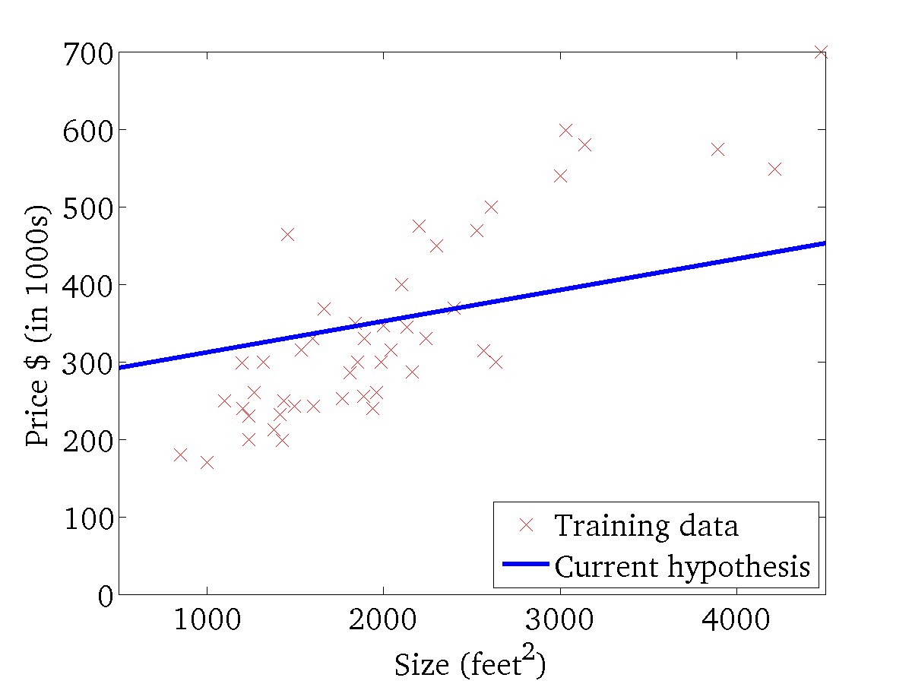

(for fixed , this is a function of x)
(function of the parameters )

Slide 24
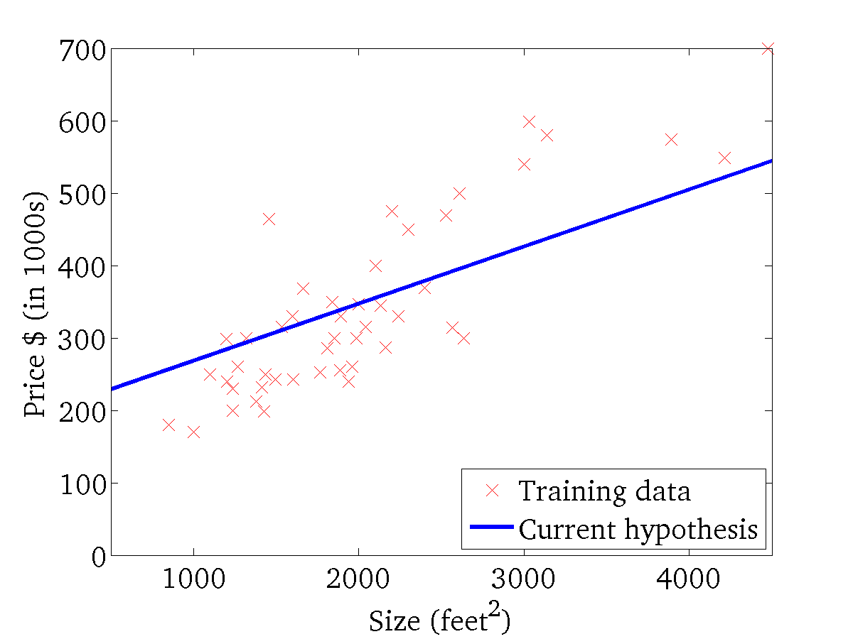
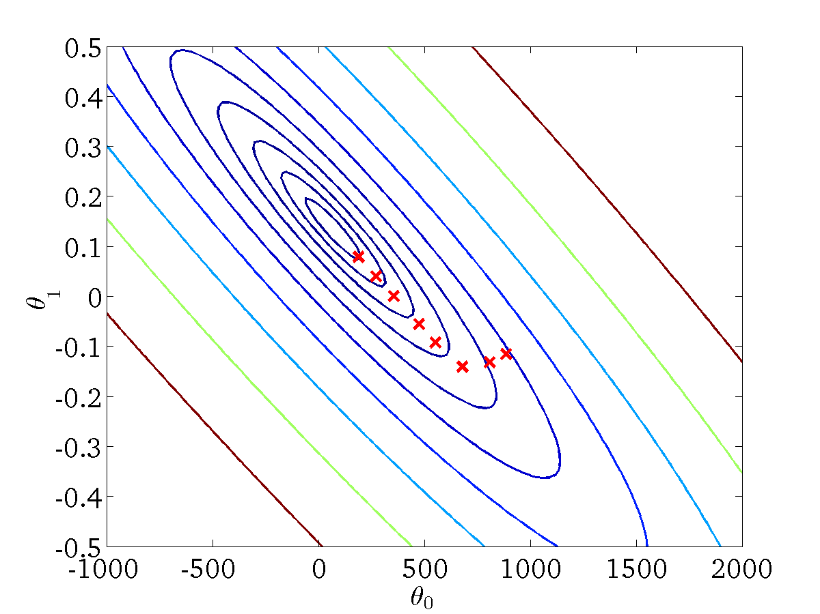
(for fixed , this is a function of x)
(function of the parameters )

Slide 25
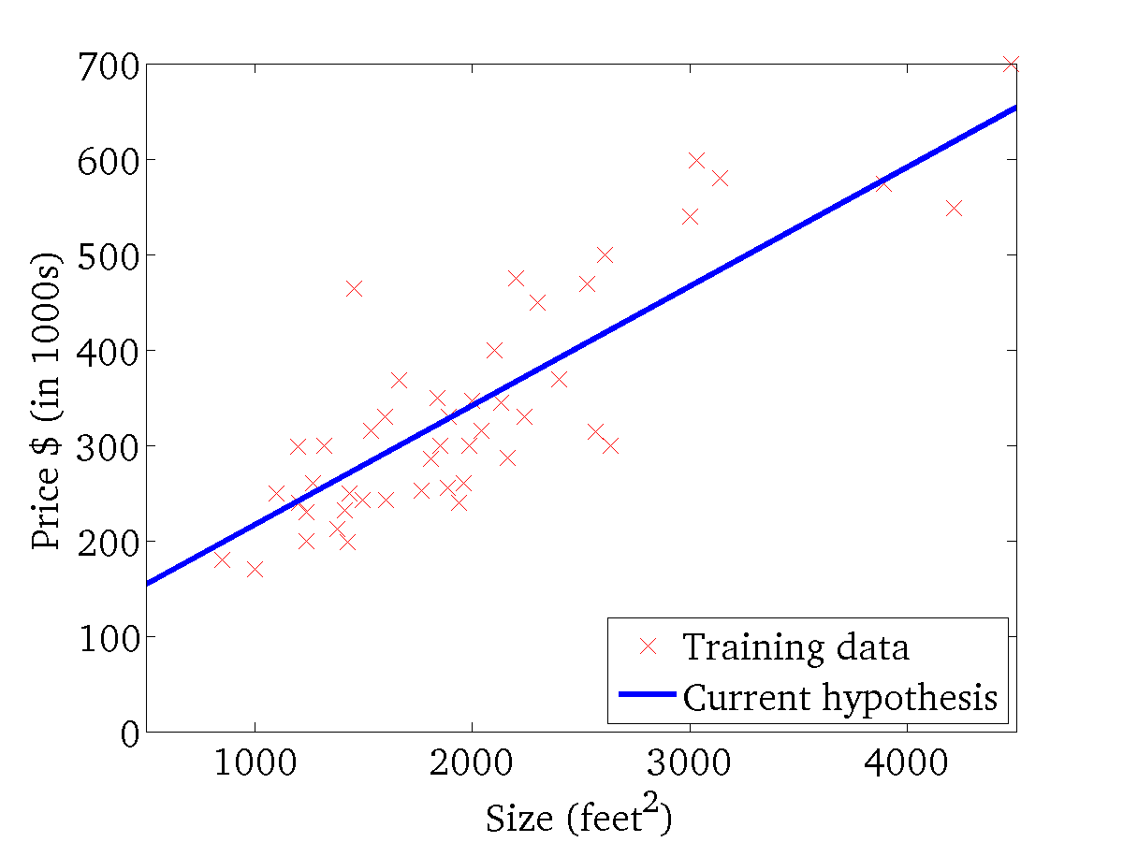

(for fixed , this is a function of x)
(function of the parameters )

Slide 26

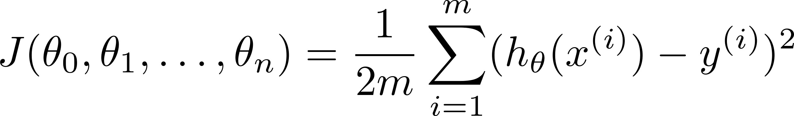

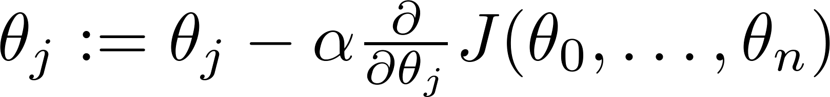

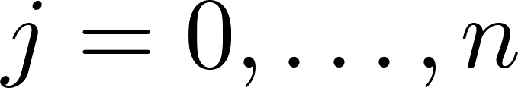
Linear Regression with multiple variables
Hypothesis:
Parameters:
Cost function:
Gradient descent:
Repeat
(simultaneously update for every )

Slide 27

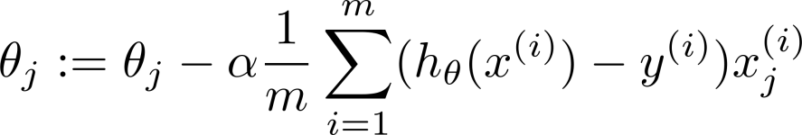
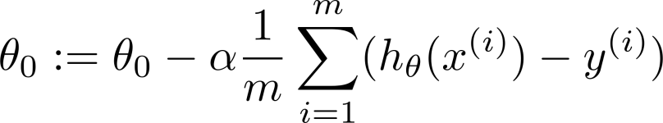



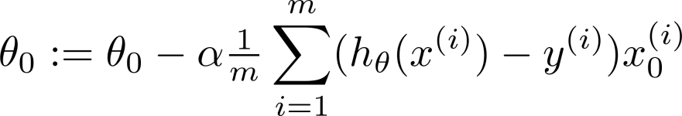




New algorithm :
Gradient Descent
Repeat
Previously (n=1):
Repeat
(simultaneously update for
)
(simultaneously update )

Slide 28









Examples:
 | Size (feet²) | Number of bedrooms | Number of floors | Age of home (years) | Price ($1000)
1 | 2104 | 5 | 1 | 45 | 460
1 | 1416 | 3 | 2 | 40 | 232
1 | 1534 | 3 | 2 | 30 | 315
1 | 852 | 2 | 1 | 36 | 178
Size (feet²) | Number of bedrooms | Number of floors | Age of home (years) | Price ($1000)
2104 | 5 | 1 | 45 | 460
1416 | 3 | 2 | 40 | 232
1534 | 3 | 2 | 30 | 315
852 | 2 | 1 | 36 | 178
Size (feet²) | Number of bedrooms | Number of floors | Age of home (years) | Price ($1000)
2104 | 5 | 1 | 45 | 460
1416 | 3 | 2 | 40 | 232
1534 | 3 | 2 | 30 | 315
852 | 2 | 1 | 36 | 178
simultaneously update

Slide 29


Slide 30


Slide 31


Slide 32


Slide 33


Slide 34


Slide 35


Slide 36


Slide 37


Slide 38


Slide 39


Slide 40


Slide 41


Slide 42


