Slide 1
Support Vector Machines: A Simple Introduction

Slide 2
Introduction
Support vector machines were invented by V. Vapnik and his co-workers in 1970s in Russia and became known to the West in 1992.
SVMs are linear classifiers that find a hyperplane to separate two class of data, positive and negative.
Kernel functions are used for nonlinear separation.
SVM not only has a rigorous theoretical foundation, but also performs classification more accurately than most other methods in applications, especially for high dimensional data.
It is perhaps the best (non-deep) classifier for text classification.
An excellent resource:
https://www.syncfusion.com/ebooks/support_vector_machines_succinctly/solving-the-optimization-problem
‹#›

Slide 3
α
Linear Classifiers
x
f
y^{est}
f(x,w,b) = sign(w x + b)
denotes +1
denotes -1
w x + b>0
w x + b=0
How would you classify this data?
w x + b<0

Slide 4
α
Linear Classifiers
x
f
y^{est}
f(x,w,b) = sign(w x + b)
denotes +1
denotes -1
How would you classify this data?

Slide 5
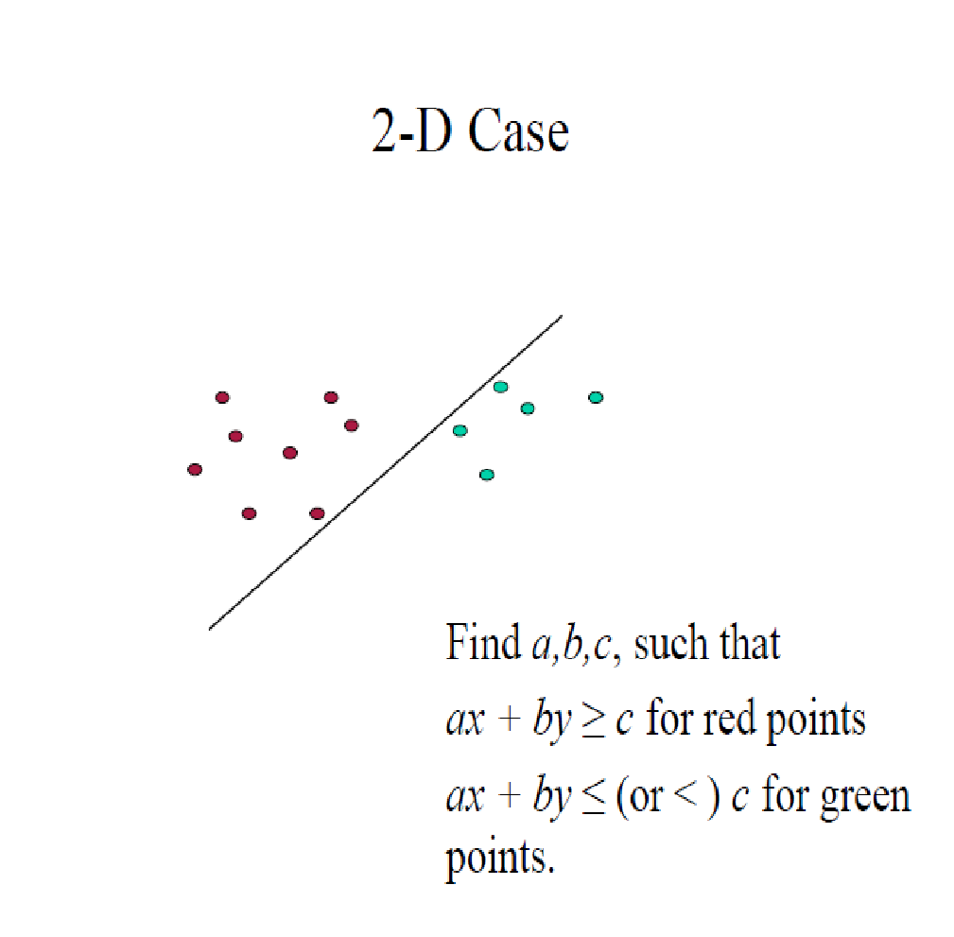
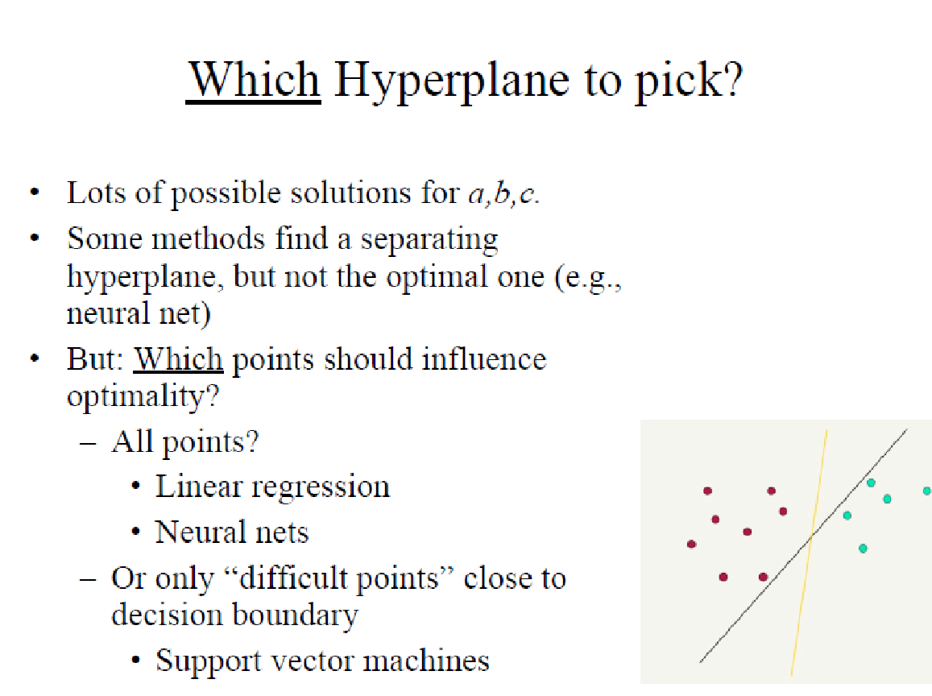

Slide 6
α
Linear Classifiers
x
f
y^{est}
f(x,w,b) = sign(w x + b)
denotes +1
denotes -1
How would you classify this data?

Slide 7
α
Linear Classifiers
x
f
y^{est}
f(x,w,b) = sign(w x + b)
denotes +1
denotes -1
Any of these would be fine..
..but which is best?

Slide 8
α
Linear Classifiers
x
f
y^{est}
f(x,w,b) = sign(w x + b)
denotes +1
denotes -1
How would you classify this data?
Misclassified
to +1 class

Slide 9
α
α
Classifier Margin
Classifier Margin
x
x
f
f
y^{est}
y^{est}
f(x,w,b) = sign(w x + b)
f(x,w,b) = sign(w x + b)
denotes +1
denotes -1
denotes +1
denotes -1
Define the margin of a linear classifier as the width that the boundary could be increased by before hitting a datapoint.
Define the margin of a linear classifier as the width that the boundary could be increased by before hitting a datapoint.

Slide 10
α
Maximum Margin
x
f
y^{est}
Maximizing the margin is good according to intuition and PAC theory
Implies that only support vectors are important; other training examples are ignorable.
Empirically it works very very well.
f(x,w,b) = sign(w x + b)
denotes +1
denotes -1
The maximum margin linear classifier is the linear classifier with the, um, maximum margin.
This is the simplest kind of SVM (Called an LSVM)
Support Vectors are those datapoints that the margin pushes up against
Linear SVM

Slide 11
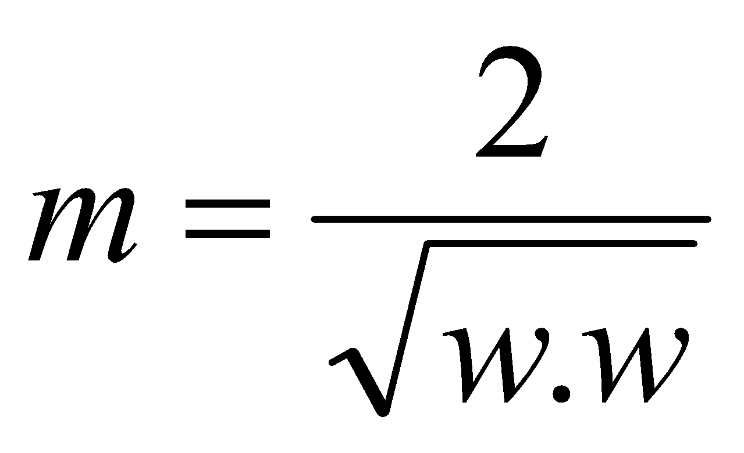
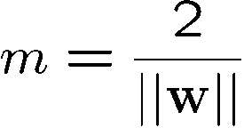





Good Decision Boundary: Margin Should Be Large
The decision boundary should be as far away from the data of both classes as possible
We should maximize the margin, m
Support vectors
datapoints that the margin
pushes up against
Class 2
The maximum margin linear
classifier is the linear classifier
with the maximum margin.
This is the simplest kind of
SVM (Called an Linear SVM)
m
Class 1
Notes:
‹#›

Slide 12
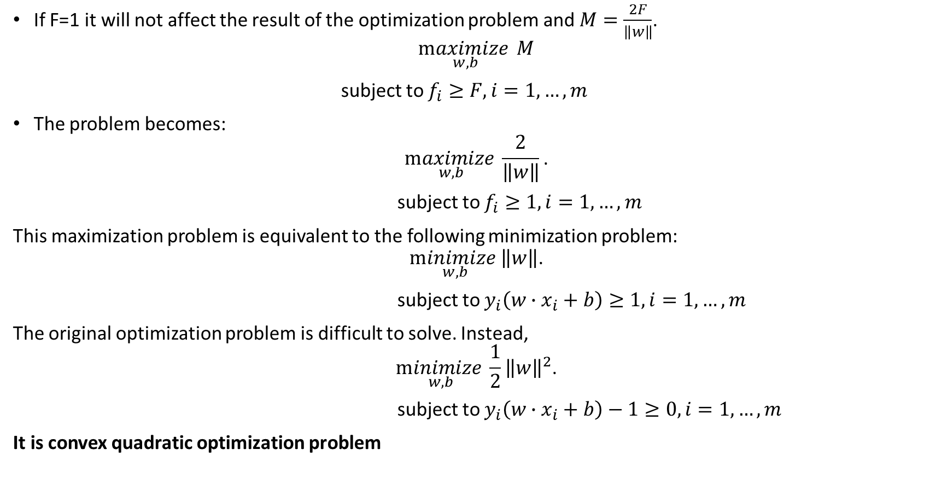
The SVMs optimization problem

Slide 13
Solving the Optimization Problem

Slide 14
The SVM Lagrangian problem

Slide 15
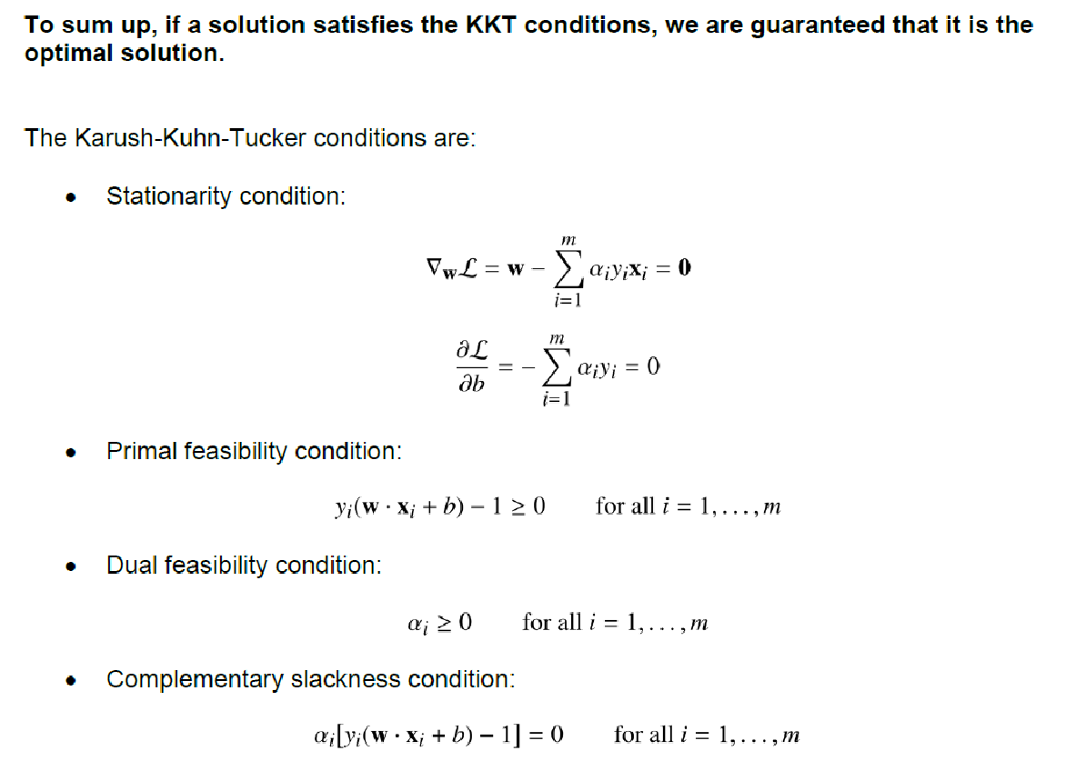

Slide 16




A Geometrical Interpretation
Class 2
Support vectors
🡪α’s with values
different from zero
(they hold up the
separating plane)!
α₁₀=0
α₈=0.6
α₇=0
α₂=0
α₅=0
α₁=0.8
α₄=0
α₆=1.4
α₉=0
α₃=0
Class 1
Notes:
‹#›
So, if change internal points, no effect on the decision boundary

Slide 17
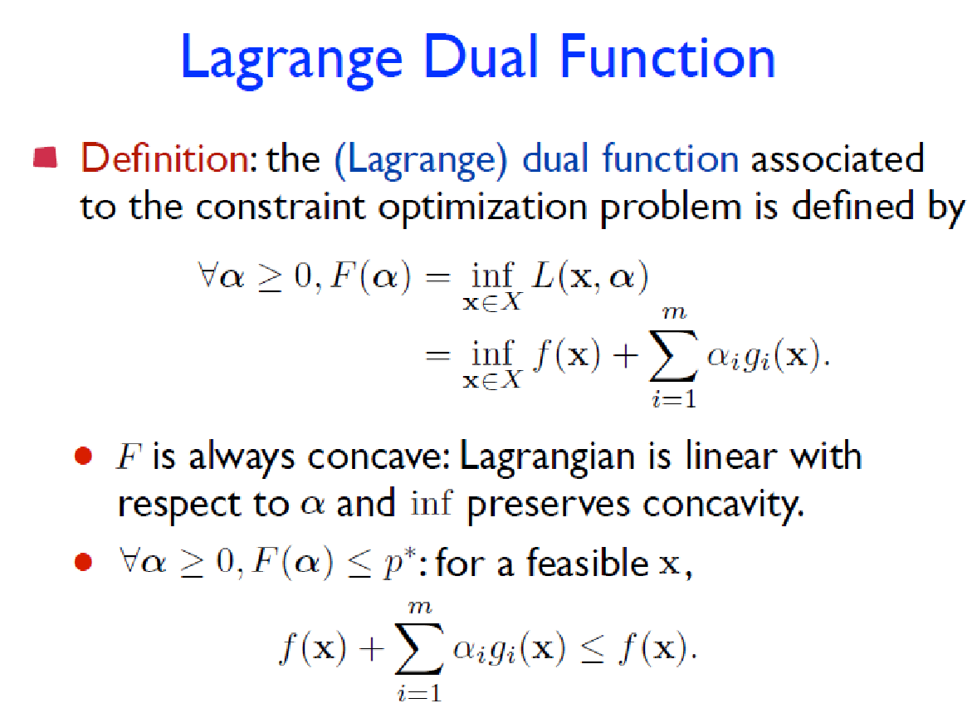
Slide:

Slide 18
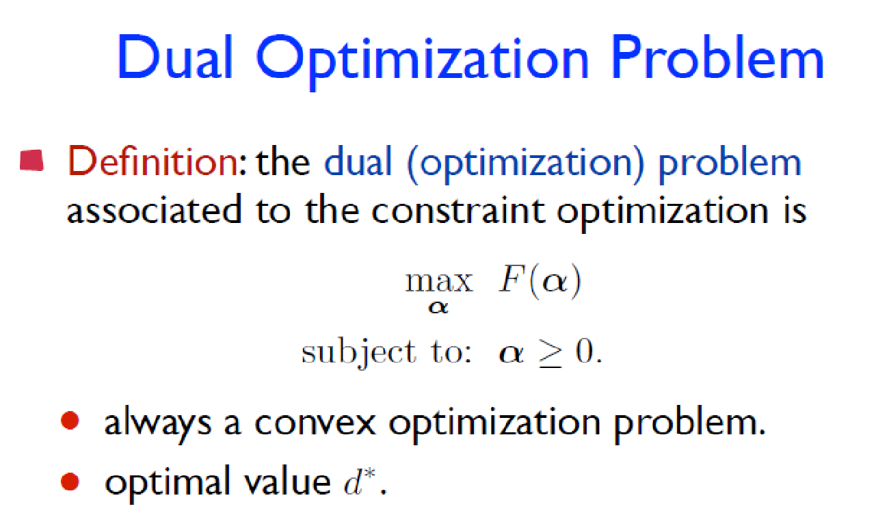

Slide 19
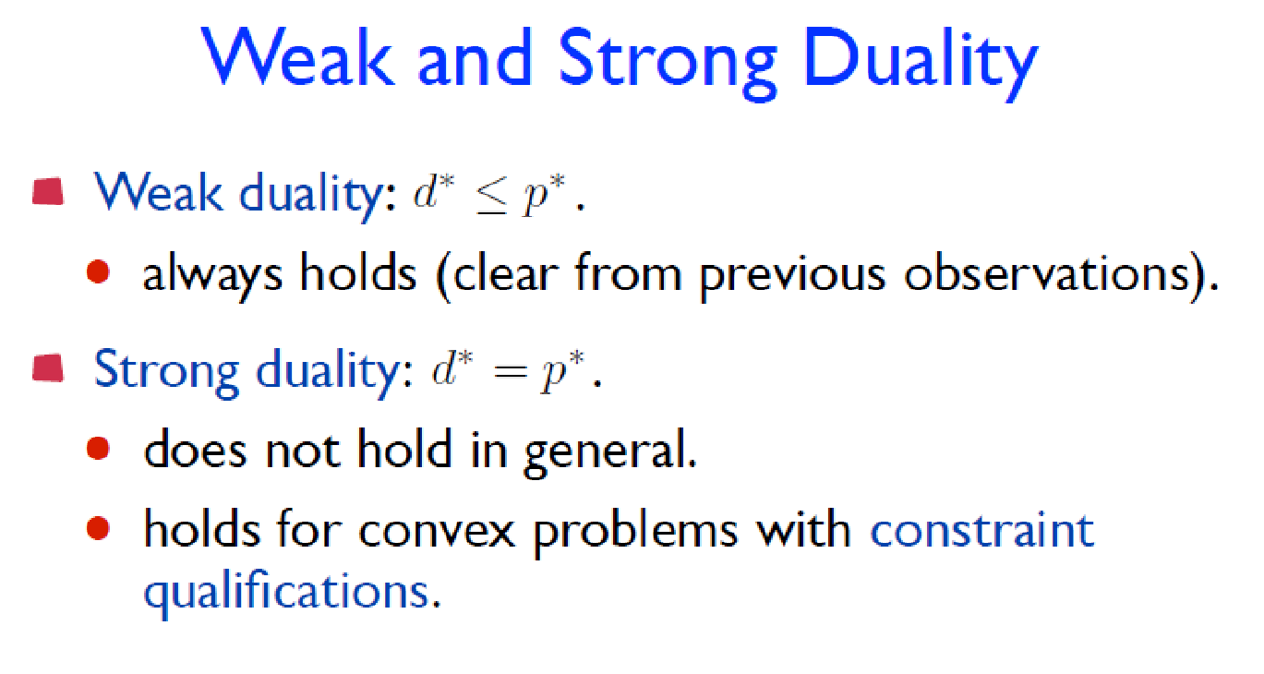
Slater's constraint qualification condition for convex programming states that strong duality holds if there exists an x that is strictly feasible (i.e. all constraints are satisfied and the nonlinear constraints are satisfied with strict inequalities).

Slide 20
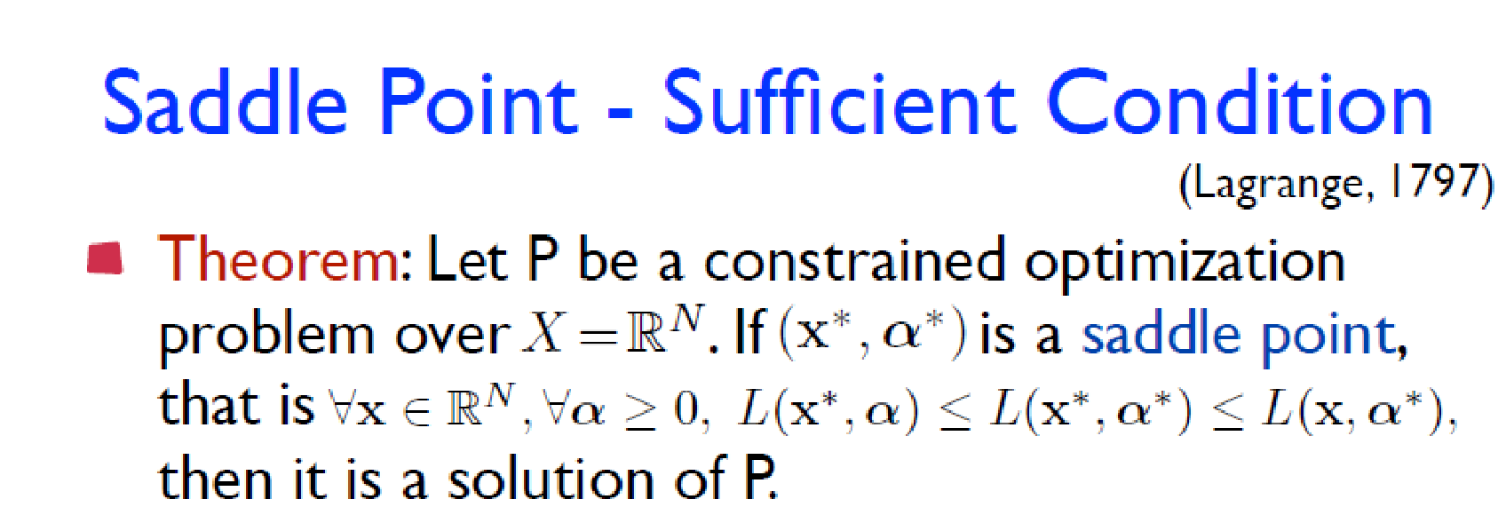

Slide 21
The Wolfe dual problem

Slide 22
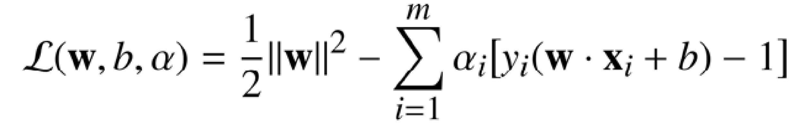
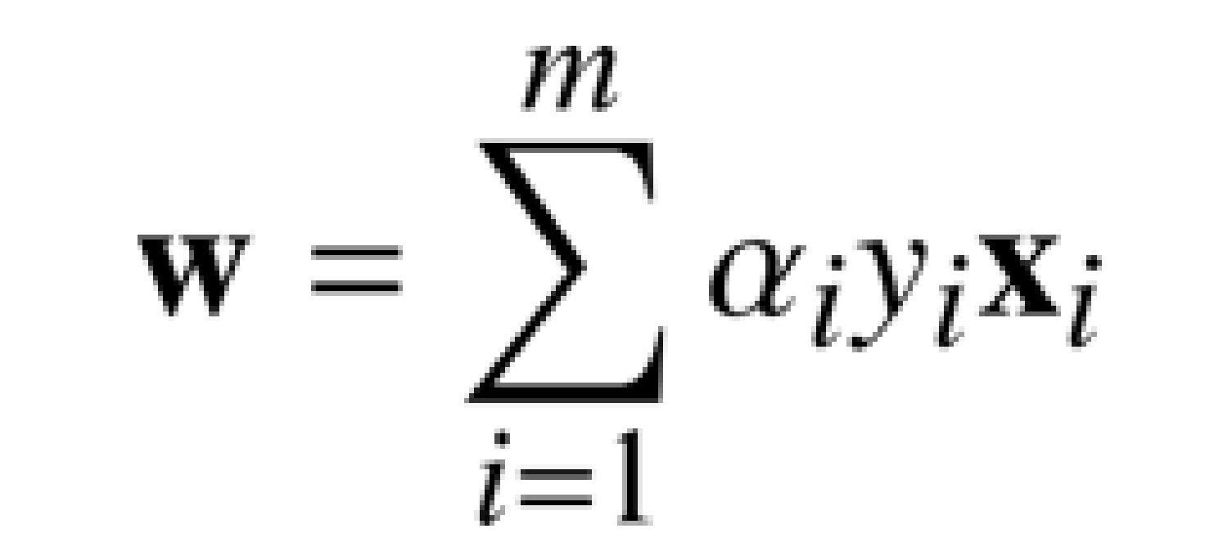
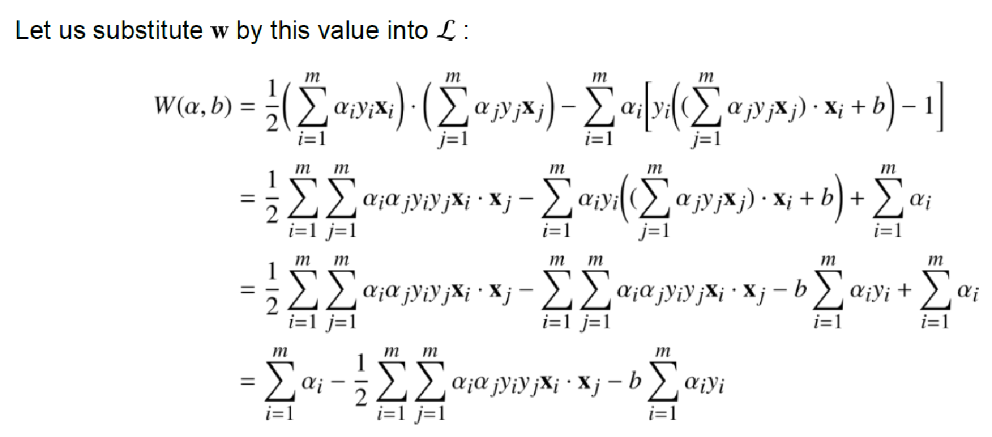
Optional

Slide 23
Wolfe dual problem

Slide 24
Hypothesis function

Slide 25
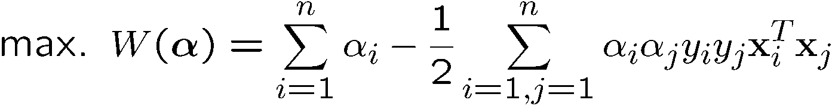
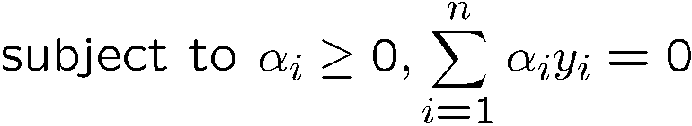
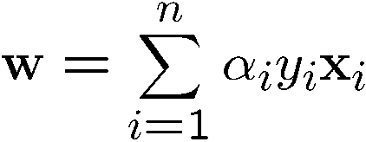
The Wolfe Dual Optimization Problem
We can transform the problem to its dual
This is a convex quadratic programming (QP) problem
Global maximum of α_{i} can always be found
🡪well established tools for solving this optimization problem (e.g. cplex)
Note:
Dot product of X
α’s 🡪 New variables
(Lagrangian multipliers)
Notes:
‹#›
Let x(1) and x(-1) be two S.V.
Then b = -1/2( w^T x(1) + w^T x(-1) )

Slide 26

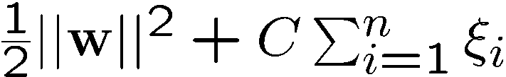







Non-linearly Separable Problems
We allow “error” ξ_{i} in classification; it is based on the output of the discriminant function w^{T}x+b
ξ_{i} approximates the number of misclassified samples
New objective function:
Class 2
C : tradeoff parameter between
error and margin;
chosen by the user;
large C means a higher
penalty to errors
Class 1

Slide 27
Soft margin SVM

Slide 28
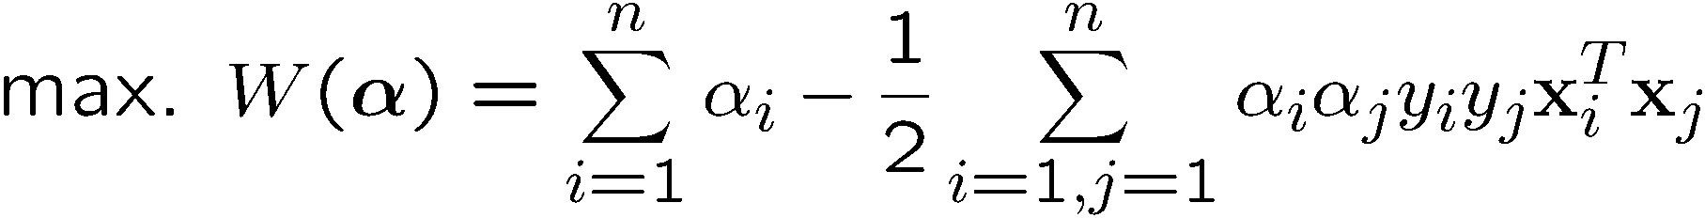
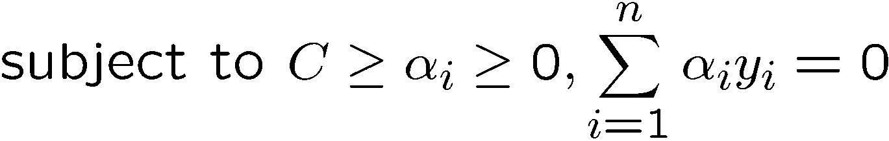
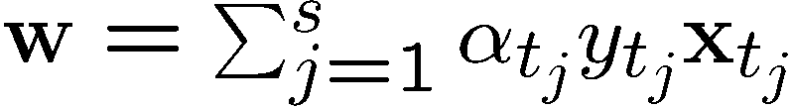
The Wolfe dual problem
The dual of the problem is
w is also recovered as
The only difference with the linear separable case is that there is an upper bound C on α_{i}
Once again, a QP solver can be used to find α_{i} efficiently!!!
Notes:
‹#›
Note also, everything is done by inner-products

Slide 29
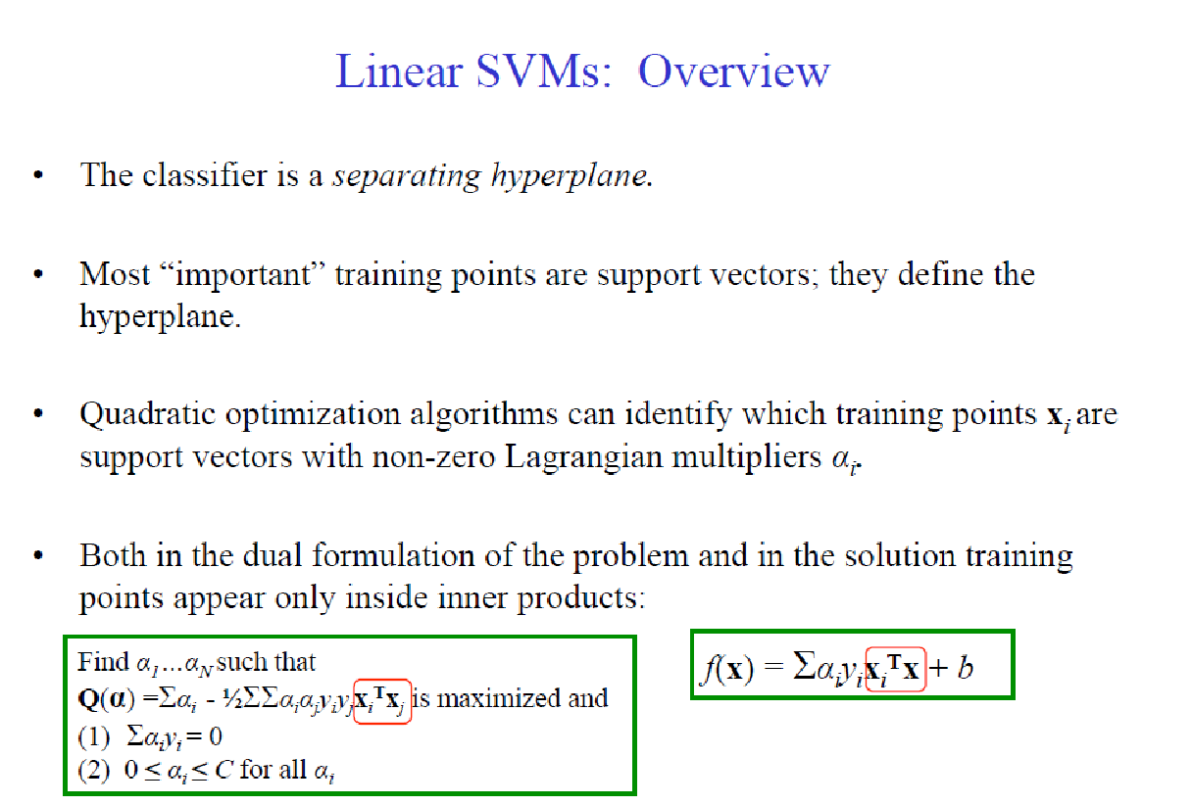

Slide 30
Extension to Non-linear SVMs (Kernel Machines)

Slide 31
Non-Linear SVM
How could we generalize this procedure to non-linear data?
Vapnik in 1992 showed that transforming input data x_{i} into a higher dimensional makes the problem easier.
We know that data appears only as dot products (x_{i∙}x_{j})
Suppose we transform the data to some (possibly infinite dimensional) space H via a mapping function Φ such that the data appears of the form Φ(x_{i})Φ(x_{j})
Why?
Linear operation in H is equivalent to non-linear operation in input space.
Similar to Hidden Layers in ANN

Slide 32
Non-linear SVMs: Feature Space
General idea: the original input space (x) can be mapped to some higher-dimensional feature space (φ(x) )where the training set is separable:
x=(x₁,x₂)
φ(x) =(x₁²,x₂²,√2x₁x₂)
√2x₁x₂
Φ: x → φ(x)
x₂²
x₁²
If data are mapped into higher a space of sufficiently high dimension,
then they will in general be linearly separable;
N data points are in general separable in a space of N-1 dimensions or more!!!
This slide is courtesy of www.iro.umontreal.ca/~pift6080/documents/papers/svm_tutorial.ppt

Slide 33
Transformation to Feature Space
Possible problem of the transformation
High computation burden due to high-dimensionality and hard to get a good estimate
SVM solves these two issues simultaneously
“Kernel tricks” for efficient computation
Minimize ||w||² can lead to a “good” classifier
φ( )
φ( )
φ( )
φ( )
φ( )
φ(.)
φ( )
φ( )
φ( )
φ( )
φ( )
φ( )
φ( )
φ( )
φ( )
φ( )
φ( )
φ( )
φ( )
Input space
Feature space
Notes:
‹#›

Slide 34
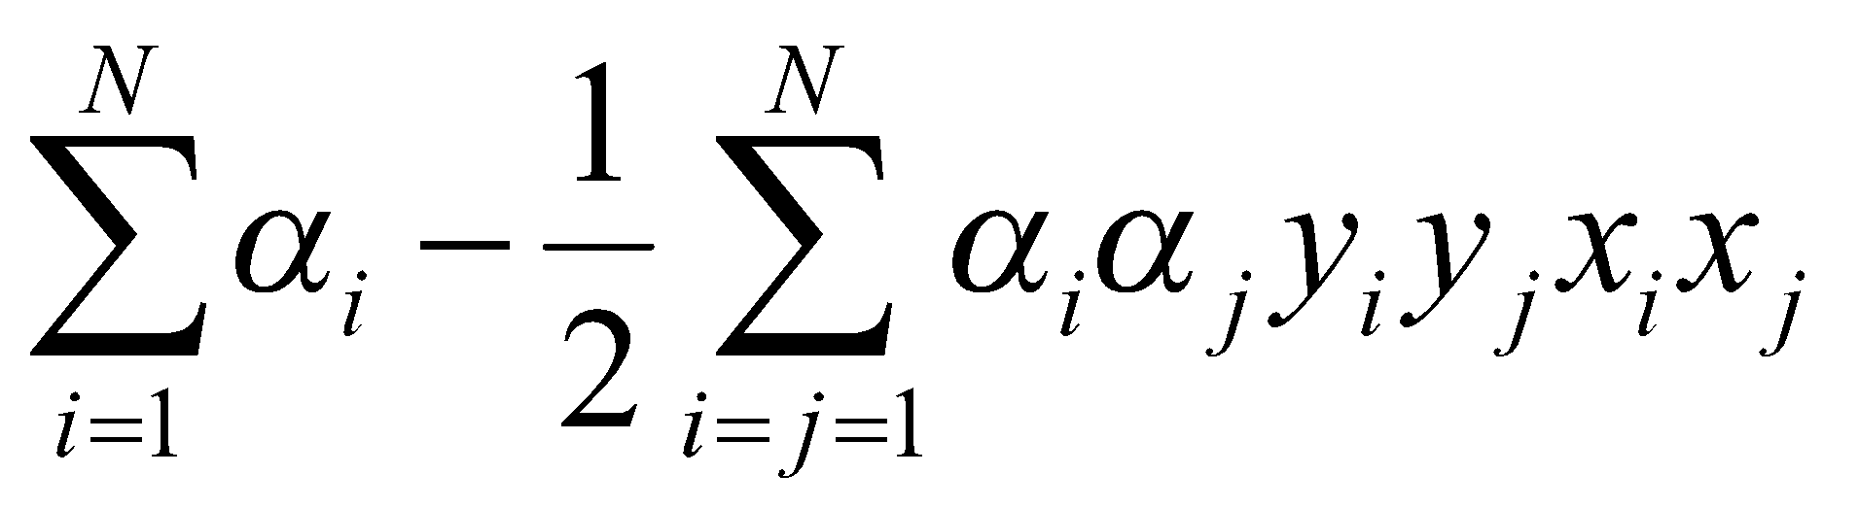
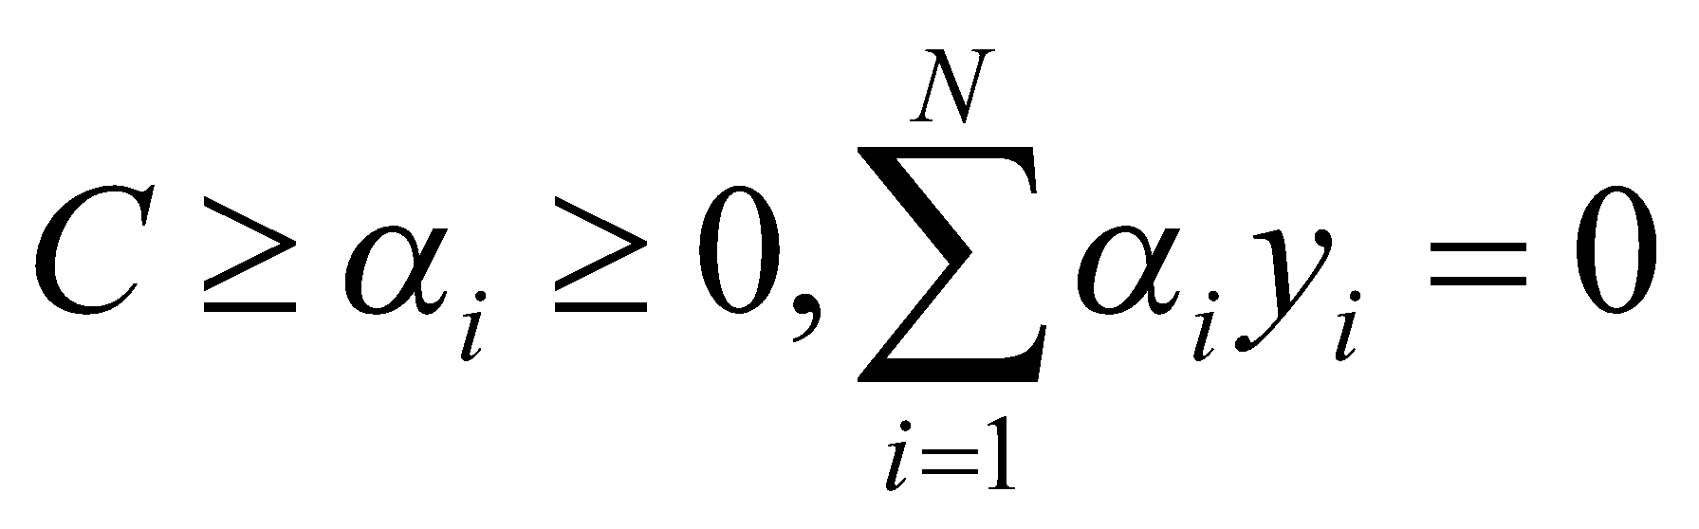
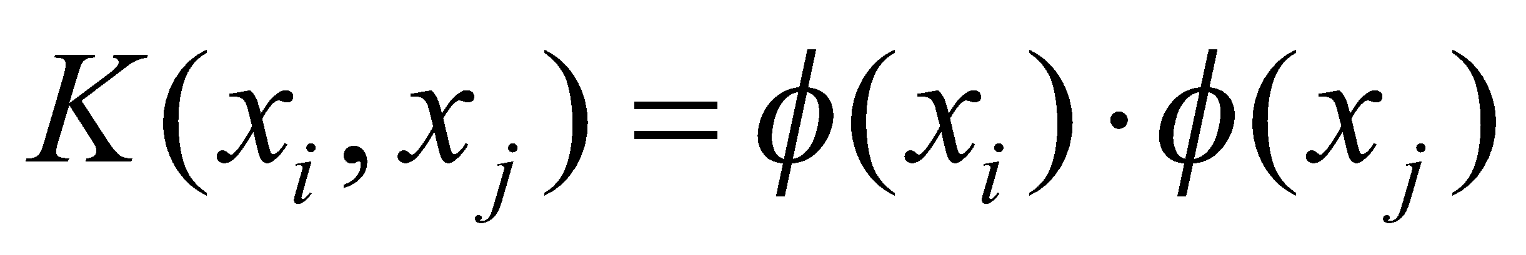
Kernel Trick ☺
Note that data only appears as dot products
Recall:
maximize
subject to
Since data is only represented as dot products, we need not do the mapping explicitly.
Introduce a Kernel Function (*) K such that:
(*)Kernel function – a function that can be applied to pairs of input data to evaluate dot products
in some corresponding feature space

Slide 35
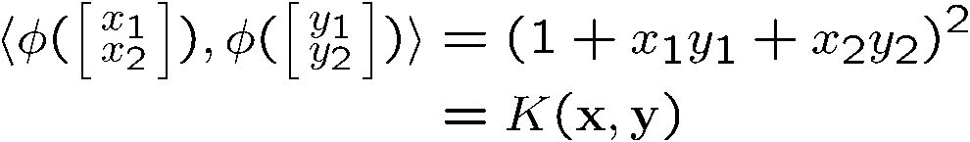
Example Transformation
Consider the following transformation
Define the kernel function K (x,y) as
The inner product φ(.)φ(.) can be computed by K without going through the map φ(.) explicitly!!!
Notes:
‹#›

Slide 36
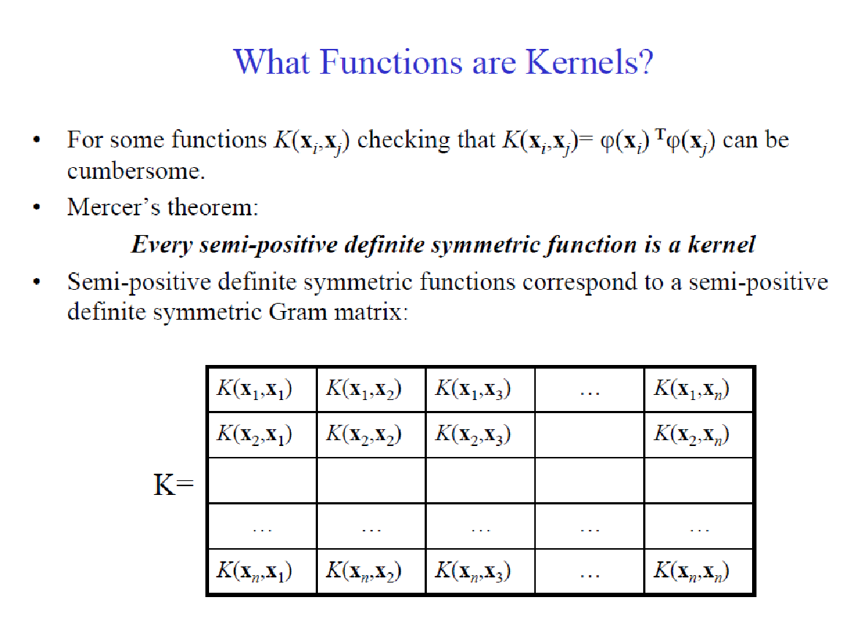

Slide 37

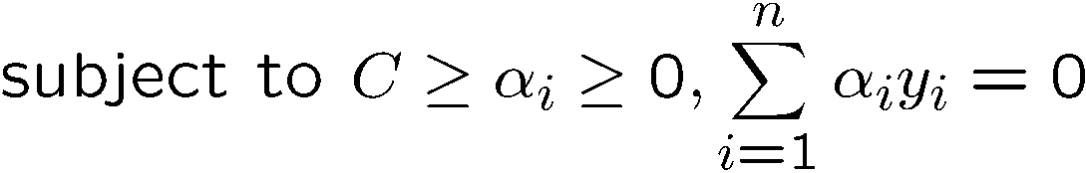
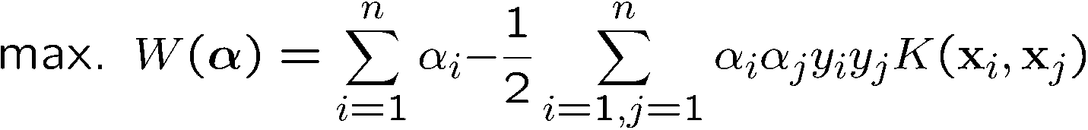

Modification Due to Kernel Function
Change all inner products to kernel functions
For training,
Original
With kernel function
Notes:
‹#›

Slide 38
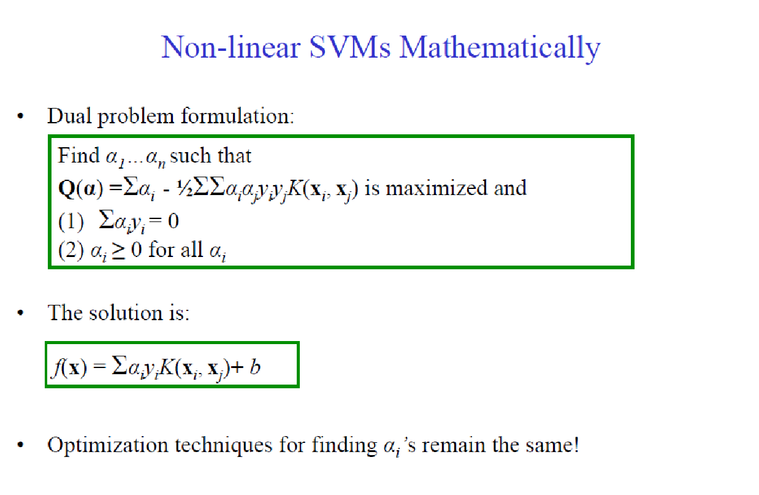

Slide 39

Examples of Kernel Functions
Polynomial kernel with degree d
Radial basis function kernel with width σ
Closely related to radial basis function neural networks
Sigmoid with parameter κ and θ
It does not satisfy the Mercer condition on all κ and θ
Research on different kernel functions in different applications is very active
Notes:
‹#›
Despite violating Mercer condition, the sigmoid kernel function can still work

Slide 40
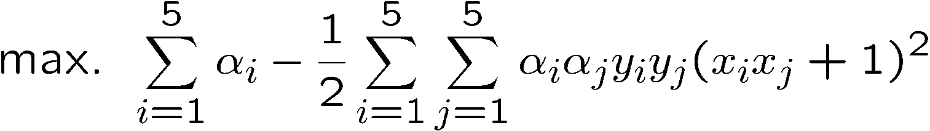
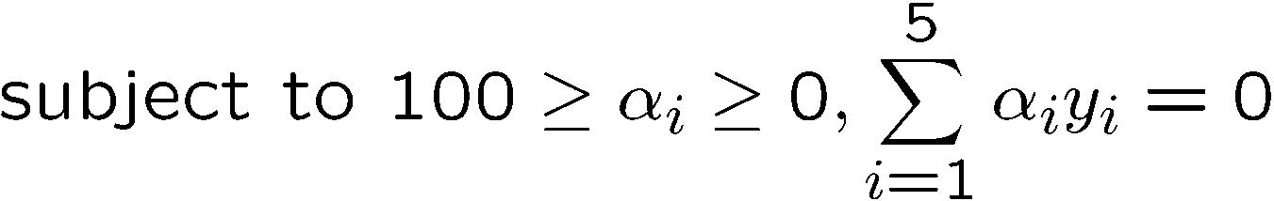
Example
Suppose we have 5 1D data points
x₁=1, x₂=2, x₃=4, x₄=5, x₅=6, with 1, 2, 6 as class 1 and 4, 5 as class 2 ⇒ y₁=1, y₂=1, y₃= -1, y₄= -1, y₅=1
We use the polynomial kernel of degree 2
K(x, y) = (xy+1)²
C is set to 100
We first find α_{i} (i=1, …, 5) by
Notes:
‹#›
H =
4 9 -25 -36 49
9 25 -81 -121 169
-25 -81 289 441 -625
-36 -121 441 676 -961
49 169 -625 -961 1369

Slide 41

Example
By using a QP solver, we get
α₁=0, α₂=2.5, α₃=0, α₄=7.333, α₅=4.833
Verify (at home) that the constraints are indeed satisfied
The support vectors are {x₂=2, x₄=5, x₅=6}
The discriminant function is
b is recovered by solving f(2)=1 or by f(5)=-1 or by f(6)=1, as x₂, x₄, x₅ lie on and all give b = 9
Notes:
‹#›
The optimization toolbox of matlab contains a quadratic programming solver

Slide 42
Example
Value of discriminant function
class 1
class 2
class 1
1
2
4
5
6
Notes:
‹#›

Slide 43
Choosing the Kernel Function
Probably the most tricky part of using SVM.
The kernel function is important because it creates the kernel matrix, which summarizes all the data
Many principles have been proposed (diffusion kernel, Fisher kernel, string kernel, …)
There is even research to estimate the kernel matrix from available information
In practice, a low degree polynomial kernel or RBF kernel with a reasonable width is a good initial try
Note that SVM with RBF kernel is closely related to RBF neural networks, with the centers of the radial basis functions automatically chosen for SVM

Slide 44
Summary
Weaknesses
Training (and Testing) is quite slow compared to ANN
Because of Constrained Quadratic Programming
Essentially a binary classifier
However, there are some tricks to evade this.
Very sensitive to noise
A few off data points can completely throw off the algorithm
Biggest Drawback: The choice of Kernel function.
There is no “set-in-stone” theory for choosing a kernel function for any given problem (still in research...)
Once a kernel function is chosen, there is only ONE modifiable parameter, the error penalty C.

Slide 45
Summary
Strengths
Training is relatively easy
We don’t have to deal with local minimum like in ANN
SVM solution is always global and unique (check “Burges” paper for proof and justification).
Unlike ANN, doesn’t suffer from “curse of dimensionality”.
How? Why? We have infinite dimensions?!
Maximum Margin Constraint: DOT-PRODUCTS!
Less prone to overfitting
Simple, easy to understand geometric interpretation.
No large networks to mess around with.

Slide 46
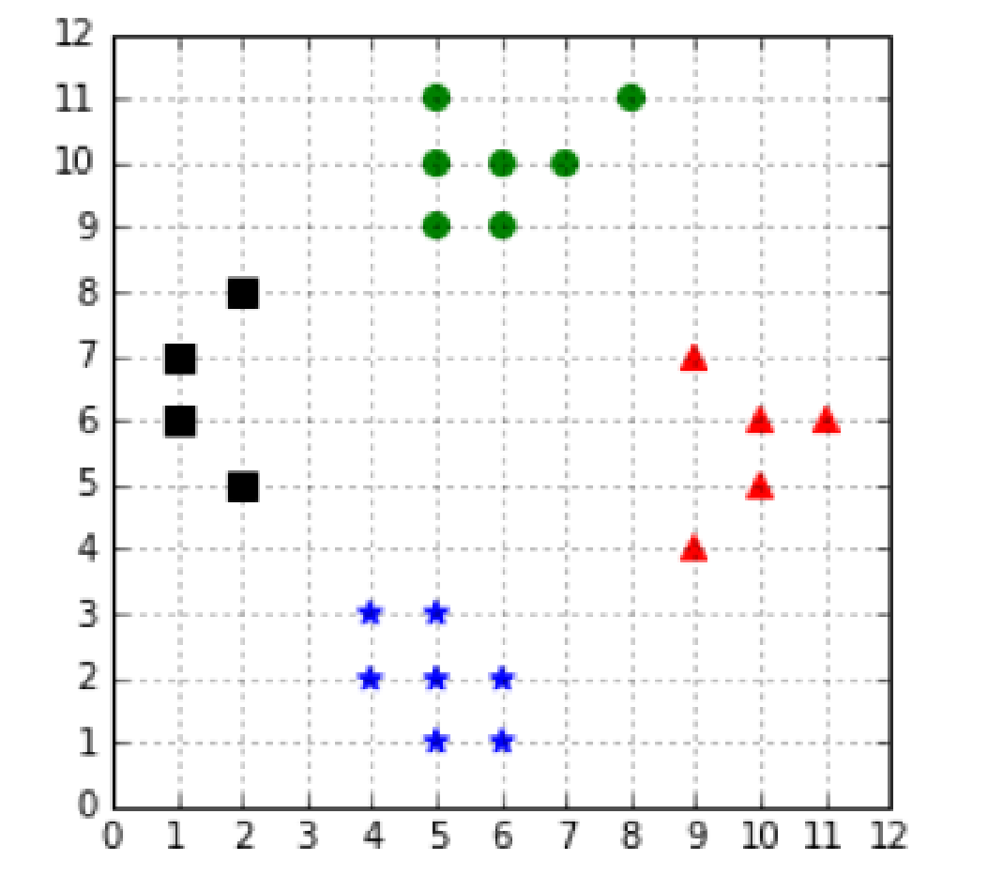
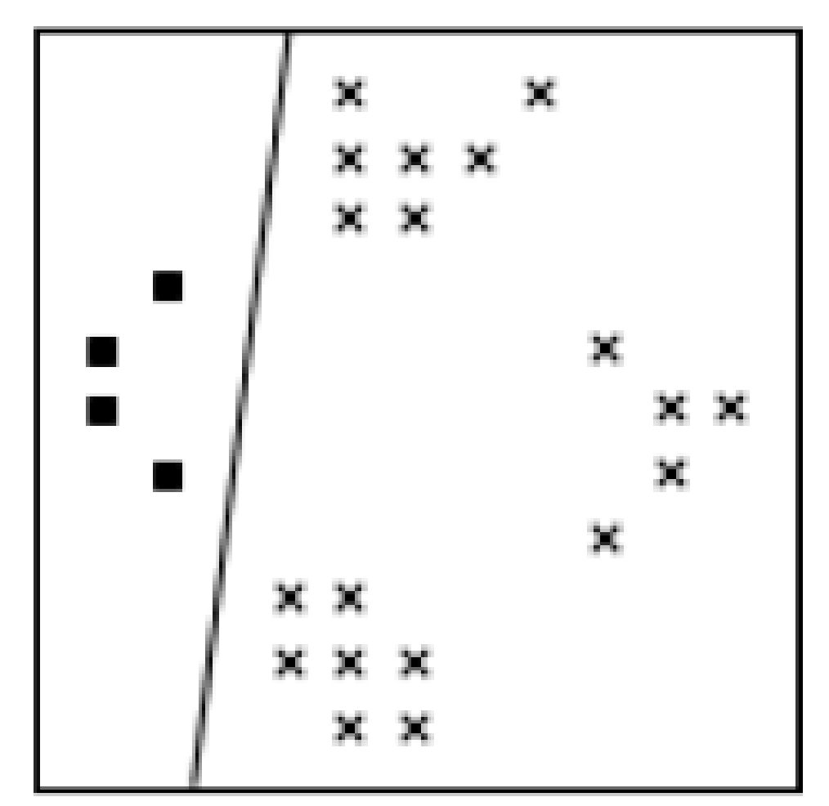
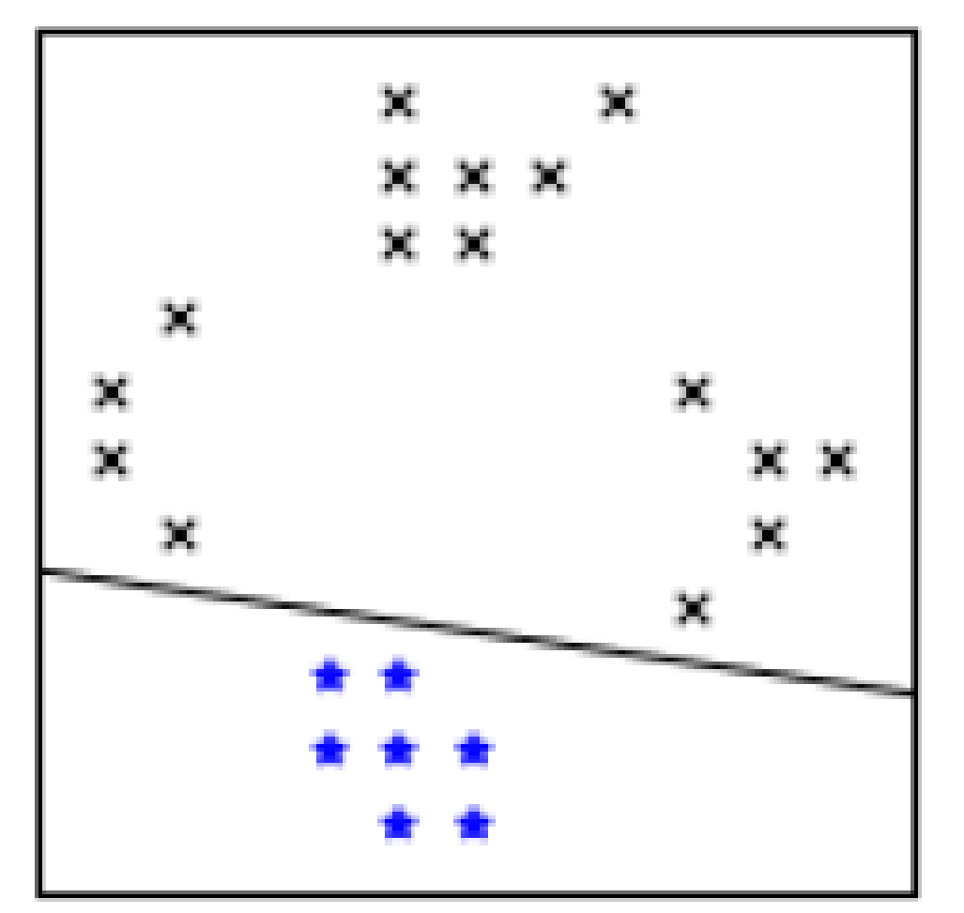
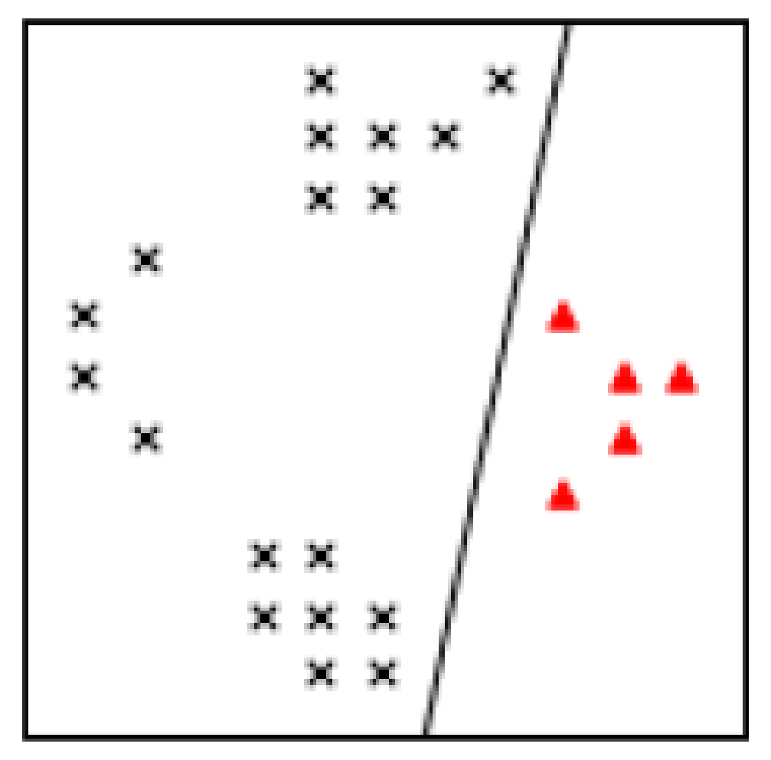
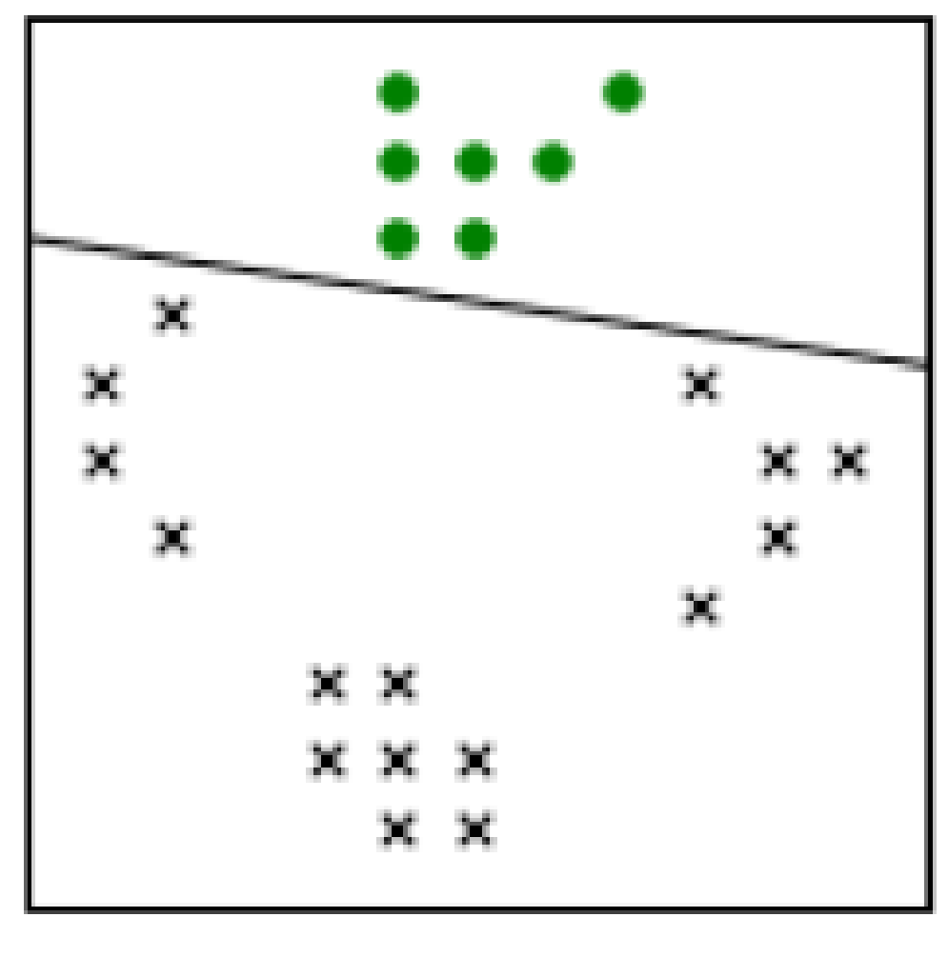
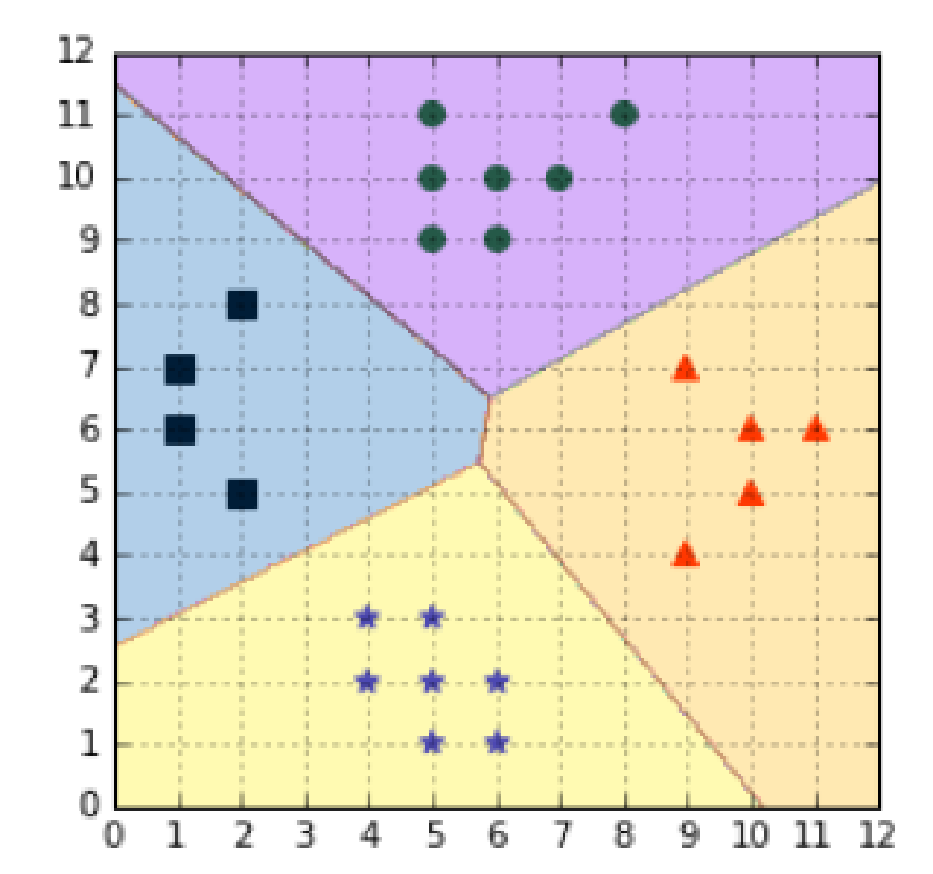
Multi-Class SVMs
One-against-all. In order to classify K classes, we construct K different binary classifiers. For a given class, the positive examples are all the points in the class, and the negative examples are all the points not in the class
A four classes classification problem
The One-against-all approach creates one classifier per class
Vladimir Vapnik suggested using the class of the classifier for which the value of the decision function is the maximum

Slide 47
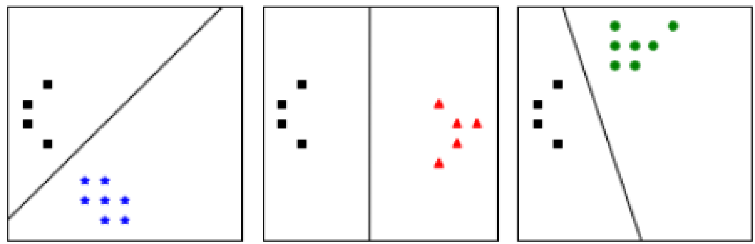
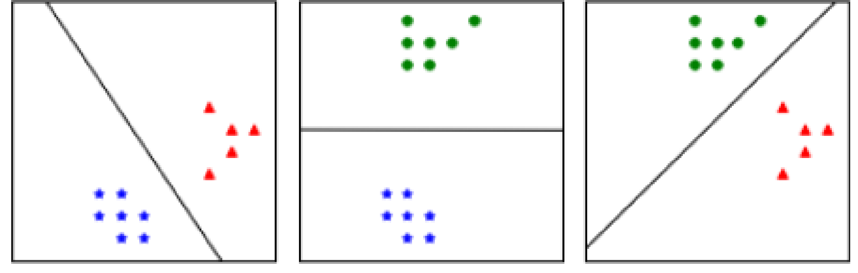
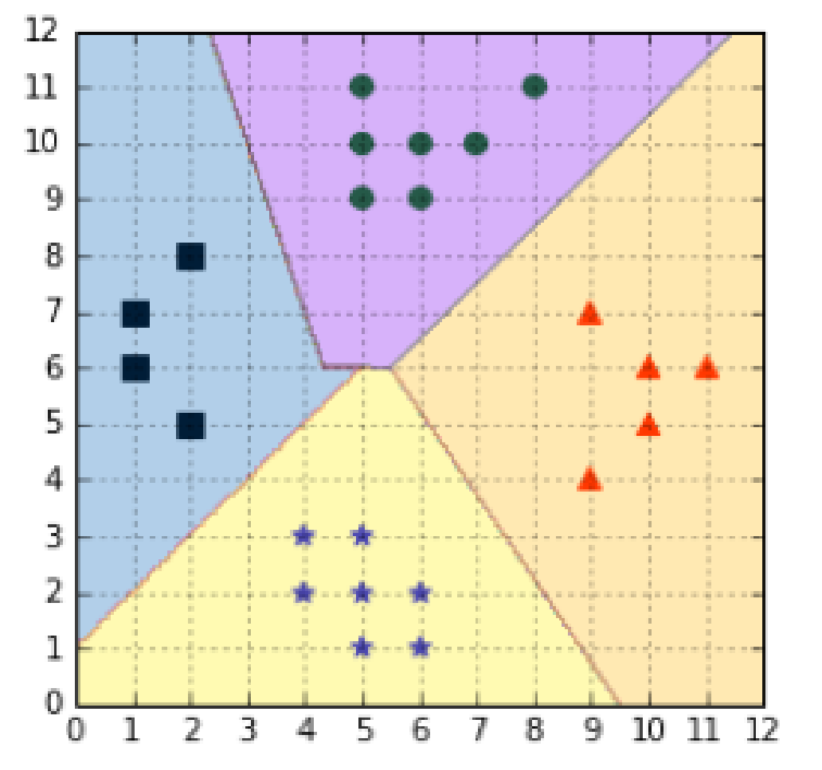
Multi-Class SVMs
One-against-one: we train one classifier per pair of classes, which leads to K(K-1)/2 classifiers for K classes. Each classifier is trained on a subset of the data and produces its own decision boundary.
Predictions are made using a simple voting strategy. Each example we wish to predict is passed to each classifier, and the predicted class is recorded. Then, the class having the most votes is assigned to the example
One-against-one construct with one classifier for each pair of classes
Predictions are made using a voting scheme
The one-against-one approach is the default approach for multi-class classification used in sklearn.

