Slide 1
Performance Measures for Classifiers

Slide 2
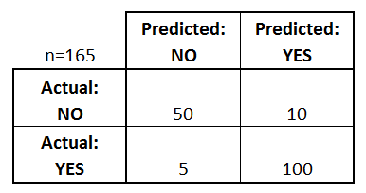
A matrix that confuses??!!!!!!
A confusion matrix is a table that is often used to describe the performance of a classification model (or "classifier") on a set of test data for which the true values are known.
What can we learn from this matrix?
There are two possible predicted classes: "yes" and "no". If we were predicting the presence of a disease, for example, "yes" would mean they have the disease, and "no" would mean they don't have the disease.
The classifier made a total of 165 predictions (e.g., 165 patients were being tested for the presence of that disease).
Out of those 165 cases, the classifier predicted "yes" 110 times, and "no" 55 times.
In reality, 105 patients in the sample have the disease, and 60 patients do not.

Slide 3
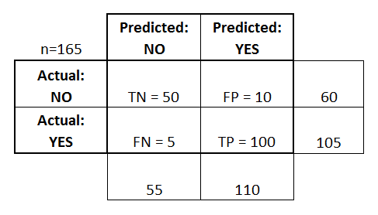
Let's now define the most basic terms, which are whole numbers (not rates):
True positives (TP): These are cases in which we predicted yes (they have the disease), and they do have the disease.
True negatives (TN): We predicted no, and they don't have the disease.
False positives (FP): We predicted yes, but they don't actually have the disease. (Also known as a "Type I error.")
False negatives (FN): We predicted no, but they actually do have the disease. (Also known as a "Type II error.")

Slide 4
This is a list of rates that are often computed from a confusion matrix for a binary classifier:
Accuracy: Overall, how often is the classifier correct?
(TP+TN)/total = (100+50)/165 = 0.91
True Positive Rate (TPR): When it's actually yes, how often does it predict yes?
TP/actual yes (TP+FN) = 100/105 = 0.95
also known as "Sensitivity" or "Recall"
True Negative Rate (TNR): When it's actually no, how often does it predict no?
TN/actual no (TN+FP) = 50/60 = 0.83, also known as "Speficity"
Precision: When it predicts yes, how often is it correct?
TP/predicted yes (FP+TP) = 100/110 = 0.91

Slide 5
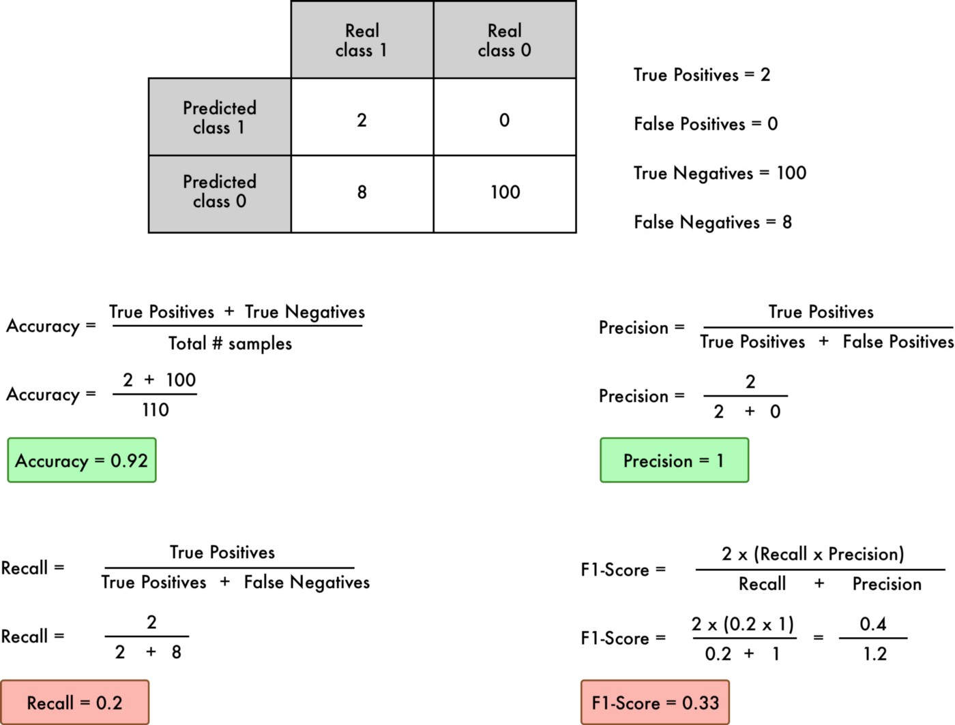
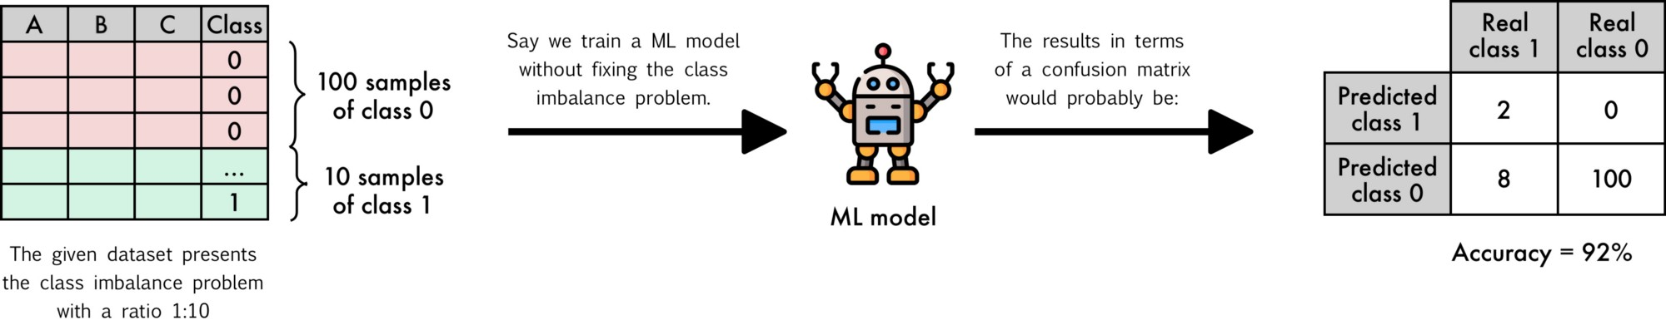

Slide 6
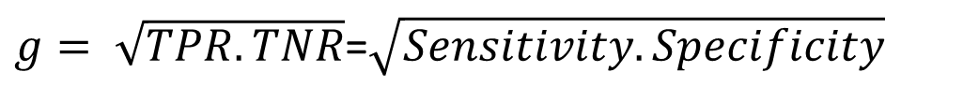
And thereby comes the Geometric Mean index….
Gmean
$g= \sqrt{TPR.TNR}$=$\sqrt{Sensitivity.Specificity}$
Suppose there are 96 negative class samples and 4 positive class samples.
The classifier predicts all samples in negative class.
Accuracy is 96/100 = 0.96
TP = 0
g = 0 !!!
 | Predicted Negative | Predicted Positive
Actual Negative | 96 (TN) | 0 (FP)
Actual Positive | 4 (FN) | 0 (TP)
But if it predicts 96 in negative and 4 in positive class
TPR = TP/(TP+FN) = 4/4 = 1, TNR = TN/(TN+FP) = 96/96 = 1
i.e., g = 1 !!!
 | Predicted Negative | Predicted Positive
Actual Negative | 96 (TN) | 0 (FP)
Actual Positive | 0 (FN) | 4 (TP)
Mullick et al., On the Choice of Appropriate Performance Indices for Imbalanced Data Classification: An Analysis, Pattern Recognition, Elsevier, 2020.

Slide 7
AUROC (Area Under the Receiver Operating Characteristic Curve) is a key evaluation metric in classification problems, especially when dealing with imbalanced datasets. It measures how well a model distinguishes between positive and negative classes.
Breaking Down AUROC:
Receiver Operating Characteristic (ROC) Curve:
It plots True Positive Rate (TPR) against False Positive Rate (FPR) at various threshold values.
The curve visually represents the trade-off between sensitivity (recall) and specificity.
True Positive Rate (TPR) / Sensitivity / Recall:
TPR = TP\(TP + FN) : Measures how many actual positives were correctly predicted.
False Positive Rate (FPR): FP}{FP + TN}FPR=FP+TNFP​
Measures how many actual negatives were incorrectly classified as positives.
Area Under the Curve (AUC):
The area under this ROC curve gives AUROC.
An AUROC value ranges from 0 to 1:
1.0 → Perfect classifier
0.5 → Random guessing (like flipping a coin)
< 0.5 → Worse than random (indicates systematic bias)

Slide 8
Numerical Example of AUROC Calculation
Let’s consider a binary classification model that assigns scores to test samples.
The goal is to determine how well the model ranks positive instances higher than negative ones.
Step 1: Consider the following dataset
Total Positive (1s) = 4, Total Negative (0s) = 4.
Sample | Actual Class | Model Score
1 | 1 (Positive) | 0.90
2 | 0 (Negative) | 0.85
3 | 1 (Positive) | 0.80
4 | 1 (Positive) | 0.70
5 | 0 (Negative) | 0.65
6 | 0 (Negative) | 0.60
7 | 1 (Positive) | 0.55
8 | 0 (Negative) | 0.50

Slide 9
Step 2: Compute True Positive Rate (TPR) and False Positive Rate (FPR) at different thresholds:
We now vary the threshold from highest to lowest model score and compute TPR and FPR.
Threshold | TP | FP | FN | TN | TPR (Recall) | FPR
≥ 0.90 | 1 | 0 | 3 | 4 | 1/4 = 0.25 | 0/4 = 0.00
≥ 0.85 | 1 | 1 | 3 | 3 | 1/4 = 0.25 | 1/4 = 0.25
≥ 0.80 | 2 | 1 | 2 | 3 | 2/4 = 0.50 | 1/4 = 0.25
≥ 0.70 | 3 | 1 | 1 | 3 | 3/4 = 0.75 | 1/4 = 0.25
≥ 0.65 | 3 | 2 | 1 | 2 | 3/4 = 0.75 | 2/4 = 0.50
≥ 0.60 | 3 | 3 | 1 | 1 | 3/4 = 0.75 | 3/4 = 0.75
≥ 0.55 | 4 | 3 | 0 | 1 | 4/4 = 1.00 | 3/4 = 0.75
≥ 0.50 | 4 | 4 | 0 | 0 | 4/4 = 1.00 | 4/4 = 1.00

Slide 10
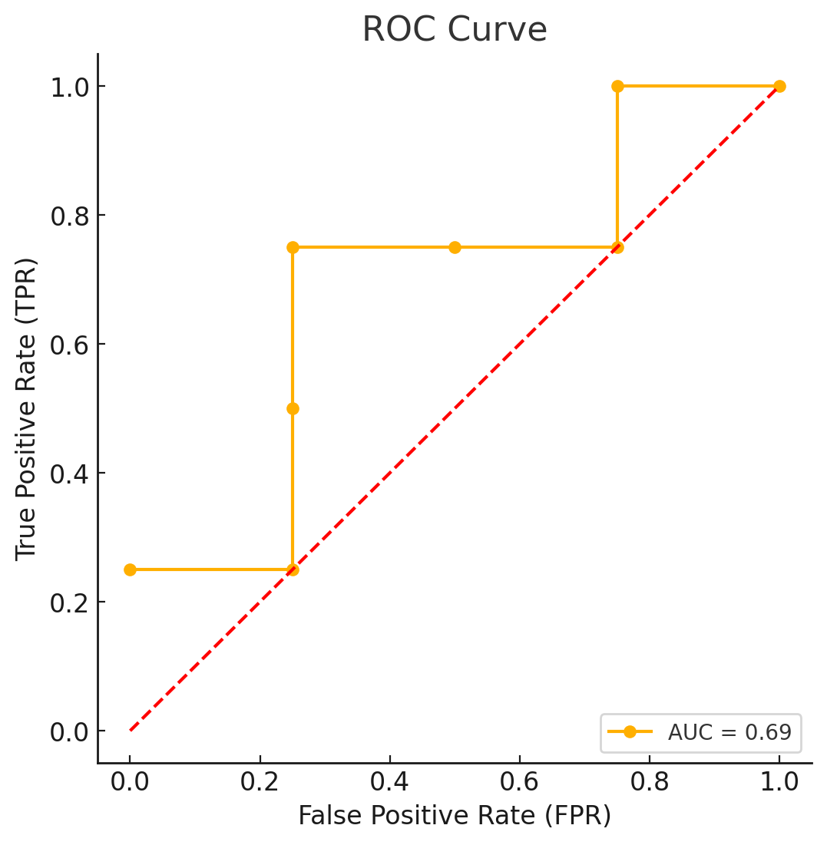
Plot the ROC Curve:
We plot TPR (y-axis) vs. FPR (x-axis) based on the computed values.

Slide 11
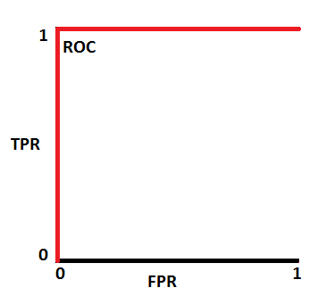
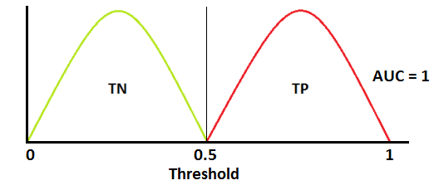
How to speculate about the performance of the model?
An excellent model has AUC near to the 1 which means it has a good measure of separability. A poor model has an AUC near 0 which means it has the worst measure of separability. In fact, it means it is reciprocating the result. It is predicting 0s as 1s and 1s as 0s. And when AUC is 0.5, it means the model has no class separation capacity whatsoever.
Let’s interpret the above statements.
As we know, ROC is a curve of probability. So let's plot the distributions of those probabilities:
Note: Red distribution curve is of the positive class (patients with disease) and the green distribution curve is of the negative class(patients with no disease).
This is an ideal situation. When two curves don’t overlap at all means model has an ideal measure of separability. It is perfectly able to distinguish between positive class and negative class.

Slide 12
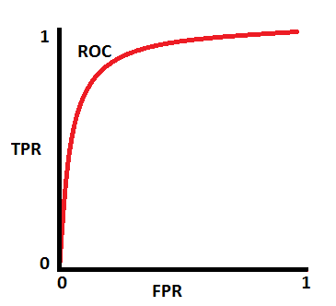
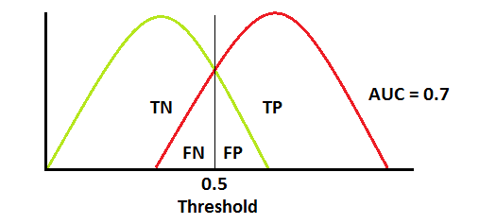
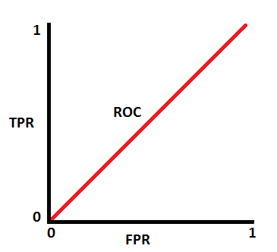
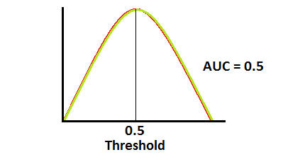
When two distributions overlap, we introduce type 1 and type 2 errors. Depending upon the threshold, we can minimize or maximize them. When AUC is 0.7, it means there is a 70% chance that the model will be able to distinguish between positive class and negative class.
This is the worst situation. When AUC is approximately 0.5, the model has no discrimination capacity to distinguish between positive class and negative class.

Slide 13
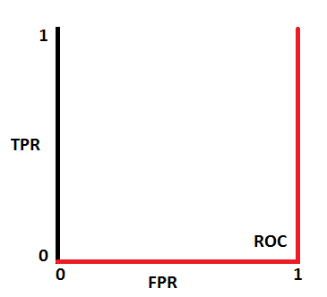
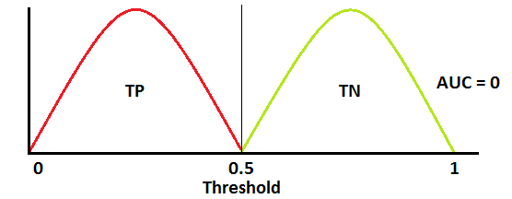
When AUC is approximately 0, the model is actually reciprocating the classes. It means the model is predicting a negative class as a positive class and vice versa.
The relation between Sensitivity, Specificity, FPR, and Threshold.
Sensitivity and Specificity are inversely proportional to each other. So when we increase Sensitivity, Specificity decreases, and vice versa.

