Slide 1
Paging and Virtual Memory
Additional slide courtesy: Prof. Mandar Mitra

Slide 2
Inverted Page Table (IPT) / Frame Table
Rather than each process having a page table and keeping track of all possible logical pages, track all physical pages
One entry for each frame of physical memory
Entry consists of the virtual address of the page stored in that real memory location, with information about the process that owns that page
Decreases memory needed to store each page table, but increases time needed to search the table when a page reference occurs
TLB can accelerate access

Slide 3

Inverted Page Table Architecture
Frame Table / IPT

Slide 4
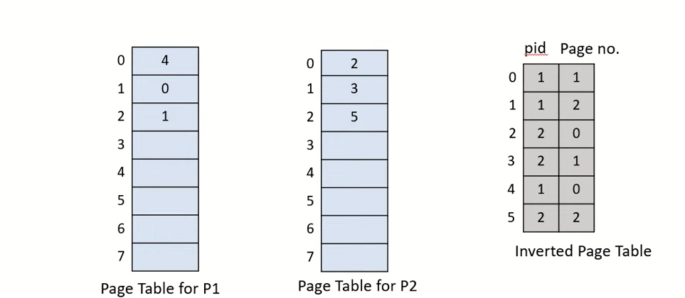
Inverted Page Table

Slide 5
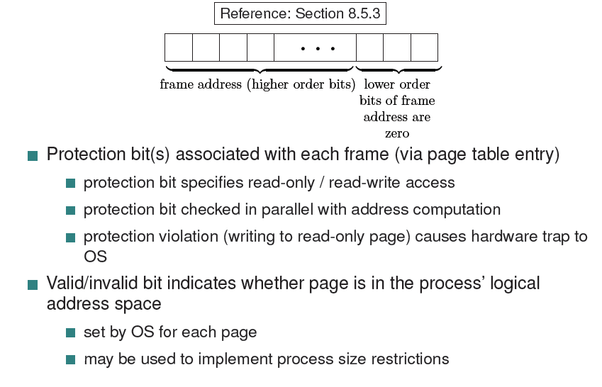
Page Table: Memory Protection

Slide 6
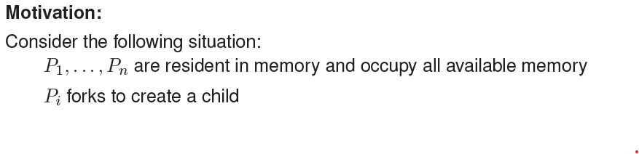
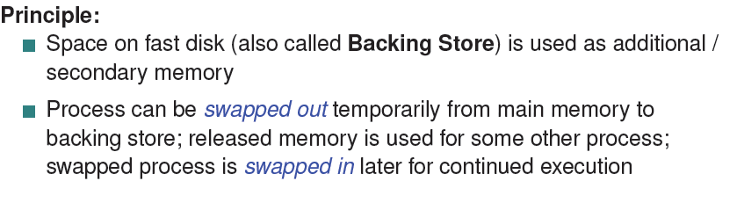
Swapping

Slide 7
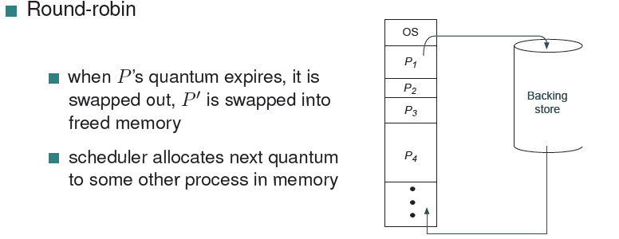
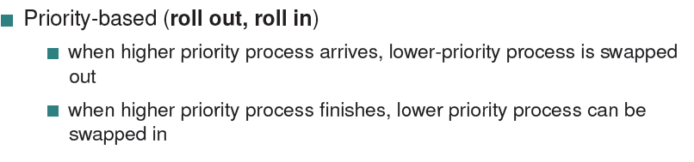
Swapping: Choosing processes

Slide 8
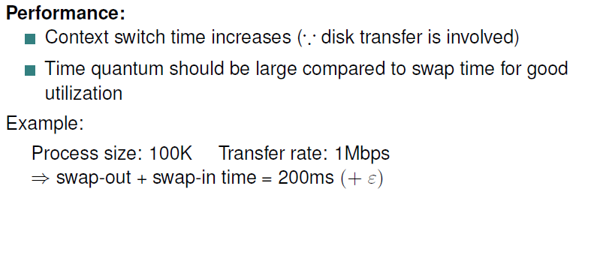
Swapping

Slide 9
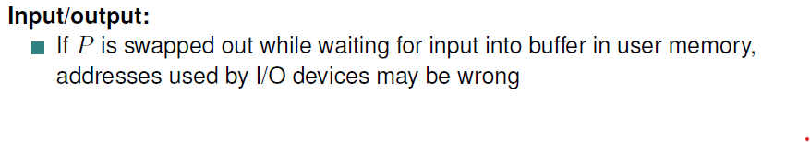
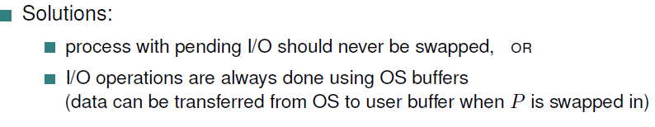
Swapping

Slide 10
Taking advantages of paging
Code needs to be in memory to execute, but entire program rarely used
Error code, unusual routines, large data structures
Entire program code not needed at same time
Program no longer constrained by limits of physical memory

Slide 11
Virtual memory
Virtual memory – separation of user logical memory from physical memory
Only part of the program needs to be in memory for execution
Logical address space can therefore be much larger than physical address space
Allows address spaces to be shared by several processes
Allows for more efficient process creation
More programs running concurrently
Less I/O needed to load or swap processes

Slide 12
Virtual memory (Cont.)
Virtual address space – logical view of how process is stored in memory
Usually start at address 0, contiguous addresses until end of space
Meanwhile, physical memory organized in page frames
MMU must map logical to physical
Virtual memory can be implemented via:
Demand paging
Demand segmentation

Slide 13
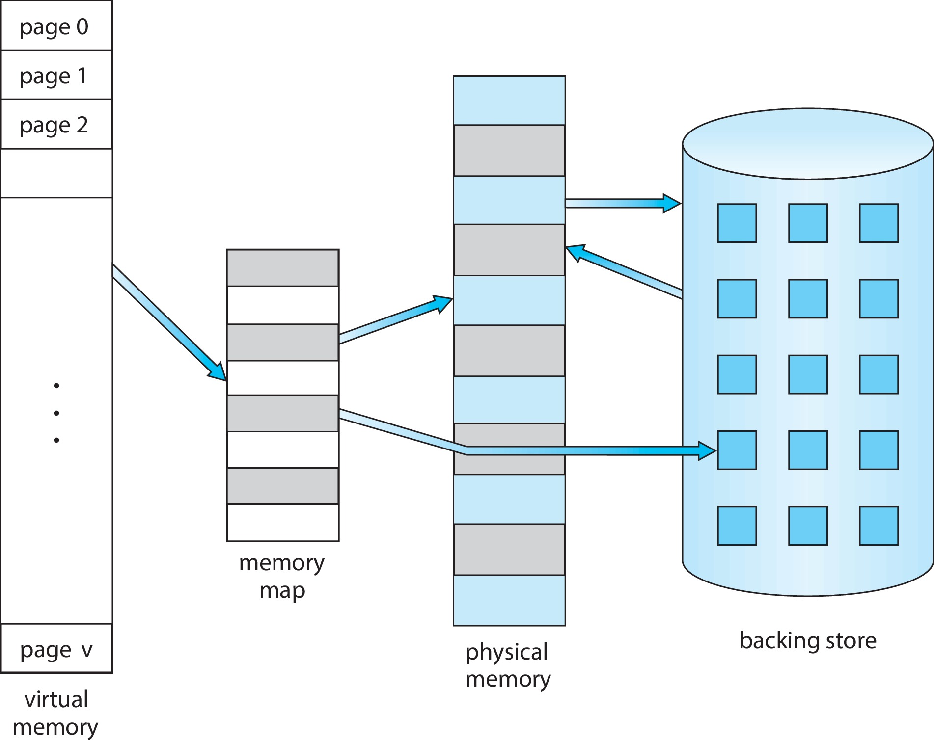
Virtual Memory That is Larger Than Physical Memory

Slide 14

Virtual-address Space
Usually design logical address space for stack to start at Max logical address and grow “down” while heap grows “up”
Maximizes address space use
Unused address space between the two is hole
System libraries shared via mapping into virtual address space
Shared memory by mapping pages read-write into virtual address space
Pages can be shared during fork(), speeding process creation

Slide 15
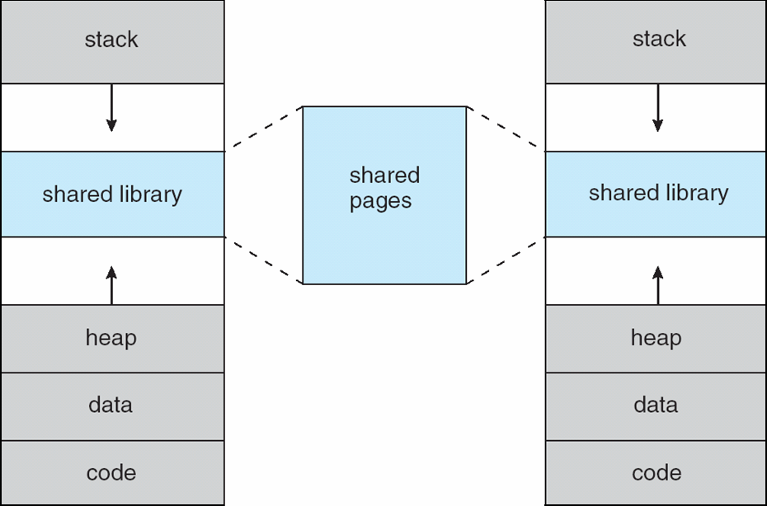
Shared Library Using Virtual Memory

Slide 16

Demand Paging
Bring a page into memory only when it is needed
Less I/O needed, no unnecessary I/O
Less memory needed
Faster response
More users
Page is needed ⇒ reference to it
invalid reference ⇒ abort
not-in-memory ⇒ bring to memory
Similar to paging system with swapping

Slide 17
Demand Paging
Could bring entire process into memory at load time
Or bring a page into memory only when it is needed
Less I/O needed, no unnecessary I/O
Less memory needed
Faster response
More users
Similar to paging system with swapping (diagram on right)

Slide 18
Basic Concepts
If pages needed are already memory resident
No difference from non demand-paging
If page needed and not memory resident
Need to detect and load the page into memory from storage

Slide 19
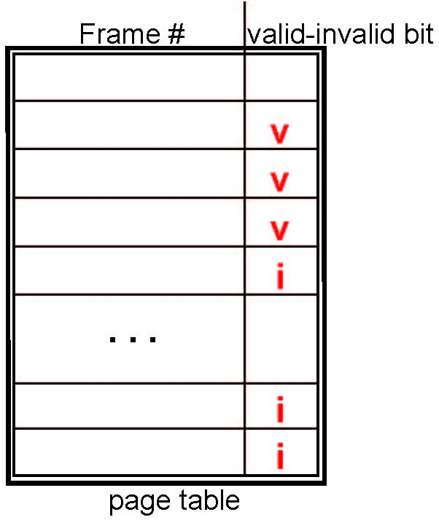
Valid-Invalid Bit
With each page table entry a valid–invalid bit is associated (v ⇒ in-memory – memory resident, i ⇒ not-in-memory)
Last n-bits are 0, use 3 of them to set rd / wr / x permission
One more bit to mark illegal entry (compiler did not generate this)
Initially valid–invalid bit is set to i on all entries
Example of a page table snapshot:
During MMU address translation, if valid–invalid bit in page table entry is i ⇒ page fault
4

Slide 20
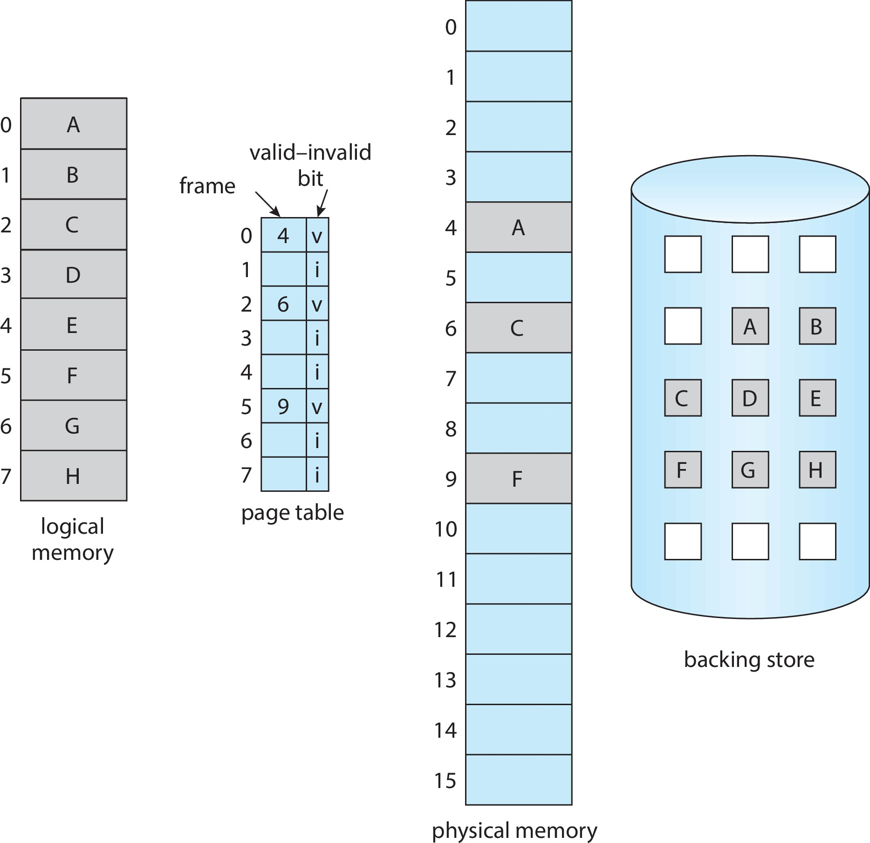
Page Table When Some Pages Are Not in Main Memory

Slide 21
Steps in Handling Page Fault
If there is a reference to a page, first reference to that page will trap to operating system
Page fault
Operating system needs to decide:
Invalid reference ⇒ abort
Just not in memory
Find free frame
Swap page into frame via scheduled disk operation
Reset tables to indicate page now in memory Set validation bit = v
Restart the instruction that caused the page fault

Slide 22

Steps in Handling a Page Fault (Cont.)

Slide 23
Aspects of Demand Paging
Extreme case – start process with no pages in memory
OS sets instruction pointer to first instruction of process, non-memory-resident -> page fault
And for every other process pages on first access
A given instruction could access multiple pages -> multiple page faults
Hardware support needed for demand paging
Page table with valid / invalid bit
Secondary memory (swap device with swap space)
Instruction restart

Slide 24
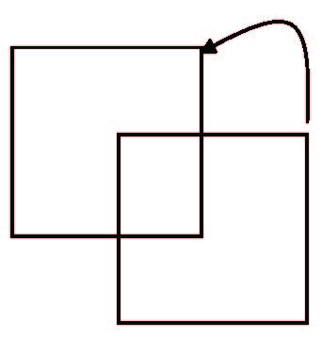
Instruction Restart
Consider an instruction that could access several different locations
Block move
Auto increment/decrement location
Restart the whole operation?
What if source and destination overlap?

Slide 25
Free-Frame List
When a page fault occurs, the operating system must bring the desired page from secondary storage into main memory.
Most operating systems maintain a free-frame list -- a pool of free frames for satisfying such requests.
When a system starts up, all available memory is placed on the free-frame list.

Slide 26
Stages in Demand Paging
Trap to the operating system
Save the user registers and process state
Determine that the interrupt was a page fault
Check that the page reference was legal and determine the location of the page on the disk
Issue a read from the disk to a free frame:
Wait in a queue for this device until the read request is serviced
Wait for the device seek and/or latency time
Begin the transfer of the page to a free frame

Slide 27
Stages in Demand Paging (Cont.)
While waiting, allocate the CPU to some other user
Receive an interrupt from the disk I/O subsystem (I/O completed)
Save the registers and process state for the other user
Determine that the interrupt was from the disk
Correct the page table and other tables to show page is now in memory
Wait for the CPU to be allocated to this process again
Restore the user registers, process state, and new page table, and then
resume the interrupted instruction

Slide 28
Performance of Demand Paging
Three major activities
Service the interrupt
Read the page – lots of time
Restart the process
Page Fault Rate 0 ≤ p ≤ 1
if p = 0 no page faults
if p = 1, every reference is a fault
Effective Access Time (EAT)
EAT = (1 – p) x memory access
+ p (page fault overhead
+ swap page out
+ swap page in )

Slide 29
Demand Paging Example
Memory access time = 200 nanoseconds
Average page-fault service time = 8 milliseconds
EAT = (1 – p) x 200 + p (8 milliseconds)
= (1 – p) x 200 + p x 8,000,000
= 200 + p x 7,999,800
If want performance degradation < 10 percent
220 > 200 + 7,999,800 x p 20 > 7,999,800 x p
p < .0000025
< one page fault in every 400,000 memory accesses

Slide 30
Demand Paging Optimizations
Swap space I/O faster than file system I/O even if on the same device
Swap allocated in larger chunks, less management needed than file system
Copy entire process image to swap space at process load time
Then page in and out of swap space

Slide 31
What Happens if There is no Free Frame?
Used up by process pages
Also in demand from the kernel, I/O buffers, etc
How much to allocate to each?
Page replacement – find some page in memory, but not really in use, page it out
Algorithm – terminate? swap out? replace the page?
Performance – want an algorithm which will result in minimum number of page faults
Same page may be brought into memory several times

Slide 32
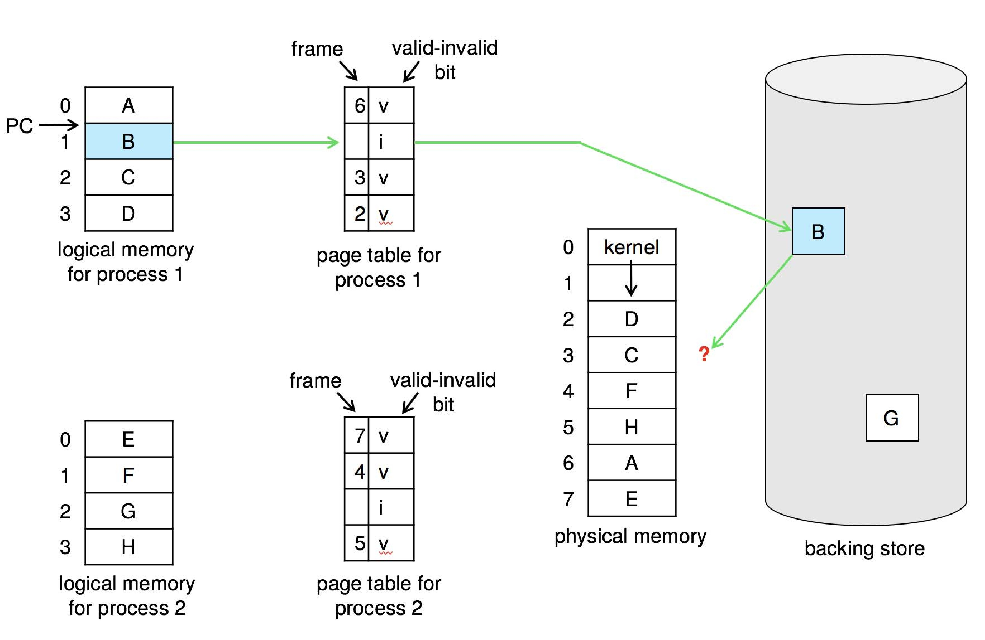
Need For Page Replacement

Slide 33
Basic Page Replacement
Find the location of the desired page on disk
Find a free frame: - If there is a free frame, use it - If there is no free frame, use a page replacement algorithm to select a victim frame - Write victim frame to disk if dirty
Bring the desired page into the (newly) free frame; update the page and frame tables
Continue the process by restarting the instruction that caused the trap
Note now potentially 2 page transfers for page fault – increasing EAT

Slide 34
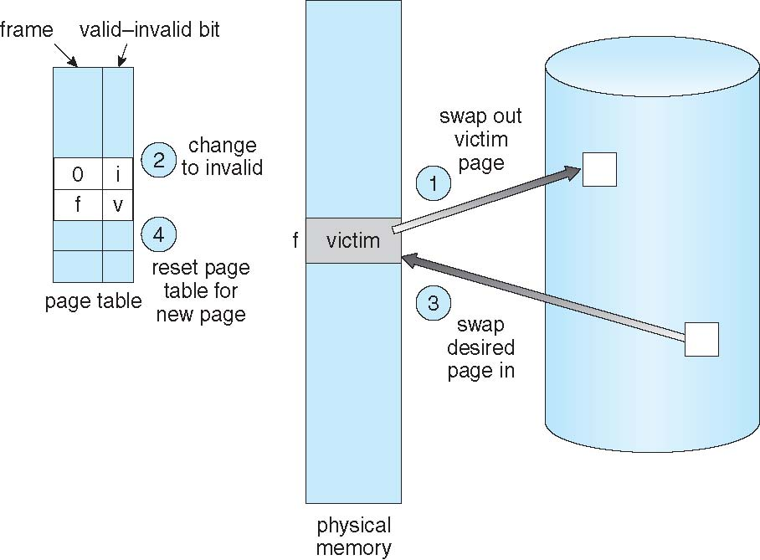
Page Replacement

Slide 35
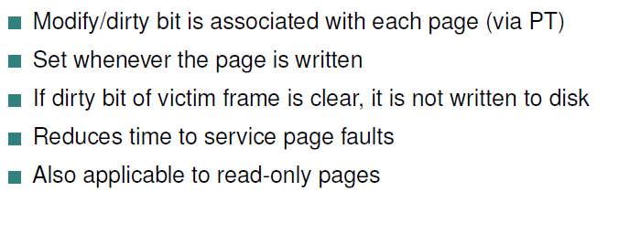
Modify / Dirty bit

Slide 36
Page and Frame Replacement Algorithms
Frame-allocation algorithm determines
How many frames to give each process
Which frames to replace
Page-replacement algorithm
Want lowest page-fault rate on both first access and re-access
Repeated access to the same page does not cause a page fault
Results depend on number of frames available

Slide 37
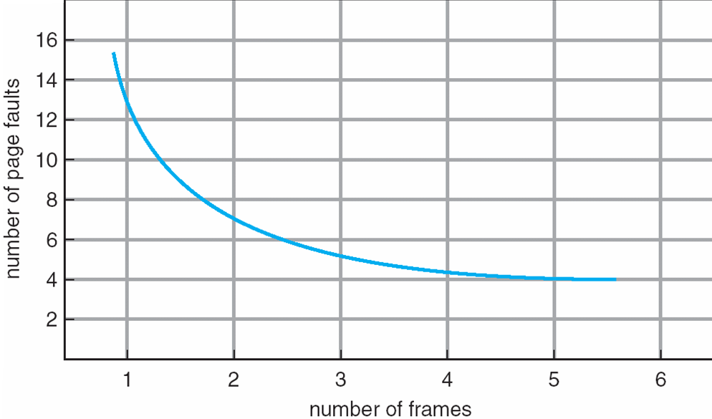
Graph of Page Faults Versus the Number of Frames
Expected Behavior

Slide 38
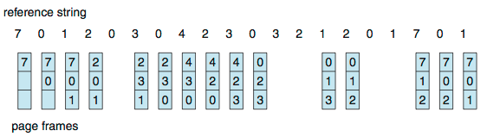
First-In-First-Out (FIFO) Algorithm
Reference string: 7,0,1,2,0,3,0,4,2,3,0,3,0,3,2,1,2,0,1,7,0,1
3 frames (3 pages can be in memory at a time per process)
Can vary by reference string: consider 1,2,3,4,1,2,5,1,2,3,4,5
Adding more frames can cause more page faults!
Belady’s Anomaly
How to track ages of pages?
Just use a FIFO queue
15 page faults

Slide 39

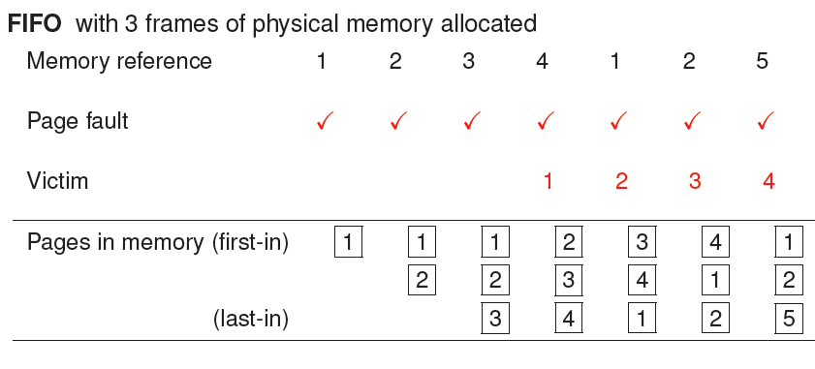
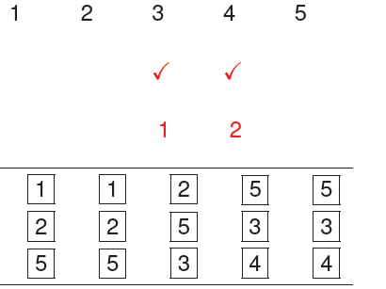
Belady’s Anomaly
No. of page faults: 9

Slide 40
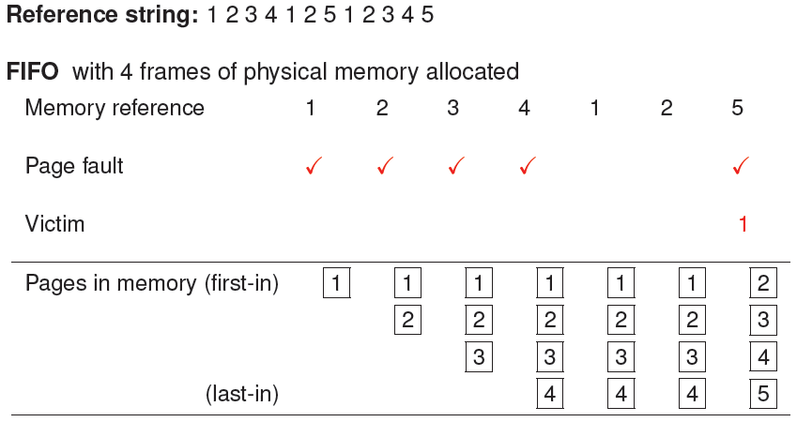
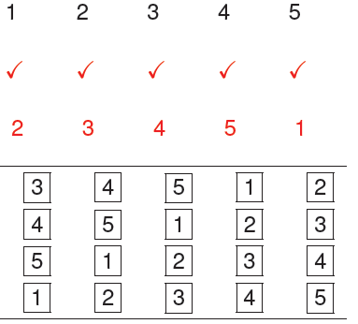
Belady’s Anomaly
No. of page faults: 10

Slide 41
FIFO Illustrating Belady’s Anomaly

Slide 42
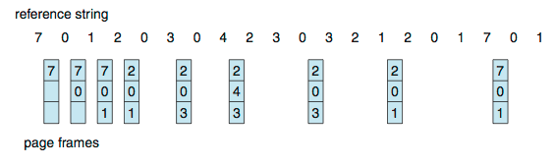
Optimal Algorithm
Replace page that will not be used for longest period of time
9 is optimal for the example
How do you know this?
Can’t read the future
Used for measuring how well your algorithm performs

Slide 43
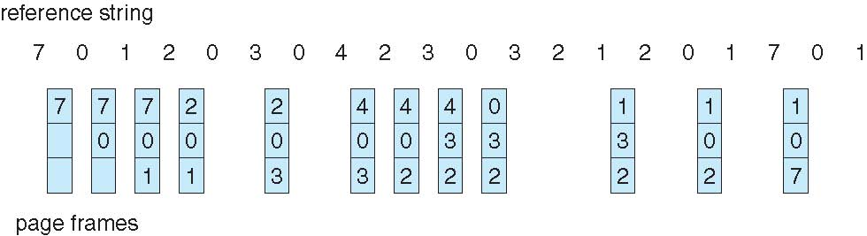
Least Recently Used (LRU) Algorithm
Use past knowledge rather than future
Replace page that has not been used in the most amount of time
Associate time of last use with each page
12 faults – better than FIFO but worse than OPT
Generally good algorithm and frequently used
But how to implement?

Slide 44
LRU Algorithm (Cont.)
Counter implementation
Every page entry has a counter; every time page is referenced through this entry, copy the clock into the counter
When a page needs to be changed, look at the counters to find smallest value
Search through table needed
Stack implementation
Keep a stack of page numbers in a double link form:
Page referenced:
move it to the top
requires 6 pointers to be changed
But each update more expensive
No search for replacement

Slide 45
LRU Algorithm (Cont.)
LRU and OPT are cases of stack algorithms that don’t have Belady’s Anomaly
Use Of A Stack to Record Most Recent Page References

Slide 46
LRU Algorithm (Cont.)
LRU and OPT are cases of stack algorithms that don’t have Belady’s Anomaly
Use Of A Stack to Record Most Recent Page References
6 pointer changes

Slide 47
LRU Approximation Algorithms
LRU needs special hardware and still slow
Reference bit
With each page associate a bit, initially = 0
When page is referenced bit set to 1
Replace any with reference bit = 0 (if one exists)
We do not know the order, however

Slide 48
LRU Approximation Algorithms (cont.)
Second-chance algorithm
Generally FIFO, plus hardware-provided reference bit
Clock replacement
If page to be replaced has
Reference bit = 0 -> replace it
reference bit = 1 then:
set reference bit 0, leave page in memory
replace next page, subject to same rules

Slide 49
Second-chance Algorithm

Slide 50
Enhanced Second-Chance Algorithm
Improve algorithm by using reference bit and modify bit (if available) in concert
Take ordered pair (reference, modify):
(0, 0) neither recently used not modified – best page to replace
(0, 1) not recently used but modified – not quite as good, must write out before replacement
(1, 0) recently used but clean – probably will be used again soon
(1, 1) recently used and modified – probably will be used again soon and need to write out before replacement
When page replacement called for, use the clock scheme but use the four classes replace page in lowest non-empty class
Might need to search circular queue several times

Slide 51
Counting Algorithms
Keep a counter of the number of references that have been made to each page
Not common
Lease Frequently Used (LFU) Algorithm:
Replaces page with smallest count
Most Frequently Used (MFU) Algorithm:
Based on the argument that the page with the smallest count was probably just brought in and has yet to be used

Slide 52
Allocation of Frames
Each process needs minimum number of frames
Example: IBM 370 – 6 pages to handle SS MOVE instruction:
instruction is 6 bytes, might span 2 pages
2 pages to handle from
2 pages to handle to
Maximum of course is total frames in the system
Two major allocation schemes
fixed allocation
priority allocation
Many variations

Slide 53
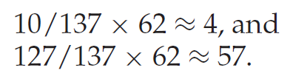
Fixed Allocation
Equal allocation – For example, if there are 100 frames (after allocating frames for the OS) and 5 processes, give each process 20 frames
Proportional allocation – Allocate according to the size of process
Dynamic as degree of multiprogramming, process sizes change
m = 62

Slide 54
Global vs. Local Allocation
Global replacement – process selects a replacement frame from the set of all frames; one process can take a frame from another
But then process execution time can vary greatly
But greater throughput so more common
Local replacement – each process selects from only its own set of allocated frames
More consistent per-process performance
But possibly underutilized memory

Slide 55
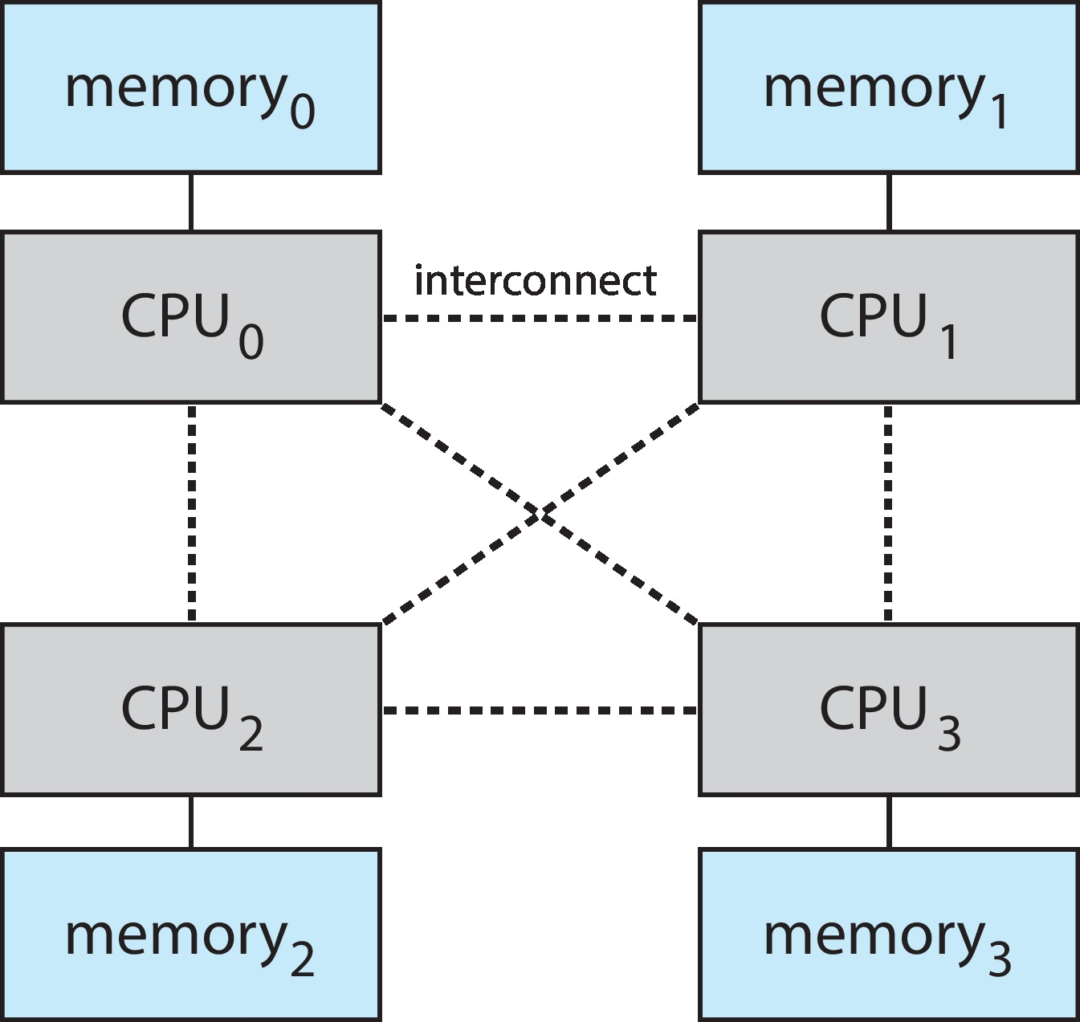
Non-Uniform Memory Access
So far, we assumed that all memory accessed equally
Many systems are NUMA – speed of access to memory varies
Consider system boards containing CPUs and memory, interconnected over a system bus
NUMA multiprocessing architecture

Slide 56
Non-Uniform Memory Access (Cont.)
Optimal performance comes from allocating memory “close to” the CPU on which the thread is scheduled
And modifying the scheduler to schedule the thread on the same system board when possible
Solved by Solaris by creating lgroups
Structure to track CPU / Memory low latency groups
Used my schedule and pager
When possible schedule all threads of a process and allocate all memory for that process within the lgroup

Slide 57
Thrashing
If a process does not have “enough” pages, the page-fault rate is very high
Page fault to get page
Replace existing frame
But quickly need replaced frame back
This leads to:
Low CPU utilization
Operating system thinking that it needs to increase the degree of multiprogramming
Another process added to the system

Slide 58
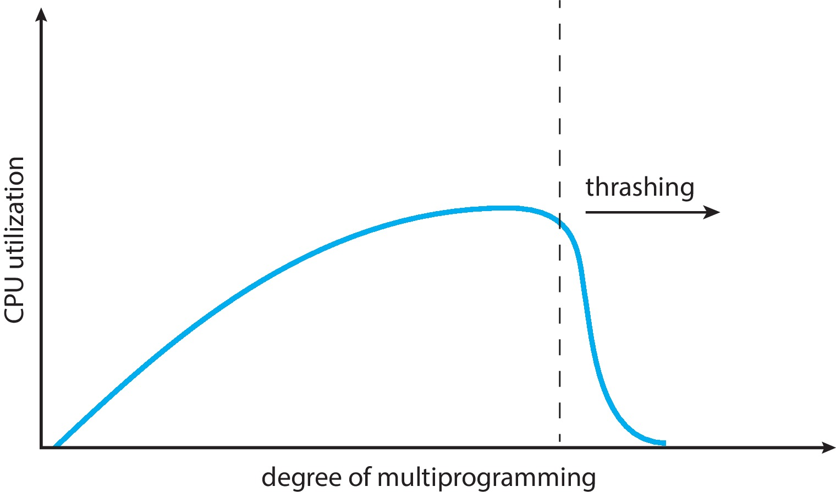
Thrashing (Cont.)
Thrashing. A process is busy swapping pages in and out

Slide 59
Allocating Kernel Memory
Treated differently from user memory
Often allocated from a free-memory pool
Kernel requests memory for structures of varying sizes
Some kernel memory needs to be contiguous
i.e., for device I/O

Slide 60
Other Considerations
Prepaging
Page size
TLB reach
Inverted page table
Program structure

Slide 61
TLB Reach
TLB Reach - The amount of memory accessible from the TLB
TLB Reach = (TLB Size) X (Page Size)
Ideally, the working set of each process is stored in the TLB
Otherwise there is a high degree of page faults
Increase the Page Size
This may lead to an increase in fragmentation as not all applications require a large page size
Provide Multiple Page Sizes
This allows applications that require larger page sizes the opportunity to use them without an increase in fragmentation

Slide 62
Program Structure
Program structure, Assume pages are 128 words in size, 1 int = 1 word
int[128,128] data;
Each row is stored in one page
Program 1
for (j = 0; j <128; j++) for (i = 0; i < 128; i++) data[i,j] = 0;
128 x 128 = 16,384 page faults
Program 2
for (i = 0; i < 128; i++) for (j = 0; j < 128; j++) data[i,j] = 0;
128 page faults

Slide 63
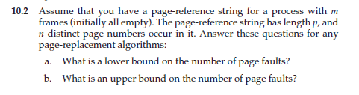
Exercises
n
p

Slide 64
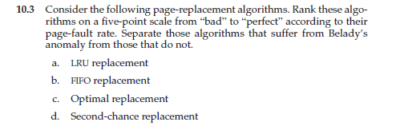
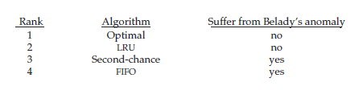

Slide 65


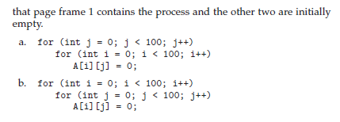

b) Every 200th element gets a page fault
a) Every alternate gets a page fault

Slide 66

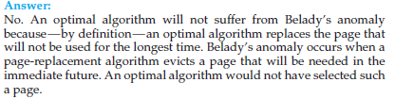

Slide 67
HOMEWORK
STUDY the concept of Segmentation
STUDY the concept of PROTECTION
STUDY the concept of Valid / Invalid Bit

