Slide 1
Convolution Arithmetic and
Details of CNN Training

Slide 2
In Deep Learning, convolution is the element-wise multiplication and addition. For an image with 1 channel, the convolution is demonstrated in the figure below.
Here the filter is a 3 x 3 matrix with element [[0, 1, 2], [2, 2, 0], [0, 1, 2]]. The filter is sliding through the input. At each position, it’s doing element-wise multiplication and addition. Each sliding position ends up with one number. The final output is then a 3 x 3 matrix. (Notice that stride = 1 and padding = 0 in this example.

Slide 3
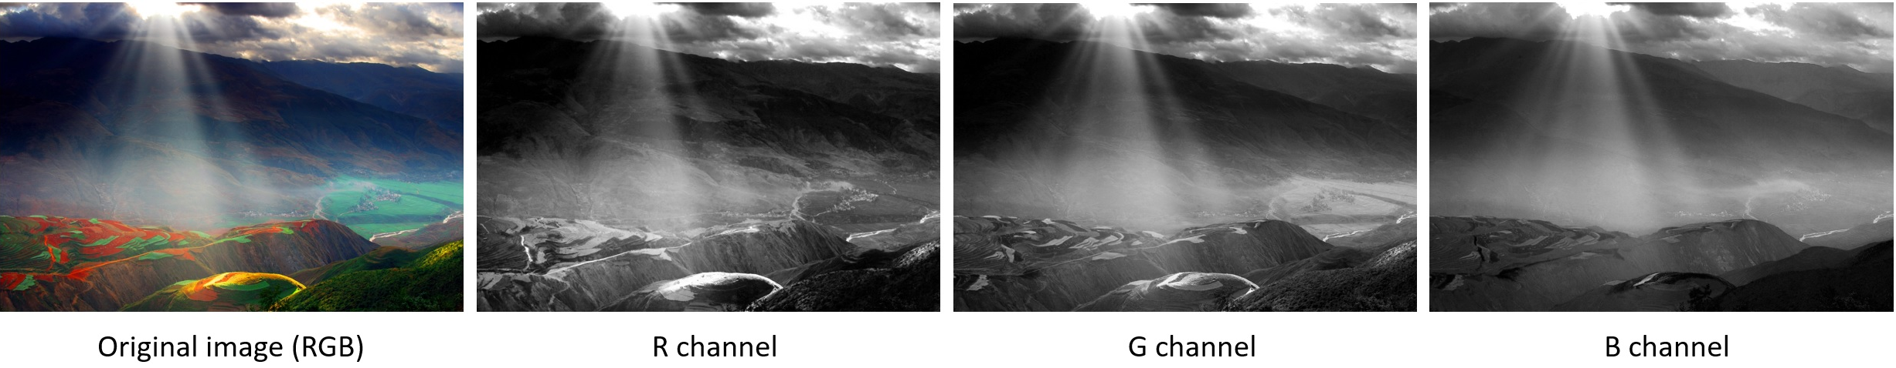
In many applications, we are dealing with images with multiple channels. A typical example is the RGB image. Each RGB channel emphasizes different aspects of the original image, as illustrated in the following image.
We would like to clarify a few terminologies: layers, channels, feature maps, filters, and kernels. From a hierarchical point of view, the concepts of layers and filters are at the same level, while channels and kernels are at one level below. Channels and feature maps are the same thing. A layer could have multiple channels (or feature maps): an input layer has 3 channels if the inputs are RGB images. “channel” is usually used to describe the structure of a “layer”. Similarly, “kernel” is used to describe the structure of a “filter”.

Slide 4
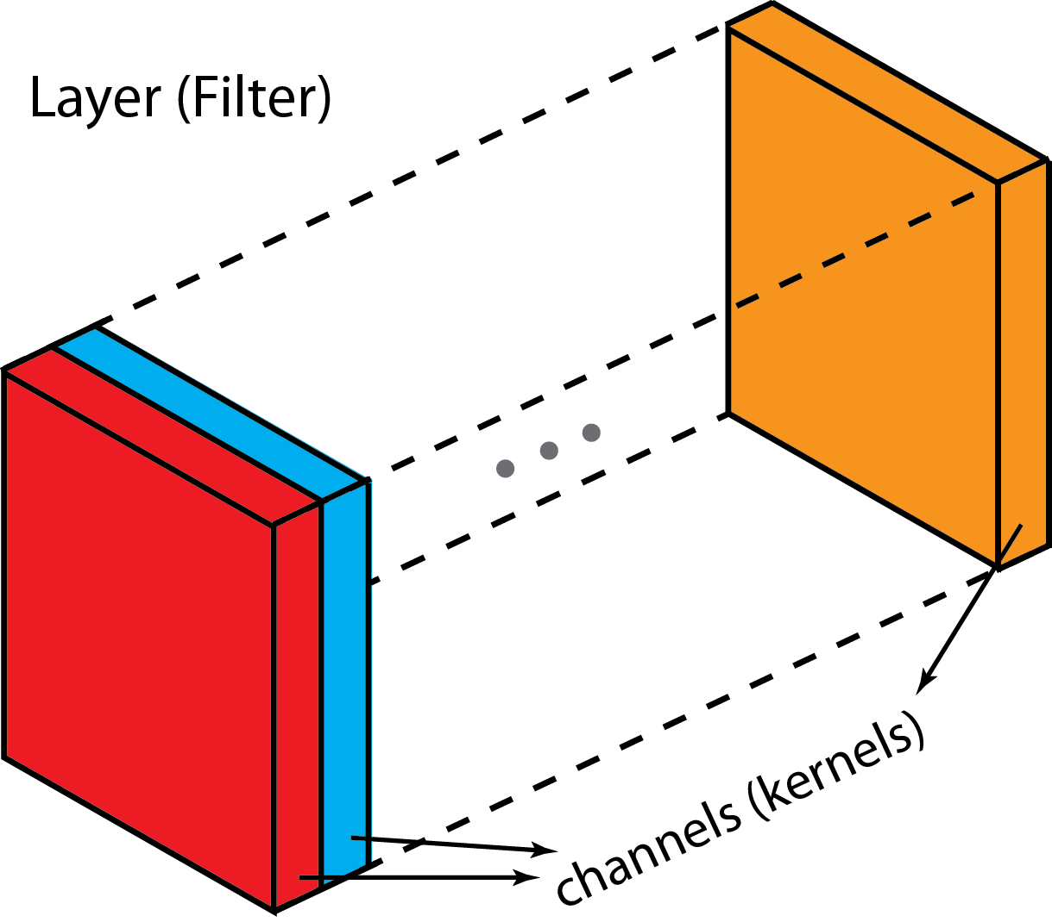
The difference between filter and kernel is a bit tricky. Sometimes, they are used interchangeably, which could create confusions. Essentially, these two terms have subtle difference. A “Kernel” refers to a 2D array of weights. The term “filter” is for 3D structures of multiple kernels stacked together. For a 2D filter, filter is same as kernel. But for a 3D filter and most convolutions in deep learning, a filter is a collection of kernels. Each kernel is unique, emphasizing different aspects of the input channel.

Slide 5
With these concepts, the multi-channel convolution goes as the following. Each kernel is applied onto an input channel of the previous layer to generate one output channel. This is a kernel-wise process. We repeat such process for all kernels to generate multiple channels. Each of these channels are then summed together to form one single output channel. The following illustration should make the process clearer.
Here the input layer is a 5 x 5 x 3 matrix, with 3 channels. The filter is a 3 x 3 x 3 matrix. First, each of the kernels in the filter are applied to three channels in the input layer, separately. Three convolutions are performed, which result in 3 channels with size 3 x 3.

Slide 6
Each of the per-channel processed versions are then summed together to form one channel. The kernels of a filter each produce one version of each channel, and the filter as a whole produces one overall output channel.

Slide 7
Finally, then there’s the bias term. The way the bias term works here is that each output filter has one bias term. The bias gets added to the output channel so far to produce the final output channel.
And with the single filter case down, the case for any number of filters is identical: Each filter processes the input with its own, different set of kernels and a scalar bias with the process described above, producing a single output channel. They are then concatenated together to produce the overall output, with the number of output channels being the number of filters. A nonlinearity is then usually applied before passing this as input to another convolution layer, which then repeats this process.

Slide 8
We assume:
Vincent Dumoulin and Francesco Visin. A guide to convolution arithmetic for deep learning. arXiv preprint arXiv:1603.07285, 2016.

Slide 17
In a neural network, pooling layers provide invariance to small translations of the input. The most common kind of pooling is max pooling, which consists in splitting the input in (usually non-overlapping) patches and outputting the maximum value of each patch. Other kinds of pooling exist, e.g., mean or average pooling, which all share the same idea of aggregating the input locally
by applying a non-linearity to the content of some patches
Since pooling does not involve zero padding, the relationship describing the general case is as follows:

