Slide 1
Expectation Maximization – A Primer
Some slides are from Dr. Stefanos Zafeiriou, Imperial College, London

Slide 2
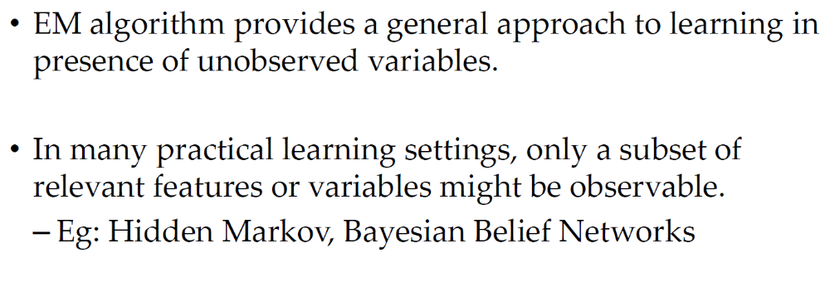
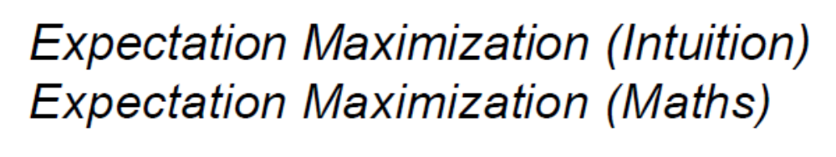
We proceed through:

Slide 3
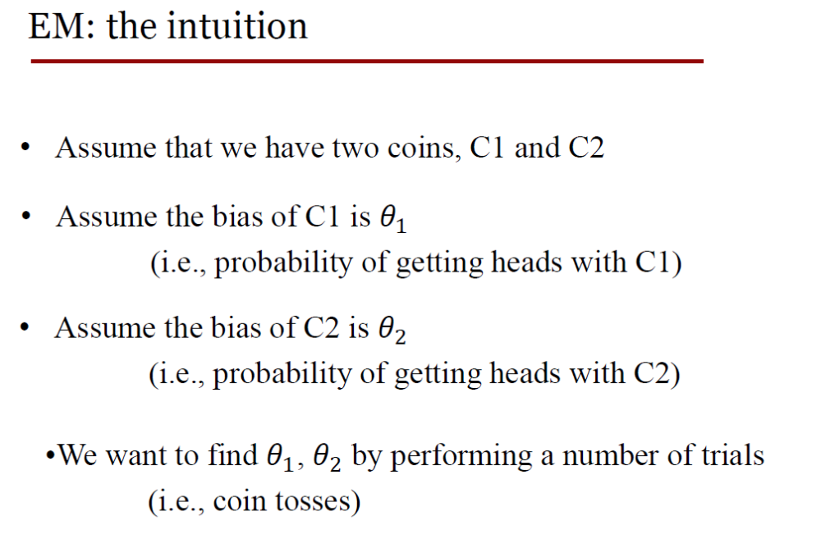

Slide 4
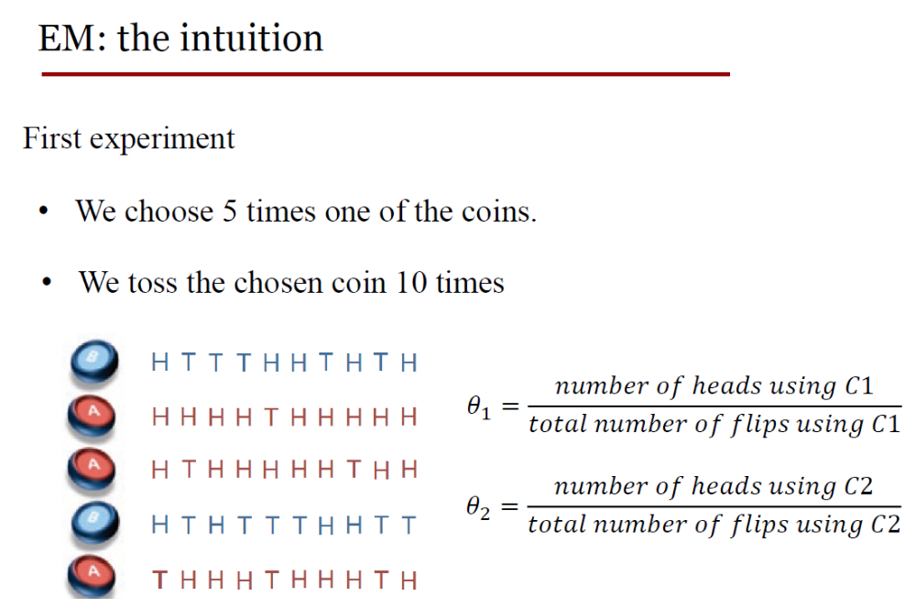

Slide 5
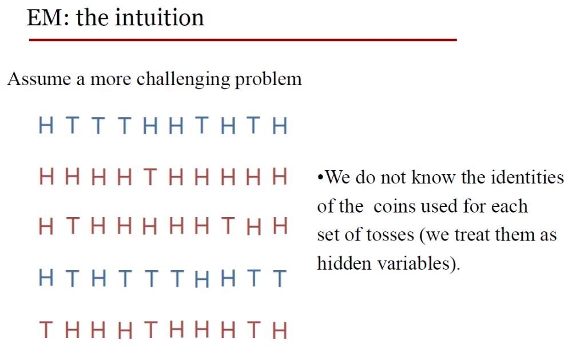

Slide 6
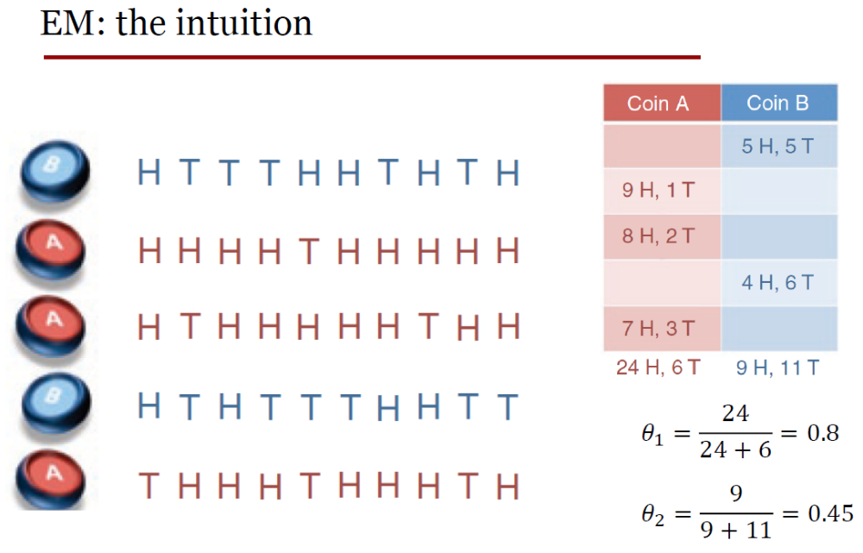

Slide 7
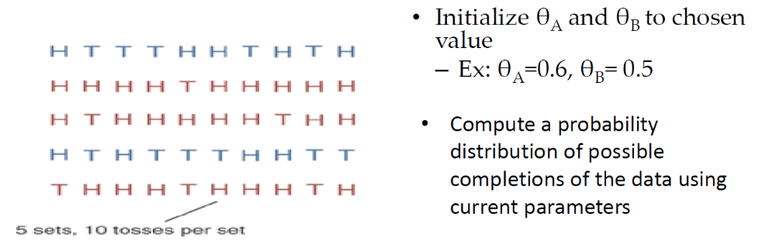
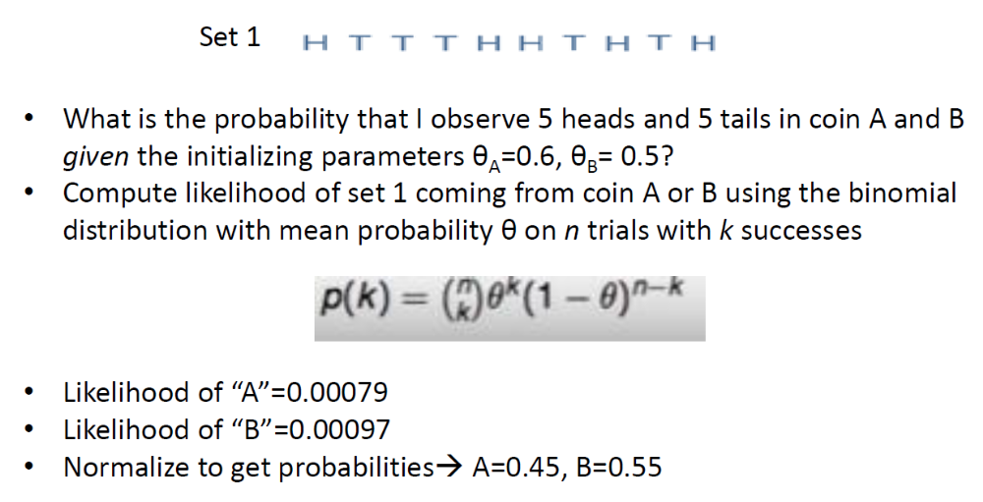

Slide 8

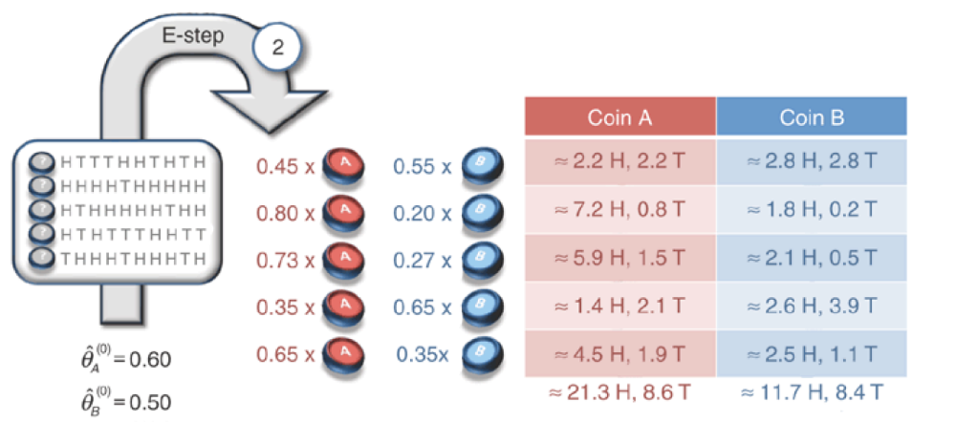

Slide 9

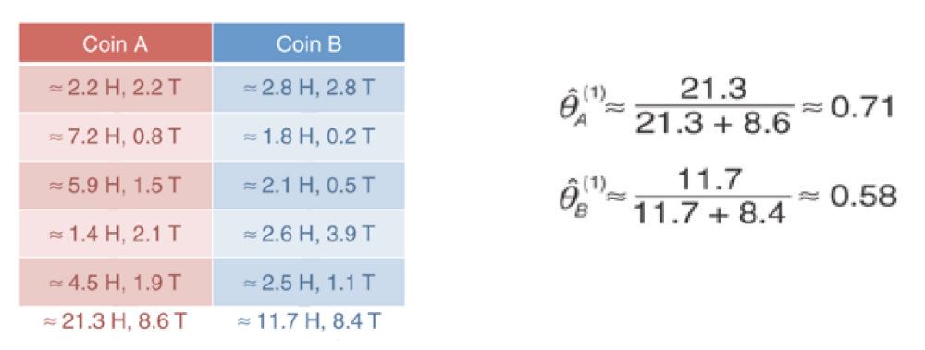

Slide 10
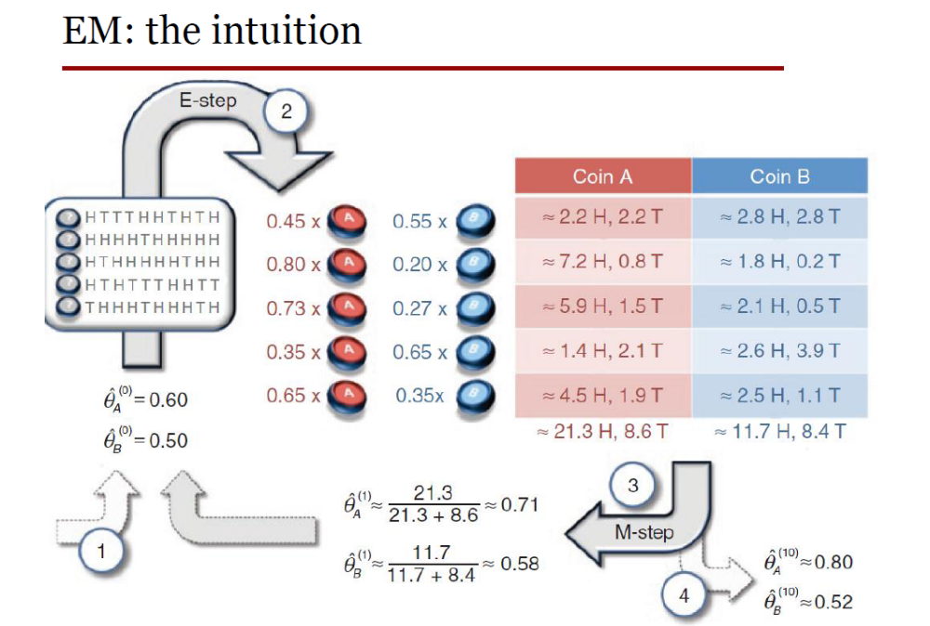

Slide 11
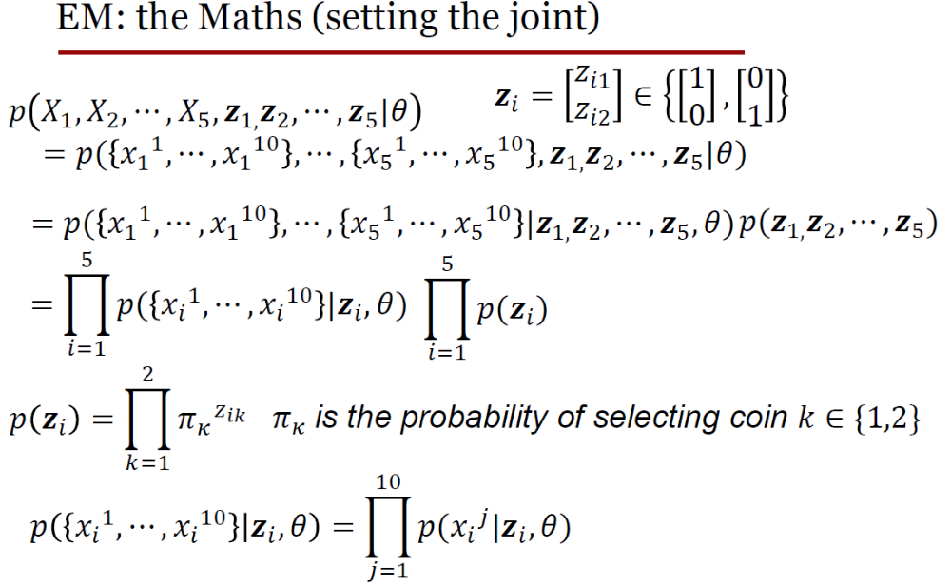

Slide 12
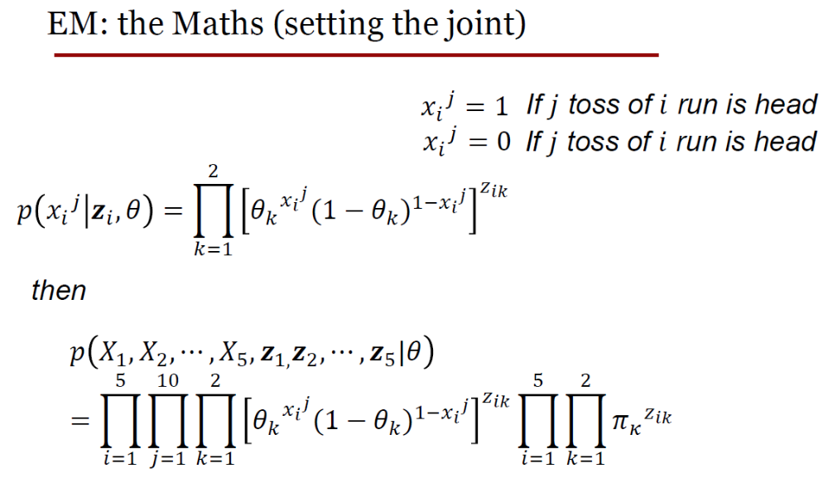
Tail

Slide 13
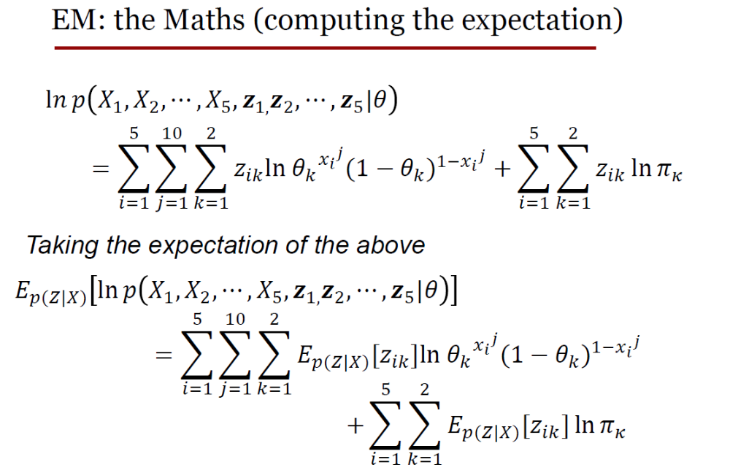

Slide 14
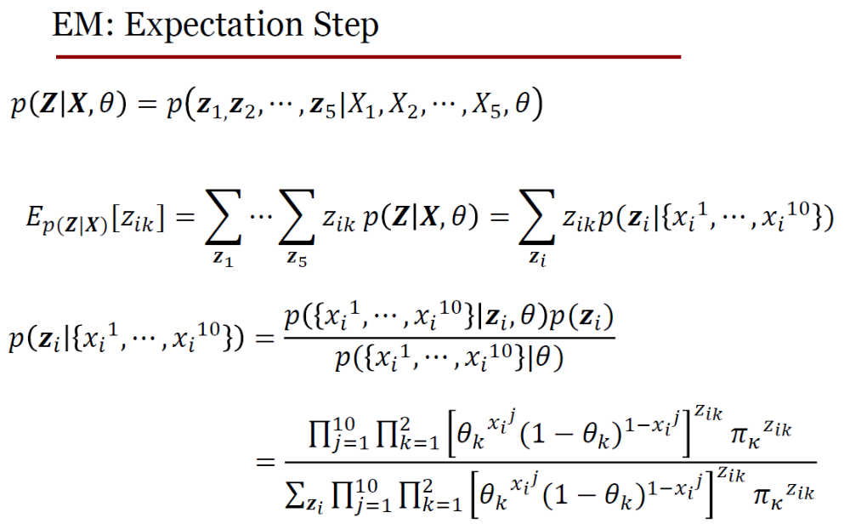

Slide 15
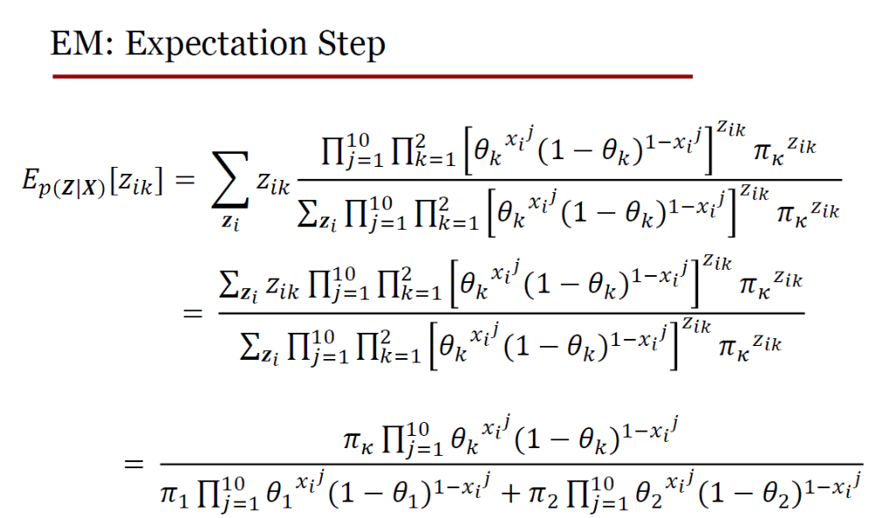

Slide 16
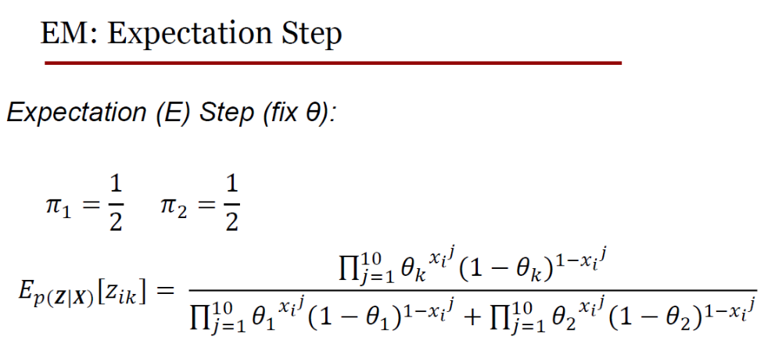

Slide 17
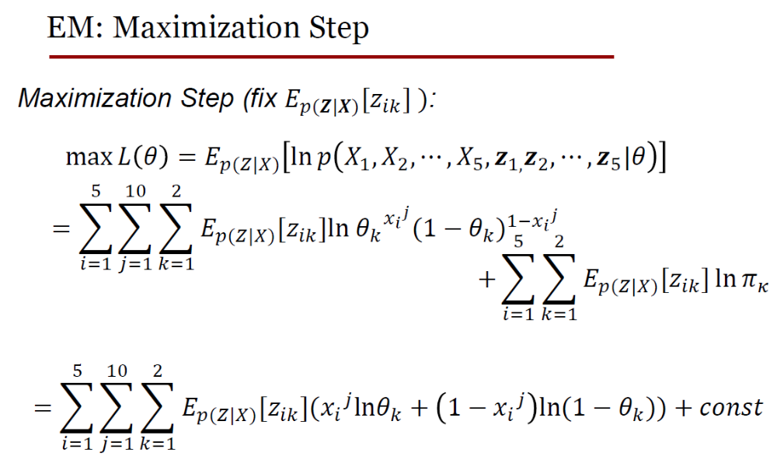

Slide 18
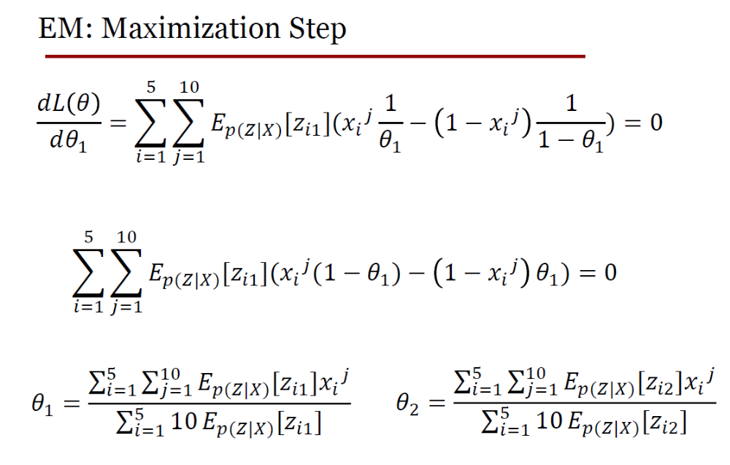

Slide 19
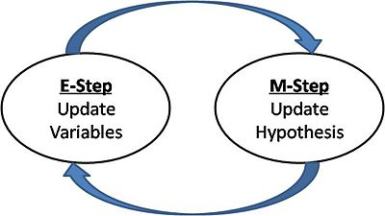
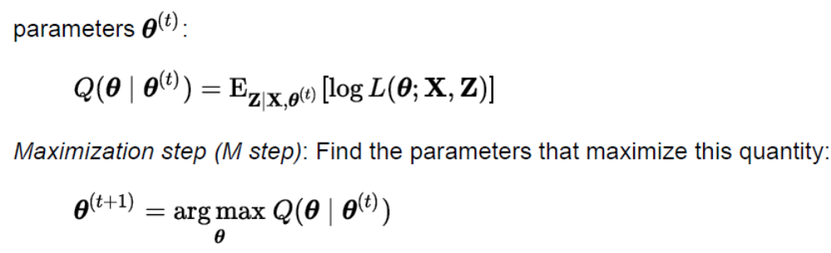
So, what did we just see?

Slide 20

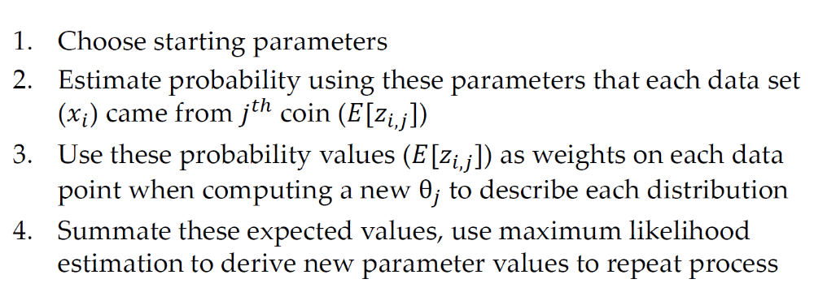

Slide 21
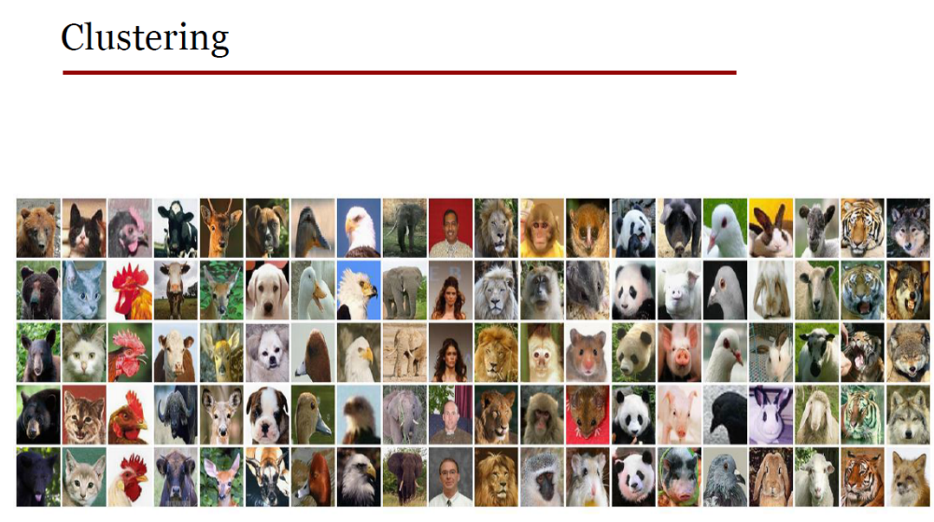

Slide 22
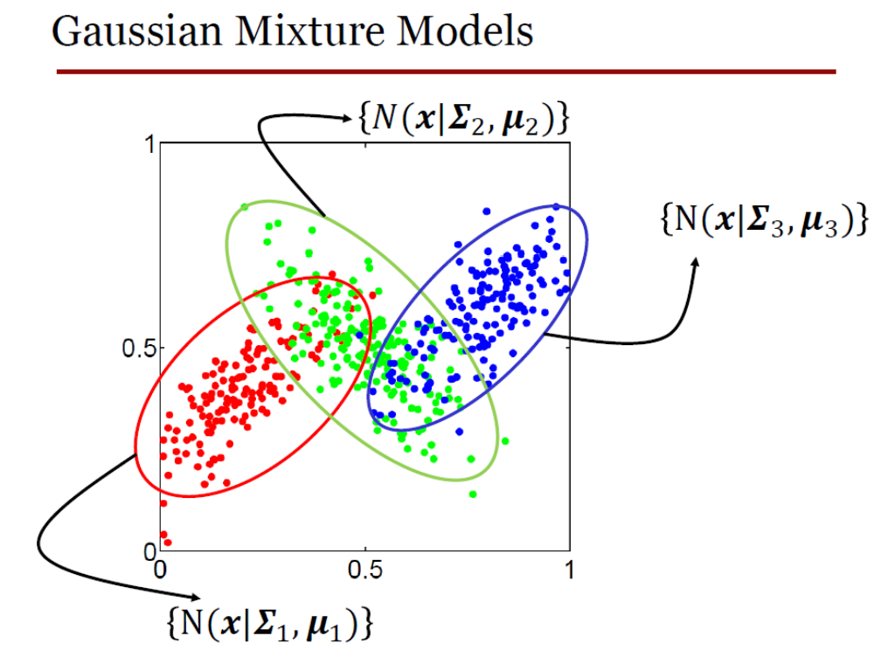

Slide 23
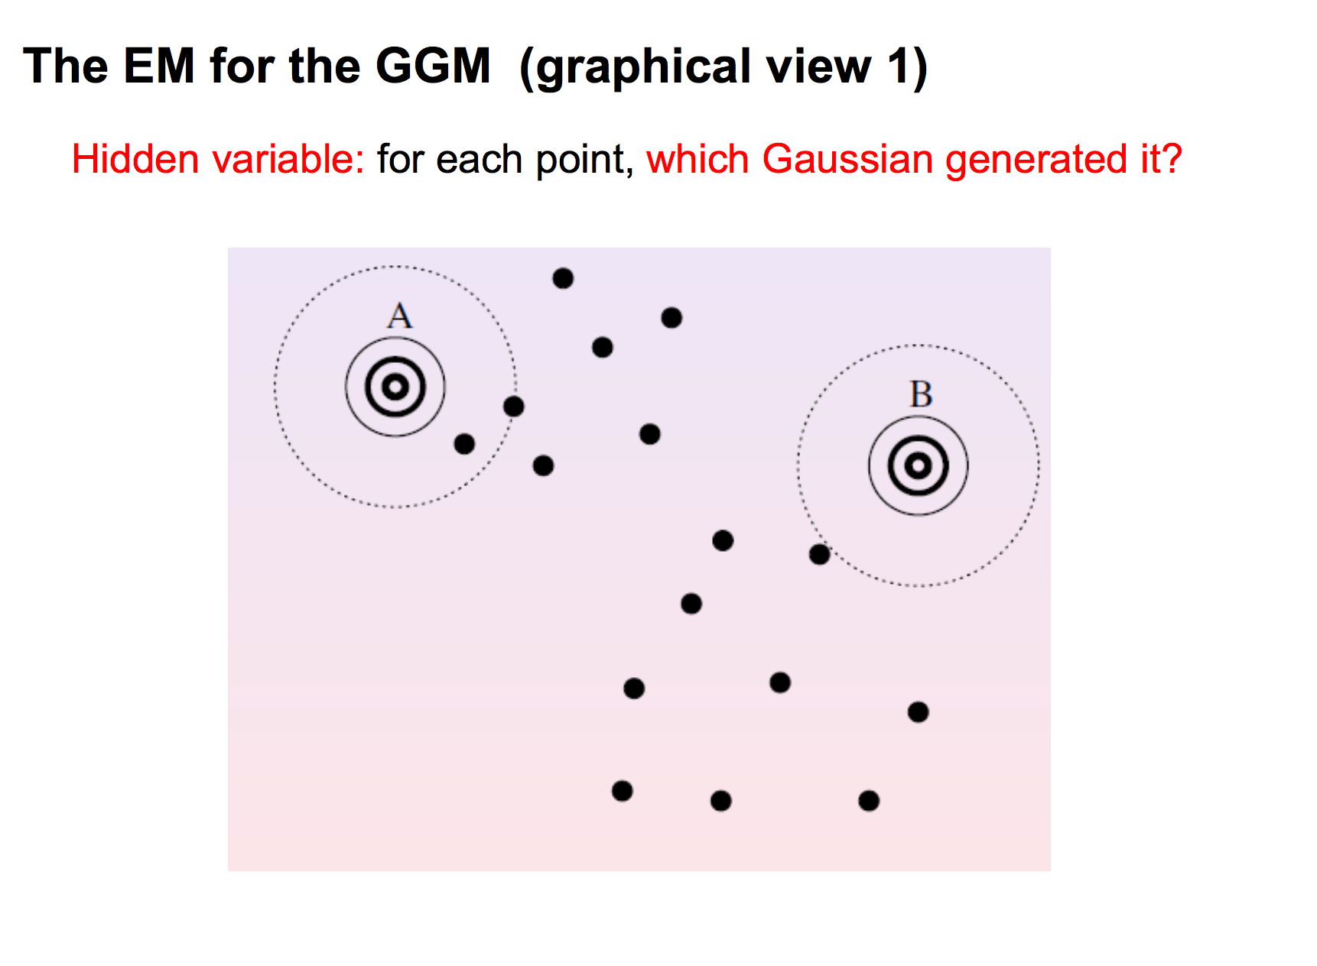
GMM

Slide 24
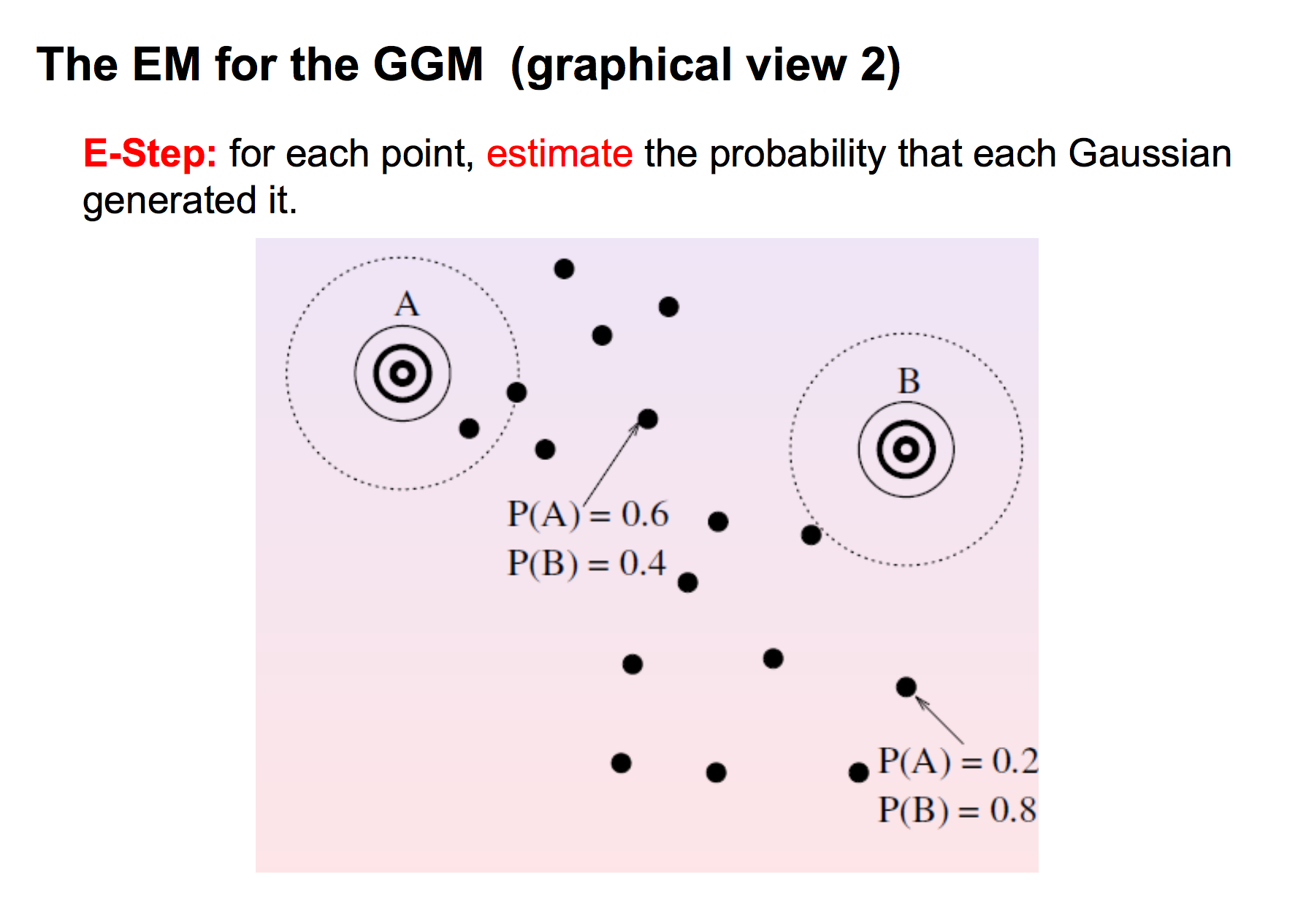
GMM

Slide 25
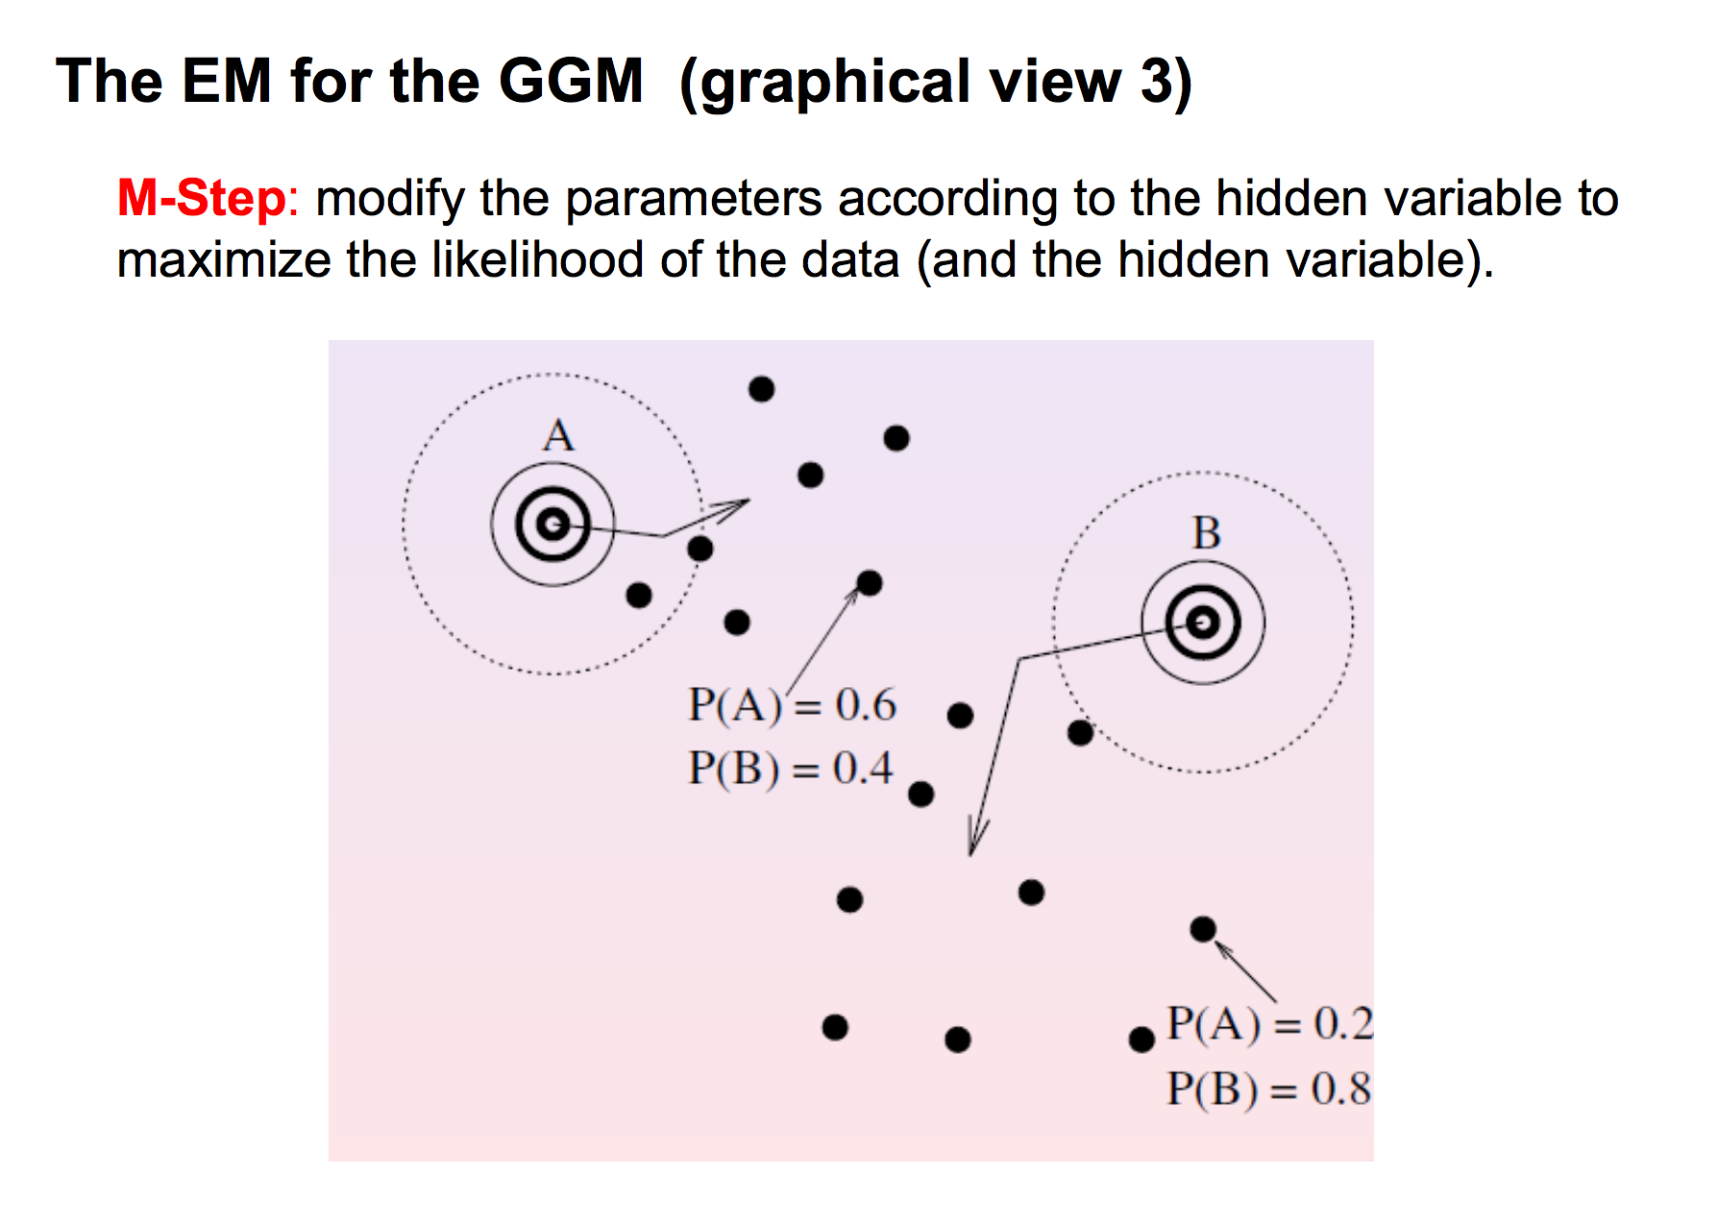
GMM

Slide 26
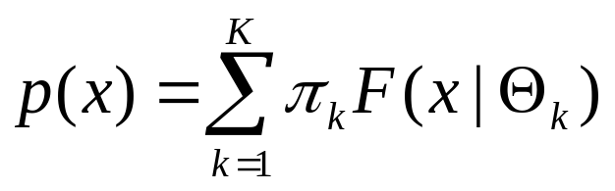
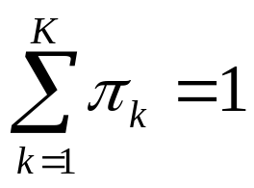
EM algorithm for mixture of Gaussians
What is a mixture of K Gaussians?
with
and F(x|Θ) is the Gaussian distribution with parameters Θ = {μ,Σ}

Slide 27
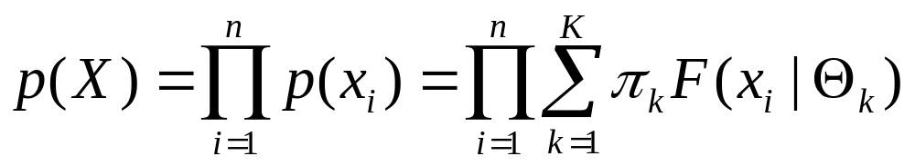
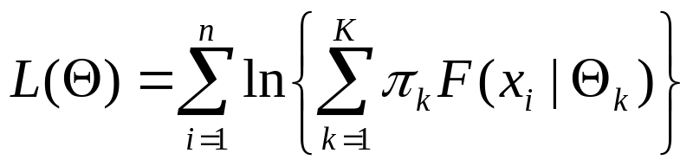
EM algorithm for mixture of Gaussians
If all points xєX are mixtures of K Gaussians then
Goal: Find π₁,…, π_{k} and Θ₁,…, Θ_{k} such that P(X) is maximized
Or, ln(P(X)) is maximized:

Slide 28
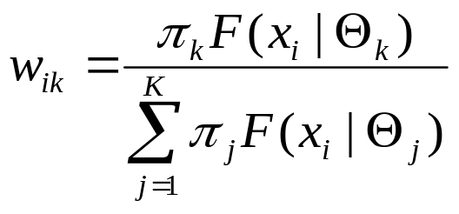
Mixtures of Gaussians -- notes
Every point x_{i} is probabilistically assigned (generated) to (by) the k-th Gaussian
Probability that point x_{i} is generated by the k-th Gaussian is

Slide 29
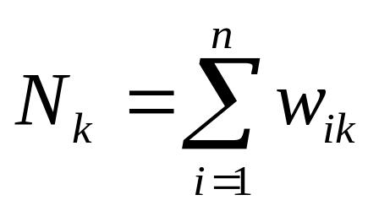
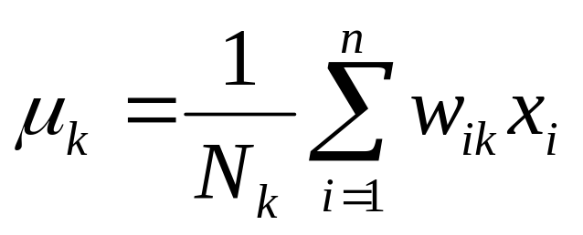
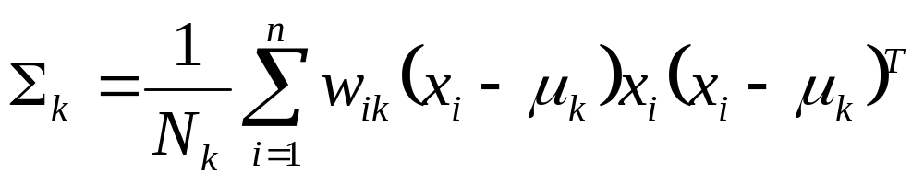
Mixtures of Gaussians -- notes
Every Gaussian (cluster) C_{k} has an effective number of points assigned to it N_{k}
With mean
And variance

Slide 30
EM for Gaussian Mixtures
Initialize the means μ_{k}, variances Σ_{k} (Θ_{k}=(μ_{k},Σ_{k})) and mixing coefficients π_{k}, and evaluate the initial value of the loglikelihood
Expectation step: Evaluate weights

Slide 31
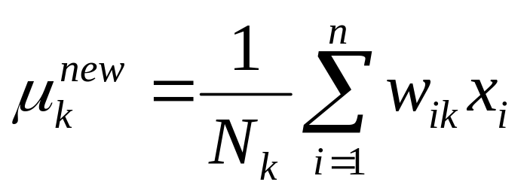
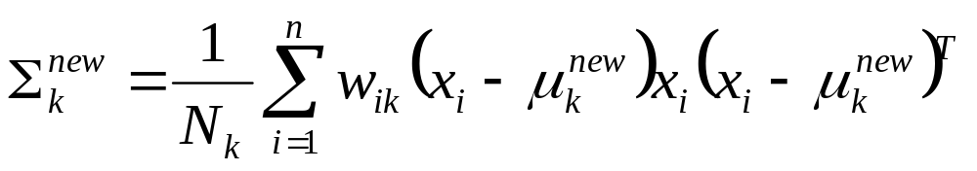
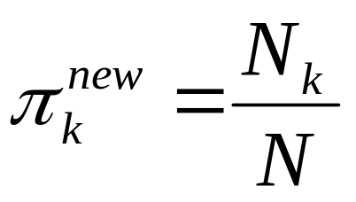
EM for Gaussian Mixtures
Maximization step: Re-evaluate parameters
Evaluate L(Θ^{new}) and stop if converged

Slide 32
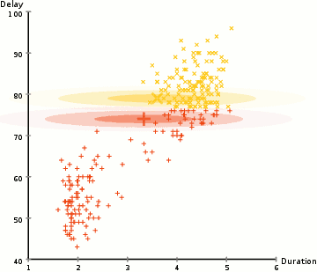
EM clustering of Old Faithful eruption data. The random initial model (which, due to the different scales of the axes, appears to be two very flat and wide spheres) is fit to the observed data. In the first iterations, the model changes substantially, but then converges to the two modes of the geyser. Visualized using ELKI.

