Slide 1
Deadlocks

Slide 2
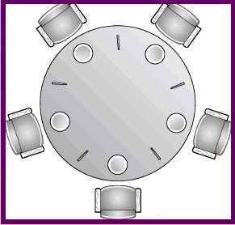
Dining Philosopher
semaphore chopstick[5] = {1,1,1,1,1};
while (1) {
wait(chopstick[(i-1) % 5]);
wait(chopstick[i]);
eat();
signal(chopstick[i]);
signal(chopstick[(i-1) % 5]);
think();
}

Slide 3
Deadlocks
R1
A holds
resource R1
A
B
B holds
resource R2
R2
Consider this situation:

Slide 4
Deadlocks
Resource Allocation Graph
A Deadlock Arises:
Deadlock : A set of processes is deadlocked if each process in the set is waiting for an event that only another process in the set can cause.
R1
A holds
resource R1
B waits for
resource R1
A
B
A waits for
resource R2
B holds
resource R2
R2

Slide 5
System Model
System consists of resources
Resource types R₁, R₂, . . ., R_{m}
CPU cycles, memory space, I/O devices
Each resource type R_{i} has W_{i} instances.
Each process utilizes a resource as follows:
request
use
release

Slide 6
Conditions for Resource Deadlocks
Mutual Exclusion
Each resource is either available or currently assigned to exactly one process
Hold and wait
A process holding a resource, can request another resource
No preemption
Resources previously granted cannot be forcibly taken away from a process
Circular wait
There must be a circular chain of two or more processes, each of which is waiting for a resouce held by the next member of the chain
All four of these conditions must be present for a resource deadlock to occur!!

Slide 7
Resource-Allocation Graph
A set of vertices V and a set of edges E.
V is partitioned into two types:
P = {P₁, P₂, …, P_{n}}, the set consisting of all the processes in the system
R = {R₁, R₂, …, R_{m}}, the set consisting of all resource types in the system
request edge – directed edge P_{i} → R_{j}
assignment edge – directed edge R_{j} → P_{i}

Slide 8
Resource-Allocation Graph
Process
Resource Type with 4 instances
P_{i} requests instance of R_{j}
P_{i} is holding an instance of R_{j}
P_{i}
R_{j}
P_{i}
R_{j}

Slide 9
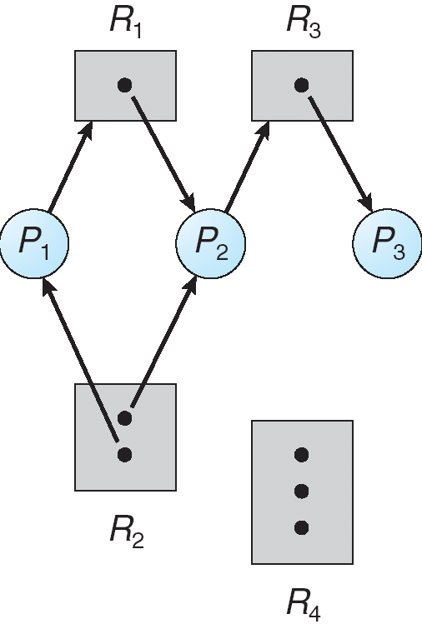
Example of a Resource Allocation Graph

Slide 10
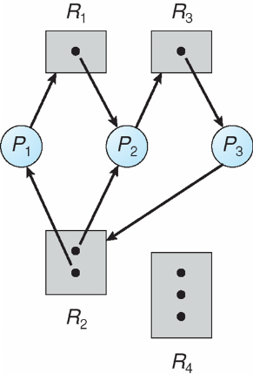
Resource Allocation Graph With A Deadlock

Slide 11
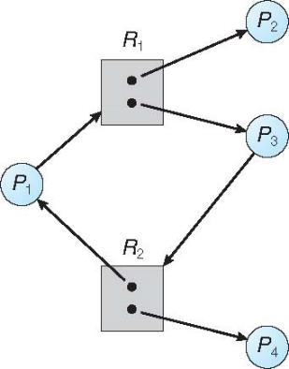
Graph With A Cycle But No Deadlock

Slide 12
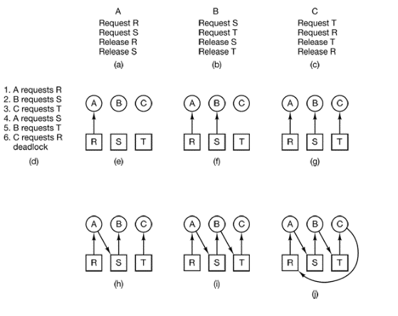
Deadlocks : (A Chanced Event)
Ordering of resource requests and allocations are probabilistic, thus deadlock occurrence is also probabilistic
Deadlock occurs

Slide 13
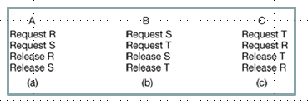
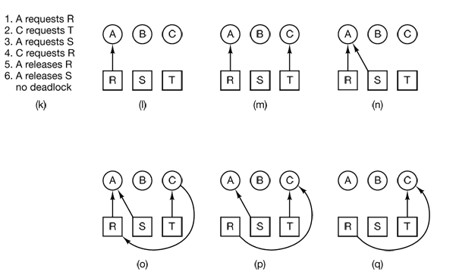
No dead lock occurrence
(B can be granted S
after step q)

Slide 14
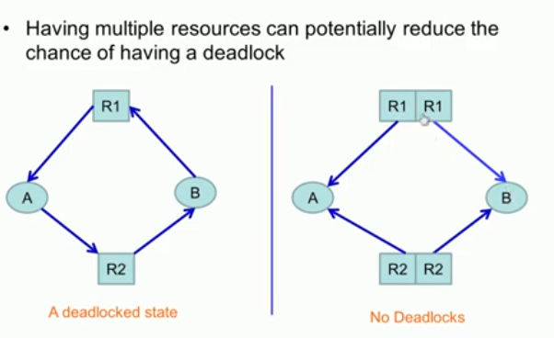
Multiple Resources

Slide 15
Should Deadlocks be handled?
Preventing / detecting deadlocks could be tedious
Can we ignore deadlocks?
Do not detect / prevent deadlocks?
What is the probability of occurrence?
What are the consequences of a deadlock?
How critical is a deadlock?
Can we just reboot the system?
Can we do that always?

Slide 16
Handling Deadlocks
Detection and Recovery
Prevention
Avoidance

Slide 17
Deadlock detection
How can an OS detect when there is a deadlock?
OS needs to keep track of
Current resource allocation
Which process has which resource
Current request allocation
Which process is waiting for which resource
Use this informaiton to detect deadlocks

Slide 18
Deadlock Detection
For systems with one resource of each type, presence of a cycle in the resource allocation graph is both a necessary and sufficient condition for deadlock to happen
For systems with multiple resource instances of a type, possibility of a deadlock
Different algorithm necessary

Slide 19
Deadlocks
Resource Allocation Graph
R1
A holds
resource R1
B waits for
resource R1
A
B
A waits for
resource R2
B holds
resource R2
R2
For systems with one resource of each type, presence of a cycle in the resource allocation graph is both a necessary and sufficient condition for deadlock to happen

Slide 20
Resource Allocation Graph With A Deadlock
For systems with multiple resource instances of a type, possibility of a deadlock

Slide 21
Graph With A Cycle But No Deadlock
For systems with multiple resource instances of a type, possibility of a deadlock

Slide 22
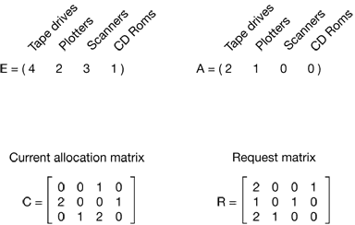

Deadlock Detection
Deadlock detection with multiple resources of each type
Existing Resource Vector
Resources Available
P₁
P₂
P₃
P₁ cannot be satisfied
P₂ cannot be satisfied
P₃ can be satisfied
Current Allocation Matrix
Request Matrix
Process P_{i} holds C_{i} resources and requests R_{i} resources, where i = 1 to 3

Slide 23
Deadlock Detection
Deadlock detection with multiple resources of each type
Existing Resource Vector
Resources Available
P₁
P₂
P₃
Current Allocation Matrix
Request Matrix
P₃ runs and its allocation is (2, 2, 2, 0)
On completion it returns the available resources A = (2 2 2 0)
P₂ can now run.
NO Deadlock!!!

Slide 24
Deadlock Detection
Deadlock detection with multiple resources of each type
Existing Resource Vector
Resources Available
P₁
P₂
P₃
P₁ cannot be satisfied
P₂ cannot be satisfied
2 1 1 0
P₃ cannot be satisfied
deadlock
Current Allocation Matrix
Request Matrix
Process P_{i} holds C_{i} resources and requests R_{i} resources, where i = 1 to 3
Deadlock detected as none of the requests can be satisfied

Slide 25
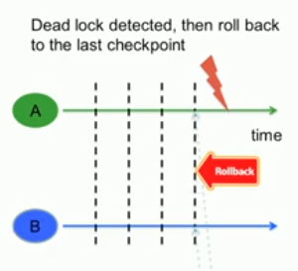
Deadlock Recovery
What should the OS do when it detects a deadlock?
Raise an alarm
Tell users and administrator
Preemption
Take away a resource temporarily (frequently not possible)
Rollback
Checkpoint states and then rollback
Kill low priority process
Keep killing processes until deadlock
is broken
(or reset the entire system)

Slide 26
Handling Deadlocks
Detection and Recovery
Prevention
Avoidance

Slide 27
Prevention
Ensure(s) that at least one of the necessary conditions does not hold
Preventing Mutual Exclusion
Not feasible in practice
But OS can ensure that resources are optimally allocated
Hold and wait
One way is to achieve this is to require all processes to request resources before starting execution
Alternative: whenever a process requests a resource, it does not hold any other resources
Require process to request and be allocated all its resources before it begins execution, or allow process to request resources only when the process has none allocated to it.

Slide 28
Prevention
Ensure(s) that at least one of the necessary conditions does not hold
No preemption
Pre-empt the processes, such as by virtualization of resources
Resources held by Preempted processes are added to the list of resources for which the process is waiting
Circular wait
One way, process holding a resource cannot hold a resource and request for another one
Alternative: Resources types are ordered. Processes must request resources in increasing order

Slide 29
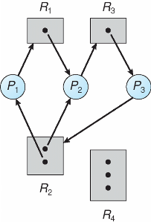
Deadlock Prevention
Restrain the ways request can be made
Hold and Wait – must guarantee that whenever a process requests a resource, it does not hold any other resources
Require process to request and be allocated all its resources before it begins execution, or allow process to request resources only when the process has none allocated to it.
Low resource utilization; starvation possible

