Slide 1
Paging
Additional slide courtesy: Prof. Mandar Mitra

Slide 2
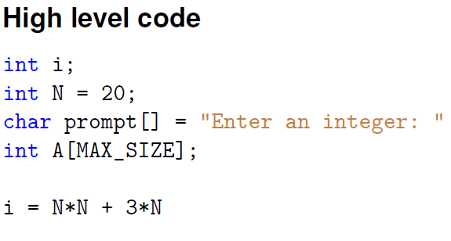
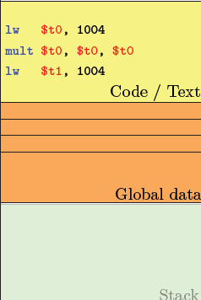

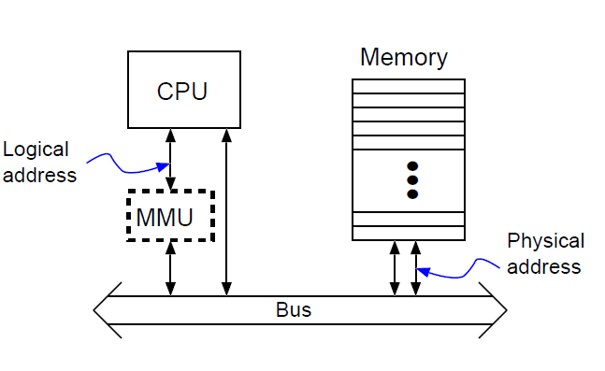

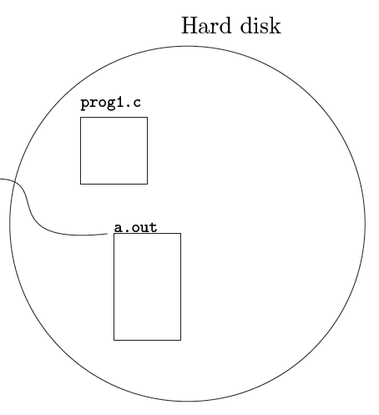
A relook at run-time address binding
Logical address / virtual address → Compiler generated
Physical address → What goes on the bus to address physical memory
Logical Address Space
0
COMPILE
1004
MAX
RUN
14K
15004
LOAD
a.out

Slide 3
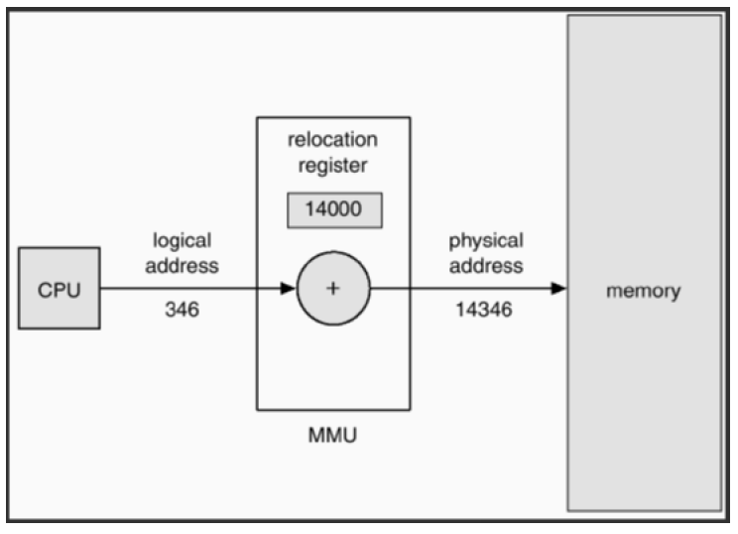
Runtime address binding
14K
1004
15004

Slide 4
Context Switch
Logical Address Space
0
For a.out process
1004
MAX
14K
4004
PCB
a.out

Slide 5
Memory Management Unit
a.out comes back
3K
3000
1004
4004

Slide 6
Paging
Physical address space of a process can be noncontiguous; process is allocated physical memory whenever the latter is available
Avoids external fragmentation
Avoids problem of varying sized memory chunks
Divide physical memory into fixed-sized blocks called frames
Size defined by hardware
Size is power of 2, between 512 bytes and 16 Mbytes
Divide logical memory into blocks of same size called pages
Kernel to keep track of all free frames

Slide 7
Paging
Logical Address Space (LAS)
Physical Address Space (PAS)
s
d
x
s
s
a_{L}
d
x
s
..
2^{m}
Given a logical address a_{L},
compute the page number as
floor (a_{L} / s) and the offset d as a_{L} mod s
If we take s = 2^{n}, then we have the lower
n bits of a_{L} selecting the offset, and the higher bits
selecting the logical page number

Slide 8
Address Translation Scheme
Address generated by CPU is divided into:
Page number (p) – used as an index into a page table which contains base address of each page in physical memory
Page offset (d) – combined with base address to define the physical memory address that is sent to the memory unit
For given logical address space 2^{m} and page size 2^{n}

Slide 9
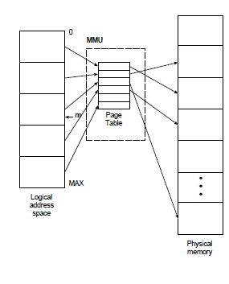
Paging
To run a program of size N pages, need to find N free frames and load program
Set up a page table to translate logical to physical addresses
Still have Internal fragmentation
If things are uniformly distributed, waste about half a page per process
For given logical address space 2^{m} and page size 2^{n}, 2^{m-n} entries in PT

Slide 10

Paging Hardware
Address translation from LAS to PAS done by MMU
Question: Page size depends on OS or hardware dependent?
Question: What all circuits for implementation?

Slide 11
Paging
Logical Address Space
Physical Address Space
s
d
x
s
Addr(f2)
s
a_{L}
d
x
Addr(f6)
s
..
Given a logical address a_{L},
compute the page number as
floor (a_{L} / s) and the offset d as a_{L} % s
If we take s = 2^{n}, then we have the lower
n bits of a_{L} selecting the offset, and the higher bits
selecting the logical page number
Multiplexer
Also, we have all frame addresses as multiples of s (2^{n}), so lower n bits of
Frame address are definitely 0. So addition of page number with d is simply
address concatenation → MMU is very simple.

Slide 12

Paging Example
Logical address: n = 2 and m = 4. Using a page size of 4 bytes and a physical memory of 32 bytes (8 pages)

Slide 13

Free Frames
Implementation?
A simple bit vector?
Before allocation
After allocation

Slide 14
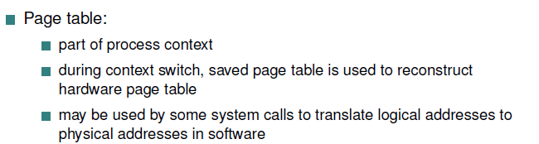
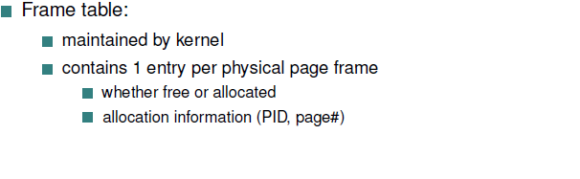
Paging

Slide 15
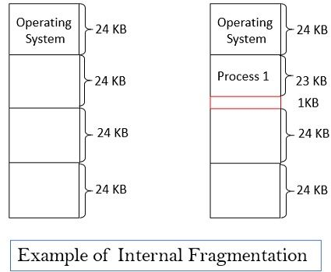
Internal Fragmentation
Internal Fragmentation – allocated memory may be slightly larger than requested memory;
Memory within a partition may be left unused

Slide 16
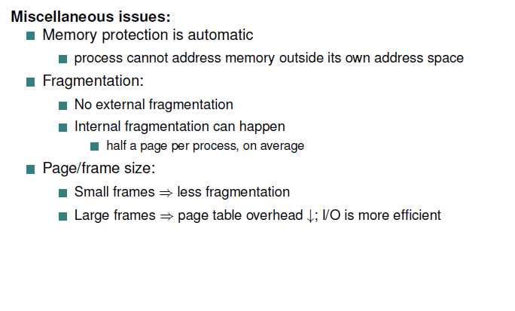
Paging

Slide 17
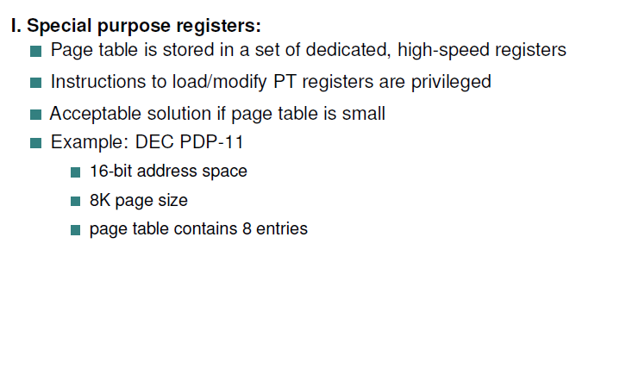
Implementation of Page Table

Slide 18
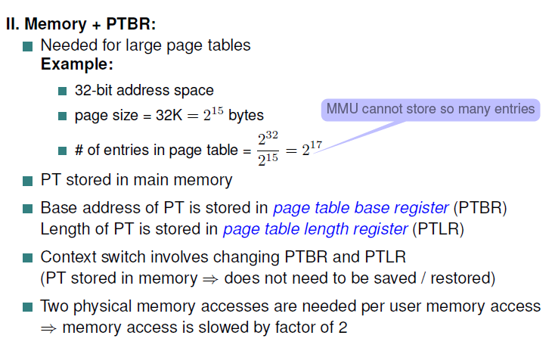
Implementation of Page Table
One for the page table and one for the data / instruction

Slide 19
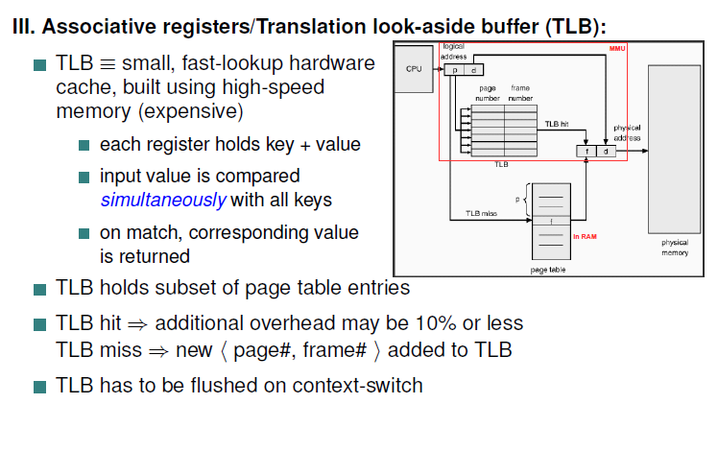
Implementation of Page Table

Slide 20
Translation Look-Aside Buffer
TLBs typically small (64 to 1,024 entries)
On a TLB miss, value is loaded into the TLB for faster access next time
Replacement policies must be considered
Question: What kind of TLB hit ratio do you expect to get?

Slide 21
Effective Access Time
Hit ratio – percentage of times that a page number is found in the TLB
An 80% hit ratio means that we find the desired page number in the TLB 80% of the time.
Suppose that 10 nanoseconds to access memory.
If we find the page in TLB then a mapped-memory access take 10 ns
Otherwise we need two memory access so it is 20 ns
Effective Access Time (EAT): average time for memory access (including TLB lookup)
EAT = 0.80 x 10 + 0.20 x 20 = 12 nanoseconds
implying 20% slowdown in access time
Consider a more realistic hit ratio of 99%,
EAT = 0.99 x 10 + 0.01 x 20 = 10.1ns
implying only 1% slowdown in access time.

Slide 22
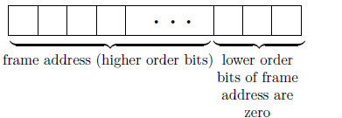
Memory Protection
Memory protection implemented by associating protection bit with each frame to indicate if read-only or read-write access is allowed
Individual process
Example: Jump instruction to a target address
While I am executing an instruction, can I edit my code section during execution?
How does the kernel enforce this?
protection bit checked in parallel with address computation
MMU can raise a memory
exception when needed
Across processes
Automatically ensured
Think: structure of logical
address
Kernel
P1
P2
P1

Slide 23
Valid / Invalid it
Question: What happens if the program generates an invalid logical address?
Last n-bits are 0, use 3 of them to set rd / wr / x permission
One more bit
Valid-invalid bit attached to each entry in the page table:
“valid” indicates that the associated page is in the process’ logical address space, and is thus a legal page (did the compiler map to this page?)
“invalid” indicates that the page is not in the process’ logical address space
Violation causes hardware trap to kernel

Slide 24

Valid (v) or Invalid (i) Bit In A Page Table

Slide 25
Shared Pages
Shared code
One copy of read-only code shared among processes (i.e., text editors, compilers, window systems)
Also useful for interprocess communication if sharing of read-write pages is allowed
Private code and data
Each process keeps a separate copy of the code and data
The pages for the private code and data can appear anywhere in the logical address space

Slide 26

Shared Pages Example

Slide 27
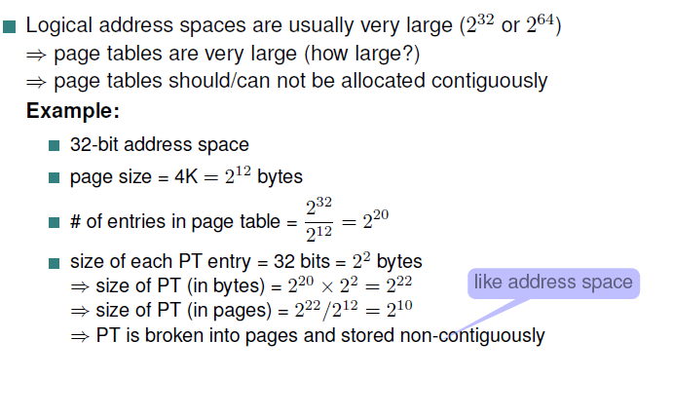
Structure of the Page Table
Multi-level paging I

Slide 28
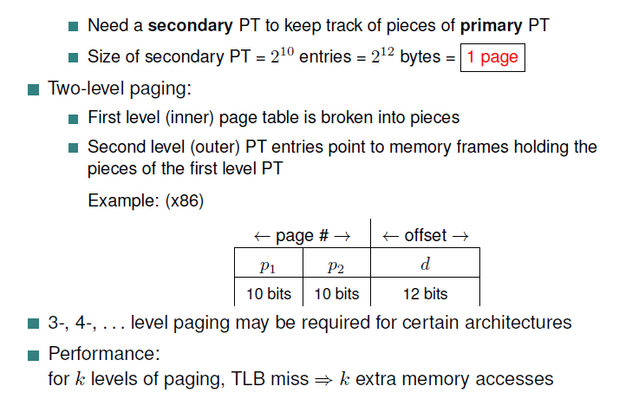
Multi-level paging II / Hierarchical PT
where p₁ is an index into the outer page table, and p₂ is the displacement within the page of the inner page table

Slide 29

2-level Page Table example
Break up the logical address space into multiple page tables
We then page the page table
Known as forward-mapped page table

Slide 30

Address-Translation Scheme

Slide 31
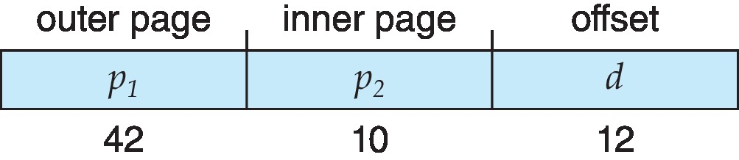
64-bit Logical Address Space
Even two-level paging scheme not sufficient
If page size is 4 KB (2¹²)
Then page table has 2⁵² entries
If two level scheme, inner page tables could be 2¹⁰ 4-byte entries
Address would look like
Outer page table has 2⁴² entries or 2⁴⁴ bytes
One solution is to add a 2nd outer page table
But in the following example the 2nd outer page table is still 2³⁴ bytes in size
And possibly 4 memory access to get to one physical memory location

Slide 32


Three-level Paging Scheme

