Slide 1
Thread (Light Weight Process)
These slides are prepared
On top of textbook slides

Slide 2
Motivation
Most modern applications are multithreaded
Threads run within application
Multiple tasks with the application can be implemented by separate threads
Update display
Fetch data
Spell checking
Answer a network request
Process creation is heavy-weight while thread creation is light-weight
Can simplify code, increase efficiency
Kernels are generally multithreaded

Slide 3
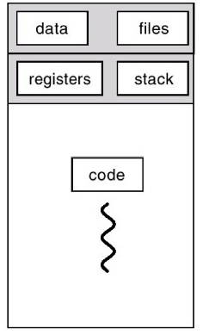
Processes
Separate streams of execution
Each process isolated from the other
Process state contains
Process ID
Environment
Working directory.
Program instructions
Registers
Stack
Heap
File descriptors
Created by the OS using fork
Significant overheads

Slide 4
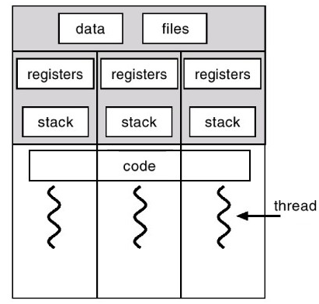
Threads
Separate streams of execution within a single process
Threads in a process not isolated from each other
Each thread state (thread control block) contains
Thread ID
Registers (including PC, EIP, ESP)
Stack
Notes:
When to use threads
--- imagine a piece of code executing in multiplie instances
--- eg. Each webpage in a browser

Slide 5
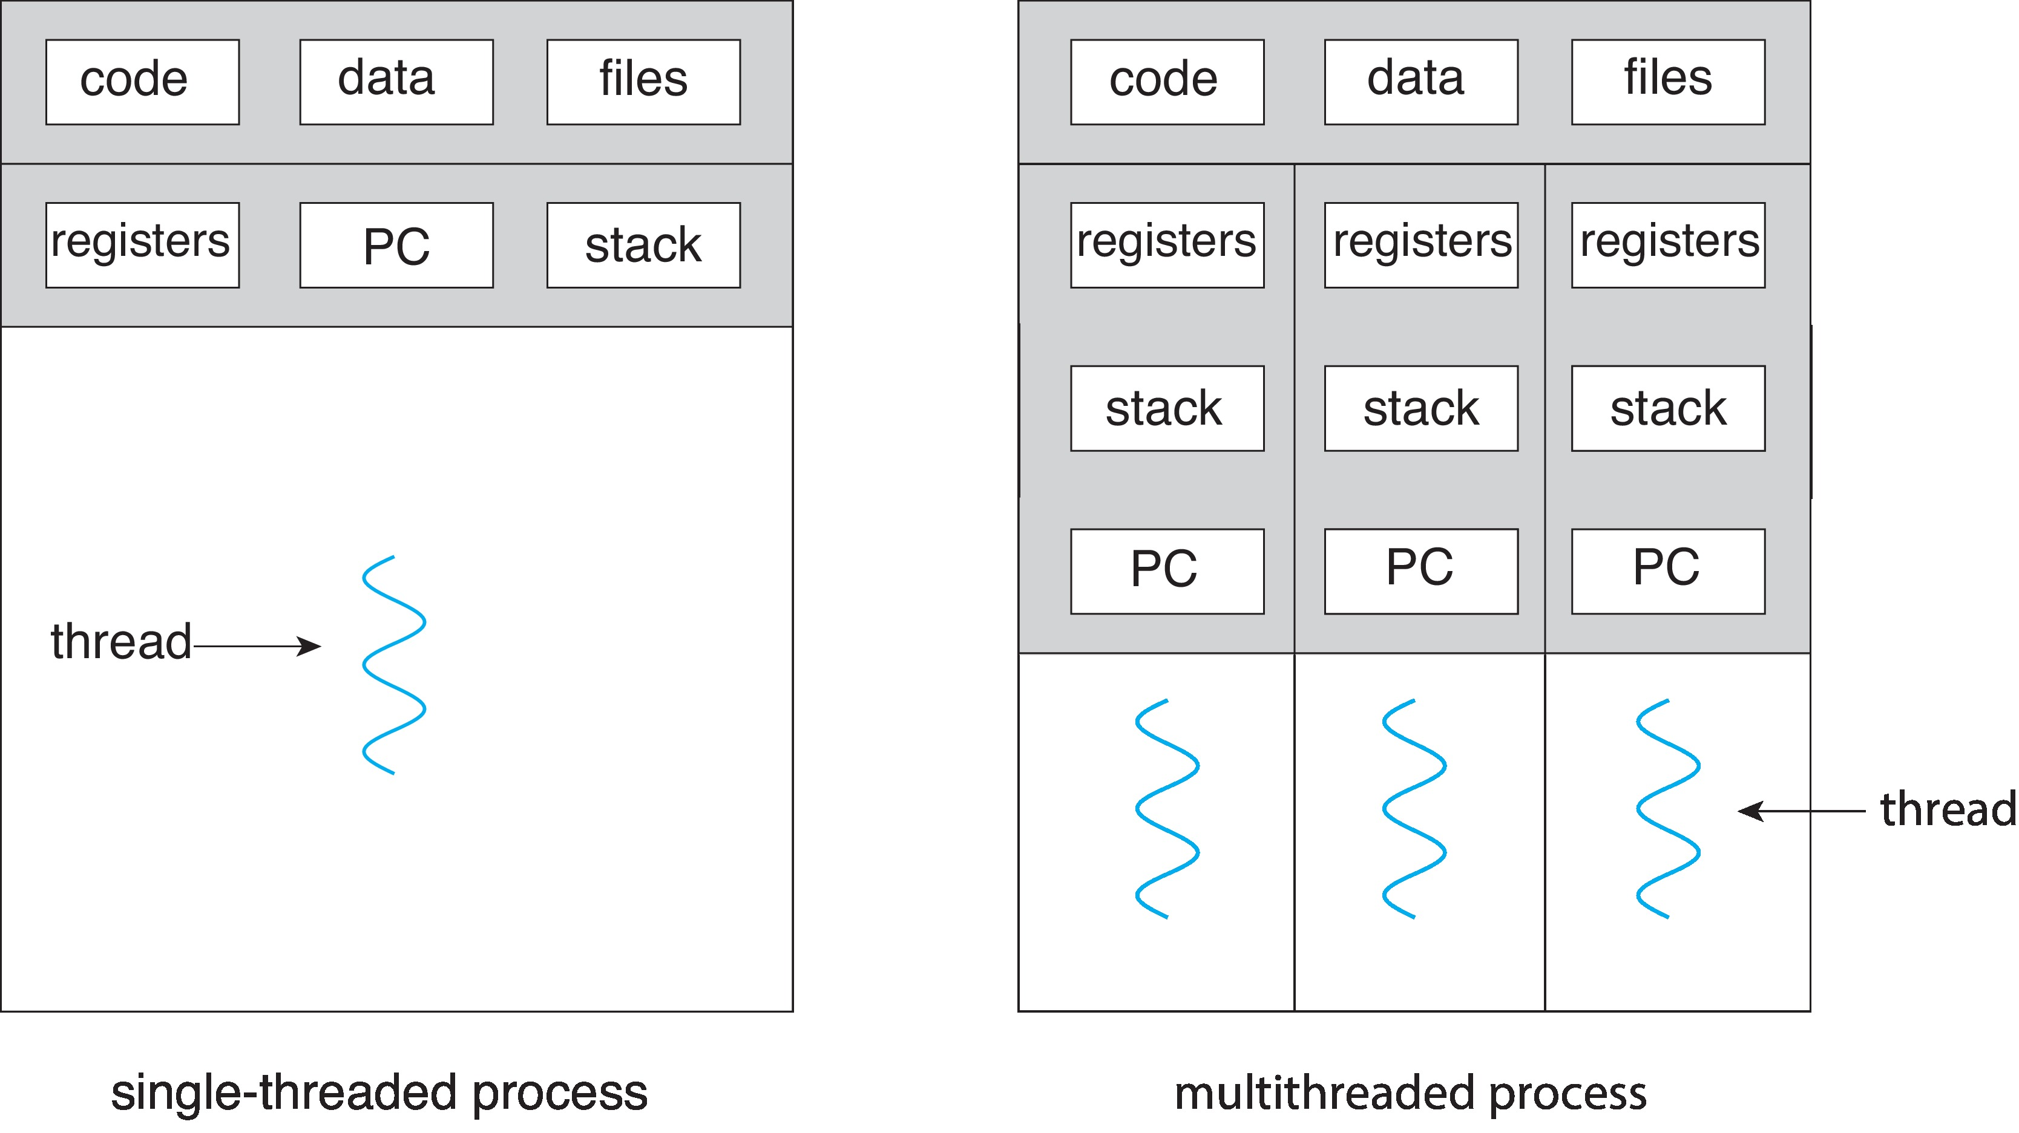
Single and Multithreaded Processes

Slide 6
Thread Control Block
Data Structure in the kernel
Contains thread-specific information needed to manage it
Thread ID: Unique tid (tid) assigned to every thread
State of the thread (running, ready, waiting)
Thread’s register values
Stack pointer: Pointer to the stack of the thread
Pointer to the PCB of the process that created it
Pointer(s) to the other threads that were created by this thread

Slide 7
Threads as Lightweight processes
Threads of same process share
Code Section
Data Section
Resources like open files
Share the address space of the same process
Threads share
Global variables
Dynamically created variables

Slide 8
Threads as Lightweight processes
Process creation is more expensive
Need to set up the entire address space
Allocation involves the MMU
Thread creation is much less expensive
Example: A process already contains 3 threads, another thread created will be running in the same address space of the associated process, share all globals…
Threads can interact without any inter-process communication mechanisms (no pipes, no sockets necessary)
NOTE: Threads DO NOT share the stack – no sharing of local variables
Even if 2 threads call the same function, their stacks are different

Slide 9
Context switch
Process context switch
Load entire PCB contents
Need to change to a different address space
Thread context switch
No need to change address space
Only switch (a) stack (b) register set
Major overhead of address space switching is saved

Slide 10
Motivation
Modern software applications are multi-threaded
Each thread performs a task
User can interact with multiple aspects of the same application
Allows an application to execute multiple similar tasks

Slide 11
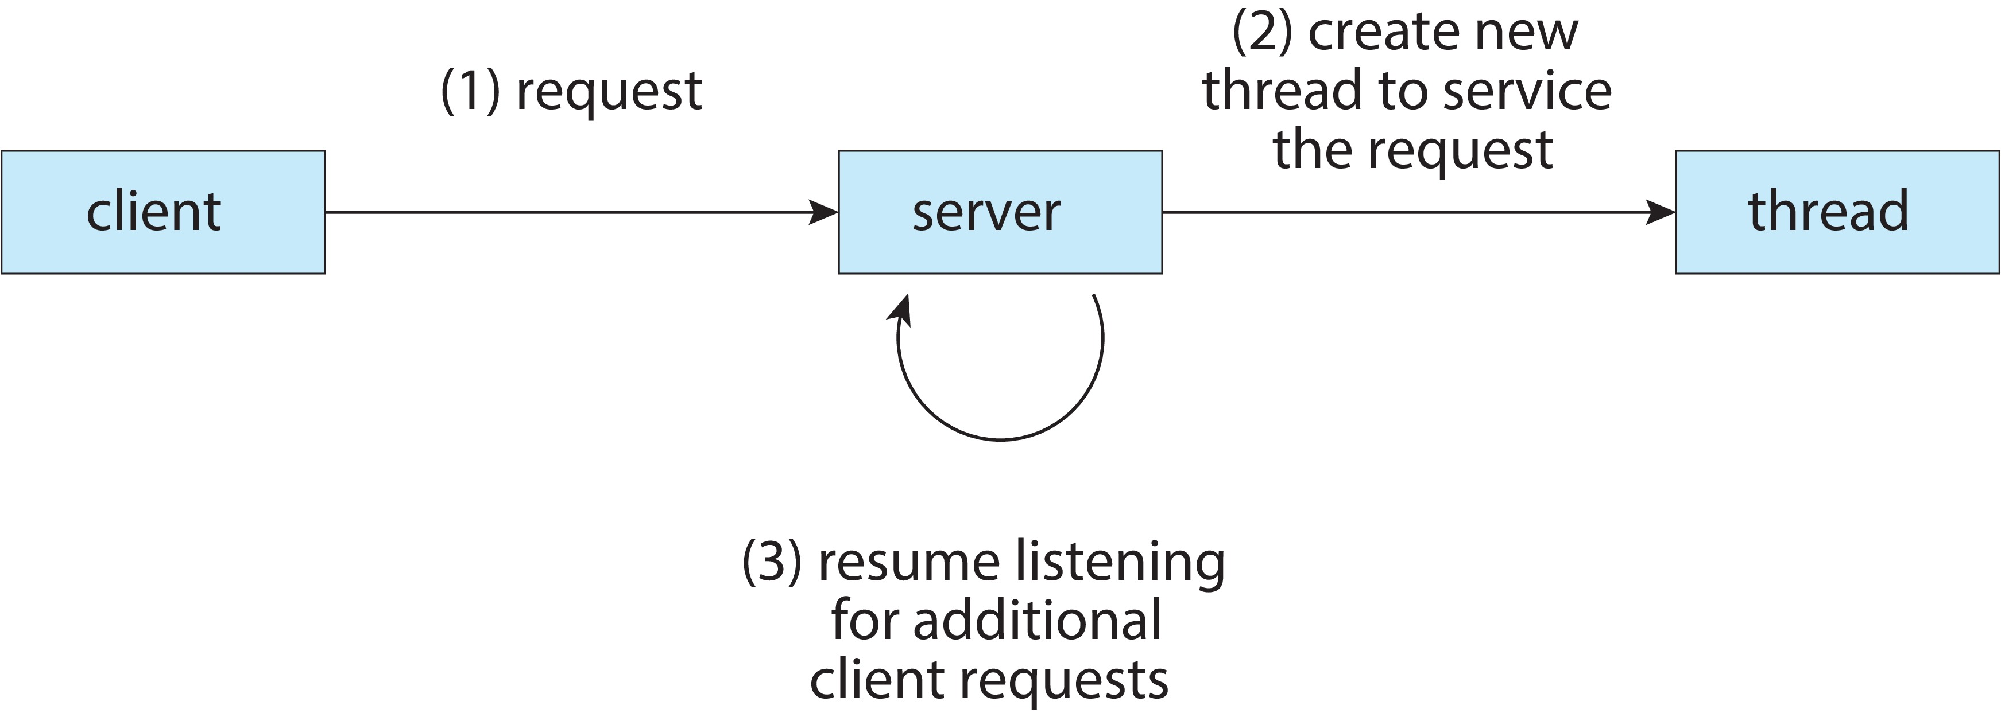
Multithreaded Server Architecture

Slide 12
Threads vs Processes
A thread has no data segment or heap
A thread cannot live on its own. It needs to be attached to a process
There can be more than one thread in a process. Each thread has its own stack
If a thread dies, its stack is reclaimed
A process has code, heap, stack, other segments
A process has at-least one thread.
Threads within a process share the same I/O, code, files.
If a process dies, all threads die.
Benefits: Lightweight, improves responsiveness, simultaneous execution,
One single lengthy task does not block other tasks, less context switching
Overhead, scalability (if multiple cores)

Slide 13
Multicore Programming
Divide an application into several tasks
Assign each task to a thread
Execute each thread on a separate processor (core)
Speedup and Cost benefit (Why?)
Tasks
Dividing activities
Balance
Data splitting
Data dependency
Parallelism implies a system can perform more than one task simultaneously [Requires multiple cores]
Concurrency supports more than one task making progress
Single processor / core, scheduler providing concurrency
Illusion of parallelism

Slide 14
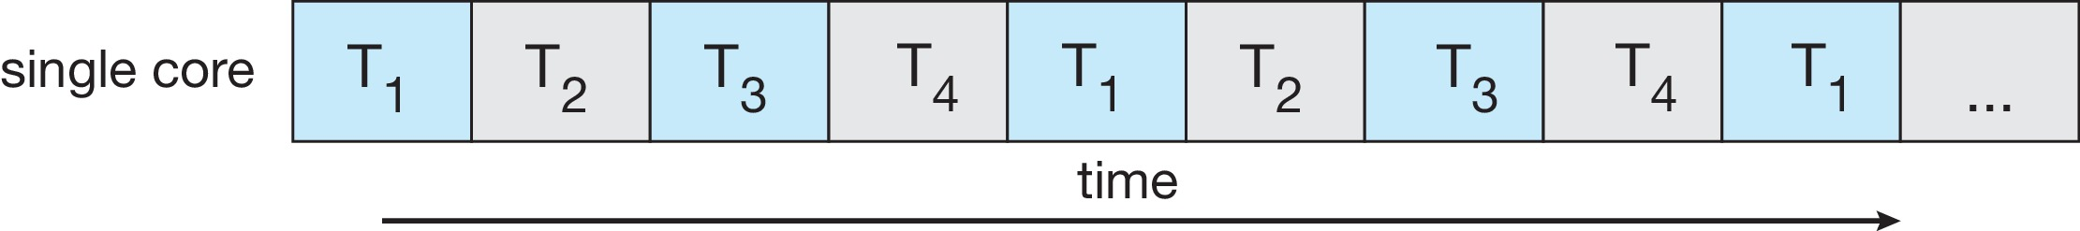
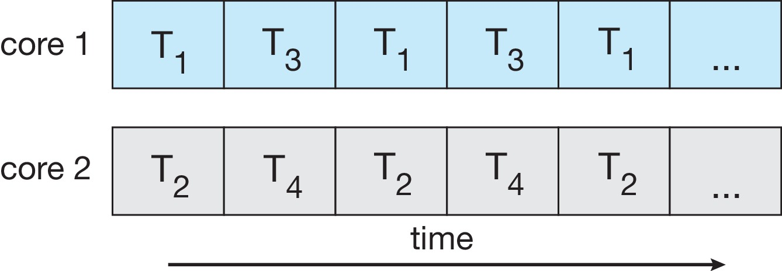
Concurrency vs. Parallelism
Concurrent execution on single-core system:
Parallelism on a multi-core system:

Slide 15
Multicore Programming
Types of parallelism
Data parallelism – distributes subsets of the same data across multiple cores, same operation on each
Task parallelism – distributing threads across cores, each thread performing unique operation
Homework: Study Flynn’s Taxonomy

Slide 16
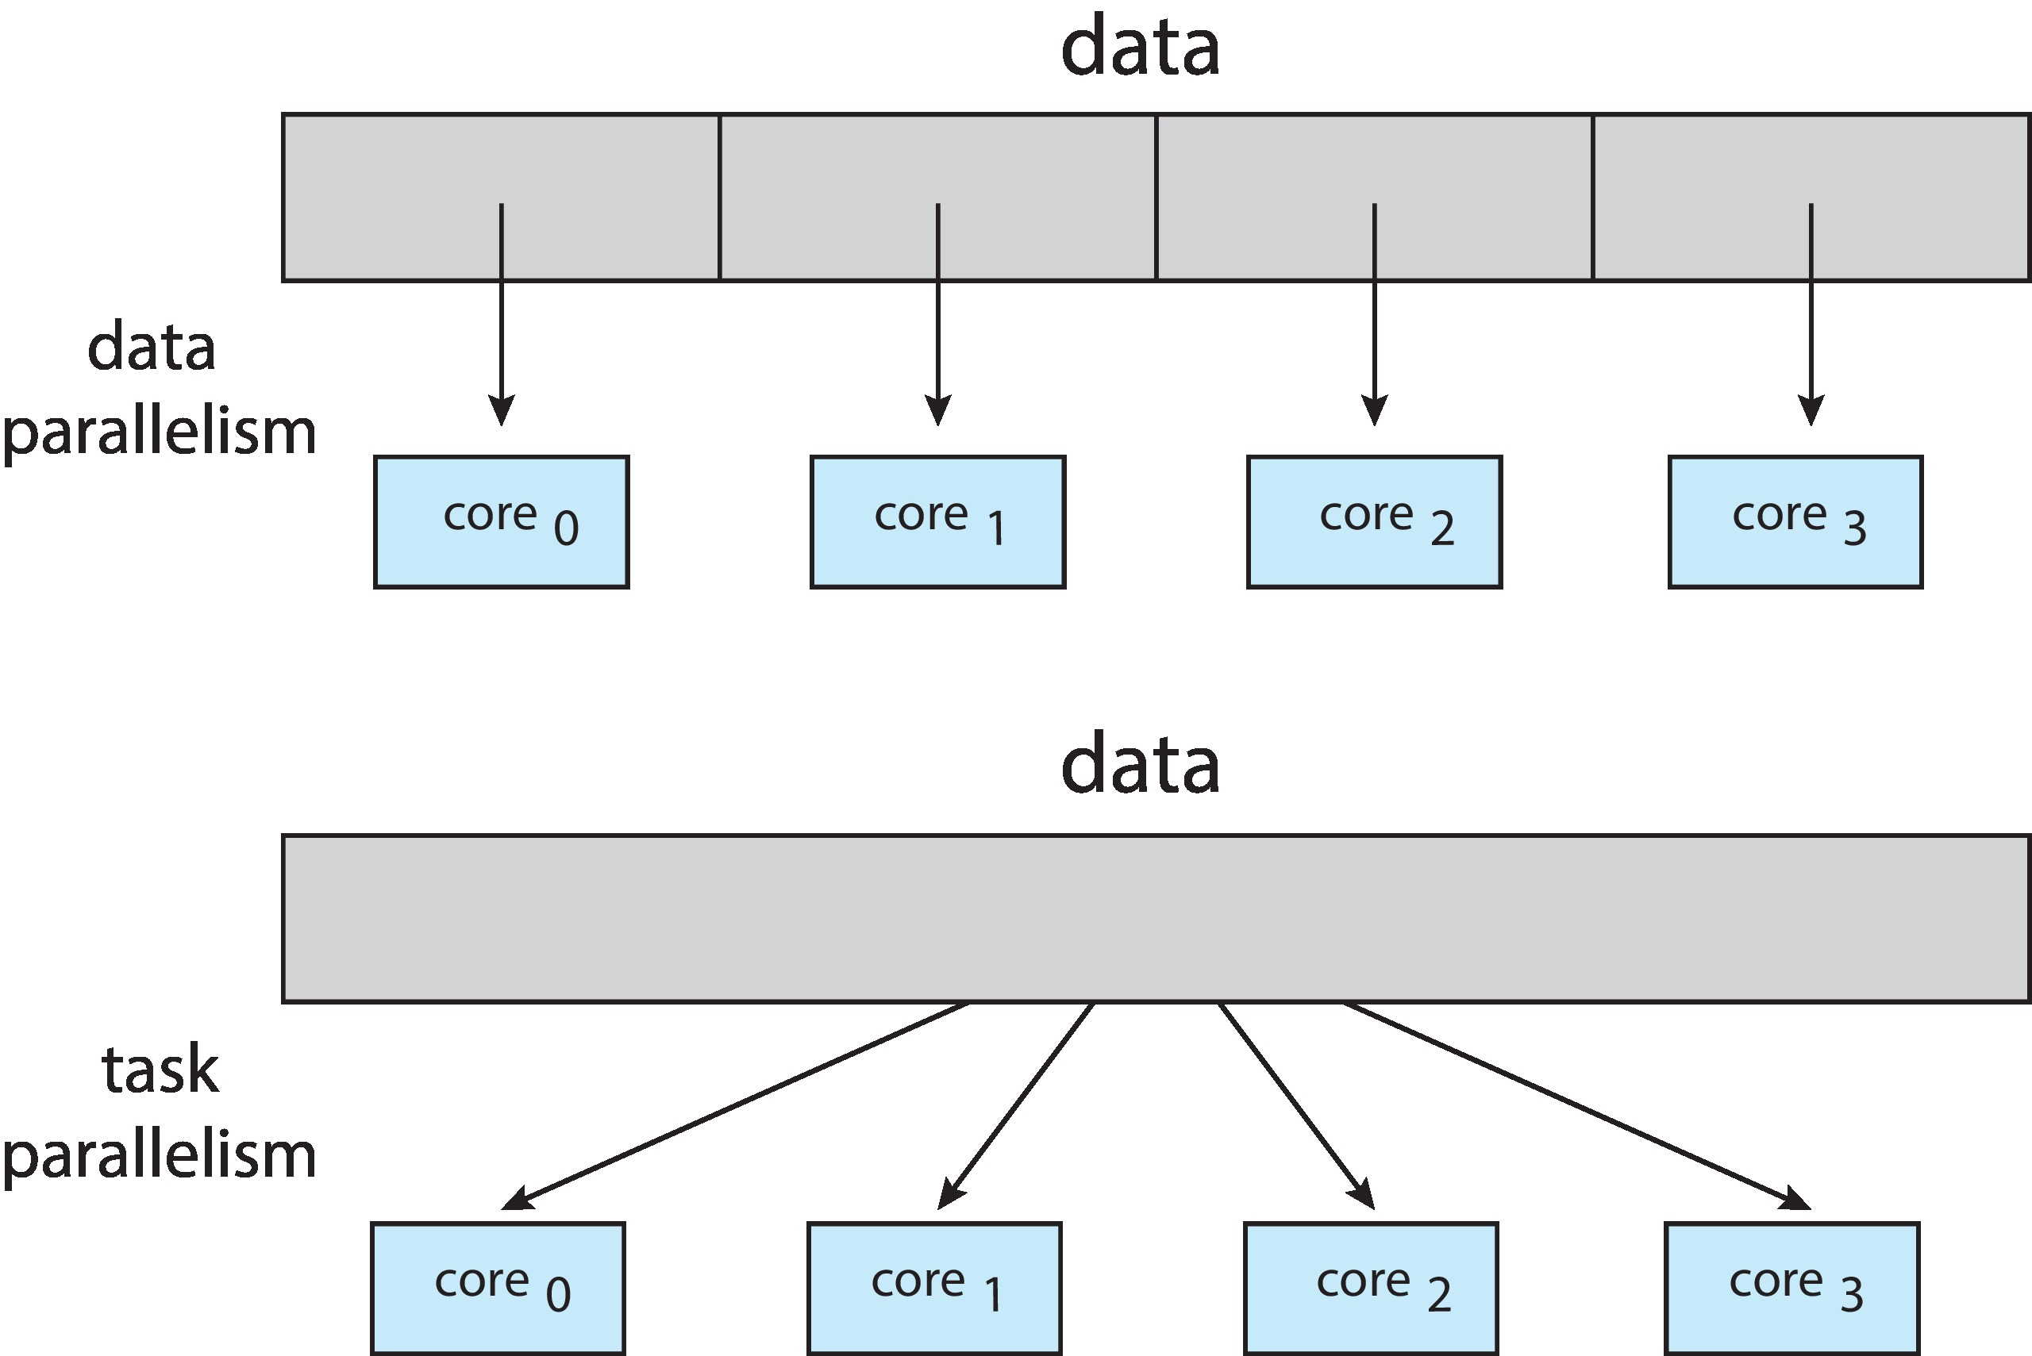
Data and Task Parallelism

Slide 17
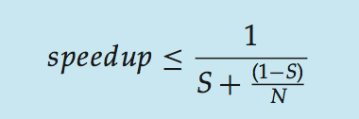
Amdahl’s Law
Identifies performance gains from adding additional cores to an application that has both serial and parallel components
S is serial portion
N processing cores
That is, if application is 75% parallel / 25% serial, moving from 1 to 2 cores results in speedup of 1.6 times
As N approaches infinity, speedup approaches 1 / S
Serial portion of an application has disproportionate effect on performance gained by adding additional cores
But does the law take into account contemporary multicore systems?

Slide 18
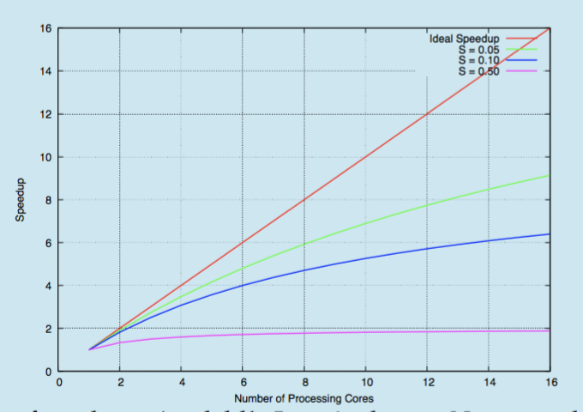
Amdahl’s Law

Slide 19
User Threads and Kernel Threads
User threads - management done by user-level threads library
No kernel support
Not recognized by kernel
All codes and data structures exist in user space
Multithreaded user space process is treated as single-threaded by kernel
One user thread performs a blocking operation → entire application blocks
Thread context switching does not require kernel privileges
Three primary thread libraries:
POSIX Pthreads, Windows threads, Java threads
Kernel threads - Supported by the Kernel
System calls are provided to create and manage threads by OS
All codes and data structure exist in kernel space
Can utilize multiple cores effectively
Multi-threaded application does not block even if one thread blocks
Thread context switching involves kernel
Examples: Windows, Linux, MacOS

Slide 20
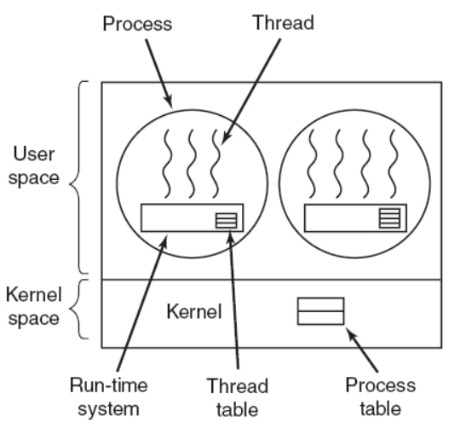
User level threads
Advantages:
Fast (really lightweight)
(no system call to manage threads. The thread library does everything).
Can be implemented on an OS that does not support threading.
Switching is fast. No, switch from user to protected mode.
Disadvantages:
Scheduling can be an issue. (Consider, one thread that is blocked on an IO and another runnable.)
Lack of coordination between kernel and threads. (A process with 1000 threads competes for a timeslice with a process having just 1 thread.)
Requires non-blocking system calls. (If one thread invokes a system call, all threads need to wait)

Slide 21
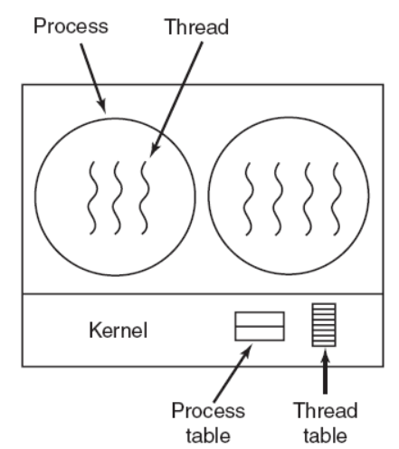
Kernel level threads
Advantages:
Scheduler can decide to give more time to a process having large number of threads than process having small number of threads.
Kernel-level threads are especially good for applications that frequently block.
Disadvantages:
The kernel-level threads are slow (they involve kernel invocations.)
Overheads in the kernel. (Since kernel must manage and schedule threads as well as processes. It require a full thread control block (TCB) for each thread to maintain information about threads.)

Slide 22
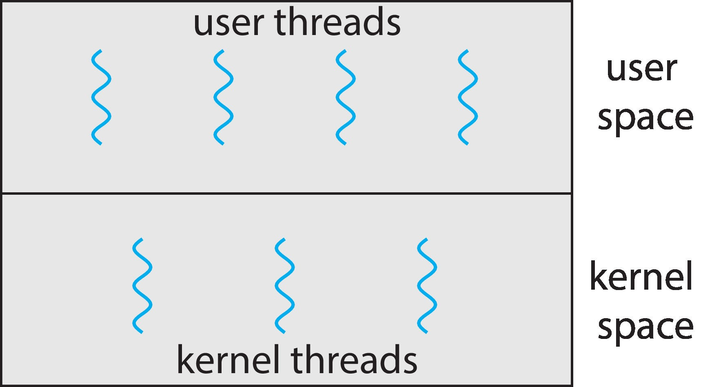
User and Kernel Threads

Slide 23
Multithreading Models
Many-to-One
One-to-One
Many-to-Many

Slide 24
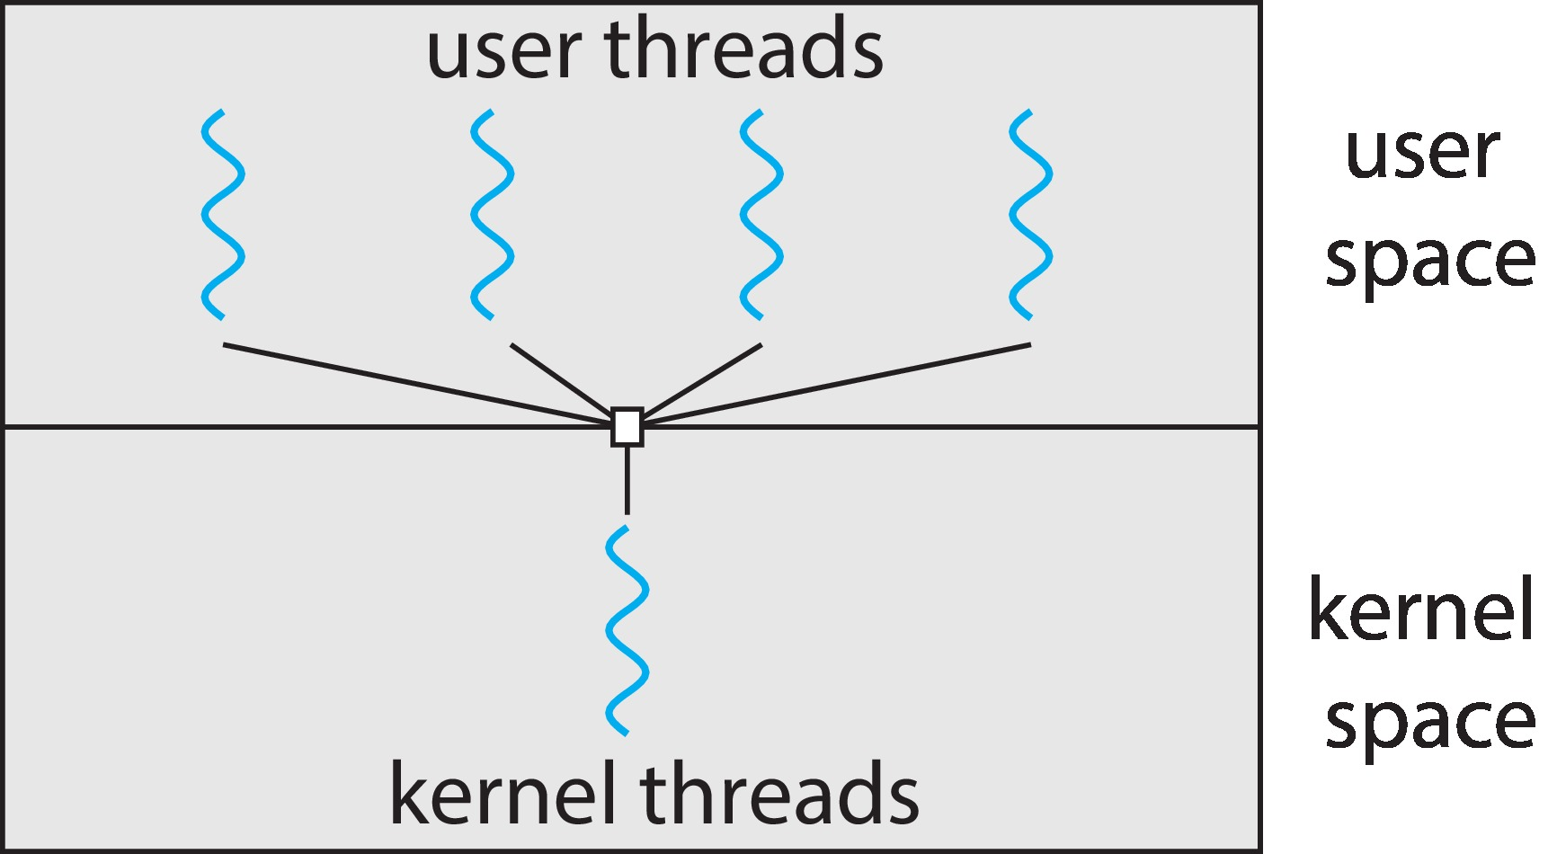
Many-to-One
Many user-level threads mapped to single kernel thread
One thread blocking causes all to block
Multiple threads may not run in parallel on multicore system because only one may be in kernel at a time
Few systems currently use this model
Examples:
Solaris Green Threads
GNU Portable Threads

Slide 25
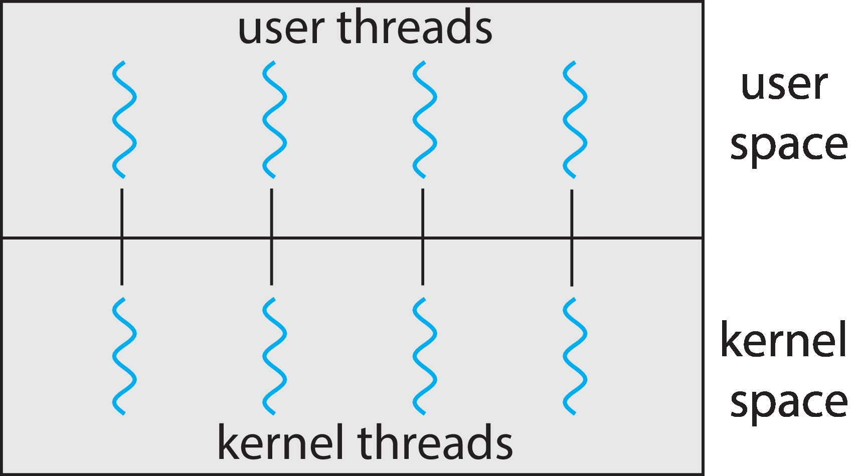
One-to-One
Each user-level thread maps to kernel thread
Creating a user-level thread creates a kernel thread
Some overhead
More concurrency than many-to-one
Number of threads per process sometimes restricted due to overhead
Examples
Windows
Linux

Slide 26
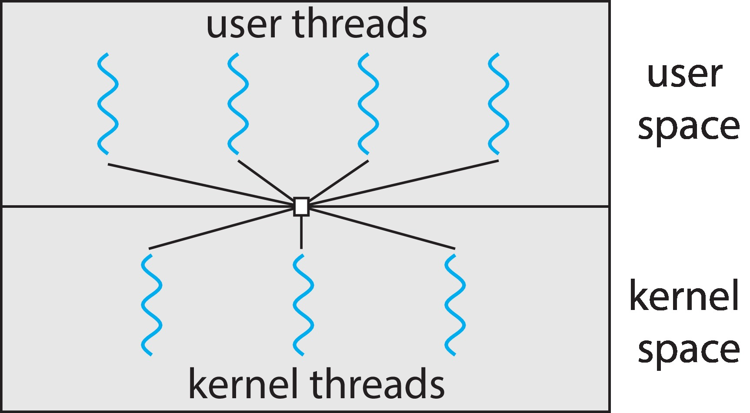
Many-to-Many Model
Allows many user level threads to be mapped to many kernel threads
Allows the operating system to create a sufficient number of kernel threads
Windows with the ThreadFiber package
Otherwise not very common

Slide 27
Pthreads
May be provided either as user-level or kernel-level
A POSIX standard (IEEE 1003.1c) API for thread creation and synchronization
Specification, not implementation
API specifies behavior of the thread library, implementation is up to development of the library
Common in UNIX operating systems (Linux & Mac OS X)

Slide 28
Pthreads Data stucture
pthread_t: used to identify a thread
Defined in pthread.h
Should be an opaque data type (not any specific primitive data type)
Actual implementation of pthread_t can be (a) any data type (b) structure
pthread_attr_t
Thread attributes object
Defined in pthread.h
Attributes
Detach state
Scope
Stack address
Stack size
Scheduling policy
Scheduling priority

Slide 29
Thread functions
int pthread_attr_init (pthread_attr_t *attr);
Takes the thread attributes object pointed to by attr
Initializes this object using default attribute values
On success, returns 0
On failure, non-zero error number
int pthread_attr_destroy (pthread_attr_t *attr);
Destroy the thread attributes object pointed to by attr
Done when the object when is no longer needed
Have to reinitialize it if destroyed again
On success, returns 0, while a non-zero error number on failure indicating what kind of error has happened

Slide 30
pthread library
Create a thread in a process
int pthread_create(pthread_t *thread,
const pthread_attr_t *attr,
void *(*start_routine) (void *),
void *arg);
New thread starts execution by invoking start_routine()
arg is passed to start_routine()
Destroying a thread
void pthread_exit(void *retval);
Can return a value to waiting threads about its exit status
Thread identifier (TID) much like
Pointer to a function, which starts execution in a different thread
Arguments to the function
Exit value of the thread
Notes:
Attribute → thread attributes,,, can for instance set stack size, scheduling policy

Slide 31
pthread library contd.
Join : Wait for a specific thread to complete
int pthread_join(pthread_t thread, void **retval);
If retval is not NULL, exit status of target thread (thread) is coped into the location pointed to by retval
On success, returns 0, returns non-zero error number if error
TID of the thread to wait for
Exit status of the thread
Notes:
Attribute → thread attributes,,, can for instance set stack size, scheduling policy
Difference with wait..
Wait waits only for child process.
Thread can wait for any other thread

Slide 32
pthread library contd.
int pthread_equal(pthread_t thread1, pthread_t thread2);
Compares 2 thread IDs
Returns a non-zero value if the two thread IDs are equal, otherwise 0
Notes:
Attribute → thread attributes,,, can for instance set stack size, scheduling policy
Difference with wait..
Wait waits only for child process.
Thread can wait for any other thread

Slide 33
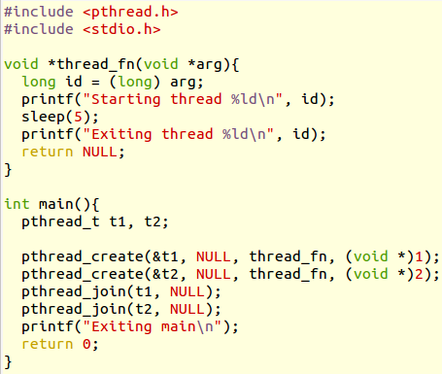
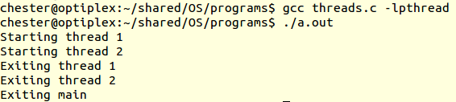
Example
How many threads are there in this program?
3
Note. You need to link the
pthread library

Slide 34
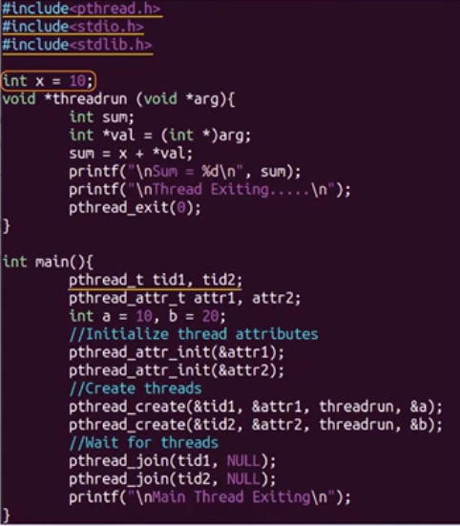
…

Slide 35
Example
main
join(t1)
t1
t2
join(t2)

Slide 36
Pthreads Code for Joining 10 Threads

Slide 37
Implicit Threading
Growing in popularity as numbers of threads increase, program correctness more difficult with explicit threads
Creation and management of threads done by compilers and run-time libraries rather than programmers
Five methods explored
Thread Pools
Fork-Join
OpenMP
Grand Central Dispatch
Intel Threading Building Blocks

Slide 38
Typical usage of threads
Event?
event occurred
No event occurred
create thread
Service
event
terminate
thread
Creating and terminating thread lead to overheads

Slide 39
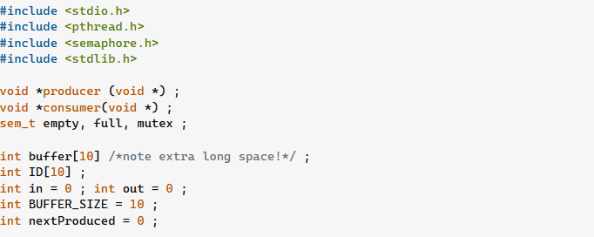
Producer Consumer

Slide 40
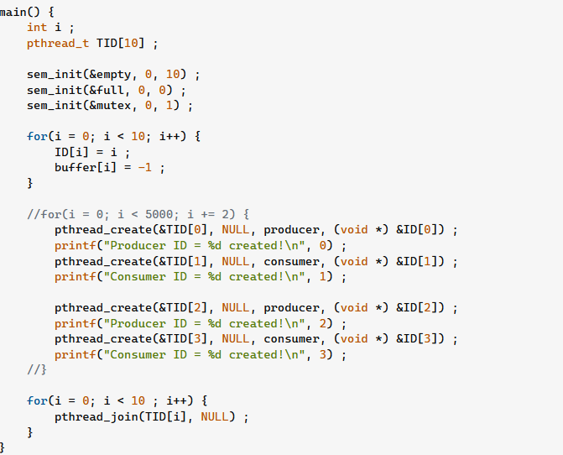

Slide 41
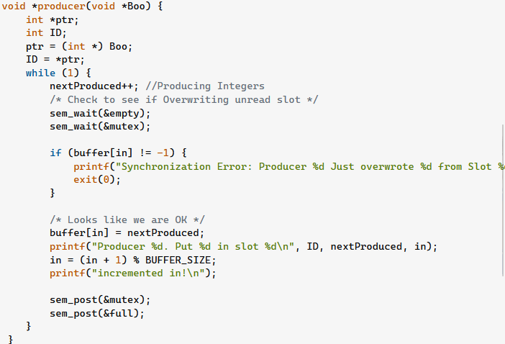

Slide 42
