Slide 1
Segmentation i386 (linux)
Additional slide courtesy: Prof. Mandar Mitra

Slide 2
Other Considerations
Reserve frames
Kernel maintains small reserve pool of free frames
When a page fault occurs, a frame is allocated from the reserve
Identifies page to be replaced in the background
Schedules write to disk for the dirty page
Adds frame to free frame pool when disk write completes
Process can start early
Pre-paging – Bringing in pages in anticipation
Page size – Tradeoffs?
TLB reach

Slide 3
TLB Reach
TLB Reach - The amount of memory accessible from the TLB
TLB Reach = (TLB Size) X (Page Size)
Ideally, the working set of each process is stored in the TLB
Otherwise there is a high degree of page faults
Increase the Page Size
This may lead to an increase in fragmentation as not all applications require a large page size
Provide Multiple Page Sizes
This allows applications that require larger page sizes the opportunity to use them without an increase in fragmentation

Slide 4
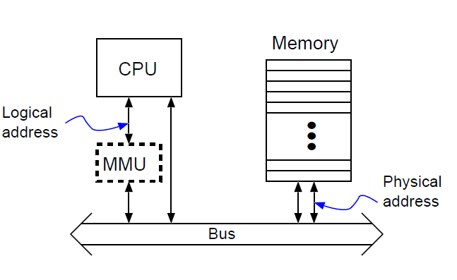
The bigger picture
Fetch Page Table Entry for address translation
Case 1.1: TLB hit
Case 1.2: TLB miss
Fetch PT entry (multiple levels possible) → PF possible
2. Is page in physical memory?
Case 2.1: Yes
Case 2.2: No → PF possible
3. Access Physical Memory

Slide 5
An alternative view of Memory Management
Segmentation
Demand Segmentation

Slide 6
Segmentation
Segmentation is a memory-management scheme that supports programmer view of memory (reference: sections in a.out) and the logical address space is divided into collection of segments.
Segmentation permits the physical address space of a process to be noncontiguous.
Each segment has a section identifier and a length. The addresses specify both the segment identifier and the offset within the segment.
The maximum number of segments is determined by hardware
Thus, a logical address consists of a two tuple:
<segment-number, offset>.

Slide 7
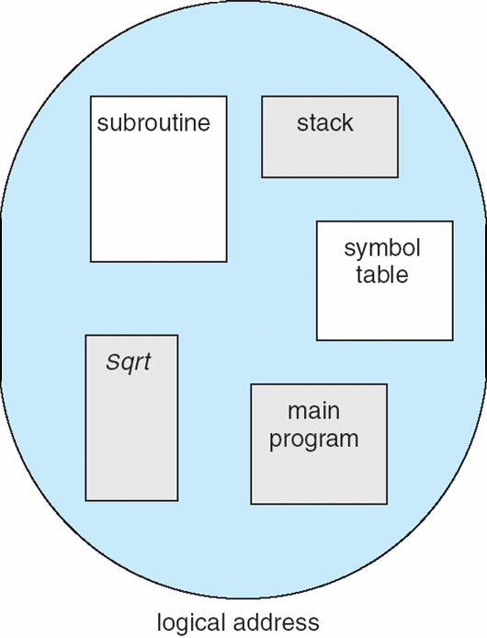
Segmentation
Compiler might create separate segments for the following:
1. The code
2. Global variables
3. The heap, from which memory is allocated
4. The stacks used by each thread
5. The standard C library
User’s View of a Program

Slide 8
Segmentation Hardware
Logical address consists of a two tuple:
<segment-number, offset>
Segment table – maps two-dimensional physical addresses; each table entry:
base – contains the starting physical address where the segments reside in memory.
limit – specifies the length of the segment.
Recall: Protection in paging (maximum offset?)
Can refer to a large offset in logical address now
Permission bits
Segment-table base register (STBR) points to the segment table’s location in memory / Keep the Segment table in MMU registers
Segment-table length register (STLR) indicates number of segments used by a program;
segment number s is legal if s < STLR.

Slide 9
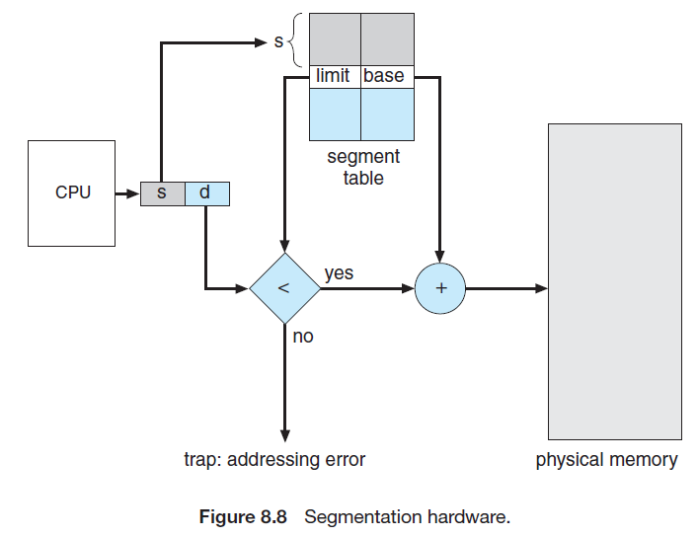
Kernel’s role: Segmentation Check
Demand Segmentation: When loading a segment, kernel has to find a
large enough contiguous chunk in RAM where the segment can be accommodated
External Fragmentation still remains (no internal fragmentation)
Full contiguous allocation was 1 piece per process, now multiple pieces
Segment table will be part of process context

Slide 10
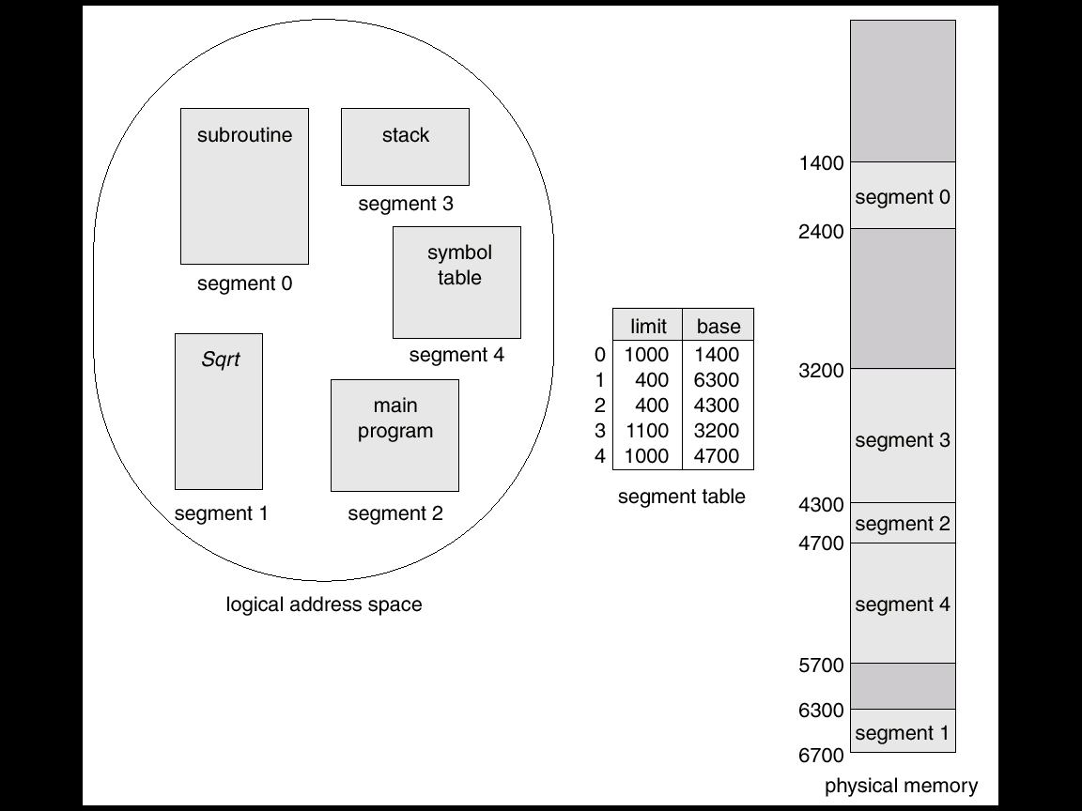
Example

Slide 11
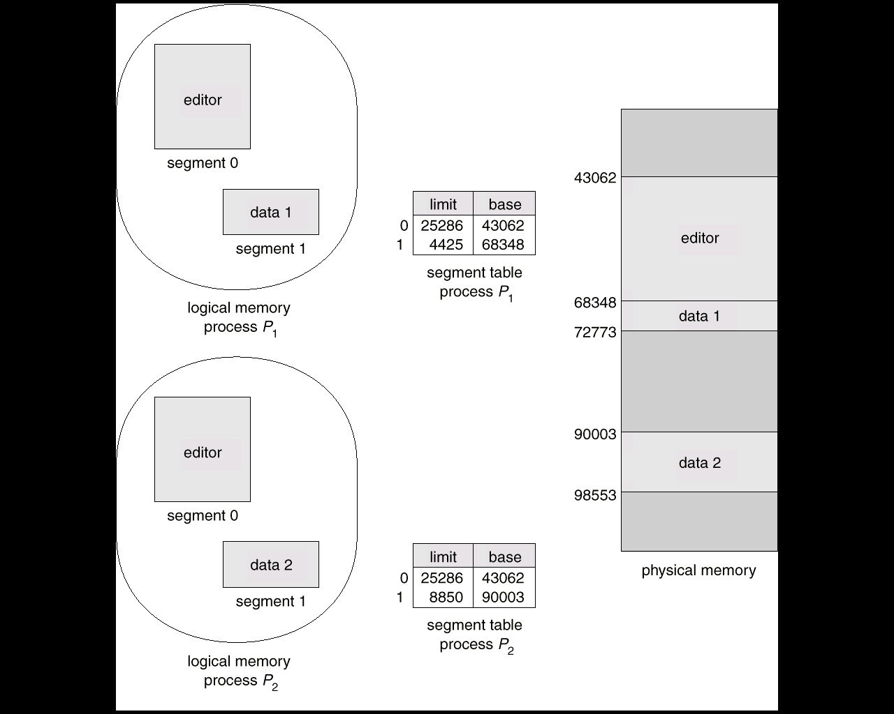
Example of Shared segments

Slide 12
Segmentation and Paging in i386
Logical Address Space
Linear Address Space
Physical Memory
S1
S2
S3
S1
Segment Table
Page Table
S2
TLB
<Segment ID, Offset>
S3
Local Descriptor Table (GDT) for process internal segments, Global Descriptor Table (GDT) for segments shared across processes → 2 segment tables

Slide 13
<Segment ID, Offset> in i386
<16, 32> bit in i386 (32 bit machine)
13 bits segment ID
Total 2¹³ segments
Each segment can be of size 2³² (4GB) – total size of Linear address space
1 bit for local / global
2 bits for descriptor privilege level: current privilege level of CPU
Processor Status Word (part of process context) contains information about many things (e.g. status of last executed instruction, current processor mode)
Intel has 4 privilege levels → 2 bits from PSW are copied into these 2 bits
Linux allows only 4 segments, each can be of size 4GB (overlapping)

Slide 14
Segment Table Entry
Each segment table is of size 64K (2¹³ entries, each 2³ bytes) – 2 such
Each segment table entry is 8 bytes long
Base Address: 4 bytes (where does the segment start in the conceptual 32-bit Linear Address space)
Size: 20 bits + 1 granularity bit 1MB / 4GB as multiples of 4KB)
Counter-intuitive: not 32 bits but 20
Granularity bit specifies the unit of expression
Granularity bit 0 → Size in units of bytes (0 to 2²⁰ bytes -- 1MB)
Granularity bit 1 → Size in units of 4KB (0 to 2²⁰ X 4KB – 4GB)
Not all sizes are possible (can span entire Linear space but jumps in 4KB units)
Permissions (read / write) [e.g. Code segment is read only]
2 Privilege bits: minimal CPU privilege level required for accessing the segment
The last 2 bits of the logical address (current privilege level / mode) will be compared with these privilege bits
Present / Absent: 1 bit (whether in RAM or swap device)

Slide 15
Segment Table Entry
Each segment table is 64KB in size – too big to fit in MMU
Full segment table in memory but some entries in something like TLB
In i386, we have 6 Segmentation Registers store 6 segment table entries
At a time, a process can at most 6 different segments
No TLB miss in this case
Accessing one of the segments other than the 6 segments stored in segmentation registers leads to a segment replacement → calls for segmentation register replacement on switching segments
These registers cannot be manipulated directly, only hardware can handle this when a logical segment address is generated

Slide 16
Segmentation and Paging in i386
Logical Address Space
Linear Address Space
Physical Memory
S1
S2
S3
S1
Segment Table
Page Table
S2
TLB
<Segment ID, Offset>
S3

Slide 17
Linear to Physical: Paging
The Linear Address Space is broken into 4K-sized pages, and mapped to 4K-sized physical frames
Page Size: 4K = 2¹²
32-bit address bus → maximum addressable physical memory size 2³²
Number of pages (primary page table entries): 2³² / 2¹² = 2²⁰
Primary Page table size = 2²⁰ X 4 bytes = 2²² / 2¹² = 2¹⁰ pages
Secondary page table has 2¹⁰ entries, each of 4byte size.
Total size: 2¹⁰ X 4 bytes = 2¹² (fits in 1 page)

Slide 18
Linear to Physical: Paging
Paging is same as earlier, we have a TLB as well
Page Table entry will have a frame address (multiple of 2¹² → lower order 12 bits are 0)
12 bits will store miscellaneous information as discussed
Permissions (rd / w)
Illegal / Legal reference
Dirty + reference bit (both cleared by OS)
Privilege levels
Valid / Invalid bit (physical memory or swap device)
If this bit is cleared, can use frame address bits to store location on swap device (block number → 2²⁰ blocks, indicating swap device limited to 4GB)

Slide 19
Note
During address translation, we can get a page fault
Pages that hold the page table itself are allocated RAM when required
May be needed to be swapped to disk

Slide 20
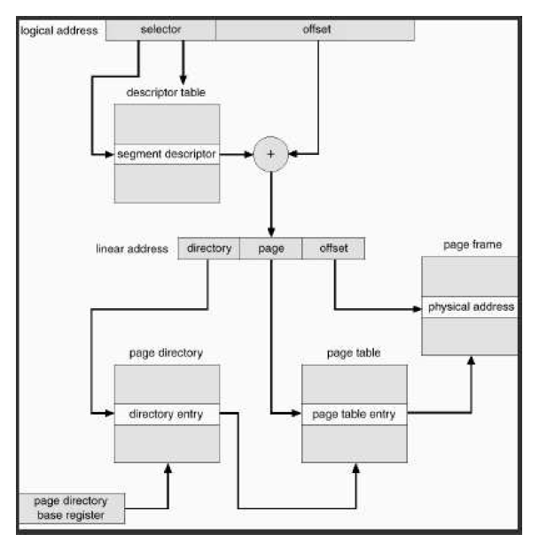
i386

Slide 21
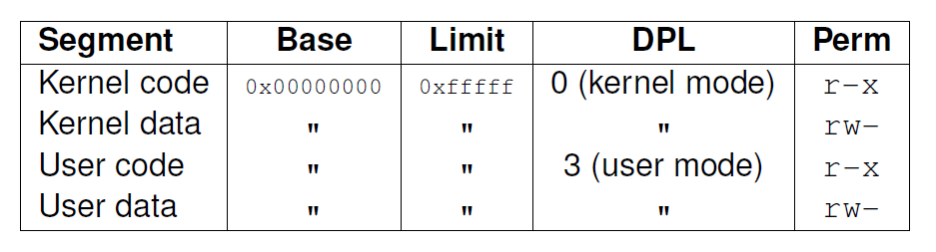
Linux
Modern RISC processors do not possibly use segmentation
Intel uses paging + segmentation
OS developed needs to keep the kernel code as much generic as possible
Linux kernel mostly ignores segmentation to keep things generic
Linux keeps only 4 segments

Slide 22
Process Address Space
Linear address space of a process is divided into two parts:
3GB (0x00000000 to 0xbfffffff)
Can be addressed in user / kernel mode
First set of 768 entries of the PT
1GB (0xc0000000 to 0xffffffff)
Can be addressed only in kernel mode
Covered by remaining 256 entries in PT
identical to corresponding entries of the kernel master PGD (same for all processes)
Only 1 copy of kernel in RAM, but mapped to the Linear Address space of every process
Benefits
When a process switches to kernel mode from user mode, we issue a trap instruction and descriptor privilege level changes to kernel mode
When change to kernel mode, the entire 4GB is visible
No fresh address translation map switching is necessary

