Slide 1
Storage and File Systems
Slides borrowed from
Prof. Chester Rebeiro
IIT Madras

Slide 2
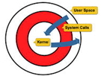

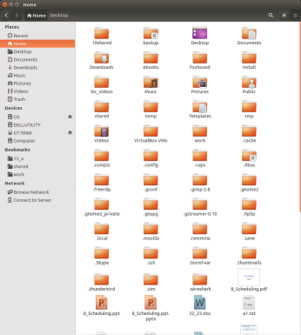
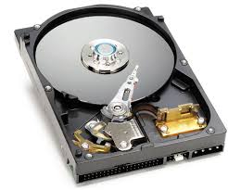
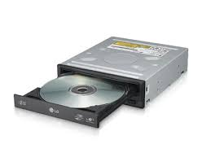
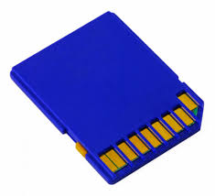
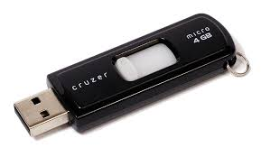
Two views of a file system
rwx
protection
attributes
system calls
Application View
Look & Feel
OS gives a transparent
View about what is
Happening internally
File system
Hardware view
Google Drive?
Moving parts
NAND Flash

Slide 3
Mass Storage Devices
High Capacity Storage systems and devices
  GB to PB
Persistent and reliable data retention
  Data is retained without power
Reliable
  Error checking and redundancy
Accessibility
  Efficient data access mechanisms for retrieval

Slide 4
Types of Mass Storage
Magnetic Storage (magnetic fields on rotating disks)
  HDDs, Tape drives
Optical Storage (laser technology for data storage)
  CD, DVD, Blu-ray disc
Solid State Storage (flash memory technology)
  SSD, Flash drives
Network Attached Storage (file storage connected to a network)
Cloud Storage (remote servers)

Slide 5
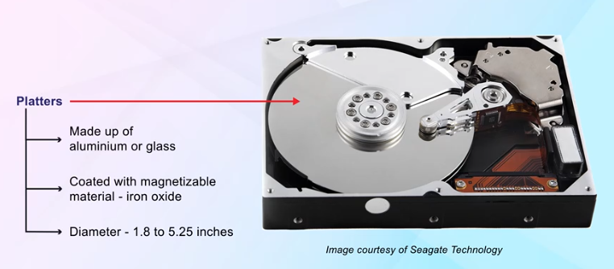
Magnetic Disk Drive
Platter coated with magnetizable material like iron oxide
Disk mounted on the spindle rotate about 5400RPM to 15K RPM

Slide 6
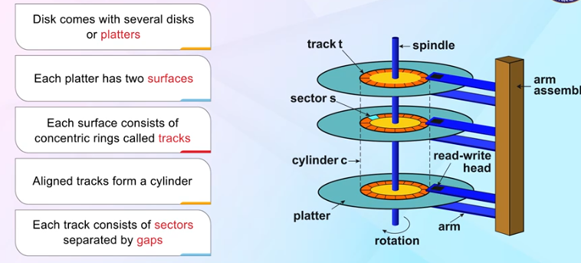
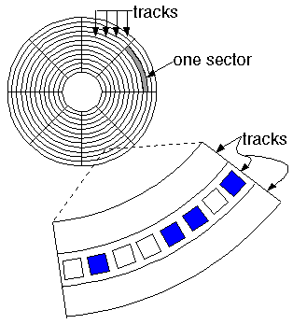
Magnetic Disks
Tracks and Sectors on a platter
Structure of a magnetic disk
Secondary devices are slow, movable
mechanical parts (momentum, friction, failure…)
Notes:
Concentric set of platters. Size of platters vary from 1.8 to 5.25 inches
The platterns connected to a spindle, which causes platter to spin….. This is the famous hard disk sound that is heard from the PC. Rotation speed : 60 – 200 times per second.
Each platter divided into concentric circles called tracks. Tracks are further divided into sectors.
Cylinder : the set of all equally positioned tracks (across all the platters)
Read / Write head used for retrevial or storage of information
The heads can move across tracks

Slide 7
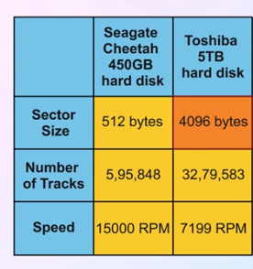
Examples

Slide 8
Disk Capacity
Number of bits that can be stored in a disk
Expressed in GB / TB
Total capacity is a product of:
  Number of bytes per sector
  Average number of sectors per track
  Number of tracks per surface
  Number of surfaces per platter (usually 2)
  Number of platters in the disk (multiple platters stacked on top of each other)

Slide 9
Modern Magnetic Disk Drives
Store data as large one-dimensional arrays of logical blocks
Logical block: Smallest unit of transfer (usually 512 bytes)
Option to format disks to different logical block sizes (e.g. 1024 bytes)

Slide 10
Logical Block Mapping
One-dimensional array of logical blocks mapped onto disk sectors sequentially
Sector 0: First sector of the first track on the outermost cylinder
Mapping proceeds through the track, cylinder, and from outermost to innermost cylinders

Slide 11
Disk Addressing
Older schemes
  CHS (cylinder, head, sector) tuple
  Well suited for disks, but not for any other medium
  Need an abstraction
Logical block addressing (LBA)
  Large 1-D array of logical blocks
  Addressing with 48 bits
  Mapping from CHS to LBA
LBA = (C × HPC + H) × SPT + (S - 1)
C : cylinder, H : head, S : sector, HPC: heads / cylinder, SPT: sectors / track
Notes:
In practice difficult because
Sectors could be defective, mapping substitutes this by using a spare sector
Sectors per track not constant on CLV drives.

Slide 12
Access Time
data
position the head
Read data
Multiple platters: Separate head per surface

Slide 13
Access Time
Seek Time
  Time it takes the head assembly to travel to the desired track
  Seek time may vary depending on the current head location
  Average seek time generally considered -- typically 4ms high end servers to 15ms in external drives but getting faster
Rotational Latency
  Delay waiting for the rotation of the disk to bring the required disk sector under the head
  Depends on the speed of the spindle motor
    CLV vs CAV
Data Rate
  Time to get data off the disk
Notes:
Min seek time : 0 when track is already positioned under the head
Max seek time : head is in max track, while we need to read from the 0th track
CLV advantage is that the rate of reading data from disk would always be a constant.
Used for audio cds because we need a constant read rate. Change of speed of spindle not
Very good, due to momentum effects. Changing speeds reduces access time. Speed lowest in outer tracks.
CAV. Data rate is higher for the outer tracks than inner tracks. Advantage. Is that it is easy to switch from reading one part of the disk to another part.

Slide 14
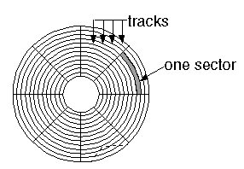
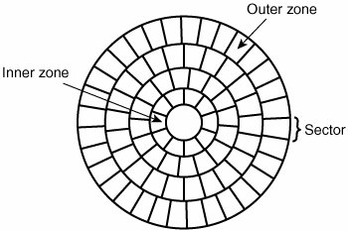
CLV
Outer sectors can typically store more
data than inner sectors
Modern Disks with zone-based
CLV (Constant linear Velocity): manage the speed at which the disk spins (spindle speed in rpm) to ensure constant rate of data transfer
  Uniform density of bits per track
  More sectors on tracks farther from the center
  Number of sectors per track decreases from outer to inner zones
  Rotation speed varies from outer to inner tracks
Used in audio CDs and DVDs to ensure constant read rate at which data is read from disk

Slide 15
CLV and CAV
CAV (Constant angular velocity) -- spindle velocity is always a constant. Used in hard disks. Easy to engineer.
  Allows higher read rates because there are no momentum issues
  User does not see this, OS uses buffering

Slide 16
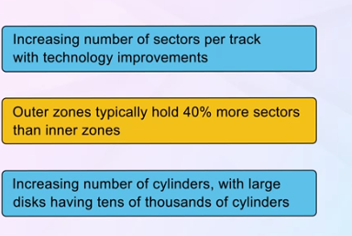
Sector and Cylinder Trends

Slide 17
Disk Scheduling
Access time and bandwidth can be managed by the order in which
Disk I/O requests are serviced
Objectives
  Access time minimize
    Two components
    Minimize Seek time by minimizing head movement
    Minimize Rotational latency
  Bandwidth
    Bytes transferred / (total time taken)

Slide 18
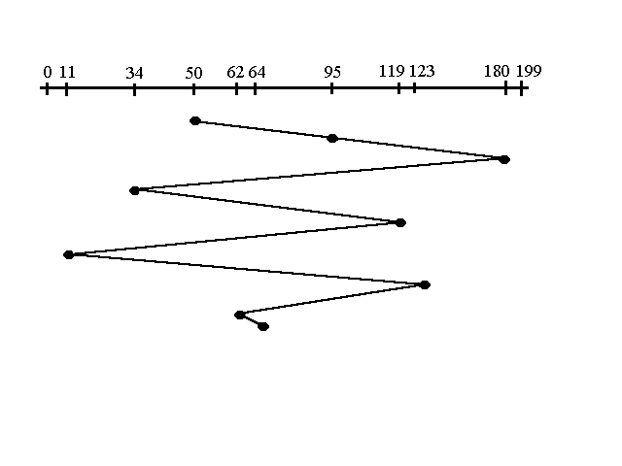
Disk Scheduling
Read/write accesses have the following cylinder queue :
  95, 180, 34, 119, 11, 123, 62, 64
The current position of the head is 50
FCFS
Track number
time
Wild Oscillations
Total head movments = |(95 – 50)| + |(180 – 95)| + |(34 – 180)| + …
= 644
Notes:
95 – 50
180 – 95
34 – 180
119 – 34
11 – 119
123 -

Slide 19
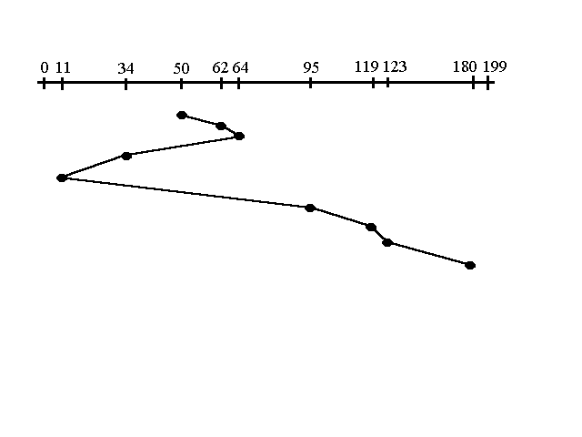
Shortest Seek Time First (SSTF)
95, 180, 34, 119, 11, 123, 62, 64
Starting at 50
Counterpart of SJF
Could lead to starvation
Track number
Total head movments = 236
time

Slide 20
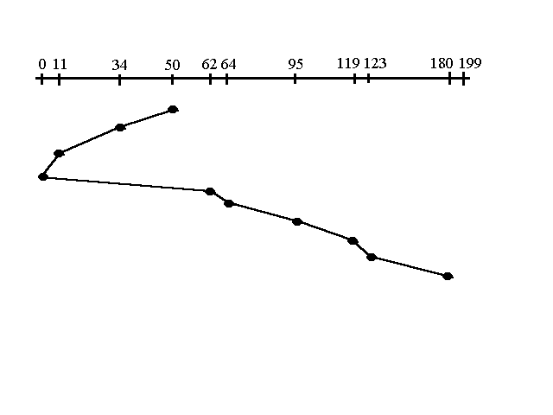
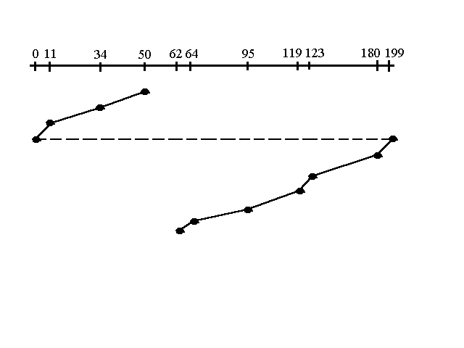
Elevators
95, 180, 34, 119, 11, 123, 62, 64
Starting at 50
SCAN
Start scanning toward the nearest end and goes till 0
Then goes all the way till the other end
C-SCAN
Start scanning toward the nearest end and go till the 0
Then go all the way to the other end
Useful if tracks accessed with uniform distribution
Shifting one extreme not included in head movement count
Total head movements = 230
Total head movements = 187
Notes:
C-SCAN is like an elevator which only stops in one direction

Slide 21
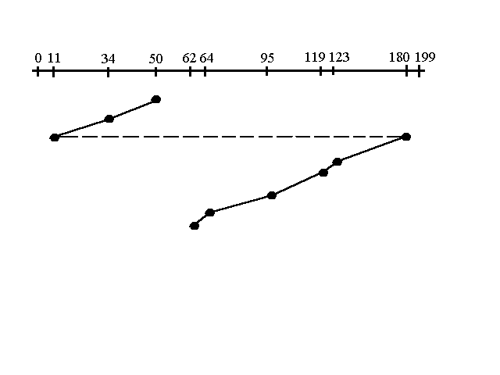
C-LOOK
95, 180, 34, 119, 11, 123, 62, 64
Starting at 50
Like C-SCAN, but don’t go to the extreme.
Stop at the minimum (or maximum)
Total head movements = 157

Slide 22
Selecting a Disk-Scheduling Algorithm
SSTF is common and has a natural appeal
SCAN and C-SCAN perform better for systems that place a heavy load on the disk

Slide 23
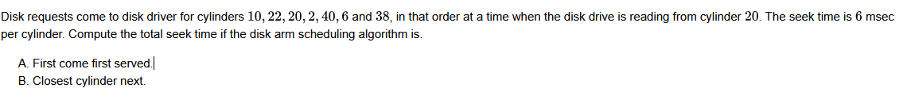
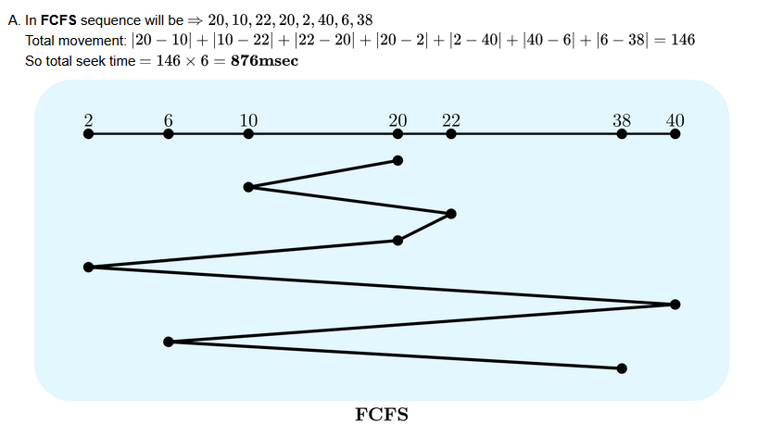

Slide 24
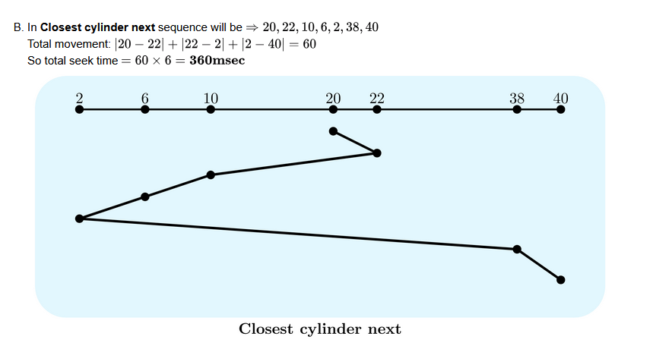

Slide 25
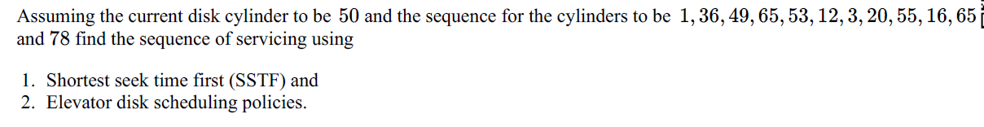
Which of the following disk scheduling strategies is likely to give the best throughput?
  Farthest cylinder next
  Nearest cylinder next
  First come first served
  Elevator algorithm
Consider an operating system capable of loading and executing a single sequential user process at a time. The disk head scheduling algorithm used is First Come First Served (FCFS). If FCFS is replaced by Shortest Seek Time First (SSTF), claimed by the vendor to give better benchmark results, what is the expected improvement in the I/O performance of user programs?

Slide 26
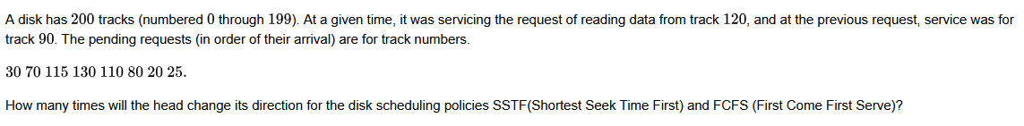
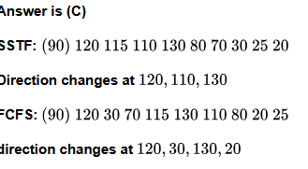

Slide 27
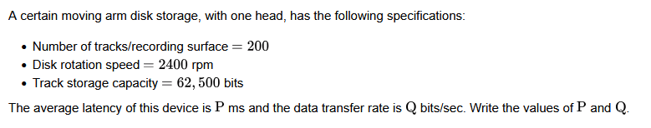
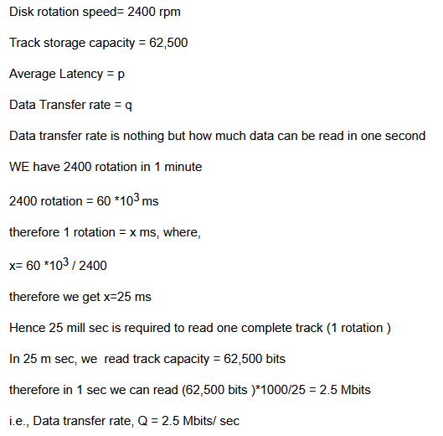
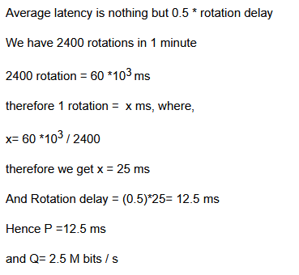

Slide 28
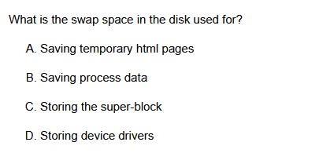
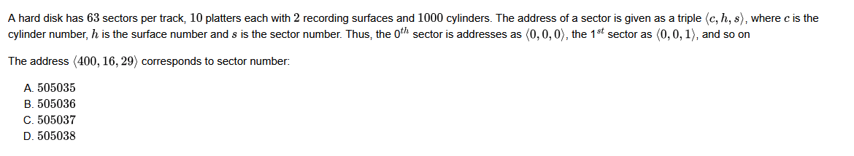
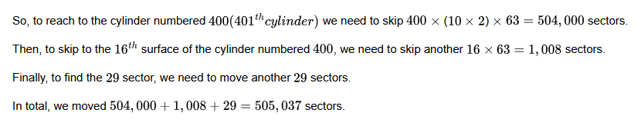

Slide 29
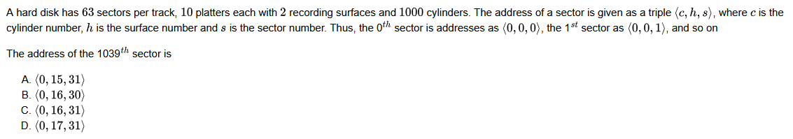
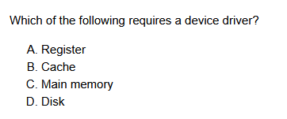

Slide 30
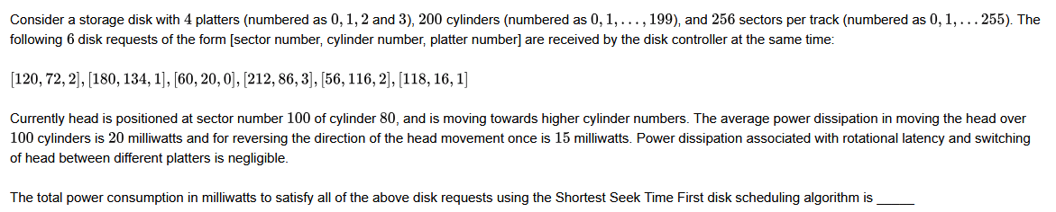
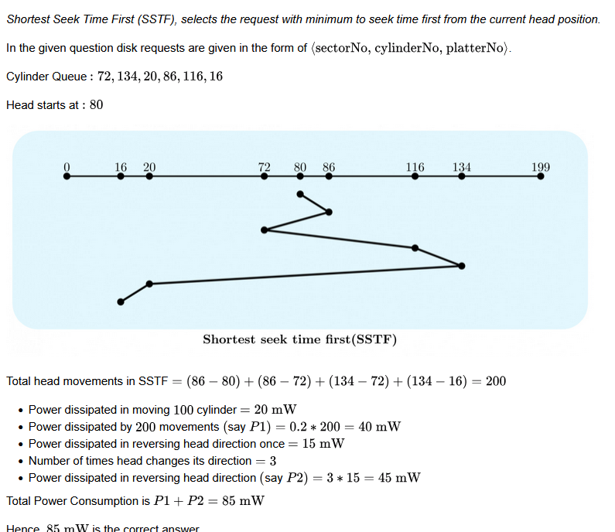

Slide 31
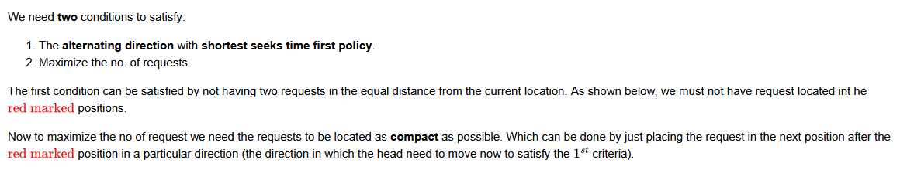
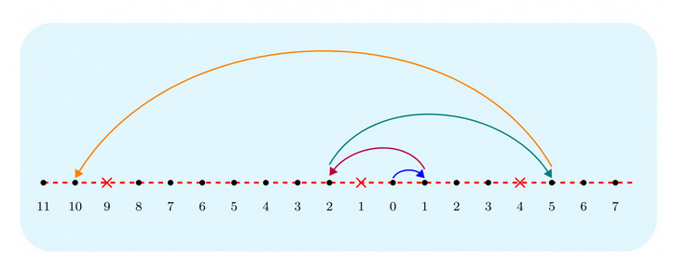
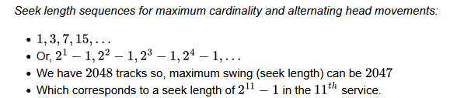

Slide 32
