Slide 1
Storage and File Systems-II

Slide 2
Disk Management
Disk Initialization
Booting from disk
Bad block recovery

Slide 3
Disk Formatting
Low level formatting or physical formatting
A specific data structure has to be set up
  Sector Data structure
    Header
    Data Area (often 512 bytes)
    Trailer
Header and Trailer
  Sector number
  Error Correcting Code (ECC)
    Maintains data integrity (ECC written when data written, compared to on every read to check data corruption)

Slide 4
ECC
When data is written to disk, it is not stored alone. The disk controller appends ECC bits to each sector (typically 512B or 4KB).
So what actually gets written is: [Data Bits] + [ECC]
These ECC bits allow the disk to:
  detect errors (bit flips due to noise, wear, etc.)
  correct small errors automatically on read

Slide 5
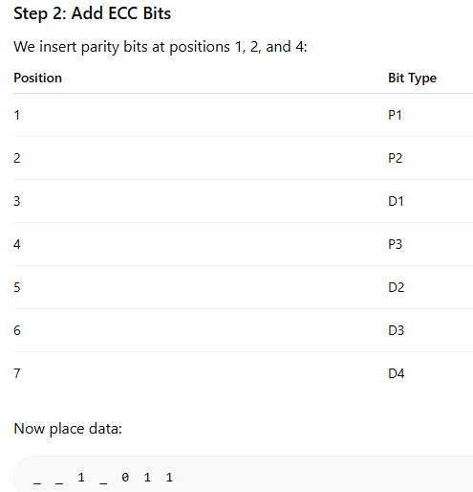
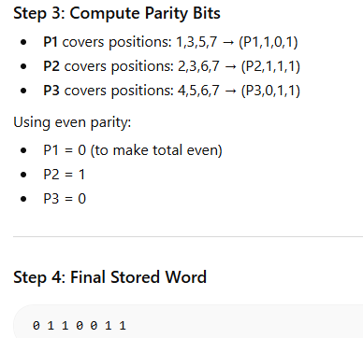
Example
Step 1: Original Data
Suppose we want to write 4 bits: Data = 1011

Slide 6
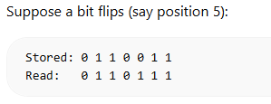
ECC
Now recompute parity:
P1: mismatch
P2: mismatch
P3: mismatch
Error syndrome: P3P2P1 = 1 0 1 = 5
Error is at position 5 → flip it back

Slide 7
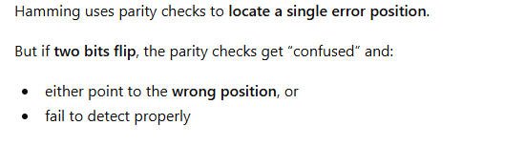
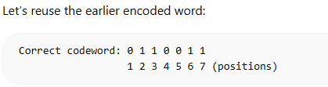

Multiple bit errors?
In real disks:
  Sector size: 512 bytes or 4KB
  ECC: typically 50–100+ bits per sector
Algorithms: more advanced than Hamming
  Reed–Solomon
  LDPC (used in modern SSDs)
P1 → positions (1, 3, 5, 7)
Bits: 0 0 1 1
Parity = 0 ^ 0 ^ 1 ^ 1 = 0
P1 = 0 → NO mismatch
P2 → positions (2, 3, 6, 7)
Bits: 1 0 1 1
Parity = 1 ^ 0 ^ 1 ^ 1 = 1
P2 = 1 → mismatch
P3 → positions (4, 5, 6, 7)
Bits: 0 1 1 1
Parity = 0 ^ 1 ^ 1 ^ 1 = 1
P3 = 1 → mismatch
Error syndrome: P3P2P1 = 110 (6) – Indicates error at position 6, which is incorrect
Introspection: Notice that 3 ⊕ 5 = 6
Does that tell you something?

Slide 8
Correction to what we discussed in class
The example we discussed in class was WRONG
With this scheme, you cannot locate any of the bit positions where there is a corruption
Note that the syndrome is P3P2P1 in that order (NOT P1P2P3 – which was mistakenly discussed in class today – leading to identification of bit 3)
For interested minds, you can also look for a proof why with this scheme we cannot even locate any of the bits
Summary: For multiple errors, you will always a syndrome (after you recompute parity) which points to an erroneous bit position

Slide 9
Factory low-level formatting
Prepares the disk for use and tests disk and initializes logical block to defect-free sector mapping
Allows customization of data space between header and trailer for actual use
  Size options (e.g. 256, 512 or 1024 bytes)
  Larger sector sizes → fewer sectors per track
  Less header and trailer → more user space

Slide 10
Logical Formatting
Step 1: Partitioning
  Divides disk into groups of cylinders, each treated as a separate disk
  One partition contains OS executable code, while another stores user files
Step 2: File system creation
  OS writes initial file-system data structure to the disk (e.g. Free space maps and directories)

Slide 11
File System Efficiency
Logical blocks grouped into clusters for efficient I/O
  OS can have special programs the ability to use some partition as a large block without any file system structure
Often called raw disk
Boot block
  Bootstrap program and loads OS kernel
  Stored in ROM for immediate execution upon power-up or reset
  ROM contains the minimal code to load the full bootstrap program from disk
  Full bootstrap program is stored in the boot block of the disk

Slide 12
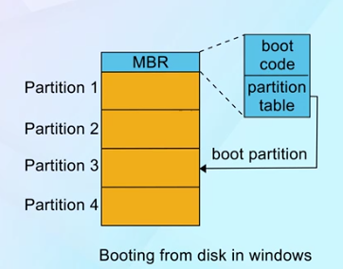
Boot process Example: Windows
Master Boot Record: First sector on hard disk with boot code and partition table
Boot partition: Contains OS and device drivers
MBR loads boot sector of boot partition to continue boot process, eventually loading OS

Slide 13
Bad Block Management
Disks are prone to defects
During formatting, defective sectors are marked and avoided
Utilities like bad blocks marks bad sectors
Advanced disks have their own utilities as well
  Sector Sparing: replaces bad sector with a spare
  Sector Slipping: Moves sectors down to free space for defective sector management
Data recovery from bad blocks
  Soft errors
  Hard errors

Slide 14
Swap Space Management
Swapping is one of the important memory management methods used in demand paging
OS optimizes memory usage during swapping
  Low-level task
Swap space is an extension of main memory in virtual memory systems
Disk access is slower → swap space management

Slide 15
Swap Space Use
Swapping systems use swap space to hold
  Entire processes
  Pages pushed out of memory
Amount of swap space depends on
  Physical Memory / Virtual Memory / Usage patterns
  Better to over-estimate
    Under-estimation can lead to system crashes
    Excessive swap wastes actual disk space
Different OS choices
  Linux: 2X RAM size (early), now considerably less in modern ones
  Also supports multiple swap spaces combining normal files

Slide 16
Swap Space Location
File system
  easy to implement
  Inefficient since it needs to navigate directory, disk structure for search
  External fragmentation
Separate disk partition (raw)
  Swap space manager
  Allocates and deallocated blocks for speed
  Storage inefficiency due to internal fragmentation
  Fixed swap space size during disk partitioning
Some OS (e.g. Linux) allows both

Slide 17
Linux swap space data structure
Each swap area has 4-KB page slots for swapped pages
Swap-map: An array of counters for each page slot
Counter value indicates the number of mappings to the swapped page
  Counter value 3 indicates swapped page mapped to 3 different processes

Slide 18
RAID structure
Multiple disks for storage instead of a single disk
Redundant Array of Independent Disks
Combines multiple disk drives to a logical unit
  Performance, redundancy improvement

Slide 19
What is RAID?
Data distributed across several physical drives of an array in a scheme known as striping
  Data is divided into multiple data blocks (stripes) and written to the disk
Redundant disk is used to store not only data but also recovery information (e.g. parity bits) used during recovery
7 RAID levels (0 to 6)
  Mirroring (each logical strip is mapped to at least 2 physical strips)
  Error correction with Hamming codes / Parity (higher levels)

