Slide 1
Main Memory
Additional slide courtesy: Prof. Mandar Mitra

Slide 2
Background
Program must be brought (from disk) into memory and placed within a process for it to be run
Main memory and registers are only storage CPU can access directly
Memory unit only sees a stream of:
addresses + read requests, or
address + data and write requests
Register access is done in one CPU clock (or less)
Main memory can take many cycles, causing a stall
Cache sits between main memory and CPU registers
Protection of memory required to ensure correct operation

Slide 3
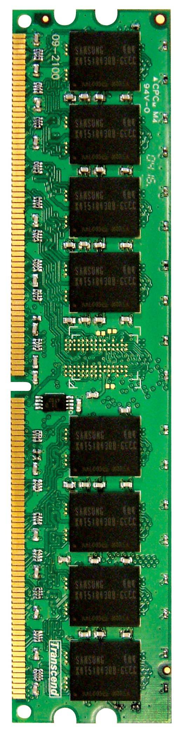
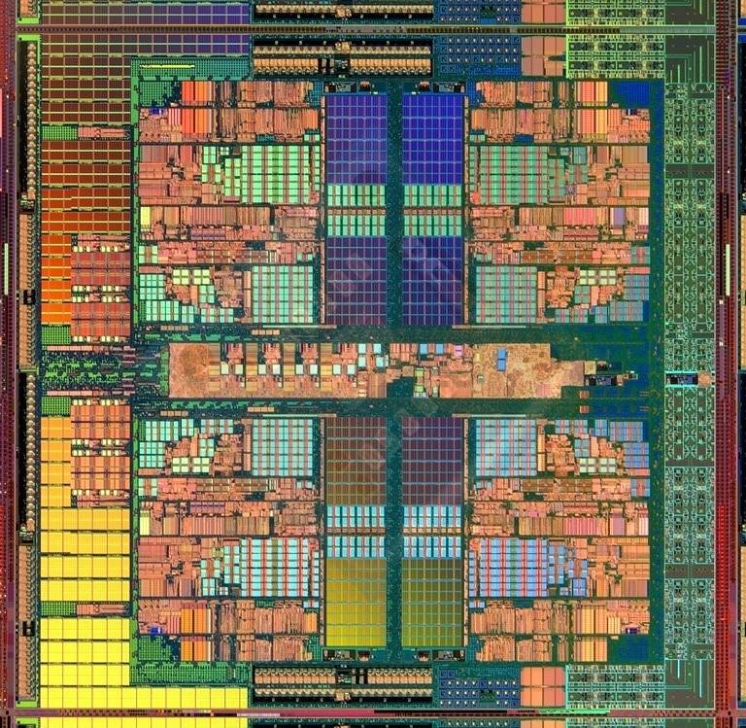
Memory in a Modern System
CORE 0
L2 CACHE 1
CORE 1
L2 CACHE 0
SHARED L3 CACHE
DRAM INTERFACE
DRAM MEMORY CONTROLLER
DRAM BANKS
L2 CACHE 2
CORE 3
CORE 2
L2 CACHE 3

Slide 4
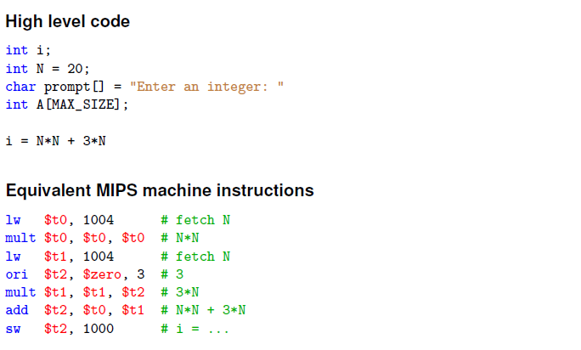
Address binding

Slide 5
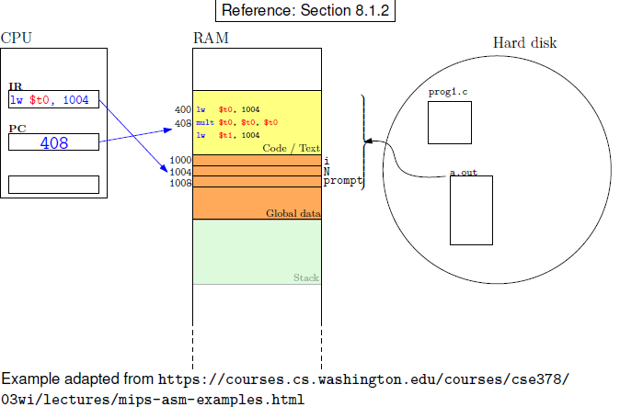
Address Binding

Slide 6
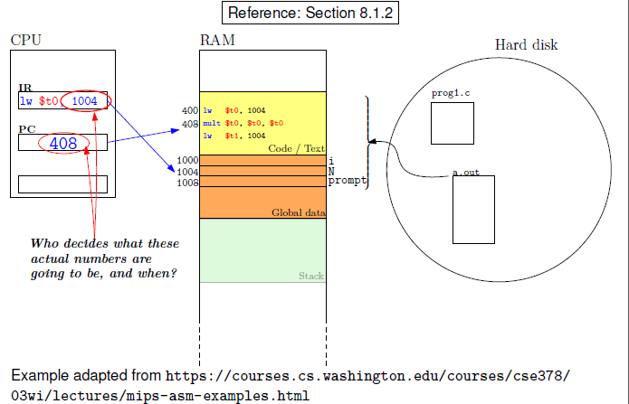
Address Binding

Slide 7

Multistep Processing of a User Program

Slide 8
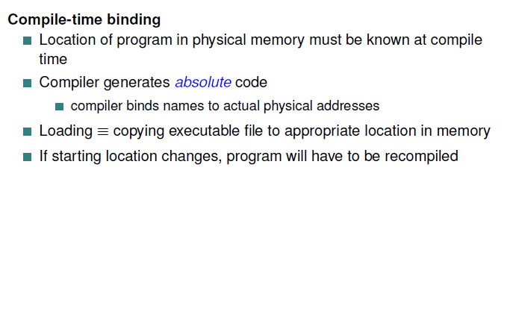
Address Binding

Slide 9
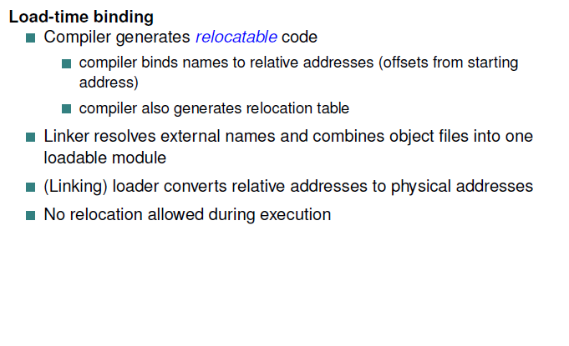
Address Binding

Slide 10
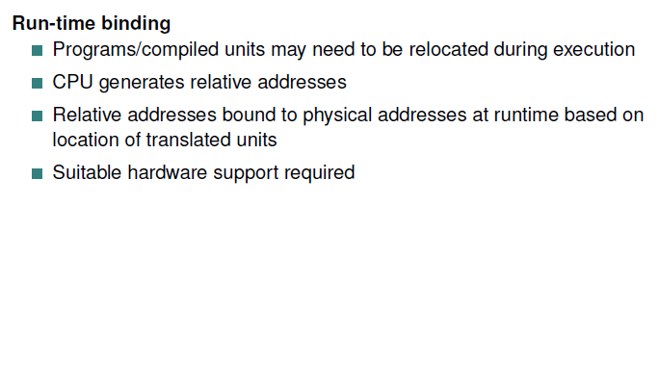
Address Binding

Slide 11
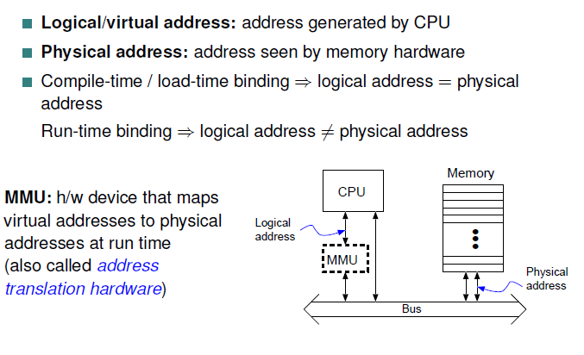
Memory Management Unit (MMU)

Slide 12
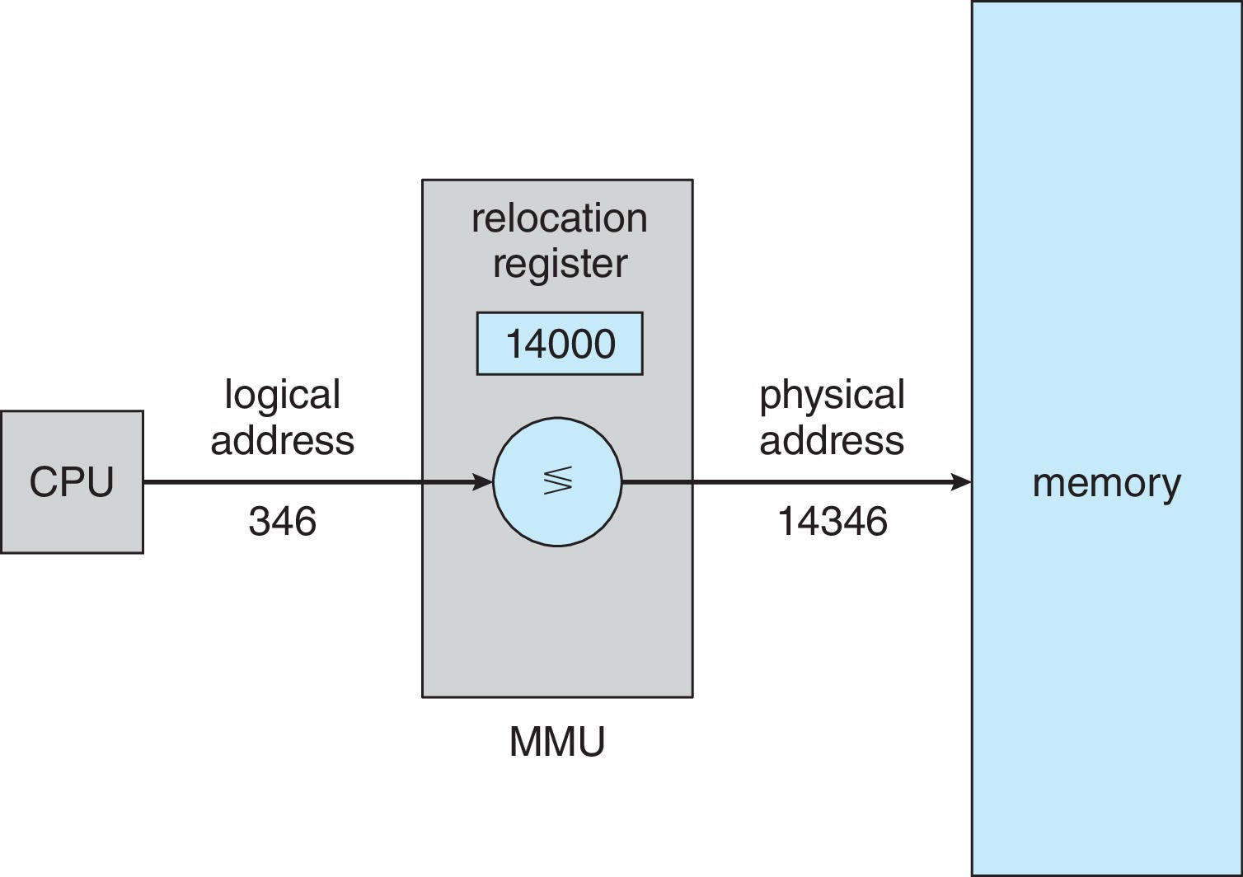
Memory-Management Unit (Cont.)
The base register now called relocation register
The value in the relocation register is added to every address generated by a user process at the time it is sent to memory
The user program deals with logical addresses; it never sees the real physical addresses
Execution-time binding occurs when reference is made to location in memory
Logical address bound to physical addresses

Slide 13

Memory Protection
Prevents process from accessing any memory outside its own
Address space
Allows OS to change dynamically

Slide 14
Dynamic Loading
The entire program does need to be in memory to execute
Routine is not loaded until it is called
Better memory-space utilization; unused routine is never loaded
All routines kept on disk in relocatable load format
Useful when large amounts of code are needed to handle infrequently occurring cases
No special support from the operating system is required
Implemented through program design
OS can help by providing libraries to implement dynamic loading

Slide 15
Dynamic Linking
Static linking – system libraries and program code combined by the loader into the binary program
Dynamic linking – linking postponed until execution time
System also known as shared libraries

Slide 16
Contiguous Allocation
Main memory must support both OS and user processes
Contiguous allocation is one early method
Main memory usually into two variable-sized partitions:
Resident operating system, usually held in low memory with interrupt vector
User processes then held in high memory
Each process contained in single contiguous section of memory

Slide 17
Contiguous Allocation
Multiple-partition allocation
OS maintains a list of allocated / free partitions (holes)
Variable-partition sizes for efficiency (sized to a given process’ needs)
Hole – block of available memory; holes of various size are scattered throughout memory
When a process arrives, it is allocated memory from a hole large enough to accommodate it
Memory is allocated to processes until requirements of next process in queue cannot be met
OS may skip down the queue to allocate memory to a smaller orocess that fits in available memory
Process exiting frees its partition, adjacent free partitions combined

Slide 18
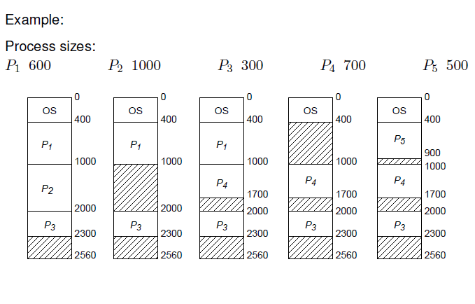
Contiguous Allocation

Slide 19
Dynamic Storage-Allocation Problem
How to satisfy a request of size n from a list of free holes?
First-fit: Allocate the first hole that is big enough
Best-fit: Allocate the smallest hole that is big enough; must search entire list, unless ordered by size
Produces the smallest leftover hole
Worst-fit: Allocate the largest hole; must also search entire list
Produces the largest leftover hole
First-fit and best-fit better than worst-fit in terms of speed and storage utilization

Slide 20
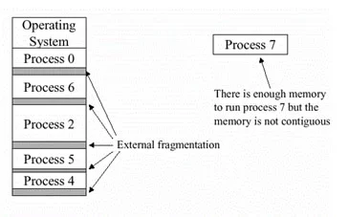
Fragmentation
External Fragmentation – total memory space exists to satisfy a request, but it is not contiguous
May be reduced slightly by allocating from appropriate end (top / bottom) of hole

Slide 21
Compaction
Reduce external fragmentation by compaction
Shuffle memory contents to place all free memory together in one large block
Compaction is possible only if relocation is dynamic, and is done at execution time
I/O problem
Latch job in memory while it is involved in I/O
Do I/O only into OS buffers

