Slide 1
Deadlocks

Slide 2
Summary of what we discussed
Deadlocks can happen in a system with at least 2 processes (or threads) and at least 2 resource types (R1, R2)
If we have a single instance of each resource, a cycle in the resource allocation graph is necessary and sufficient to conclude a deadlock
If we have multiple instances of resources, a cycle in the resource allocation graph is a necessary condition but not sufficient – deadlock may or may not occur
Studied a different method for deadlock detection for such situations

Slide 3
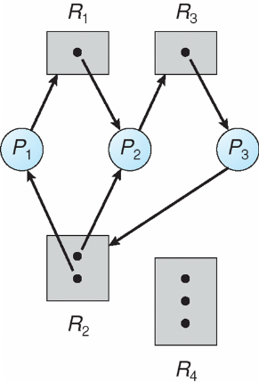
Resource Allocation Graph With A Deadlock

Slide 4
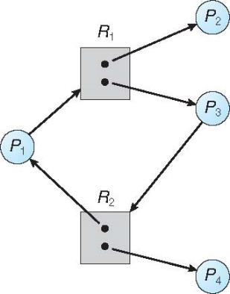
Graph With A Cycle But No Deadlock

Slide 5
Conditions for Resource Deadlocks
Mutual Exclusion
Each resource is either available or currently assigned to exactly one process
Hold and wait
A process holding a resource, can request another resource
No preemption
Resources previously granted cannot be forcibly taken away from a process
Circular wait
There must be a circular chain of two or more processes, each of which is waiting for a resouce held by the next member of the chain
All four of these conditions must be present for a resource deadlock to occur!!

Slide 6
Handling Deadlocks
Cycle in RAG
Detection and Recovery
Prevention → Restrict satisfaction of at least one of the 4 necessary conditions
Avoidance
Matrix-based

Slide 7
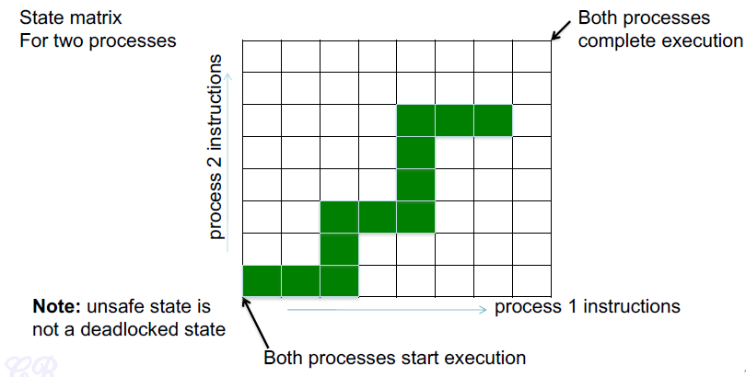
Deadlock Avoidance
System decides in advance if allocating a resource to a process will lead to a deadlock

Slide 8
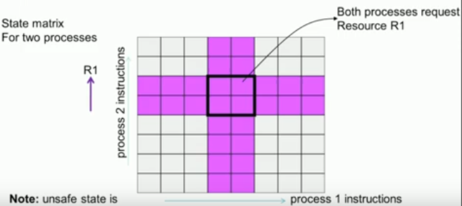
Deadlock Avoidance
State Matrix for two processes
Unsafe state is not a deadlock state

Slide 9
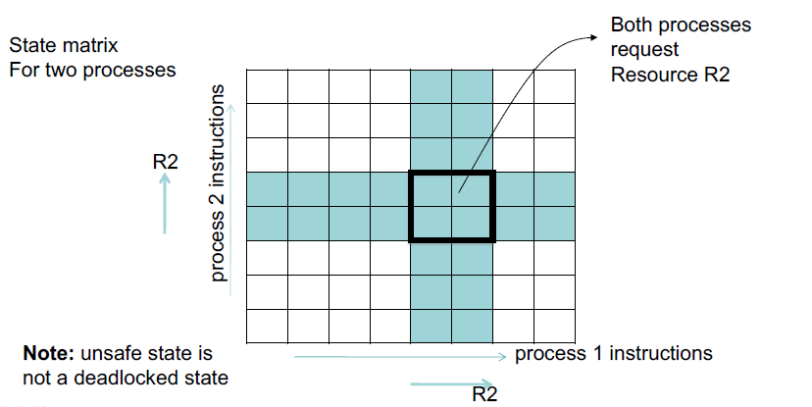
Deadlock Avoidance
State matrix for two processes

Slide 10
Deadlock Avoidance
System decides in advance if allocating a resource to a process will lead to a deadlock
Both processes request
Resource R1
R1
Unsafe state
(may cause a deadlock)
process 2 instructions
R2
Both processes request
Resource R2
Note: unsafe state is
not a deadlocked state
process 1 instructions
R1
R2

Slide 11
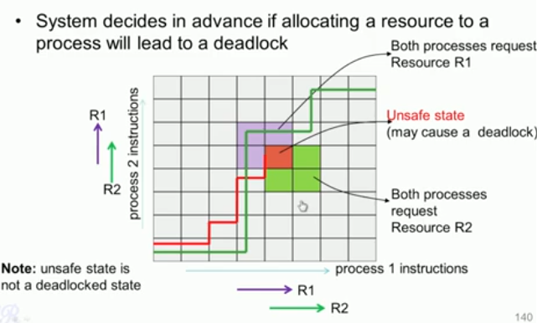
Deadlock Avoidance

Slide 12
Deadlock Avoidance
Is there an algorithm that can always avoid deadlocks by conservatively making the right choice.
Ensures system never reaches an unsafe state
Safe state : A state is said to be safe, if there is some scheduling order in which every process can run to completion even if all of them suddenly requests their maximum number of resources immediately
An unsafe state does not have to lead to a deadlock; it could lead to a deadlock

Slide 13
Deadlock Avoidance
Requires that the system has some additional a priori information available
Simplest and most useful model requires that each process declare the maximum number of resources of each type that it may need
The deadlock-avoidance algorithm dynamically examines the resource-allocation state to ensure that there can never be a circular-wait condition
Resource-allocation state is defined by the number of available and allocated resources, and the maximum demands of the processes

Slide 14
Safe State
When a process requests an available resource, system must decide if immediate allocation leaves the system in a safe state
System is in safe state if there exists a sequence <P₁, P₂, …, P_{n}> of ALL the processes in the systems such that for each P_{i}, the resources that P_{i} can still request can be satisfied by currently available resources + resources held by all the P_{j}, with j < i
If P_{i} resource needs are not immediately available, then P_{i} can wait until all P_{j} have finished
When P_{j} is finished, P_{i} can obtain needed resources, execute, return allocated resources, and terminate
When P_{i} terminates, P_{i +1} can obtain its needed resources, and so on

Slide 15
Basic Facts
If a system is in safe state ⇒ no deadlocks
If a system is in unsafe state ⇒ possibility of deadlock
Avoidance ⇒ ensure that a system will never enter an unsafe state.

Slide 16
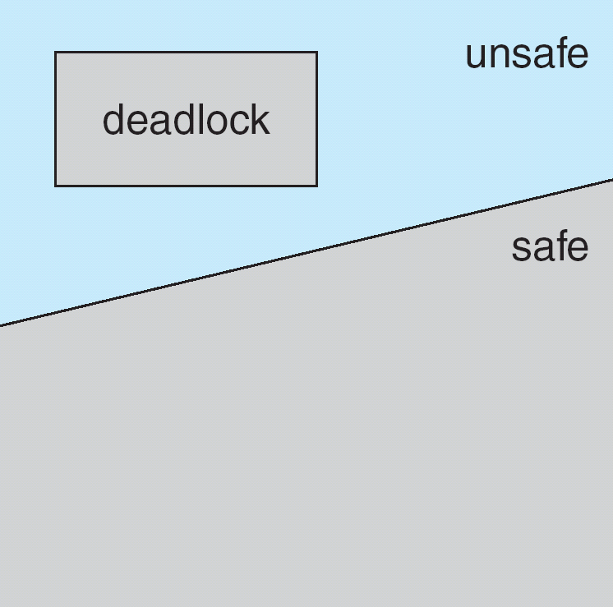
Safe, Unsafe, Deadlock State

Slide 17
Avoidance Algorithms
Single instance of a resource type
Use a resource-allocation graph
Multiple instances of a resource type
Use the banker’s algorithm

Slide 18
Resource-Allocation Graph Scheme
Claim edge P_{i} → R_{j} indicated that process P_{j} may request resource R_{j}; represented by a dashed line
Claim edge converts to request edge when a process requests a resource
Request edge converted to an assignment edge when the resource is allocated to the process
When a resource is released by a process, assignment edge reconverts to a claim edge
Resources must be claimed a priori in the system

Slide 19
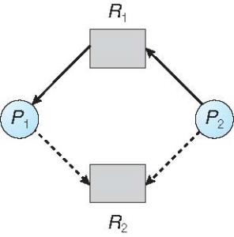
Resource-Allocation Graph
P2 requests for R2
Claim edge converted to a request edge

Slide 20
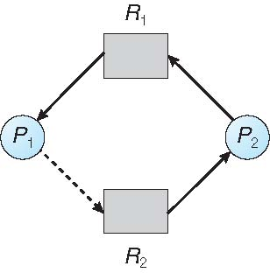
Unsafe State In Resource-Allocation Graph
Pretend to be allocated
Check for cycle
Will not be allocated
P2 put to sleep

Slide 21
Resource-Allocation Graph Algorithm
Suppose that process P_{i} requests a resource R_{j}
The request can be granted only if converting the request edge to an assignment edge does not result in the formation of a cycle in the resource allocation graph

Slide 22
Banker’s Algorithm
Multiple resource instances
Each process must a priori claim maximum use
When a process requests a resource it may have to wait
When a process gets all its resources it must return them in a finite amount of time

Slide 23

Example with a Banker
Consider a banker with 4 clients (P₁, P₂, P₃, P₄).
Each client has certain credit limits (totaling 20 units)
The banker knows that max credits will not be used at once, so he keeps only 10 units
Clients declare maximum credits in advance. The banker can allocate credits provided no unsafe state is reached.
 | Has | Max
A | 3 | 9
B | 2 | 4
C | 2 | 7
Total : 10 units
free : 3 units
Notes:
Dijkstra 1965

Slide 24
Safe State
Allocate 2 units to B
B completes
 | Has | Max
A | 3 | 9
B | 2 | 4
C | 2 | 7
 | Has | Max
A | 3 | 9
B | 4 | 4
C | 2 | 7
 | Has | Max
A | 3 | 9
B | 0 | -
C | 2 | 7
free : 3 units
free : 1 units
free : 5 units
Allocate 5 to C
 | Has | Max
A | 3 | 9
B | 0 | -
C | 7 | 7
free : 0 units
Allocate 6 units to A
C completes
 | Has | Max
A | 9 | 9
B | 0 | -
C | 0 | -
 | Has | Max
A | 3 | 9
B | 0 | -
C | 0 | -
free : 0 units
free : 7 units
This is a safe state because there is some scheduling
order in which every process executes

Slide 25
Unsafe State
Allocate 2 units to B
B completes
 | Has | Max
A | 4 | 9
B | 2 | 4
C | 2 | 7
 | Has | Max
A | 4 | 9
B | 4 | 4
C | 2 | 7
 | Has | Max
A | 4 | 9
B | 0 | -
C | 2 | 7
free : 2 units
free : 0 units
free : 4 units
This is an unsafe state because there exists NO scheduling
order in which every process executes

Slide 26
Data Structures for the Banker’s Algorithm
Let n = number of processes, and m = number of resources types.
Available: Vector of length m. If available [j] = k, there are k instances of resource type R_{j} available
Max: n x m matrix. If Max [i,j] = k, then process P_{i} may request at most k instances of resource type R_{j}
Allocation: n x m matrix. If Allocation[i,j] = k then P_{i} is currently allocated k instances of R_{j}
Need: n x m matrix. If Need[i,j] = k, then P_{i} may need k more instances of R_{j} to complete its task
Need [i,j] = Max[i,j] – Allocation [i,j]

Slide 27
Safety Algorithm
1. Let Work and Finish be vectors of length m and n, respectively. Initialize:
Work = Available
Finish [i] = false for i = 0, 1, …, n- 1
2. Find an i such that both:
(a) Finish [i] = false
(b) Need_{i} ≤ Work
If no such i exists, go to step 4
3.Work = Work + Allocation_{i} Finish[i] = true go to step 2
4. If Finish [i] == true for all i, then the system is in a safe state

Slide 28
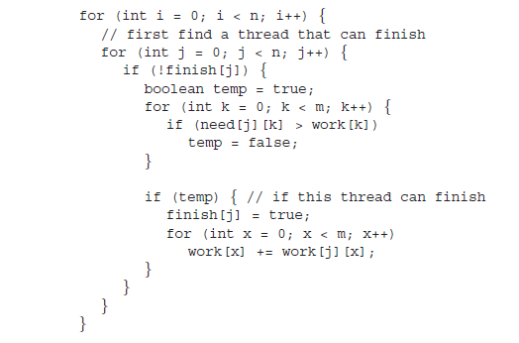

Slide 29
Resource-Request Algorithm for Process P_{i}
Request_{i} = request vector for process P_{i}.
If Request_{i} [j] = k then process P_{i} wants k instances of resource type R_{j}
If Request_{i} ≤ Need_{i} go to step 2. Otherwise, raise error condition, since process has exceeded its maximum claim
If Request_{i} ≤ Available, go to step 3. Otherwise P_{i} must wait, since resources are not available
3. Pretend to allocate requested resources to P_{i} by modifying the state as follows:
Available = Available – Request_{i};
Allocation_{i} = Allocation_{i} + Request_{i};
Need_{i} = Need_{i} – Request_{i};
If safe ⇒ the resources are allocated to P_{i}
If unsafe ⇒ P_{i} must wait, and the old resource-allocation state is restored

Slide 30
Example of Banker’s Algorithm
5 processes P₀ through P₄;
3 resource types:
A (10 instances), B (5instances), and C (7 instances)
Snapshot at time T₀:
Allocation Max Available
A B C A B C A B C
P₀ 0 1 0 7 5 3 3 3 2
P₁ 2 0 0 3 2 2
P₂ 3 0 2 9 0 2
P₃ 2 1 1 2 2 2
P₄ 0 0 2 4 3 3

Slide 31
Example (Cont.)
The content of the matrix Need is defined to be Max – Allocation
Need
A B C
P₀ 7 4 3
P₁ 1 2 2
P₂ 6 0 0
P₃ 0 1 1
P₄ 4 3 1
The system is in a safe state since the sequence < P₁, P₃, P₄, P₂, P₀> satisfies safety criteria

Slide 32
Example: P₁ Request (1,0,2)
Check that Request ≤ Available (that is, (1,0,2) ≤ (3,3,2) ⇒ true
Allocation Need Available
A B C A B C A B C
P₀ 0 1 0 7 4 3 2 3 0
P₁ 3 0 2 0 2 0
P₂ 3 0 2 6 0 0
P₃ 2 1 1 0 1 1
P₄ 0 0 2 4 3 1
Executing safety algorithm shows that sequence < P₁, P₃, P₄, P₀, P₂> satisfies safety requirement
Can request for (3,3,0) by P₄ be granted? -- unavailable
Can request for (0,2,0) by P₀ be granted? -- unsafe

Slide 33
Banker’s Algorithm
When a request occurs
If(is_system_in_a_safe_state)
Grant request
else
postpone until later
Deadlock
unsafe
safe
Please read Banker’s Algorithm with multiple resources from
Modern Operating Systems, Tanenbaum
Notes:
Dijkstra 1965
Is_safe_state_reachable
--- check if there is some sequence of resource allocation so that a safe state is reached

Slide 34
A point to discuss
while (1) {
entry section;
CS;
exit section;
}
Please note that the code above is inside a while(1) loop meaning that it will run for indefinite period. So analysis of ME, Progress, Bounded Wait has to be always done taking into account that the process may go into CS multiple times.

Slide 35
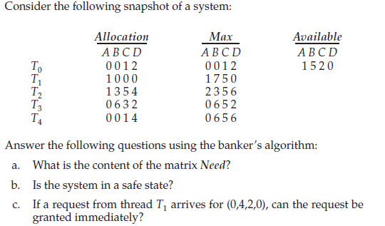




Slide 36
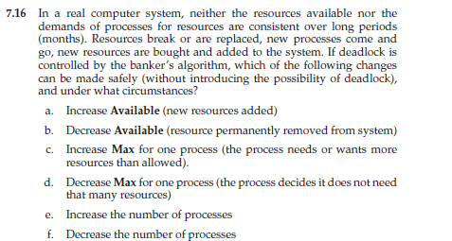
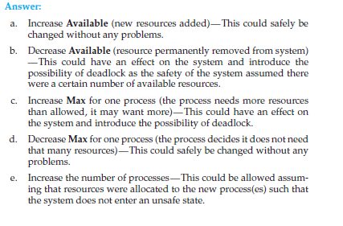

Slide 37
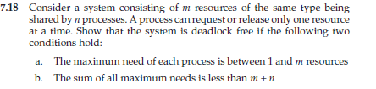
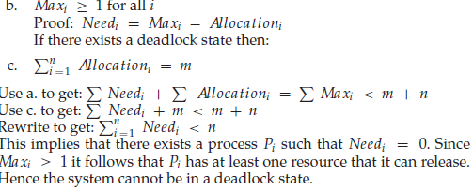

Slide 38
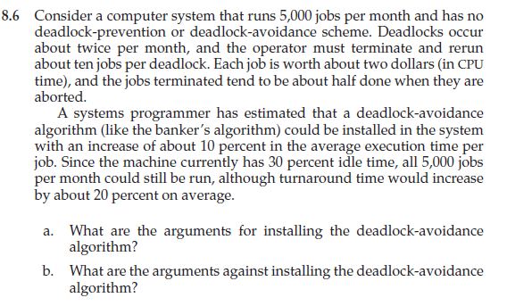


Slide 39
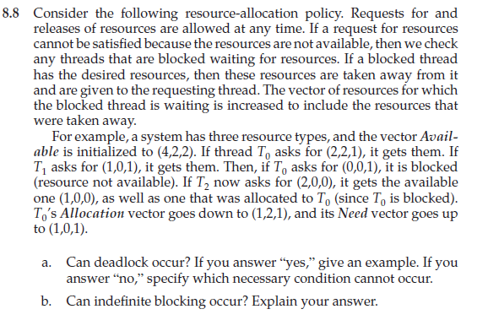


Slide 40
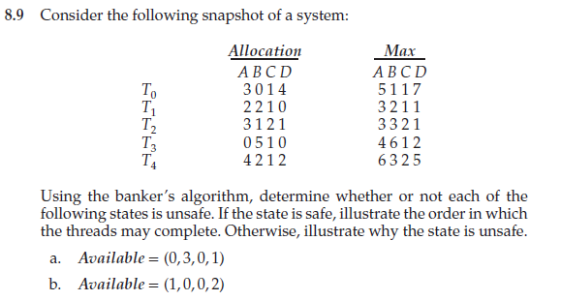


Slide 41
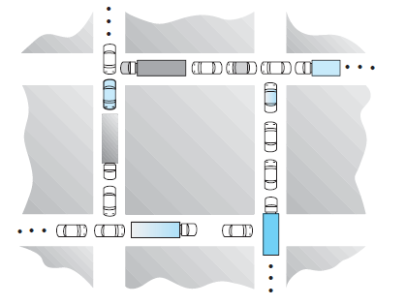

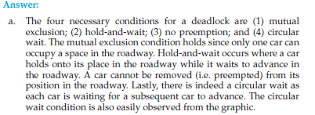


Slide 42
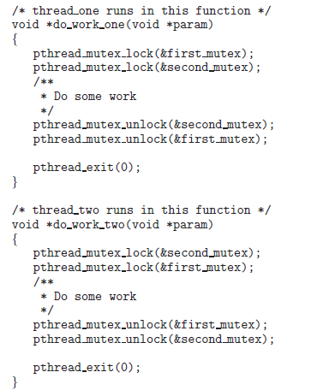



Slide 43
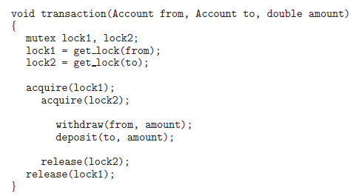
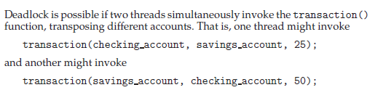
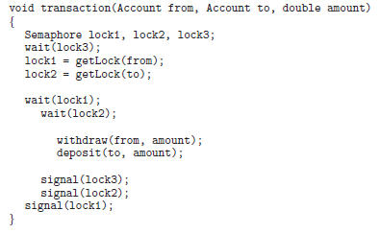

Slide 44



