Slide 1
Scheduling

Slide 2
Terminology
Arrival Time (AT): Time when a process enters the ready state
Burst Time (BT): Total CPU time required for process completion
Completion Time (CT): Time when a process completes execution
Turnaround time (TT): Total time taken to complete a process
    (CT - AT)
            or
            (BT + WT)
Waiting Time (WT): Total time the process spends in the ready queue (TT - BT)
Response Time (RT): Time from when the process is created to the time it first gets the CPU
Throughput : Number of processes completed per unit time
Minimize
Maximize

Slide 3
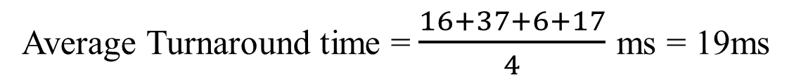
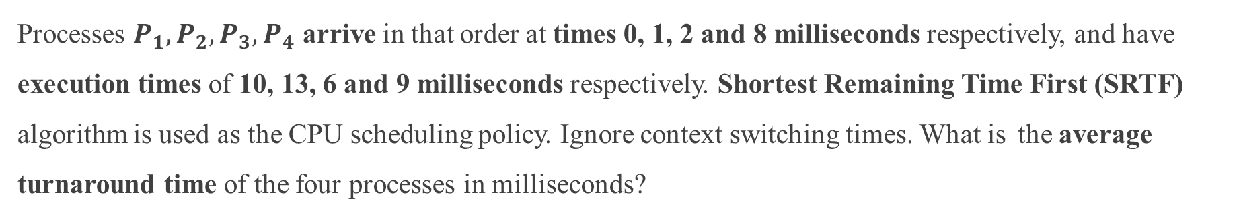
Problem 1 (GATE 2025)
Processes $P_{1},P_{2},P_{3},P_{4}$ arrive in that order at times 0, 1, 2 and 8 milliseconds respectively, and have execution times of 10, 13, 6 and 9 milliseconds respectively. Shortest Remaining Time First (SRTF) algorithm is used as the CPU scheduling policy. Ignore context switching times. What is the average turnaround time of the four processes in milliseconds?
Processes | Arrival Time (AT) | Burst Time (BT) | Completion Time | Turnaround Time (TT = CT - AT)
P1 | 0 | 10 | 16 | (16 - 0) = 16
P2 | 1 | 13 | 38 | (38 – 1) = 37
P3 | 2 | 6 | 8 | (8 – 2) = 6
P4 | 8 | 9 | 25 | (25 - 8) = 17
Processes | Arrival Time (AT) | Burst Time (BT) | Completion Time | Turnaround Time (TT = CT - AT)
P1 | 0 | 10
P2 | 1 | 13
P3 | 2 | 6
P4 | 8 | 9
8
0
0
0
0
Average Turnaround time = $\frac{16+37+6+17}{4}$ ms = 19ms
P1
P3
P1
P4
P2
0
2
8
16
25
38

Slide 4
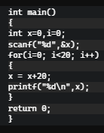
Problem 2 (GATE 2025)
Suppose in a multiprogramming environment, the following C program segment is executed. A process goes into I/O queue whenever an I/O related operation is performed. Assume that there will always be a context switch whenever a process requests for an I/O, and also whenever the process returns from an I/O. The number of times the process will enter the ready queue during its lifetime (not counting the time the process enters the ready queue when it is run initially) is ___________ .
21 times
new
terminated
admitted
dispatched
exit
Executed once
ready
running
interrupt
I/O completion
I/O or event wait
Executed 20 times
waiting

Slide 5
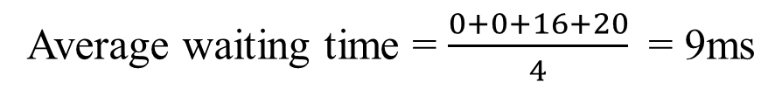
Problem 3 (GATE 2025)
A computer has two processors, M1 and M2. Four processes P1, P2, P3 and P4 with CPU bursts of 20, 16, 25 and 10 milliseconds, respectively, arrive at the same time and these are the only processes in the system. The scheduler uses non-preemptive priority scheduling, with priorities decided as follows:
M1 uses priority of execution for the processes as, P1 > P3 > P2 > P4 , i.e., P1 and P4 have highest and lowest priorities, respectively.
M2 uses priority of execution for the processes as, P2 > P3 > P4 > P1 , i.e., P2 and P1 have highest and lowest priorities, respectively.
A process is scheduled to a processor Mk, if the processor is free and no other process Pj is waiting with higher priority. At any given point of time, a process can be allocated to any one of the free processors without violating the execution priority rules. Ignore the context switch time. What will be the average waiting time of the processes in milliseconds?
Processes | Burst Time (BT) | Waiting Time (WT)
P1 | 20 | 0
P2 | 16 | 0
P3 | 25 | 16
P4 | 10 | 20
Processes | Burst Time (BT) | Waiting Time (WT)
P1 | 20
P2 | 16
P3 | 25
P4 | 10
P1
P4
M1
0
20
30
P2
P3
M2
0
16
41
Average waiting time = $\frac{0+0+16+20}{4}$ = 9ms

Slide 6
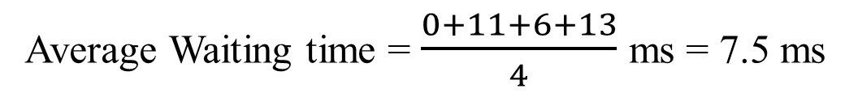
Problem 4 (GATE 2024)
​​​​Consider a single processor system with four processes A, B, C and D. Find the average waiting time for SRTF and SJF
Processes | Arrival Time (AT) | Burst Time (BT) | Completion Time | Waiting Time (WT = CT – AT - BT)
A | 0 | 10
B | 2 | 6
C | 4 | 3
D | 6 | 7
Processes | Arrival Time (AT) | Burst Time (BT) | Completion Time | Waiting Time (WT = CT – AT - BT)
A | 0 | 10 | 10 | 10 – 10 – 0 = 0
B | 2 | 6 | 19 | 19 – 6 – 2 = 11
C | 4 | 3 | 13 | 13 – 3 – 4 = 6
D | 6 | 7 | 26 | 26 – 7 – 6 = 13
Average Waiting time = $\frac{0+11+6+13}{4}$ ms = 7.5 ms
A
C
B
D
0
10
13
19
26

Slide 7
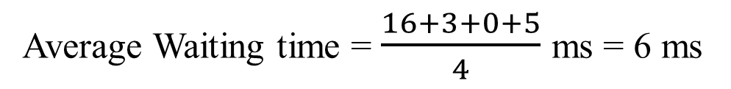
Problem 4 (GATE 2024)
​​​​Consider a single processor system with four processes A, B, C and D. Find the average waiting time for SRTF and SJF
Processes | Arrival Time (AT) | Burst Time (BT) | Completion Time | Waiting Time (WT = CT – AT - BT)
A | 0 | 10
B | 2 | 6
C | 4 | 3
D | 6 | 7
Processes | Arrival Time (AT) | Burst Time (BT) | Completion Time | Waiting Time (WT = CT – AT - BT)
A | 0 | 10 | 26
B | 2 | 6 | 11
C | 4 | 3 | 7
D | 6 | 7 | 18
Processes | Arrival Time (AT) | Burst Time (BT) | Completion Time | Waiting Time (WT = CT – AT - BT)
A | 0 | 10 | 26 | 16
B | 2 | 6 | 11 | 3
C | 4 | 3 | 7 | 0
D | 6 | 7 | 18 | 5
8
0
4
0
0
0
Average Waiting time = $\frac{16+3+0+5}{4}$ ms = 6 ms
A
B
C
B
D
A
0
2
4
7
11
18
26

Slide 8
Problem 5 (GATE 1995)
Which scheduling policy is most suitable for a time-shared operating system?
  Shortest Job First
  Round Robin
  First Come First Serve
Time shared OS:
  Multiple users at the same time
  Rapid context switching between processes
  Non-preemptive approaches like FCFS and SJF, a process/user might monopolize the CPU
  RR is suitable as it gives a turn to execute, to each active process

Slide 9
Problem 6 (Galvin 5.2)
Discuss how the following pairs of scheduling criteria conflict in certain settings.
  CPU utilization and response time
      CPU utilization (keeping CPU busy with process execution)
      Response Time (Time from when the process is created to the time it first gets the CPU)
      We want to – increase CPU utilization
        decrease response time
      CPU utilization increases by reducing CONTEXT SWITCHING
      CONTEXT SWITCHING – CPU wastes time in saving state of one process, loading saved state of another process
      Lower context switching means processes get CPU for more time
      Waiting processes will have to wait for CPU for more time
      Hence, RESPONSE TIME INCERASES
  Average turnaround time and maximum waiting time
  I/O device utilization and CPU utilization

Slide 10
Problem 6 (Galvin 5.2)
Discuss how the following pairs of scheduling criteria conflict in certain settings.
  CPU utilization and response time
  Average turnaround time and maximum waiting time
    Turnaround time (total time to complete the process)
    Waiting time (time spent in ready queue)
    We want to reduce both
    Average TT is reduced by scheduling smaller processes first
    This starves longer processes → INCREASING THEIR WAITING TIME
  I/O device utilization and CPU utilization

Slide 11
Problem 6 (Galvin 5.2)
Discuss how the following pairs of scheduling criteria conflict in certain settings.
  CPU utilization and response time
  Average turnaround time and maximum waiting time
  I/O device utilization and CPU utilization
    CPU utilization (keeping CPU busy with process execution)
    I/O utilization (prioritizing I/O processes)
    I/O process are small, with less burst time
    Improving I/O utilization requires prioritizing these small jobs, as and when they come
    Improving CPU utilization requires lesser context switches, favoring longer CPU bound processes
    This contradicts requirement of small I/O bound jobs

Slide 12
Problem 7 (Galvin)
Consider the following set of processes, with the length of the CPU-burst time given in milliseconds. Compute the Average Turnaround Time and Average Waiting Time for
a. FCFS b. SJF c. non-preemptive priority d. RR (quantum = 1ms)
Processes | Arrival Time (AT) | Burst Time (BT) | Priority | Turnaround Time(TT = CT - AT) | Waiting Time (WT = TT - BT)
P1 | 0 | 10 | 3 | 10 | 10 – 10 = 0
P2 | 0 | 1 | 1 | 11 | 11 – 1 = 10
P3 | 0 | 2 | 3 | 13 | 13 – 2 = 11
P4 | 0 | 1 | 4 | 14 | 14 – 1 = 13
P5 | 0 | 5 | 2 | 19 | 19 – 5 = 14
Processes | Arrival Time (AT) | Burst Time (BT) | Priority | Turnaround Time(TT = CT - AT) | Waiting Time (WT = TT - BT)
P1 | 0 | 10 | 3 | 10
P2 | 0 | 1 | 1 | 11
P3 | 0 | 2 | 3 | 13
P4 | 0 | 1 | 4 | 14
P5 | 0 | 5 | 2 | 19
Processes | Arrival Time (AT) | Burst Time (BT) | Priority | Turnaround Time(TT = CT - AT) | Waiting Time (WT = TT - BT)
P1 | 0 | 10 | 3
P2 | 0 | 1 | 1
P3 | 0 | 2 | 3
P4 | 0 | 1 | 4
P5 | 0 | 5 | 2
P1
P2
P3
P4
P5
0
10
11
13
14
19

Slide 13
Problem 7 (Galvin)
Consider the following set of processes, with the length of the CPU-burst time given in milliseconds. Compute the Average Turnaround Time and Average Waiting Time for
a. FCFS b. SJF c. non-preemptive priority d. RR (quantum = 1ms)
Processes | Arrival Time (AT) | Burst Time (BT) | Priority | Turnaround Time(TT = CT - AT) | Waiting Time (WT = TT - BT)
P1 | 0 | 10 | 3
P2 | 0 | 1 | 1
P3 | 0 | 2 | 3
P4 | 0 | 1 | 4
P5 | 0 | 5 | 2
Processes | Arrival Time (AT) | Burst Time (BT) | Priority | Turnaround Time(TT = CT - AT) | Waiting Time (WT = TT - BT)
P1 | 0 | 10 | 3 | 19
P2 | 0 | 1 | 1 | 1
P3 | 0 | 2 | 3 | 4
P4 | 0 | 1 | 4 | 2
P5 | 0 | 5 | 2 | 9
Processes | Arrival Time (AT) | Burst Time (BT) | Priority | Turnaround Time(TT = CT - AT) | Waiting Time (WT = TT - BT)
P1 | 0 | 10 | 3 | 19 | (19 - 10) = 9
P2 | 0 | 1 | 1 | 1 | (1 - 1) = 0
P3 | 0 | 2 | 3 | 4 | (4 - 2) = 2
P4 | 0 | 1 | 4 | 2 | (2 - 1) = 1
P5 | 0 | 5 | 2 | 9 | (9 - 5) = 4
P2
P4
P3
P5
P1
0
1
2
4
9
19

Slide 14
Problem 7 (Galvin)
Consider the following set of processes, with the length of the CPU-burst time given in milliseconds. Compute the Average Turnaround Time and Average Waiting Time for
a. FCFS b. SJF c. non-preemptive priority d. RR (quantum = 1ms)
Processes | Arrival Time (AT) | Burst Time (BT) | Priority | Turnaround Time(TT = CT - AT) | Waiting Time (WT = TT - BT)
P1 | 0 | 10 | 3 | 16 | 6
P2 | 0 | 1 | 1 | 1 | 0
P3 | 0 | 2 | 3 | 18 | 16
P4 | 0 | 1 | 4 | 19 | 18
P5 | 0 | 5 | 2 | 6 | 1
Processes | Arrival Time (AT) | Burst Time (BT) | Priority | Turnaround Time(TT = CT - AT) | Waiting Time (WT = TT - BT)
P1 | 0 | 10 | 3
P2 | 0 | 1 | 1
P3 | 0 | 2 | 3
P4 | 0 | 1 | 4
P5 | 0 | 5 | 2
Processes | Arrival Time (AT) | Burst Time (BT) | Priority | Turnaround Time(TT = CT - AT) | Waiting Time (WT = TT - BT)
P1 | 0 | 10 | 3 | 16
P2 | 0 | 1 | 1 | 1
P3 | 0 | 2 | 3 | 18
P4 | 0 | 1 | 4 | 19
P5 | 0 | 5 | 2 | 6
P2
P5
P1
P3
P4
0
1
6
16
18
19

Slide 15
Problem 7 (Galvin)
Consider the following set of processes, with the length of the CPU-burst time given in milliseconds. Compute the Average Turnaround Time and Average Waiting Time for
a. FCFS b. SJF c. non-preemptive priority d. RR (quantum = 1ms)
Processes | Arrival Time (AT) | Burst Time (BT) | Priority | Turnaround Time(TT = CT - AT) | Waiting Time (WT = TT - BT)
P1 | 0 | 10 | 3
P2 | 0 | 1 | 1
P3 | 0 | 2 | 3
P4 | 0 | 1 | 4
P5 | 0 | 5 | 2
Processes | Arrival Time (AT) | Burst Time (BT) | Priority | Turnaround Time(TT = CT - AT) | Waiting Time (WT = TT - BT)
P1 | 0 | 10 | 3 | 19
P2 | 0 | 1 | 1 | 2
P3 | 0 | 2 | 3 | 7
P4 | 0 | 1 | 4 | 4
P5 | 0 | 5 | 2 | 14
Processes | Arrival Time (AT) | Burst Time (BT) | Priority | Turnaround Time(TT = CT - AT) | Waiting Time (WT = TT - BT)
P1 | 0 | 10 | 3 | 19 | 9
P2 | 0 | 1 | 1 | 2 | 1
P3 | 0 | 2 | 3 | 7 | 5
P4 | 0 | 1 | 4 | 4 | 3
P5 | 0 | 5 | 2 | 14 | 9
P1
P2
P3
P4
P5
P1
P3
P5
P1
P5
P1
P5
P1
P5
P1
0
2
4
7
14
19

Slide 16
Problem 8 (Galvin)
Which of the following could result in starvation?
  FCFS
  SJF
  Round robin
  Priority
FCFS: Every process gets CPU based on their arrival, no starvation

Slide 17
Problem 8 (Galvin)
Which of the following could result in starvation?
  FCFS
  SJF
  Round robin
  Priority
FCFS: Every process gets CPU based on their arrival, no starvation
SJF: Processes with shorter CPU time gets the CPU, hence can starve longer processes

Slide 18
Problem 8 (Galvin)
Which of the following could result in starvation?
  FCFS
  SJF
  Round robin
  Priority
FCFS: Every process gets CPU based on their arrival, no starvation
SJF: Processes with shorter CPU time gets the CPU, hence can starve longer processes
Round robin: No starvation, turn based

Slide 19
Problem 8 (Galvin)
Which of the following could result in starvation?
  FCFS
  SJF
  Round robin
  Priority
FCFS: Every process gets CPU based on their arrival, no starvation
SJF: Processes with shorter CPU time gets the CPU, hence can starve longer processes
Round robin: No starvation, turn based
Priority: Lower priority processes might never get CPU if we always have higher priority processes in the ready queue. Hence, can starve lower priority processes.

Slide 20
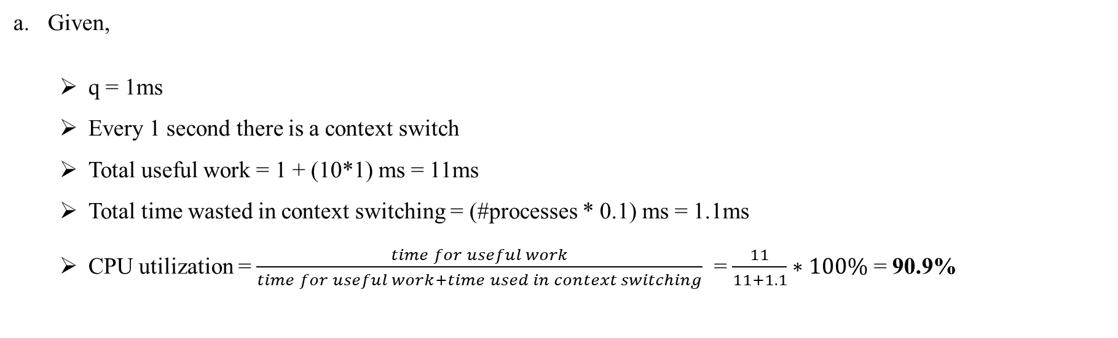
Problem 9 (Galvin)
Consider a system running ten I/O-bound tasks and one CPU-bound task. Assume that the I/O-bound tasks issue an I/O operation once for every millisecond of CPU computing and that each I/O operation takes 10 milliseconds to complete. Also assume that the context switching overhead is 0.1 millisecond and that all processes are long-running tasks. What is the CPU utilization for a round-robin scheduler when:
  The time quantum is 1 millisecond
  The time quantum is 10 milliseconds
Given,
  q = 1ms
  Every 1 second there is a context switch
  Total useful work = 1 + (10*1) ms = 11ms
  Total time wasted in context switching = (#processes * 0.1) ms = 1.1ms
  CPU utilization = $\frac{time for useful work}{time for useful work+time used in context switching}$ = $\frac{11}{11+1.1}∗100\%$ = 90.9%

Slide 21
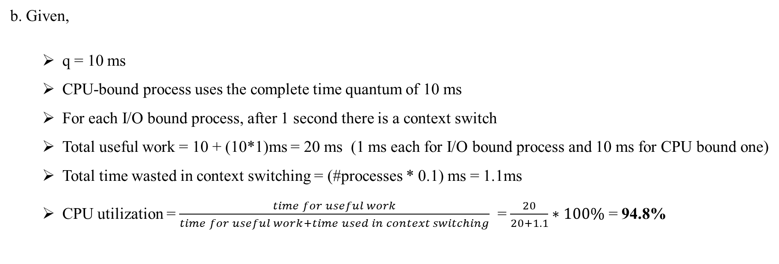
Problem 9 (Galvin)
Consider a system running ten I/O-bound tasks and one CPU-bound task. Assume that the I/O-bound tasks issue an I/O operation once for every millisecond of CPU computing and that each I/O operation takes 10 milliseconds to complete. Also assume that the context switching overhead is 0.1 millisecond and that all processes are long-running tasks. What is the CPU utilization for a round-robin scheduler when:
  The time quantum is 1 millisecond
  The time quantum is 10 milliseconds
b. Given,
  q = 10 ms
  CPU-bound process uses the complete time quantum of 10 ms
  For each I/O bound process, after 1 second there is a context switch
  Total useful work = 10 + (10*1)ms = 20 ms (1 ms each for I/O bound process and 10 ms for CPU bound one)
  Total time wasted in context switching = (#processes * 0.1) ms = 1.1ms
  CPU utilization = $\frac{time for useful work}{time for useful work+time used in context switching}$ = $\frac{20}{20+1.1}∗100\%$ = 94.8%

