Slide 1
Deep Convolutional Neural Architectures

Slide 2
Behavior of multilayer neural networks
Types of
Decision Regions
Exclusive-OR
Problem
Classes with
Meshed regions
Most General
Region Shapes
Structure
Single-Layer
Half Plane
Bounded By
Hyper plane
A
B
B
A
B
A
Two-Layer
Convex Open
Or
Closed Regions
A
B
B
A
B
A
Three-Layer
Arbitrary
(Complexity
Limited by No.
of Nodes)
A
B
B
A
B
A
  Slides Courtsey: Abin Roozgard

Slide 3
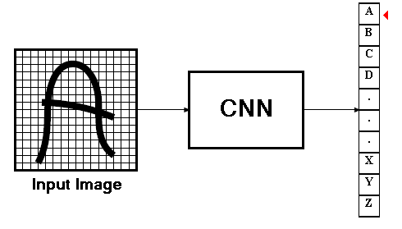
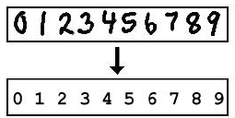
Convolutional neural networks
  Signal processing, Image processing
improvement over the multilayer perceptron
  performance, accuracy and some degree of invariance to distortions in the input images

Slide 4
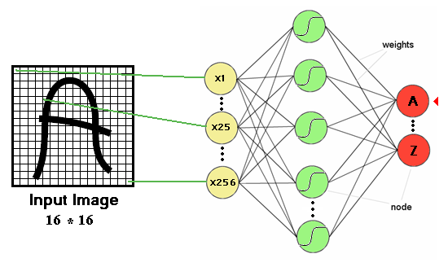
Multi-layer perceptron and image processing
One or more hidden layers
Sigmoid activations functions

Slide 5
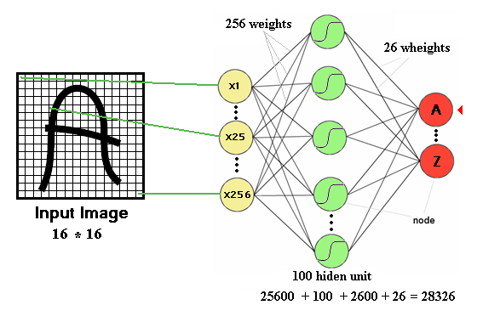
Drawbacks of previous neural networks
the number of trainable parameters becomes extremely large

Slide 6
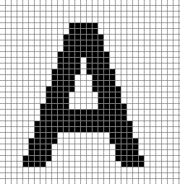
Drawbacks of previous neural networks
Little or no invariance to shifting, scaling, and other forms of distortion

Slide 7
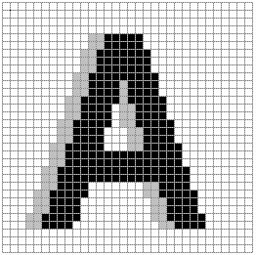
Drawbacks of previous neural networks
Little or no invariance to shifting, scaling, and other forms of distortion
Shift left

Slide 8
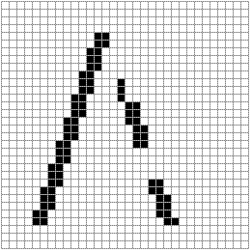
Drawbacks of previous neural networks
154 input change from 2 shift left
77 : black to white
77 : white to black

Slide 9
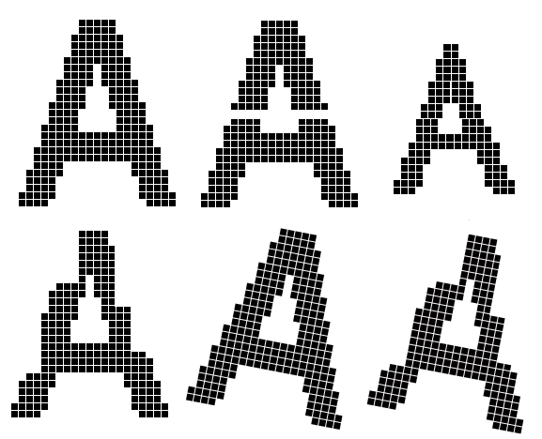
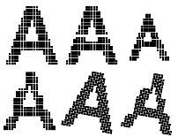
Drawbacks of previous neural networks
scaling, and other forms of distortion

Slide 10
Drawbacks of previous neural networks
the topology of the input data is completely ignored
work with raw data.
Feature 1
Feature 2

Slide 11
Drawbacks of previous neural networks
Black and white patterns:
Gray scale patterns :
32 * 32 input image

Slide 12
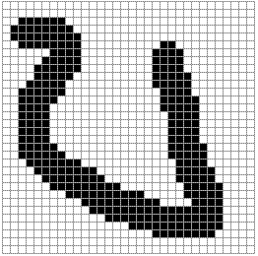
Drawbacks of previous neural networks
A
A

Slide 13
Improvement
Fully connected network of sufficient size can produce outputs that are invariant with respect to such variations.
  Training time
  Network size
  Free parameters

Slide 14
A Predictive DL Model:
Convolutional Neural Networks (CNNs)
Liu et al., A survey of deep neural network architectures and their applications. Neurocomputing 234: 11-26 (2017)

Slide 15
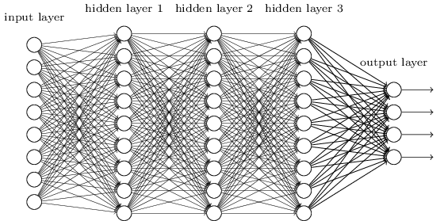
The CNN
We know it is good to learn a small model.
From this fully connected model, do we really need all the edges?
Can some of these be shared?

Slide 16
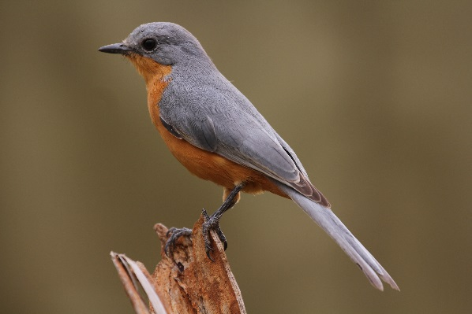
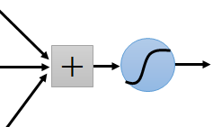
Consider learning an image:
Some patterns are much smaller than the whole image
Can represent a small region with fewer parameters
“beak” detector

Slide 17
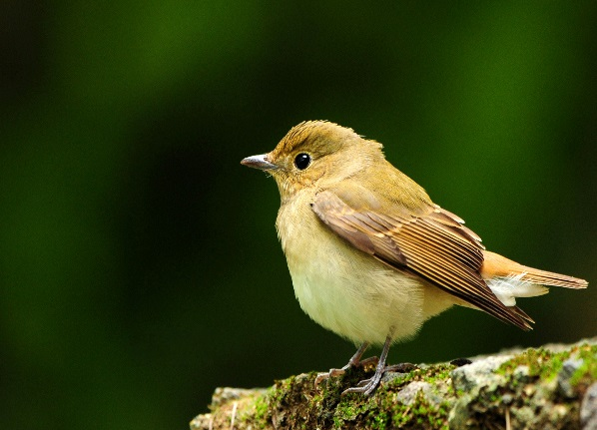
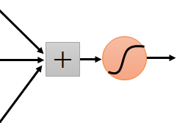
Same pattern appears in different places:
They can be compressed!
What about training a lot of such “small” detectors and each detector must “move around”.
“upper-left beak” detector
They can be compressed
to the same parameters.
“middle beak” detector

Slide 18
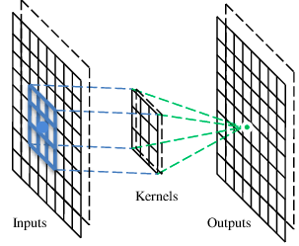
A convolutional layer
A CNN is a neural network with some convolutional layers
(and some other layers). A convolutional layer has a number
of filters that does convolutional operation.
Beak detector
A filter

Slide 25
Convolution
These are the network parameters to be learned.
1 | -1 | -1
-1 | 1 | -1
-1 | -1 | 1
1 | 0 | 0 | 0 | 0 | 1
0 | 1 | 0 | 0 | 1 | 0
0 | 0 | 1 | 1 | 0 | 0
1 | 0 | 0 | 0 | 1 | 0
0 | 1 | 0 | 0 | 1 | 0
0 | 0 | 1 | 0 | 1 | 0
Filter 1
-1 | 1 | -1
-1 | 1 | -1
-1 | 1 | -1
Filter 2
……
6 x 6 image
Each filter detects a small pattern (3 x 3).

Slide 26
Convolution
1 | -1 | -1
-1 | 1 | -1
-1 | -1 | 1
Filter 1
stride=1
1 | 0 | 0 | 0 | 0 | 1
0 | 1 | 0 | 0 | 1 | 0
0 | 0 | 1 | 1 | 0 | 0
1 | 0 | 0 | 0 | 1 | 0
0 | 1 | 0 | 0 | 1 | 0
0 | 0 | 1 | 0 | 1 | 0
Dot
product
3
-1
6 x 6 image

Slide 27
Convolution
1 | -1 | -1
-1 | 1 | -1
-1 | -1 | 1
Filter 1
If stride=2
1 | 0 | 0 | 0 | 0 | 1
0 | 1 | 0 | 0 | 1 | 0
0 | 0 | 1 | 1 | 0 | 0
1 | 0 | 0 | 0 | 1 | 0
0 | 1 | 0 | 0 | 1 | 0
0 | 0 | 1 | 0 | 1 | 0
3
-3
6 x 6 image

Slide 28
Convolution
1 | -1 | -1
-1 | 1 | -1
-1 | -1 | 1
Filter 1
stride=1
1 | 0 | 0 | 0 | 0 | 1
0 | 1 | 0 | 0 | 1 | 0
0 | 0 | 1 | 1 | 0 | 0
1 | 0 | 0 | 0 | 1 | 0
0 | 1 | 0 | 0 | 1 | 0
0 | 0 | 1 | 0 | 1 | 0
3
-1
-3
-1
-3
1
0
-3
-3
-3
0
1
3
-2
-2
-1
6 x 6 image

Slide 29
Convolution
-1 | 1 | -1
-1 | 1 | -1
-1 | 1 | -1
Filter 2
stride=1
Repeat this for each filter
1 | 0 | 0 | 0 | 0 | 1
0 | 1 | 0 | 0 | 1 | 0
0 | 0 | 1 | 1 | 0 | 0
1 | 0 | 0 | 0 | 1 | 0
0 | 1 | 0 | 0 | 1 | 0
0 | 0 | 1 | 0 | 1 | 0
3
-1
-3
-1
-1
-1
-1
-1
-3
1
0
-3
-1
-1
-2
1
Feature
Map
-3
-3
0
1
-1
-1
-2
1
3
-2
-2
-1
6 x 6 image
-1
0
-4
3
Two 4 x 4 images
Forming 2 x 4 x 4 matrix

Slide 30
CNN – Zero Padding
1 | -1 | -1
-1 | 1 | -1
-1 | -1 | 1
Filter 1
0
0
0
0
1 | 0 | 0 | 0 | 0 | 1
0 | 1 | 0 | 0 | 1 | 0
0 | 0 | 1 | 1 | 0 | 0
1 | 0 | 0 | 0 | 1 | 0
0 | 1 | 0 | 0 | 1 | 0
0 | 0 | 1 | 0 | 1 | 0
0
You will get another 6 x 6 images in this way
0
0
Zero padding
0
0
0
6 x 6 image

Slide 31
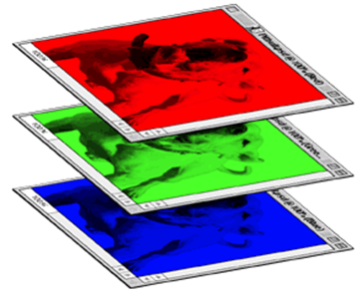
Color image: RGB 3 channels
1 | -1 | -1
-1 | 1 | -1
-1 | -1 | 1
-1 | 1 | -1
-1 | 1 | -1
-1 | 1 | -1
1 | -1 | -1
-1 | 1 | -1
-1 | -1 | 1
-1 | 1 | -1
-1 | 1 | -1
-1 | 1 | -1
1 | -1 | -1
-1 | 1 | -1
-1 | -1 | 1
-1 | 1 | -1
-1 | 1 | -1
-1 | 1 | -1
Filter 1
Filter 2
Color image
1 | 0 | 0 | 0 | 0 | 1
0 | 1 | 0 | 0 | 1 | 0
0 | 0 | 1 | 1 | 0 | 0
1 | 0 | 0 | 0 | 1 | 0
0 | 1 | 0 | 0 | 1 | 0
0 | 0 | 1 | 0 | 1 | 0
1 | 0 | 0 | 0 | 0 | 1
0 | 1 | 0 | 0 | 1 | 0
0 | 0 | 1 | 1 | 0 | 0
1 | 0 | 0 | 0 | 1 | 0
0 | 1 | 0 | 0 | 1 | 0
0 | 0 | 1 | 0 | 1 | 0
1 | 0 | 0 | 0 | 0 | 1
0 | 1 | 0 | 0 | 1 | 0
0 | 0 | 1 | 1 | 0 | 0
1 | 0 | 0 | 0 | 1 | 0
0 | 1 | 0 | 0 | 1 | 0
0 | 0 | 1 | 0 | 1 | 0

Slide 35
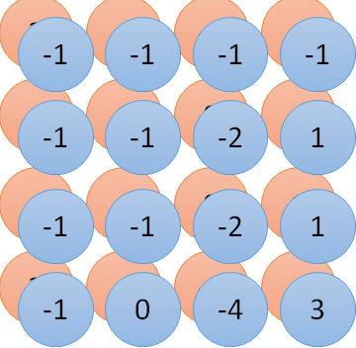
Convolution v.s. Fully Connected
1 | 0 | 0 | 0 | 0 | 1
0 | 1 | 0 | 0 | 1 | 0
0 | 0 | 1 | 1 | 0 | 0
1 | 0 | 0 | 0 | 1 | 0
0 | 1 | 0 | 0 | 1 | 0
0 | 0 | 1 | 0 | 1 | 0
1 | -1 | -1
-1 | 1 | -1
-1 | -1 | 1
-1 | 1 | -1
-1 | 1 | -1
-1 | 1 | -1
convolution
image
1 | 0 | 0 | 0 | 0 | 1
0 | 1 | 0 | 0 | 1 | 0
0 | 0 | 1 | 1 | 0 | 0
1 | 0 | 0 | 0 | 1 | 0
0 | 1 | 0 | 0 | 1 | 0
0 | 0 | 1 | 0 | 1 | 0
Fully-connected
……
……

Slide 36
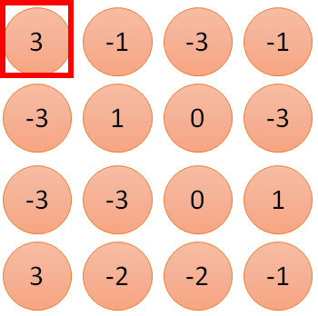
1 | -1 | -1
-1 | 1 | -1
-1 | -1 | 1
1
1
Filter 1
2
0
3
0
3
4:
0
1 | 0 | 0 | 0 | 0 | 1
0 | 1 | 0 | 0 | 1 | 0
0 | 0 | 1 | 1 | 0 | 0
1 | 0 | 0 | 0 | 1 | 0
0 | 1 | 0 | 0 | 1 | 0
0 | 0 | 1 | 0 | 1 | 0
…
0
8
1
9
0
10:
0
…
13
0
6 x 6 image
14
0
fewer parameters!
15
Only connect to 9 inputs, not fully connected
1
16
1
…

Slide 37
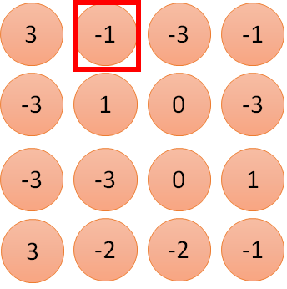
1 | -1 | -1
-1 | 1 | -1
-1 | -1 | 1
1:
1
Filter 1
2:
0
3:
0
3
4:
0
1 | 0 | 0 | 0 | 0 | 1
0 | 1 | 0 | 0 | 1 | 0
0 | 0 | 1 | 1 | 0 | 0
1 | 0 | 0 | 0 | 1 | 0
0 | 1 | 0 | 0 | 1 | 0
0 | 0 | 1 | 0 | 1 | 0
…
7:
0
8:
1
-1
9:
0
10:
0
…
13:
0
6 x 6 image
14:
0
Fewer parameters
15:
1
16:
1
Shared weights
Even fewer parameters
…

Slide 38
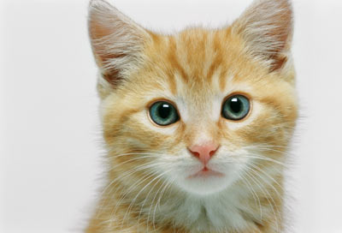
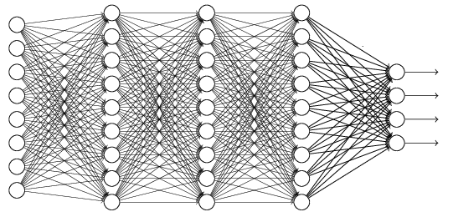
The whole CNN
cat dog ……
Convolution
Max Pooling
Can repeat many times
Fully Connected Feedforward network
Convolution
Max Pooling
Flattened

Slide 39
Max Pooling
1 | -1 | -1
-1 | 1 | -1
-1 | -1 | 1
-1 | 1 | -1
-1 | 1 | -1
-1 | 1 | -1
Filter 1
Filter 2
3
-1
-3
-1
-1
-1
-1
-1
-3
1
0
-3
-1
-1
-2
1
-3
-3
0
1
-1
-1
-2
1
3
-2
-2
-1
-1
0
-4
3

Slide 40
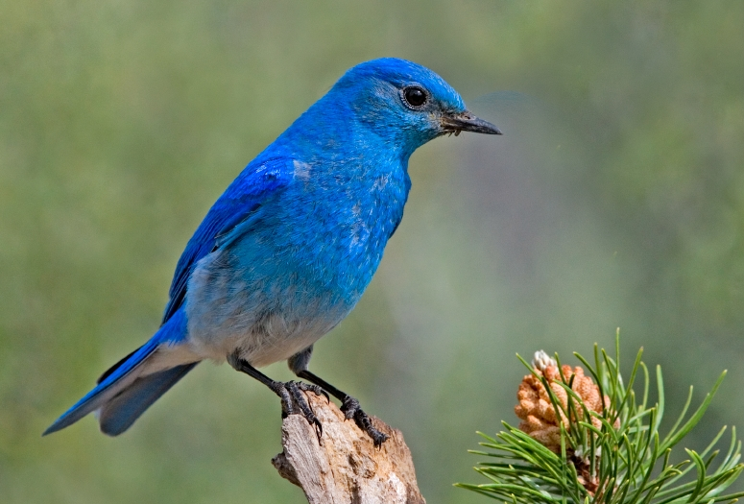

Why Pooling
Subsampling pixels will not change the object
bird
bird
Subsampling
We can subsample the pixels to make image smaller
fewer parameters to characterize the image

Slide 41
A CNN compresses a fully connected network in two ways:
Reducing number of connections
Shared weights on the edges
Max pooling further reduces the complexity

Slide 42
Max Pooling
New image
but smaller
1 | 0 | 0 | 0 | 0 | 1
0 | 1 | 0 | 0 | 1 | 0
0 | 0 | 1 | 1 | 0 | 0
1 | 0 | 0 | 0 | 1 | 0
0 | 1 | 0 | 0 | 1 | 0
0 | 0 | 1 | 0 | 1 | 0
Conv
3
0
-1
1
Max
Pooling
3
1
0
3
2 x 2 image
6 x 6 image
Each filter
is a channel

Slide 44
The whole CNN
3
0
-1
1
Convolution
3
1
0
3
Max Pooling
Can repeat many times
A new image
Convolution
Smaller than the original image
The number of channels is the number of filters
Max Pooling

Slide 45
The whole CNN
cat dog ……
Convolution
Max Pooling
Fully Connected Feedforward network
A new image
Convolution
Max Pooling
Flattened
A new image

Slide 46
Flattening
3
0
1
3
0
-1
1
3
3
1
-1
0
3
Flattened
1
Fully Connected Feedforward network
0
3

Slide 47
Classification
Classification
Convolutional neural network
f1
f 2
Pre-processing for feature extraction
f1 … fn
Input
Classification
output
Input
Feature extraction
Shift and distortion invariance
classification
output

Slide 48
CNN’s Topology
Feature maps
C
Feature extraction layer
Convolution layer
Shift and distortion invariance or
Subsampling layer
S

Slide 49
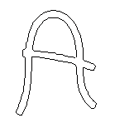
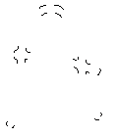
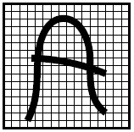
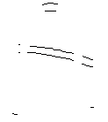
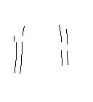

Feature extraction layer or Convolution layer
detect the same feature at different positions in the
input image.
features

Slide 50
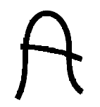
Feature extraction
-1
0
1
Convolve with
Threshold
-1
0
1
-1
0
1
w11
w12
w13
w11
w12
w13
w21
w22
w23
w21
w22
w23
w31
w32
w33
w31
w32
w33

Slide 51
Feature extraction
Shared weights: all neurons in a feature share the
same weights (but not the biases).
In this way all neurons detect the same feature at
different positions in the input image.
Reduce the number of free parameters.
Inputs
C
S

Slide 52

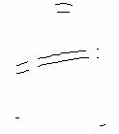
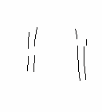
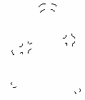
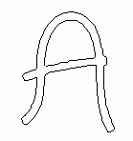
Feature extraction
If a neuron in the feature map fires, this corresponds to a match with the template.

Slide 53

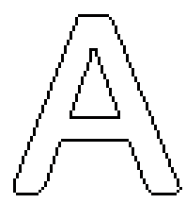
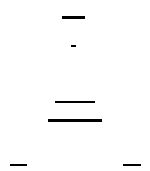
Subsampling layer
the subsampling layers reduce the spatial resolution of each feature map
By reducing the spatial resolution of the feature map, a certain degree of shift and distortion invariance is
achieved.

Slide 54
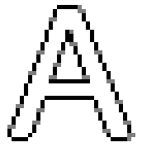
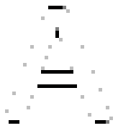

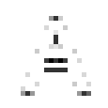


Subsampling layer
the subsampling layers reduce the spatial resolution of each feature map

Slide 55

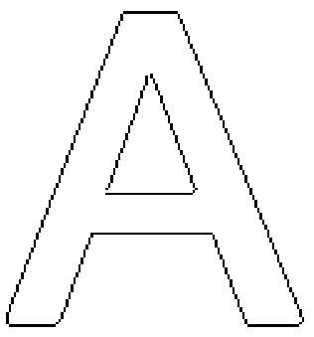
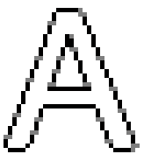



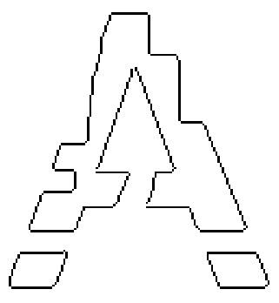
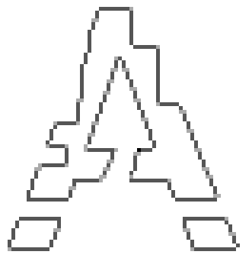


Subsampling layer

Slide 56

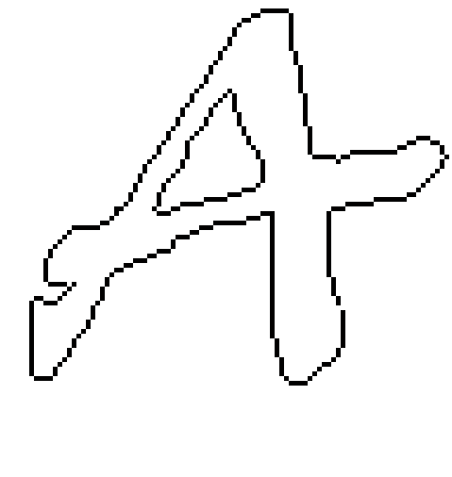
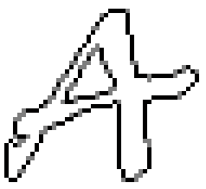
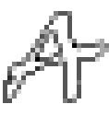

Subsampling layer
The weight sharing is also applied in subsampling
layers.

Slide 57
Subsampling layer
the weight sharing is also applied in subsampling layers
reduce the effect of noises and shift or distortion
Feature map

Slide 58
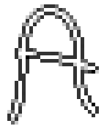
Up to now …

Slide 59
LeNet 5

Slide 60
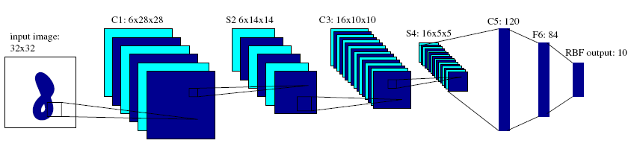
LeNet5
Introduced by LeCun.
raw image of 32 × 32 pixels as input.

Slide 61
LeNet5
C1,C3,C5 : Convolutional layer.
5 × 5 Convolution matrix.
S2 , S4 : Subsampling layer.
Subsampling by factor 2.
F6 : Fully connected layer.

Slide 62
LeNet5
All the units of the layers up to F6 have a sigmoidal activation function of the type:

Slide 63
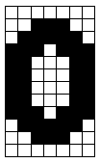
LeNet5
+1
+1
F1
W1
F2
W2
0
Y0
+1
W84
F84

Slide 64
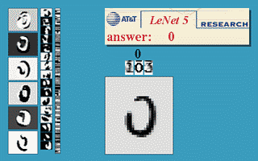

LeNet5
About 187,000 connection.
About 14,000 trainable weight.

Slide 65
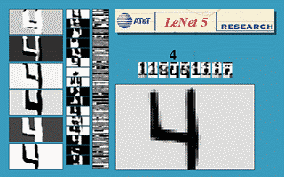


LeNet5

Slide 66




LeNet5

Slide 67



What does CNN learn?
The output of the k-th filter is a 11 x 11 matrix.
x
input
Degree of the activation of the k-th filter:
$$a^{k}=\sum_{i=1}^{11}{\sum_{j=1}^{11}{a_{ij}^{k}}}$$
25 3x3 filters
Convolution
$$x^{∗}=arg\max_{x}{a^{k}}$$
(gradient ascent)
11
Max Pooling
3
-1
……
-1
50 3x3 filters
$$a_{ij}^{k}$$
Convolution
-3
1
……
-3
11
50 x 11 x 11
……
……
……
Max Pooling
3
-2
……
-1

Slide 68

What does CNN learn?
The output of the k-th filter is a 11 x 11 matrix.
input
Degree of the activation of the k-th filter:
$$a^{k}=\sum_{i=1}^{11}{\sum_{j=1}^{11}{a_{ij}^{k}}}$$
25 3x3 filters
Convolution
$$x^{∗}=arg\max_{x}{a^{k}}$$
(gradient ascent)
Max Pooling
50 3x3 filters
Convolution
50 x 11 x 11
Max Pooling
For each filter

Slide 69




What does CNN learn?
input
$$x^{∗}=arg\max_{x}{y^{i}}$$
Can we see digits?
Convolution
Max Pooling
0
1
2
Convolution
Max Pooling
3
4
5
flatten
6
7
8
Deep Neural Networks are Easily Fooled
https://www.youtube.com/watch?v=M2IebCN9Ht4
$$y_{i}$$

Slide 70



What does CNN learn?
Over all pixel values
$$x^{∗}=arg\max_{x}\left(y^{i}+\sum_{i,j}{\left|x_{ij}\right|}\right)$$
$$x^{∗}=arg\max_{x}{y^{i}}$$
0
1
2
0
1
2
3
4
5
3
4
5
6
7
8
6
7
8

Slide 71



Deep Dream
CNN
Modify image
Given a photo, machine adds what it sees ……
$$\left[\begin{aligned}3.9 \\ −1.5 \\ 2.3 \\ ⋮\end{aligned}\right]$$
CNN exaggerates what it sees
http://deepdreamgenerator.com/

Slide 72

Deep Dream
Given a photo, machine adds what it sees ……
http://deepdreamgenerator.com/

Slide 73

Deep Style
Given a photo, make its style like famous paintings
https://dreamscopeapp.com/

Slide 74

Deep Style
Given a photo, make its style like famous paintings
https://dreamscopeapp.com/

Slide 75

Deep Style
CNN
CNN
A Neural Algorithm of Artistic Style
https://arxiv.org/abs/1508.06576
content
style
CNN
?

Slide 76

ImageNet Large Scale Visual Recognition Challenge (ILSVRC) winners
Slide taken from Fei-Fei & Justin Johnson & Serena Yeung. Lecture 9.
Notes:
הזוכה משנת 2015 –
כאן המודל הוא כבר ממש עמוק עם 152 שכבות

Slide 87
CVPR 2017

Slide 88
… And many more predictive CNN Models
ICLR 2017

Slide 89

…and that’s it!
Thank You
Prof. P. C. Mahalanobis, remember Mahalanobis distance?

