Slide 1
Tips for Training DNN
New Activation Function

Slide 2





ReLU
Rectified Linear Unit (ReLU)
Reason:
$$a$$
$$σ\left(z\right)$$
$$a=z$$
1. Fast to compute
2. Biological reason
$$a=0$$
3. Infinite sigmoid with different biases
$$z$$
4. Resistant to vanishing gradient problem
[Xavier Glorot, AISTATS’11]
[Andrew L. Maas, ICML’13]
[Kaiming He, arXiv’15]
Notes:
Parametric ReLU, -> PReLU
Ref: Glorot, Xavier, Antoine Bordes, and Yoshua Bengio. "Deep sparse rectifier neural networks." International Conference on Artificial Intelligence and Statistics. 2011.
No differentailalbe how about 0
Benefit:
2011
Where does it come from?
fast to compute
biology?
many sigmoid

Slide 3
Vanishing Gradient Problem
……
y₁
In 2006, people used RBM pre-training.
In 2015, people use ReLU.
……
y₂
……
……
……
……
……
……
y_{M}
Smaller gradients
Larger gradients
Learn very slow
Learn very fast
Almost random
Already converge
based on random!?
Notes:
The problem of gradient vanish is very hard to explain ……………….!!!!!!!!!!!!!!!!!!!!!!!!!!!!!!!!!
See Gradient flow in recurrent nets: the difficulty of learning long-term dependencies, by Sepp Hochreiter, Yoshua Bengio, Paolo Frasconi, and Jürgen Schmidhuber (2001). This paper studied recurrent neural nets, but the essential phenomenon is the same as in the feedforward networks we are studying. See also Sepp Hochreiter's earlier Diploma Thesis,Untersuchungen zu dynamischen neuronalen Netzen (1991, in German).
Stuck at a bad local minima
When deep learning is difficult in early year
Need initialization
Another point of view
Definition of gradient

Slide 4
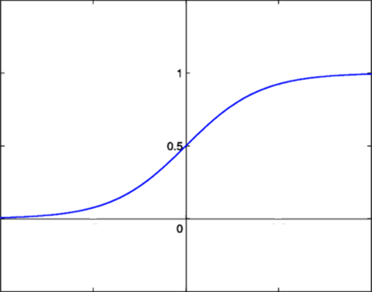




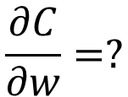






Vanishing Gradient Problem
Smaller gradients
……
$$y_{1}$$
$${\hat{y}}_{1}$$
Small output
……
$$y_{2}$$
$${\hat{y}}_{2}$$
……
……
……
……
……
$$C$$
……
$$+∆C$$
……
$$y_{M}$$
$${\hat{y}}_{M}$$
Large input
$$+∆w$$
Intuitive way to compute the gradient …
$$\frac{∂C}{∂w}=?$$
$$\frac{∆C}{∆w}$$

Slide 5




ReLU
$$a$$
$$a=z$$
$$a=0$$
$$z$$
0
0
0
0

Slide 6
ReLU
$$a$$
$$a=z$$
A Thinner linear network
$$a=0$$
$$z$$
Do not have smaller gradients

Slide 7












Maxout
ReLU is a special cases of Maxout
Learnable activation function [Ian J. Goodfellow, ICML’13]
+
neuron
+
$$5$$
$$1$$
Input
Max
$$7$$
Max
$$2$$
+
$$7$$
+
$$2$$
+
$$−1$$
+
$$4$$
Max
$$1$$
Max
$$4$$
+
$$1$$
+
$$3$$
You can have more than 2 elements in a group.
Notes:
How to train? Latter
2013
Ian J. Goodfellow goodfeli@iro.umontreal.ca David Warde-Farley wardefar@iro.umontreal.ca Mehdi Mirza mirzamom@iro.umontreal.ca Aaron Courville aaron.courville@umontreal.ca Yoshua Bengio

Slide 8
Maxout
ReLU is a special cases of Maxout
Learnable activation function [Ian J. Goodfellow, ICML’13]
  Activation function in maxout network can be any piecewise linear convex function
  How many pieces depending on how many elements in a group
2 elements in a group
3 elements in a group
Notes:
3,4,5

Slide 9
Tips for Training DNN
Dropout

Slide 10

Dropout
Pick a mini-batch
$$θ^{t}←θ^{t−1}−η∇C\left(θ^{t−1}\right)$$
Training:
Each time before computing the gradients
Each neuron has p% to dropout
Notes:
Iteration v.s. epoch!!!!!!!!

Slide 11
Dropout
Pick a mini-batch
$$θ^{t}←θ^{t−1}−η∇C\left(θ^{t−1}\right)$$
Training:
Thinner!
Each time before computing the gradients
Each neuron has p% to dropout
The structure of the network is changed.
Using the new network for training
For each mini-batch, we resample the dropout neurons
Notes:
Do not worry that someone will not update

Slide 12
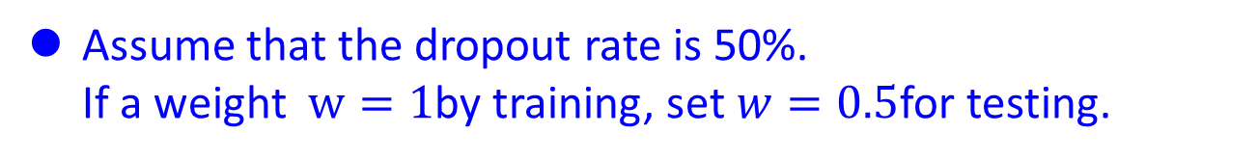
Dropout
Testing:
No dropout
If the dropout rate at training is p%, all the weights times (1-p)%
Assume that the dropout rate is 50%.
If a weight $w=1$by training, set $w=0.5$for testing.
Notes:
Bias do not have to multiply !!!!!!!!!!!!!!!!!!!!!!!!!!!!!!!!!!!
Reasonable !!!!!!!!!!!!!!!!!!!!

Slide 13
Dropout - Intuitive Reason
My partner can get in the way, so I have to do it well
When teams up, if everyone expect the partner will do the work, nothing will be done finally.
However, if you know your partner will dropout, you will do better.
When testing, no one dropout actually, so obtaining good results eventually.
Notes:
Why the weights should multiply p (dropout rate) at testing?

Slide 14
















Dropout - Intuitive Reason
Why the weights should multiply (1-p)% (dropout rate) when testing?
Training of Dropout
Testing of Dropout
Assume dropout rate is 50%
No dropout
Weights from training
$$w_{1}$$
$$0.5×$$
$$w_{1}$$
$$z^{′}≈2z$$
$$w_{2}$$
$$z$$
$$0.5×$$
$$w_{2}$$
$$z^{′}$$
$$w_{3}$$
$$0.5×$$
$$w_{3}$$
$$w_{4}$$
$$w_{4}$$
Weights multiply (1-p)%
$$z^{′}≈z$$
Notes:
important

Slide 15
Dropout is a kind of ensemble.
Training Set
Ensemble
Set 1
Set 2
Set 3
Set 4
Network
1
Network
2
Network
3
Network
4
Train a bunch of networks with different structures

Slide 16
Dropout is a kind of ensemble.
Ensemble
Testing data x
Network
1
Network
2
Network
3
Network
4
y₁
y₂
y₃
y₄
average

Slide 17
Dropout is a kind of ensemble.
minibatch
1
minibatch
2
minibatch
3
minibatch
4
Training of Dropout
M neurons
……
2^{M} possible networks
Using one mini-batch to train one network
Some parameters in the network are shared

Slide 18
Dropout is a kind of ensemble.
Testing of Dropout
testing data x
All the weights multiply (1-p)%
……
y₁
y₂
y₃
average
≈
y
Notes:
0,0 -> 0
1,0 -> 1
0,-1 -> -2
1,-1 -> -1
½, -1/2 -> -0.5
1,2
Geometric Mean?

Slide 19
More about dropout
    More reference for dropout [Nitish Srivastava, JMLR’14] [Pierre Baldi, NIPS’13][Geoffrey E. Hinton, arXiv’12]
    Dropout works better with Maxout [Ian J. Goodfellow, ICML’13]
    Dropconnect [Li Wan, ICML’13]
      Dropout delete neurons
      Dropconnect deletes the connection between neurons
    Annealed dropout [S.J. Rennie, SLT’14]
      Dropout rate decreases by epochs
    Standout [J. Ba, NISP’13]
      Each neural has different dropout rate

Slide 20
Convolution Arithmetic and
Details of CNN Training

Slide 21
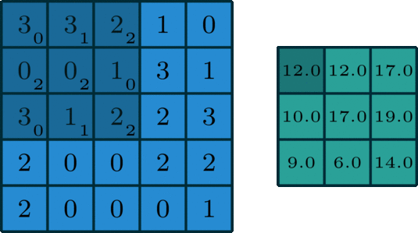
In Deep Learning, convolution is the element-wise multiplication and addition. For an image with 1 channel, the convolution is demonstrated in the figure below.
Here the filter is a 3 x 3 matrix with element [[0, 1, 2], [2, 2, 0], [0, 1, 2]]. The filter is sliding through the input. At each position, it’s doing element-wise multiplication and addition. Each sliding position ends up with one number. The final output is then a 3 x 3 matrix. (Notice that stride = 1 and padding = 0 in this example.

Slide 22
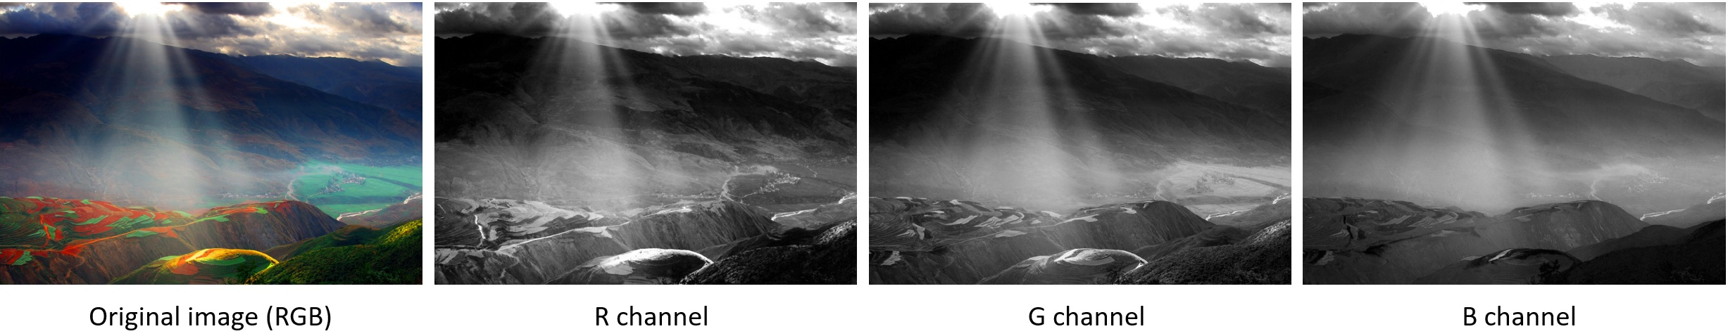
In many applications, we are dealing with images with multiple channels. A typical example is the RGB image. Each RGB channel emphasizes different aspects of the original image, as illustrated in the following image.
We would like to clarify a few terminologies: layers, channels, feature maps, filters, and kernels. From a hierarchical point of view, the concepts of layers and filters are at the same level, while channels and kernels are at one level below. Channels and feature maps are the same thing. A layer could have multiple channels (or feature maps): an input layer has 3 channels if the inputs are RGB images. “channel” is usually used to describe the structure of a “layer”. Similarly, “kernel” is used to describe the structure of a “filter”.

Slide 23
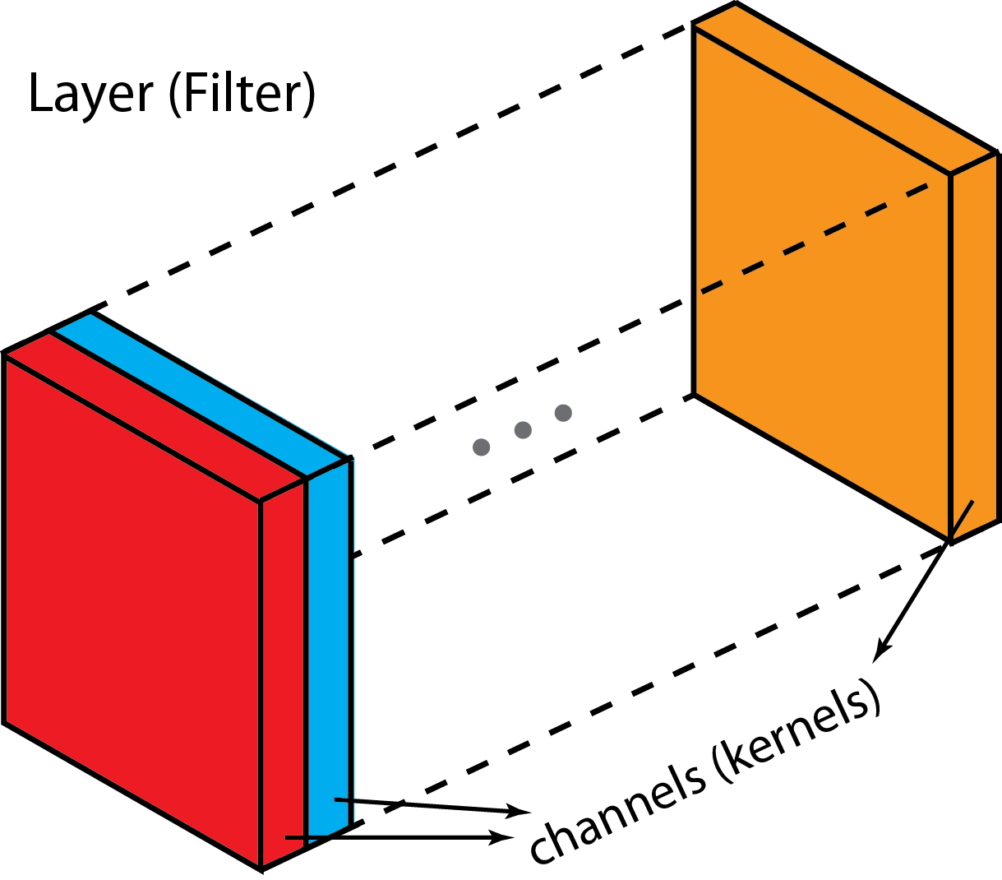
The difference between filter and kernel is a bit tricky. Sometimes, they are used interchangeably, which could create confusions. Essentially, these two terms have subtle difference. A “Kernel” refers to a 2D array of weights. The term “filter” is for 3D structures of multiple kernels stacked together. For a 2D filter, filter is same as kernel. But for a 3D filter and most convolutions in deep learning, a filter is a collection of kernels. Each kernel is unique, emphasizing different aspects of the input channel.

Slide 24
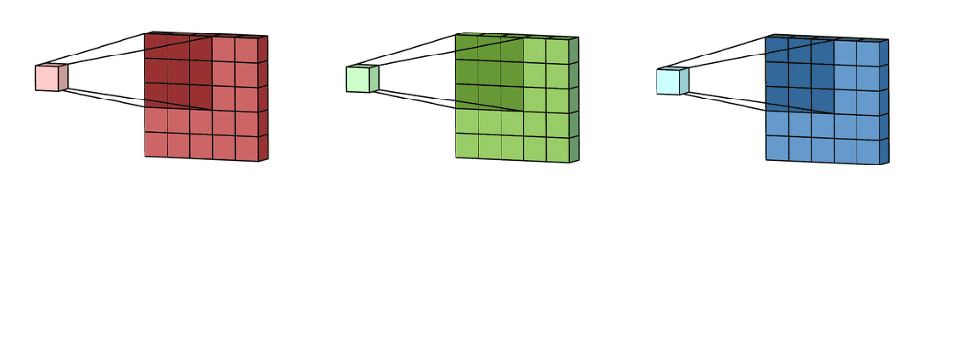
With these concepts, the multi-channel convolution goes as the following. Each kernel is applied onto an input channel of the previous layer to generate one output channel. This is a kernel-wise process. We repeat such process for all kernels to generate multiple channels. Each of these channels are then summed together to form one single output channel. The following illustration should make the process clearer.
Here the input layer is a 5 x 5 x 3 matrix, with 3 channels. The filter is a 3 x 3 x 3 matrix. First, each of the kernels in the filter are applied to three channels in the input layer, separately. Three convolutions are performed, which result in 3 channels with size 3 x 3.

Slide 25
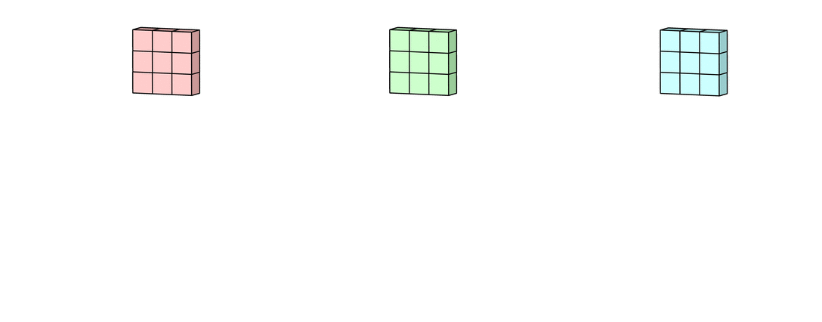
Each of the per-channel processed versions are then summed together to form one channel. The kernels of a filter each produce one version of each channel, and the filter as a whole produces one overall output channel.

Slide 26
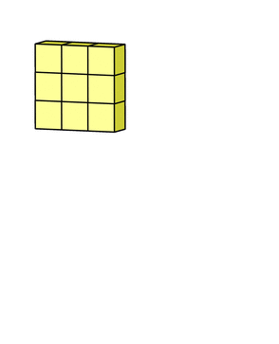
Finally, then there’s the bias term. The way the bias term works here is that each output filter has one bias term. The bias gets added to the output channel so far to produce the final output channel.
And with the single filter case down, the case for any number of filters is identical: Each filter processes the input with its own, different set of kernels and a scalar bias with the process described above, producing a single output channel. They are then concatenated together to produce the overall output, with the number of output channels being the number of filters. A nonlinearity is then usually applied before passing this as input to another convolution layer, which then repeats this process.

Slide 27
We assume:
Vincent Dumoulin and Francesco Visin. A guide to convolution arithmetic for deep learning. arXiv preprint arXiv:1603.07285, 2016.

Slide 36
In a neural network, pooling layers provide invariance to small translations of the input. The most common kind of pooling is max pooling, which consists in splitting the input in (usually non-overlapping) patches and outputting the maximum value of each patch. Other kinds of pooling exist, e.g., mean or average pooling, which all share the same idea of aggregating the input locally
by applying a non-linearity to the content of some patches
Since pooling does not involve zero padding, the relationship describing the general case is as follows:

Slide 62
Batch Normalization: Accelerating Deep Network Training by Reducing Internal Covariate Shift

Slide 63
Motivation
Old school related concept:
Feature scaling
The range of values of raw training data often varies widely
  Example: Has kids feature in {0,1}
  Value of car: $500-$100’sk
In machine learning algorithms, the functions involved in the optimization process are sensitive to normalization
  For example: Distance between two points by the Euclidean distance. If one of the features has a broad range of values, the distance will be governed by this particular feature.
  After, normalization, each feature contributes approximately proportionately to the final distance.
In general, Gradient descent converges much faster with feature scaling than without it.
Good practice for numerical stability for numerical calculations, and to avoid ill-conditioning when solving systems of equations.

Slide 64


Common normalizations
Two methods are usually used for rescaling or normalizing data:
Scaling data all numeric variables to the range [0,1]. One possible formula is given below:
To have zero mean and unit variance:
In the NN community this is call Whitening

Slide 65
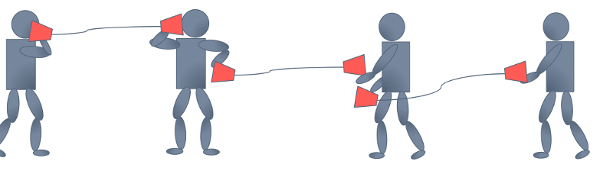


Internal covariate shift:
The cup game example
The first guy tells the second guy, “go water the plants”, the second guy tells the third guy, “got water in your pants”, and so on until the last guy hears, “kite bang eat face monkey” or something totally wrong.
Let’s say that the problems are entirely systemic and due entirely to faulty red cups. Then, the situation is analogous to forward propagation
If can get new cups to fix the problem by trial and error, it would help to have a consistent way of passing messages in a more controlled and standardized (“normalized”) way. e.g: Same volume, same language, etc.
“First layer parameters change and so the distribution of the input to your second layer changes”

Slide 66
Proposed Solution:
Batch Normalization (BN)
Batch Normalization (BN) is a normalization method/layer for neural networks.
Usually inputs to neural networks are normalized to either the range of [0, 1] or [-1, 1] or to mean=0 and variance=1
BN essentially performs Whitening to the intermediate layers of the networks.

Slide 67
Batch normalization
Why it is good?
BN reduces Covariate Shift. That is the change in distribution of activation of a component. By using BN, each neuron's activation becomes (more or less) a Gaussian distribution, i.e. its usually not active, sometimes a bit active, rare very active.
Covariate Shift is undesirable, because the later layers have to keep adapting to the change of the type of distribution (instead of just to new distribution parameters, e.g. new mean and variance values for Gaussian distributions).
BN reduces effects of exploding and vanishing gradients, because every becomes roughly normal distributed. Without BN, low activations of one layer can lead to lower activations in the next layer, and then even lower ones in the next layer and so on.

Slide 68
The BN transformation is scalar invariant
Batch Normalization also makes training more resilient to the parameter scale.
Normally, large learning rates may increase the scale of layer parameters, which then amplify the gradient during backpropagation and lead to the model explosion
However, with Batch Normalization, backpropagation through a layer is unaffected by the scale of its parameters. Indeed, for a scalar a,

Slide 69
Batch normalization:
Other benefits in practice
BN reduces training times. (Because of less Covariate Shift, less exploding/vanishing gradients.)
BN reduces demand for regularization, e.g. dropout or L2 norm.
  Because the means and variances are calculated over batches and therefore every normalized value depends on the current batch. I.e. the network can no longer just memorize values and their correct answers.)
BN allows higher learning rates. (Because of less danger of exploding/vanishing gradients.)
BN enables training with saturating nonlinearities in deep networks, e.g. sigmoid. (Because the normalization prevents them from getting stuck in saturating ranges, e.g. very high/low values for sigmoid.)

Slide 70
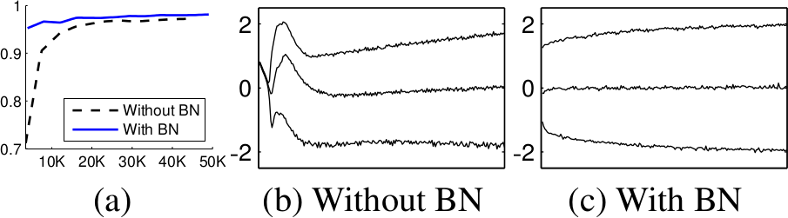
Batch normalization:
Better accuracy , faster.
BN applied to MNIST (a), and activations of a randomly selected neuron over time (b, c), where the middle line is the median activation, the top line is the 15th percentile and the bottom line is the 85th percentile.

Slide 71
Why the naïve approach Does not work?
Normalizes layer inputs to zero mean and unit variance. whitening.
Naive method: Train on a batch. Update model parameters. Then normalize. Doesn't work: Leads to exploding biases while distribution parameters (mean, variance) don't change.
  If we do it this way gradient always ignores the effect that the normalization for the next batch would have
  i.e. : “The issue with the above approach is that the gradient descent optimization does not take into account the fact that the normalization takes place”

Slide 72
Doing it the “correct way”
Is too expensive!
A proper method has to include the current example batch and somehow all previous batches ( all examples) in the normalization step.
This leads to calculating in covariance matrix and its inverse square root. That's expensive. The authors found a faster way!

Slide 73
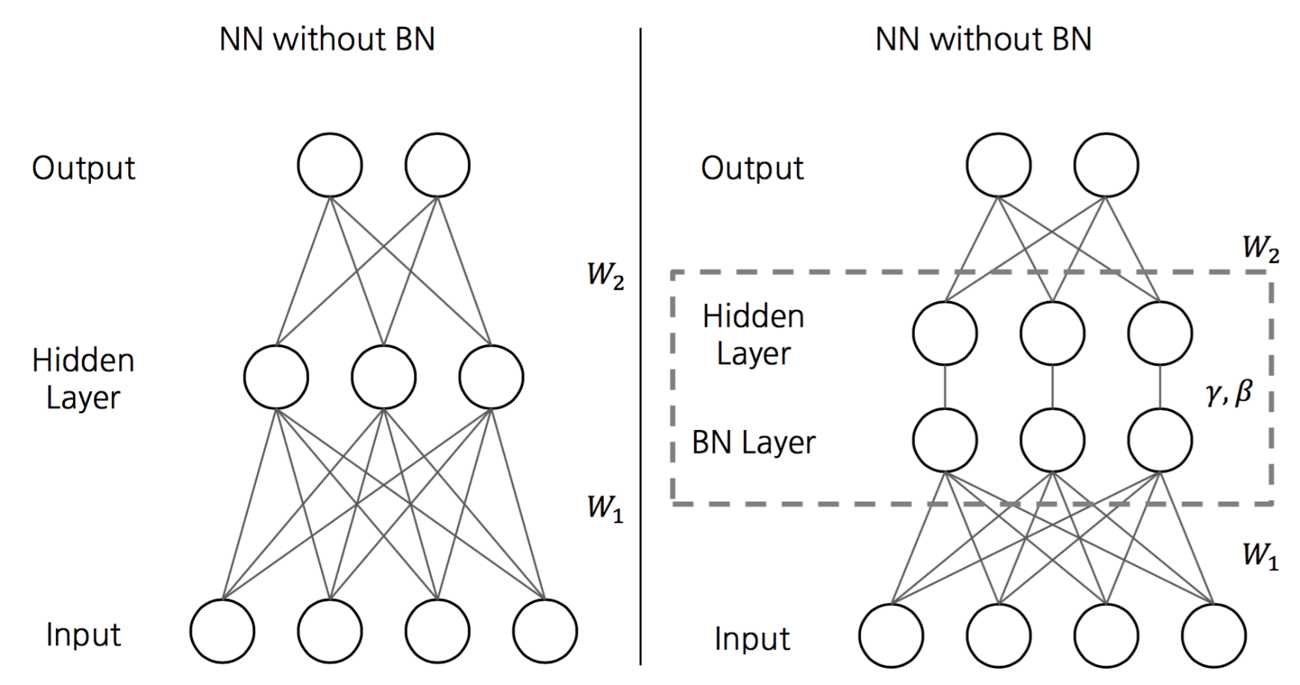
The proposed solution: To add an extra regularization layer
A new layer is added so the gradient can “see” the normalization and make adjustments if needed.

Slide 74
Algorithm Summary:
Normalization via Mini-Batch Statistics
Each feature (component) is normalized individually
Normalization according to:
  componentNormalizedValue = (componentOldValue - E[component]) / sqrt(Var(component))
A new layer is added so the gradient can “see” the normalization and made adjustments if needed.
  The new layer has the power to learn the identity function to de-normalize the features if necessary!
  Full formula: newValue = gamma * componentNormalizedValue + beta (gamma and beta learned per component)
E and Var are estimated for each mini batch.
BN is fully differentiable.

Slide 75
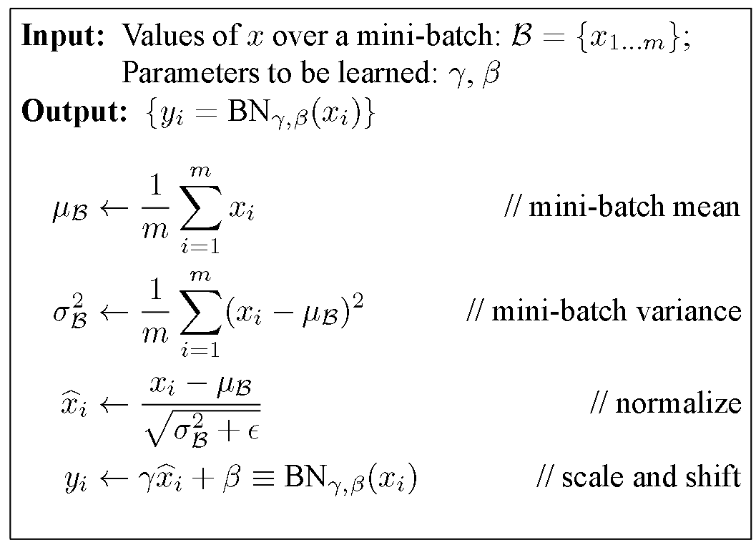
The Batch Transformation: formally from the paper.

Slide 76
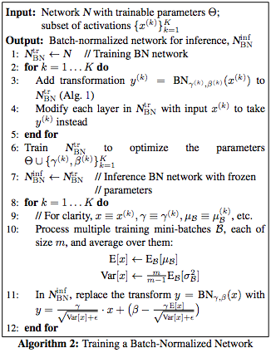
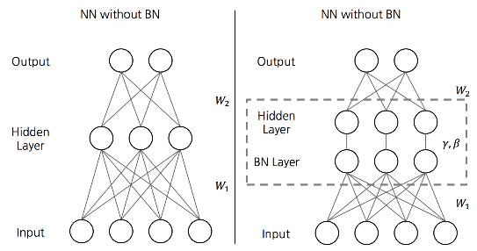
The full algorithm as proposed in the paper
Alg 1 (previous slide)
Architecture modification
Note that BN(x) is different
during test…
Vs.

Slide 77
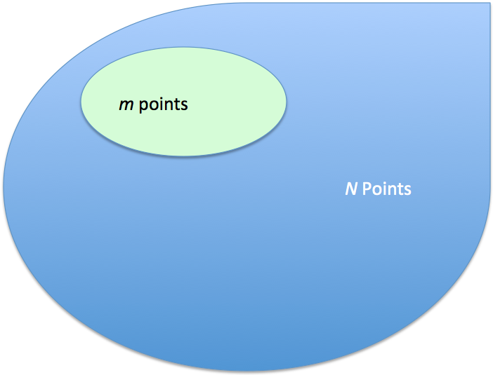
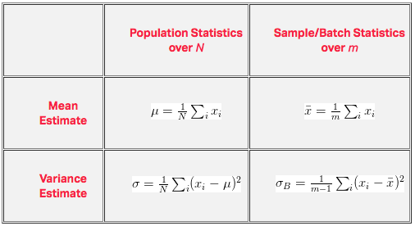
Populations stats vs. sample stats
In algorithm 1, we are estimating the true mean and variance over the entire population for a given batch.
When doing inference you’re minibatching your way through the entire dataset, you’re calculating statistics on a per sample/batch basis. We want our sample statistics to be unbiased to population statistics.

Slide 78
ACCELERATING BN NETWORKS
Batch normalization only not enough!
Increase learning rate.
Remove Dropout.
Shuffle training examples more thoroughly
Reduce the L2 weight regularization.
Accelerate the learning rate decay.
Reduce the photometric distortions.

Slide 79
Useful links
Blog posts
  https://gab41.lab41.org/batch-normalization-what-the-hey-d480039a9e3b#.s4ftttada
  https://kratzert.github.io/2016/02/12/understanding-the-gradient-flow-through-the-batch-normalization-layer.html
A lecture mentioning the technique:
  https://www.youtube.com/watch?v=gYpoJMlgyXA&feature=youtu.be&list=PLkt2uSq6rBVctENoVBg1TpCC7OQi31AlC&t=3078
Paper summaries:
  https://github.com/aleju/papers/blob/master/neural-nets/Batch_Normalization.md
  https://wiki.tum.de/display/lfdv/Batch+Normalization
  https://aresearch.wordpress.com/2015/11/05/batch-normalization-accelerating-deep-network-training-b-y-reducing-internal-covariate-shift-ioffe-szegedy-arxiv-2015/
Q&A:
  http://stats.stackexchange.com/questions/215458/what-is-an-explanation-of-the-example-of-why-batch-normalization-has-to-be-done

Slide 102
Neural Network with Memory
Notes:
Not just process, but memory

Slide 103
Neural Network needs Memory
Name Entity Recognition
  Detecting named entities like name of people, locations, organization, etc. in a sentence.
1
DNN
0.1
people
apple
0
…
0.1
location
0
0.5
organization
0.3
none
0

Slide 104
Neural Network needs Memory
Name Entity Recognition
  Detecting named entities like name of people, locations, organization, etc. in a sentence.
target
ORG
target
NONE
y¹
y²
y³
y⁴
y⁵
y⁶
y⁷
DNN
DNN
DNN
DNN
DNN
DNN
DNN
x¹
x²
x³
x⁴
x⁵
x⁶
x⁷
the president of apple eats an apple
DNN needs memory!
Notes:
DNN: input and output are both vector

Slide 105
Recurrent Neural Network (RNN)
The output of hidden layer are stored in the memory.
copy
Memory can be considered as another input.

Slide 106
RNN
y¹
y²
y³
Wº
copy
Wº
copy
Wº
a¹
a²
a³
a¹
a²
W^{h}
W^{h}
W^{i}
W^{i}
W^{i}
x¹
x²
x³
The same network is used again and again.
Output y^{i} depends on x¹, x², …… x^{i}
Notes:
General idea

Slide 107



RNN
How to train?
$${\hat{y}}^{1}$$
target
$${\hat{y}}^{2}$$
target
$${\hat{y}}^{3}$$
target
L¹
L²
L³
y¹
y²
y³
Wº
Wº
Wº
W^{h}
W^{h}
……
W^{i}
W^{i}
W^{i}
x¹
x²
x³
Find the network parameters to minimize the total cost:
Backpropagation through time (BPTT)
Notes:
General idea

Slide 108
Of course it can be deep …
y^{t}
y^{t+1}
y^{t+2}
……
……
……
……
……
……
……
……
……
x^{t}
x^{t+1}
x^{t+2}

Slide 109
Bidirectional RNN
……
x^{t}
x^{t+1}
x^{t+2}
……
y^{t}
y^{t+1}
y^{t+2}
……
……
x^{t}
x^{t+1}
x^{t+2}
Notes:
To determine yi, you have to consider a lot ……
You should see the whole sequence

Slide 110
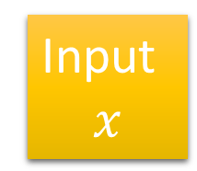
Boosting
Weak classifier
Input
$$x$$
Weak classifier
Combine
……
Weak classifier
Deep Learning
Weak classifier
Boosted weak classifier
Boosted Boosted weak classifier
……
……
…
…
…
…
……
Notes:
Adaboost

Slide 111


Deep Learning to Optimize…!!
The recent machine learning boom is caused by a move from hand-designed features to learned features.
In spite of this, optimization algorithms are still designed by hand.
Can we cast the design of an optimization algorithm as a learning problem, allowing the algorithm to learn to exploit structure in the problems of interest in an automatic way?
A recent NIPS paper from Google DeepMind says yes we can….they use LSTM:
Andrychowicz M. et al. (2016). Learning to learn by gradient descent by gradient descent. NIPS 2016.
The authors make a clever replacement:
Learn the updating function g
By LSTM
Can we learn the optimal adaptation rules for EAs, instead of hand-crafting them?

