Slide 5
A Derivation of PCA: How to represent a set of multivariate
observations by using a single point?
Define a squared loss function:
with
Clearly,
Thus, sample mean
provides a zero-dimensional
representation
implies x₀ has to be m
independent of x₀

Slide 6
Instead of a point, can we represent the set of multivariate
points (data objects) using a line passing through m?
e
m
Letting
differentiating w.r.t.
and setting it to zero,
Now can we find the best direction for the line e?

Slide 7
Let’s define the scatter matrix:
Now by plugging in
Clearly, e that minimizes J₁ also maximizes

Slide 8
Let’s form the Lagrangian as:
By differentiating,
As,
maximizing this term is equivalent to
finding the largest eigenvalue of S
Thus, we project along the eigenvector corresponding to the
largest eigenvalue of matrix S.

Slide 9
Can we generalize to a d’ dimensional space instead of a line
(which is 1D)?
Yes, just choose:
and minimize:
The minimization corresponds to the largest d’ eigenvalues
of the scatter matrix S.

Slide 10
Principal Component Analysis
Principal component analysis
  It is a way of identifying the underlying patterns in data
  It can extract information in a large data set with many variables and approximate this data set with fewer factors
  In other words, it can reduce the number of variables to a more manageable set
Steps of the principal component analysis
  Step 1: Get some data
  Step 2: Subtract the mean
  Step 3: Calculate the covariance matrix
  Step 4: Calculate the eigenvectors and eigenvalues of the
  covariance matrix
  Step 5: Deriving the transformed data set
  Step 6: Getting the original data back

Slide 11
  Step 1:
  Step 2:
x* | y*
2.5 | 2.4
0.5 | 0.7
2.2 | 2.9
1.9 | 2.2
3.1 | 3.0
2.3 | 2.7
2.0 | 1.6
1.0 | 1.1
1.5 | 1.6
1.1 | 0.9
1.81 | 1.91
x | y
0.69 | 0.49
-1.31 | -1.21
0.39 | 0.99
0.09 | 0.29
1.29 | 1.09
0.49 | 0.79
0.19 | -0.31
-0.81 | -0.81
-0.31 | -0.31
-0.71 | -1.01
0 | 0
  Step 3:

Slide 12
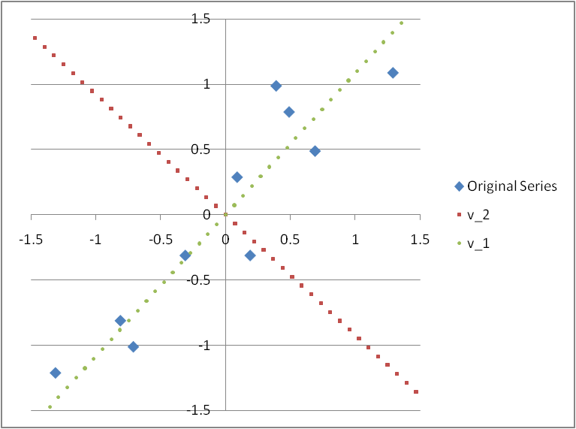
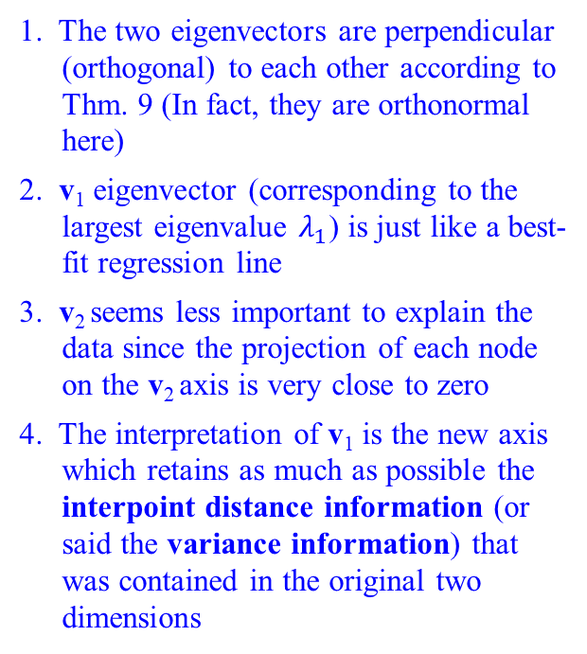
  Step 4: Calculate the eigenvectors and eigenvalues of the covariance matrix A
1. The two eigenvectors are perpendicular (orthogonal) to each other according to Thm. 9 (In fact, they are orthonormal here)
2. v₁ eigenvector (corresponding to the largest eigenvalue $λ_{1}$) is just like a best-fit regression line
3. v₂ seems less important to explain the data since the projection of each node on the v₂ axis is very close to zero
4. The interpretation of v₁ is the new axis which retains as much as possible the interpoint distance information (or said the variance information) that was contained in the original two dimensions

Slide 13
※ The intuition behind the principal component analysis:
(It also implies that the new series of x’ and y’ are independent)

Slide 14
  Step 5: Deriving the transformed data set:
x’ | y’
-0.82797 | -0.17512
1.77758 | 0.14286
-0.99220 | 0.38437
-0.27421 | 0.13042
-1.67580 | -0.20950
-0.91295 | 0.17528
0.09911 | -0.34982
1.14457 | 0.04642
0.43805 | 0.01776
1.22382 | -0.16268
0 | 0
x’ | y’
-0.82797 | 0
1.77758 | 0
-0.99220 | 0
-0.27421 | 0
-1.67580 | 0
-0.91295 | 0
0.09911 | 0
1.14457 | 0
0.43805 | 0
1.22382 | 0
0 | 0

Slide 15
  Step 6: Getting the original data back:
  case 1 case 2
x* | y*
2.5 | 2.4
0.5 | 0.7
2.2 | 2.9
1.9 | 2.2
3.1 | 3
2.3 | 2.7
2 | 1.6
1 | 1.1
1.5 | 1.6
1.1 | 0.9
1.81 | 1.91
x* | y*
2.37 | 2.52
0.61 | 0.60
2.48 | 2.64
2.00 | 2.11
2.95 | 3.14
2.43 | 2.58
1.74 | 1.84
1.03 | 1.07
1.51 | 1.59
0.98 | 1.01
1.81 | 1.91
※ We can derive the original data set if we take both v₁ and v₂ and thus x’ and y’ into account when deriving the transformed data
※ Although when we derive the transformed data, only v₁ and thus only x’ are considered, the data gotten back is still similar to the original data. That means, x’ can be a common factor almost able to explain both series x and y

Slide 16
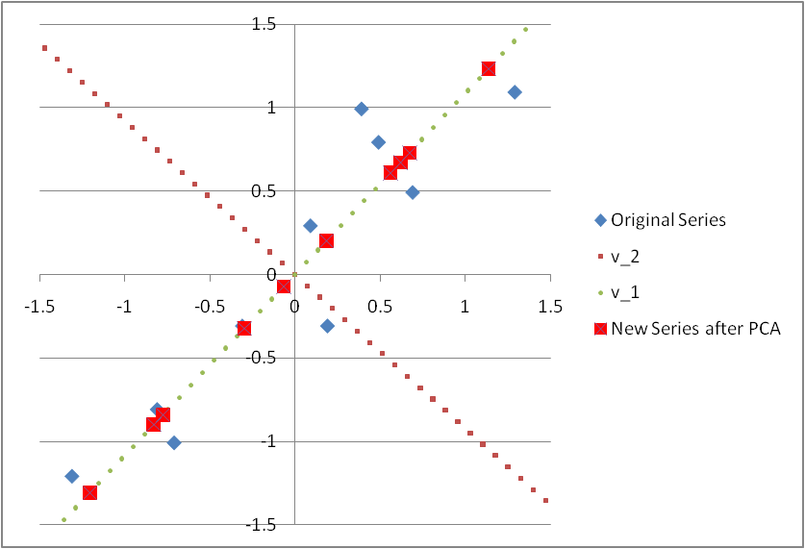
※ If only the principal component x’ is considered in the Principal Component Analysis, it is equivalent to project all points onto the v₁ vector
※ It can be observed in the above figure that the projection onto v₁ vector can retains as much as possible the interpoint distance information (variance) that was contained in the original series of (x, y)

Slide 17
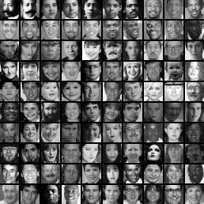
Starting idea of the eigenface algorithm:
Treat pixels as a vector
Recognize face by nearest neighbor

Slide 18
The space of all face images
When viewed as vectors of pixel values, face images are extremely high-dimensional
  100x100 image = 10,000 dimensions
  Slow and lots of storage
But very few 10,000-dimensional vectors are valid face images
We want to effectively model the subspace of face images

Slide 19
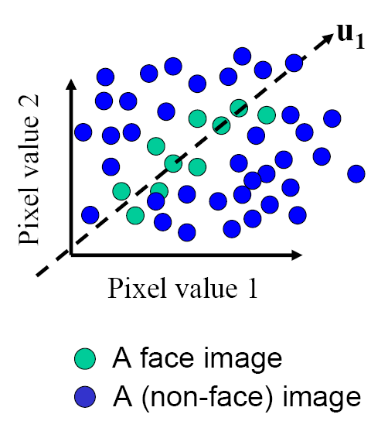
The space of all face images
Eigenface idea: construct a low-dimensional linear subspace that best explains the variation in the set of face images

Slide 20
Principal Component Analysis (PCA)
Given: N data points x₁, … ,x_{N} in R^{d}
We want to find a new set of features that are linear combinations of original ones:
u(x_{i}) = u^{T}(x_{i} – µ)
(µ: mean of data points)
Choose unit vector u in R^{d} that captures the most data variance
Forsyth & Ponce, Sec. 22.3.1, 22.3.2

Slide 21
Principal Component Analysis
Direction that maximizes the variance of the projected data:
N
Maximize
subject to ||u||=1
Projection of data point
N
1/N
Covariance matrix of data
The direction that maximizes the variance is the eigenvector associated with the largest eigenvalue of Σ

Slide 22
Implementation issue
Covariance matrix is huge (N² for N pixels)
But typically # examples << N
Simple trick
  X is matrix of normalized training data
  Solve for eigenvectors u of X^{T}X instead of XX^{T}
  Then X^{T}u is eigenvector of covariance X^{T}X
  May need to normalize (to get unit length vector)

Slide 23
Eigenfaces (PCA on face images)
Compute covariance matrix of face images
Compute the principal components (“eigenfaces”)
  K eigenvectors with largest eigenvalues
Represent all face images in the dataset as linear combinations of eigenfaces
  Perform nearest neighbor on these coefficients
M. Turk and A. Pentland, Face Recognition using Eigenfaces, CVPR 1991

Slide 24
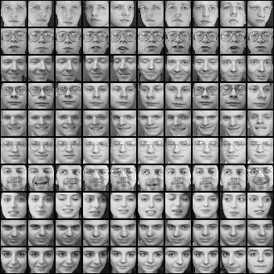
Eigenfaces example
Training images
x₁,…,x_{N}

Slide 25
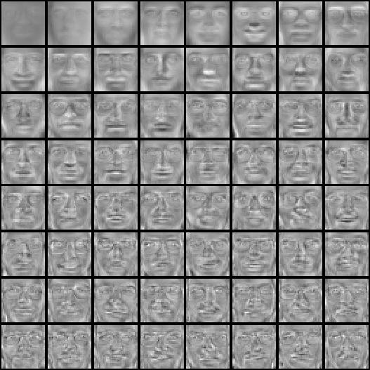
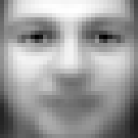
Eigenfaces example
Top eigenvectors: u₁,…u_{k}
Mean: μ

Slide 26
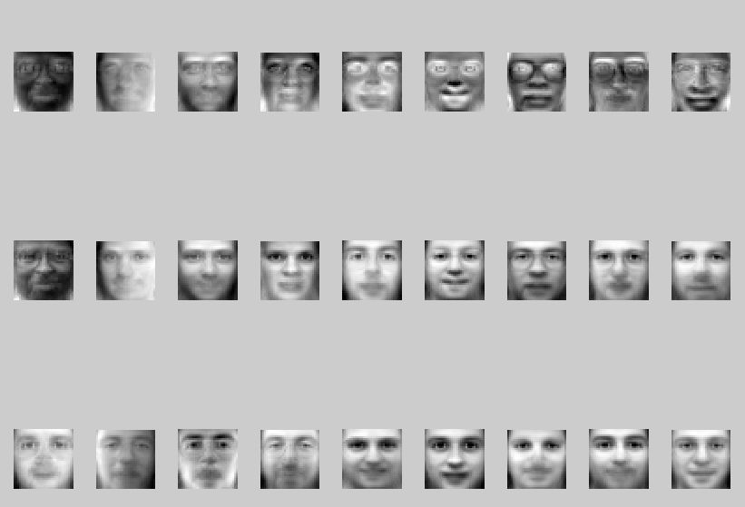
Visualization of eigenfaces
Principal component (eigenvector) u_{k}
μ + 3σ_{k}u_{k}
μ – 3σ_{k}u_{k}

Slide 27

Representation and reconstruction
Face x in “face space” coordinates:
=

Slide 28

Representation and reconstruction
Face x in “face space” coordinates:
Reconstruction:
=
=
+
^
x
=
µ + w₁u₁+w₂u₂+w₃u₃+w₄u₄+ …

Slide 29
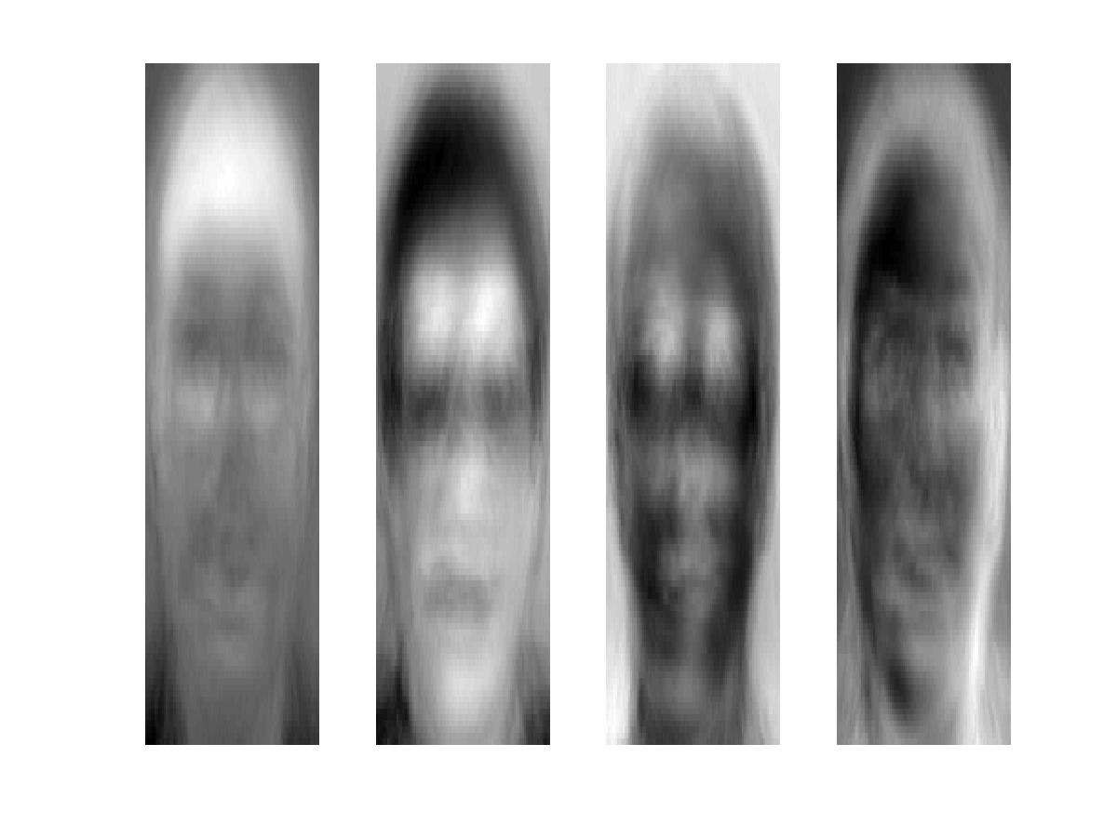
Reconstruction example
The visualization of eigenvectors:
These are the first 4 eigenvectors from a training set of 400 images (ORL Face Database). They look like faces, hence called Eigenface.

Slide 30
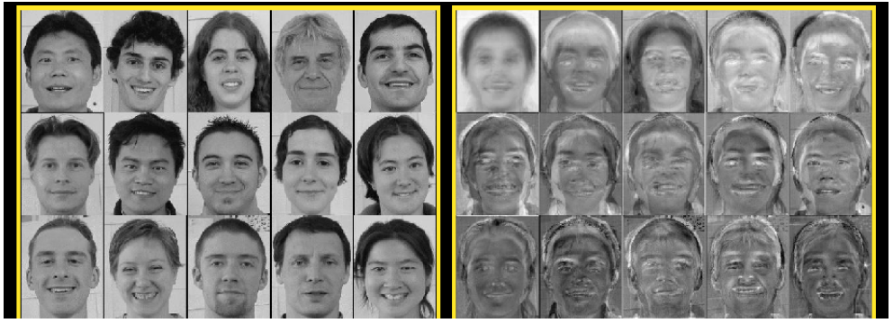
Eigenfaces
Computed using 400 face images from ORL face database

Slide 31
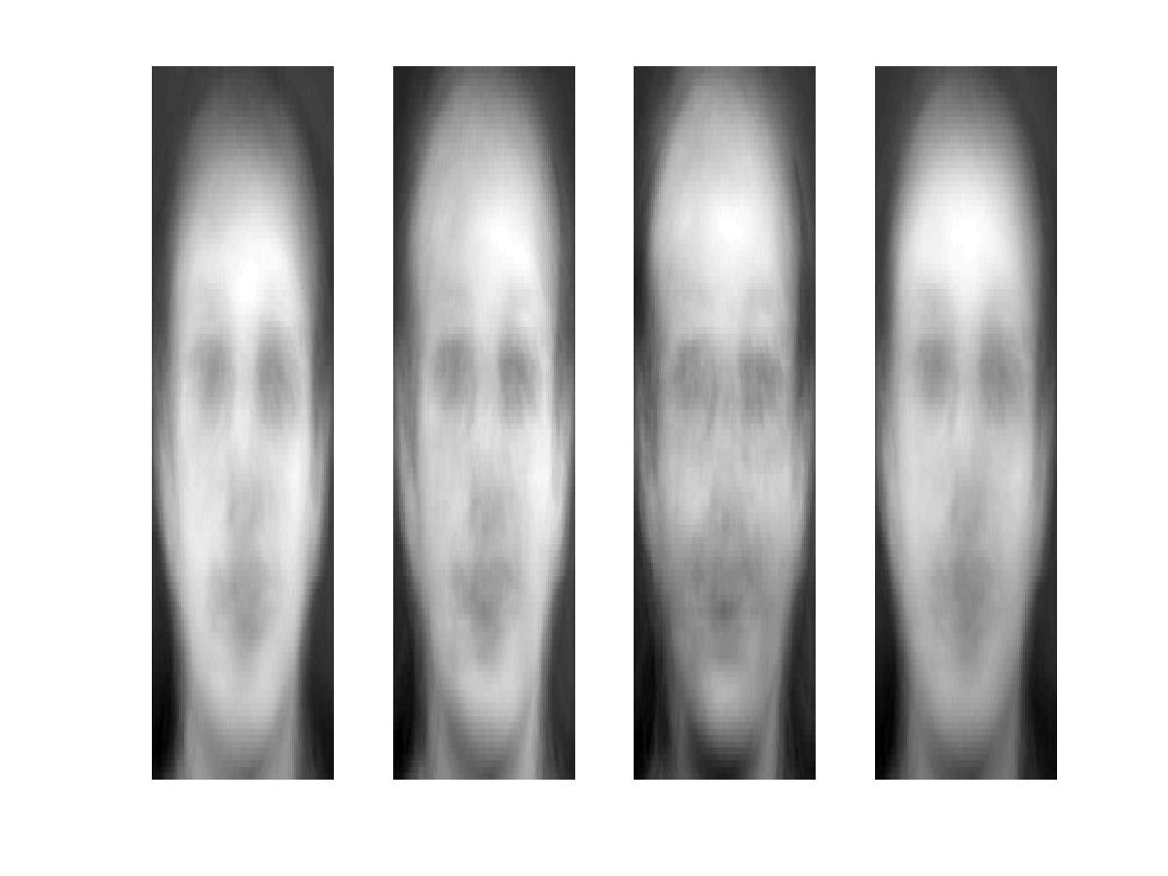
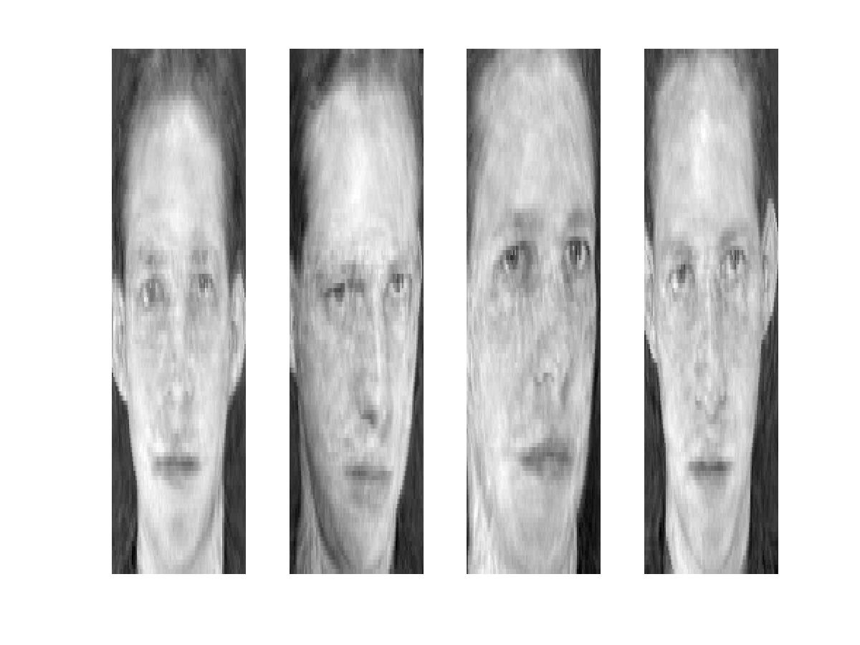
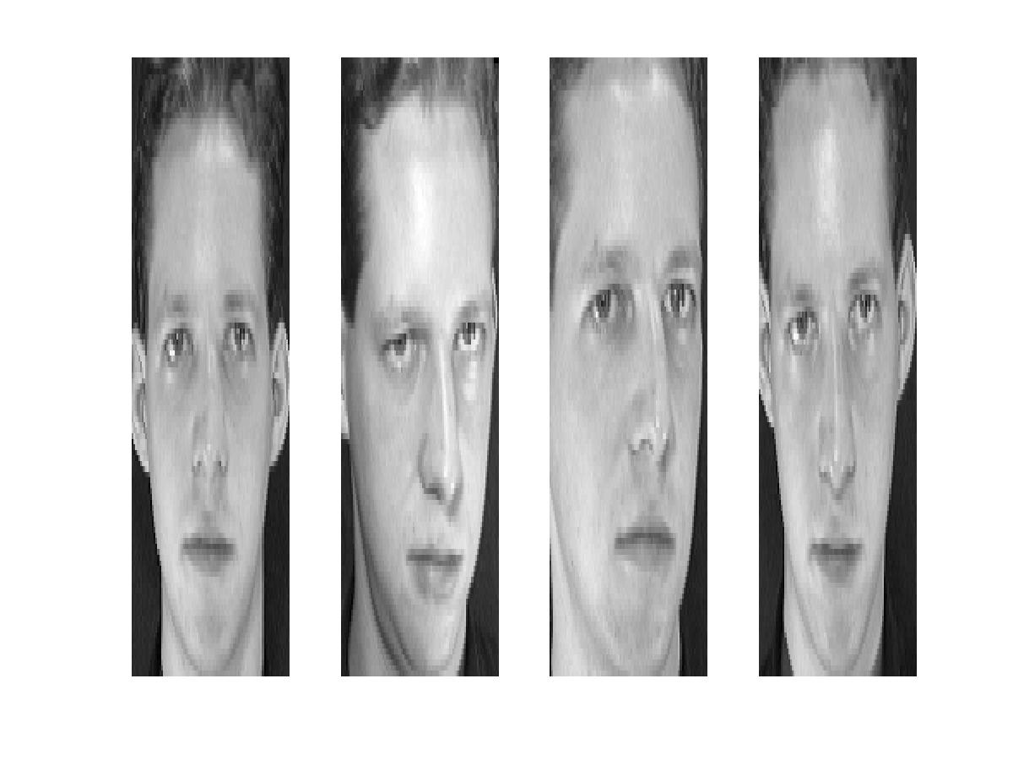
Reconstruction
P = 4
P = 200
P = 400
After computing eigenfaces using 400 face images from ORL face database

Slide 32
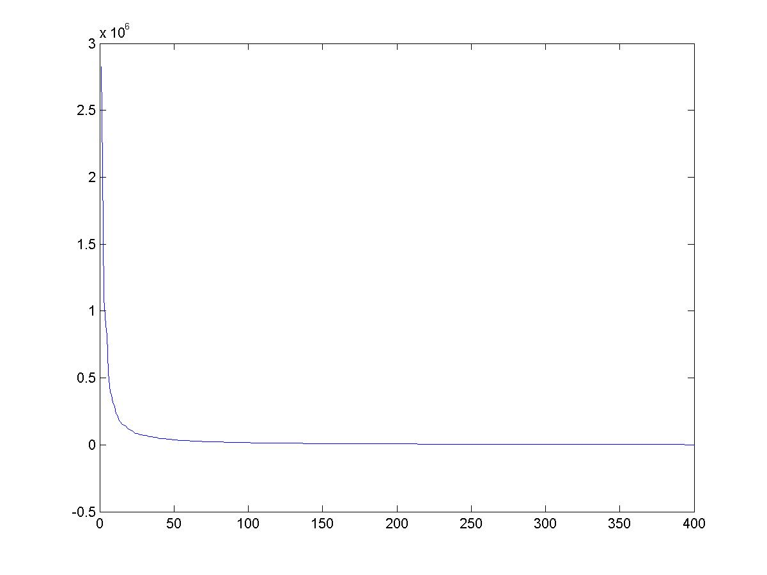
Eigenvalues (variance along eigenvectors)

Slide 33
Note
Preserving variance (minimizing MSE) does not necessarily lead to qualitatively good reconstruction.
P = 200

Slide 34
Recognition with eigenfaces
Process labeled training images
Find mean µ and covariance matrix Σ
Find k principal components (eigenvectors of Σ) u₁,…u_{k}
Project each training image x_{i} onto subspace spanned by principal components:
(w_{i1},…,w_{ik}) = (u₁^{T}(x_{i} – µ), … , u_{k}^{T}(x_{i} – µ))
Given novel image x
Project onto subspace:
(w₁,…,w_{k}) = (u₁^{T}(x – µ), … , u_{k}^{T}(x – µ))
Optional: check reconstruction error x – x to determine whether image is really a face
Classify as closest training face in k-dimensional subspace
^
M. Turk and A. Pentland, Face Recognition using Eigenfaces, CVPR 1991

Slide 35
PCA
General dimensionality reduction technique
Preserves most of variance with a much more compact representation
  Lower storage requirements (eigenvectors + a few numbers per face)
  Faster matching
What are the problems for face recognition?

Slide 36


Limitations
Global appearance method: not robust to misalignment, background variation

Slide 37
Question
Would PCA on image pixels work well as a general compression technique?
P = 200

Slide 38
Limitations
The direction of maximum variance is not always good for classification

Slide 39
A more discriminative subspace: FLD
Fisher Linear Discriminants → “Fisher Faces”
PCA preserves maximum variance
FLD preserves discrimination
  Find projection that maximizes scatter between classes and minimizes scatter within classes
Reference: Eigenfaces vs. Fisherfaces, Belheumer et al., PAMI 1997

Slide 40
LDA Slides: Prof. Olga Veksler, Univ. of Waterloo

Slide 53
Maximize

Slide 63
Recognition with FLD
Similar to “eigenfaces”
Compute within-class and between-class scatter matrices
Solve generalized eigenvector problem
Project to FLD subspace and classify by nearest neighbor

Slide 64
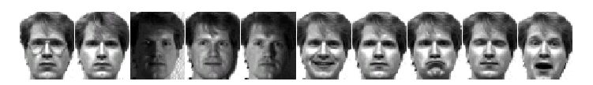
Results: Eigenface vs. Fisherface
Input: 160 images of 16 people
Train: 159 images
Test: 1 image
Variation in Facial Expression, Eyewear, and Lighting
With glasses
Without glasses
3 Lighting conditions
5 expressions
Reference: Eigenfaces vs. Fisherfaces, Belheumer et al., PAMI 1997

Slide 65
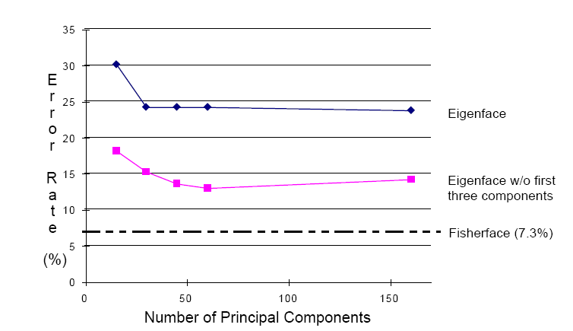
Eigenfaces vs. Fisherfaces
Reference: Eigenfaces vs. Fisherfaces, Belheumer et al., PAMI 1997

Slide 66
Things to remember
PCA is a generally useful dimensionality reduction technique
  But not ideal for discrimination
FLD better for discrimination, though only ideal under Gaussian data assumptions
Computer face recognition works very well under controlled environments – still room for improvement in general conditions

