Slide 1
Optimization for
Deep Learning
Notes:
Three questions:
Model
Cost
Train

Slide 2
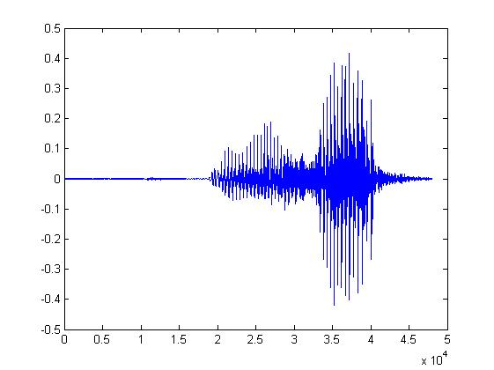


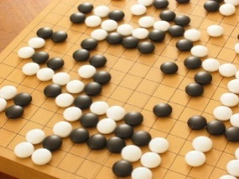

Machine Learning
≈ Looking for a Function
  Slides from Deep Learning Tutorial. Hung-yi Lee, NTU.
Speech Recognition
Image Recognition
Playing Go
Dialogue System
“How are you”
“Cat”
“5-5”
(next move)
“Hi”
“Hello”
(what the user said)
(system response)

Slide 3


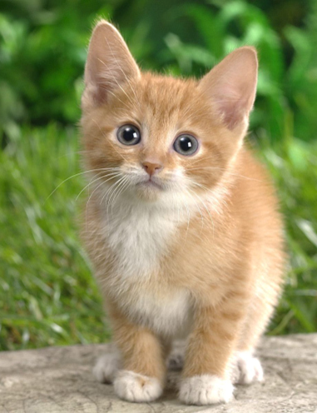



Framework
Image Recognition:
“cat”
A set of function
Model
“cat”
“money”
“dog”
“snake”
Notes:
Repeat again

Slide 4
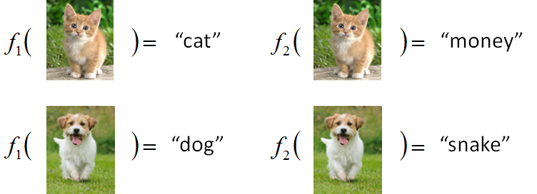

Framework
Image Recognition:
“cat”
A set of function
Model
Better!
Goodness of function f
Supervised Learning
Training
Data
function input:
function output:
“monkey”
“cat”
“dog”
Notes:
Repeat again

Slide 5


Framework
Image Recognition:
“cat”
A set of function
Model
Training
Testing
“cat”
Step 1
Goodness of function f
Pick the “Best” Function
Using
Step 2
Step 3
Training
Data
“monkey”
“cat”
“dog”
Notes:
Repeat again

Slide 6
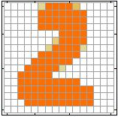
Example Application
Handwriting Digit Recognition
Machine
“2”
Notes:
“Hello world” for deep learning
Data: http://yann.lecun.com/exdb/mnist/

Slide 7


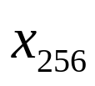
Handwriting Digit Recognition
Input
Output
y₁
is 1
0.1
y₂
is 2
0.7
The image is “2”
……
……
……
y₁₀
0.2
is 0
16 x 16 = 256
Ink → 1
No ink → 0
Each dimension represents the confidence of a digit.
Notes:
The same for even more complex tasks.

Slide 8

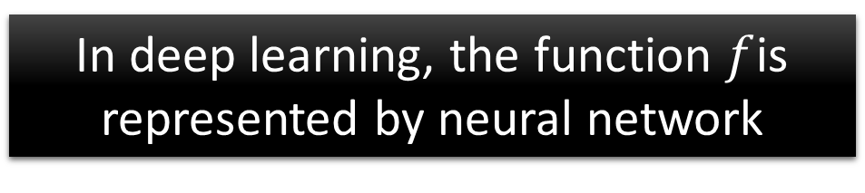
Example Application
Handwriting Digit Recognition
y₁
Machine
y₂
“2”
……
……
y₁₀

Slide 9

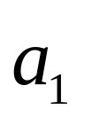
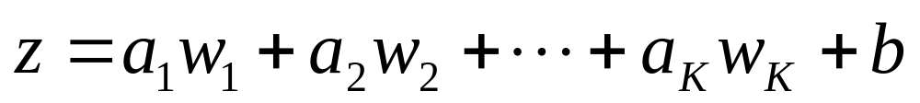
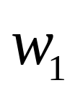
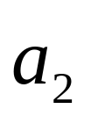
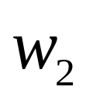

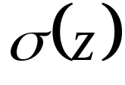


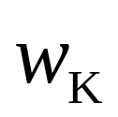
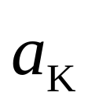

Element of Neural Network
Neuron
…
Activation function
weights
bias
Notes:
sigmoid

Slide 10

Neural Network
neuron
Input
Layer 1
Layer 2
Layer L
Output
……
y₁
……
y₂
……
……
……
……
……
……
y_{M}
Input Layer
Output Layer
Hidden Layers
Deep means many hidden layers
Notes:
Fully Connected Feedforward Network
You can always connect the neurons in your own way.
“+” is ignored
Each dimension corresponds to a digit (10 dimension is needed)

Slide 11
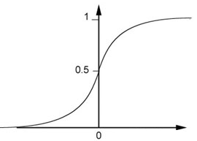
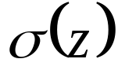
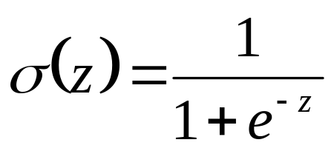

Example of Neural Network
1
4
0.98
1
-2
1
-1
-2
0.12
-1
1
0
Sigmoid Function
Notes:
Ignore +

Slide 12
Example of Neural Network
1
4
0.98
2
0.86
3
0.62
1
-2
-1
-1
1
0
-2
-1
-2
0.12
-2
0.11
-1
0.83
-1
1
-1
4
0
0
2

Slide 13

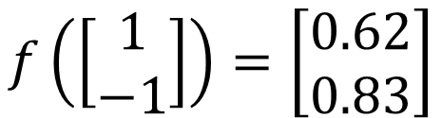
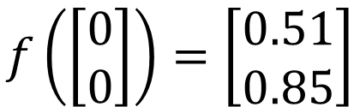
Example of Neural Network
0.73
2
0.72
3
0.51
1
0
-2
-1
-1
1
0
-2
-1
0.5
-2
0.12
-1
0.85
0
1
-1
4
0
0
2
Different parameters define different function
Notes:
For example, if we modify “1” to “2”, then we have another function

Slide 14


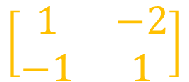
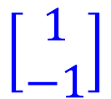


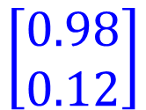

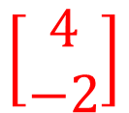
Matrix Operation
1
4
0.98
1
-2
1
-1
-2
0.12
-1
1
0
Notes:
Make sure you know how to do it
author: Adam Coates, Baidu, Inc.
Deep Learning (hopefully faster)
http://videolectures.net/deeplearning2015_coates_deep_learning/

Slide 15



Neural Network
……
y₁
W¹
W²
W^{L}
……
y₂
b¹
b²
b^{L}
……
……
……
……
……
x
a¹
a²
y
……
y_{M}
W¹
x
b¹
+
W²
a¹
b²
+
W^{L}
b^{L}
a^{L-1}
+
Notes:
Draw it?

Slide 16


Neural Network
……
y₁
W¹
W²
W^{L}
……
y₂
b¹
b²
b^{L}
……
……
……
……
……
x
a¹
a²
y
……
y_{M}
y
x
Using parallel computing techniques to speed up matrix operation
W^{L}
…
W²
W¹
x
b¹
b²
…
b^{L}
+
+
+
x
Notes:
Draw it?

Slide 17

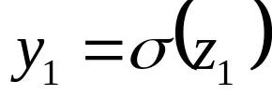


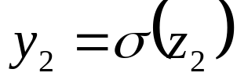

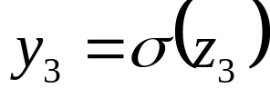

Softmax
Softmax layer as the output layer
Ordinary Layer
In general, the output of network can be any value.
May not be easy to interpret
Notes:
Original output layer is local

Slide 18
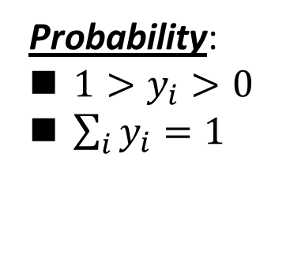

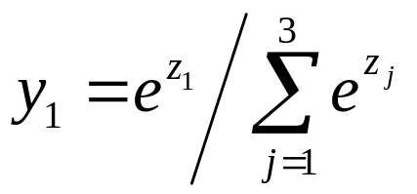



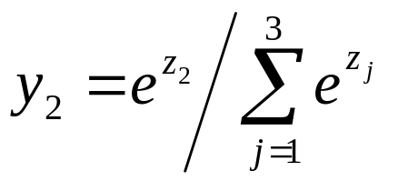

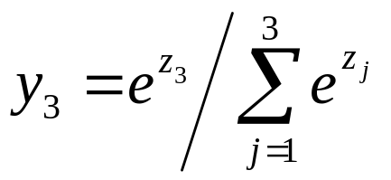
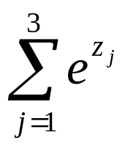
Softmax
Softmax layer as the output layer
Softmax Layer
3
20
0.88
1
2.7
0.12
-3
0.05
≈0
Notes:
Why it is name soft max?
Monotonicity of softmax
Non-locality of softmax

Slide 19
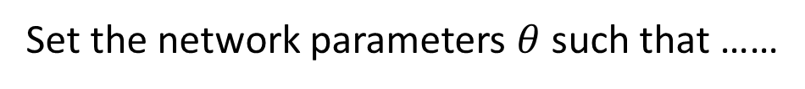

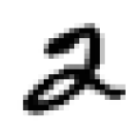
How to set network parameters
……
y₁
is 1
0.1
……
y₂
0.7
is 2
Softmax
……
……
……
……
y₁₀
is 0
0.2
16 x 16 = 256
Ink → 1
No ink → 0
Input:
How to let the neural network achieve this
y₁ has the maximum value
Input:
y₂ has the maximum value

Slide 20








Training Data
Preparing training data: images and their labels
“5”
“0”
“4”
“1”
“9”
“2”
“1”
“3”
Using the training data to find the network parameters.

Slide 21
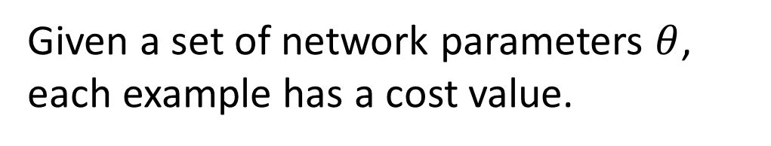

Cost
“1”
……
y₁
0.2
1
……
y₂
0
0.3
……
……
……
Cost
……
……
……
y₁₀
0
0.5
target
Cost can be Euclidean distance or cross entropy of the network output and target
Notes:
With softmax, the summation of all the ouputs would be one.
Can be considered as probability if you want ……

Slide 22
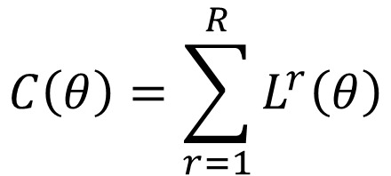



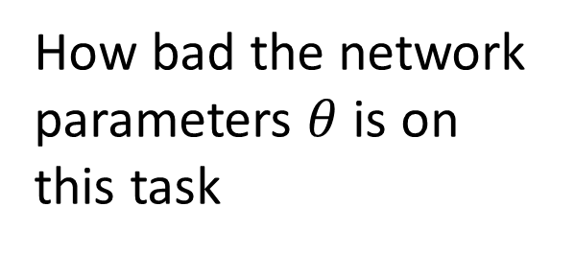



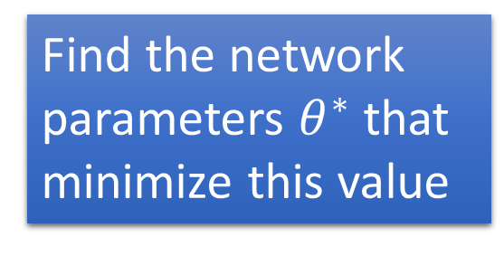


Total Cost
For all training data …
Total Cost:
x¹
NN
y¹
x²
NN
y²
x³
NN
y³
……
……
……
……
x^{R}
NN
y^{R}
Notes:
Randomly picked one
Two approaches update the parameters towards the same direction, but stochastic is faster!
Better!

Slide 23
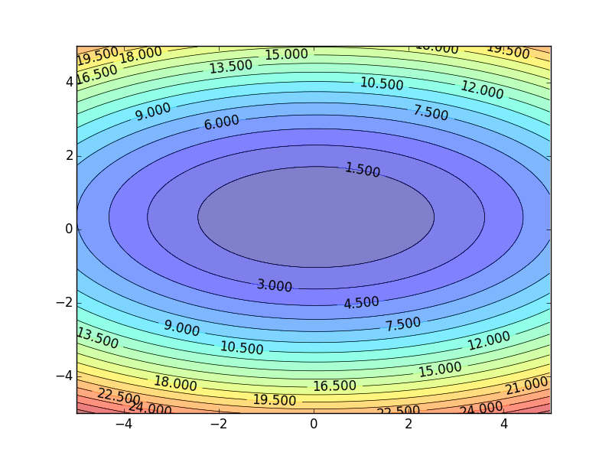

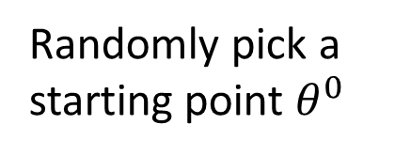
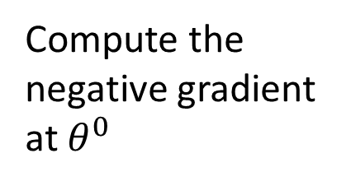


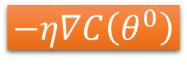


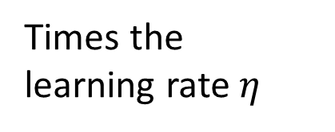
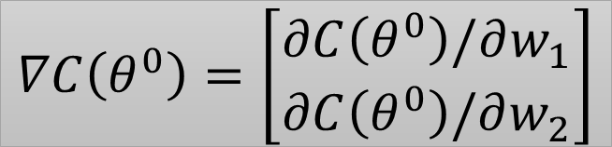



Gradient Descent
Assume there are only two parameters w₁ and w₂ in a network.
Error Surface
The colors represent the value of C.
Notes:
Eta
人站在 ｔｈｅｔａ０ 環顧四周 看看哪裡最低，那個方向就是 ｇｒａｄｉｅｎｔ

Slide 24

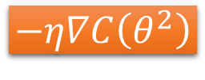




Gradient Descent
Eventually, we would reach a minima …..

Slide 25
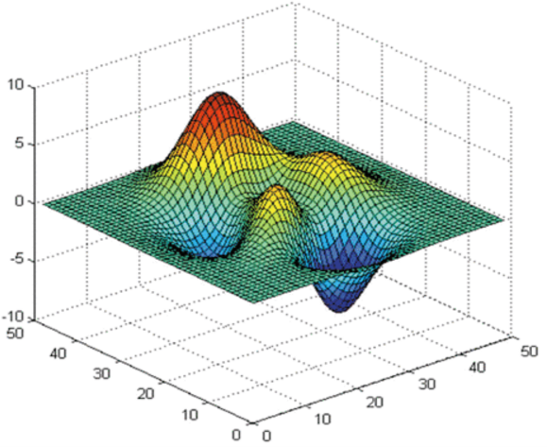



Local Minima
Gradient descent never guarantee global minima
Different initial point
Reach different minima, so different results
Notes:
看人品的方法
Who is Afraid of Non-Convex Loss Functions?
http://videolectures.net/eml07_lecun_wia/

Slide 26
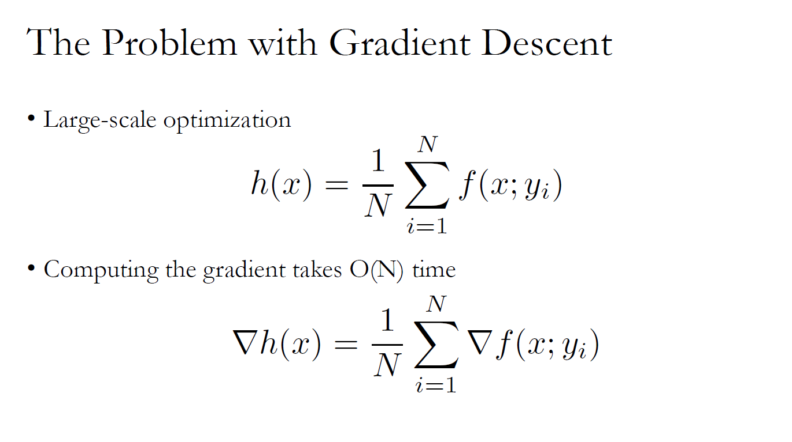

Slide 27
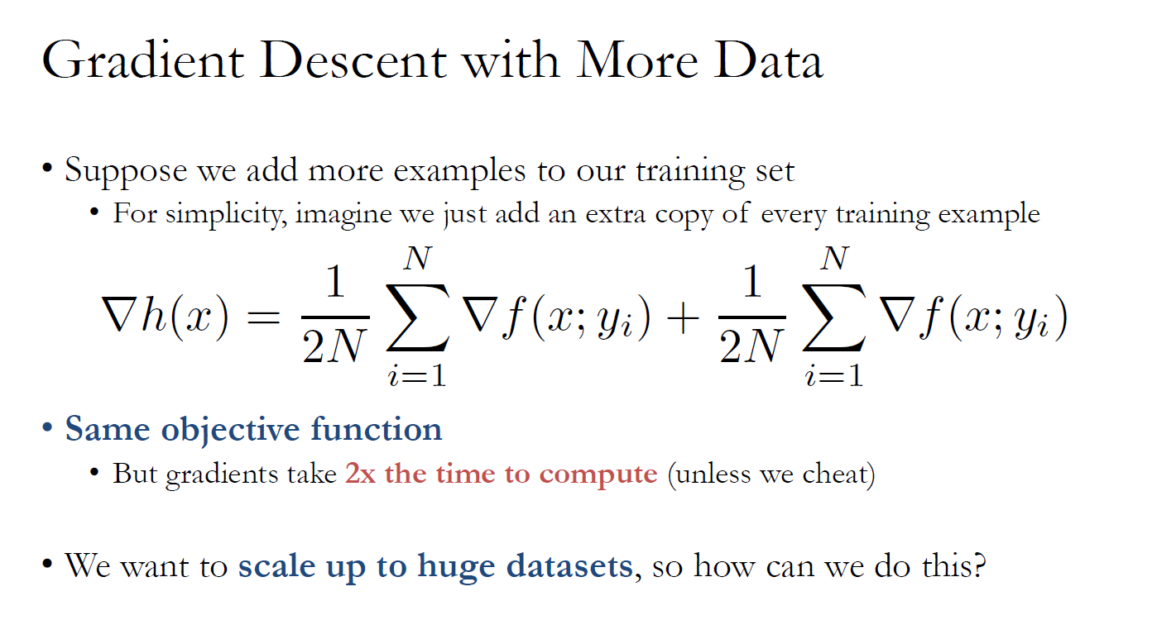

Slide 28
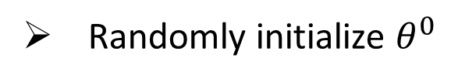












Mini-batch
x¹
NN
y¹
Pick the 1st batch
Mini-batch
NN
x³¹
y³¹
Pick the 2nd batch
……
x²
NN
y²
…
Mini-batch
C is different each time when we update parameters!
x¹⁶
NN
y¹⁶
……
Notes:
Each time we update paramters, we have different target -> 不安
Shuffle data, and repeat above process

Slide 29






Mini-batch
Faster
Better!
x¹
NN
y¹
Pick the 1st batch
Mini-batch
NN
x³¹
y³¹
Pick the 2nd batch
……
x²
NN
y²
…
Until all mini-batches have been picked
Mini-batch
x¹⁶
NN
y¹⁶
one epoch
……
Repeat the above process
Notes:
Ｉｎ ｏｐｅｎ ｅｐｏｃｈ， ｕｐｄａｔｅ ｍａｎｙ ｔｉｍｅｓ
Shuffle data, and repeat above process

Slide 30
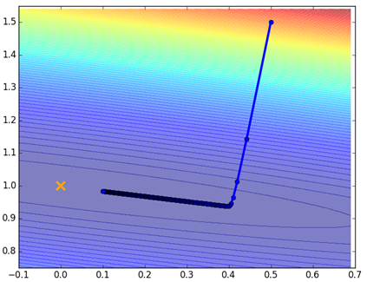

Mini-batch
Original Gradient Descent
With Mini-batch
unstable
The colors represent the total C on all training data.
Notes:
Hopefully, when the match size is large enough,
Not that stateble

Slide 31

(SGD)
- A special case of mini-batch gradient descent with batch size 1
Herbert Robbins and Sutton Monro, A Stochastic Approximation Method,The Annals of Mathematical Statistics, Vol. 22, No. 3. (Sep., 1951), pp. 400-407.

Slide 32



Besides local minima ……
cost
Very slow at the plateau
Stuck at saddle point
Stuck at local minima
parameter space

Slide 33
In physical world ……
Momentum
How about put this phenomenon in gradient descent?
Notes:
Momentum: 動量

Slide 34
Momentum
Still not guarantee reaching global minima, but give some hope ……
cost
Movement =
Negative of Gradient + Momentum
Negative of Gradient
Momentum
Real Movement
Gradient = 0
Notes:
What can we see?

Slide 35













Original Gradient descent
Gradient
Movement
……

Slide 36















Gradient descent with Momentum
Momentum v⁰=0
(v^{i} : movement at the i-th update)
Gradient
Movement
Momentum
……

Slide 37



Gradient descent with Momentum
Momentum v⁰=0
(v^{i} : movement at the i-th update)
v⁰=0
……
……

Slide 38
Gradient descent with Momentum
Problem
Gradient
cost
Movement
Momentum
Gradient = 0
parameter space

Slide 39


Momentum update
- Physical interpretation as ball rolling down the loss function + friction (mu coefficient).
- mu = usually ~0.5, 0.9, or 0.99 (Sometimes annealed over time, e.g. from 0.5 -> 0.99)

Slide 40
Momentum update
Allows a velocity to “build up” along shallow directions
Velocity becomes damped in steep direction due to quickly changing sign

Slide 41

SGD
vs
Momentum
notice momentum
overshooting the target, but overall getting to the minimum much faster than vanilla SGD.

Slide 42
Nesterov Momentum update
Ordinary momentum update:
momentum
step
actual step
gradient
step

Slide 43
Nesterov Momentum update
Momentum update
Nesterov momentum update
“lookahead” gradient step (bit different than original)
momentum
step
momentum
step
actual step
actual step
gradient
step

Slide 44

Nesterov Momentum update
Momentum update
Nesterov momentum update
“lookahead” gradient step (bit different than original)
momentum
step
momentum
step
actual step
actual step
gradient
step
Nesterov: the only difference...

Slide 45

Nesterov Momentum update
Slightly inconvenient…
usually we have :

Slide 46

Nesterov Momentum update
Slightly inconvenient…
usually we have :
Variable transform and rearranging saves the day:

Slide 47


Nesterov Momentum update
Slightly inconvenient…
usually we have :
Variable transform and rearranging saves the day:
Replace all thetas with phis, rearrange and obtain:

Slide 48
nag =
Nesterov Accelerated Gradient

Slide 49

Gradient descent,
Momentum, NAG
Methods:
Gradient descent
Momentum
NAG
Source: http://www.cs.toronto.edu/~fritz/absps/momentum.pdf

Slide 50

Outline - Training

Slide 51
Learning Rates
cost
Very Large
small
Large
Error
Surface
Just make
epoch

Slide 52


Learning Rates
Not always true
Notes:
Advanced Idea:
Can we give each parameters different learning rates?

Slide 53


Adaptive Learning Rates
Each parameter should have different learning rates
Smaller Learning Rate
Larger Gradient
Smaller Learning
Rate
Larger Learning Rate

Slide 54






RProp
Each parameter should have different learning rates
Gradient descent:
1
-1
Another Aspect:
Notes:
Resilient彈回的；有彈力的
pro
This is what we want
Can be time dependent

Slide 55



RProp - Problem
RProp is problematic for stochastic gradient descent
Gradient descent:
0.1
1
Stochastic Gradient descent:
0.9
-0.1
-0.1
-0.1
-0.1
1
-1
-1
-1
-1
Notes:
𝐶(𝜃)=1/(|𝕋|) ∑_((𝑥,𝑦 ̂ )∈𝕋)▒〖𝐶_𝑥 (𝜃) 〗

Slide 56



RMSProp
Error Surface can be complex in deep learning.
Smaller Learning Rate
Larger Learning Rate

Slide 57









RMSProp
Notes:
Why square

Slide 58




Adagrad
Duchi et al., Adaptive subgradient methods for online learning and stochastic optimization, JMLR 2011
Divide the learning rate by “average” gradient
Estimated while updating the parameters
Larger learning rate
Smaller learning rate

Slide 59



Adagrad
Notes:
Why square

Slide 60





Adagrad
Divide the learning rate by “average” gradient
  The “average” gradient is obtained while updating the parameters
1/t decay

Slide 61




Adagrad
Original Gradient Descent
Each parameter w are considered separately
Parameter dependent learning rate
constant
Summation of the square of the previous derivatives

Slide 62











Adagrad
g⁰ | g¹ | ……
0.1 | 0.2 | ……
g⁰ | g¹ | ……
20.0 | 10.0 | ……
Learning rate:
Learning rate:
Observation:
1. Learning rate is smaller and smaller for all parameters
2. Smaller derivatives, larger learning rate, and vice versa
Why?
Notes:
反差
http://seed.ucsd.edu/mediawiki/images/6/6a/Adagrad.pdf
http://courses.cs.washington.edu/courses/cse547/15sp/slides/adagrad.pdf

Slide 63
Not the whole story ……
Adadelta
  http://www.matthewzeiler.com/pubs/googleTR2012/googleTR2012.pdf
Adam
  http://arxiv.org/pdf/1412.6980.pdf
AdaSecant
  http://arxiv.org/pdf/1412.7419v4.pdf
“No more pesky learning rates”
  Using second order information
  http://arxiv.org/pdf/1206.1106.pdf
Notes:
Ada delta: google
Adam?
Adasecodn: Yoshua Bengio
No learning rate: Yann LeCun
I have also considered the algorithms presented in the paper "No More Pesky Learning Rates" and "Adaptive learning rates and parallelization for stochastic, sparse, non-smooth gradients". However, these algorithms require either computing the diagonal hessian or doing two steps of feed-forwarding/back-propagation for each mini-batch, so they don't fit into my current learning framework. Moreover, since I'm using relu activation function, the loss function is non-smooth, so the algorithm presented in "No More Pesky Learning Rates", which requires diagonal hessian, does not work. On the other hand, the algorithm presented in "Adaptive learning rates and parallelization for stochastic, sparse, non-smooth gradients" has been experimented only on extremely simple one-dimensional learning tasks, and is not compared with other adaptive learning rate algorithm.
SECANT: sec (not mentioned)
http://arxiv.org/pdf/1412.7419v4.pdf

Slide 64


More on Gradient Descent with Adaptive Learning Rates
Some Slides: Prof. Mitesh M. Khapra, IIT Madras

Slide 65


Slide 66


Slide 67

Adam — a most popular choice in deep learning optimization
Adam can be looked at as a combination of RMSprop and Stochastic Gradient Descent with momentum.
It uses the squared gradients to scale the learning rate like RMSprop and it takes advantage of momentum by using moving average of the gradient instead of gradient itself like SGD with momentum.
Adam is an adaptive learning rate method, which means, it computes individual learning rates for different parameters. Its name is derived from adaptive moment estimation, and the reason it’s called that is because Adam uses estimations of first and second moments of gradient to adapt the learning rate for each weight of the neural network.
Now, what is moment ? N-th moment of a random variable is defined as the expected value of that variable to the power of n. More formally:
Courtesy: Vitaly Bushaev, through www.towardsdatacience.com

Slide 68

Note, that gradient of the cost function of neural network can be considered a random variable, since it usually evaluated on some small random batch of data. The first moment is mean, and the second moment is uncentered variance (meaning we don’t subtract the mean during variance calculation).
To estimates the moments, Adam utilizes exponentially moving averages, computed on the gradient evaluated on a current mini-batch:
where m and v are moving averages, g is gradient on current mini-batch, and betas — new introduced hyper-parameters of the algorithm. They have really good default values of 0.9 and 0.999 respectively. Almost no one ever changes these values. The vectors of moving averages are initialized with zeros at the first iteration.

Slide 69


To see how these values correlate with the moment, defined as in first equation, let’s take look at expected values of our moving averages. Since m and v are estimates of first and second moments, we want to have the following property:
Expected values of the estimators should equal the parameter we’re trying to estimate, as it happens, the parameter in our case is also the expected value. If these properties held true, that would mean, that we have unbiased estimators.
Now, we will see that these do not hold true for the our moving averages. Because we initialize averages with zeros, the estimators are biased towards zero. Let’s prove that for m (the proof for v would be analogous). To prove that we need to formula for m to the very first gradient. Let’s try to unroll a couple values of m to see the pattern we’re going to use:

Slide 70


Slide 71


Slide 72


Now we need to correct the estimator, so that the expected value is the one we want. This step is usually referred to as bias correction. The final formulas for our estimator will be as follows:
The only thing left to do is to use those moving averages to scale learning rate individually for each parameter. The way it’s done in Adam is very simple, to perform weight update we do the following:
where w is model weights, eta (look like the letter n) is the step size (it can depend on iteration). And that’s it, that’s the update rule for Adam.

Slide 73

Putting it all together…..
Kingma, D and Ba, J . (2015) Adam: A method for Stochastic Optimization. ICLR 2015, Available at: https://arxiv.org/pdf/1412.6980.pdf

