Slide 1
Interrupts, Exceptions, System Calls and Context Switching
Chester Rebeiro
IIT Madras

Slide 2

OS and Events
OS is event driven
  i.e. executes only when there is an interrupt, trap, or system call
OS
S
3
Privilege level
1
U
User process 1
User process 2
event
time

Slide 3
Why event driven design?
OS cannot trust user processes
  User processes may be buggy or malicious
  User process crash should not affect OS
OS needs to guarantee fairness to all user processes
  One process cannot ‘hog’ CPU time
  Timer interrupts

Slide 4
Event Types
Events
Interrupts
Exceptions
Hardware Interrupts
Software Interrupts

Slide 5
Events
Interrupts : raised by hardware or programs to get OS attention
  Types
    Hardware interrupts: raised by hardware devices
    Software Interrupts: raised by user programs (such as ecall instruction)
Exceptions : due to illegal operations
Notes:
Fault : example page fault
Trap : example system calls?
Abort : divide by zero.

Slide 6
Why Hardware Interrupts?
Several devices connected to the CPU
  eg. Keyboards, mouse, network card, etc.
These devices occasionally need to be serviced by the CPU
  eg. Inform CPU that a key has been pressed
These events are asynchronous i.e. we cannot predict when they will happen.

Slide 7
Event view of CPU
while(fetch next instruction)
Current task suspended
Execute Instruction
If event
Execute event
in handler
yes
no

Slide 8
Interrupt Handlers
Typical Interrupt Handler
  Save additional CPU context (written in assembly)
  Process interrupt (communicate with I/O devices)
  Invoke kernel scheduler
  Restore CPU context and return (written in assembly)

Slide 9
Interrupt Latency
time needed to service an interrupt
OS
S
3
Privilege level
1
U
User process 1
User process 2
interrupt
Interrupt handler executes
time
Interrupt latency can be significant
Notes:
Interrupt latency dependent on
the interrupt itself (shared / notshared)
APIC/8259 controller
when / how the processor detects interrupts

Slide 10
Importance of Interrupt Latency
Real time systems
  OS should ‘guarantee’ interrupt latency is less than a specified value
Minimum Interrupt Latency
  Mostly due to the interrupt controller
Maximum Interrupt Latency
  Due to the OS
  Occurs when interrupt handler cannot be serviced immediately
    Eg. when OS executing atomic operations, interrupt handler would need to wait till completion of atomic operations.

Slide 11
Atomic Operations
Interrupt handler
Global variable :
int x;
Kernel code
Kernel code
Atomic start
interrupt
for(i = 0; I < 1000; ++i)
x++
x = x * 5
Atomic end
Value of x depends on whether an interrupt occurred or not!
Solution : make the part of code atomic (i.e. disable interrupts while executing this code)

Slide 12
Nested Interrupts
Interrupt handler 2
Interrupt handler 1
interrupt
Kernel code
Kernel code
interrupt
Typically interrupts disabled until handler executes
  This reduces system responsiveness
To improve responsiveness, enable Interrupts within handlers
  This often causes nested interrupts
  Makes system more responsive but difficult to develop and validate
Linux Interrupt handler approach: design interrupt handlers to be small so that nested interrupts are less likely

Slide 13
Small Interrupt Handlers
Do as little as possible in the interrupt handler
  Often just queue a work item or set a flag
Defer non-critical actions till later

Slide 14
Timer Interrupts
Event
EPC: exception program counter
Store PC in EPC
CPU in kernel mode
CPU in user mode
kernelvec
uservec
kerneltrap (trap.c)
usertrap (trap.c)
Use function
devintr to identify cause of interrupt

Slide 15
Timer Interrupts
Event
EPC: exception program counter
Store PC in EPC
CPU in kernel mode
CPU in user mode
kernelvec
uservec
kerneltrap (trap.c)
usertrap (trap.c)
If it is a timer interrupt
yield the processor

Slide 16
Recall: Process Stacks
Each process has 2 stacks
  User space stack
    Used when executing user code
  Kernel space stack
    Used when executing kernel code (for eg. during system calls)
trampoline
trapframe
Heap
Kernel Stack for process
User stack
for process
Data
Text
(instructions)
Proc (PCB)
Process Address Space
Kernel Address Space

Slide 17
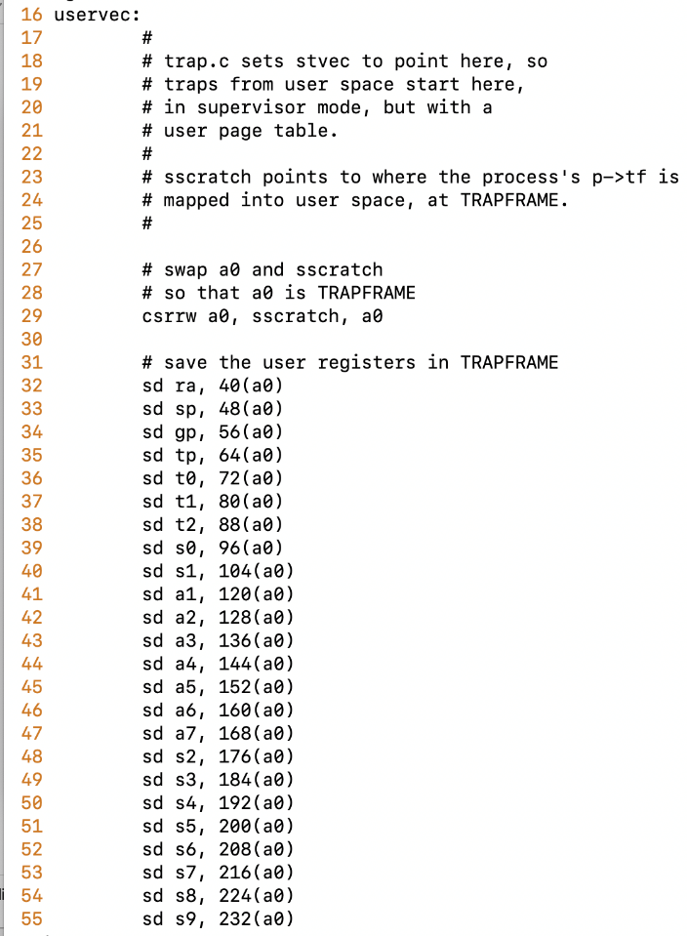
Context Switching
trampoline.S
Process 1
Timer interrupt
uservec
Save user registers in trapframe
change to kernel address space

Slide 18
Context Switching
Process 1
Timer interrupt
uservec
usertrap
Identify cause of the interrupt. If the interrupt happens to be a timer interrupt invoke yield

Slide 19
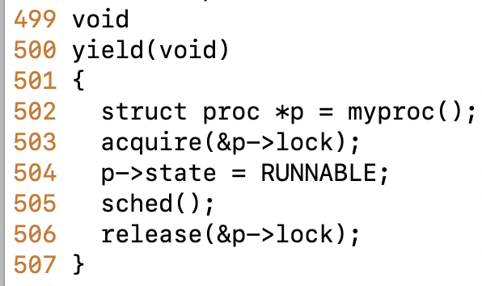
Context Switching
Process 1
proc.c
Timer interrupt
uservec
usertrap
yield
Set process 1 to RUNNABLE
Invoke sched

Slide 20
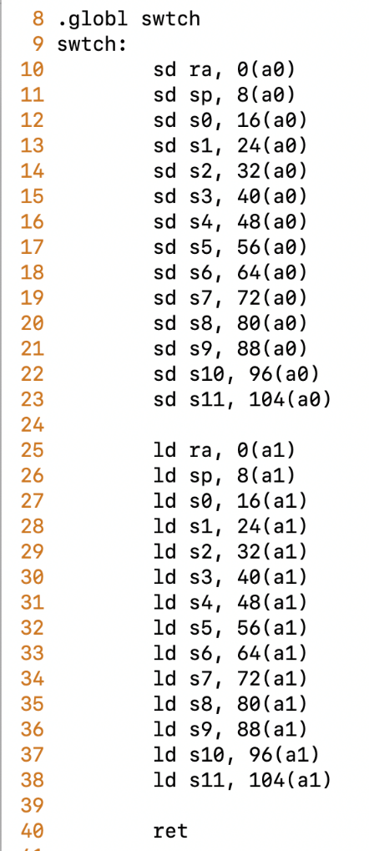
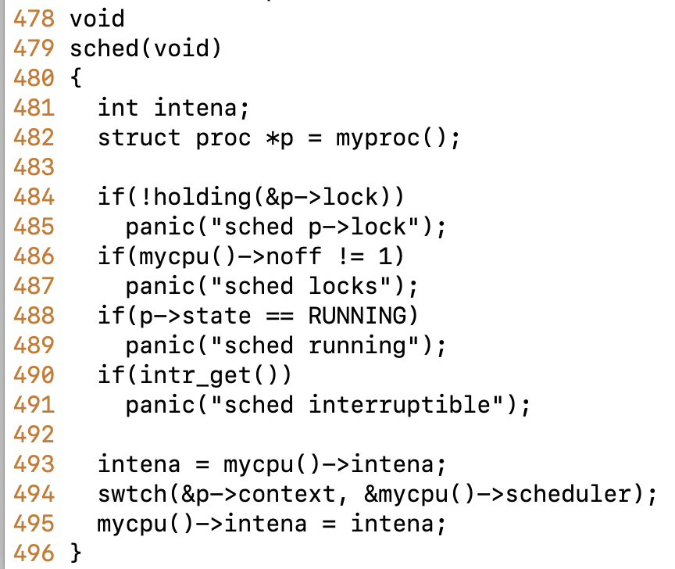
Context Switching
a0: &p->context
a1: &mycpu()->scheduler
swtch.c
Process 1
proc.c
Timer interrupt
uservec
usertrap
yield
sched
Process context saved in proc struct;
Scheduler context loaded from mycpu()->scheduler
On return from swtch, CPU continues executing from the
location of the saved scheduler’s context
swtch

Slide 21
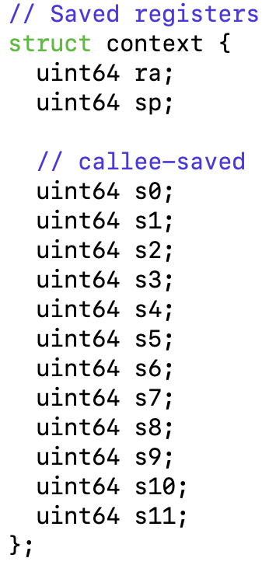
Context
Process 1
Timer interrupt
Context saves registers and permits to
continue executing at a later time
by reloading the registers.
uservec
usertrap
yield
Process 1 context
Process 2 context
sched
Scheduler context
swtch

Slide 22
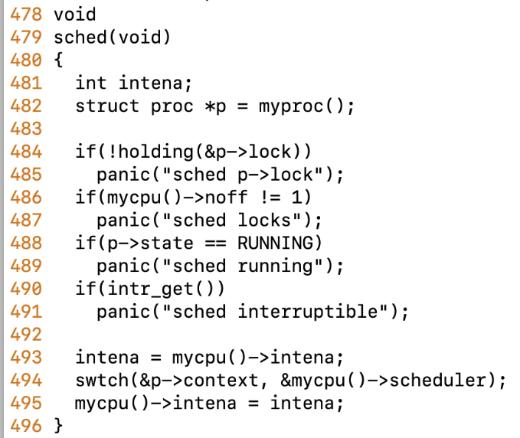
Context Switching
Process 1 context
proc.c:494
Process 1
proc.c
Scheduler context
proc.c:460
uservec
Assume scheduler context is
this for now
usertrap
yield
sched
Process context saved in proc.context (proc.c:494)
Scheduler context loaded from mycpu()->scheduler
The current register has context proc.c:494
swtch

Slide 23
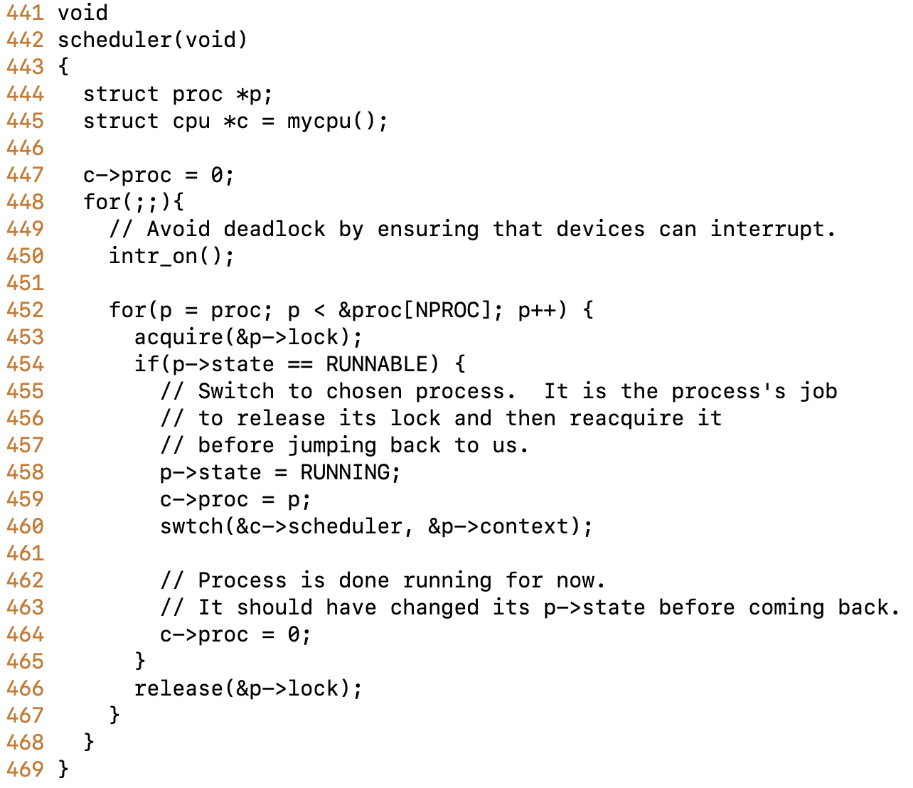
Context Switching
Process 1 context
proc.c:494
Process 2 context
proc.c:494
Process 1
proc.c
Scheduler context
proc.c:460
Timer interrupt
uservec
usertrap
Scheduler chooses Process 2
to execute. Moves it RUNNING.
Switches context to new process
yield
sched
swtch
scheduler
swtch

Slide 24
Context Switching
Process 1 context
proc.c:494
Process 2 context
proc.c:494
proc.c
Process 1
proc.c
Scheduler context
proc.c:460
uservec
usertrap
yield
sched
sched
Process 2 continues to execute from its last known context
that was at proc.c:494
swtch
scheduler
swtch

Slide 25
Context Switching
Process 1 context
proc.c:494
Process 2 context
proc.c:494
Scheduler context
proc.c:460
Process 1
uservec
Setup trapframe with pointers to kernel satp, kernel stack for process2
and change from kernel address space to process address space
usertrap
usertrapret
yield
yield
sched
sched
swtch
scheduler
swtch

Slide 26
Context Switching
Process 1 context
proc.c:494
Process 2 context
proc.c:494
Scheduler context
proc.c:460
Process 1
uservec
userret
Executes in trampoline in the process 2’s address space.
Restores the process 2’s registers from the trapframe
and return from interrupt using mret
usertrap
usertrapret
yield
yield
sched
sched
swtch
scheduler
swtch

Slide 27
Context Switching
Process 1 context
proc.c:494
Process 2 context
proc.c:494
Process 2
Scheduler context
proc.c:460
Process 1
uservec
userret
Process 2 finally executes from where had previously
stopped ☺☺☺
usertrap
usertrapret
yield
yield
sched
sched
swtch
scheduler
swtch

Slide 28
Multitasking and Context Switch
1
2
3
3
1
4
2
3
4
4
time
Context switch time

Slide 29
Context Switching Overheads
Direct Factors affecting context switching time
  Timer Interrupt latency
  Saving/restoring contexts
  Finding the next process to execute
Indirect factors
  TLB needs to be reloaded
  Loss of cache locality (therefore more cache misses)
  Processor pipeline flush

Slide 30
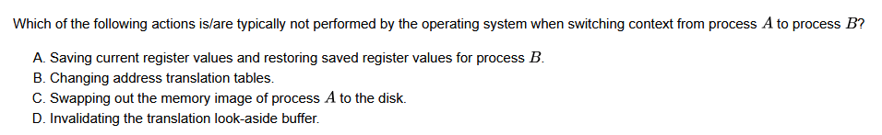
Answer: C

Slide 31
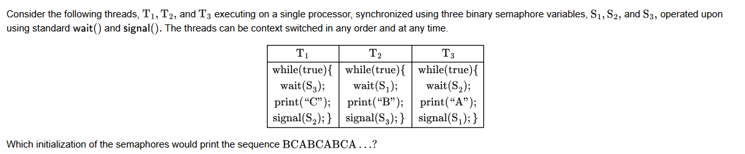
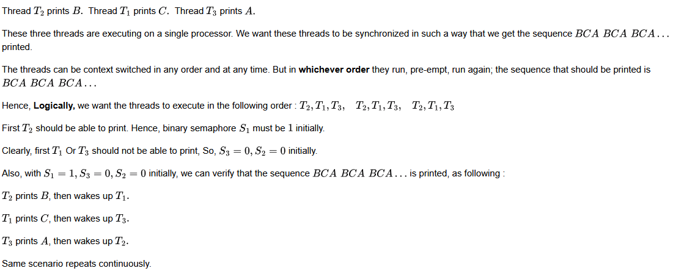
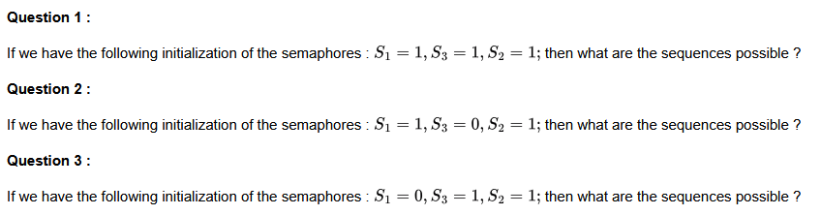

Slide 32
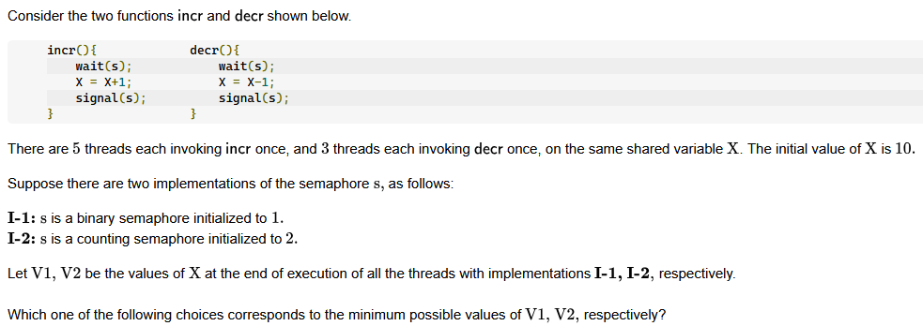

Slide 33
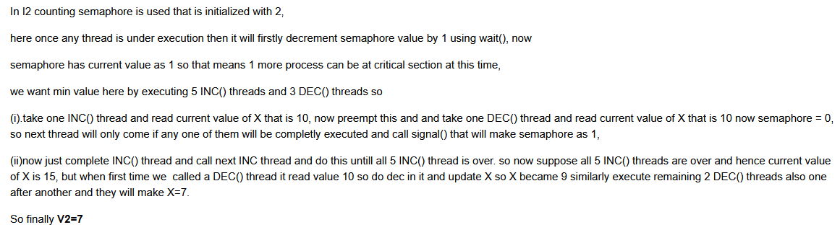
For I-1:
Initially, X = 10, s = 1
(mutual exclusion), and ‘s’ is
a binary semaphore.
So, after executing 5 incr() the value
of X becomes 10 + 5 = 15, and after
executing 3 decr() the value of X
becomes 15 - 3 = 12.

