Slide 1
SMART BLIND STICK (ECHOPATH)
AJAY KUMAR GARG ENGINEERING COLLEGE Department of Electronics and Communication Engineering
Ankit Kumar Yadav – Roll No. 2300270310039 (ECE-I) Shobhit Maurya – Roll No. 2300270310176 (ECE-III)

Slide 2
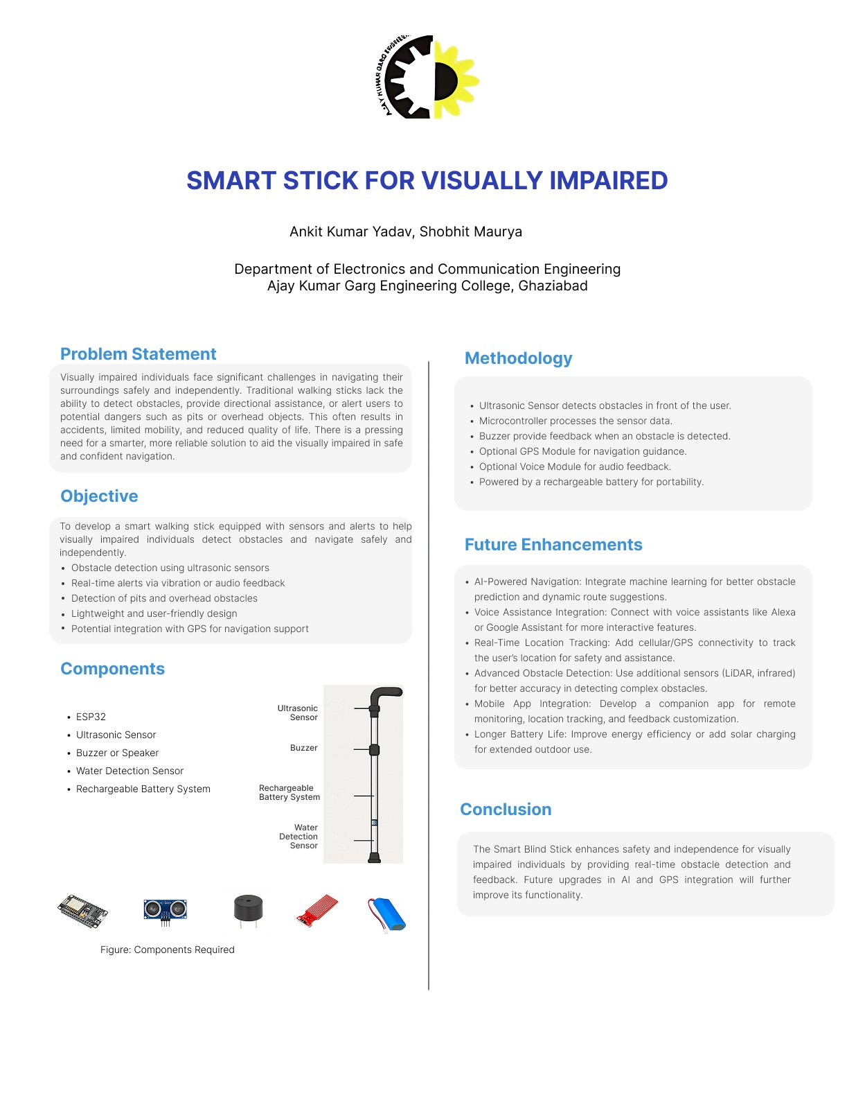

Slide 3
Contents Overview
Introduction
Objective
Setting the stage for what the Smart Blind Stick (EchoPath) is and how it aids visually impaired individuals.
Describes the goals of the project, focusing on obstacle detection and safety.
Materials Required
Component Overview
A list of the key electronic components and tools used in the prototype.
Individual breakdown of the devices that make the stick smart and interactive.
Future Scope
Conclusion
Exploration of potential upgrades and features to enhance the assistive technology.
Summary of the impact and future direction for the device.

Slide 4
Introduction
The Smart Blind Stick leverages ultrasonic sensors to detect obstacles ahead. By sending out high-frequency sound waves and measuring their reflections, it accurately calculates distances to barriers in the user's path.
This technology aims to increase the safety and independent mobility of visually impaired users, empowering them with confidence in navigating complex environments.
Feedback is delivered via a buzzer alert to notify users of nearby obstacles, with an optional vibration motor offering tactile feedback for improved accessibility.

Slide 5
Project Objective
Assist Detection
Real-time Feedback
Help blind or partially sighted individuals sense obstacles in real time to avoid accidents.
Provide immediate audio or vibrational cues guiding safe movement and spatial awareness.
Enhanced Safety
Reduce reliance on traditional canes by integrating smart sensors for proactive hazard alerts.

Slide 6




Materials Required
ESP32
Ultrasonic Sensor
Moisture Sensor
Processor with Wi-Fi & Bluetooth for device control and communication.
Measures distance to objects using sound waves.
Detects wet surfaces to warn users from slipping hazards.
Buzzer
Audio alert system indicating nearby obstacles or hazards.
Additional components include jumper wires for connections and a rechargeable battery for power autonomy.

Slide 7
Component Overview
ESP32
The main microcontroller that processes sensor data and manages communication via Wi-Fi and Bluetooth.
Ultrasonic Sensor
It emits and receives sound waves to calculate distance and detect obstacles in front of the stick.
Moisture Sensor
Alerts when the stick encounters wet or slippery surfaces, enhancing safety beyond obstacle detection.
Buzzer
Provides immediate sound alerts to the user to help identify hazards in their surroundings.

Slide 8




Future Scope
GPS Integration
Adding GPS will enable real-time navigation and route guidance for outdoor use.
Mobile App Support
A companion app can provide emergency contact features and remote monitoring.
AI Object Recognition
Artificial intelligence can help the stick identify specific objects or obstacles for detailed feedback.
Voice Control
Incorporating voice commands will enhance usability.

Slide 9
Conclusion
Improved Mobility
Safety Enhancement
The prototype enhances independent movement and awareness for visually impaired users.
Real-time obstacle detection reduces accident risk, making navigation safer.
Future Potential
With planned upgrades, this device can evolve into a comprehensive smart mobility aid.

