Slide 1
Banking Management System
B.Tech(CSE AI & ML)
Ankit Yadav
Admission No: 24SCSE1180510
Aayush Choudhary
Admission No:24SCSE1180326
Dewansh Gupta
Admission No:24SCSE1180491

Slide 2
INTRODUCTION
Bank is the place where customers feel the sense of safety for their property. In the bank, customers deposit and withdraw their money.
Transaction of money also is a part where customer takes shelter of the bank. Now to keep the belief and trust of customers, there is the positive need for management of the bank, which can handle all this with comfort and ease. Smooth and efficient management affects the satisfaction of the customers and staff members, indirectly.
And of course, it encourages management committee in taking some needed decision for future enhancement of the bank. Now a days, managing a bank is tedious job upto certain limit. So a bank management system that reduces the work is essential. Also today’s world is a genuine computer world and is getting faster and faster day-by-day.
Thus, considering above necessities, the system for bank management has became necessary which would be useful in managing the bank more efficiently.

Slide 3
PROBLEM STATEMENT
The Bank Management system consists of the bank administrator and the customer. The administrator will need to create a new account for the customer by logging into their existing account.
For creating a new account on the system the administrator will need to enter details of customer like first name, last name, address, contact no and will add the branch where the account has been created.
The system executes operations like creating new account, checking the balance of the account, withdrawing, depositing, money transfers between two accounts and viewing transaction history.

Slide 4
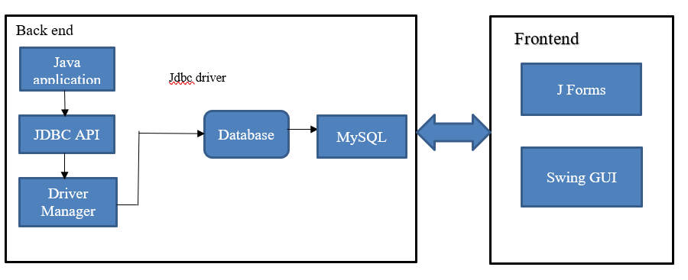
System prototype

Slide 5
System Requirements
FRONT END: JAVA Forms and Swing GUI is utilized to implement the frontend.
BACK END: The back end is implemented by using JDBC which is connected with MYSQL and XAMPP server.

Slide 6
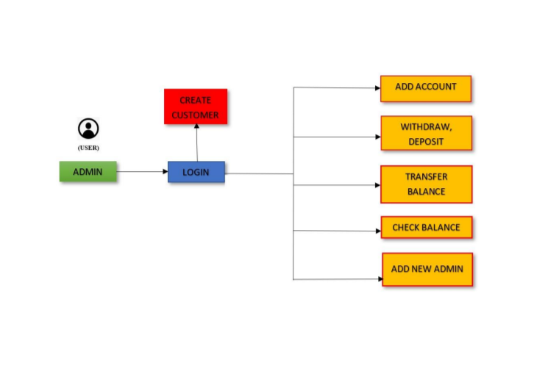
Screen-shorts of Project:

Slide 7
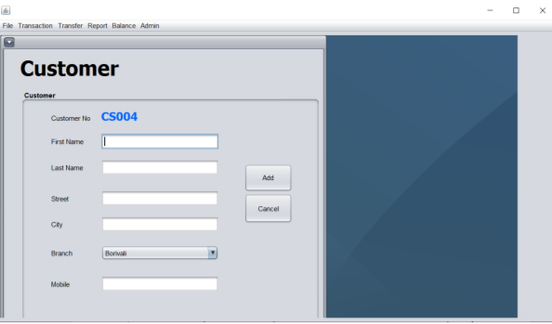
Adding Customer:

Slide 8
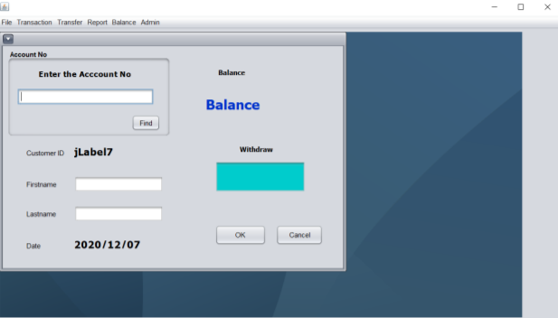
Withdraw Process:

Slide 9
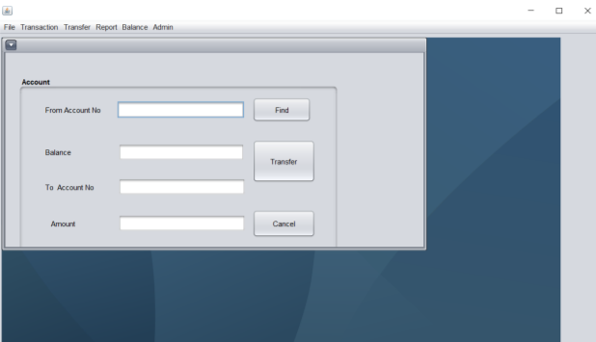
Transactions:

Slide 10
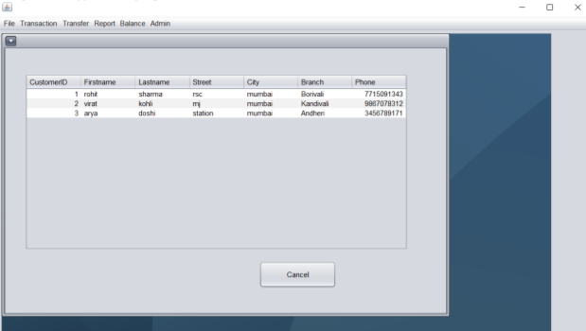
Database Information:

Slide 11
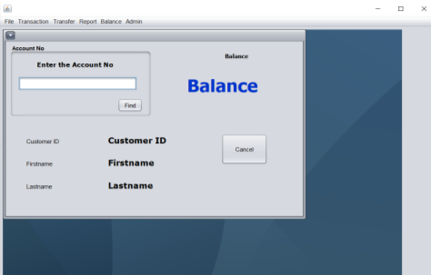
Configuring Balance:

Slide 12
References
https://netbeans.org/kb/index.html
https://www.javatpoint.com/online-banking-project
https://projectsgeek.com/2016/02/complete-banking-system-java-project.html#:~:text=Proposed%20System,valid%20user%20id%20and%20password.
https://www.apachefriends.org/index.html

