Slide 1



LoCoMo (Phone mode changer)
Submitted by:
Ankita Wankhede,
SaiJyothi Gudibandi,
Sai Tejaswee Reddy Pasham,
Naveena Nallamotu

Slide 2
PROJECT DESCRIPTION
LoCoMo (Phone Mode Changer) is an android application which automatically changes the mode of your phone(i.e. Ringer to silent) based on your location.
It determines your location with the help of GPS and we are able to give specific time and location of a desired event and mode of the phone we want at that time. It changes accordingly.
For example, if you want to be at church on every Sunday and you want your phone to be in silent mode; You can create an event accordingly in this application and the mode automatically changes from ringer mode to silent mode and vice-versa come out of the church.

Slide 3





TOOLS/TECHNOLOGY

Slide 4
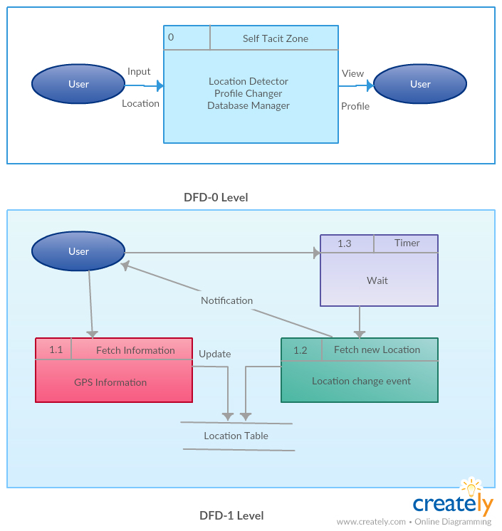
DATAFLOW DIAGRAM

Slide 5
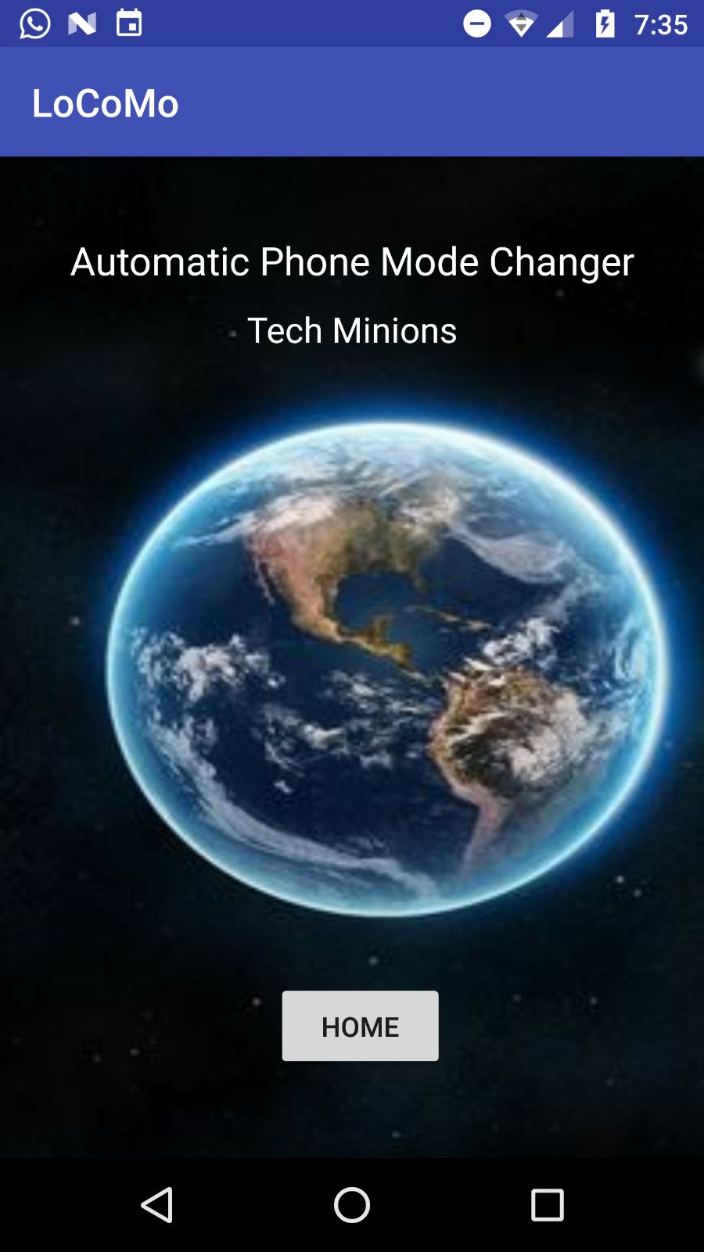
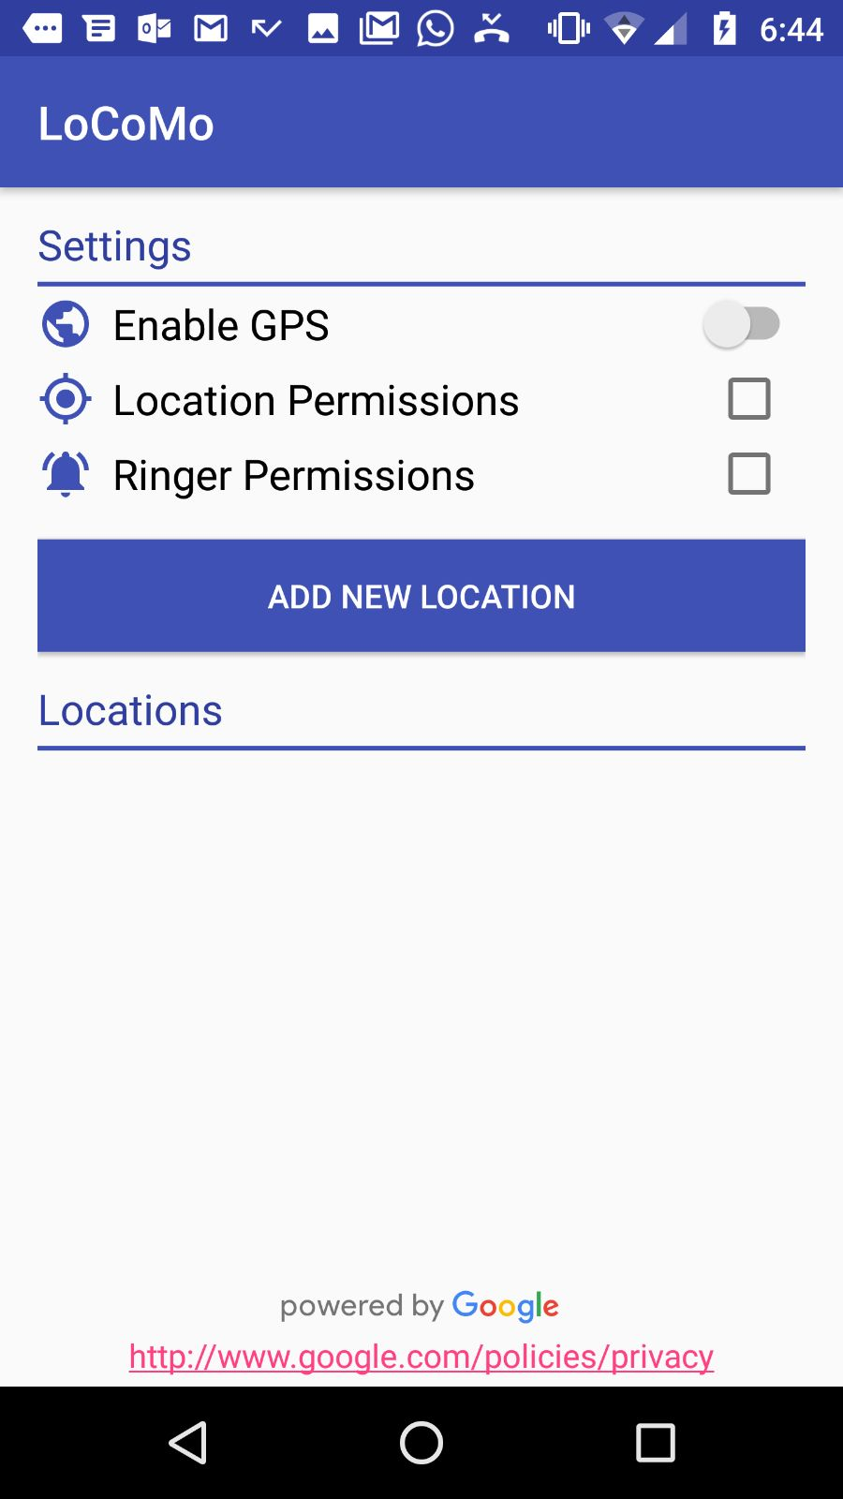
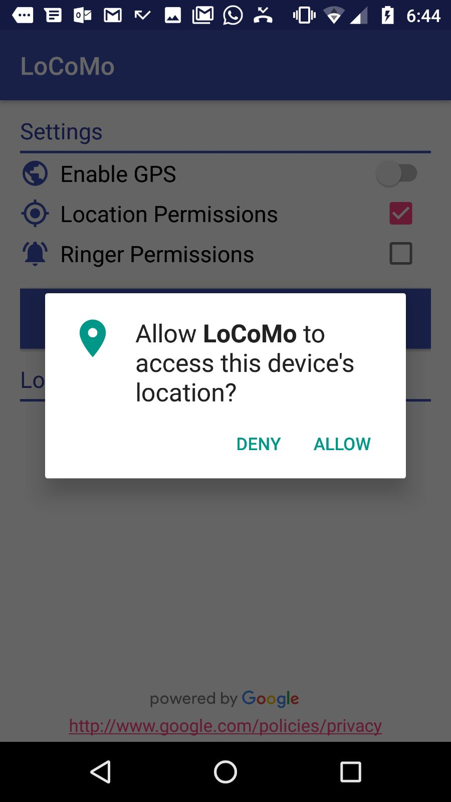
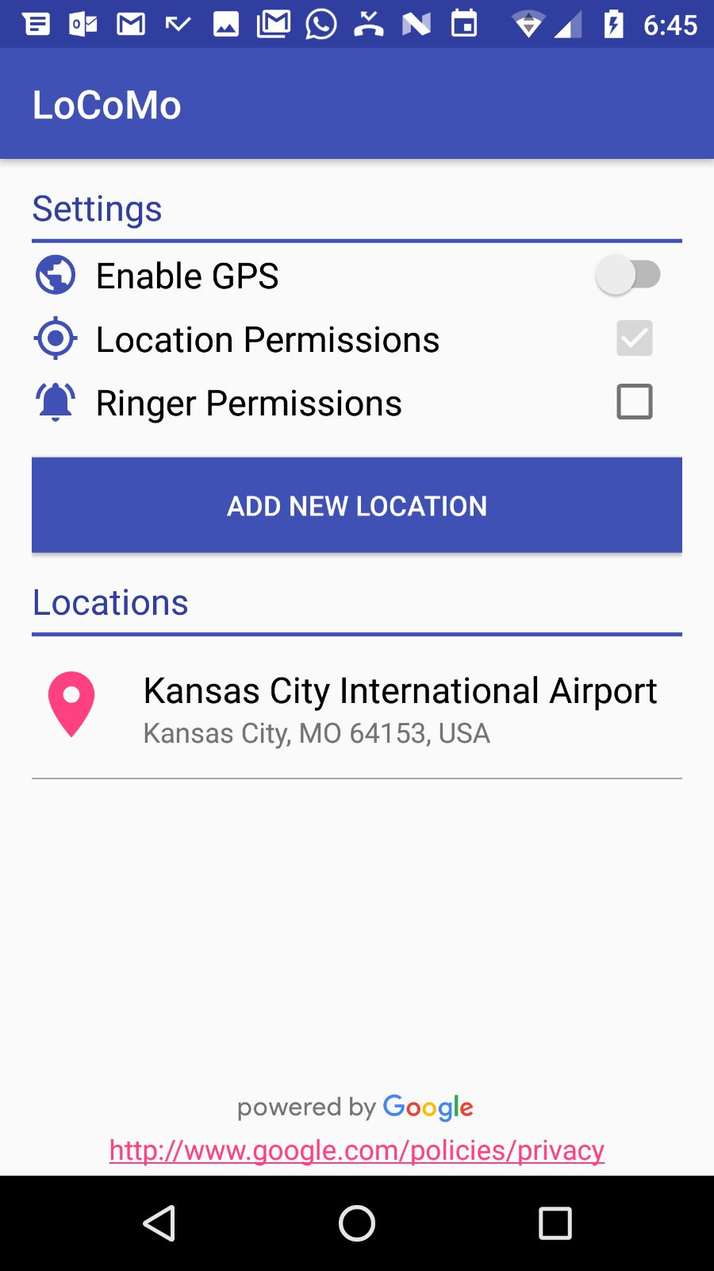
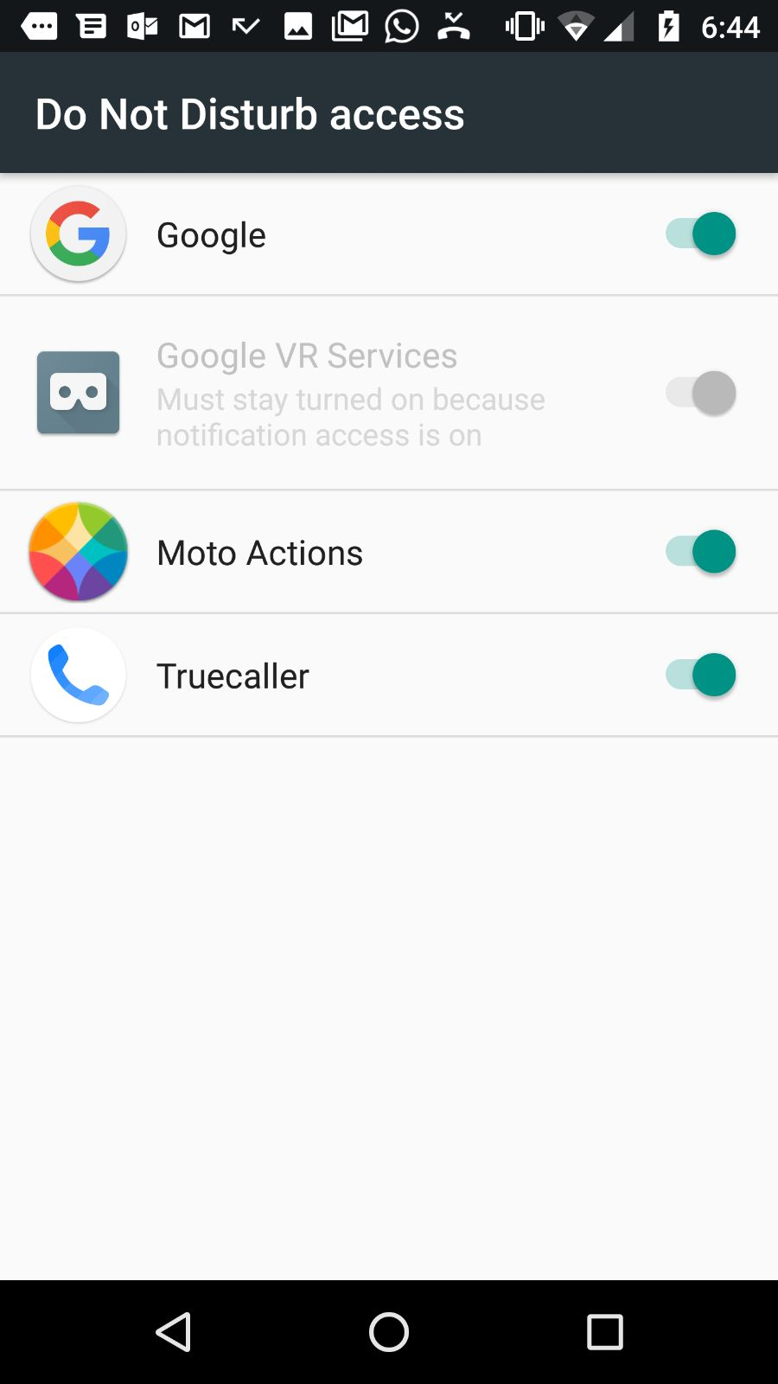
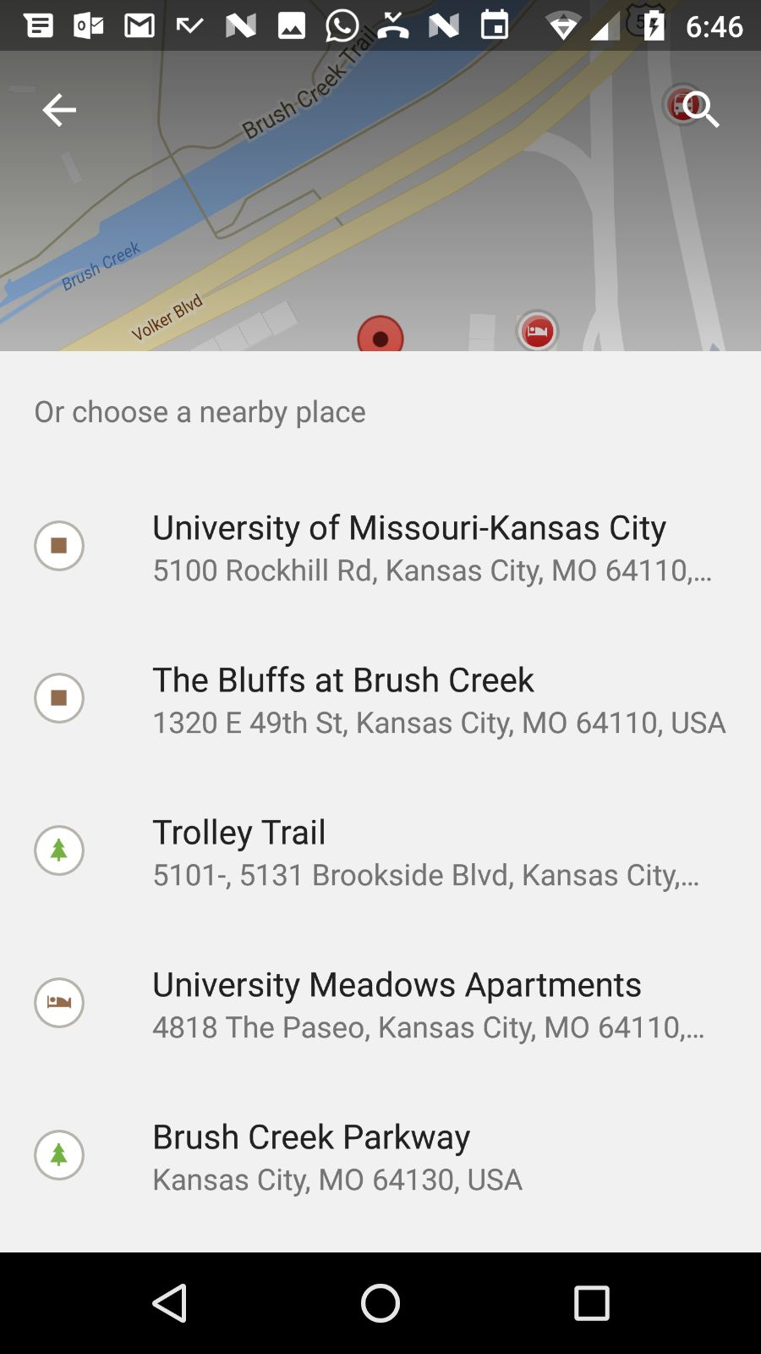
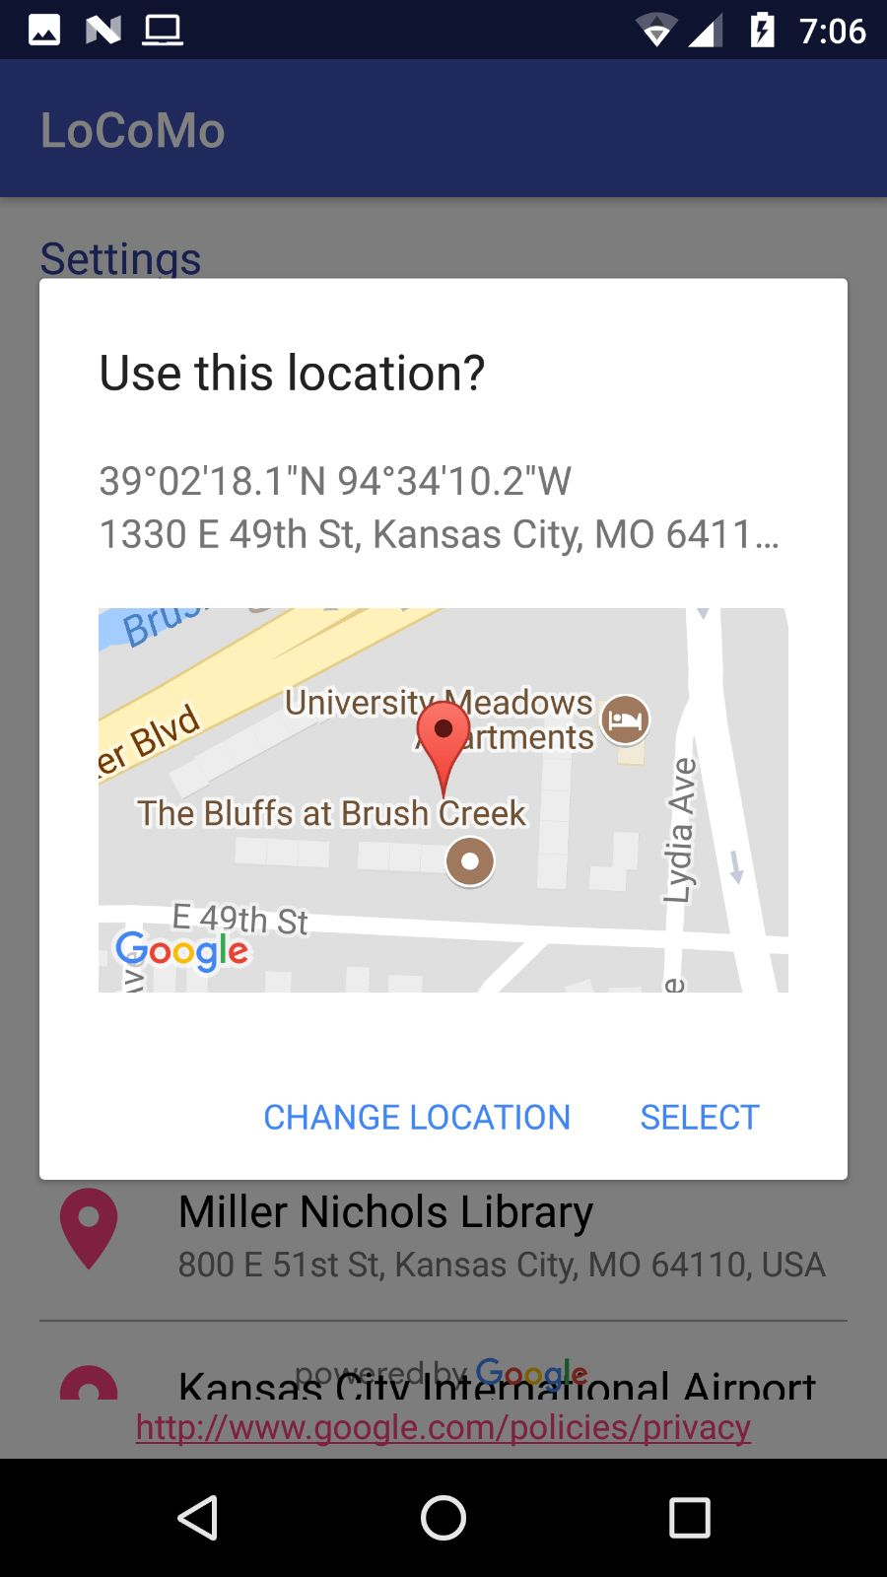
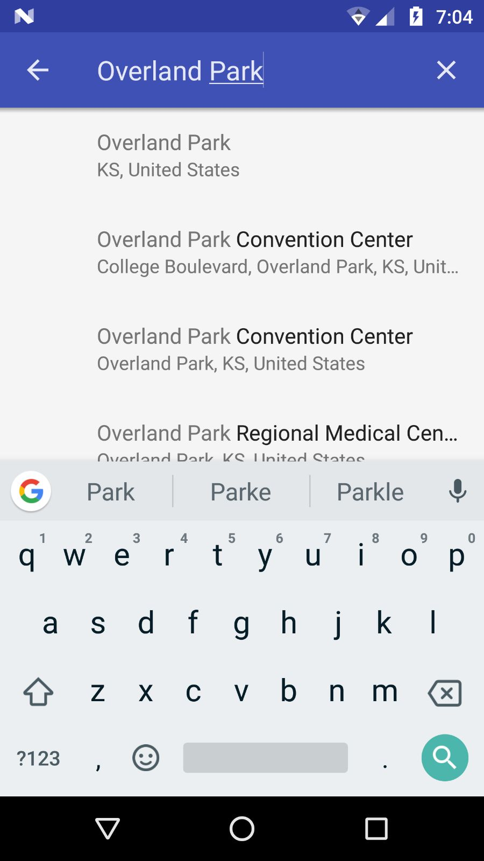
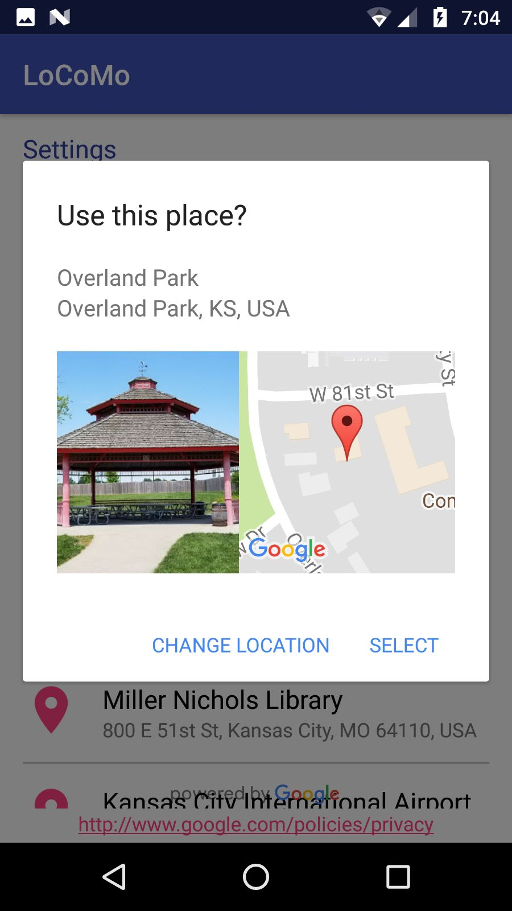
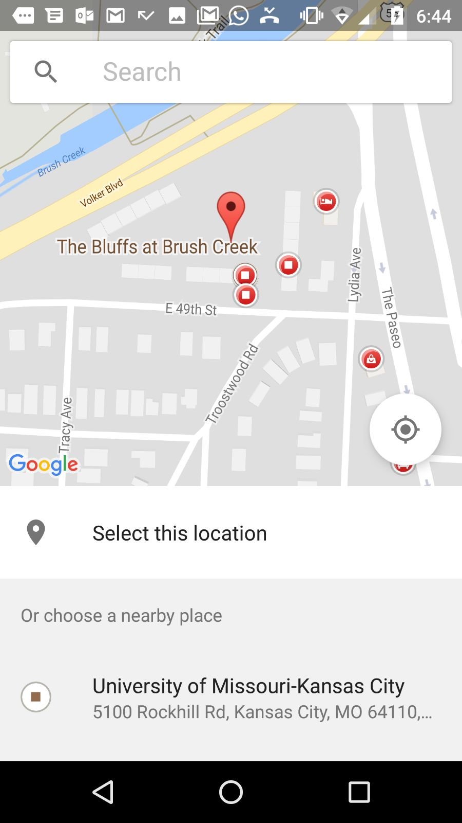

Slide 6
BIBLIOGRAPHY
https://ionicframework.com/getting-started/
"ionic threads and thread handlers - an android studio tutorial - techotopia”. techotopia.com. n.p., 2015. web. 12 sept. 2015.
https://www.sitepoint.com/firefox-os-game-development-ionic-framework/
https://developer.android.com/studio/run/index.html
https://developers.google.com/maps/documentation/android-api
https://developer.android.com/training/maps/index.html
https://www.tutorialspoint.com/android/android_google_maps.htm

