Slide 1

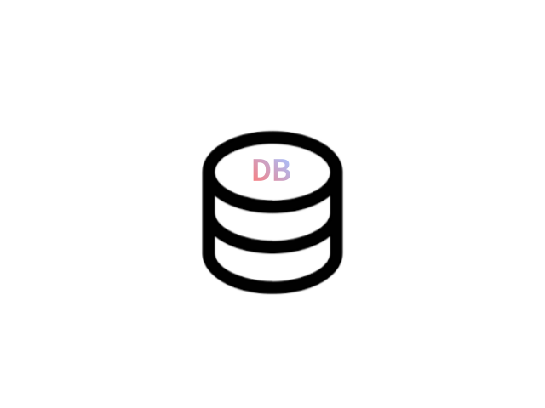



수집
저장
사용자
Cluster
Node1
Master/data/ingest/cordinator
192.168.219.xxx
Xms1g/Xmx1g
Node2
Data
Request
http.enabled: true
Master/data/ingest/cordinator
192.168.219.xxx
Data
Node3
WAS
WEB
Master/data/ingest/cordinator
Xms1g/Xmx1g
Search_template
http.enabled: true
192.168.219.xxx
Xms1g/Xmx1g
http.enabled: true

