Slide 1
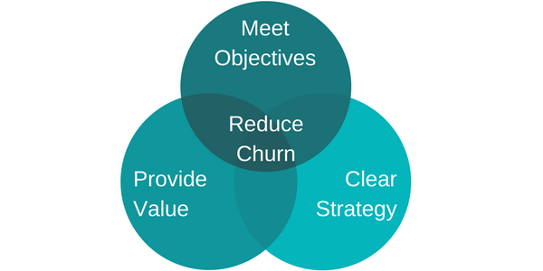
Customer Retention Analysis
Presented By:
Ankur Jain
Eklavya Saxena
Amandeep Singh

Slide 2
Introduction
Customer Churn is one of the most critical challenges in the service industry. This project investigates determinants of customer churn in any service provider firm. The subject of customer retention, loyalty, and churn is receiving attention in many industries. This is important in the customer lifetime value context. A company will have a sense of how much is really being lost because of the customer churn and the scale of the efforts that would be appropriate for retention campaign. The mass marketing approach cannot succeed in the diversity of consumer business today. Customer value analysis along with customer churn predictions will help marketing programs target more specific groups of customers.
We will be discussing:
Business problem
Need of Customer Churn Prediction
Factors influencing Customer Churn
Approach for predicting customer churn
Results & Conclusion

Slide 3
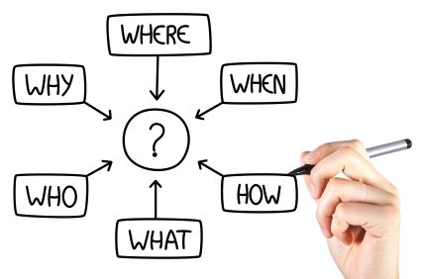
Business Problem
Consumers today go through a complex decision making process before subscribing to any of the service. The service provided by any vendors are not highly differentiated.
For such reason customer loyalty becomes an issue, hence it is becoming really important for companies to proactively identify factors that have a tendency to take preventive measures to retain customers.According to a telecom company , loss due to customer churn to the company is approximately $ 140k per month.
For such reasons customer retention analysis is required which will help to face these challenges.

Slide 4
Data Description
In this study a customer data from a Telecommunication is used and analyzed.
The dataset consists of 7043 records/rows and 21 fields/columns
1. Customers who left within the last month – the column is called Churn(Target Variable)
2. Services that each customer has signed up for – phone, multiple lines, internet, online security, online backup, device protection, tech support, and streaming TV and movies
3. Customer account information – how long they’ve been a customer, contract, payment method, paperless billing, monthly charges, and total charges
4. Demographic info about customers – gender, age range, and if they have partners and dependents

Slide 5
Data Analysis
Since this dataset consists both numeric and categorical data , then we decided to analyse both type of data differently to facilitate the analysis
Process followed
Univariate analysis (Numeric variables)
Bivariate analysis
Categorical variable analysis

Slide 6
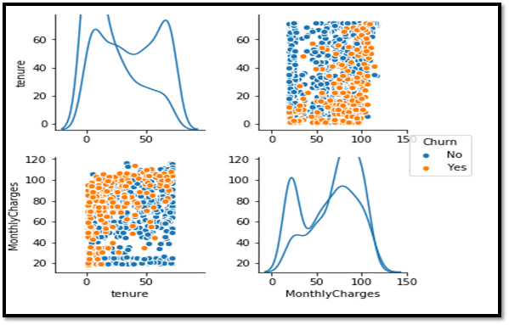
Univariate Analysis
Univariate analysis is done by plotting
Box plots
Histograms
From the plots, it is clear that
Numeric variables like MonthlyCharges and tenure are not evenly distributed
But are evenly distributed in the context of churn and are good predictors of churn variable.

Slide 7
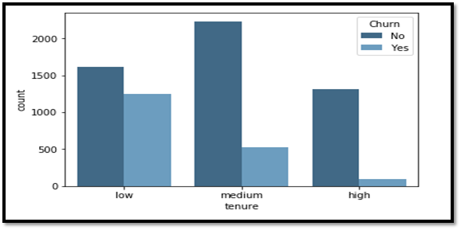
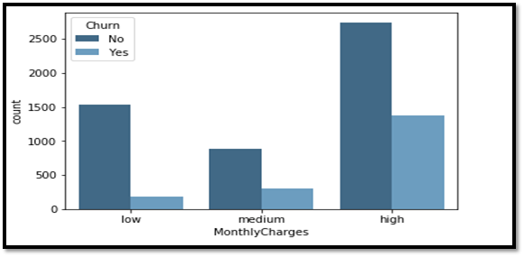
Bivariate Analysis
With the help of countplots during bivariate analysis of data, we deduce that
Less than a year tenure category has highest churn
Customers paying high Monthly charges tends to churn more
2 to 5 years tenure category results in highest revenue loss
There is not much variation in medium bin which means customer remain loyal as they cross a year

Slide 8
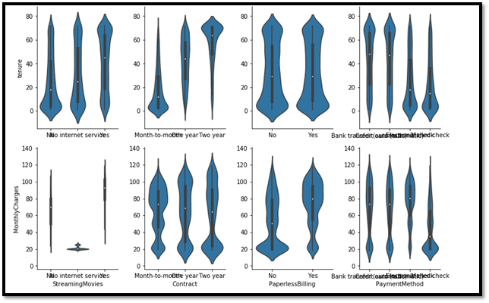
Numerical vs Categorical
This part of analysis helps to explore the dependency of variables on each other.
This analysis help to evaluate below
Customers with Electronic or Mailed check payment method have a lower tenure
Variable like gender does not influence tenure and monthly charges
Fibre optic service is closely related to monthly revenue
Notes:
The above section of analysis is very important to design the campaigns for the firm to focus on the specific areas which needs to be enhanced in terms of service quality or affordable price to reduce the customer's churn rate.

Slide 9
Categorical variable Analysis
This analysis gives a better picture of important variables like
Month-to-month contract is a strong indicator if the client might leave
Electronic check payment method also provides clear view to the client stability
On the other hand, Senior citizen is a good predictor but only represents a small amount of clients
Notes:
Main target for analysis of categorical values is to focus on the variables that delivers best results in context of churn of clients

Slide 10
Feature Engineering
It includes the process of transforming variables which includes
Dropping CustomerId which does not help in prediction of customer churn
Dropping TotalCharges as it is correlated with MonthlyCharges and deriving from product of MonthlyCharges and tenure
Creating Dummy variables to sort the data into mutually extensive categories which will indicate the indicate the occurrence of major prediction values.

Slide 11
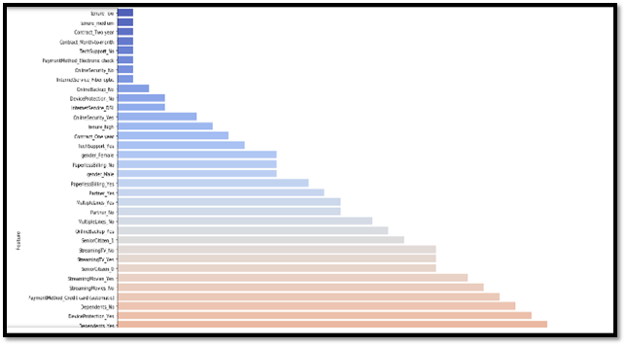
Feature Selection
In feature selection we have implemented
Boruta Library - To rank the predicting features
2. Defined Hyperparameters - Here variables of rank 1&2 are selected as input for higher accuracy of prediction algorithms.

Slide 12
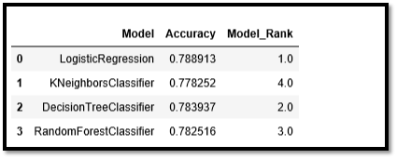
Prediction Algorithms
To predict customer churn , we have used 4 different algorithms
Logistic Regression
KNeighbors Classifier
Decision Tree Classifier
Random Forest Classifier
By training each model , we get the below metrics with Ranking as per their accuracy score
For this data Logistic Regression is the best model with accuracy score of approx 0.79 .

Slide 13

Deployment
Our deployment phase consists of
Serialization using Pickle
Cloud Storage at Amazon S3
Parallel Processing using Dask
Dockerzing
Git

Slide 14

Web Application
It is very important to create a framework for user-server interface.For which we have used Flask platform to create a web application to interact with our user,
This application mainly aims for
Business aiming to prevent Customer Churn
Evaluation of revenue loss due to churn
Services requires quality improvement
Most influential services in context of cost

Slide 15
Conclusion
The analysis focused on Churn prediction based on various models give following results
Accuracy measure formulate one standard model that could be used as the predictive model in the future.
Various parameters in the data are of no use
Logistic Regression model is able to produce predictions with high accuracy.
By using best model, company can decide which customers to focus to prevent them leaving

Slide 16
Recommendations & Future Work
Various solutions are proposed by this study
By using best model , concerns of churning customers should be prioritized first.
Leverage the time to improve quality of high cost services like Fibre optic.
Collect customer feedback and act on it immediately to prevent churn.
Future work can be done to enhance model accuracy and precision
Customer profile should be included in data to know whether the churning customer is worth retaining or not.
A probabilistic model can be introduced to list the clients with highest chance of leaving.

Slide 17

Thank You
GitHub Link - https://github.com/eklavyasaxena/FinalProject_ADS_Team4

