Slide 1
Exploratory Data Analysis
Energy Dataset
Submitted By
Ankur Jain
Eklavya Saxena
Amandeep Singh

Slide 2
EDA PLAN
Exploratory data analysis consists of following major tasks
Form hypotheses/develop investigation themes to explore
Wrangle data
Assess quality of data
Profile data
Explore each individual variable in the dataset
Assess the relationship between each variable and the target
Assess interactions between variables
Explore data across many dimensions

Slide 3
LIBRARIES
Plotting Libraries EDA Tools
Matplotlib missingno
Seaborn Panadas_profiling
Wrangling Libraries More Technical EDA
Numpy sklearn
Pandas scipy
System Packages
Os
Sys
warnings

Slide 4
Data Quality Assessment
Assess the prevalence of missing data across all data fields, assess whether its missing is random or systematic, and identify patterns when such data is missing
Identify any default values that imply missing data for a given field
For datetime data types, ensure consistent formatting and granularity of data, and perform sanity checks on all dates present in the data.
In cases where multiple fields capture the same or similar information, understand the relationships between them and assess the most effective field to use
Assess data type of each field
For discrete value types, ensure data formats are consistent
For discrete value types, assess number of distinct values and percent unique and do sanity check on types of answers
For continuous data types, assess descriptive statistics and perform sanity check on values
Slice data by device type, operating system, software version and ensure consistency in data across slices

Slide 5
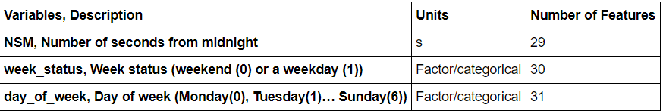
Additional Key features
Added 3 additional features which are
NSM, Number of seconds from midnight
Week_status, week status(weekend(0) or a weekday(1))
Day_of_week, day of week(Monday(0),Tuesday(1)......Sunday(6))

Slide 6
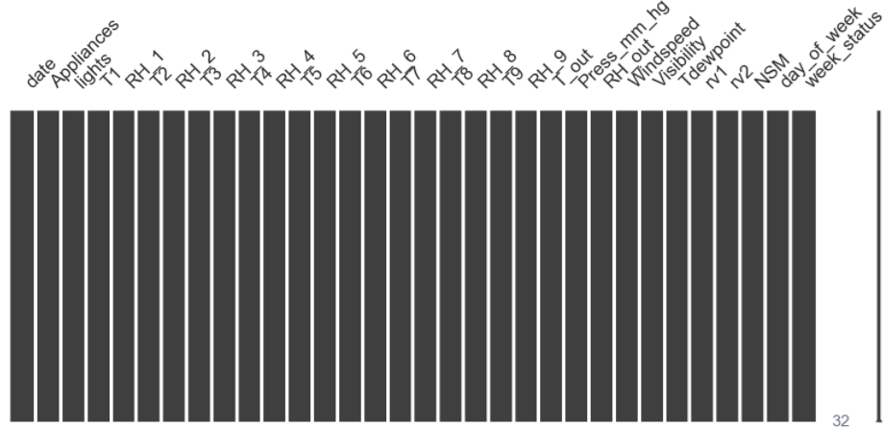
Evaluating Missingness
Aim is to identified
1.Systemic reasons for missing data
2.Fields that are always missing at the same time
3.Information in what data is missing
Visualize missingness
From above plot we concluded that there is no missing data.

Slide 7
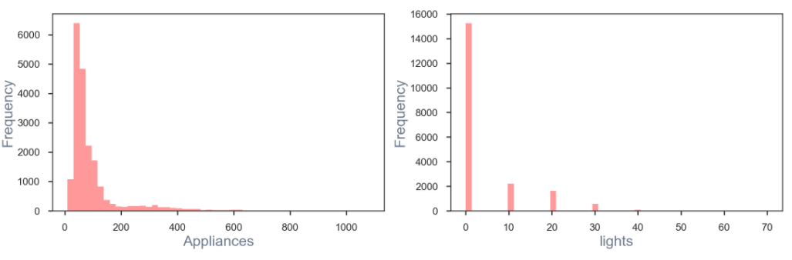
Data Visualization
Cross-section for Univariate Distributions
From above plots we concluded following points
1.Appliances: Majority consumption is in the range of 0 ~ 200 kWh
2.Lights: 77% of observations hace ZERO Lights Energy Consumption

Slide 8
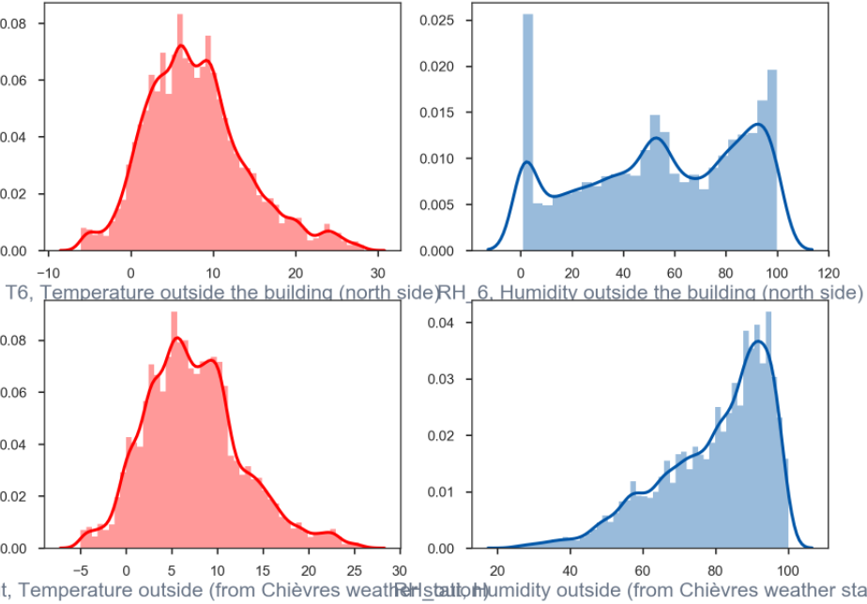
Data Visualization
Univariate Distributions
It can be concluded that
While the temperatures are related,humidities vary significantly between Building outside and Chievres weather station
Temperature peaks at 5.C and are normally distributed

Slide 9
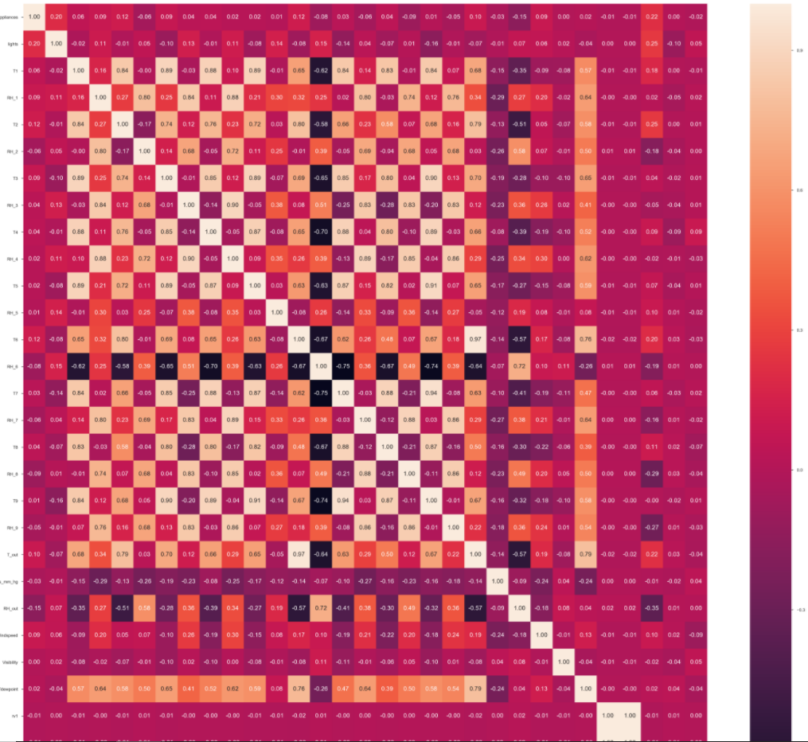
Data Visualization
Pairwise Relationship (Correlation Heat Map)
From above correlation map, it is concluded that only few attributes are closely related to Appliances Energy Consumption which are
Lights, T2(Temp in living room), T6(Temp outside the building), T_out(Temp outside), RH_out(Humidity outside), NSM(Number of seconds from midnight)

Slide 10
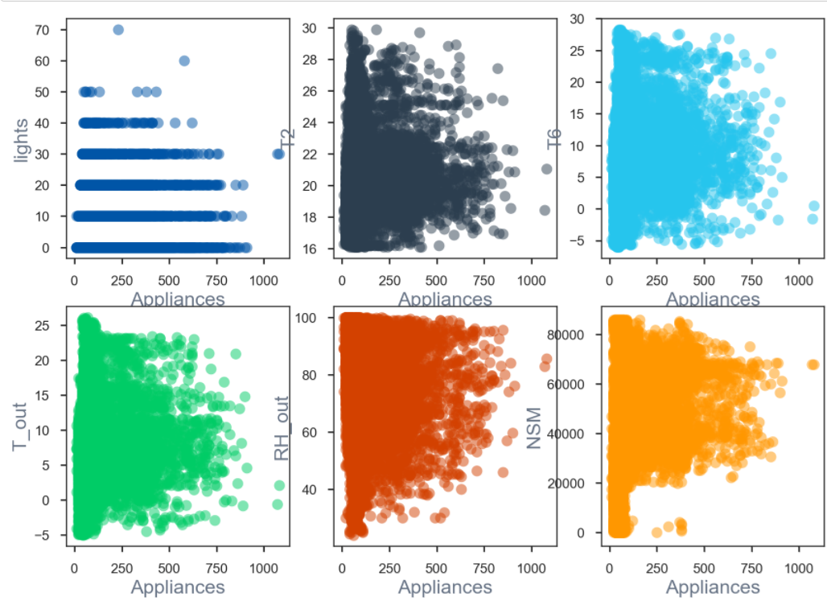
Data Visualization
Scatter plots of most related attributes with respect to Appliances Energy Consumption

Slide 11
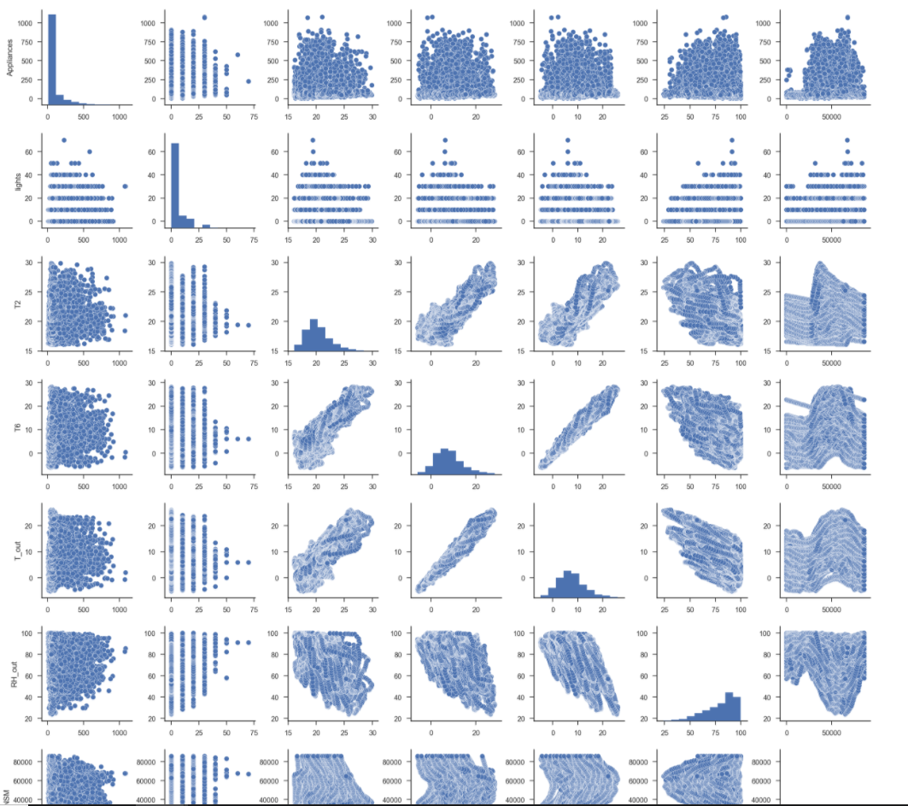
Pairplot of most related attributes with respect to Appliances Energy Consumption
From the scatter and pair plots of related variables with Appliances energy consumption shows that there are many outliers in the data

Slide 12
Detecting Outliers
Following steps are done to detect outliers in the dataset
1.Arrange all the dataset points and calculate median
2.Calculate the upper quartile
3.Calculate the lower quartile
4.Calculate the interquartile range
Product of numeric value of 1.5 and difference of the upper quartile(75%) and lower quartile(25%)
1.5 X (Upper Quartile - Lower Quartile)
5. Calculate the inner fences for the dataset
Set of numerical boundaries which is classified as major and minor outlier:
Major Outlier = Upper Quartile + Interquartile Range
Minor Outlier = Lower Quartile - Interquartile Range

Slide 13
Removing Outliers
Outliers from variables are dropped excluding below
RH_6, Humidity outside the building (north side)
RH_out, Humidity outside (from Chièvres weather station)
Wind Speed, Wind Speed (from Chièvres weather station)
Visibility, Visibility (from Chièvres weather station)
rv1, Random Variable 1
rv2, Random Variable 2
Outliers drop will only remove max. 15% of the data, which is acceptable.

Slide 14
THANK YOU

