Slide 1

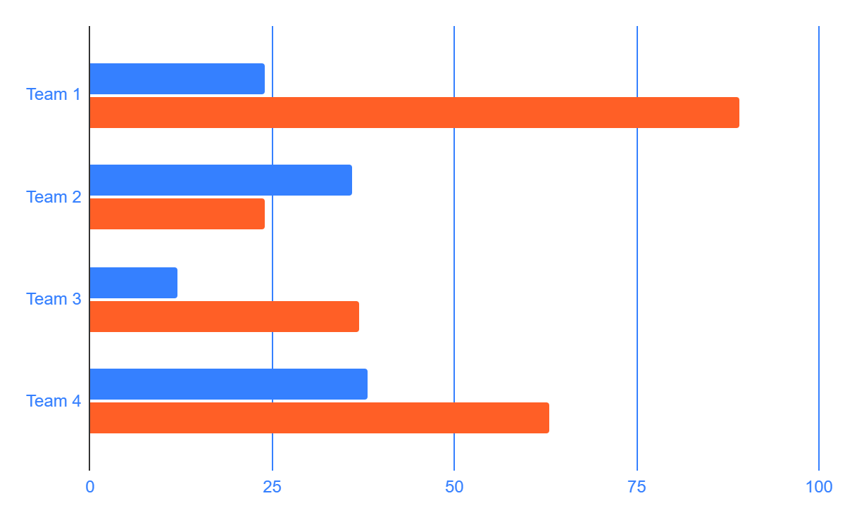

OCEAN DEEPS RESEARCH POSTER
Your name, Faculty Mentor: Suxing Liu
Department of Computer Science & Engineering, Georgia State University, Perimeter College
INTRODUCTION
RESEARCH
CONCLUSIONS
ABSTRACT
MATERIAL
METHODOLOGY
CONCLUSION
Neptune is the farthest planet from the Sun. It's also the fourth-largest planet by diameter in the Solar System. Saturn is a gas giant and has several rings. It's composed mostly of hydrogen and helium
Jupiter is a gas giant and the biggest planet in the Solar System
Since Jupiter is a gas giant, it doesn’t have a solid surface. It's composed mostly of hydrogen and helium
Venus has a beautiful name, but also very high temperatures
Despite being red, Mars is actually a cold place. It's full of iron oxide dust, which gives the planet its reddish cast. Mars has two moons, called Deimos and Phobos in honor to the Greek gods of fear
Jupiter is the biggest planet in the Solar System
BACKGROUND
ANALYSIS
RESULTS
RECOMMENDATIONS
Mercury is the closest planet to the Sun and the smallest one. Its name has nothing to do with the liquid metal since it was named after a Roman god
Neptune is the farthest planet from the Sun. It's also the fourth-largest object by diameter in the Solar System
Venus has a beautiful name and is the second planet from the Sun. It’s terribly hot, even hotter than Mercury, and its atmosphere is extremely poisonous. It’s the second-brightest natural object in the night sky after the Moon
Write your recommendations here
Write your recommendations here
Write your recommendations here
Write your recommendations here
HYPOTHESIS
DISCUSSION
You can write a hypothesis here.
You can write a hypothesis here.
You can write a hypothesis here.
You can write a hypothesis here.
You can write a hypothesis here.
 | A | B
MARS | 25 | 25
MERCURY | 25 | 96
JUPITER | 66 | 32
The Sun is the star at the center of the Solar System. Pluto is now considered a dwarf planet. Venus has a beautiful name and is the second planet from the Sun. Mars is actually a cold planet, not hot
OBJECTIVES
Follow the link in the graph to modify its data and then paste the new one here. For more info, click here
ACKNOWLEDGEMENTS
Earth is the only planet known to harbor life in the Solar System
Venus has a beautiful name and is the second planet from the Sun
Jupiter is the biggest planet in the Solar System
Saturn is a gas giant and has several rings
Mars is actually a cold planet
The Sun is the star at the center of the Solar System. Neptune is the farthest
CERES
MODELS
Ceres is located in the main asteroid belt
CONTACT INFO
Mercury is the closest planet to the Sun and the smallest one in the Solar System—it’s only a bit larger than the Moon. Venus has a beautiful name and is the second planet from the Sun.
youremail@freepik.com
+91 620 421 838
yourwebsite.com
SATURN
Saturn is a gas giant and has several rings
Your software Link QR code

