Slide 1
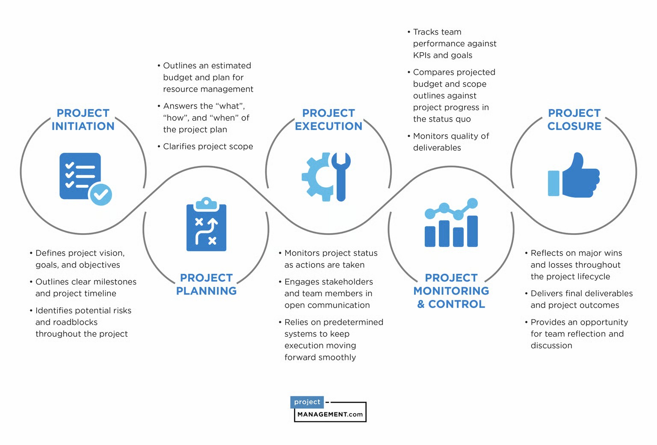

Slide 2
Project planning (Time table)

Slide 3
Project risk evaluation

Slide 4
Project deliverable & Input

