Slide 1
cosi
A Local Hybrid Search Engine
Utilizing completely local high-dimensional vector geometry for private note retrieval aware of semantic meaning
Presenter: Matthew Lindsey
Course: CSC 2510: Theoretical Foundations of Computer Science
Instructor: Dr. Suxing Liu | Georgia State University

Slide 2
Structuring a 5-Phase Project Lifecycle to Deliver cosi
PHASE 01
Initiation
Defining scope.
—
• General project research and understanding
• Baseline functionality analysis
PHASE 02
Planning
Understanding the task.
—
• Mapping out the core logic
• Understanding the tools I’ve decided to use
PHASE 03
Execution
Core script development.
—
• Implement the core functionality, such as:
• Paragraph-level chunker
• Ollama API integration
• Weighted hybrid scoring
PHASE 04
Monitoring
Diagnostic testing & verification.
—
• Testing on different systems
• Testing under different data circumstances
PHASE 05
Closure
Deployment & final evaluation.
—
• Docker containerization
• Review with Dr. Liu
• Project presentations

Slide 3
Mitigating 3 Architectural Risks to Ensure Platform Portability
Data Syncronization
Identified Operational Risk:
Possibility of the SQLite database to become outdated when run on frequently updated directories. However, running the indexer on every search creates unecessary overhead.
Mitigation Strategy: Prompted Refresh
Give the user an easy way to refresh the database that’s obvious, rather than making it a hidden background process. This relies on the user’s intuition on if they’ve changed enough to warrant a refresh.
Imbalance of Vague or Overly Precise Search
Identified Operational Risk:
Traditional keyword matchers (like BM25) fail completely if a query uses synonyms. On the other hand, pure semantic search can sometimes be too vague, focusing on general concepts at all times rather than matching technical names or variables specifically searched for.
Mitigation Strategy: A balanced mixture
Design the search function to balance (For example: 40% weight to BM25 and 60% weight to Cosine Similarity) both, capturing both the general idea and specific keywords when necessary.
Semantic Meaning Dilution
Identified Operational Risk:
Passing a whole multi-page study note or textbook chapter to an embedding model yields a single vector coordinate representing everything. This dilutes semantic granularity, ruining retrieval precision.
Mitigation Strategy: Paragraph-Level Chunking
Engineer an ingestion module that intelligently partitions markdown text structures into paragraph-level chunks. Index, embed, and similarity-rank each paragraph chunk as a discrete database record.

Slide 4
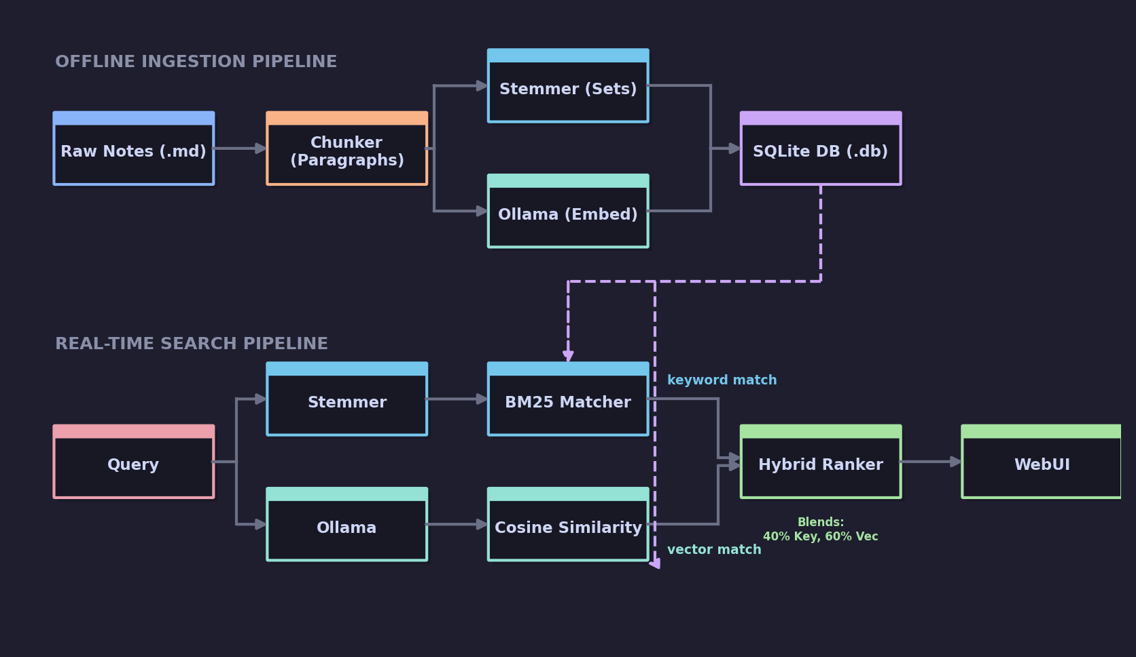
Integrating Pipelines into 3 Containerized Deliverables
Key Project Deliverables
• cosi.py: Core program. Handles paragraph chunking, SQLite indexing, BM25 set frequency math, and NumPy-based query vector comparisons.
• test_ollama.py: Local connectivity verifier. Isolated diagnostic utility testing 768-dimensional float coordinates returned from host-side Ollama engine.
• Dockerfile: Standardized docker container. Declares environment, downloads dependencies (NLTK, NumPy), and simplifies compatability.

