Slide 1

WINDOWS FUNDAMENTALS

Slide 2
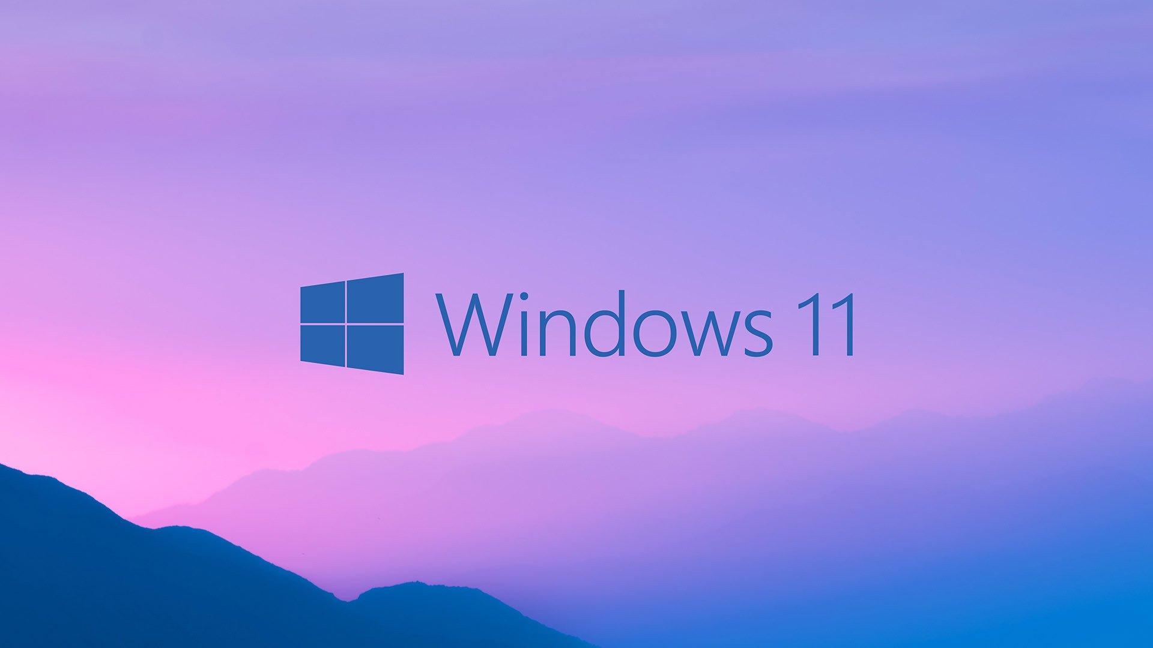
WINDOWS OS
PREPARED BY
Mr. ANKMRAO

Slide 3

WINDOWS :WINDOWS IS AN OS WHICH IS USED TO PERSONAL COMPUTESR.IT IS COLLETON OF A PROGRAMS,AND IT IS DEVELOPED BY MICROSOFT IN 1985
VERSIONS OF WINDOWS:
WINDOWS 95
WINDOWS 98
WINDOWS 2000
WINDOWS XP
WINDOWS VISTA
WINDOWS 7
WINDOWS 8
WINDOWS 10

Slide 4
COMPONENTS OF WINDOWS:
TASKBAR
MENUBAR
MENUS
TITLEBAR
ICONS
STARTBUTTONS
CONTROL BUTTONS
TOOLBARS
STATUSBAR
FORWARD AND BACK WORD BUTTONS
DESKTOP
PICTURES
GALLERY
DOCUMENTS
MUSIC
VIDEOS
CAMERA
DOWNLOADS

Slide 5
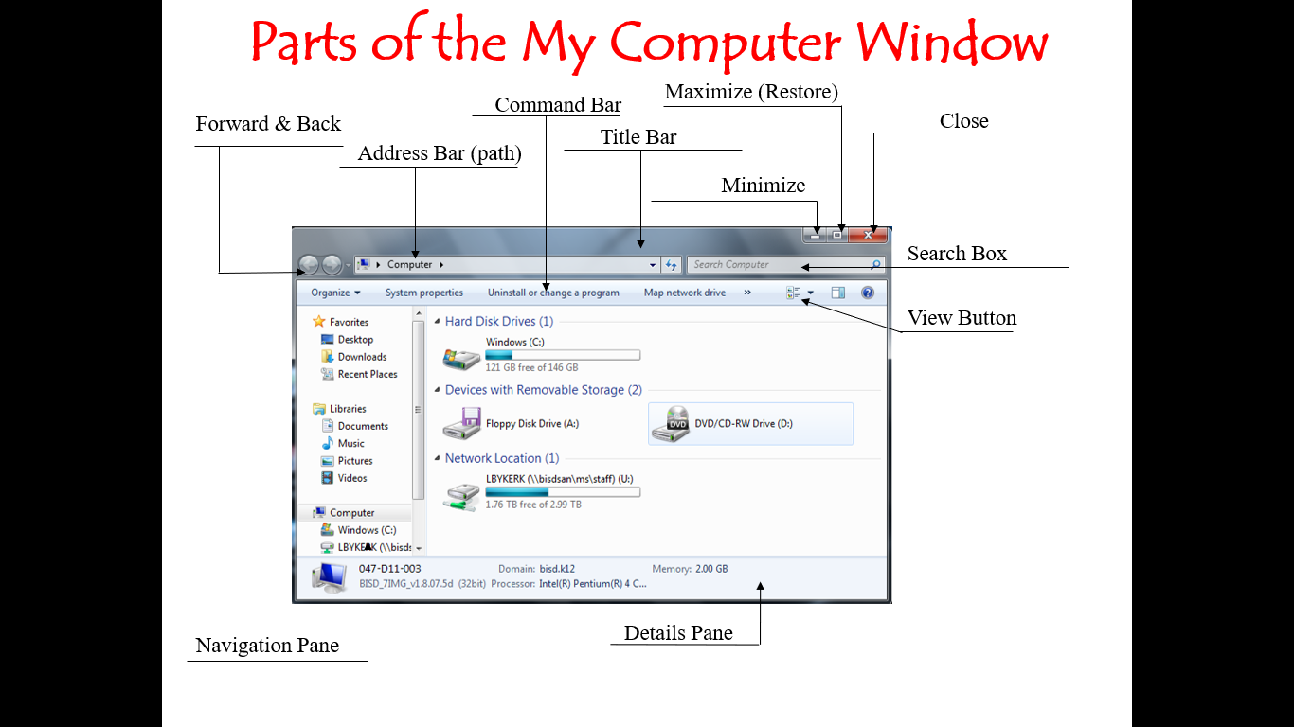

Slide 6
APPLICATIONS OF WINDOWS:
BROWSER
INTERNET
CALENDER
DATE AND TIME
MEDIA PLAYER
EMAIL
GAMES
MAPS
MULTIMEDIA
MS-PAINT
MS-DOS
CALUCULATOR
PICTURES
PHOTOVIWER
MS-OFFICE
PHOTOSHOP
INTERNET EXPLORER
MICROSOFT STORE

