Slide 1
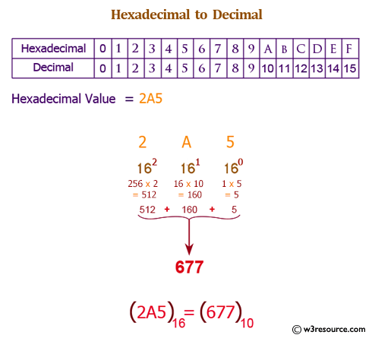

Slide 2


Slide 3
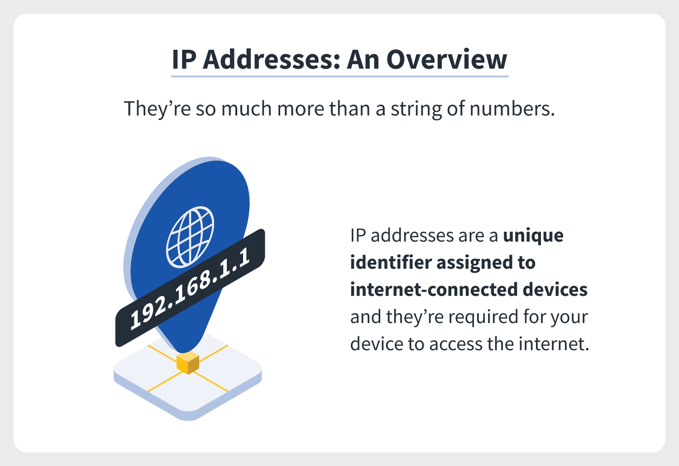

Slide 4
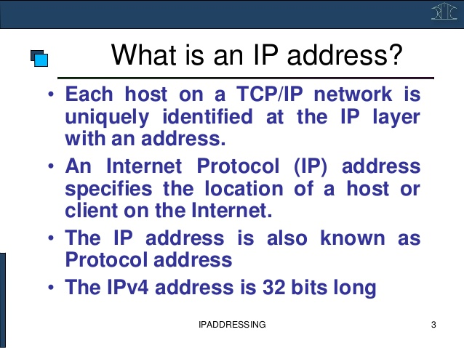

Slide 5
A modem is a network device that converts digital signal from computer to analogue
signal and converts analogue signals to digital signals”
A modem is a short form of modulator and demodulator.
Data transfer in analogue form in the telephone cables. There are different cables like coaxial cable and twisted pair cables.
In these cables data travels in analogue form. And our computer understands digital data.
So to convert analogue data to digital form and digital data to analogue form we need a network device. This network device is known as a modem.

