Slide 1
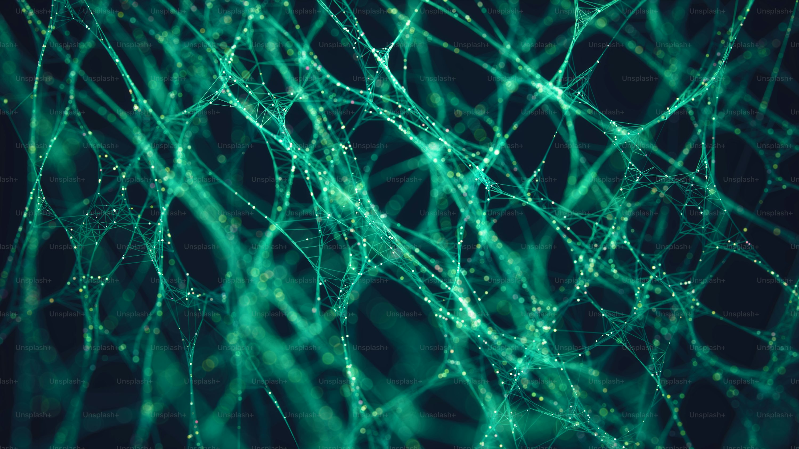


Atari Go AI Agents
Project Presentation
Presented by
Ankon Roy
Albi
Roll: 2107113
Roll: 2107107
1

Slide 2
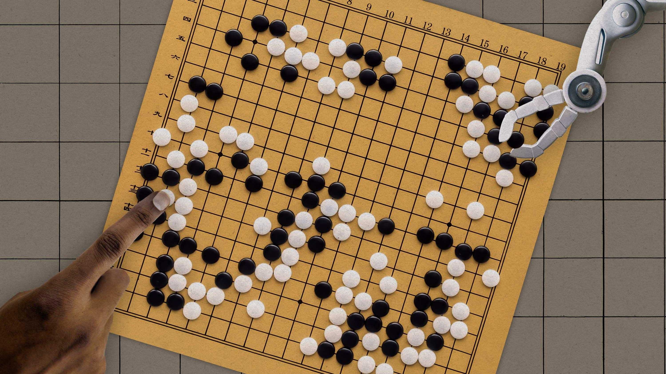




Project Overview
Three AI Agents
Different approaches to Atari Go
Game Environment
Atari Go capture rules
Performance Comparison
Minimax vs Monte Carlo vs Neural Net
Competitive Play
Agents compete against each other
28 April 2026
2

Slide 3
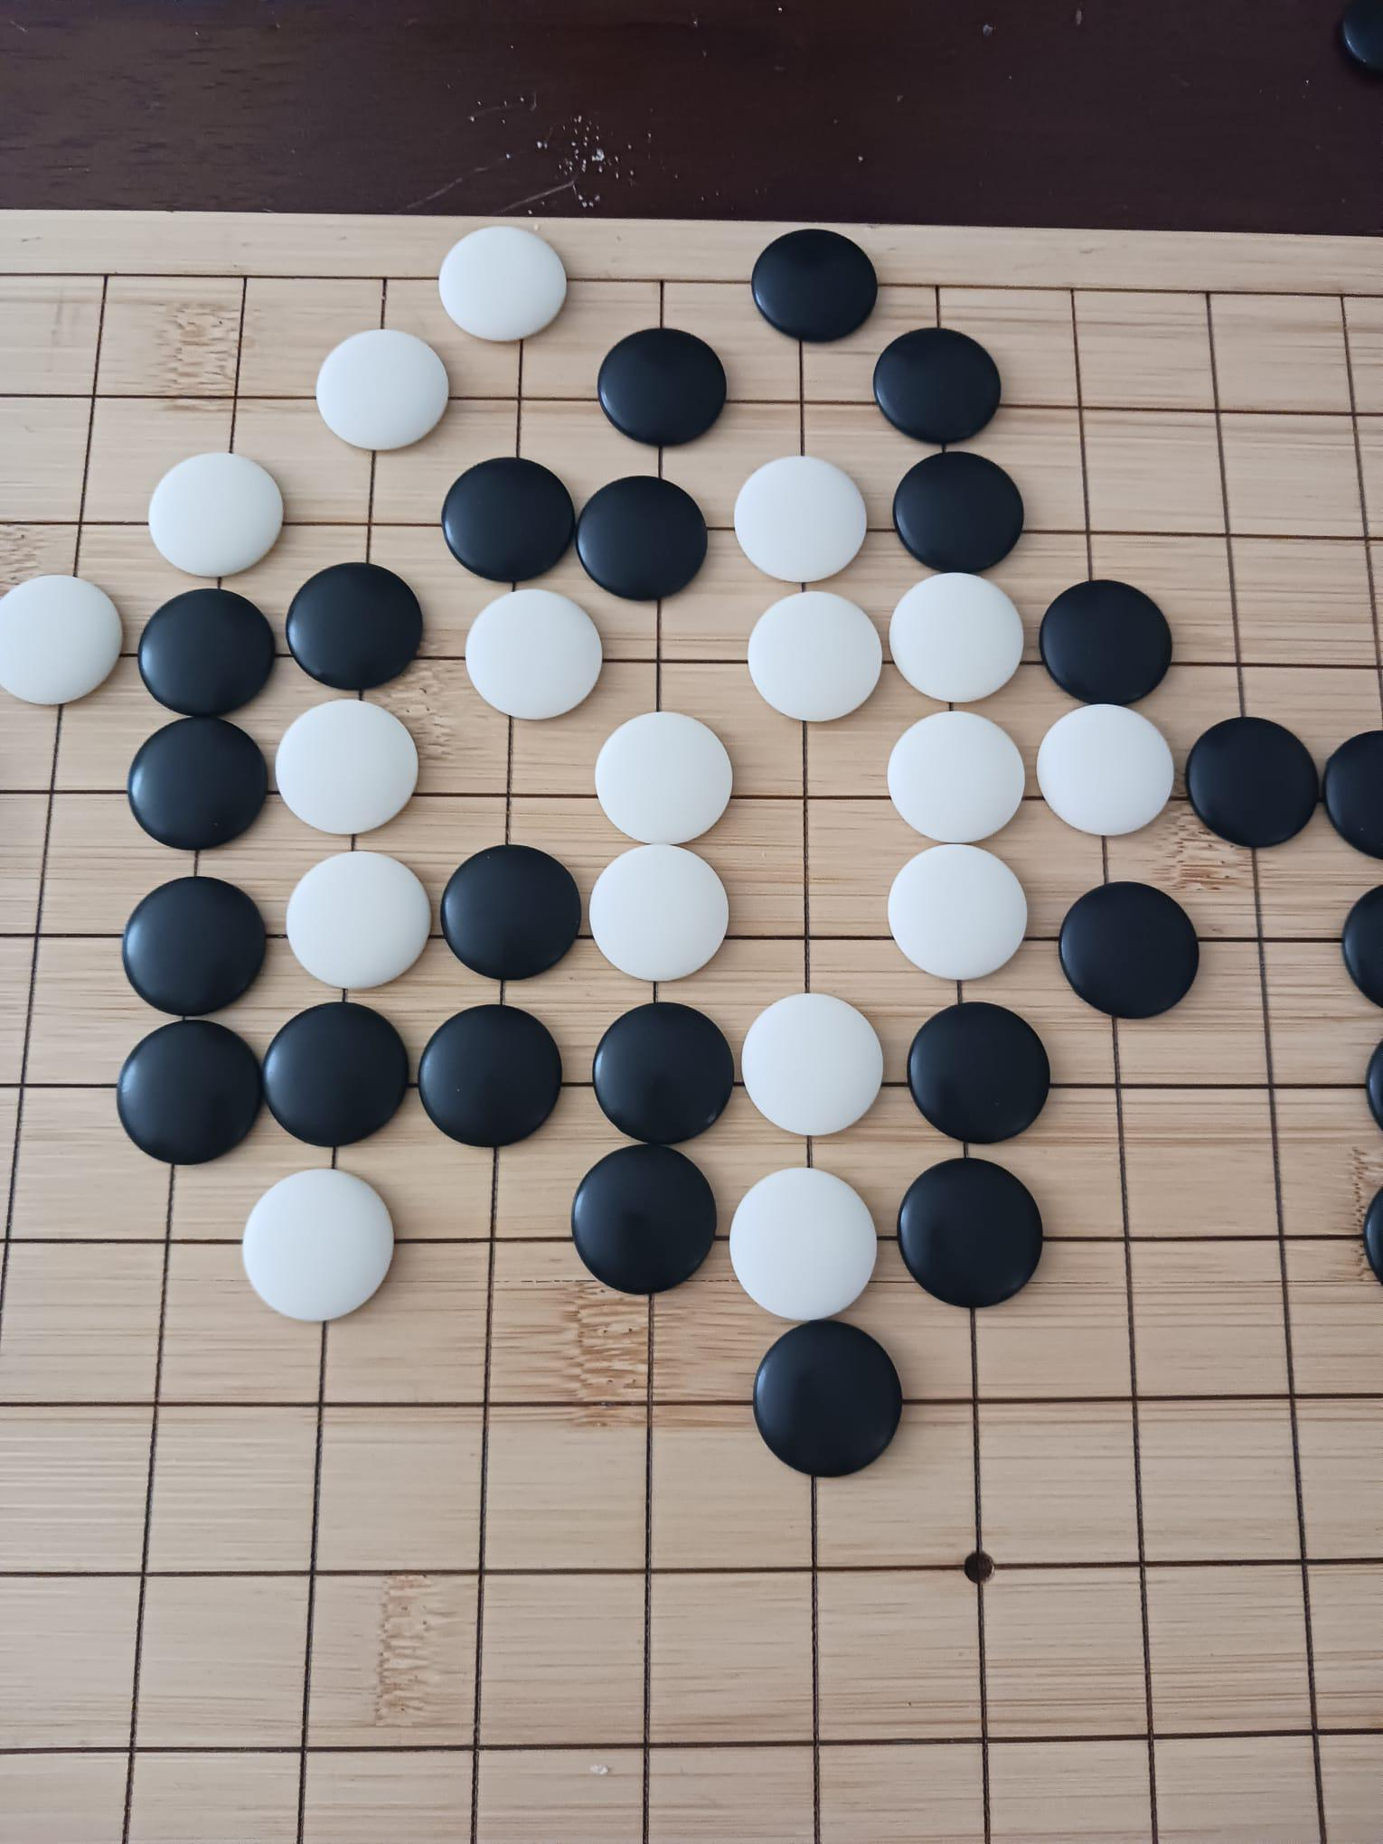




Atari Go Rules
Place on Intersections
Stones on empty points
Alternate Turns
Black and White play
Liberties
Empty adjacent points
Connected Groups
Stones share liberties
28 April 2026
3

Slide 4
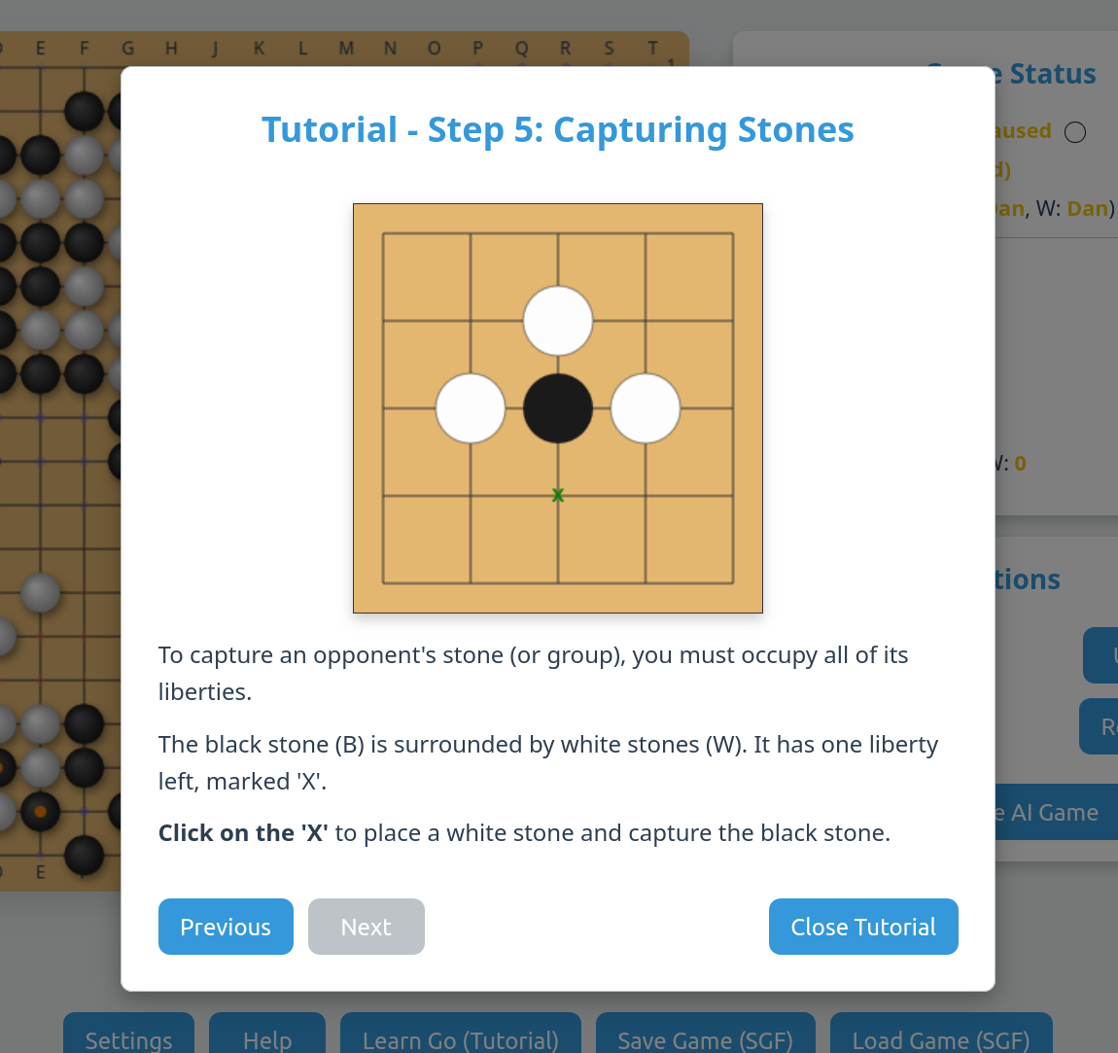



Winning Conditions
First to Capture
Win by capturing any stone
Immediate Victory
Games end rapidly
Focus on Combat
Aggressive play rewarded
No Territory
Territory not relevant
28 April 2026
4

Slide 5
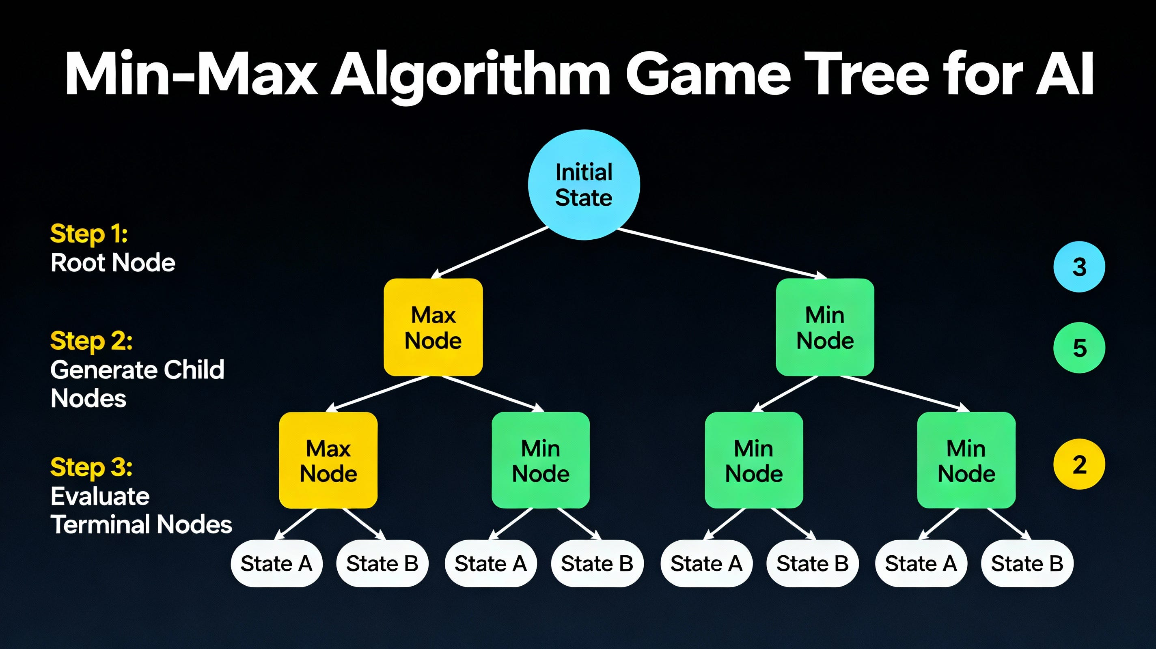

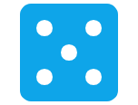


Agent: Ankon
Minimax
Explore game tree
Monte Carlo
Random sampling evaluation
Hybrid Approach
Combines strengths
Deep Search
Optimal decision making
28 April 2026
5

Slide 6
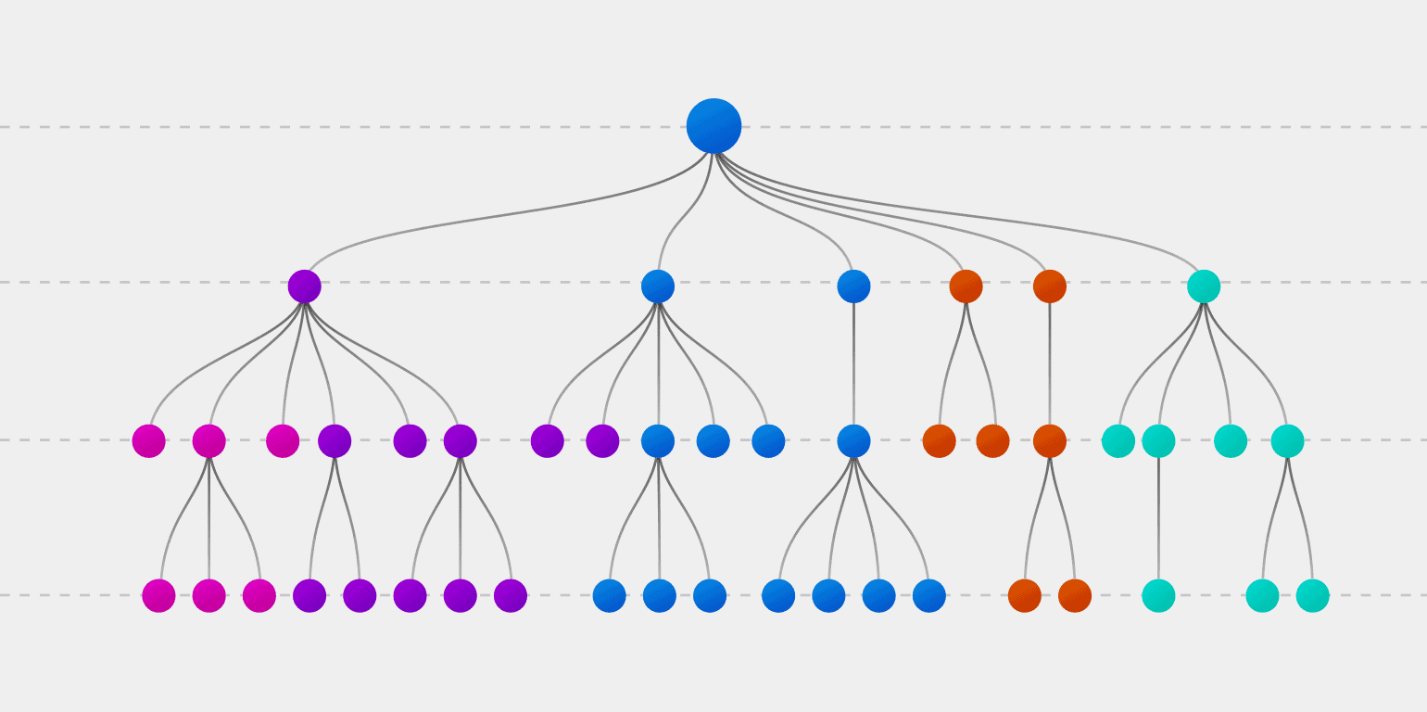

Agent: Albi
Monte Carlo
Random simulations
Minimax
Tree exploration
Different Order
MC + Minimax sequence
Adaptive Strategy
Dynamic decision making
28 April 2026
6

Slide 7
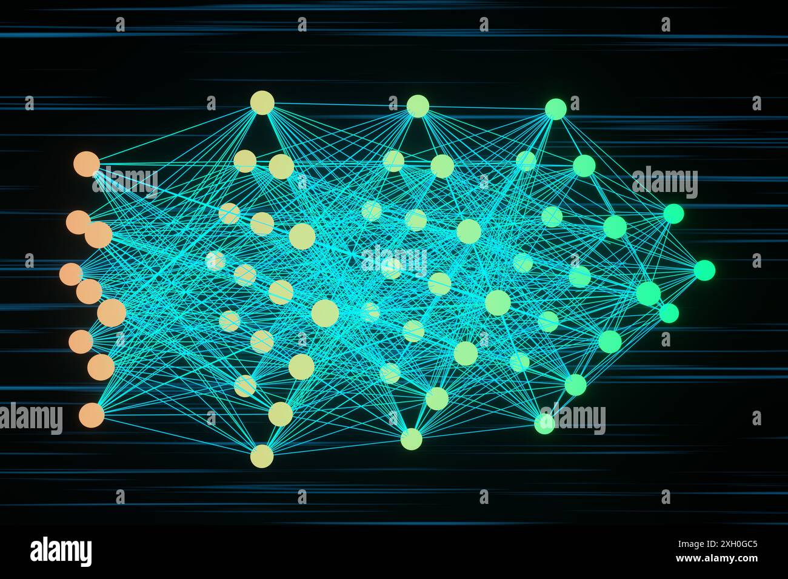


Agent: Neural Network
Deep Learning
Learns from experience
No Search Tree
Pattern recognition only
Convolutional CNN
Trained on Go games
Value Network
Position evaluation
28 April 2026
7

Slide 8
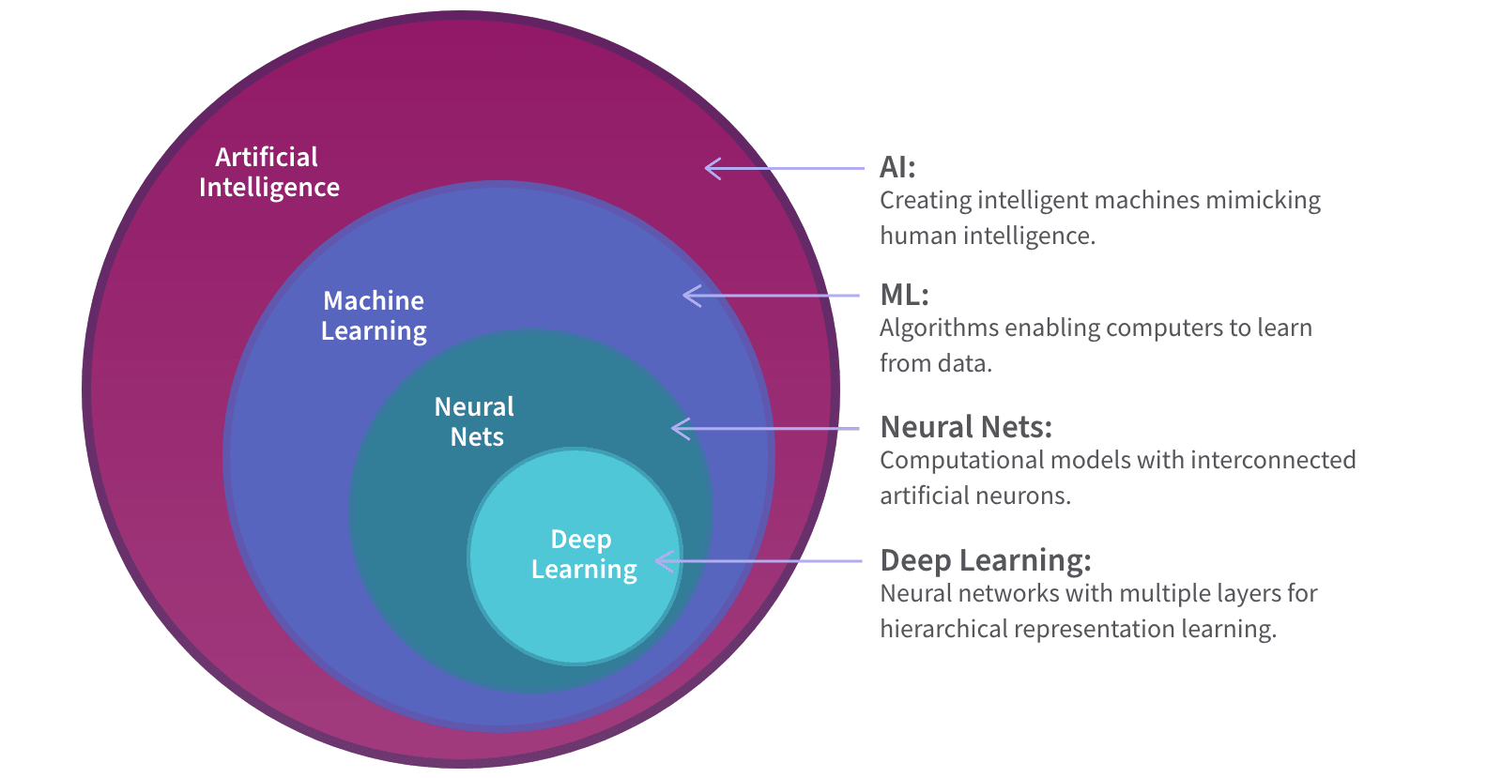



Agent Comparison
Ankon
Minimax + Monte Carlo • Explicit search
Albi
Monte Carlo + Minimax • Different sequence
Neural Network
Deep Learning • Pattern recognition
Trade-offs
Search depth vs Learning vs Randomness
28 April 2026
8

Slide 9
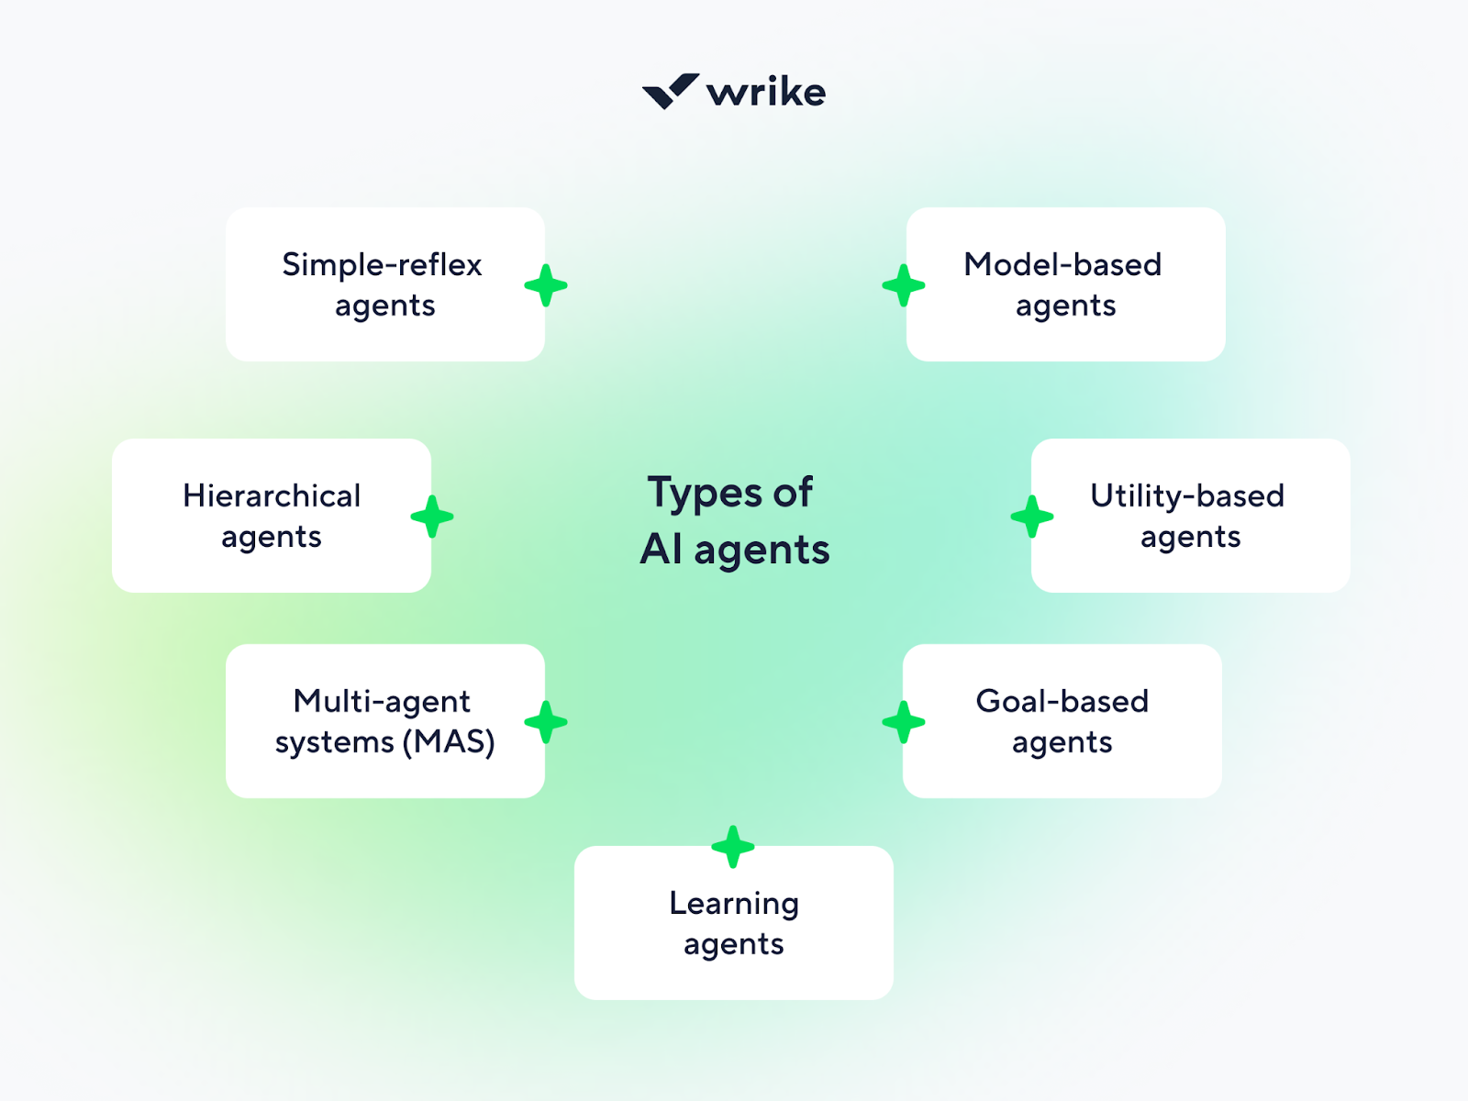




Experimental Setup & Results
Agent Competition
All agents play against each other
Win Rate Analysis
Performance measured by capture success
Search vs Learning
Ankon/Albi: Explicit tree search
Neural Net: Learned patterns
Key Findings
Each approach has unique strengths
28 April 2026
9

Slide 10
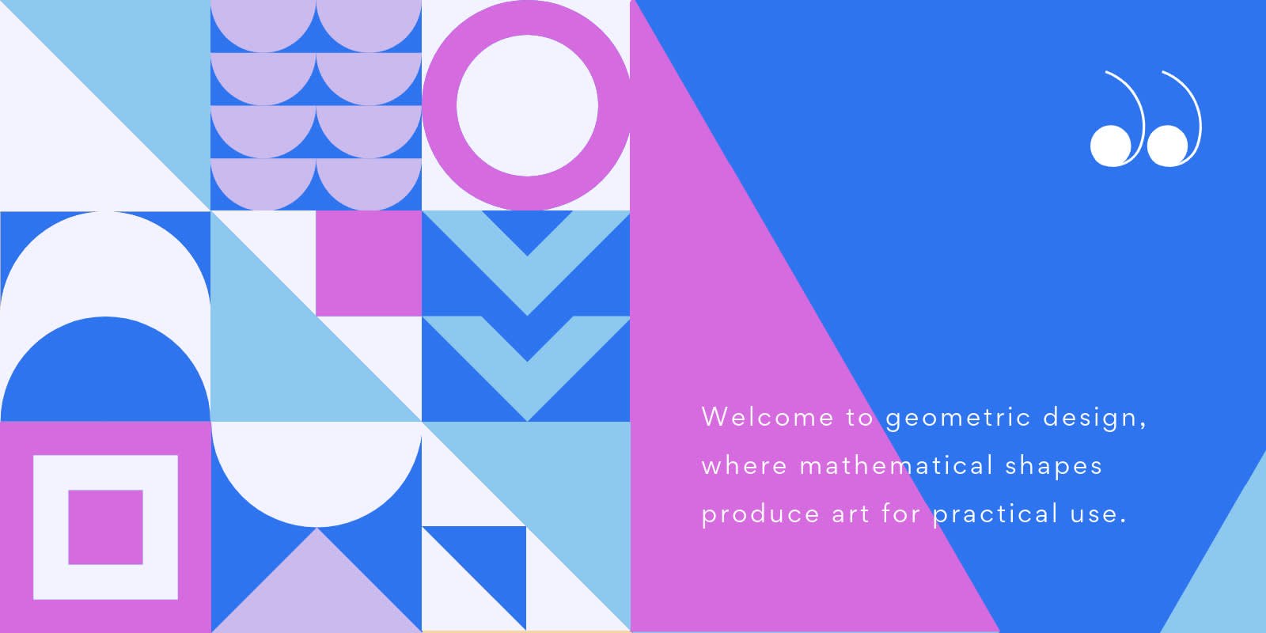

Thank You
Questions?
10

