Slide 1
Lectures 16-17
CS436/536: Introduction to
Machine Learning
Zhaohan Xi
Binghamton University
^{zxi1@binghamton.edu}

Slide 2

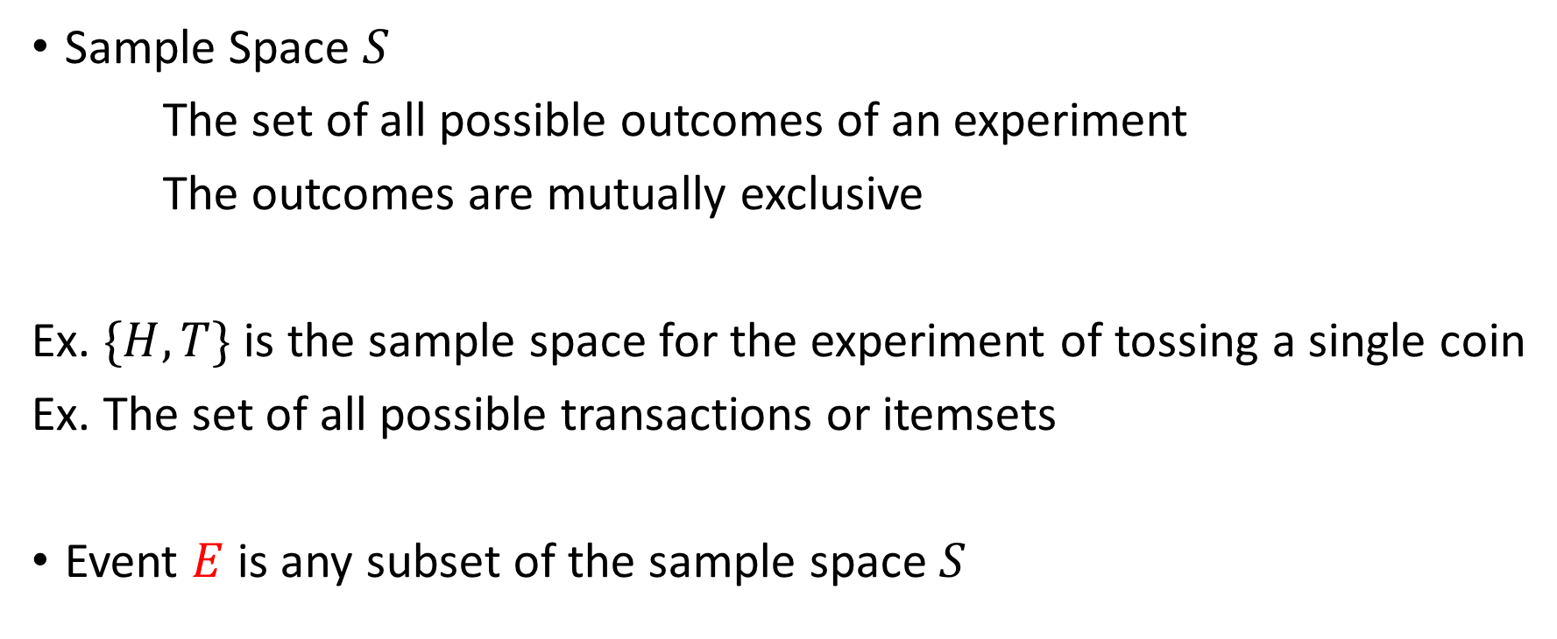

Probability Primer: Towards Probabilistic Methods
$$S$$
Sample Space $S$
The set of all possible outcomes of an experiment
The outcomes are mutually exclusive
Ex. $\{H,T\}$ is the sample space for the experiment of tossing a single coin
Ex. The set of all possible transactions or itemsets
Event $E$ is any subset of the sample space $S$
$$E$$

Slide 3


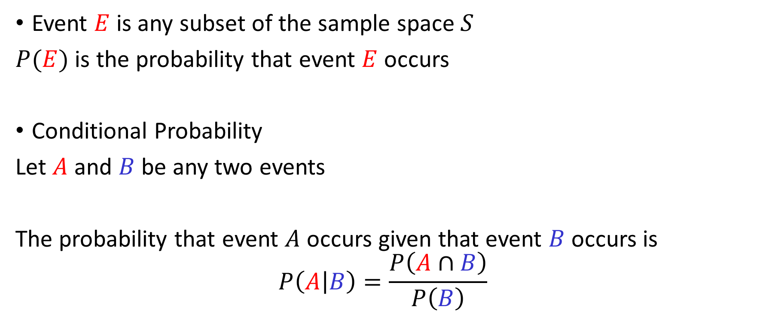



Probability Primer: Towards Probabilistic Methods
$$S$$
Event $E$ is any subset of the sample space $S$
$P(E)$ is the probability that event $E$ occurs
Conditional Probability
Let $A$ and $B$ be any two events
The probability that event $A$ occurs given that event $B$ occurs is
$$P\left(A | B\right)=\frac{P\left(A∩B\right)}{P\left(B\right)}$$
$$E$$
$$S$$
$$A$$
$$B$$

Slide 4



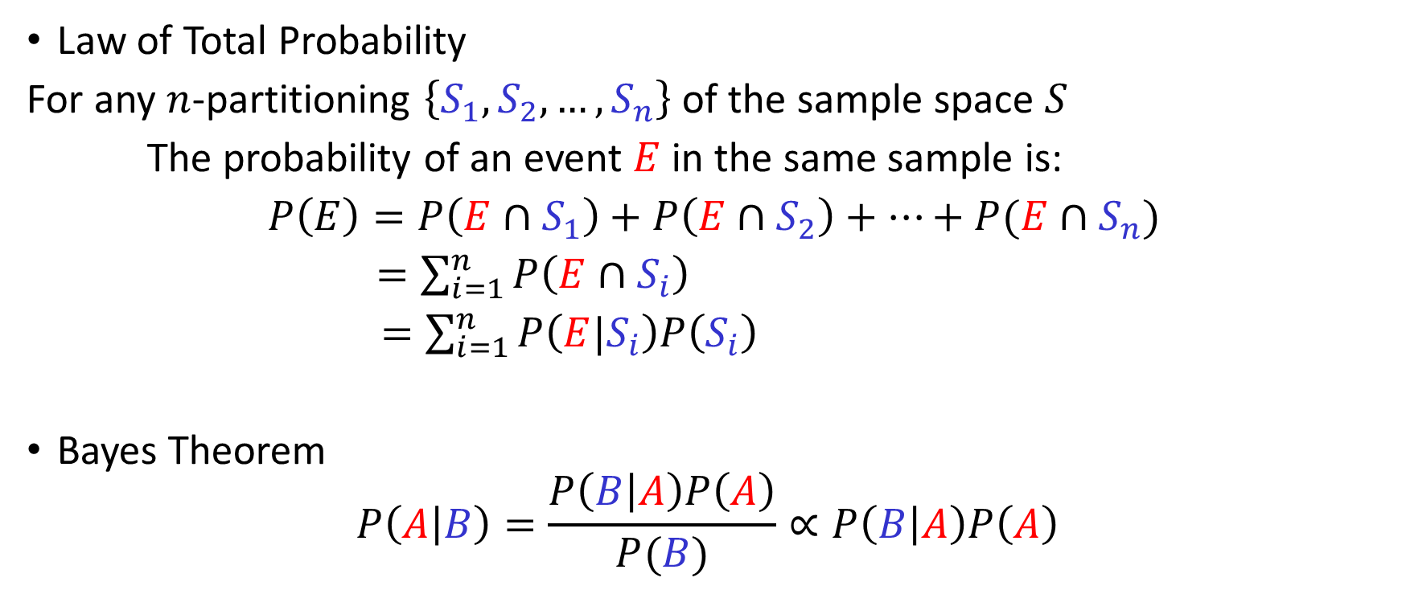






Probability Primer: Towards Probabilistic Methods
$$S$$
$$S_{1}$$
$$S_{2}$$
Law of Total Probability
For any $n$-partitioning $\left\{S_{1},S_{2},…, S_{n}\right\}$ of the sample space $S$
The probability of an event $E$ in the same sample is:
$P\left(E\right)=P\left(E∩S_{1}\right)+P\left(E∩S_{2}\right)+…+P(E∩S_{n})$
$=\sum_{i=1}^{n}{P\left(E∩S_{i}\right)}$
$=\sum_{i=1}^{n}{P\left(E|S_{i}\right)P\left(S_{i}\right)}$
Bayes Theorem
$$P\left(A | B\right)=\frac{P\left(B | A\right)P\left(A\right)}{P(B)}∝P\left(B | A\right)P\left(A\right)$$
$$E$$
$$S_{4}$$
$$S_{3}$$
$$S$$
$$A$$
$$B$$
“is proportional to”

Slide 5
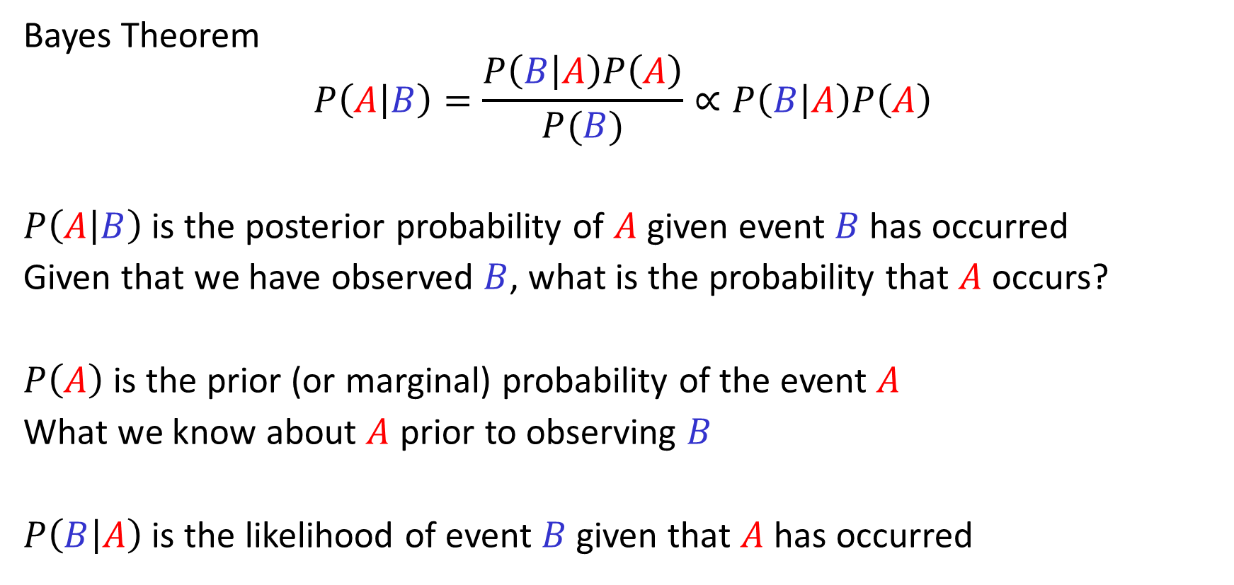
Probability Primer: Bayes’ Theorem
Bayes Theorem
$$P\left(A | B\right)=\frac{P\left(B | A\right)P\left(A\right)}{P(B)}∝P\left(B | A\right)P\left(A\right)$$
$P\left(A | B\right)$is the posterior probability of $A$ given event $B$ has occurred
Given that we have observed $B$, what is the probability that $A$ occurs?
$P\left(A\right)$is the prior (or marginal) probability of the event $A$
What we know about $A$ prior to observing $B$
$P\left(B | A\right)$ is the likelihood of event $B$ given that $A$ has occurred

Slide 6
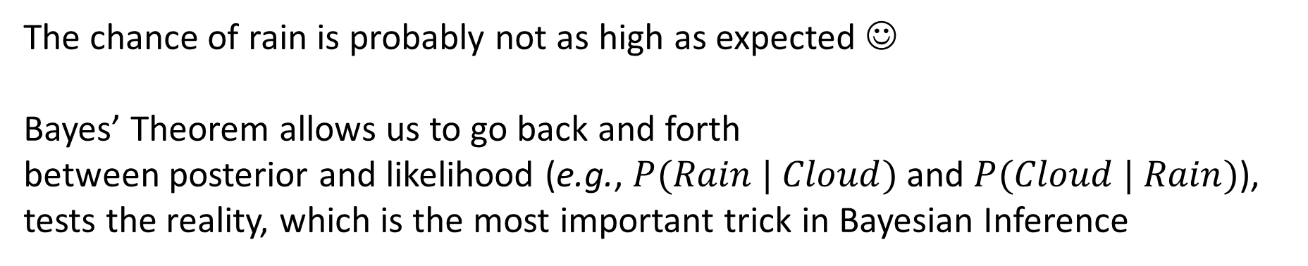





Example: Weather Predictions
The morning is cloudy ☹
What is the chance of rain?
50% of all rainy days start off cloudy.
Cloudy mornings are common (40% of days start cloudy)
This is usually a dry month (only $∼$ 3 of 30 days are rainy)
$$P(Rain | Cloud) =\frac{P(Cloud\left|Rain\right)P\left(Rain\right)}{P\left(Cloud\right)}= \frac{10\%∗50\%}{40\%}=12.5\%$$
$$P(Rain | Cloud) = ?$$
$$P(Cloud | Rain) = 50\%$$
$$P(Cloud) = 40\%$$
$$P(Rain) = 10\%$$
The chance of rain is probably not as high as expected ☺
Bayes’ Theorem allows us to go back and forth
between posterior and likelihood (e.g., $P(Rain | Cloud)$and $P(Cloud | Rain)$), tests the reality, which is the most important trick in Bayesian Inference

Slide 7
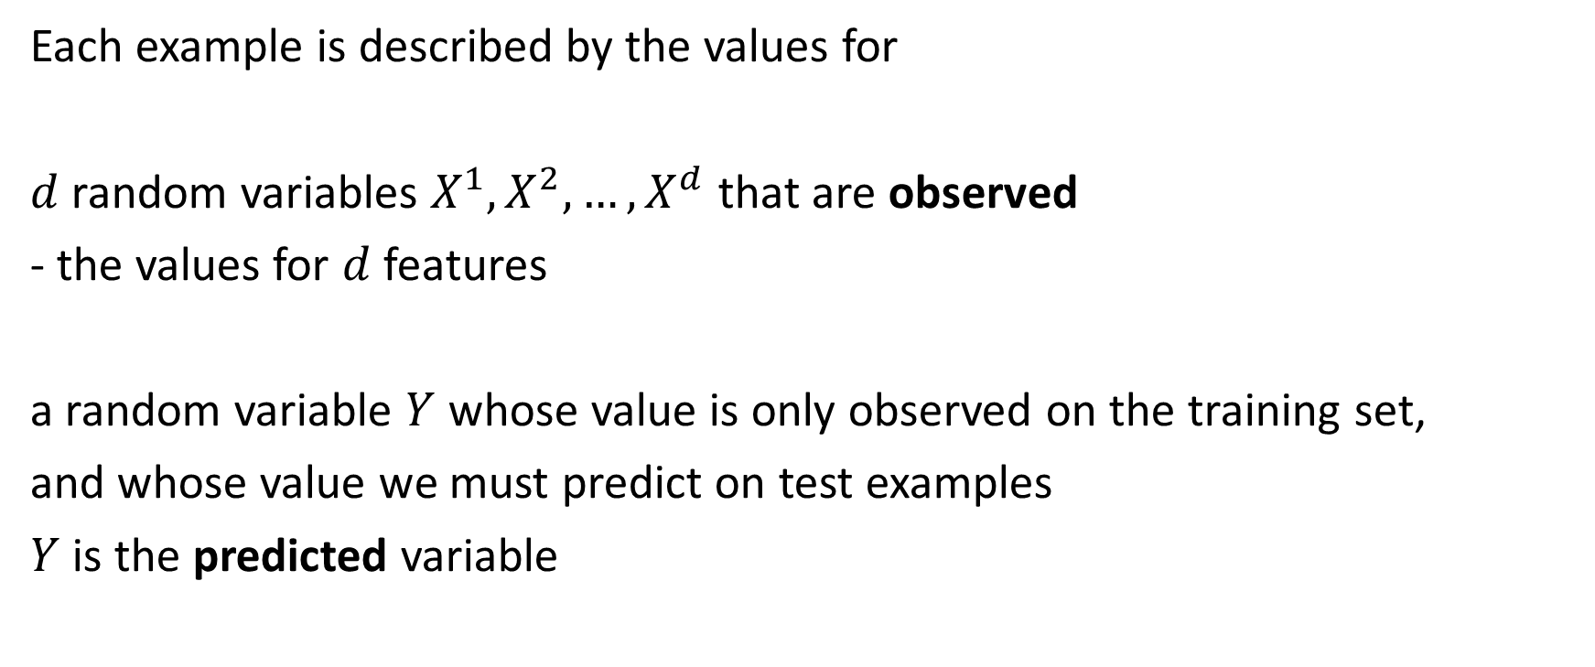
Towards Probabilistic Methods for Machine Learning
Each example is described by the values for
$d$ random variables $X^{1},X^{2},…, X^{d}$ that are observed
- the values for $d$ features
a random variable $Y$ whose value is only observed on the training set,
and whose value we must predict on test examples
$Y$ is the predicted variable

Slide 8
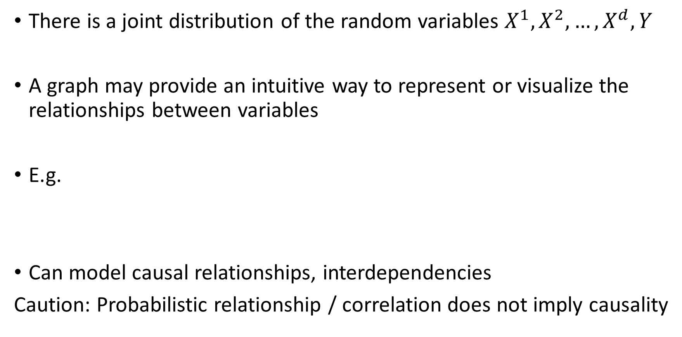
Graphical Models
There is a joint distribution of the random variables $X^{1},X^{2},…, X^{d},Y$
A graph may provide an intuitive way to represent or visualize the relationships between variables
E.g.
Can model causal relationships, interdependencies
Caution: Probabilistic relationship / correlation does not imply causality
Lung cancer
X-Ray artefacts
Smoking history
Bronchitis
Fatigue

Slide 9


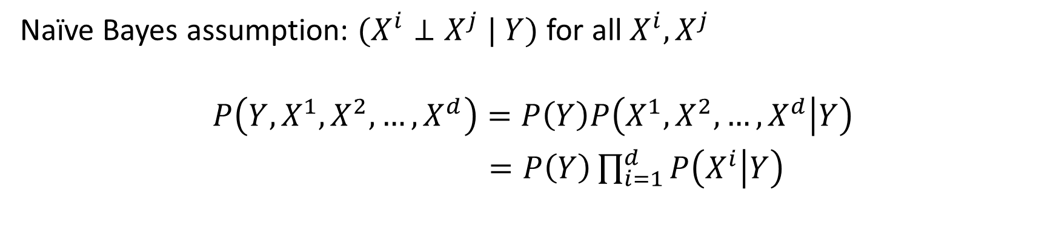



Naïve Bayes Model
to be inferred
$$Y$$
given
what is observed
$$X^{1}$$
$$X^{2}$$
$$⋯$$
$$X^{d}$$
Naïve Bayes assumption: $(X^{i}⊥X^{j} | Y)$ for all $X^{i}, X^{j}$
$$P\left(Y,X^{1},X^{2},…,X^{d}\right)=P\left(Y\right)P\left(X^{1},X^{2},…,X^{d} | Y\right)$$
$=P\left(Y\right)\prod_{i=1}^{d}{P\left(X^{i} | Y\right)}$

Slide 10



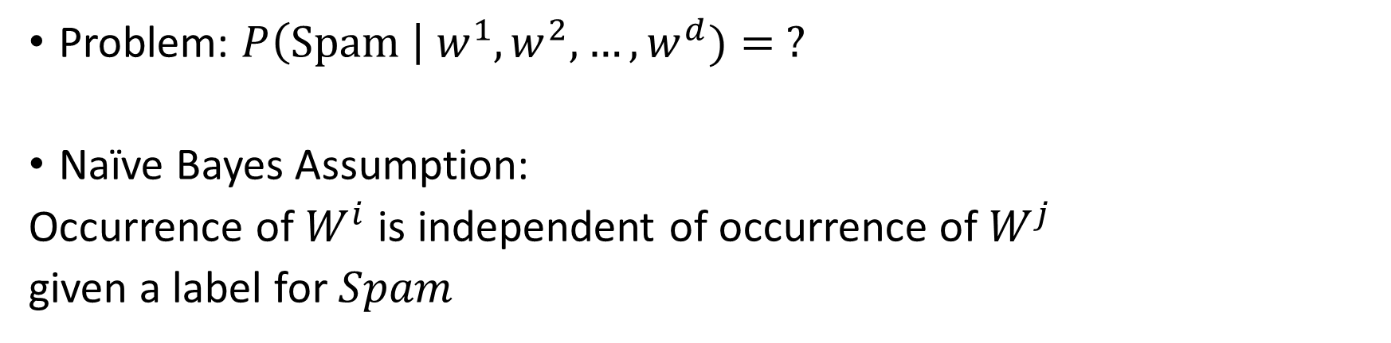



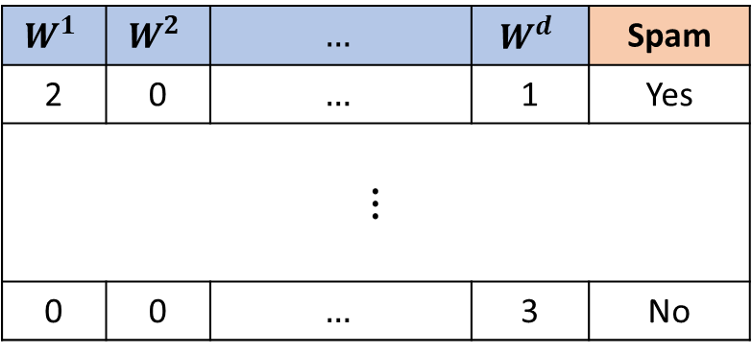
Example: Text Classification
$$W^{1}$$ | $$W^{2}$$ | $$…$$ | $$W^{d}$$ | Spam
2 | 0 | $$…$$ | 1 | Yes
$$⋮$$
0 | 0 | $$…$$ | 3 | No
Infer whether
document is spam
$$Spam?$$
Given observed
word frequencies
$$W^{1}$$
$$W^{2}$$
$$⋯$$
$$W^{d}$$
$d$ words in dictionary
Problem: $P\left(Spam \right| w^{1},w^{2},…,w^{d})= ?$
Naïve Bayes Assumption:
Occurrence of $W^{i}$ is independent of occurrence of $W^{j}$
given a label for $Spam$

Slide 11



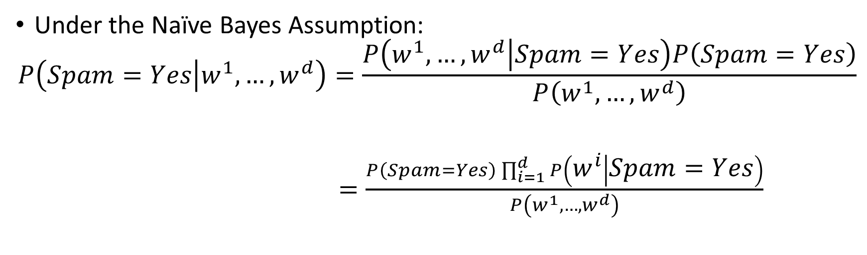



Example: Text Classification
Infer whether
document is spam
$$Spam?$$
Given observed
word frequencies
$$W^{1}$$
$$W^{2}$$
$$⋯$$
$$W^{d}$$
$d$ words in dictionary
Under the Naïve Bayes Assumption:
$$P\left(Spam=Yes | w^{1},…,w^{d}\right)=\frac{P\left(w^{1},…,w^{d} | Spam=Yes\right)P\left(Spam=Yes\right)}{P\left(w^{1},…,w^{d}\right)}$$
$=\frac{P\left(Spam=Yes\right)\prod_{i=1}^{d}{P\left(w^{i} | Spam=Yes\right)}}{P\left(w^{1},…,w^{d}\right)}$

Slide 12
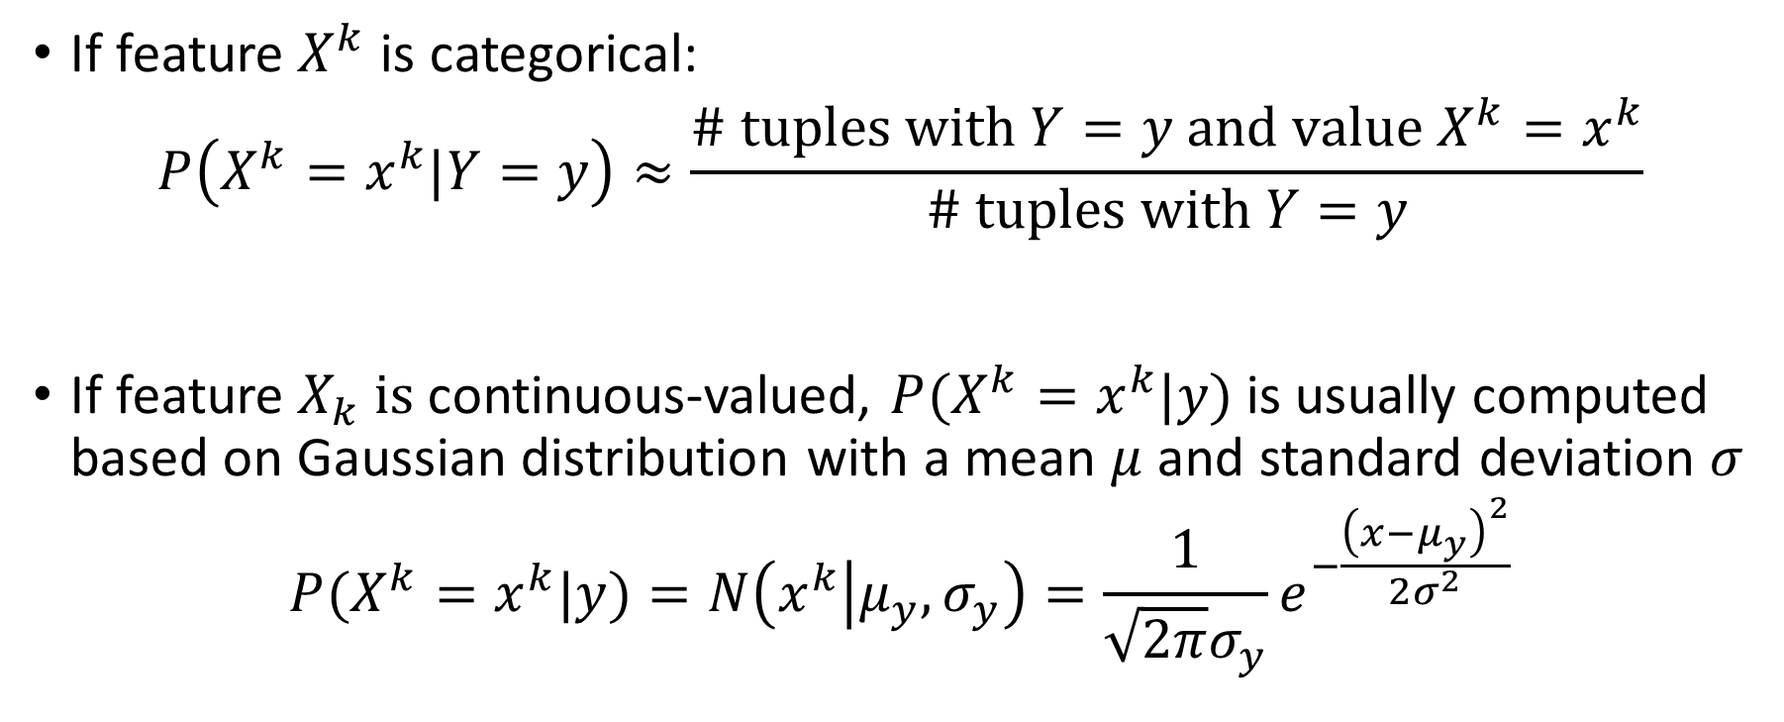
Naïve Bayes: Categorical vs. Continuous Features
If feature $X^{k}$ is categorical:
$$P\left(X^{k}=x^{k}|Y=y\right)≈\frac{\# tuples with Y=y and value {X^{k}=x}^{k}}{\# tuples with Y=y}$$
If feature $X_{k} is$continuous-valued, $P(X^{k}=x^{k}|y)$ is usually computed based on Gaussian distribution with a mean $μ$ and standard deviation $σ$
$$P(X^{k}=x^{k}|y)=N\left(x^{k} | μ_{y}, σ_{y}\right)=\frac{1}{\sqrt{2π}σ_{y}}e^{−\frac{{\left(x−μ_{y}\right)}^{2}}{2σ^{2}}}$$

Slide 13

Continuous Features
Suppose you're classifying whether a person is "Fit" or "Unfit" based on their weight (a continuous feature).
Problem definition

Slide 14
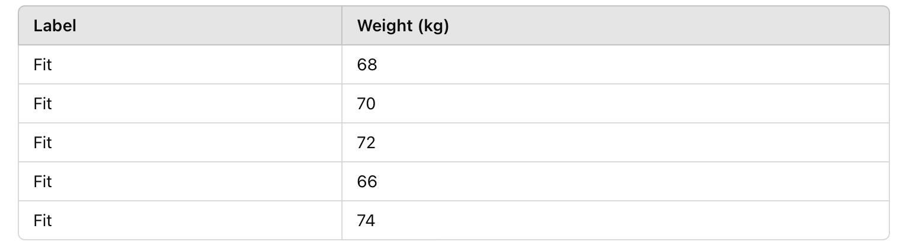
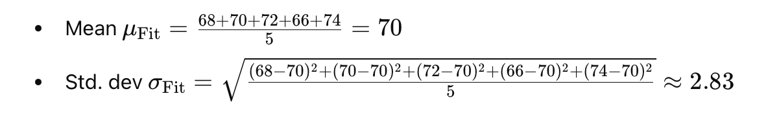
Continuous Features
Your training data
Calculate from training data

Slide 15
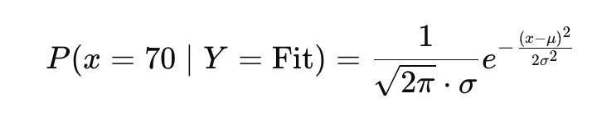
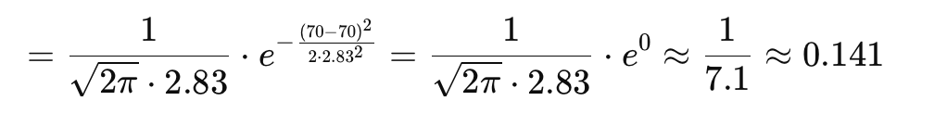
Continuous Features
Gaussian Likelihood:
Conclusion
the likelihood of someone weighing 70kg given they are "Fit" is about 0.141 under the Gaussian Naïve Bayes model.

Slide 16
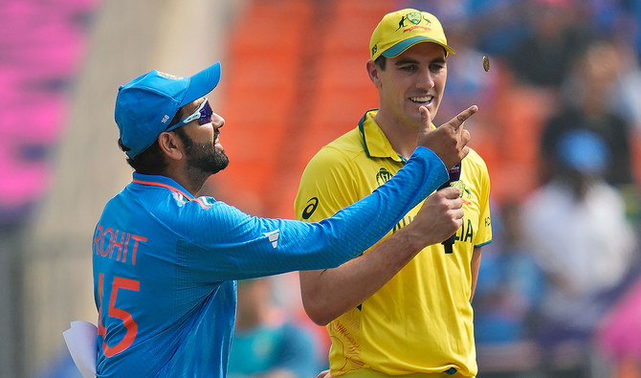
Naïve Bayes Classifier Example 1: Training Dataset
Class:
Bat first= ‘yes’
Bat first = ‘no’
Outlook | Temperature | Humidity | Wind | Bat First
Rainy | Hot | High | False | No
Rainy | Hot | High | True | No
Overcast | Hot | High | False | Yes
Sunny | Mild | High | False | Yes
Sunny | Cool | Normal | False | Yes
Sunny | Cool | Normal | True | No
Overcast | Cool | Normal | True | Yes
Rainy | Mild | High | False | No
Rainy | Cool | Normal | False | Yes
Sunny | Mild | Normal | False | Yes
Rainy | Mild | Normal | True | Yes
Overcast | Mild | High | True | Yes
Overcast | Hot | Normal | False | Yes
Sunny | Mild | High | True | No
Rainy | Hot | High | False | No
Notes:
https://www.saedsayad.com/naive_bayesian.htm

Slide 17
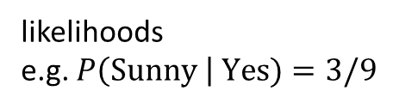
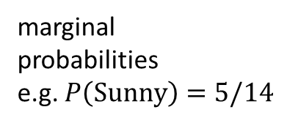
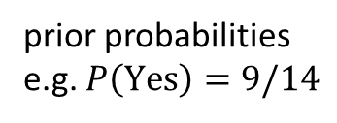
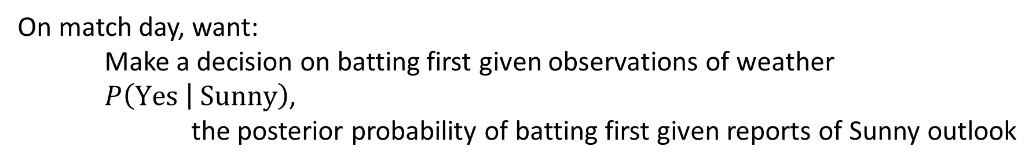
Naïve Bayes Classifier Example $P(Yes | Sunny)$
On match day, want:
Make a decision on batting first given observations of weather
$P\left(Yes | Sunny\right)$,
the posterior probability of batting first given reports of Sunny outlook
likelihoods
e.g. $P\left(Sunny \right| Yes)=3/9$
Frequency table |  | Bat first
 |  | Yes | No
Outlook | Sunny | 3 | 2
 | Overcast | 4 | 0
 | Rainy | 2 | 3
Likelihood table |  | Bat first
 |  | Yes | No
Outlook | Sunny | 3/9 | 2/5 | 5/14
 | Overcast | 4/9 | 0/5 | 4/14
 | Rainy | 2/9 | 3/5 | 5/14
 |  | 9/14 | 5/14
marginal
probabilities
e.g. $P\left(Sunny\right)=5/14$
prior probabilities
e.g. $P\left(Yes\right)=9/14$
Posterior probability: $P\left(Yes \right| Sunny)=\frac{P\left(Sunny \right| Yes) P(Yes)}{P(Sunny)}=\frac{(3/9)(9/14)}{5/14}=\frac{3}{5}$

Slide 18
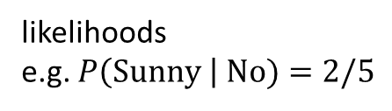
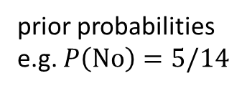
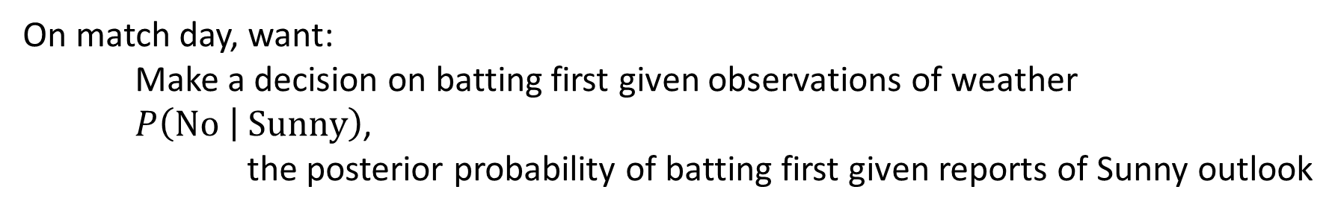
Naïve Bayes Classifier Example $P(No | Sunny)$
On match day, want:
Make a decision on batting first given observations of weather
$P\left(No | Sunny\right)$,
the posterior probability of batting first given reports of Sunny outlook
likelihoods
e.g. $P\left(Sunny \right| No)=2/5$
Frequency table |  | Bat first
 |  | Yes | No
Outlook | Sunny | 3 | 2
 | Overcast | 4 | 0
 | Rainy | 2 | 3
Likelihood table |  | Bat first
 |  | Yes | No
Outlook | Sunny | 3/9 | 2/5 | 5/14
 | Overcast | 4/9 | 0/5 | 4/14
 | Rainy | 2/9 | 3/5 | 5/14
 |  | 9/14 | 5/14
marginal
probabilities
e.g. $P\left(Sunny\right)=5/14$
prior probabilities
e.g. $P\left(No\right)=5/14$
Posterior probability: $P\left(No \right| Sunny)=\frac{P\left(Sunny \right| No) P\left(No\right)}{P(Sunny)}=\frac{(2/5)(5/14)}{5/14}=\frac{2}{5}$

Slide 19
Naïve Bayes Classifier Example: Likelihood Tables
Frequency table |  | Bat first
 |  | Yes | No
Outlook | Sunny | 3 | 2
 | Overcast | 4 | 0
 | Rainy | 2 | 3
Likelihood table |  | Bat first
 |  | Yes | No
Outlook | Sunny | 3/9 | 2/5
 | Overcast | 4/9 | 0/5
 | Rainy | 2/9 | 3/5
Frequency table |  | Bat first
 |  | Yes | No
Humidity | High | 3 | 4
 | Normal | 6 | 1
Likelihood table |  | Bat first
 |  | Yes | No
Humidity | High | 3/9 | 4/5
 | Normal | 6/9 | 1/5
Frequency table |  | Bat first
 |  | Yes | No
Temp | Hot | 2 | 2
 | Mild | 4 | 2
 | Cold | 3 | 1
Likelihood table |  | Bat first
 |  | Yes | No
Temp | Hot | 2/9 | 2/5
 | Mild | 4/9 | 2/5
 | Cold | 3/9 | 1/5
Outlook | Temperature | Humidity | Wind | Bat First
Rainy | Cool | High | True | ?
Frequency table |  | Bat first
 |  | Yes | No
Windy | False | 6 | 2
 | True | 3 | 3
Likelihood table |  | Bat first
 |  | Yes | No
Windy | False | 6/9 | 2/5
 | True | 3/9 | 3/5

Slide 20
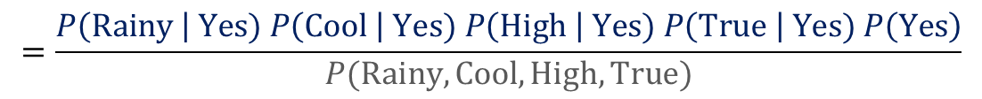
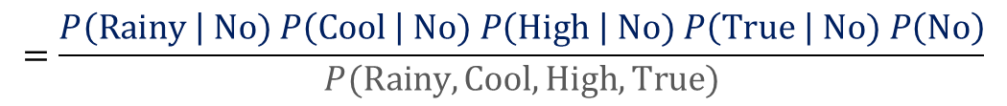
Naïve Bayes Classifier Example
Outlook | Temperature | Humidity | Wind | Bat First
Rainy | Cool | High | True | ?
$$P\left(Yes \right| Rainy, Cool, High, True)=\frac{P\left(Rainy, Cool, High, True \right| Yes) P\left(Yes\right)}{P(Rainy, Cool, High, True)}$$
$$=\frac{P\left(Rainy \right| Yes) P\left(Cool \right| Yes) P\left(High \right| Yes) P\left(True \right| Yes) P\left(Yes\right)}{P(Rainy, Cool, High, True)}$$
$$P\left(No \right| Rainy, Cool, High, True)=\frac{P\left(Rainy, Cool, High, True \right| No) P\left(No\right)}{P(Rainy, Cool, High, True)}$$
$$=\frac{P\left(Rainy \right| No) P\left(Cool \right| No) P\left(High \right| No) P\left(True \right| No) P\left(No\right)}{P(Rainy, Cool, High, True)}$$
$$P\left(Rainy, Cool, High, True\right)=P\left(Rainy, Cool, High, True \right| Yes) P\left(Yes\right)+P\left(Rainy, Cool, High, True \right| No) P\left(No\right)$$

Slide 21
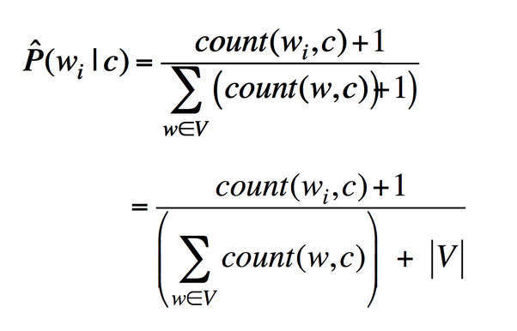
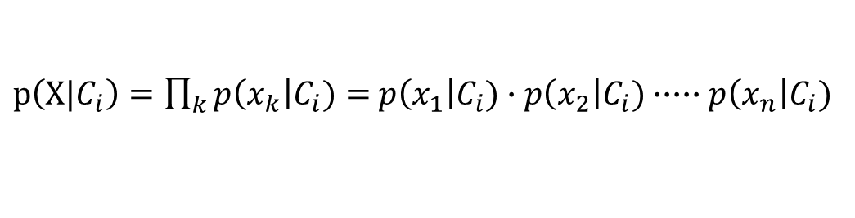
Avoiding the Zero-Probability Problem
Naïve Bayesian prediction requires each conditional probability be non-zero
Otherwise, the predicted probability will be zero
Example. Suppose a dataset with 1,000 tuples:
income = low (10), income= medium (990), and income = high (0)
Use Laplacian correction (or Laplacian estimator)
Adding 1 (or a small integer) to each case
Prob(income = low) = (10 + 1)/(1000 + 3)
Prob(income = medium) = (990 + 1)/(1000 + 3)
Prob(income = high) = 1/(1000 + 3)
The “corrected” probability estimates are close to their “uncorrected” counterparts
$p\left(X|C_{i}\right)=\prod_{k}{p\left(x_{k}\right|C_{i})}=$ $p\left(x_{1}\right|C_{i})∙p\left(x_{2}\right|C_{i})∙∙∙∙∙p\left(x_{n}\right|C_{i})$
Notes:
For a given class, if there is no tuple whose income is low. Then given a test tuple whose income is low, its posterior probability by NB is zero and we will never predict this tuple to belong to this class

Slide 22
Naïve Bayes Classifier: Strength vs. Weakness
Strength
Performance: A naïve Bayesian classifier, has comparable performance with decision tree and some neural network classifiers
Incremental: Each training example can incrementally increase/decrease the probability that a hypothesis is correct—prior knowledge can be combined with observed data
Weakness
Assumption: attributes’ conditional independence, therefore loss of accuracy
E.g., Patient’s Profile: (age, family history),
Patient’s Symptoms: (fever, cough),
Patient’s Disease: (lung cancer, diabetes).
Dependencies among these cannot be modeled by Naïve Bayes Classifier
Bayesian Belief Networks to deal with these dependencies

Slide 23
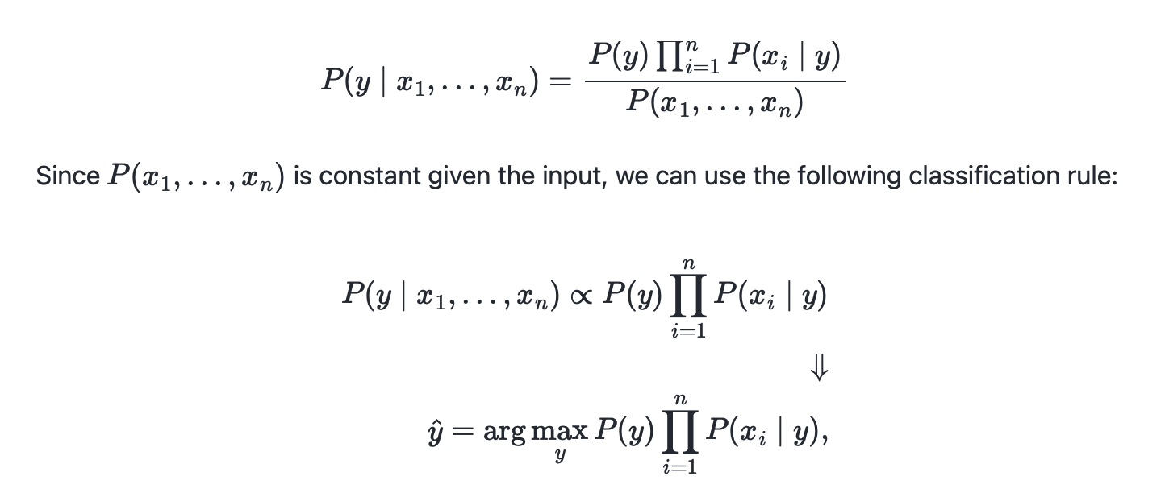
Implementation via Scikit-learn

Slide 24

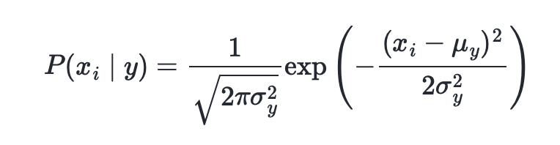
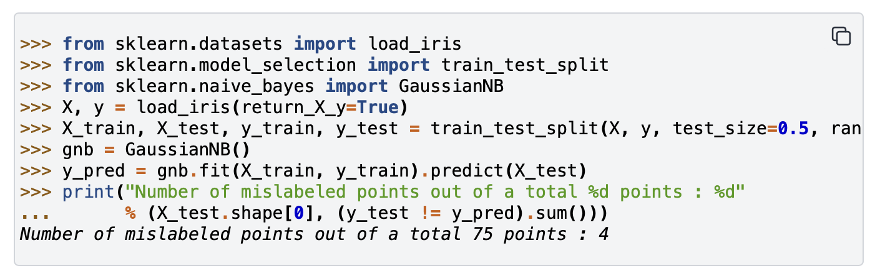
The likelihood of the features is assumed to be Gaussian:

Slide 25

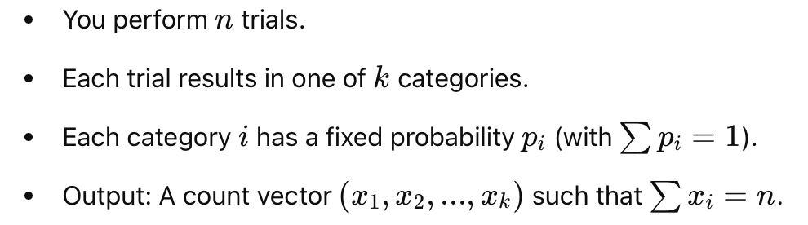

Slide 26
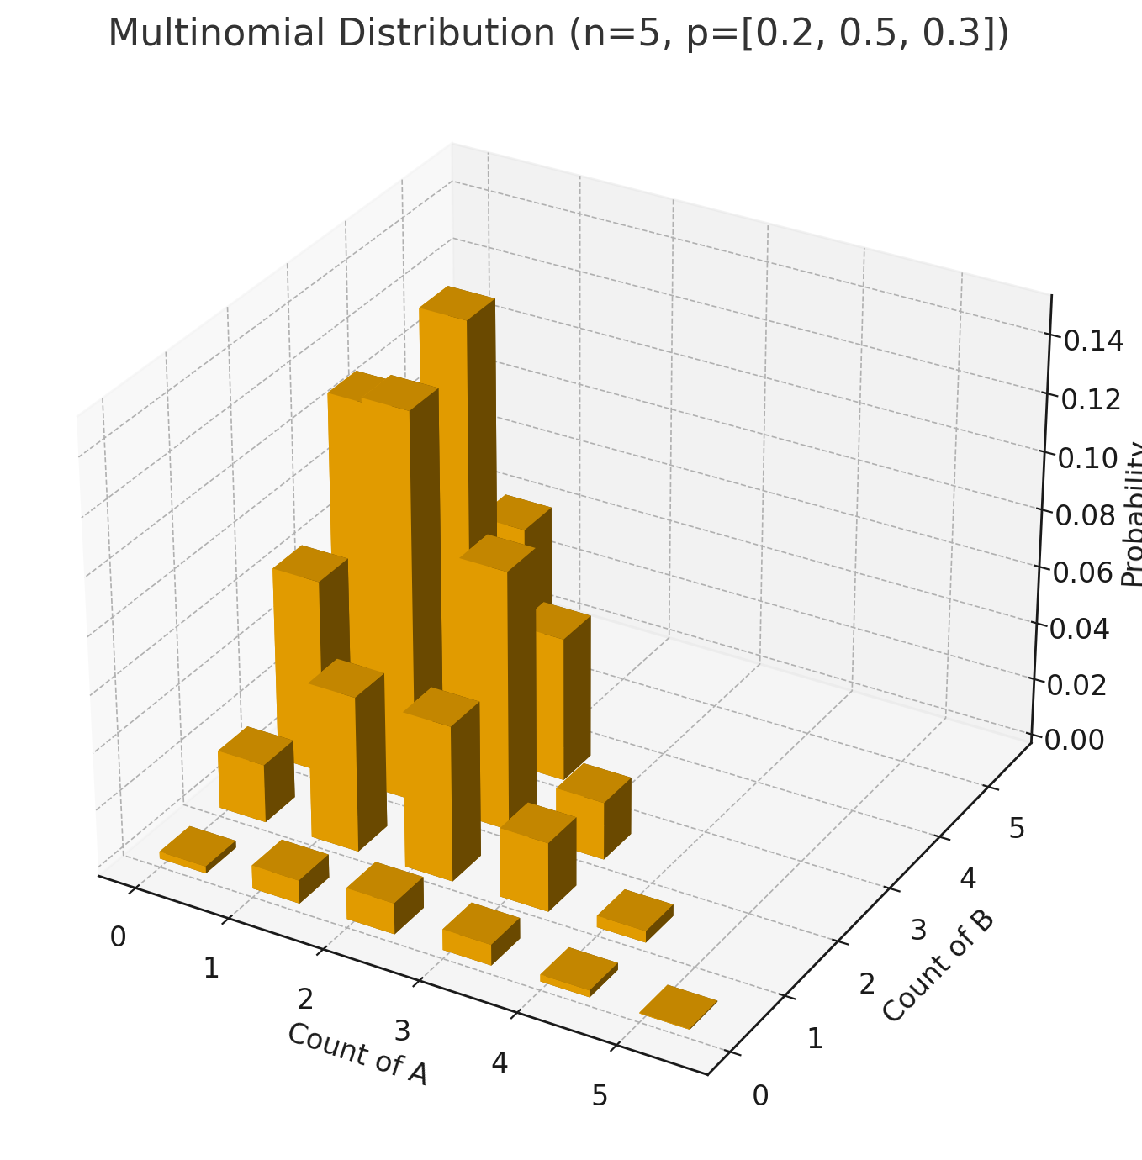

Slide 27
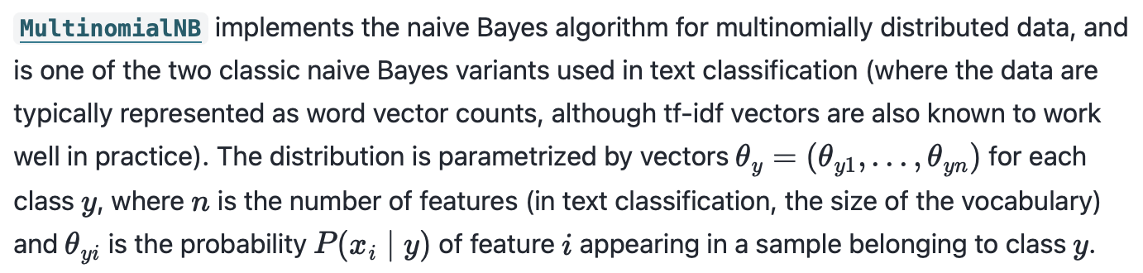

Slide 28
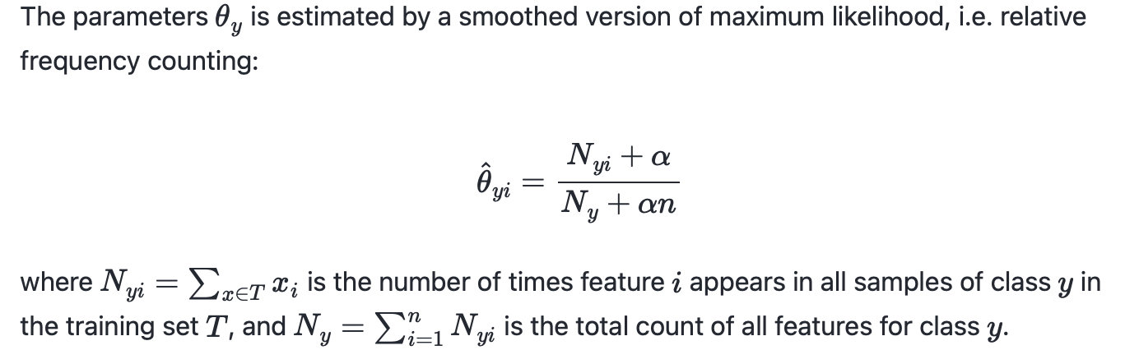

Slide 29
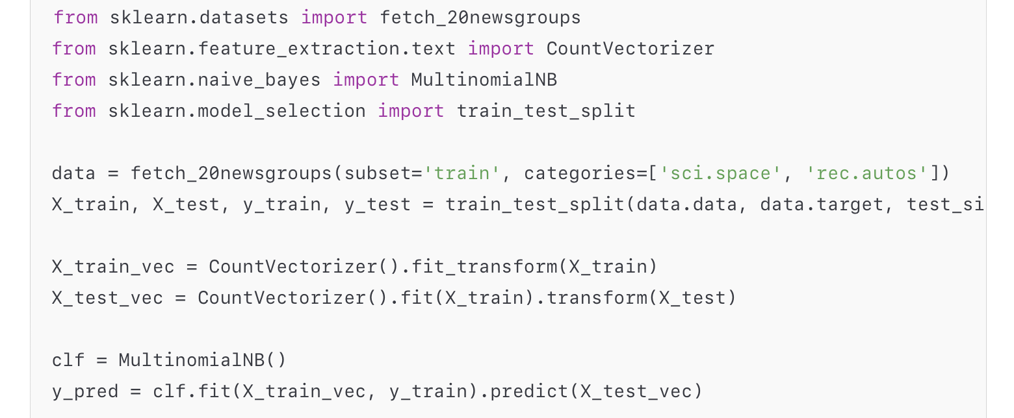

Slide 30

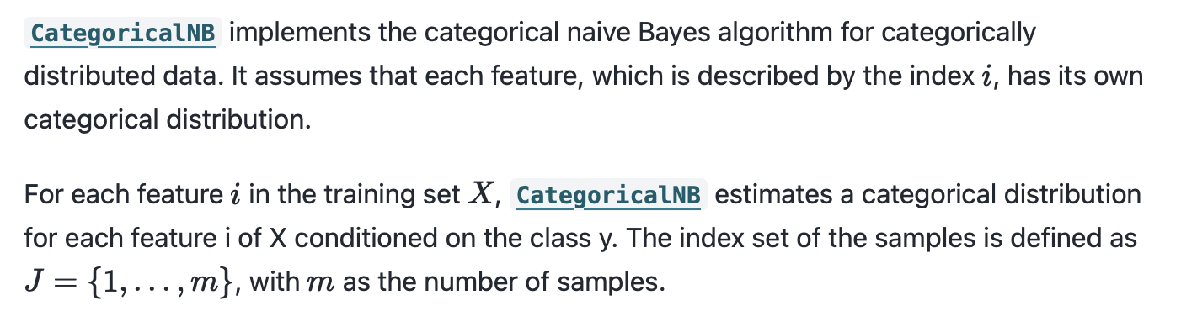

Slide 31
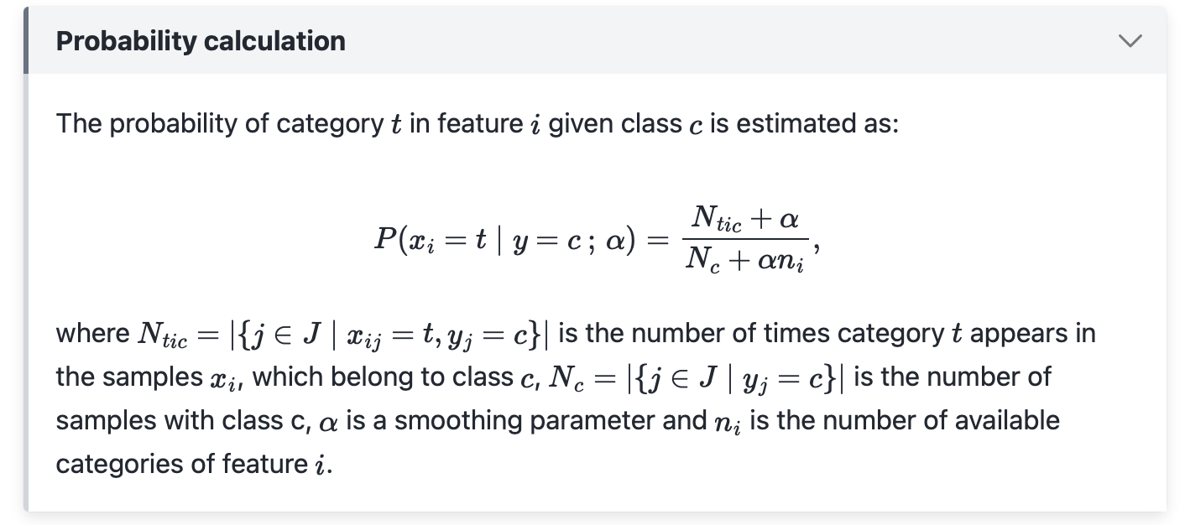
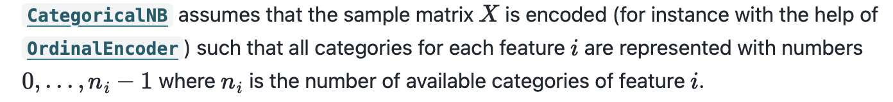

Slide 32
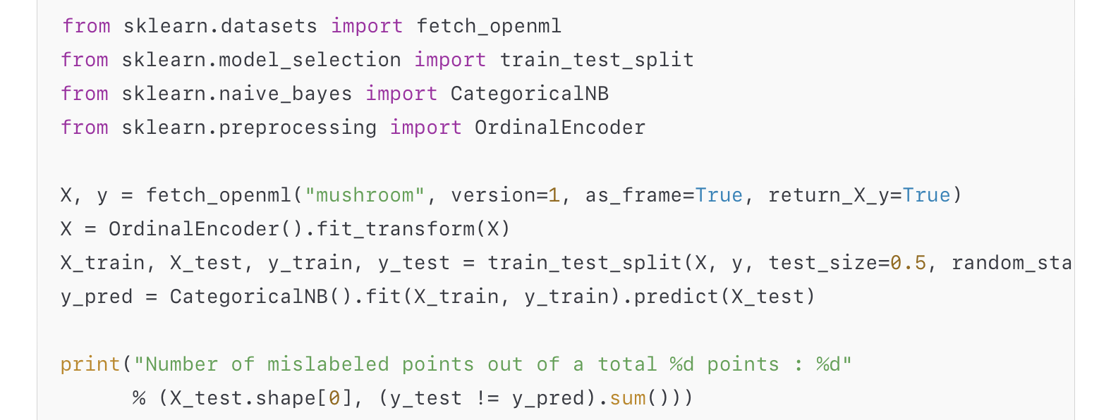

Slide 33
