Slide 1
Lectures 17-18
CS436/536: Introduction to
Machine Learning
Zhaohan Xi
Binghamton University
^{zxi1@binghamton.edu}

Slide 2
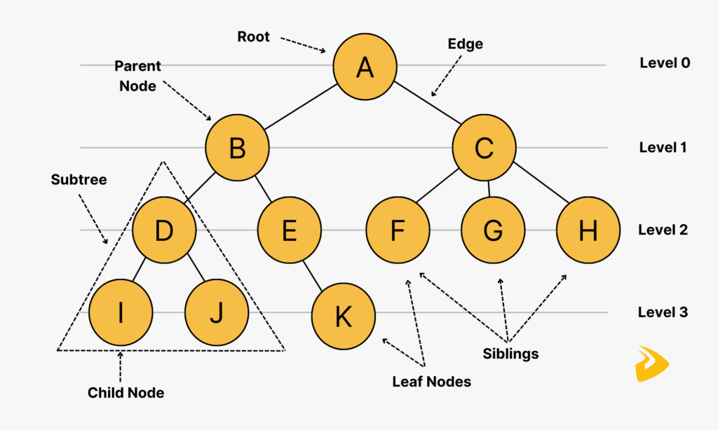
Tree Structure

Slide 3
Decision Trees
Can represent any Boolean Function
Can be viewed as a way to compactly represent a lot of data.
Natural representation: (20 questions)
The evaluation of the Decision Tree Classifier is easy
Clearly, given data, there are
many ways to represent it as
a decision tree.
Learning a good representation
from data is the challenge.
Outlook
Sunny
Overcast
Rain
Humidity
Wind
Yes
High
Normal
Strong
Weak
No
Yes
No
Yes

Slide 4
Will I play tennis today?
 | O | T | H | W | Play?
1 | S | H | H | W | -
2 | S | H | H | S | -
3 | O | H | H | W | +
4 | R | M | H | W | +
5 | R | C | N | W | +
6 | R | C | N | S | -
7 | O | C | N | S | +
8 | S | M | H | W | -
9 | S | C | N | W | +
10 | R | M | N | W | +
11 | S | M | N | S | +
12 | O | M | H | S | +
13 | O | H | N | W | +
14 | R | M | H | S | -
Outlook: S(unny), O(vercast), R(ainy)
Temperature: H(ot), M(edium), C(ool)
Humidity: H(igh), N(ormal), L(ow)
Wind: S(trong), W(eak)

Slide 5
Will I play tennis today?
Features
Outlook: {Sun, Overcast, Rain}
Temperature: {Hot, Mild, Cool}
Humidity: {High, Normal, Low}
Wind: {Strong, Weak}
Labels
Binary classification task: Y = {+, -}

Slide 6
Basic Decision Trees Learning Algorithm
 | O | T | H | W | Play?
1 | S | H | H | W | -
2 | S | H | H | S | -
3 | O | H | H | W | +
4 | R | M | H | W | +
5 | R | C | N | W | +
6 | R | C | N | S | -
7 | O | C | N | S | +
8 | S | M | H | W | -
9 | S | C | N | W | +
10 | R | M | N | W | +
11 | S | M | N | S | +
12 | O | M | H | S | +
13 | O | H | N | W | +
14 | R | M | H | S | -
Data is processed in Batch (i.e. all the data available)
Recursively build a decision tree top down.
Algorithm?
Outlook
Sunny
Overcast
Rain
Humidity
Yes
Wind
High
Normal
Strong
Weak
No
Yes
No
Yes

Slide 7
Picking the Root Attribute
The goal is to have the resulting decision tree as small as possible (Occam’s Razor)
But, finding the minimal decision tree consistent with the data is NP-hard
A recursive algorithm is a greedy heuristic search for a simple tree, but cannot guarantee optimality.
The main decision in the algorithm is the selection of the next attribute to condition on.

Slide 8
Picking the Root Attribute
Consider data with two Boolean attributes (A,B).
(A=0,B=0), - : 50 examples
(A=0,B=1), - : 50 examples
(A=1,B=0), - : 0 examples
(A=1,B=1), + : 100 examples
What should be the first attribute we select?
Splitting on A: we get purely labeled nodes.
Splitting on B: we don’t get purely labeled nodes.
What if we have: (A=1,B=0), - : 3 examples?
(one way to think about it: # of queries required to label a random data point)
A
1
0
+
-
splitting on A
B
1
0
A
-
1
0
+
-
splitting on B
Notes:
One

Slide 9
Picking the Root Attribute
Consider data with two Boolean attributes (A,B).
(A=0,B=0), - : 50 examples
(A=0,B=1), - : 50 examples
(A=1,B=0), - : 0 examples 3 examples
(A=1,B=1), + : 100 examples
What should be the first attribute we select?
Trees looks structurally similar; which attribute should we choose?
A
B
1
0
1
0
B
-
A
-
1
0
100
1
0
53
+
-
+
-
100
3
100
50
splitting on A
splitting on B

Slide 10
Picking the Root Attribute
Advantage A. But…Need a way to quantify things
One way to think about it: # of queries required to label a random data point.
If we choose A we have less uncertainty about the labels.
A
B
1
0
1
0
B
-
A
-
1
0
100
1
0
53
+
-
+
-
100
3
100
50
splitting on A
splitting on B

Slide 11
Picking the Root Attribute
The goal is to have the resulting decision tree as small as possible (Occam’s Razor)
The main decision in the algorithm is the selection of the next attribute to condition on.
We want attributes that split the examples to sets that are relatively pure in one label; this way we are closer to a leaf node.
The most popular heuristics is based on information gain

Slide 12
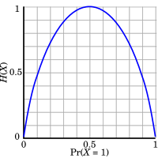
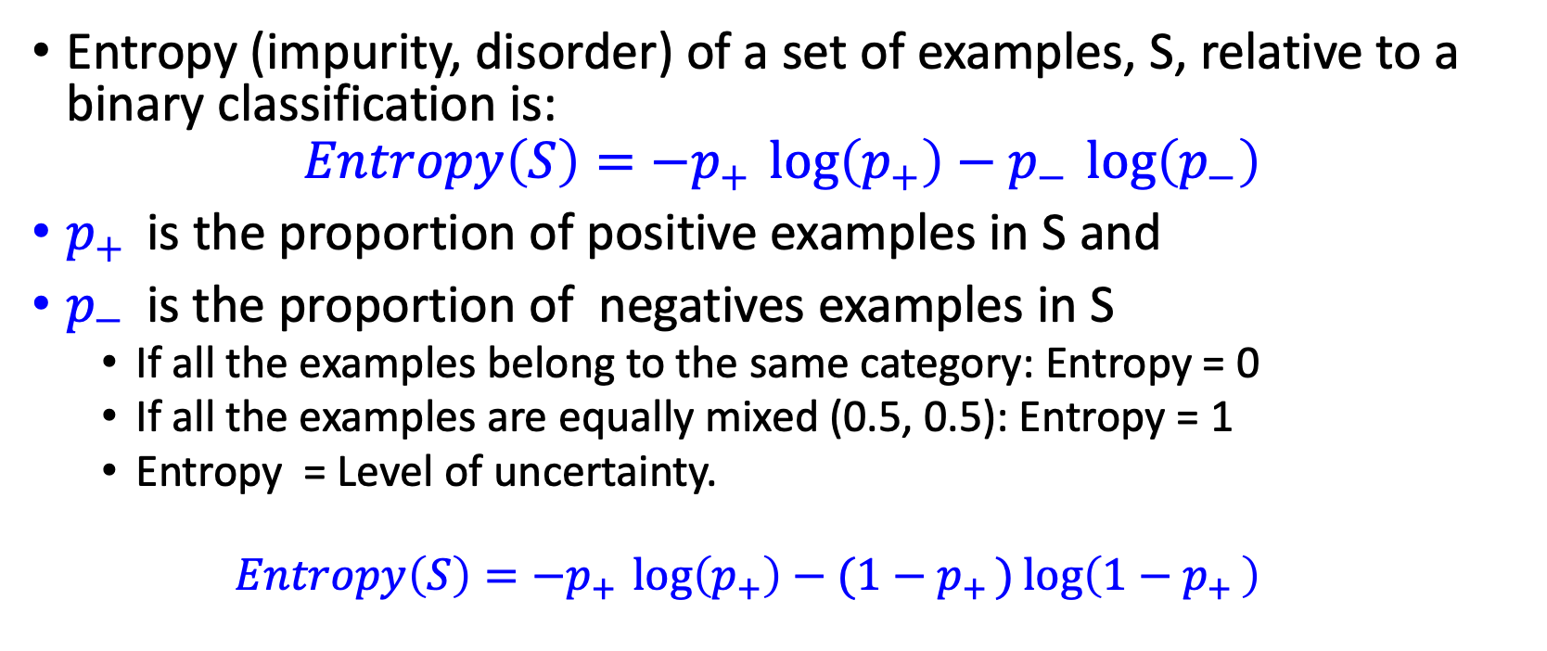
Entropy
Entropy (impurity, disorder) of a set of examples, S, relative to a binary classification is:
$$Entropy\left(S\right)=−p_{+ }\log\left(p_{+}\right)−p_{− }\log\left(p_{−}\right)$$
$p_{+ }$is the proportion of positive examples in S and
$p_{− }$is the proportion of negatives examples in S
If all the examples belong to the same category: Entropy = 0
If all the examples are equally mixed (0.5, 0.5): Entropy = 1
Entropy = Level of uncertainty.
$$Entropy\left(S\right)=−p_{+ }\log\left(p_{+}\right)−(1−p_{+ })\log\left(1−p_{+ }\right)$$

Slide 13
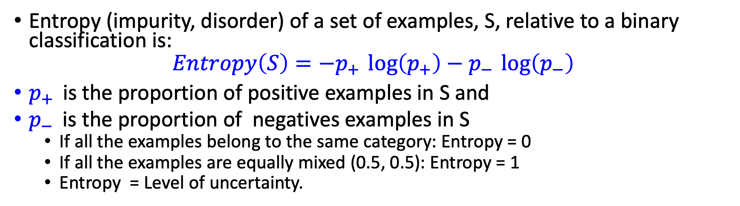
Entropy
Entropy (impurity, disorder) of a set of examples, S, relative to a binary classification is:
$$Entropy\left(S\right)=−p_{+ }\log\left(p_{+}\right)−p_{− }\log\left(p_{−}\right)$$
$p_{+ }$is the proportion of positive examples in S and
$p_{− }$is the proportion of negatives examples in S
If all the examples belong to the same category: Entropy = 0
If all the examples are equally mixed (0.5, 0.5): Entropy = 1
Entropy = Level of uncertainty.
1
1
1
--
+
--
+
--
+

Slide 14
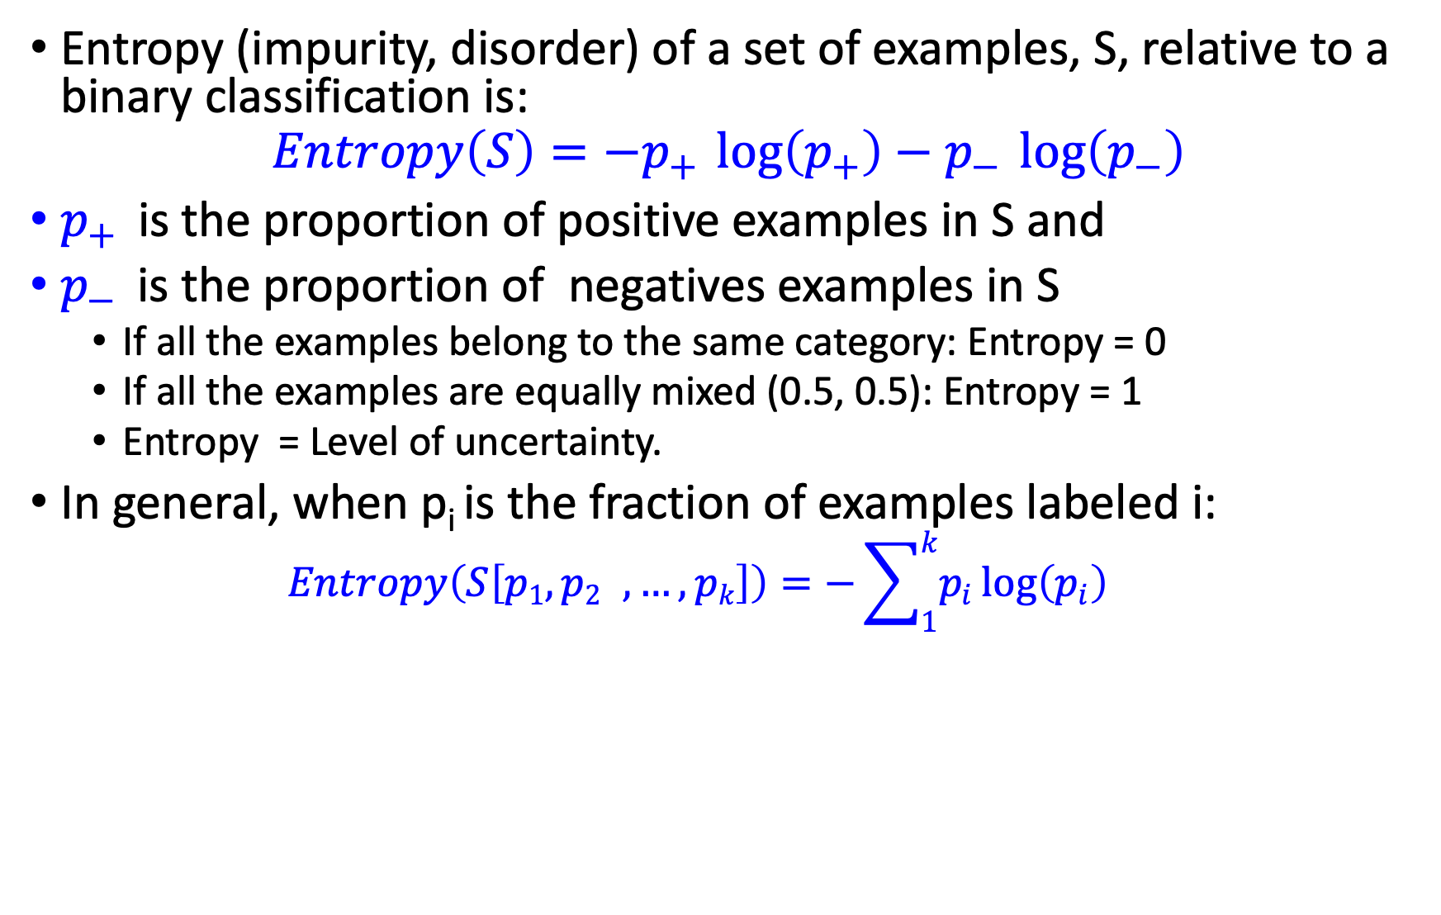
Entropy
Entropy (impurity, disorder) of a set of examples, S, relative to a binary classification is:
$$Entropy\left(S\right)=−p_{+ }\log\left(p_{+}\right)−p_{− }\log\left(p_{−}\right)$$
$p_{+ }$is the proportion of positive examples in S and
$p_{− }$is the proportion of negatives examples in S
If all the examples belong to the same category: Entropy = 0
If all the examples are equally mixed (0.5, 0.5): Entropy = 1
Entropy = Level of uncertainty.
In general, when p_{i} is the fraction of examples labeled i:
$$Entropy\left(S\left[p1,p2 ,…,pk\right]\right)=−\sum_{1}^{k}{p_{i}}\log\left(p_{i}\right)$$

Slide 15

Entropy
(Convince yourself that the max value would be $\log\left(k\right)$ )
(Also note that the base of the log only introduce a constant factor; therefore, we’ll think about base 2)
1
1
1

Slide 16
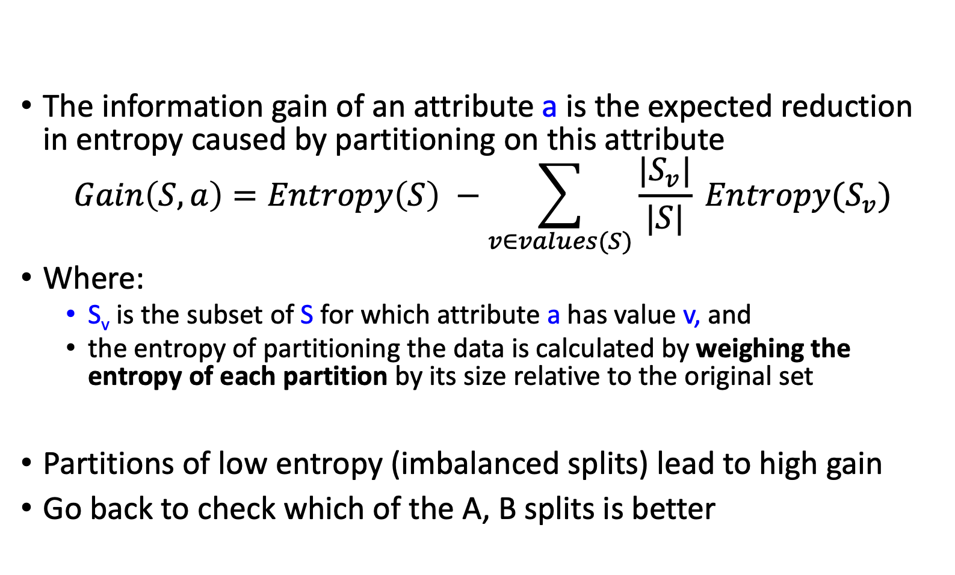
Information Gain
High Entropy – High level of Uncertainty
Low Entropy – No Uncertainty.
The information gain of an attribute a is the expected reduction in entropy caused by partitioning on this attribute
$$Gain\left(S,a\right)=Entropy\left(S\right) −\sum_{v∈values(S)}{\frac{|S_{v}|}{|S|} Entropy(S_{v})}$$
Where:
S_{v} is the subset of S for which attribute a has value v, and
the entropy of partitioning the data is calculated by weighing the entropy of each partition by its size relative to the original set
Partitions of low entropy (imbalanced splits) lead to high gain
Go back to check which of the A, B splits is better
Outlook
Sunny
Overcast
Rain
Notes:
The A, B case:
If we choose A: the reduction is: 100/203 Ent(100,0) + 103/203 Ent(100,3) ~~ 0
If we choose B: the reduction is: 53/203 Ent(53,0) + 150/203 Ent(100,50) >> 0

Slide 17
Will I play tennis today?
 | O | T | H | W | Play?
1 | S | H | H | W | -
2 | S | H | H | S | -
3 | O | H | H | W | +
4 | R | M | H | W | +
5 | R | C | N | W | +
6 | R | C | N | S | -
7 | O | C | N | S | +
8 | S | M | H | W | -
9 | S | C | N | W | +
10 | R | M | N | W | +
11 | S | M | N | S | +
12 | O | M | H | S | +
13 | O | H | N | W | +
14 | R | M | H | S | -
Outlook: S(unny), O(vercast), R(ainy)
Temperature: H(ot), M(edium), C(ool)
Humidity: H(igh), N(ormal), L(ow)
Wind: S(trong), W(eak)

Slide 18

Will I play tennis today?
 | O | T | H | W | Play?
1 | S | H | H | W | -
2 | S | H | H | S | -
3 | O | H | H | W | +
4 | R | M | H | W | +
5 | R | C | N | W | +
6 | R | C | N | S | -
7 | O | C | N | S | +
8 | S | M | H | W | -
9 | S | C | N | W | +
10 | R | M | N | W | +
11 | S | M | N | S | +
12 | O | M | H | S | +
13 | O | H | N | W | +
14 | R | M | H | S | -
calculate current entropy
$p_{+ }= \frac{9}{14}$ ${ p}_{− }= \frac{5}{14}$
$Entropy\left(Play\right)=−p_{+ }\log{2\left(p_{+}\right)}−p_{− }\log{2\left(p_{−}\right)}$ $=−\frac{9}{14}log2\frac{9}{14}−\frac{5}{14}log2\frac{5}{14}$
≈ 0.94

Slide 19
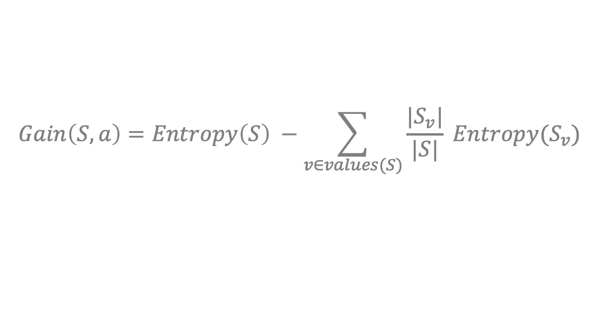
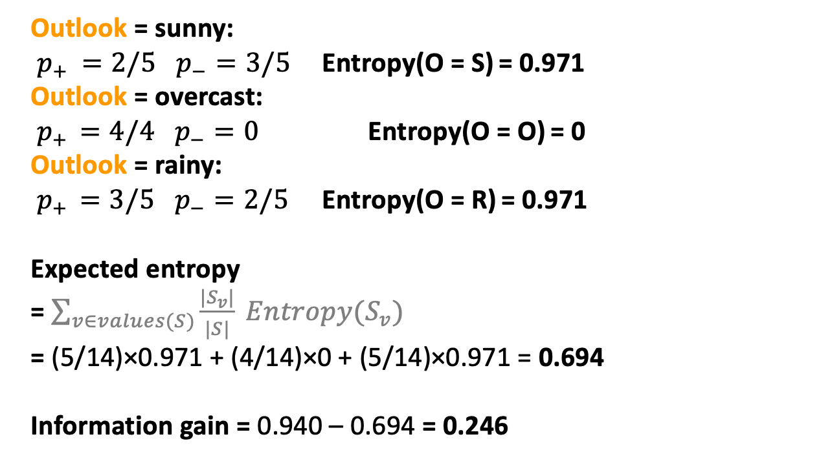
Information Gain: Outlook
$$Gain\left(S,a\right)=Entropy\left(S\right) −\sum_{v∈values(S)}{\frac{|S_{v}|}{|S|} Entropy(S_{v})}$$
 | O | T | H | W | Play?
1 | S | H | H | W | -
2 | S | H | H | S | -
3 | O | H | H | W | +
4 | R | M | H | W | +
5 | R | C | N | W | +
6 | R | C | N | S | -
7 | O | C | N | S | +
8 | S | M | H | W | -
9 | S | C | N | W | +
10 | R | M | N | W | +
11 | S | M | N | S | +
12 | O | M | H | S | +
13 | O | H | N | W | +
14 | R | M | H | S | -
Outlook = sunny: $p_{+ }=2/5$ $p_{−}=3/5$ Entropy(O = S) = 0.971 Outlook = overcast:
${ p}_{+ } =4/4$ $p_{−}=0$ Entropy(O = O) = 0
Outlook = rainy:
${ p}_{+ } =3/5$ $p_{−}=2/5$ Entropy(O = R) = 0.971
Expected entropy
= $\sum_{v∈values(S)}{\frac{|S_{v}|}{|S|} Entropy(S_{v})}$
= (5/14)×0.971 + (4/14)×0 + (5/14)×0.971 = 0.694
Information gain = 0.940 – 0.694 = 0.246

Slide 20
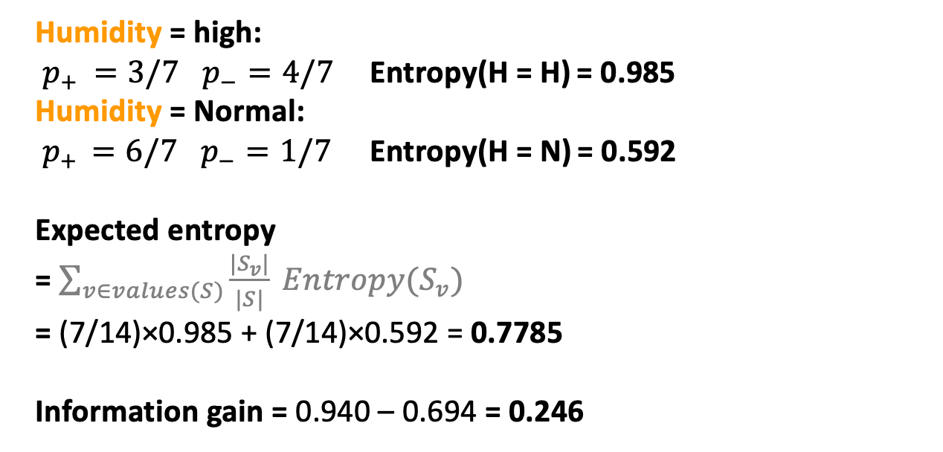
Information Gain: Humidity
$$Gain\left(S,a\right)=Entropy\left(S\right) −\sum_{v∈values(S)}{\frac{|S_{v}|}{|S|} Entropy(S_{v})}$$
 | O | T | H | W | Play?
1 | S | H | H | W | -
2 | S | H | H | S | -
3 | O | H | H | W | +
4 | R | M | H | W | +
5 | R | C | N | W | +
6 | R | C | N | S | -
7 | O | C | N | S | +
8 | S | M | H | W | -
9 | S | C | N | W | +
10 | R | M | N | W | +
11 | S | M | N | S | +
12 | O | M | H | S | +
13 | O | H | N | W | +
14 | R | M | H | S | -
Humidity = high: $p_{+ }=3/7$ $p_{−}=4/7$ Entropy(H = H) = 0.985 Humidity = Normal:
${ p}_{+ } =6/7$ $p_{−}=1/7$ Entropy(H = N) = 0.592
Expected entropy
= $\sum_{v∈values(S)}{\frac{|S_{v}|}{|S|} Entropy(S_{v})}$
= (7/14)×0.985 + (7/14)×0.592 = 0.7785
Information gain = 0.940 – 0.694 = 0.246

Slide 21
Which feature to split on?
 | O | T | H | W | Play?
1 | S | H | H | W | -
2 | S | H | H | S | -
3 | O | H | H | W | +
4 | R | M | H | W | +
5 | R | C | N | W | +
6 | R | C | N | S | -
7 | O | C | N | S | +
8 | S | M | H | W | -
9 | S | C | N | W | +
10 | R | M | N | W | +
11 | S | M | N | S | +
12 | O | M | H | S | +
13 | O | H | N | W | +
14 | R | M | H | S | -
Information gain: Outlook: 0.246 Humidity: 0.151 Wind: 0.048 Temperature: 0.029
→ Split on Outlook

Slide 22
An Illustrative Example (III)
Gain(S,Humidity)=0.151
Gain(S,Wind) = 0.048
Gain(S,Temperature) = 0.029
Gain(S,Outlook) = 0.246
Outlook

Slide 23
An Illustrative Example (III)
 | O | T | H | W | Play?
1 | S | H | H | W | -
2 | S | H | H | S | -
3 | O | H | H | W | +
4 | R | M | H | W | +
5 | R | C | N | W | +
6 | R | C | N | S | -
7 | O | C | N | S | +
8 | S | M | H | W | -
9 | S | C | N | W | +
10 | R | M | N | W | +
11 | S | M | N | S | +
12 | O | M | H | S | +
13 | O | H | N | W | +
14 | R | M | H | S | -
Outlook
Sunny
Overcast
Rain
1,2,8,9,11
3,7,12,13
4,5,6,10,14
2+,3-
4+,0-
3+,2-
?
Yes
?

Slide 24
An Illustrative Example (III)
Outlook
 | O | T | H | W | Play?
1 | S | H | H | W | -
2 | S | H | H | S | -
3 | O | H | H | W | +
4 | R | M | H | W | +
5 | R | C | N | W | +
6 | R | C | N | S | -
7 | O | C | N | S | +
8 | S | M | H | W | -
9 | S | C | N | W | +
10 | R | M | N | W | +
11 | S | M | N | S | +
12 | O | M | H | S | +
13 | O | H | N | W | +
14 | R | M | H | S | -
Sunny
Overcast
Rain
1,2,8,9,11
3,7,12,13
4,5,6,10,14
2+,3-
4+,0-
3+,2-
?
Yes
?
Continue until:
Every attribute is included in path, or,
All examples in the leaf have same label

Slide 25
An Illustrative Example (IV)
Outlook
 | O | T | H | W | Play?
1 | S | H | H | W | -
2 | S | H | H | S | -
4 | R | M | H | W | +
5 | R | C | N | W | +
6 | R | C | N | S | -
7 | O | C | N | S | +
8 | S | M | H | W | -
9 | S | C | N | W | +
10 | R | M | N | W | +
11 | S | M | N | S | +
12 | O | M | H | S | +
13 | O | H | N | W | +
14 | R | M | H | S | -
Sunny
Overcast
Rain
1,2,8,9,11
3,7,12,13
4,5,6,10,14
2+,3-
4+,0-
3+,2-
?
Yes
?
.97-(3/5) 0-(2/5) 0 = .97
.97- 0-(2/5) 1 = .57
.97-(2/5) 1 - (3/5) .92= .02
Split on Humidity

Slide 26
An Illustrative Example (V)
Outlook
Sunny
Overcast
Rain
1,2,8,9,11
3,7,12,13
4,5,6,10,14
2+,3-
4+,0-
3+,2-
?
Yes
?

Slide 27
An Illustrative Example (V)
Outlook
Sunny
Overcast
Rain
1,2,8,9,11
3,7,12,13
4,5,6,10,14
2+,3-
4+,0-
3+,2-
Humidity
Yes
?
High
Normal
No
Yes

Slide 28
induceDecisionTree(S)
1. Does S uniquely define a class? if all s ∈ S have the same label y: return S;
2. Find the feature with the most information gain:
i = argmax _{i} Gain(S, X_{i})
3. Add children to S:
for k in Values(X_{i}):
S_{k} = {s ∈ S | x_{i} = k} addChild(S, S_{k})
induceDecisionTree(S_{k})
return S;

Slide 29
An Illustrative Example (VI)
Outlook
Sunny
Overcast
Rain
1,2,8,9,11
3,7,12,13
4,5,6,10,14
2+,3-
4+,0-
3+,2-
Humidity
Yes
Wind
High
Normal
Strong
Weak
No
Yes
No
Yes

Slide 30
Hypothesis Space in Decision Tree Induction
Conduct a search of the space of decision trees which can represent all possible discrete functions. (pros and cons)
Goal: to find the best decision tree
Best could be “smallest depth”
Best could be “minimizing the expected number of tests”
Finding a minimal decision tree consistent with a set of data is NP-hard.
Performs a greedy heuristic search: hill climbing without backtracking
Makes statistically based decisions using all data

Slide 31
Pros and Cons
Pros
Easy to explain (even for non-expert)
Easy to implement (many software)
Efficient
Can tolerant missing data
White box
No need to normalize data
Non-parametric: No assumption on data distribution, no assumption on attribute independency
Can work on various attribute types

Slide 32
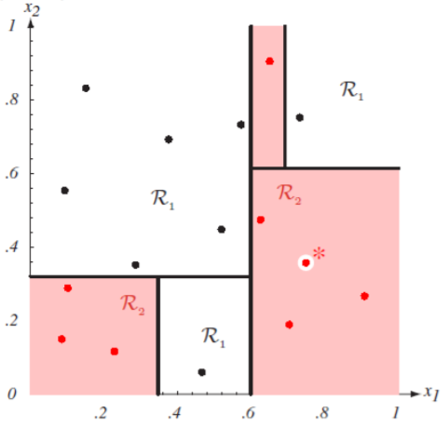
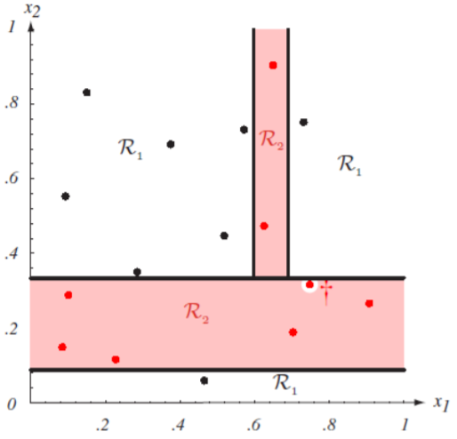
Cons
Con’s
Unstable. Sensitive to noise
Accuracy may be not good enough (depending on your data)
The optimal splitting is NP. Greedy algorithms are used
Overfitting
Notes:
http://cse.msu.edu/~cse802/DecisionTrees.pdf

Slide 33
Overfitting

Slide 34
Example
Outlook
Outlook = Sunny,
Temp = Hot
Humidity = Normal
Wind = Strong
label: NO
this example doesn’t exist in the tree
Sunny
Overcast
Rain
1,2,8,9,11
3,7,12,13
4,5,6,10,14
2+,3-
4+,0-
3+,2-
Humidity
Yes
Wind
High
Normal
Strong
Weak
No
Yes
No
Yes

Slide 35
Overfitting - Example
This can always be done – may fit noise or other coincidental regularities
Outlook
Outlook = Sunny,
Temp = Hot
Humidity = Normal
Wind = Strong
label: NO
this example doesn’t exist in the tree
Sunny
Overcast
Rain
1,2,8,9,11
3,7,12,13
4,5,6,10,14
2+,3-
4+,0-
3+,2-
Humidity
Yes
Wind
High
Normal
Strong
Weak
No
Wind
No
Yes
Strong
Weak
No
Yes

Slide 36
Our training data

Slide 37
The instance space

Slide 38
Reasons for overfitting
Too much variance in the training data
Training data is not a representative sample of the instance space
We split on features that are actually irrelevant
Too much noise in the training data
Noise = some feature values or class labels are incorrect
We learn to predict the noise
In both cases, it is a result of our will to minimize the empirical error when we learn, and the ability to do it (with DTs)

Slide 39
Pruning a decision tree
Prune = remove leaves and assign majority label of the parent to all items
Prune the children of node s if:
all children are leaves, and
the accuracy on the validation set does not decrease if we assign the most frequent class label to all items at s.

Slide 40
Avoiding Overfitting
Two basic approaches
Pre-pruning: Stop growing the tree at some point during construction when it is determined that there is not enough data to make reliable choices.
Post-pruning: Grow the full tree and then remove nodes that seem not to have sufficient evidence.

Slide 41
DT Extensions: continuous attributes and missing values

Slide 42
Continuous Attributes
Real-valued attributes can, in advance, be discretized into ranges, such as big, medium, small
Alternatively, one can develop splitting nodes based on thresholds of the form A<c that partition the data into examples that satisfy A<c and A>=c.
The information gain for these splits is calculated in the same way and compared to the information gain of discrete splits.
How to find the split with the highest gain?

Slide 43
Continuous Attributes
Example:
Length (L): 10 15 21 28 32 40 50
Class: - + + - + + -
Check thresholds: L < 12.5; L < 24.5; L < 45
Subset of Examples= {…}, Split= k+,j-
How to find the split with the highest gain ?
For each continuous feature A:
Sort examples according to the value of A
For each ordered pair (x,y) with different labels
Check the mid-point as a possible threshold. I.e,
S_{a < x}, S_{a >= y}

Slide 44
Missing Values
Diagnosis = < fever, blood_pressure,…, blood_test=?,…>
Many times values are not available for all attributes during training or testing (e.g., medical diagnosis)
Training: evaluate Gain(S,a) where in some of the examples a value for a is not given

Slide 45
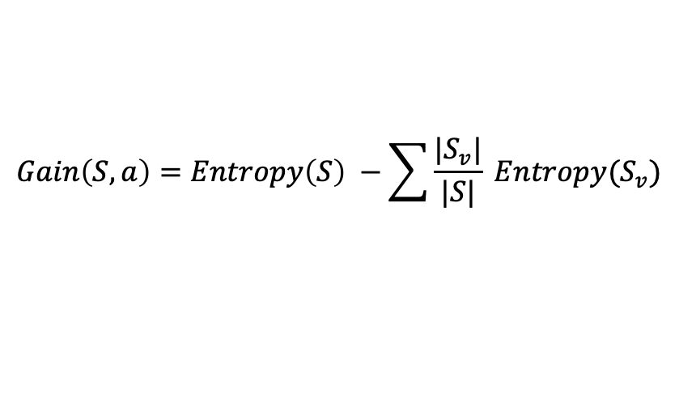
Missing Values
$$Gain\left(S,a\right)=Entropy\left(S\right) −\sum{\frac{|S_{v}|}{|S|} Entropy(S_{v})}$$
Other suggestions?
Outlook
.97- 0-(2/5) 1 = .57
Fill in: assign the most likely value of X_{i} to s: argmax _{k} P( X_{i} = k ): Normal
97-(3/5) Ent[+0,-3] -(2/5) Ent[+2,-0] = .97
Assign fractional counts P(X_{i} =k) for each value of X_{i} to s
.97-(2.5/5) Ent[+0,-2.5] - (2.5/5) Ent[+2,-.5] < .97
Sunny
Overcast
Rain
1,2,8,9,11
3,7,12,13
4,5,6,10,14
2+,3-
4+,0-
3+,2-
?
Yes
?
Day Outlook Temperature Humidity Wind PlayTennis
1 Sunny Hot High Weak No
2 Sunny Hot High Strong No
8 Sunny Mild ??? Weak No
9 Sunny Cool Normal Weak Yes
11 Sunny Mild Normal Strong Yes
Notes:
Other suggestions: hints about EM

Slide 46
Missing Values
Diagnosis = < fever, blood_pressure,…, blood_test=?,…>
Many times values are not available for all attributes during training or testing (e.g., medical diagnosis)
Training: evaluate Gain(S,a) where in some of the examples a value for a is not given
Testing: classify an example without knowing the value of a

Slide 47
Missing Values
Outlook = Sunny, Temp = Hot, Humidity = ???, Wind = Strong, label = ??
Normal/High
Outlook = ???, Temp = Hot, Humidity = Normal, Wind = Strong, label = ??
Outlook
1/3 Yes + 1/3 Yes +1/3 No = Yes
Sunny
Overcast
Rain
1,2,8,9,11
3,7,12,13
4,5,6,10,14
2+,3-
4+,0-
3+,2-
Humidity
Yes
Wind
High
Normal
Strong
Weak
No
Yes
No
Yes

Slide 48
Other Issues
Attributes with different costs
Change information gain so that low cost attribute are preferred
Dealing with features with different # of values
Alternative measures for selecting attributes
When different attributes have different number of values information gain tends to prefer those with many values
Oblique Decision Trees
Decisions are not axis-parallel
Incremental Decision Trees induction
Update an existing decision tree to account for new examples incrementally (Maintain consistency?)

Slide 49
Summary: Decision Trees
Presented the hypothesis class of Decision Trees
Very expressive, flexible, class of functions
Presented a learning algorithm for Decision Tress
Recursive algorithm.
Key step is based on the notion of Entropy
Discussed the notion of overfitting and ways to address it within DTs
In your problem set – look at the performance on the training vs. test
Briefly discussed some extensions
Real valued attributes
Missing attributes

Slide 50
Techniques to Improve Classification Accuracy
Introducing Ensemble Methods
Bagging
Boosting
Random Forests
Imbalanced Classification
Notes:
50

Slide 51
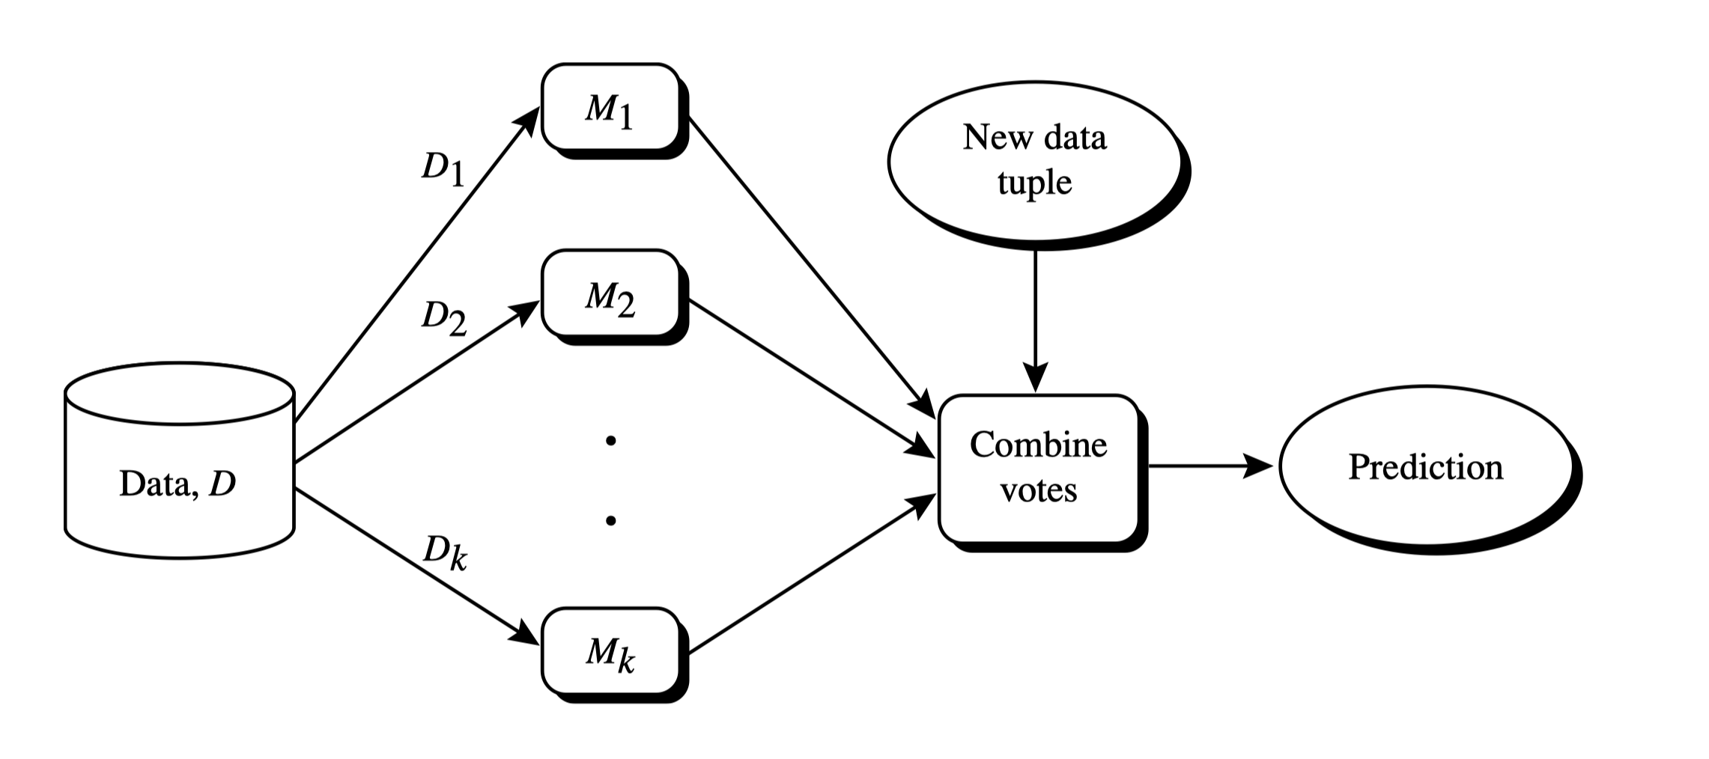




Ensemble Methods: Increasing the Accuracy
Ensemble methods
Use a combination of models to increase accuracy
Combine a series of $k$ learned hypotheses $g_{1},g_{2},…,g_{k}$,
with the aim of creating an improved hypothesis $g^{∗}$
$$g_{1}$$
$$g_{2}$$
$$g_{k}$$

Slide 52
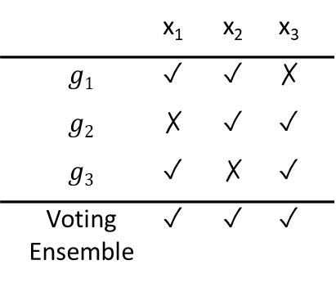
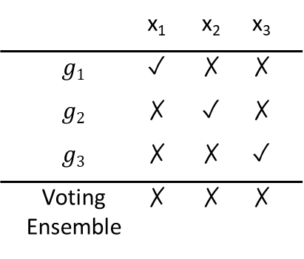
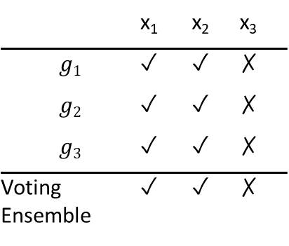
Ensemble Methods: Increasing the Accuracy
What are the requirements to generate an improved model?
Base models should be
Accurate
Diverse
Example: majority voting
Accurate,
but highly correlated
Inaccurate,
not correlated
 | x₁ | x₂ | x₃
$$g1$$ | ✓ | ✓ | ✗
$$g2$$ | ✗ | ✓ | ✓
$$g3$$ | ✓ | ✗ | ✓
Voting Ensemble | ✓ | ✓ | ✓
 | x₁ | x₂ | x₃
$$g1$$ | ✓ | ✓ | ✗
$$g2$$ | ✓ | ✓ | ✗
$$g3$$ | ✓ | ✓ | ✗
Voting Ensemble | ✓ | ✓ | ✗
 | x₁ | x₂ | x₃
$$g1$$ | ✓ | ✗ | ✗
$$g2$$ | ✗ | ✓ | ✗
$$g3$$ | ✗ | ✗ | ✓
Voting Ensemble | ✗ | ✗ | ✗
Base hypothesis performance
Ensemble performance
Case 1:
Ensemble has positive effect
Case 2:
Ensemble has no effect
Case 3:
Ensemble has negative effect

Slide 53
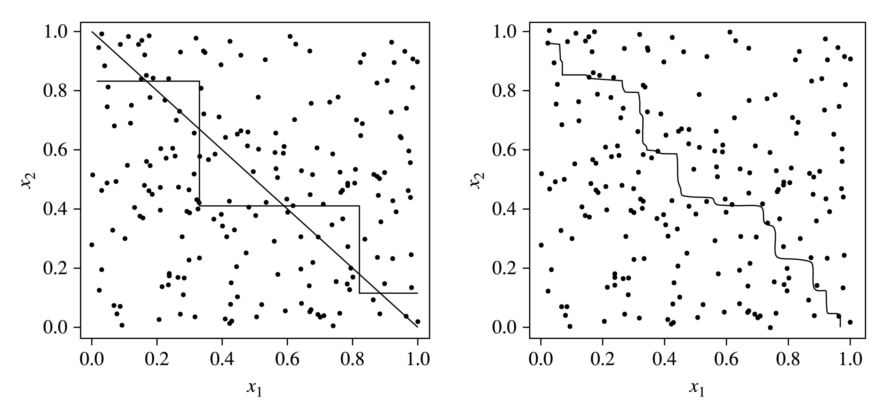
Ensemble Methods: Example of Decision Trees
Decision trees cannot easily approximate a linear classifier
Ensembles can help
ensemble of
Decision trees
target
decision tree
approximation

Slide 54
Ensemble Methods: Increasing the Accuracy
Popular ensemble methods
Bagging: Picks different hypotheses, each using a possibly different subset of the training set
Can be learned in parallel
Boosting: Picks each new hypothesis sequentially to emphasize the training instances that previous hypotheses mis-classified
Bagging
Boosting

Slide 55
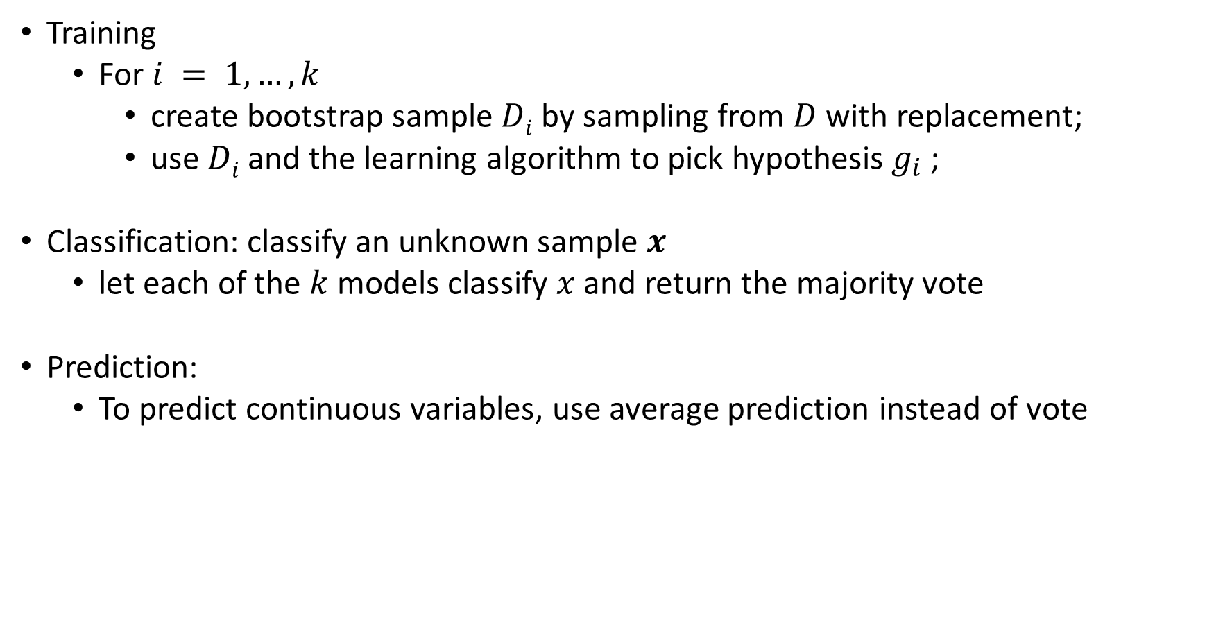
Bagging: Bootstrap Aggregation
Training
For $i = 1, …, k$
create bootstrap sample $Di$ by sampling from $D$ with replacement;
use $Di$ and the learning algorithm to pick hypothesis $g_{i}$ ;
Classification: classify an unknown sample $x$
let each of the $k$ models classify $x$ and return the majority vote
Prediction:
To predict continuous variables, use average prediction instead of vote

Slide 56
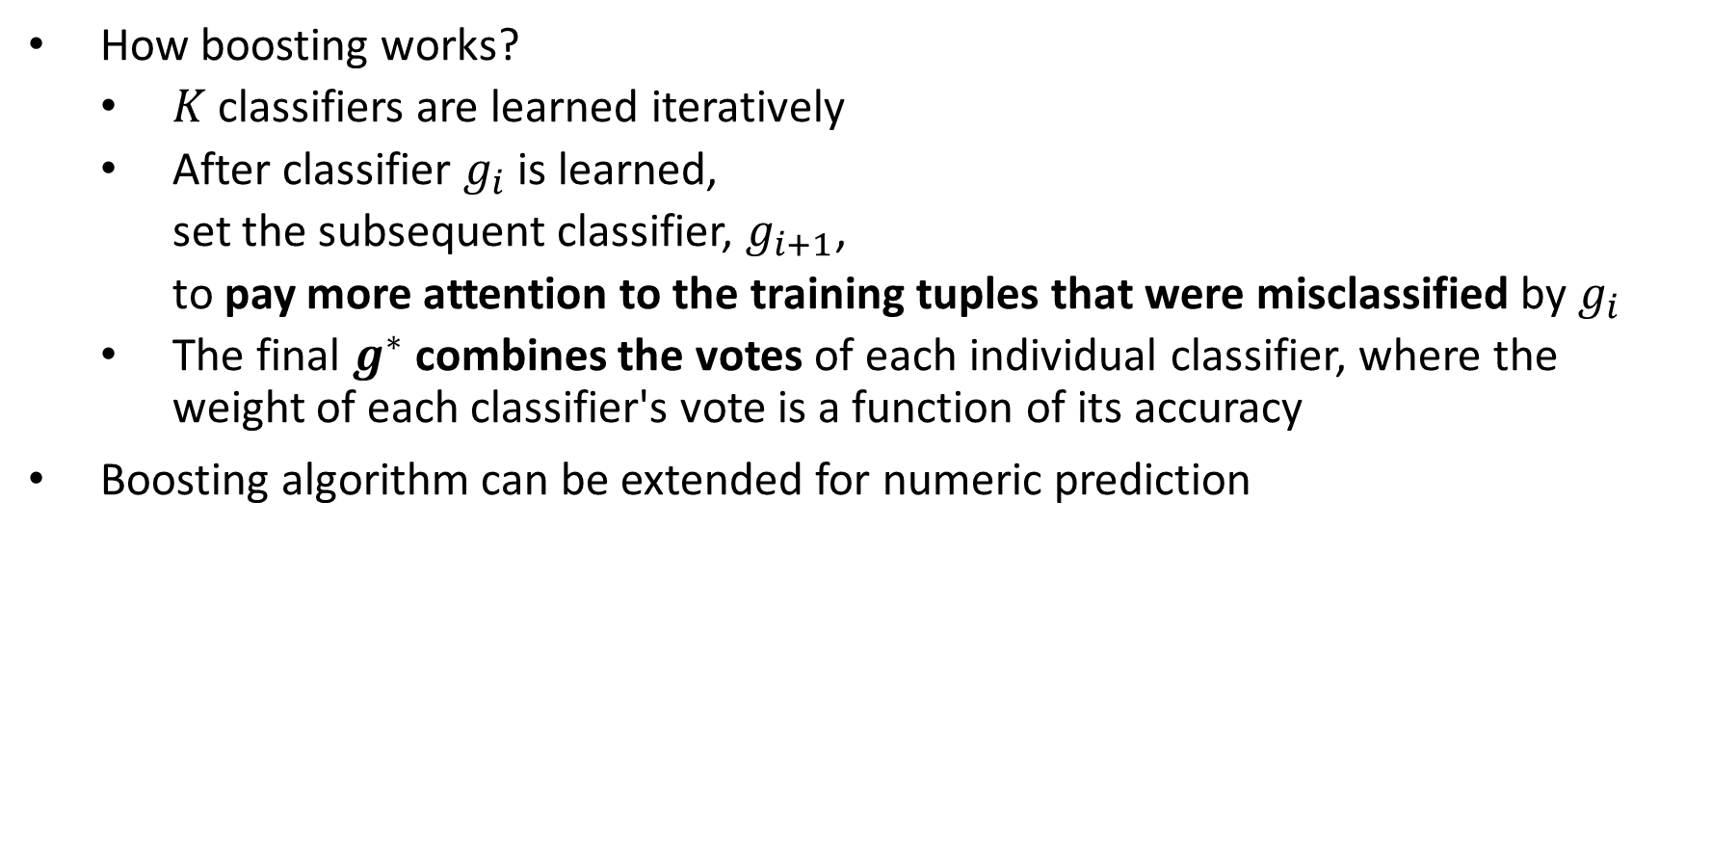
Boosting
How boosting works?
$K$ classifiers are learned iteratively
After classifier $g_{i}$ is learned,
set the subsequent classifier, $g_{i+1}$,
to pay more attention to the training tuples that were misclassified by $g_{i}$
The final $g^{∗}$ combines the votes of each individual classifier, where the weight of each classifier's vote is a function of its accuracy
Boosting algorithm can be extended for numeric prediction

Slide 57
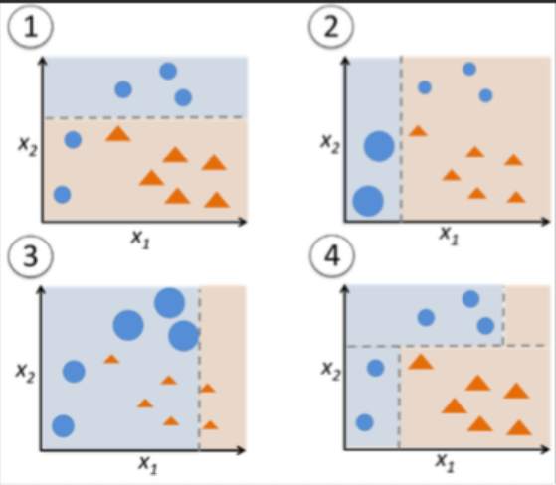

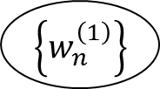


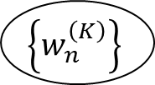
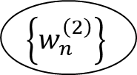
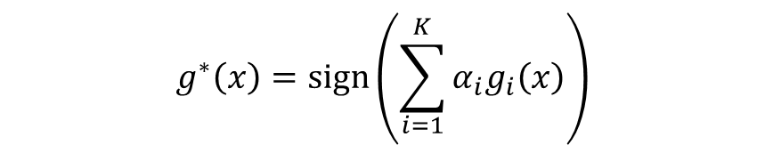
Adaboost (Freund and Schapire, 1997)
3. Update weights based on current model
1. Assign initial weights to each training tuple
$\left\{w_{n}^{\left(1\right)}\right\}$
$$\left\{w_{n}^{\left(2\right)}\right\}$$
$$\left\{w_{n}^{\left(K\right)}\right\}$$
…
2. Train base classifier on weighted dataset
$$g_{1}$$
$$g_{2}$$
…
$$g_{K}$$
4. After base classifiers are trained, they are combined to give the final classifier
Two ‘weighting’ strategy:
Assign weights to each training example
Sample dataset based on weight distribution
$$g^{∗}\left(x\right)=sign\left(\sum_{i=1}^{K}{α_{i}g_{i}\left(x\right)}\right)$$

Slide 58
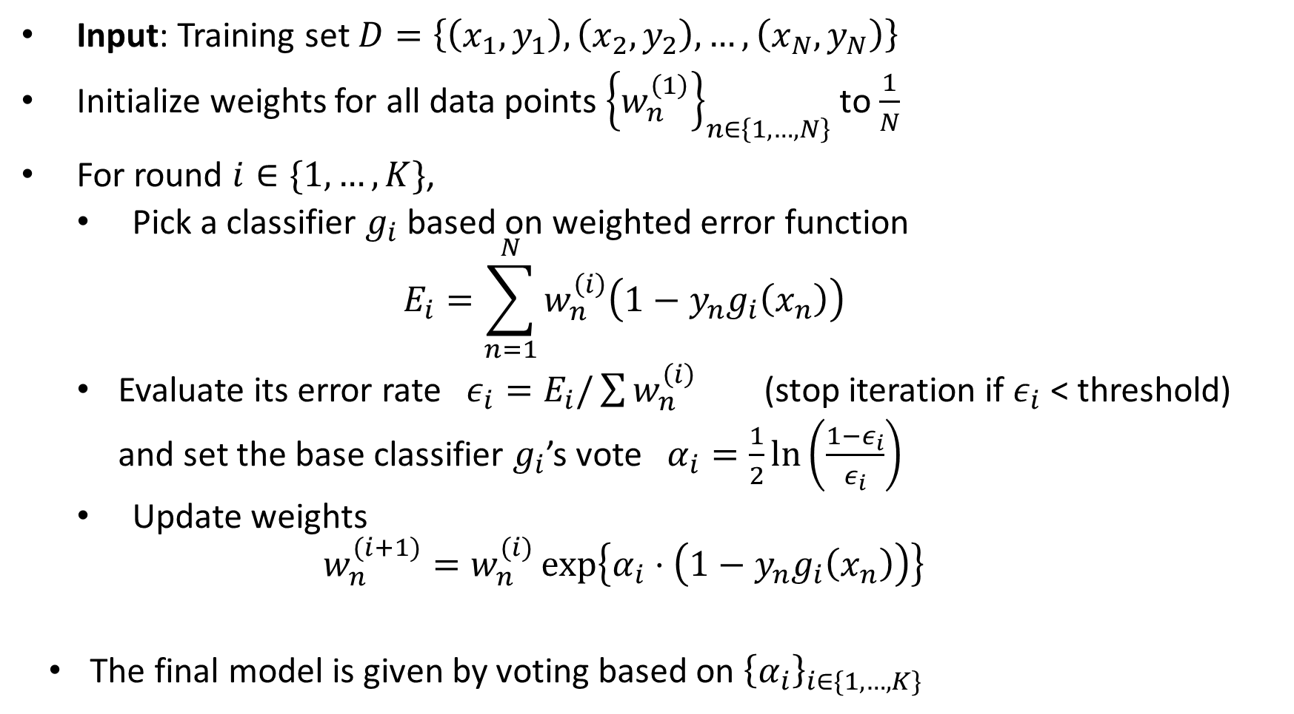
Adaboost (Freund and Schapire, 1997)
Input: Training set $D=\left\{\left(x_{1},y_{1}\right), \left(x_{2},y_{2}\right), …, \left(x_{N},y_{N}\right)\right\}$
Initialize weights for all data points ${\left\{w_{n}^{\left(1\right)}\right\}}_{n∈\left\{1,…,N\right\}}$ to $\frac{1}{N}$
For round $i∈\{1,…,K\}$,
Pick a classifier $g_{i}$ based on weighted error function
$$E_{i}=\sum_{n=1}^{N}{w_{n}^{\left(i\right)}\left(1−y_{n}g_{i}\left(x_{n}\right)\right)}$$
Evaluate its error rate $ε_{i}=E_{i}/\sum{w_{n}^{\left(i\right)}}$ (stop iteration if $ε_{i}$ < threshold)
and set the base classifier $g_{i}$’s vote $α_{i}=\frac{1}{2}\ln\left(\frac{1−ε_{i}}{ε_{i}}\right)$
Update weights
$$w_{n}^{(i+1)}=w_{n}^{(i)}\exp\left\{α_{i}⋅\left(1−y_{n}g_{i}\left(x_{n}\right)\right)\right\}$$
The final model is given by voting based on ${\left\{α_{i}\right\}}_{i∈\{1,…,K\}}$

Slide 59
Random Forest: Basic Concepts
Random Forest (first proposed by L. Breiman in 2001)
Bagging with decision trees as base hypotheses
Data bagging
Use a subset of training data by sampling with replacement for each tree
Feature bagging
At each node use a random selection of attributes as candidates and split by the best attribute among them
During classification, each tree votes and the most popular class is returned
Advantage of decision trees – more diversity

Slide 60
Random Forest
Two Methods:
Forest-RI (random input selection):
At each node, randomly select F attributes as candidates for the split at the node.
Forest-RC (random linear combinations):
Creates new features that are a linear combination of the existing attributes (reduces the correlation between individual classifiers)
Comparable in accuracy to Adaboost, but more robust to errors and outliers
Insensitive to the number of attributes selected for consideration at each split, and faster than typical bagging or boosting

Slide 61
Ensemble Methods Recap
Random forest, XGBoost are the most commonly used algorithms for tabular data
Pros
Good performance for tabular data, requires no data scaling
Can scale to large datasets
Can handle missing data to some extent
Cons
Can overfit to training data if not tuned properly
Lack of interpretability (compared to decision trees)

Slide 62
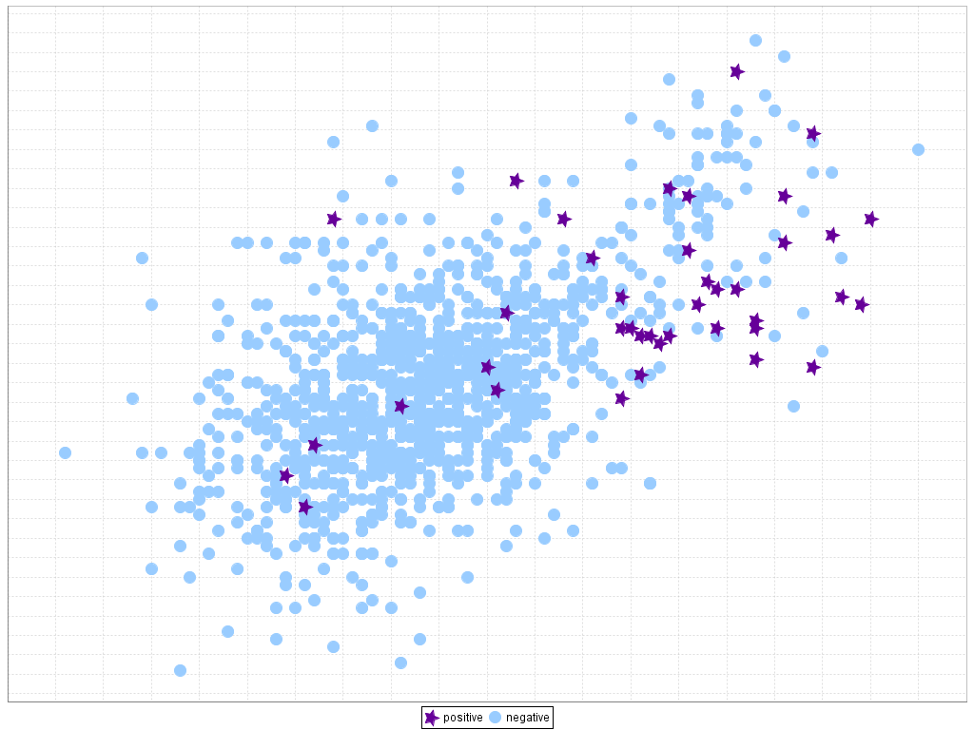
Classification of Class-Imbalanced Data Sets
Traditional methods assume a balanced distribution of classes and equal error costs. But in real world situations, we may face imbalanced data sets, which has rare positive examples but numerous negative ones.
Medical diagnosis: Medical screening for a condition
is usually performed on a large population of people
without the condition, to detect a small minority
with it (e.g., HIV prevalence in the USA is ~0.4%)
Fraud detection: About 2% of credit card accounts
are defrauded per year. (Most fraud detection domains are heavily imbalanced.)
Product defect, accident (oil-spill), disk drive failures, etc.

Slide 63
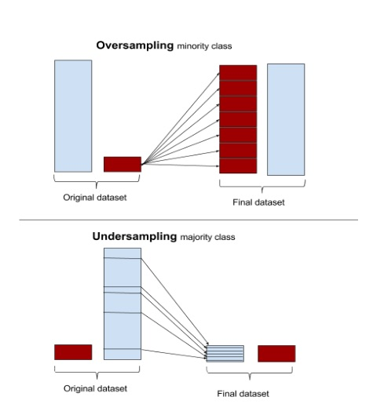
Classification of Class-Imbalanced Data Sets
Typical methods on imbalanced data (Balance the training set)
Oversampling: Oversample the minority class.
Under-sampling: Randomly eliminate tuples from majority class
Synthesizing: Synthesize new minority classes

Slide 64
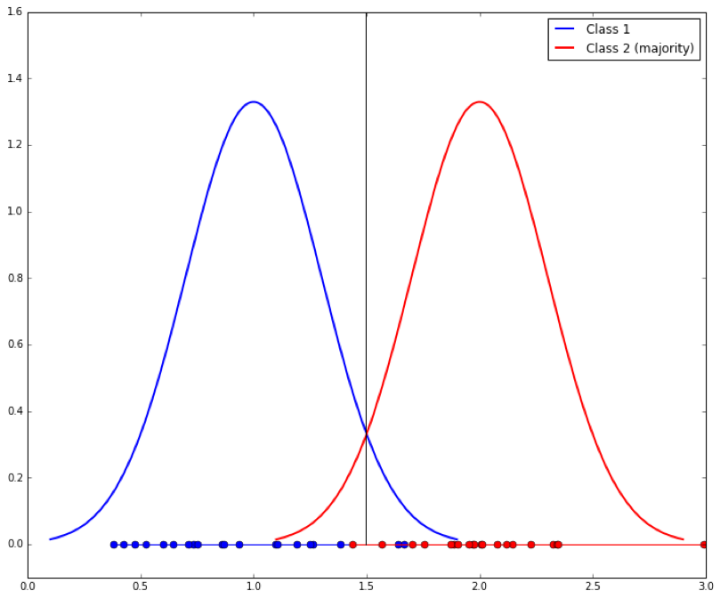
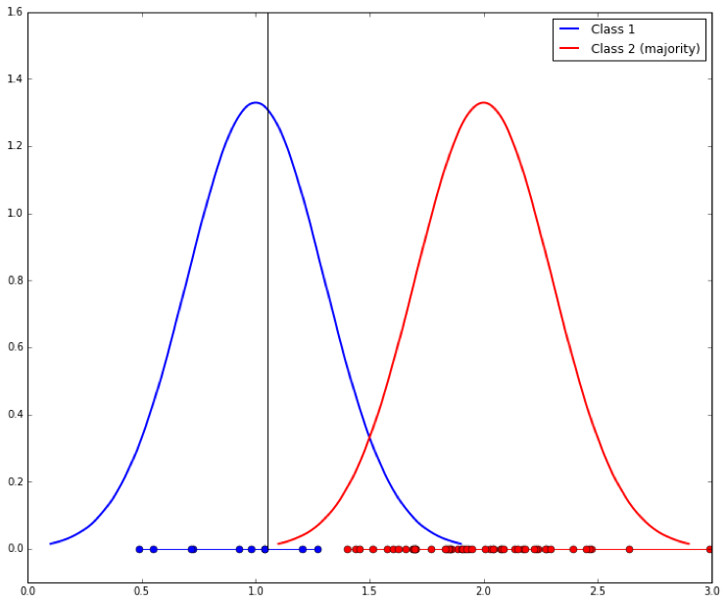

Classification of Class-Imbalanced Data Sets
Typical methods on imbalanced data (At the algorithm level)
Threshold-moving: Move the decision threshold $t$ so that the rare class tuples are easier to classify, and hence, less chance of costly false negative errors
Class weight adjusting: When false negative costs more than false positive, we can give larger weight to false negative
Ensemble techniques: Ensemble of multiple classifiers
Threshold-moving

Slide 65
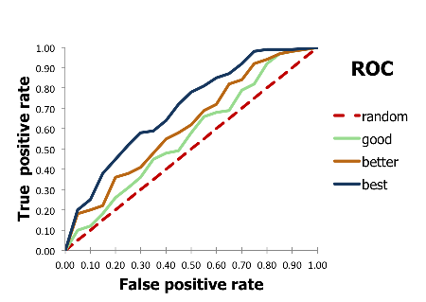
Evaluate imbalanced data classifier
Accuracy alone can be misleading
Accuracy simply counts the number of errors.
If a data set has 2% positive labels and 98% negative labels,
a classifier that maps all inputs to negative class will get an accuracy of 98%!
ROC Curve

Slide 66
Summary
Classification: Model construction from a set of training data
Effective and scalable methods
Decision tree induction, Bayes classification methods, lazy learners, linear classifier
No single method has been found to be superior over all others for all data sets
Evaluation metrics: Accuracy, sensitivity, specificity, precision, recall, F measure
Model evaluation: Holdout, cross-validation, bootstrapping, ROC curves (AUC)
Techniques to improve classification accuracy: Ensemble Methods (bagging, boosting, random forests), imbalanced classification

