Slide 1
Lectures 19 & 20
CS436/536: Introduction to
Machine Learning
Zhaohan Xi
Binghamton University
^{zxi1@binghamton.edu}

Slide 2

Linear Model for Classification
$$h\left(x\right)=sign(w^{T}x)$$
Find $w$ with smallest $E_{in}\left(h\right)=E_{in}\left(w\right)$
1. $E_{out}≈E_{in}$
2. Fit the Data: $E_{in}→0$

Slide 3
Support Vector Machines
Based on e-Chapter available here
The password is the first word of the 4th chapter of the LFD textbook

Slide 4
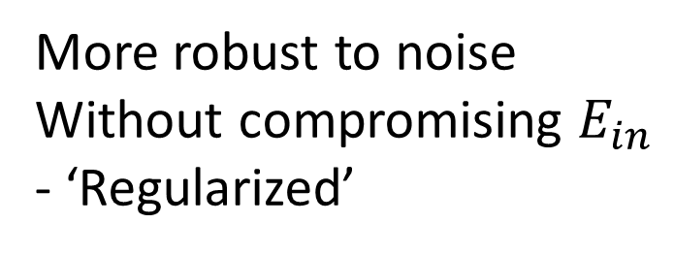
Robustness to Noisy Data
More robust to noise
Without compromising $E_{in}$
- ‘Regularized’
Margin of ‘safety’ w.r.t. measurement error of the data points

Slide 5
Robustness: The Cushion Around the Separator
Fat cushion
thickness =
distance to closest data point
margin
The amount of noise the separator can tolerate

Slide 6

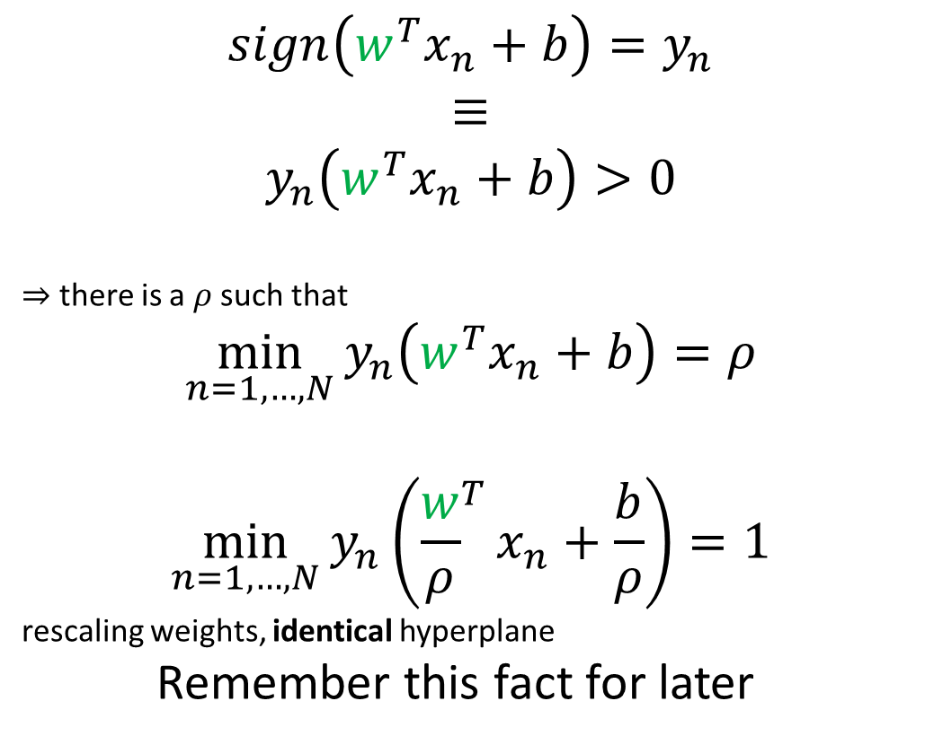


Separating Data
$$sign\left(w^{T}x_{n}+b\right)=y_{n}$$
$$≡$$
$$y_{n}\left(w^{T}x_{n}+b\right)>0$$
$⇒$ there is a $ρ$ such that
$$\min_{n=1,…,N}{y_{n}\left(w^{T}x_{n}+b\right)=ρ}$$
$$\min_{n=1,…,N}{y_{n}\left({\frac{w}{ρ}}^{T}x_{n}+\frac{b}{ρ}\right)=1}$$
rescaling weights, identical hyperplane
Remember this fact for later
+1
$$w^{T}x+b>0$$
always +ve
$$w^{T}x+b=0$$
$$w^{T}x+b<0$$
X
-1

Slide 7

Preview
Up next:
The thickness / margin of a separating hyperplane $γ(h)$

Slide 8
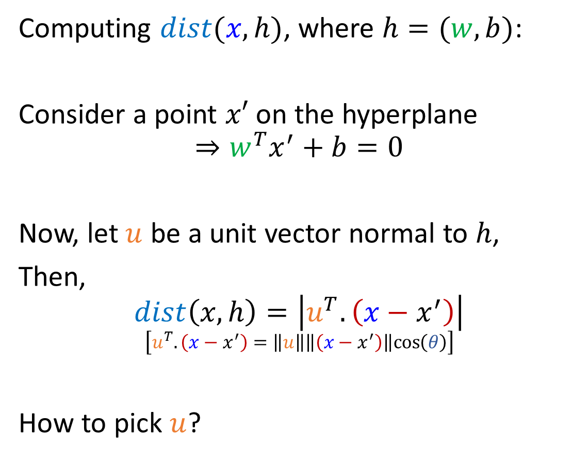




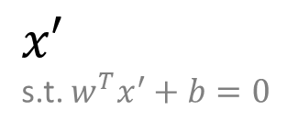
Distance between Data Point and Hyperplane
Computing $dist(x,h)$, where $h=(w,b)$:
Consider a point $x′$ on the hyperplane
$$⇒w^{T}x^{′}+b=0$$
Now, let $u$ be a unit vector normal to $h$,
Then,
$$dist\left(x,h\right)=\left|u^{T}.\left(x−x^{′}\right)\right|$$
$$\left[u^{T}.\left(x−x^{′}\right)=\left\|u\right\|\left\|\left(x−x^{′}\right)\right\|cos\left(θ\right)\right]$$
How to pick $u$?
$$x$$
$$θ$$
$$h=(w,b)$$
$$u$$
$x′$
s.t. $w^{T}x^{′}+b=0$

Slide 9
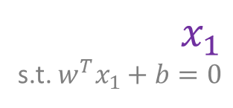


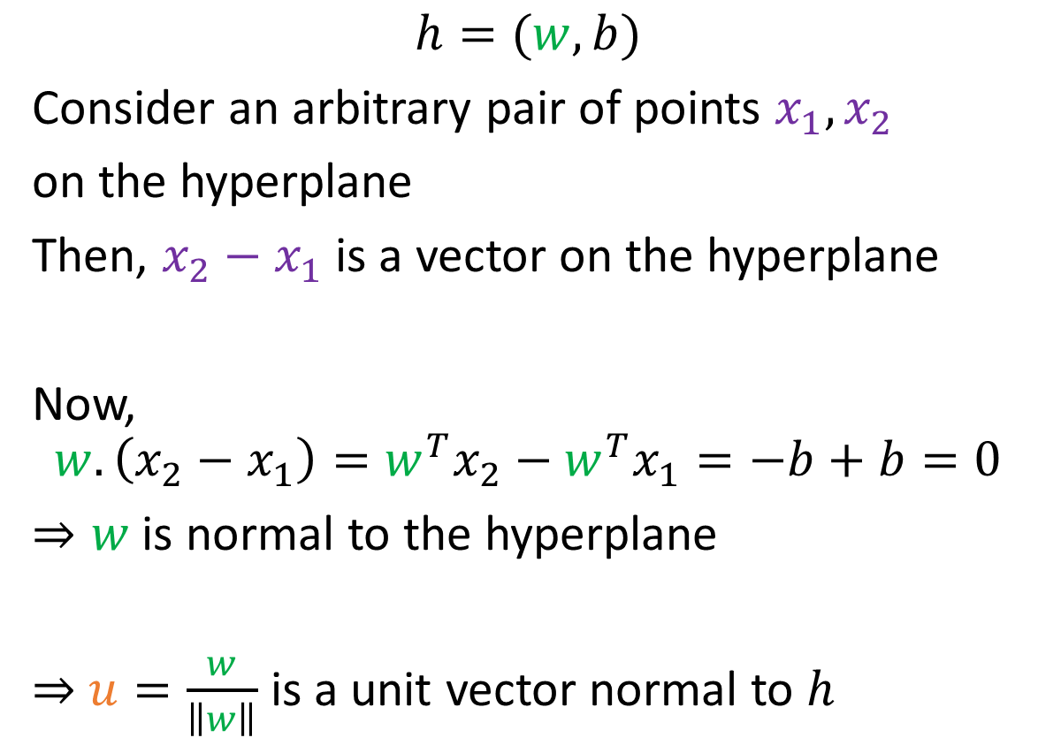
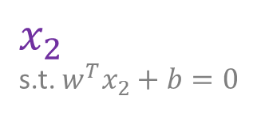


Distance between Data Point and Hyperplane
$$h=(w,b)$$
Consider an arbitrary pair of points $x_{1}, x_{2}$
on the hyperplane
Then, $x_{2}−x_{1}$ is a vector on the hyperplane
Now,
$$w.\left(x_{2}−x_{1}\right)=w^{T}x_{2}−w^{T}x_{1}=−b+b=0$$
$⇒w$ is normal to the hyperplane
$⇒$ $u=\frac{w}{\left\|w\right\|}$ is a unit vector normal to $h$
$$x$$
$$w$$
$$u$$
$x_{2}$
s.t. $w^{T}x_{2}+b=0$
$x_{1}$
s.t. $w^{T}x_{1}+b=0$
$$x′$$

Slide 10
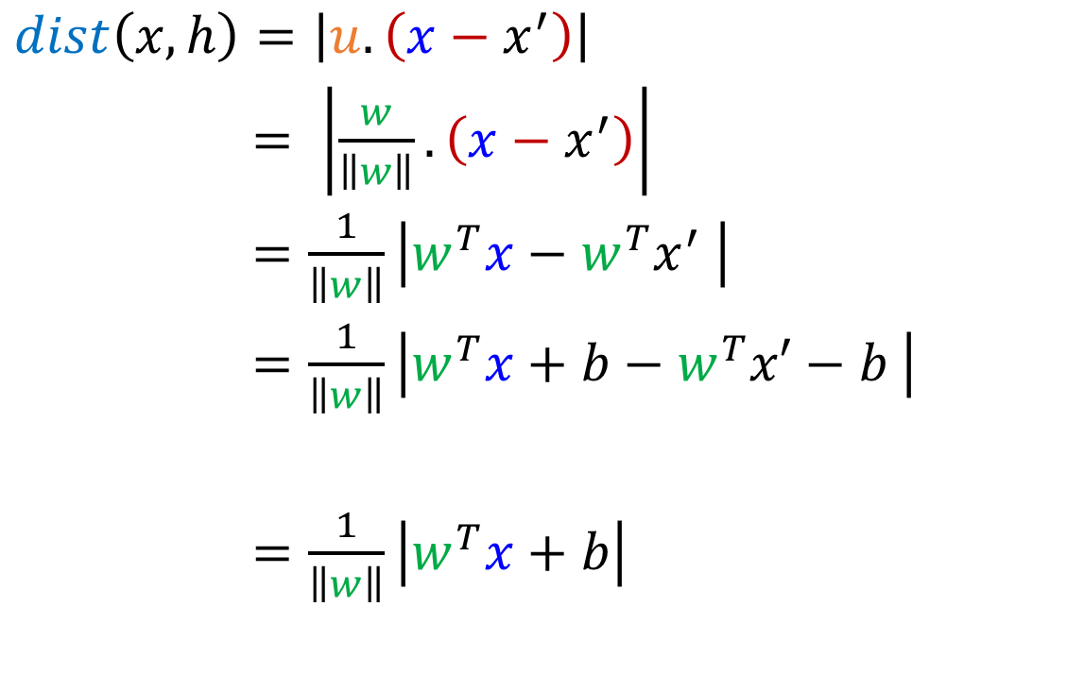
Distance between Data Point and Hyperplane
$$x$$
$dist\left(x,h\right)=\left|u.\left(x−x^{′}\right)\right|$
$= \left|\frac{w}{\left\|w\right\|}.\left(x−x^{′}\right)\right|$
$=\frac{1}{\left\|w\right\|}\left|w^{T}x−w^{T}x^{′} \right|$
$=\frac{1}{\left\|w\right\|}\left|w^{T}x+b−w^{T}x′−b \right|$
$=\frac{1}{\left\|w\right\|}\left|w^{T}x+b\right|$
$$θ$$
$$h=(w,b)$$
$$u$$
$x′$
s.t. $w^{T}x^{′}+b=0$
0

Slide 11
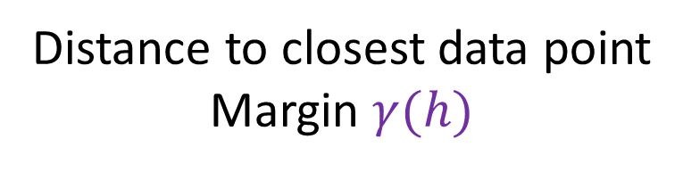
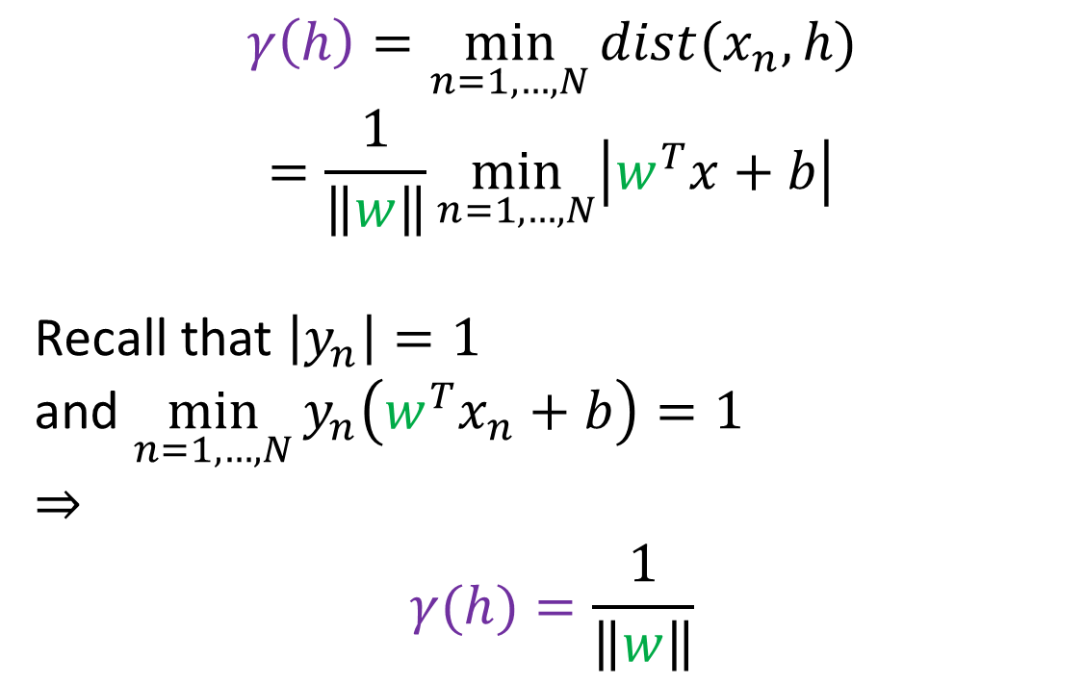
Fatness of a Separating Hyperplane
Distance to closest data point
Margin $γ(h)$
$$γ\left(h\right)=\min_{n=1,…,N}{dist(x_{n},h)}$$
$$=\frac{1}{\left\|w\right\|}\min_{n=1,…,N}\left|w^{T}x+b\right|$$
Recall that $\left|y_{n}\right|=1$
and $\min_{n=1,…,N}{y_{n}\left(w^{T}x_{n}+b\right)=1}$
$⇒$
$$γ(h)=\frac{1}{\left\|w\right\|}$$

Slide 12
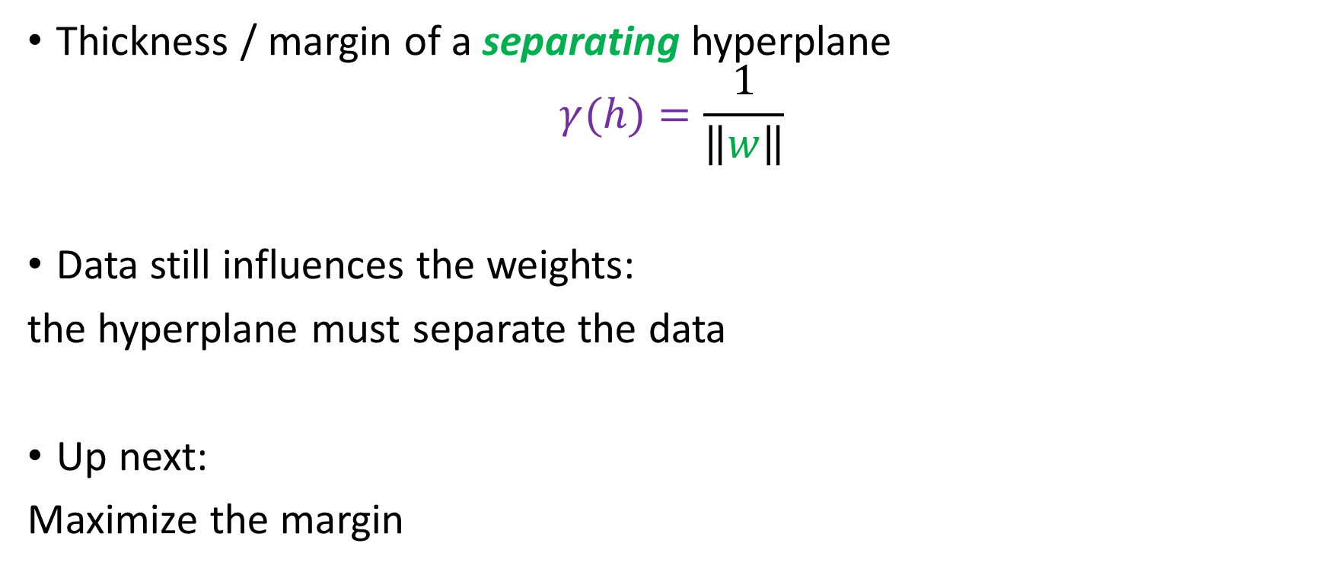
Recap
Thickness / margin of a separating hyperplane
$$γ(h)=\frac{1}{\left\|w\right\|}$$
Data still influences the weights:
the hyperplane must separate the data
Up next:
Maximize the margin

Slide 13



Maximizing the Margin
Margin:
$$γ\left(h\right)=\frac{1}{\left\|w\right\|}$$
Want: Maximum Margin $γ(h)$, i.e. Minimum $\left\|w\right\|$
$$minimize_{b,w} w^{T}w$$
$$subject to: \min_{n=1,…,N}{y_{n}\left(w^{T}x_{n}+b\right)=1}$$
$$\left[Maximize Margin\right]$$
$$\left[\begin{aligned}Hyperplane Must \\ Separate Data\end{aligned}\right]$$

Slide 14

Maximizing the Margin
$$minimize_{b,w} w^{T}w$$
$$subject to: \min_{n=1,…,N}{y_{n}\left(w^{T}x_{n}+b\right)=1}$$
Is equivalent to:
$$minimize_{b,w} w^{T}w$$
$$subject to: y_{n}\left(w^{T}x_{n}+b\right)≥1$$
A quadratic program (QP)

Slide 15
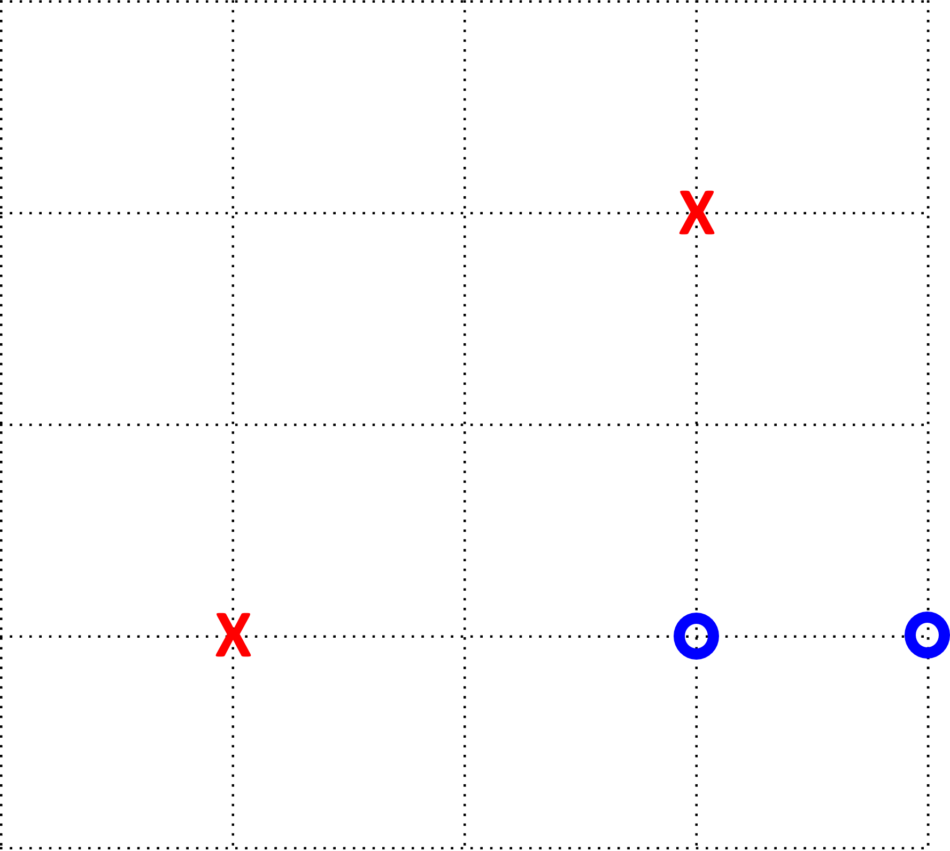

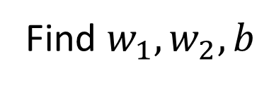
An Example
$$X=\left[\begin{aligned}0 0 \\ 2 2 \\ 2 0 \\ 3 0\end{aligned}\right], y=\left[\begin{aligned}−1 \\ −1 \\ +1 \\ +1\end{aligned}\right]$$
$$minimize_{b,w} w^{T}w$$
$$subject to: y_{n}\left(w^{T}x_{n}+b\right)≥1$$
Find $w_{1}, w_{2}, b$

Slide 16

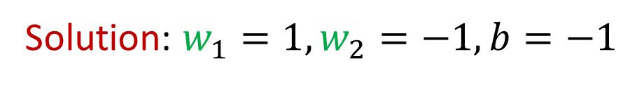
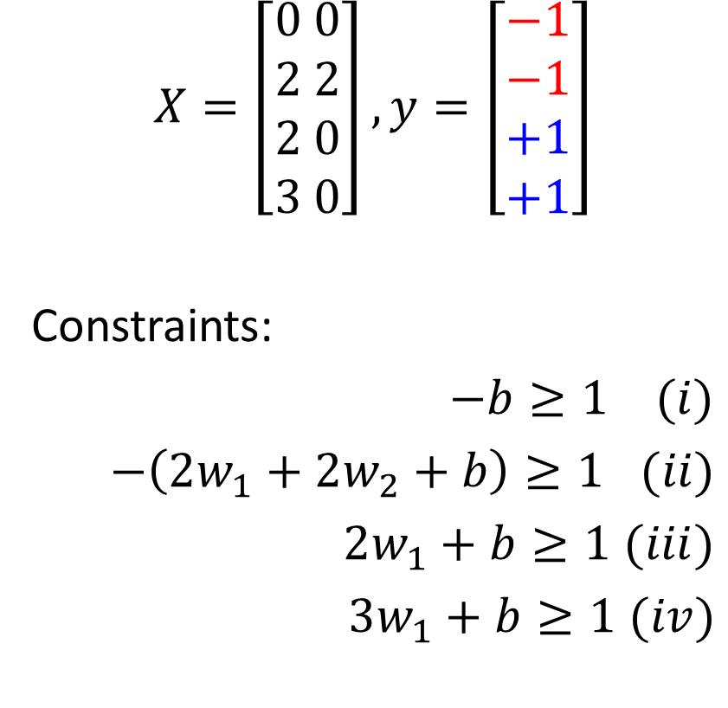
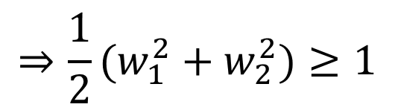
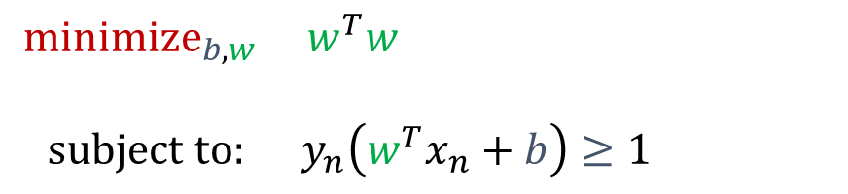

An Example
$$X=\left[\begin{aligned}0 0 \\ 2 2 \\ 2 0 \\ 3 0\end{aligned}\right], y=\left[\begin{aligned}−1 \\ −1 \\ +1 \\ +1\end{aligned}\right]$$
Constraints:
$−b≥1$ $(i)$
$−\left(2w_{1}+2w_{2}+b\right)≥1$ $(ii)$
$2w_{1}+b≥1$ $(iii)$
$3w_{1}+b≥1$ $(iv)$
$$minimize_{b,w} w^{T}w$$
$$subject to: y_{n}\left(w^{T}x_{n}+b\right)≥1$$
$$⇒w_{1}≥1$$
$$⇒\frac{1}{2}(w_{1}^{2}+w_{2}^{2})≥1$$
$$⇒w_{2}≤−1$$
Solution: $w_{1}=1, w_{2}=−1,b=−1$

Slide 17
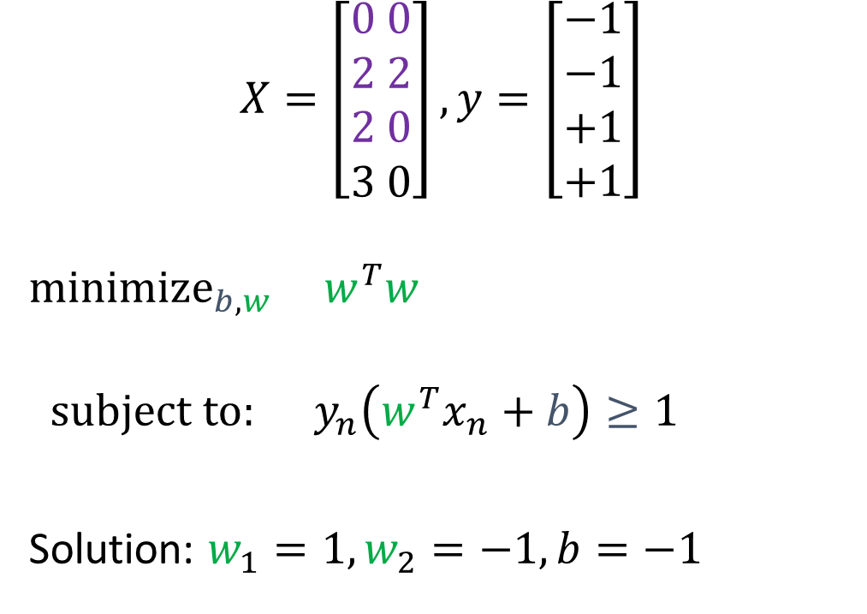

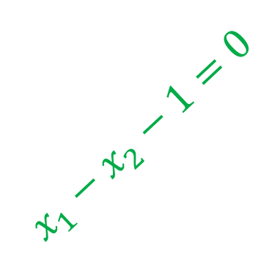
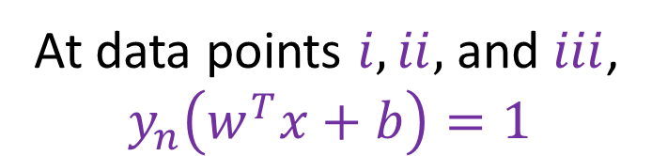
An Example
At data points $i, ii,$and $iii$,
$$y_{n}\left(w^{T}x+b\right)=1$$
margin$=\frac{1}{\sqrt{2}}=0.707$
$$X=\left[\begin{aligned}0 0 \\ 2 2 \\ 2 0 \\ 3 0\end{aligned}\right], y=\left[\begin{aligned}−1 \\ −1 \\ +1 \\ +1\end{aligned}\right]$$
$$minimize_{b,w} w^{T}w$$
$$subject to: y_{n}\left(w^{T}x_{n}+b\right)≥1$$
Solution: $w_{1}=1, w_{2}=−1,b=−1$
support vectors
$$x_{1}−x_{2}−1=0$$

Slide 18
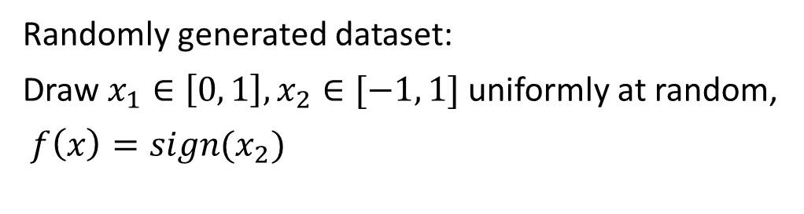
SVM vs. PLA
Randomly generated dataset:
Draw $x_{1}∈\left[0, 1\right], x_{2}∈[−1, 1]$ uniformly at random,
$f\left(x\right)=sign(x_{2})$

Slide 19


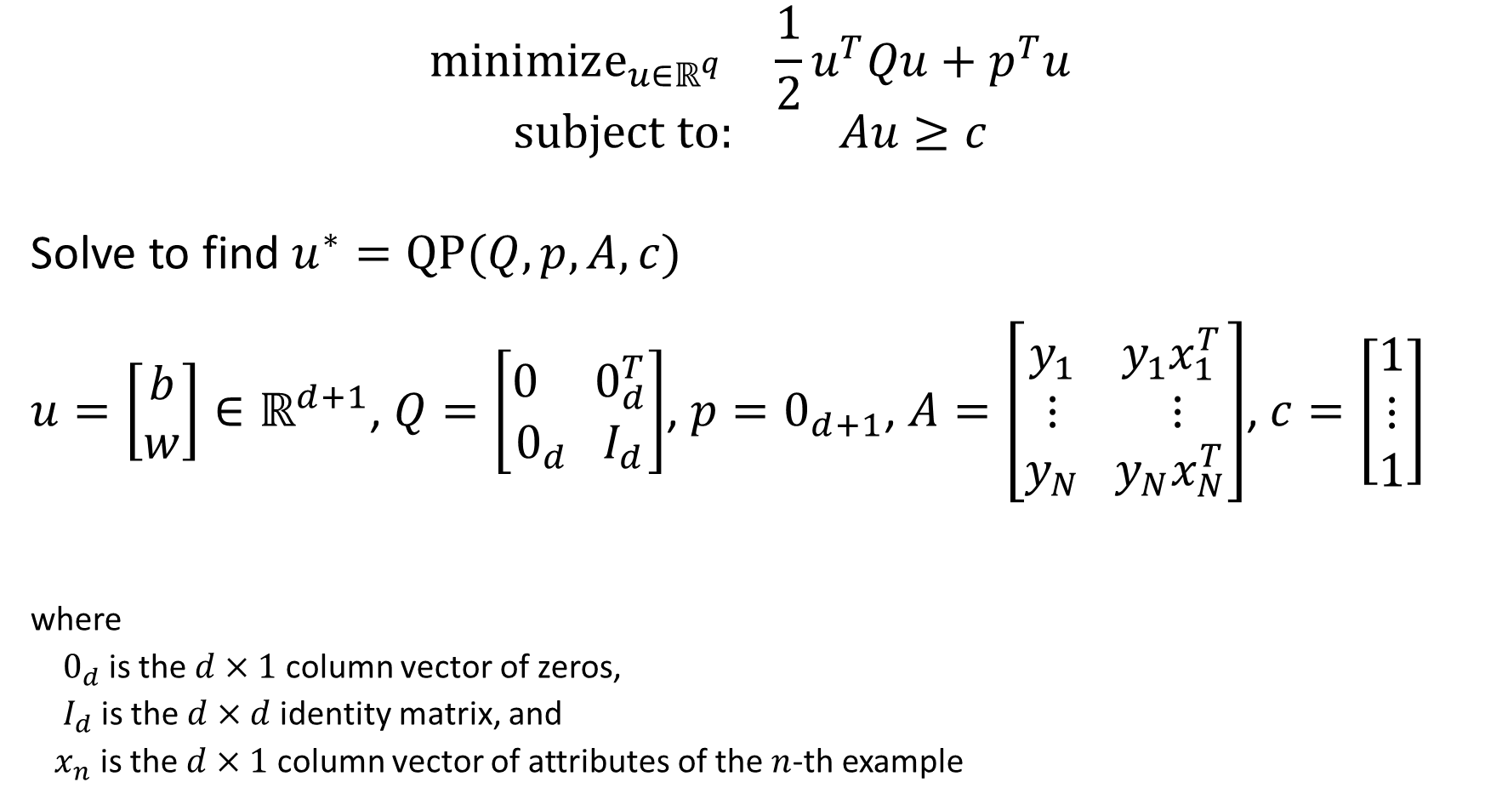



Quadratic Programming
$$minimize_{u∈ℝ^{q}} \frac{1}{2}u^{T}Qu+p^{T}u$$
$$subject to: Au≥c$$
Solve to find $u^{∗}=QP(Q,p,A,c)$
$u=\left[\begin{aligned}b \\ w\end{aligned}\right]∈ℝ^{d+1}$, $Q=\left[\begin{aligned}0 0_{d}^{T} \\ 0_{d} I_{d}\end{aligned}\right]$, $p=0_{d+1}$, $A=\left[\begin{aligned}y_{1} y_{1}x_{1}^{T} \\ ⋮ ⋮ \\ y_{N} y_{N}x_{N}^{T}\end{aligned}\right]$, $c=\left[\begin{aligned}1 \\ ⋮ \\ 1\end{aligned}\right]$
where
$0_{d}$ is the $d×1$ column vector of zeros,
$I_{d}$ is the $d×d$ identity matrix, and
$x_{n}$ is the $d×1$ column vector of attributes of the $n$-th example
$$(d+1)×1$$
$$(d+1)×(d+1)$$
$$(d+1)×1$$
$$N×(d+1)$$
$$N×1$$

Slide 20
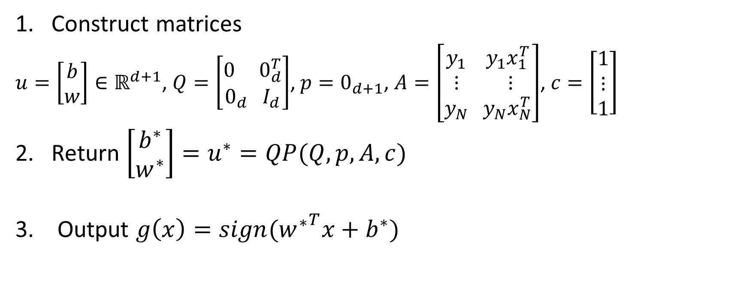
Primal QP Algorithm for Linear SVMs
Construct matrices
$u=\left[\begin{aligned}b \\ w\end{aligned}\right]∈ℝ^{d+1}$, $Q=\left[\begin{aligned}0 0_{d}^{T} \\ 0_{d} I_{d}\end{aligned}\right]$, $p=0_{d+1}$, $A=\left[\begin{aligned}y_{1} y_{1}x_{1}^{T} \\ ⋮ ⋮ \\ y_{N} y_{N}x_{N}^{T}\end{aligned}\right]$, $c=\left[\begin{aligned}1 \\ ⋮ \\ 1\end{aligned}\right]$
2. Return $\left[\begin{aligned}b^{∗} \\ w^{∗}\end{aligned}\right]=u^{∗}=QP(Q,p,A,c)$
3. Output $g\left(x\right)=sign({w^{∗}}^{T}x+b^{∗})$

Slide 21
Why SVMs? Are Larger Margins Better?

Slide 22
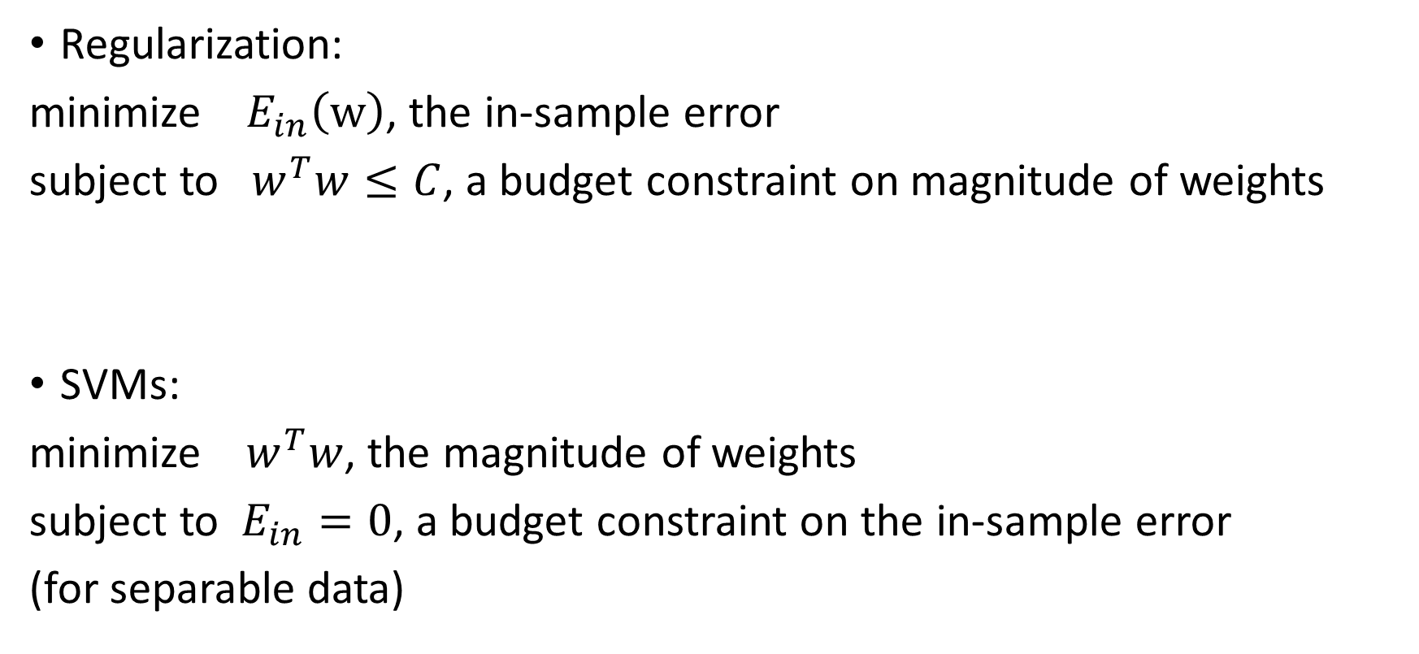
Link to Regularization – Fit Data with Small Weights (Simple Hypothesis)
Regularization:
minimize $E_{in}\left(w\right)$, the in-sample error
subject to $w^{T}w≤C$, a budget constraint on magnitude of weights
SVMs:
minimize $w^{T}w$, the magnitude of weights
subject to $E_{in}=0$, a budget constraint on the in-sample error
(for separable data)
weight decay regularization is ‘automatic’

Slide 23
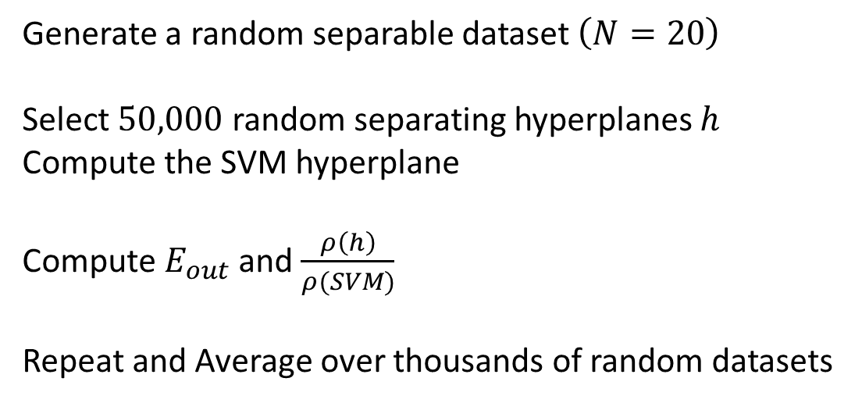

#1: Larger Margin is Better – Empirical Evidence
Generate a random separable dataset $\left(N=20\right)$
Select $50,000$ random separating hyperplanes $h$
Compute the SVM hyperplane
Compute $E_{out}$ and $\frac{ρ\left(h\right)}{ρ(SVM)}$
Repeat and Average over thousands of random datasets
y
Larger Margin is Better in General
… up to a point
Thickest Margin is Not Best (but close)
x
Larger margin
How frequently $ρ(h)/ρ\left(SVM\right)$ is x

Slide 24
#2: Fatter Hyperplanes Shatter Fewer Points - VC Analysis
Thin hyperplanes can implement more dichotomies:
Zero Thickness
Can implement all 8 dichotomies
(just flip the colors)

Slide 25

#2: Fatter Hyperplanes Shatter Fewer Points - VC Analysis
Thick hyperplanes can implement fewer dichotomies:
$ρ$ Thickness
Can implement only 4 dichotomies
(just flip the colors)

Slide 26


#2: Fatter Hyperplanes Shatter Fewer Points - VC Analysis
Theorem: If the input space is the ball of radius $R$ in $ℝ^{d}$
$$d_{VC}\left(γ\right)≤\left\lceil \frac{R^{2}}{γ^{2}}\right\rceil +1$$
Smaller the VC dimension $d_{VC}$,
The closer $E_{out}$ is to $E_{in}$ with high probability
$γ$ is margin of the hyperplanes

Slide 27
Non-Separable Data
Two Strategies we’ve used before:
Tolerate errors
Nonlinear transforms

Slide 28



Recall: Maximizing the Margin
$$minimize_{b,w} w^{T}w$$
$$subject to: y_{n}\left(w^{T}x_{n}+b\right)≥1$$
$$\left[Maximize Margin\right]$$
$$\left[\begin{aligned}Hyperplane Must \\ Separate Data\end{aligned}\right]$$

Slide 29
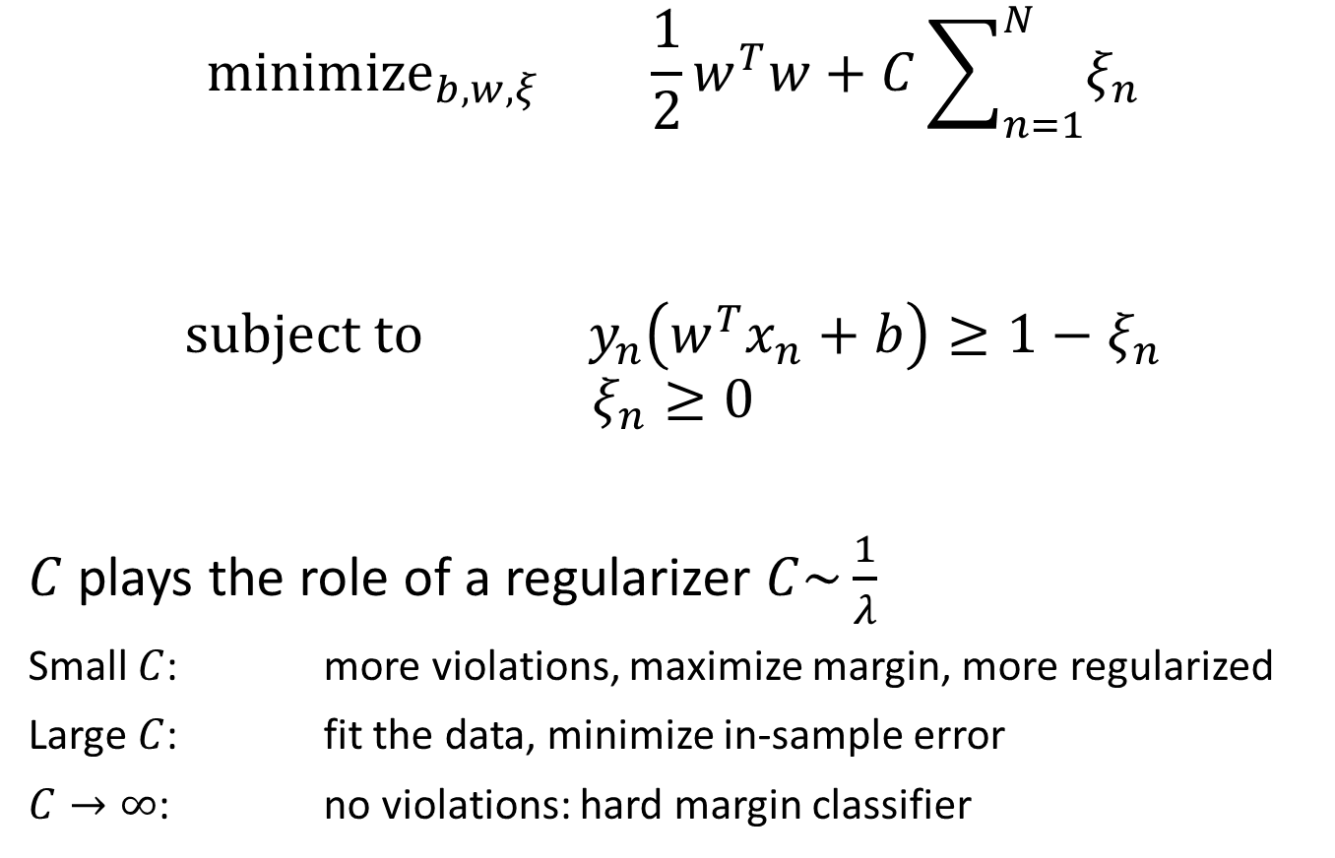
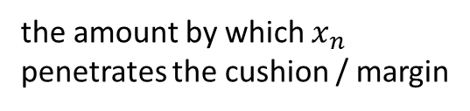
Strategy 1. Soft Margin SVM: Tolerate Errors
$${minimize}_{b,w,ξ} \frac{1}{2}w^{T}w+C\sum_{n=1}^{N}{ξ_{n}}$$
$$subject to y_{n}\left(w^{T}x_{n}+b\right)≥1−ξ_{n}$$
$$ξ_{n}≥0$$
$C$ plays the role of a regularizer $C\sim \frac{1}{λ}$
Small $C$: more violations, maximize margin, more regularized
Large $C$: fit the data, minimize in-sample error
$C→∞$: no violations: hard margin classifier
the amount by which $x_{n}$
penetrates the cushion / margin
Tolerate errors

Slide 30
Strategy 1. Soft Margin SVM: Tolerate Errors

Slide 31
Non-Separable Data
Two Strategies we’ve used before:
Tolerate errors
Nonlinear transforms

Slide 32
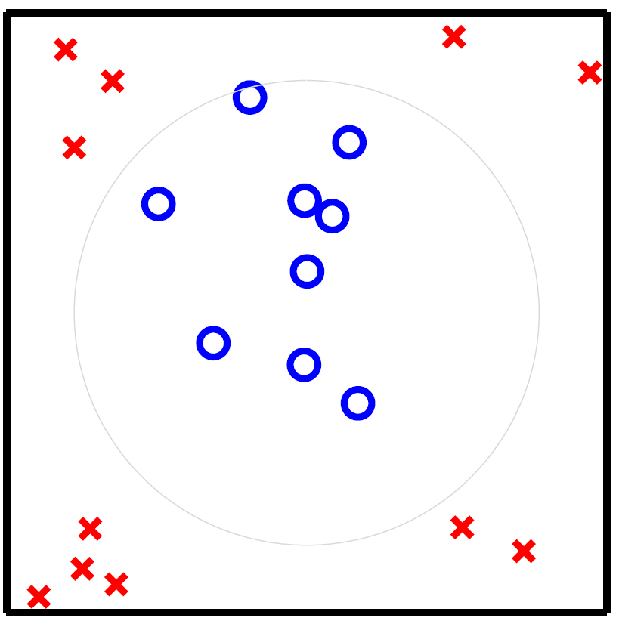
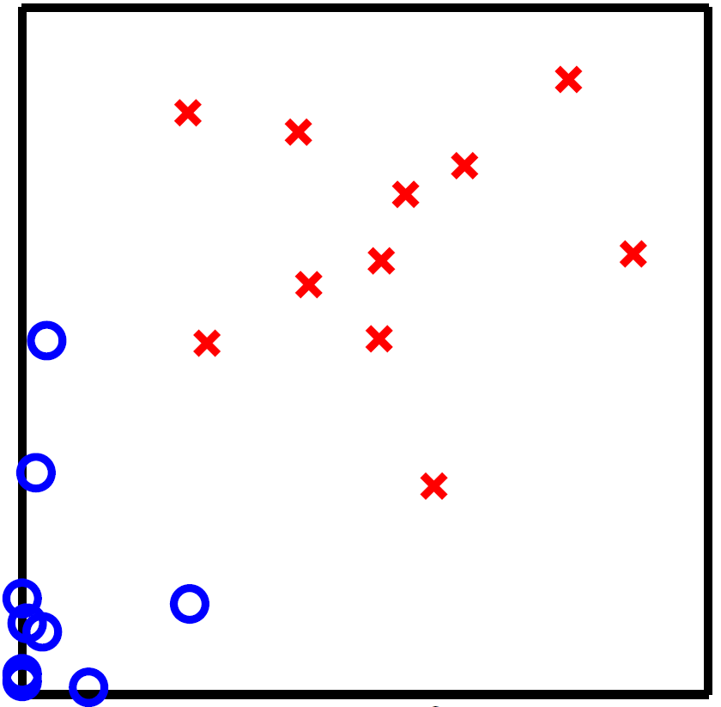
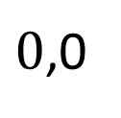

















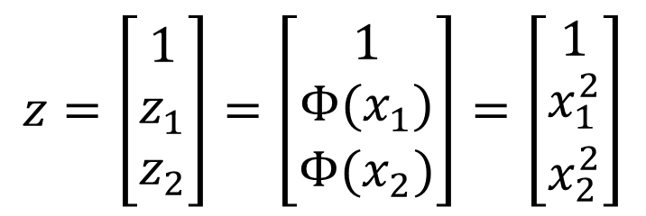
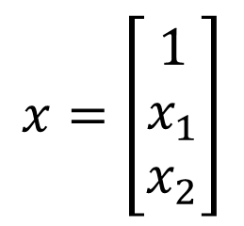





Mechanics of Non-Linear Feature Transforms
1. Original Data
$$𝒳$$
$$𝒵$$
2. Transform the Data
$$Φ$$
$$x_{2}$$
$$z_{2}=x_{2}^{2}$$
$0$,0
$$sign(w^{T}z)$$
$$Φ^{−1}$$
$$x_{1}$$
4. Classify in $𝒳$-space
$$z_{1}=x_{1}^{2}$$
3. ‘Fit’ data in $𝒵$-space
$$z=\left[\begin{aligned}1 \\ z_{1} \\ z_{2}\end{aligned}\right]=\left[\begin{aligned}1 \\ Φ(x_{1}) \\ Φ(x_{2})\end{aligned}\right]=\left[\begin{aligned}1 \\ x_{1}^{2} \\ x_{2}^{2}\end{aligned}\right]$$
$$x=\left[\begin{aligned}1 \\ x_{1} \\ x_{2}\end{aligned}\right]$$
$$Φ$$

Slide 33
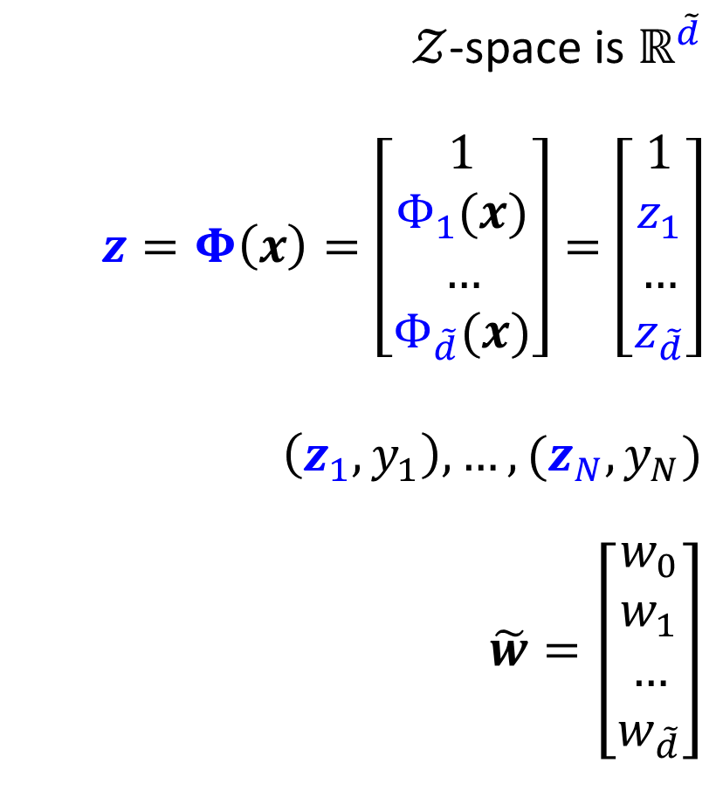
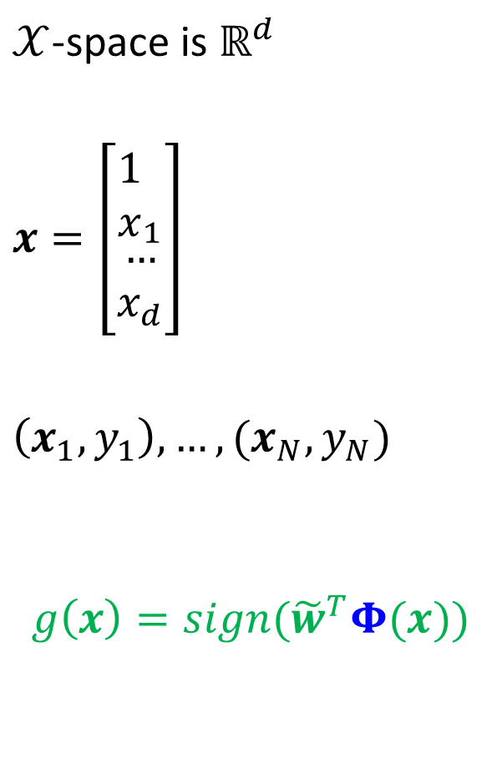
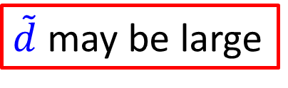
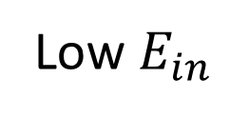
Feature Transforms In General
$𝒳$-space is $ℝ^{d}$
$x=\left[\begin{aligned}{\begin{aligned}1 \\ x\end{aligned}}_{1} \\ … \\ x_{d}\end{aligned}\right]$
$\left(x_{1},y_{1}\right),…,(x_{N},y_{N})$
$$g\left(x\right)=sign({\tilde{w}}^{T}Φ(x))$$
$𝒵$-space is $ℝ^{\tilde{d}}$
$z=Φ\left(x\right)=\left[\begin{aligned}1 \\ Φ_{1}(x) \\ … \\ Φ_{\tilde{d}}(x)\end{aligned}\right]=\left[\begin{aligned}1 \\ z_{1} \\ … \\ z_{\tilde{d}}\end{aligned}\right]$
$\left(z_{1},y_{1}\right),…,(z_{N},y_{N})$
$\tilde{w}=\left[\begin{aligned}w_{0} \\ w_{1} \\ … \\ w_{\tilde{d}}\end{aligned}\right]$
$\tilde{d}$ may be large
Low $E_{in}$

Slide 34
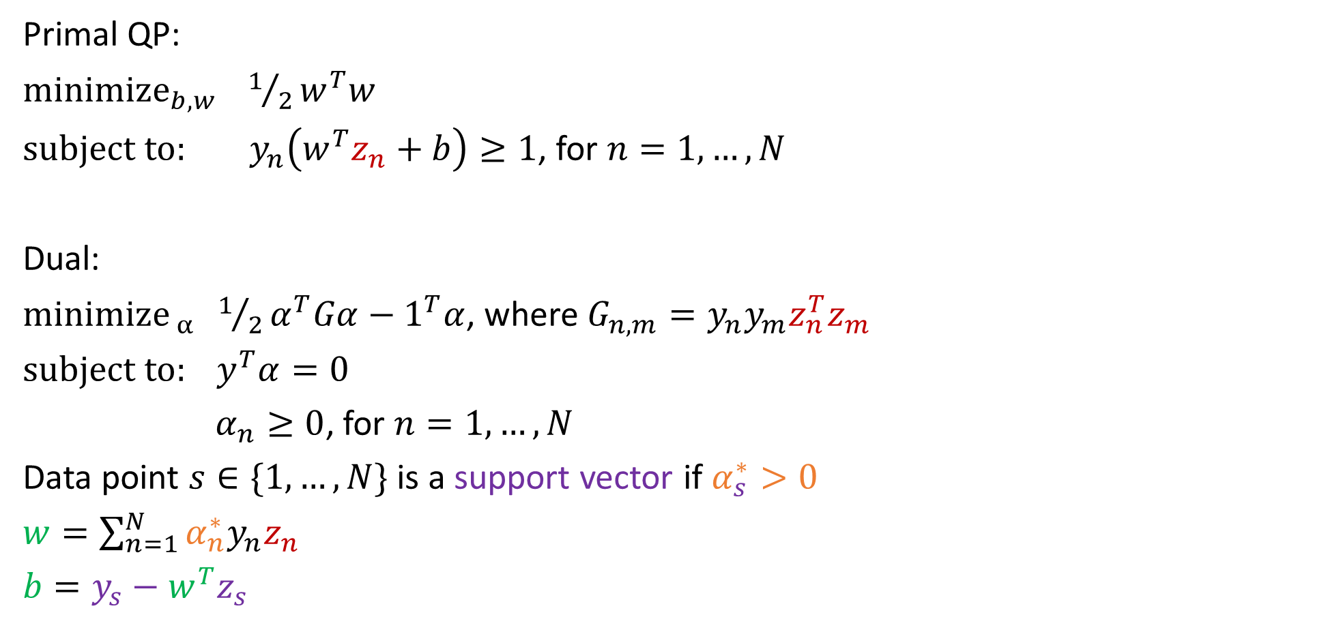
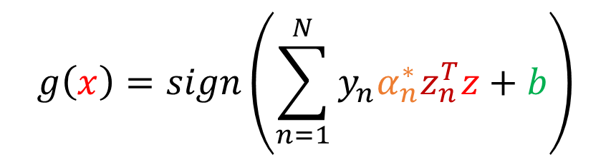



Hard Margin SVM: Nonlinear Transform
Primal QP:
${minimize}_{b,w} 1/2w^{T}w$
$subject to: y_{n}\left(w^{T}z_{n}+b\right)≥1$, for $n=1,…,N$
Dual:
$minimize_{ α} 1/2α^{T}Gα−1^{T}α$, where $G_{n,m}=y_{n}y_{m}z_{n}^{T}z_{m}$
$subject to: y^{T}α=0$
$α_{n}≥0$, for $n=1,…,N$
Data point $s∈\{1,…,N\}$ is a support vector if $α_{s}^{∗}>0$
$w=\sum_{n=1}^{N}{α_{n}^{∗}y_{n}z_{n}}$
$b=y_{s}−w^{T}z_{s}$
Solve
$$w,b$$
$$g\left(x\right)=sign(w^{T}z+b)$$
Solve
$$α_{n}^{∗}$$
$$g\left(x\right)=sign\left(\sum_{n=1}^{N}{y_{n}α_{n}^{∗}z_{n}^{T}z}+b\right)$$

Slide 35
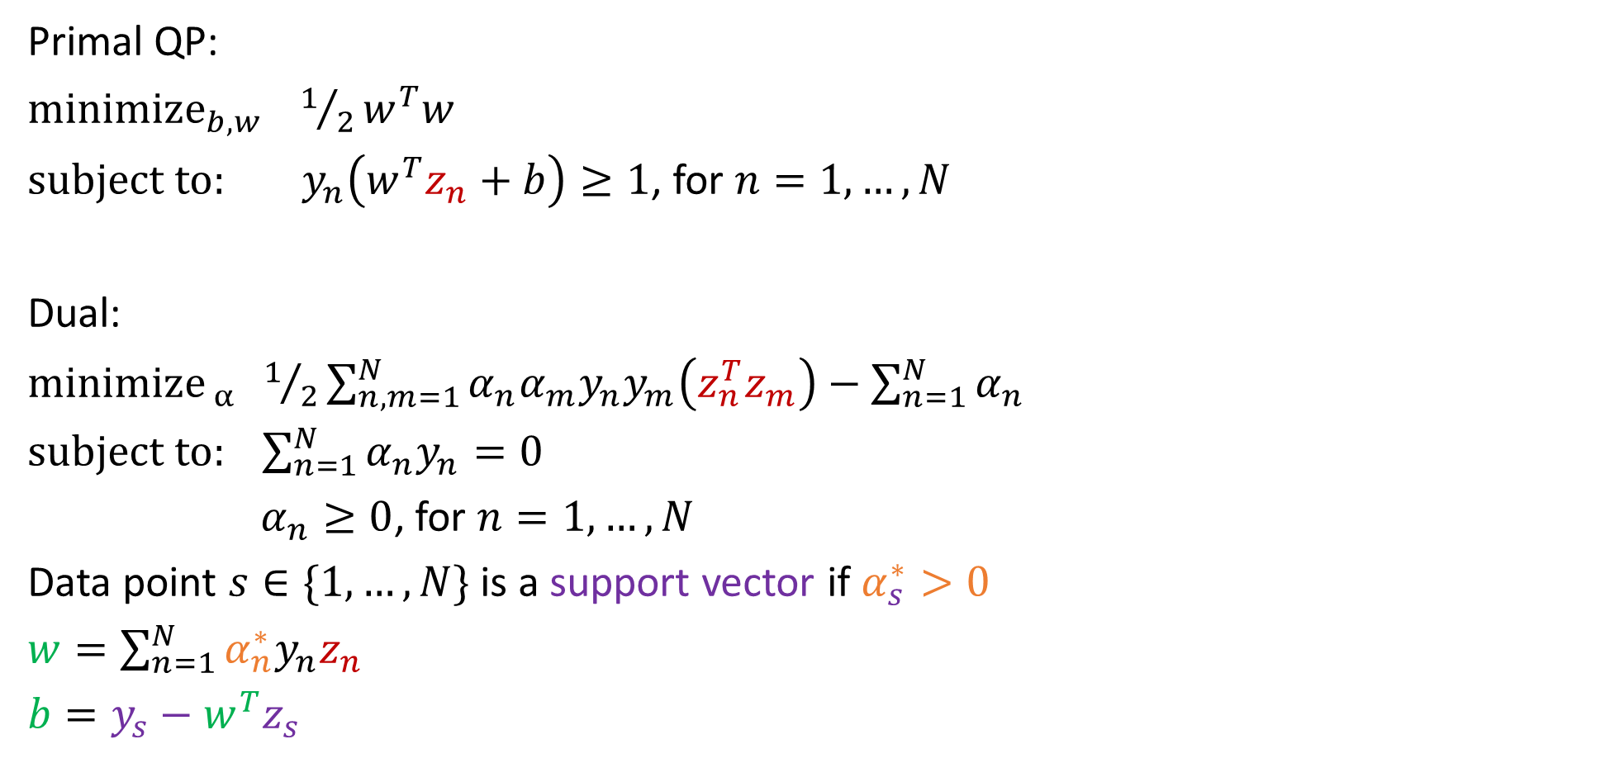

Hard Margin SVM: Nonlinear Transform
Primal QP:
${minimize}_{b,w} 1/2w^{T}w$
$subject to: y_{n}\left(w^{T}z_{n}+b\right)≥1$, for $n=1,…,N$
Dual:
$minimize_{ α} 1/2\sum_{n,m=1}^{N}{α_{n}α_{m}y_{n}y_{m}\left(z_{n}^{T}z_{m}\right)}−\sum_{n=1}^{N}{α_{n}}$
$subject to: \sum_{n=1}^{N}{α_{n}y_{n}=0}$
$α_{n}≥0$, for $n=1,…,N$
Data point $s∈\{1,…,N\}$ is a support vector if $α_{s}^{∗}>0$
$w=\sum_{n=1}^{N}{α_{n}^{∗}y_{n}z_{n}}$
$b=y_{s}−w^{T}z_{s}$
Solve
$$w,b$$
$$g\left(x\right)=sign(w^{T}z+b)$$
Solve
$$α_{n}^{∗}$$
$$g\left(x\right)=sign\left(\sum_{n=1}^{N}{y_{n}α_{n}^{∗}z_{n}^{T}z}+b\right)$$

Slide 36

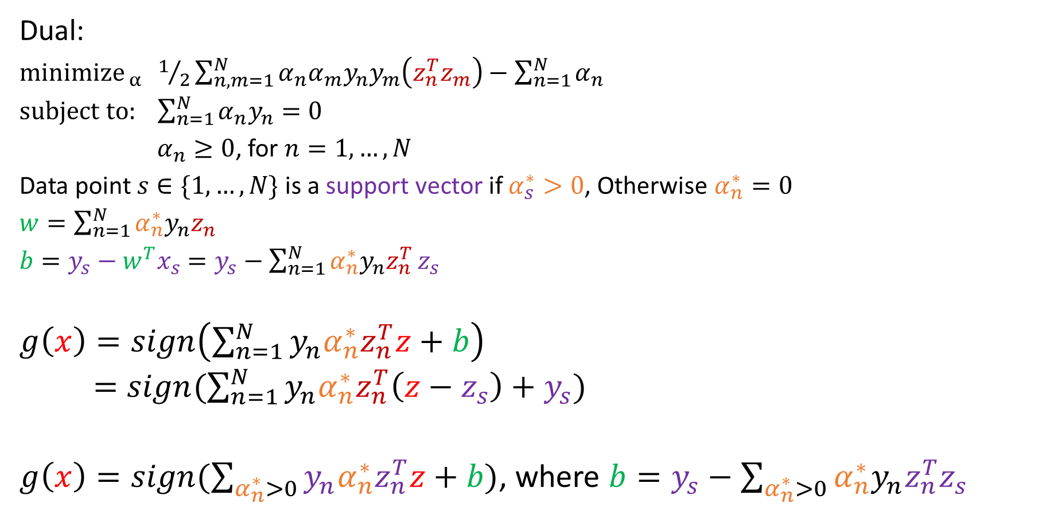
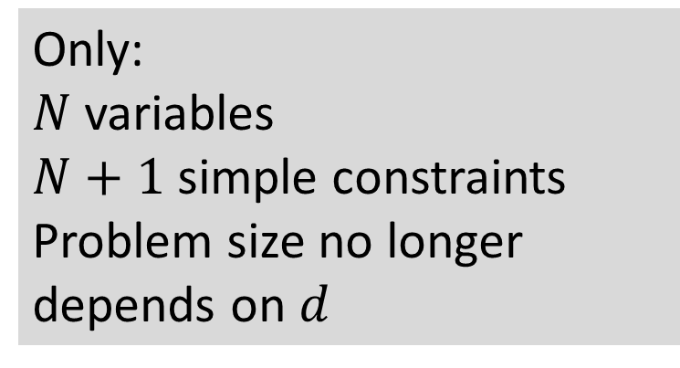
In terms of Support Vectors
need to compute this efficiently
Dual:
$minimize_{ α} 1/2\sum_{n,m=1}^{N}{α_{n}α_{m}y_{n}y_{m}\left(z_{n}^{T}z_{m}\right)}−\sum_{n=1}^{N}{α_{n}}$
$subject to: \sum_{n=1}^{N}{α_{n}y_{n}=0}$
$α_{n}≥0$, for $n=1,…,N$
Data point $s∈\{1,…,N\}$ is a support vector if $α_{s}^{∗}>0$, Otherwise $α_{n}^{∗}=0$
$w=\sum_{n=1}^{N}{α_{n}^{∗}y_{n}z_{n}}$
$b=y_{s}−w^{T}x_{s}$ $=y_{s}−\sum_{n=1}^{N}{α_{n}^{∗}y_{n}z_{n}^{T}}z_{s}$
$g\left(x\right)=sign\left(\sum_{n=1}^{N}{y_{n}α_{n}^{∗}z_{n}^{T}z}+b\right)$
$=sign(\sum_{n=1}^{N}{y_{n}α_{n}^{∗}z_{n}^{T}\left(z−z_{s}\right)}+y_{s})$
$g\left(x\right)=sign(\sum_{α_{n}^{∗}>0}{y_{n}α_{n}^{∗}z_{n}^{T}z}+b)$, where $b=y_{s}−\sum_{α_{n}^{∗}>0}{α_{n}^{∗}y_{n}z_{n}^{T}z_{s}}$
Solve
$$α_{n}^{∗}$$
Only:
$N$ variables
$N+1$ simple constraints
Problem size no longer depends on $d$

Slide 37
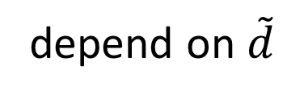
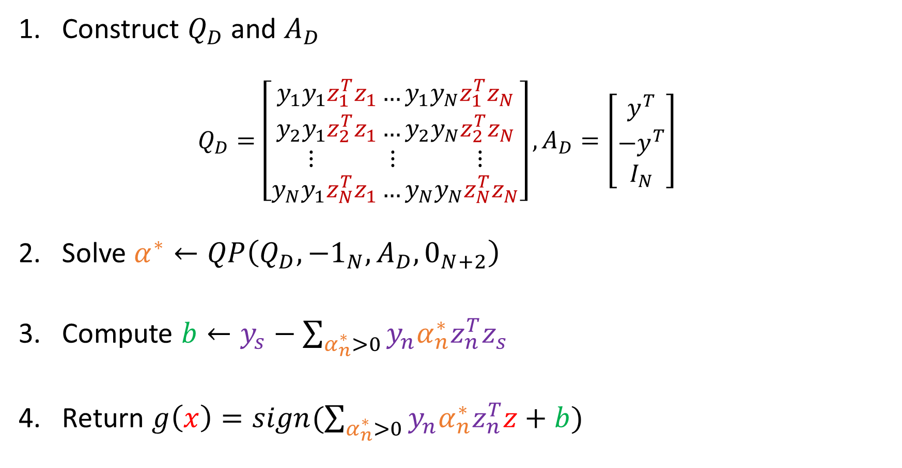
Hard Margin SVM with Dual QP: An inner product Algorithm
Construct $Q_{D}$ and $A_{D}$
$$Q_{D}=\left[\begin{aligned}y_{1}y_{1}z_{1}^{T}z_{1}…y_{1}y_{N}z_{1}^{T}z_{N} \\ y_{2}y_{1}z_{2}^{T}z_{1}…y_{2}y_{N}z_{2}^{T}z_{N} \\ ⋮ ⋮ ⋮ \\ y_{N}y_{1}z_{N}^{T}z_{1}…y_{N}y_{N}z_{N}^{T}z_{N}\end{aligned}\right], A_{D}=\left[\begin{aligned}y^{T} \\ −y^{T} \\ I_{N}\end{aligned}\right]$$
Solve $α^{∗}←QP\left(Q_{D},−1_{N},A_{D},0_{N+2}\right)$
Compute $b←y_{s}−\sum_{α_{n}^{∗}>0}{y_{n}α_{n}^{∗}z_{n}^{T}z_{s}}$
Return $g\left(x\right)=sign(\sum_{α_{n}^{∗}>0}{y_{n}α_{n}^{∗}z_{n}^{T}z}+b)$
depend on $\tilde{d}$

Slide 38


The Kernel Trick: Remove Dependence on $\tilde{d}$
Want to Use Nonlinear Transform $Φ$
Learn Linear Model in $𝒵$-space,
$g\left(x\right)=sign(\sum_{α_{n}^{∗}>0}{y_{n}α_{n}^{∗}z_{n}^{T}z}+b)$, where $z_{n}=Φ\left(x_{n}\right)$ and $z=Φ\left(x\right)$
Involves computing $Φ{\left(x\right)}^{T}Φ\left(x^{′}\right)=z^{T}z′$
depends on $\tilde{d}$, which may be large
Can we compute $z^{T}z′$ without visiting $𝒵$-space?
Kernel Function:
$$K\left(x,x^{′}\right)≡Φ{\left(x\right)}^{T}Φ\left(x^{′}\right)=z^{T}z′$$

Slide 39



The Kernel $K(⋅,⋅)$ for a Transform $Φ(⋅)$
$$Φ\left(x\right)=\left[\begin{aligned}x_{1} \\ x_{2} \\ x_{1}^{2} \\ \sqrt{2}x_{1}x_{2} \\ x_{2}^{2}\end{aligned}\right]$$
$$K\left(x,x^{′}\right)≡Φ{\left(x\right)}^{T}Φ\left(x^{′}\right)=z^{T}z′$$
Example: For the 2nd Order Polynomial Transform
$K\left(x,x^{′}\right)=Φ{\left(x\right)}^{T}Φ\left(x^{′}\right)=\left[\begin{aligned}x_{1} \\ x_{2} \\ x_{1}^{2} \\ \sqrt{2}x_{1}x_{2} \\ x_{2}^{2}\end{aligned}\right]⋅\left[\begin{aligned}{x^{′}}_{1} \\ {x^{′}}_{2} \\ {x^{′}}_{1}^{2} \\ \sqrt{2}{x^{′}}_{1}{x^{′}}_{2} \\ {x^{′}}_{2}^{2}\end{aligned}\right]$
$={\left(\frac{1}{2}+x^{T}x^{′}\right)}^{2}−\frac{1}{4}$

Slide 40


Infinite Dimensional Gaussian Kernel
$$Φ\left(x\right)=\left[\begin{aligned}\begin{aligned}e^{−x^{2}}\sqrt{\frac{2^{0}}{0!}} \\ e^{−x^{2}}\sqrt{\frac{2^{1}}{1!}}x\end{aligned} \\ e^{−x^{2}}\sqrt{\frac{2^{2}}{2!}}x^{2} \\ e^{−x^{2}}\sqrt{\frac{2^{3}}{3!}}x^{3} \\ ⋮\end{aligned}\right]$$
$$K\left(x,x^{′}\right)=e^{γ{\left\|x−x^{′}\right\|}^{2}}$$
Example: The Gaussian Kernel in 1 dimension
$$K\left(x,x^{′}\right)=Φ{\left(x\right)}^{T}Φ\left(x^{′}\right)=\left[\begin{aligned}e^{−x^{2}}\sqrt{\frac{2^{0}}{0!}} \\ e^{−x^{2}}\sqrt{\frac{2^{1}}{1!}}x \\ e^{−x^{2}}\sqrt{\frac{2^{2}}{2!}}x^{2} \\ ⋮\end{aligned}\right]⋅\left[\begin{aligned}e^{−{x^{′}}^{2}}\sqrt{\frac{2^{0}}{0!}} \\ e^{−{x^{′}}^{2}}\sqrt{\frac{2^{1}}{1!}}x^{′} \\ e^{−{x^{′}}^{2}}\sqrt{\frac{2^{2}}{2!}}{x^{′}}^{2} \\ ⋮\end{aligned}\right]$$
$$=e^{−x^{2}}e^{−x^{′2}}\sum_{i=0}^{∞}{\frac{{\left(2xx^{′}\right)}^{i}}{i!}}=e^{−{\left(x−x^{′}\right)}^{2}}$$

Slide 41


Kernel Trick Allows Us to Bypass $𝒵$-space
Construct $Q_{D}$ and $A_{D}$
$$Q_{D}=\left[\begin{aligned}y_{1}y_{1}K(x_{1}^{T}x_{1})…y_{1}y_{N}K(x_{1}^{T}x_{N}) \\ y_{2}y_{1}K(x_{2}^{T}x_{1})…y_{2}y_{N}K(x_{2}^{T}x_{N}) \\ ⋮ ⋮ ⋮ \\ y_{N}y_{1}K(x_{N}^{T}x_{1})…y_{N}y_{N}K(x_{N}^{T}x_{N})\end{aligned}\right], A_{D}=\left[\begin{aligned}y^{T} \\ −y^{T} \\ I_{N}\end{aligned}\right]$$
Solve $α^{∗}←QP\left(Q_{D},−1_{N},A_{D},0_{N+2}\right)$
Compute $b←y_{s}−\sum_{α_{n}^{∗}>0}{y_{n}α_{n}^{∗}K(x_{n},x_{s})}$
Return $g\left(x\right)=sign(\sum_{α_{n}^{∗}>0}{y_{n}α_{n}^{∗}K(x_{n},x)}+b)$

Slide 42
Quiz 5: Take Home Quiz
1. Using Scikit-learn to fit one SVM classifier for multi-label classification
(your dataset should have at least 100 samples)
2. Plot your decision boundary

