Slide 1
Lectures 21-22
CS436/536: Introduction to
Machine Learning
Zhaohan Xi
Binghamton University
^{zxi1@binghamton.edu}

Slide 2
Similarity and Nearest Neighbor
Based on e-Chapter available here
The password is the first word of the 4th chapter of the LFD textbook

Slide 3

Similarity
Measuring similarity:
Compute features
Given two data points $x$ and $x′$
$$d\left(x,x^{′}\right)=\left\|x−x′\right\|$$
e.g. Euclidean distance $d\left(x,x^{′}\right)={\left\|x−x^{′}\right\|}_{2}$

Slide 4

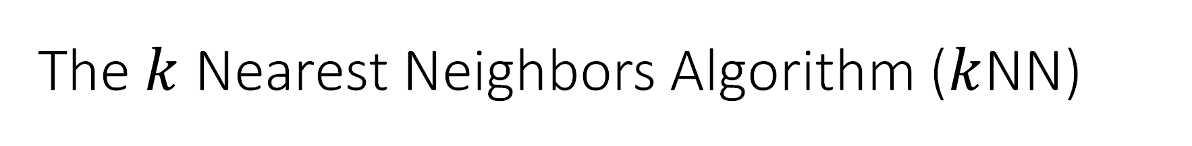
The $k$ Nearest Neighbors Algorithm ($k$NN)
Given a test data point $x$,
Classify it using $k$ of its nearest neighbors (in the training set)

Slide 5
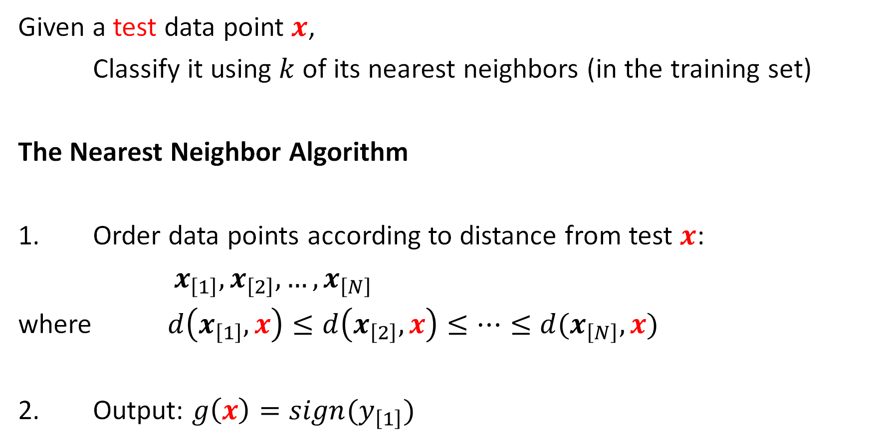
The $k$ Nearest Neighbors Algorithm ($k$NN)
Given a test data point $x$,
Classify it using $k$ of its nearest neighbors (in the training set)
The Nearest Neighbor Algorithm
1. Order data points according to distance from test $x$:
$x_{\left[1\right]}, x_{\left[2\right]}, …, x_{\left[N\right]}$
where $d\left(x_{\left[1\right]},x\right)≤d\left(x_{\left[2\right]},x\right)≤…≤d(x_{\left[N\right]},x)$
2. Output: $g\left(x\right)=sign(y_{\left[1\right]})$

Slide 6
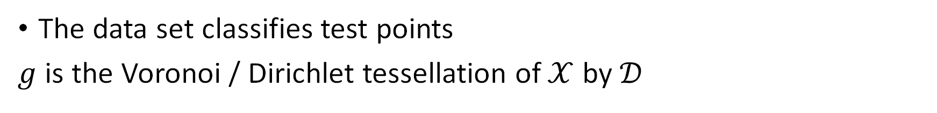

What is $g$? A geometric Interpretation
The data set classifies test points
$g$ is the Voronoi / Dirichlet tessellation of $𝒳$ by $𝒟$

Slide 7


What about $E_{out}$?
No Training Needed
$E_{in}=0$!
What is $ℋ$?
All possible Voronoi tessellations
Can perfectly fit every data set!
$d_{VC}=∞$
No link from $E_{in}$ to $E_{out}$
${\text{Theorem}\text{:} E}_{out}\left(g\right)≤2 E_{out}^{∗}$

Slide 8
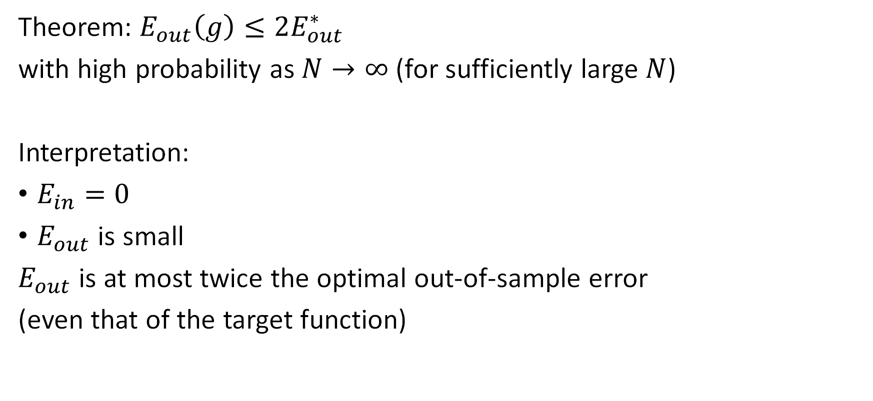

$$E_{out}\left(g\right)≤2E_{out}^{∗}$$
Theorem: $E_{out}\left(g\right)≤2E_{out}^{∗}$
with high probability as $N→∞$ (for sufficiently large $N$)
Interpretation:
$E_{in}=0$
$E_{out}$ is small
$E_{out}$ is at most twice the optimal out-of-sample error
(even that of the target function)

Slide 9


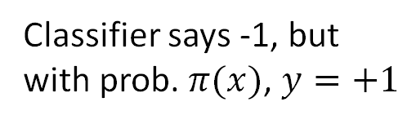
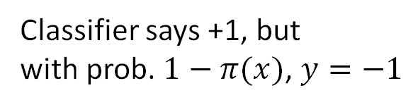
$$E_{out}\left(g\right)≤2E_{out}^{∗}$$
Target is $π\left(x\right)=P\left[y=+1 \right| x]$
Optimal Classifier:
+1 if $π\left(x\right)≥\frac{1}{2}$
-1 if $π\left(x\right)<\frac{1}{2}$
$E_{out}^{∗}\left(x\right)=\left\{\begin{aligned}1−π\left(x\right), if π\left(x\right)≥\frac{1}{2} \\ π\left(x\right), if π\left(x\right)<\frac{1}{2}\end{aligned}\right.$
Classifier says +1, but
with prob. $1−π(x)$, $y=−1$
Classifier says -1, but
with prob. $π(x)$, $y=+1$
out of sample error
for optimal classifier

Slide 10

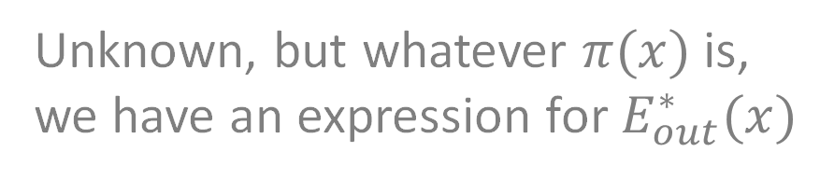
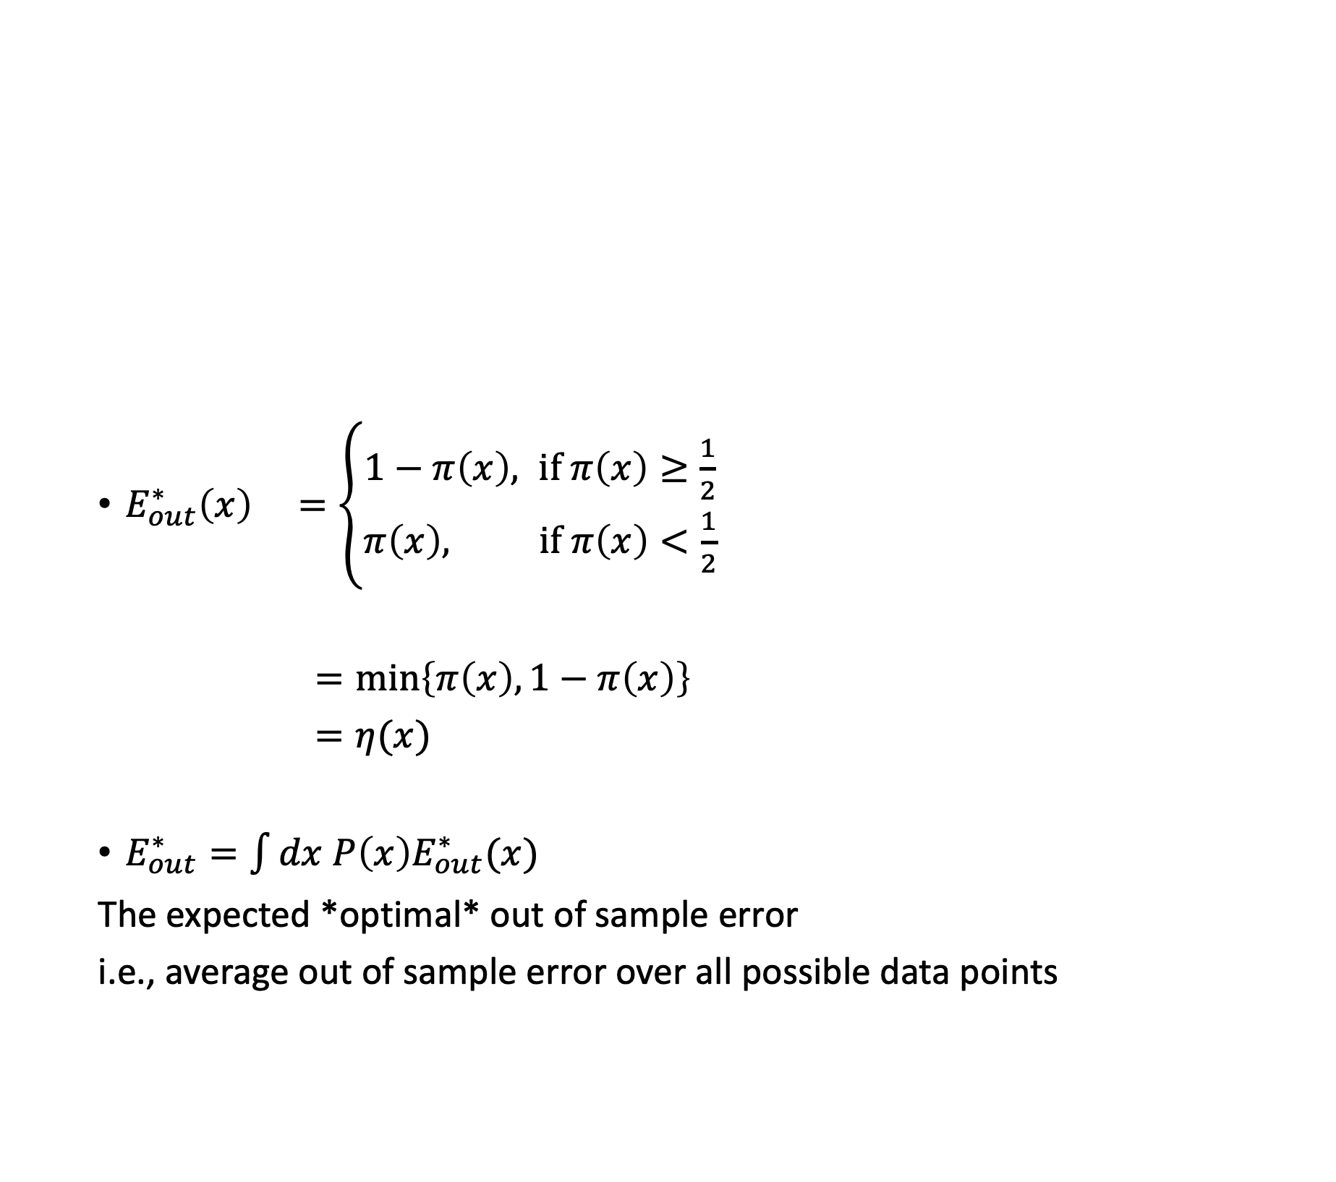
$$E_{out}^{∗}$$
$E_{out}^{∗}\left(x\right) =\left\{\begin{aligned}1−π\left(x\right), if π\left(x\right)≥\frac{1}{2} \\ π\left(x\right), if π\left(x\right)<\frac{1}{2}\end{aligned}\right.$
$=\min\left\{π\left(x\right), 1−π\left(x\right)\right\}$
$=η(x)$
$E_{out}^{∗}=\int{dx P\left(x\right)E_{out}^{∗}(x)}$
The expected *optimal* out of sample error
i.e., average out of sample error over all possible data points
Unknown, but whatever $π(x)$ is,
we have an expression for $E_{out}^{∗}(x)$

Slide 11

A few assumptions
[Property 1]: $π(x)$ is continuous
[Property 2]: for all $x$, as $N→∞$,
the nearest neighbor to $x$, $x_{\left[1\right]}→x$

Slide 12

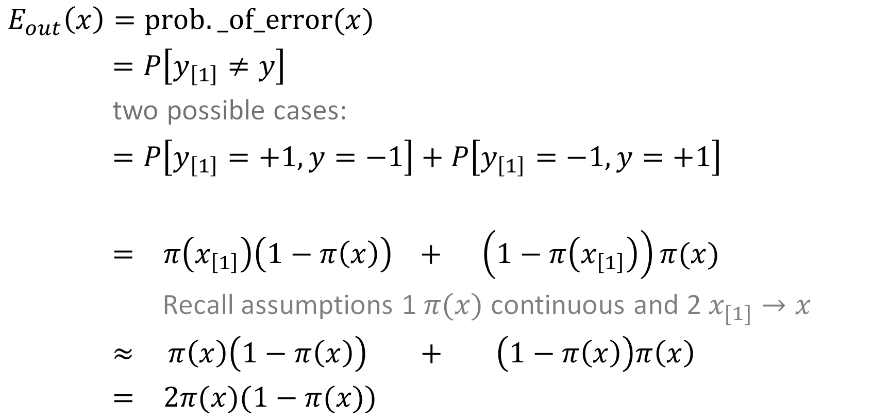

Out-of-sample Error of NN
$E_{out}\left(x\right)=prob._of_error(x)$
$=P\left[y_{\left[1\right]}≠y\right]$
two possible cases:
$=P\left[y_{\left[1\right]}=+1, y=−1\right]+P\left[y_{\left[1\right]}=−1, y=+1\right]$
$= π\left(x_{\left[1\right]}\right)\left(1−π\left(x\right)\right) + \left(1−π\left(x_{\left[1\right]}\right)\right)π(x)$
Recall assumptions 1 $π(x)$ continuous and 2 $x_{[1]}→x$
$≈$ $π\left(x\right)\left(1−π\left(x\right)\right) + \left(1−π\left(x\right)\right)π\left(x\right)$
$= 2π(x)(1−π(x))$
Law of total probability
as $x_{[1]}→x, π\left(x_{\left[1\right]}\right)→π(x)$
$$≤2η\left(x\right) = 2E_{out}^{∗}$$

Slide 13


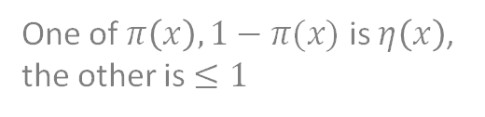
$$E_{out}\left(g\right)≤2E_{out}^{∗}$$
One of $π\left(x\right), 1−π(x)$ is $η\left(x\right)$, the other is $≤1$
$E_{out}(x)≈2π\left(x\right)\left(1−π\left(x\right)\right)$
$≤2\min\left\{π\left(x\right),1−π\left(x\right)\right\}={2E}_{out}^{∗}\left(x\right)$
When $E_{out}^{∗}→\frac{1}{2}$, $E_{out}→E_{out}^{∗}$, the bound is loose
The bound gets saturated as $E_{out}^{∗}→0$

Slide 14
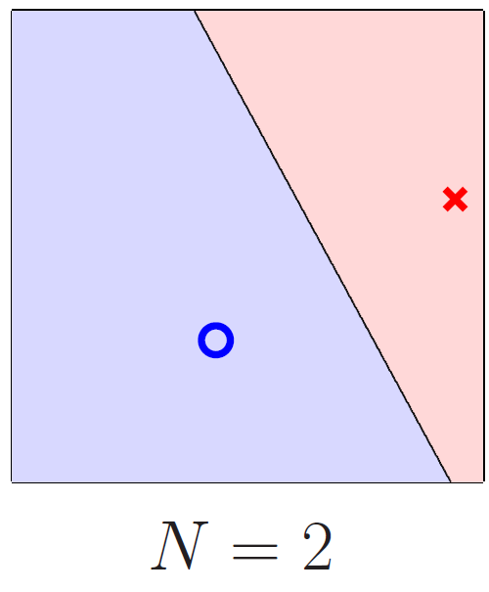
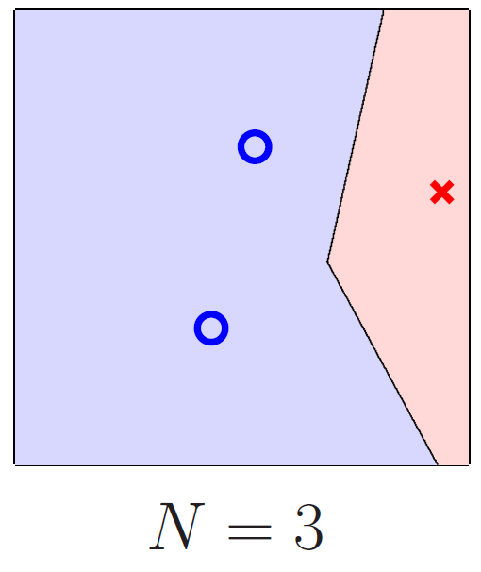
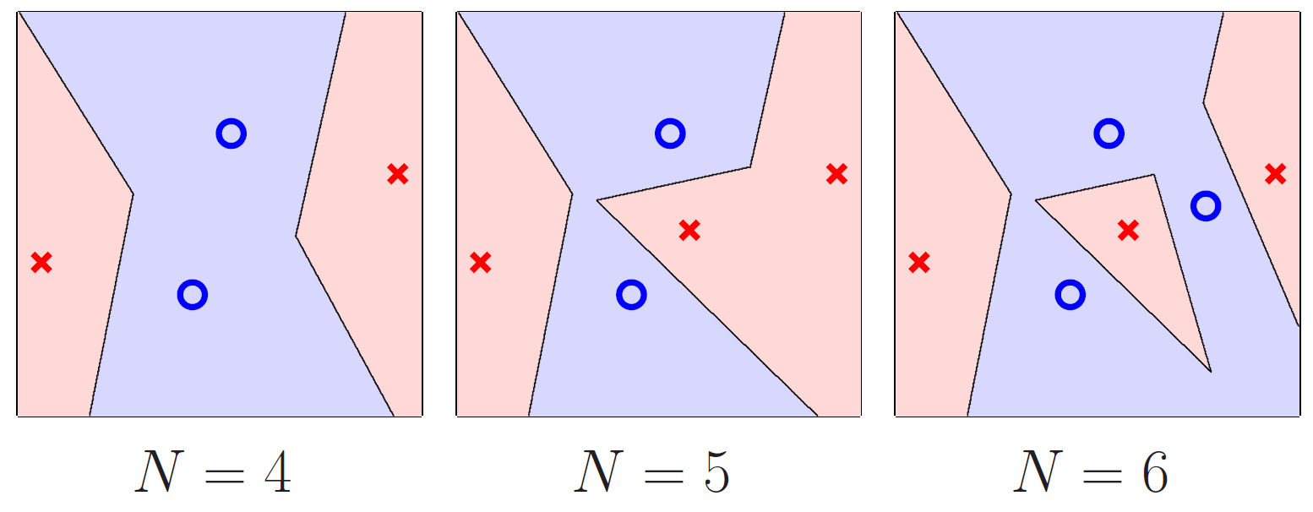

Does it Overfit?
No link from $E_{in}$ to $E_{out}$
The Nearest Neighbor algorithm is ‘self-regularizing’
The classifier only becomes more complex with more data points

Slide 15



The $k$ Nearest Neighbor Algorithm
$$g\left(x\right)=sign\left(\sum_{i=1}^{k}{y_{\left[i\right]}\left(x\right)}\right)$$
$k$ is odd, $y_{n}=±1$

Slide 16
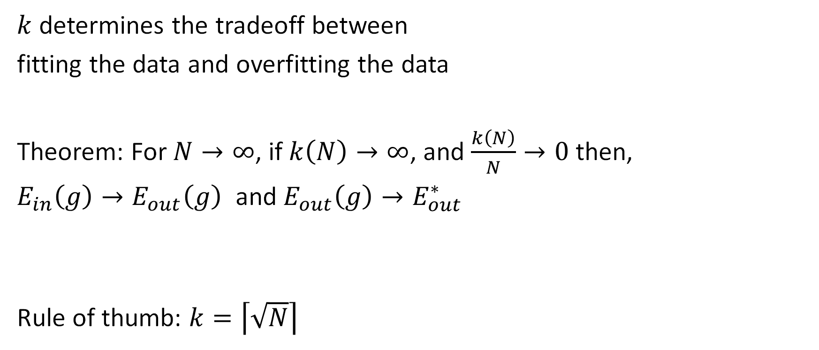

The Role of $k$
$k$ determines the tradeoff between
fitting the data and overfitting the data
Theorem: For $N→∞$, if $k\left(N\right)→∞$, and $\frac{k\left(N\right)}{N}→0$ then,
$E_{in}\left(g\right)→E_{out}\left(g\right)$ and $E_{out}\left(g\right)→E_{out}^{∗}$
Rule of thumb: $k=\left\lceil \sqrt{N}\right\rceil$

Slide 17

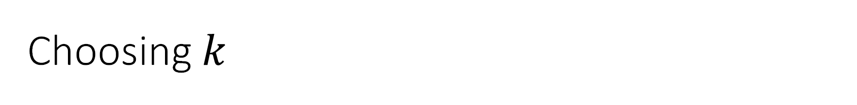
Choosing $k$
1 vs. -1
$k=3$
$k=\left\lceil \sqrt{N}\right\rceil$
(Cross) Validation
For each $k$,
$g_{k}^{−}$ is the hypothesis defined by $𝒟_{train}$
estimate $E_{out}$ using $𝒟_{val}$
Pick best $k$

Slide 18
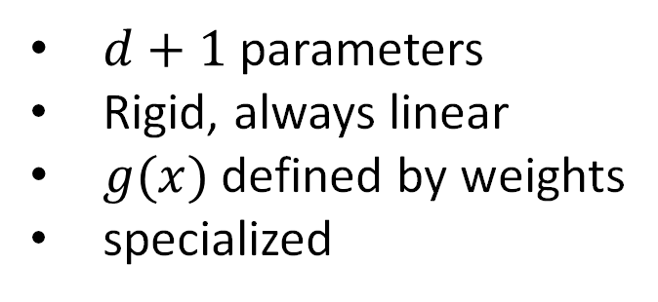
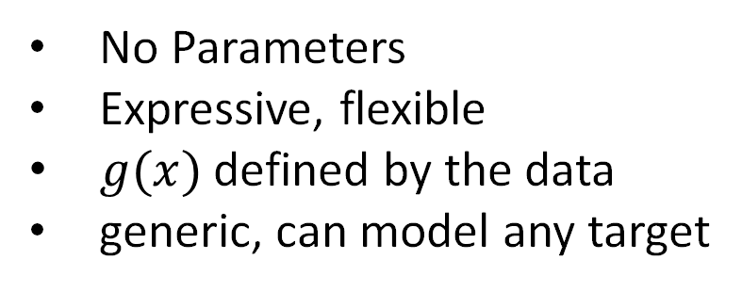
Nearest Neighbor is Non-Parametric
NN
Linear
No Parameters
Expressive, flexible
$g(x)$ defined by the data
generic, can model any target
$d+1$ parameters
Rigid, always linear
$g(x)$ defined by weights
specialized

Slide 19
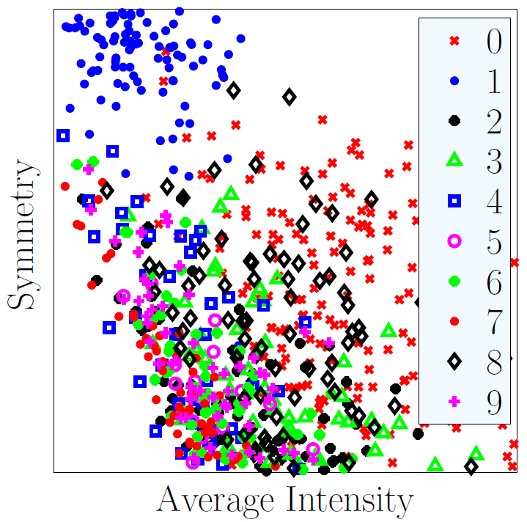
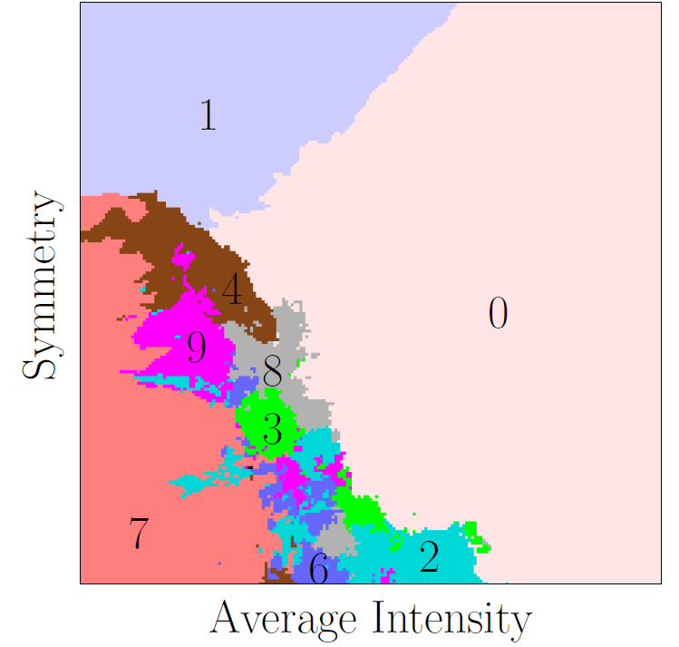
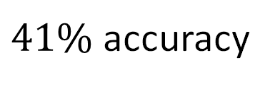
Nearest Neighbor Extends to Multiclass
$41\%$ accuracy

Slide 20

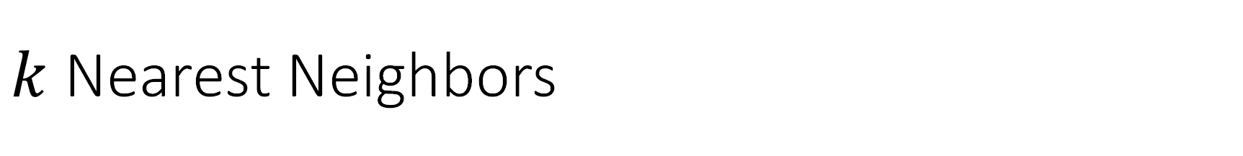
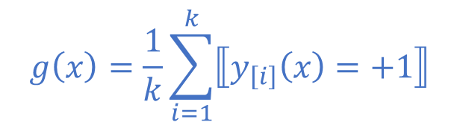
$k$ Nearest Neighbors
Simple
No training
Near optimal out-of-sample error
Easy to justify / communicate
Easily adapted to multiclass classification
Can easily adapt to regression or logistic regression
Computationally demanding
$$g\left(x\right)=\frac{1}{k}\sum_{i=1}^{k}{y_{\left[i\right]}(x)}$$
$$g\left(x\right)=\frac{1}{k}\sum_{i=1}^{k}{⟦y_{\left[i\right]}\left(x\right)=+1⟧}$$

Slide 21
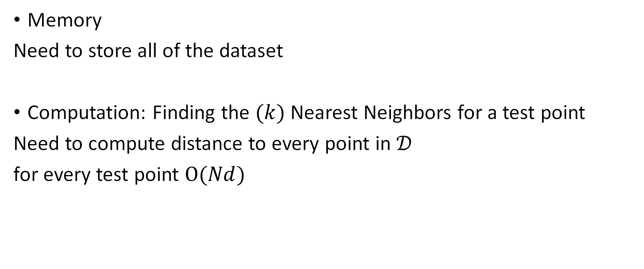
Nearest Neighbor is Computationally Demanding
Memory
Need to store all of the dataset
Computation: Finding the $(k)$ Nearest Neighbors for a test point
Need to compute distance to every point in $𝒟$
for every test point $O(Nd)$

Slide 22
Two Basic Approaches
Reduce the amount of data
Find a few representative examples
Specialized data structures

Slide 23

Condensed Nearest Neighbor
Throw out as much data as possible
so that
all training points are correctly classified
Find a subset $S$ of the dataset $D$
Computationally hard (NP-hard)

Slide 24
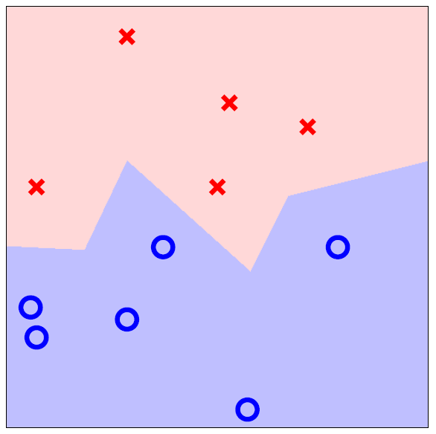
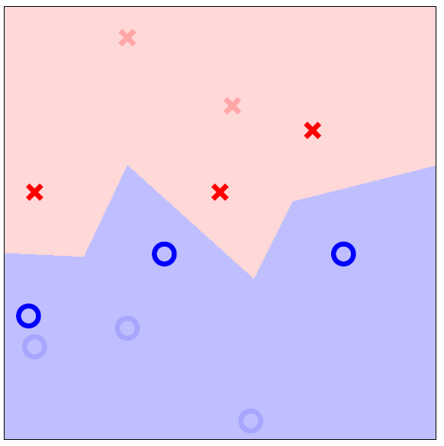
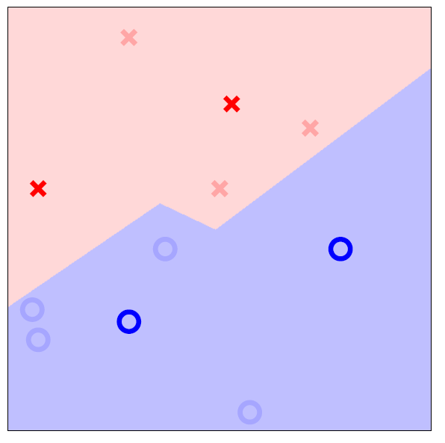
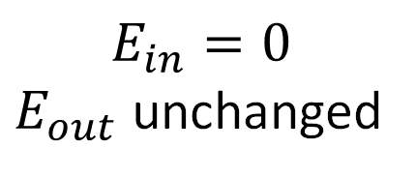
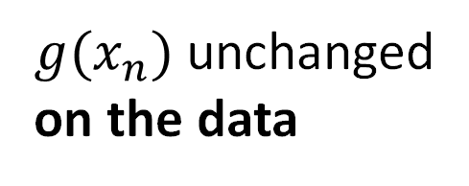
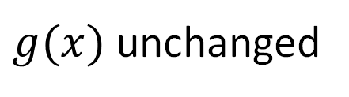
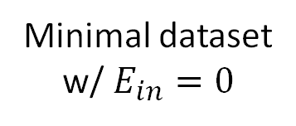
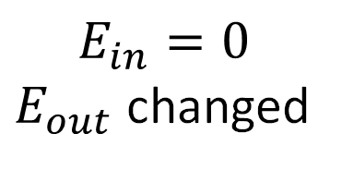
Condensed Dataset
Decision Boundary
Unchanged
$g(x)$ unchanged
$$E_{in}=0$$
$E_{out}$ unchanged
Minimal dataset
w/ $E_{in}=0$
$g(x_{n})$ unchanged
on the data
$$E_{in}=0$$
$E_{out}$ changed

Slide 25


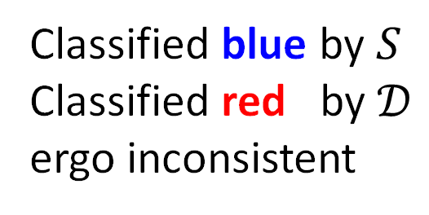
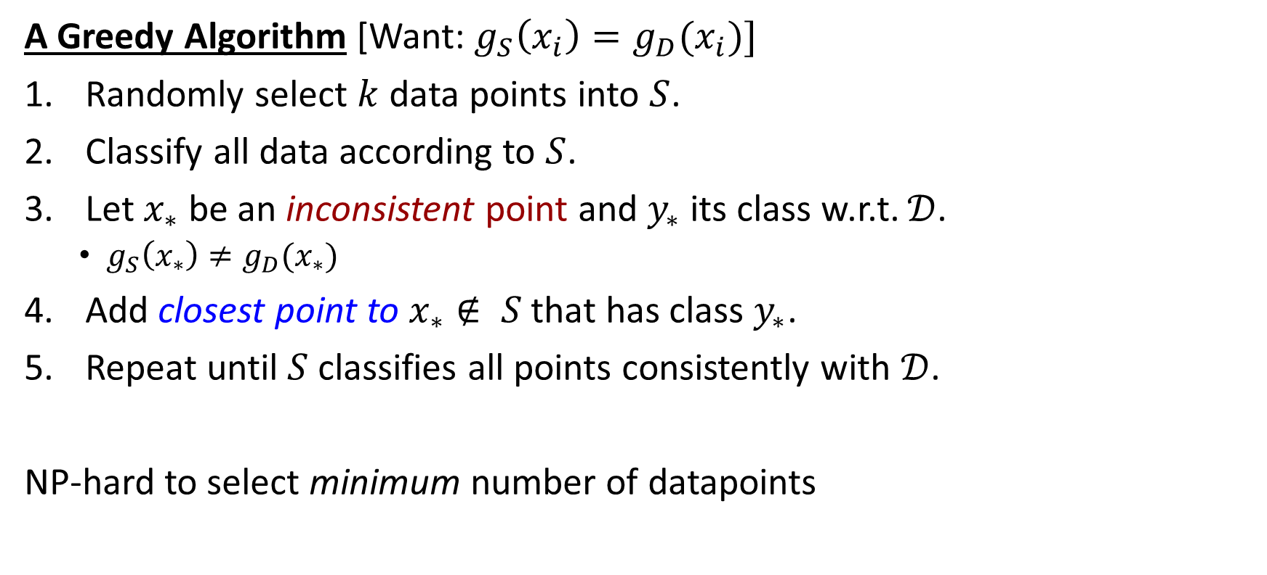
Condensed Nearest Neighbor
$$k=3$$
A Greedy Algorithm [Want: $g_{S}\left(x_{i}\right)=g_{D}(x_{i})]$
Randomly select $k$ data points into $S$.
Classify all data according to $S$.
Let $x_{∗}$ be an inconsistent point and $y_{∗}$ its class w.r.t. $𝒟$.
$g_{S}\left(x_{∗}\right)≠g_{D}(x_{∗})$
Add closest point to $x_{∗}∉ S$ that has class $y_{∗}$.
Repeat until $S$ classifies all points consistently with $𝒟$.
NP-hard to select minimum number of datapoints
$$×$$
Classified blue by $S$
Classified red by $𝒟$
ergo inconsistent

Slide 26
Condensing the Dataset

Slide 27
Unsupervised Learning
Supervised learning requires a large amount of labeled data, which is expensive to obtain in many real-world applications
Unsupervised learning (with semi-supervised learning as the middle/special case), on the other hand, does not suffer from this
While supervised learning has seen several developments reaching human like performance, unsupervised learning techniques do not currently match human ability to find patterns in data

Slide 28
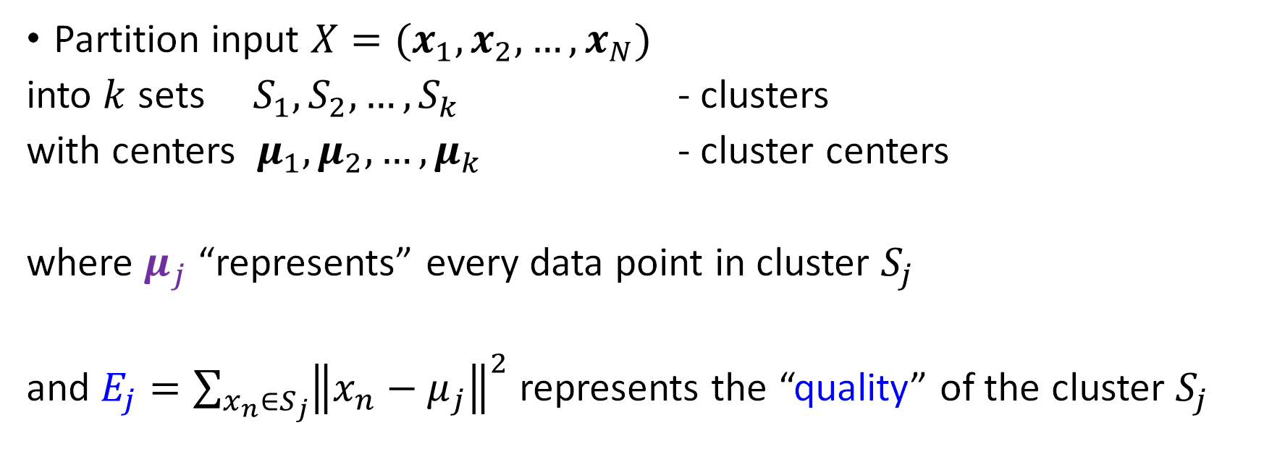
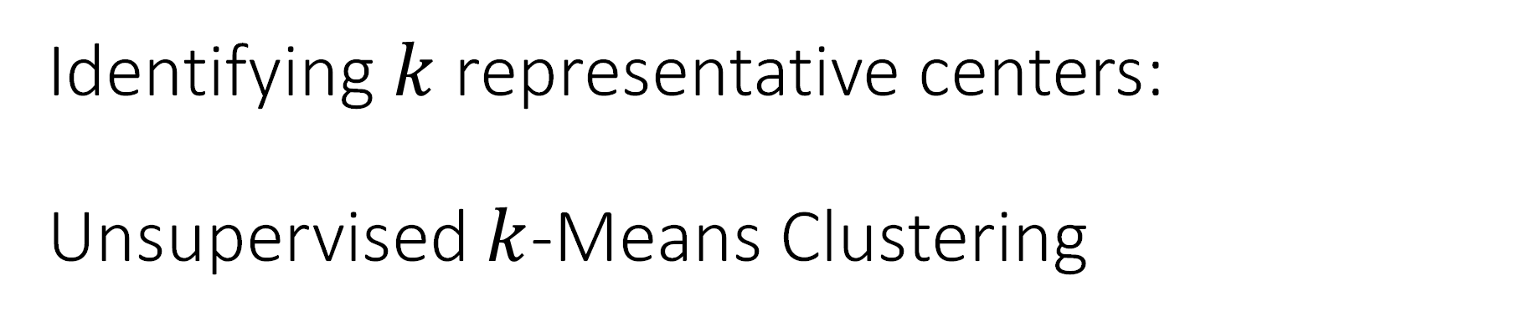
Identifying $k$ representative centers: Unsupervised $k$-Means Clustering
Partition input $X=(x_{1},x_{2},…,x_{N})$
into $k$ sets $S_{1},S_{2},…,S_{k}$ - clusters
with centers $μ_{1},μ_{2},…,μ_{k}$ - cluster centers
where $μ_{j}$ “represents” every data point in cluster $S_{j}$
and $E_{j}={\sum_{x_{n}∈S_{j}}{\left\|x_{n}−μ_{j}\right\|}}^{2}$ represents the “quality” of the cluster $S_{j}$

Slide 29
Finding Clusters – Lloyd’s Algorithm
Pick well separated cluster centers

Slide 30
Finding Clusters – Lloyd’s Algorithm
Pick well separated cluster centers
Compute Voronoi regions
as Clusters

Slide 31
Finding Clusters – Lloyd’s Algorithm
Pick well separated cluster centers
Compute Voronoi regions
as Clusters
Update cluster centers

Slide 32
Finding Clusters – Lloyd’s Algorithm
Pick well separated cluster centers
Compute Voronoi regions
as Clusters
Update cluster centers
Compute centers and radii

Slide 33
On the Digits Data

Slide 34
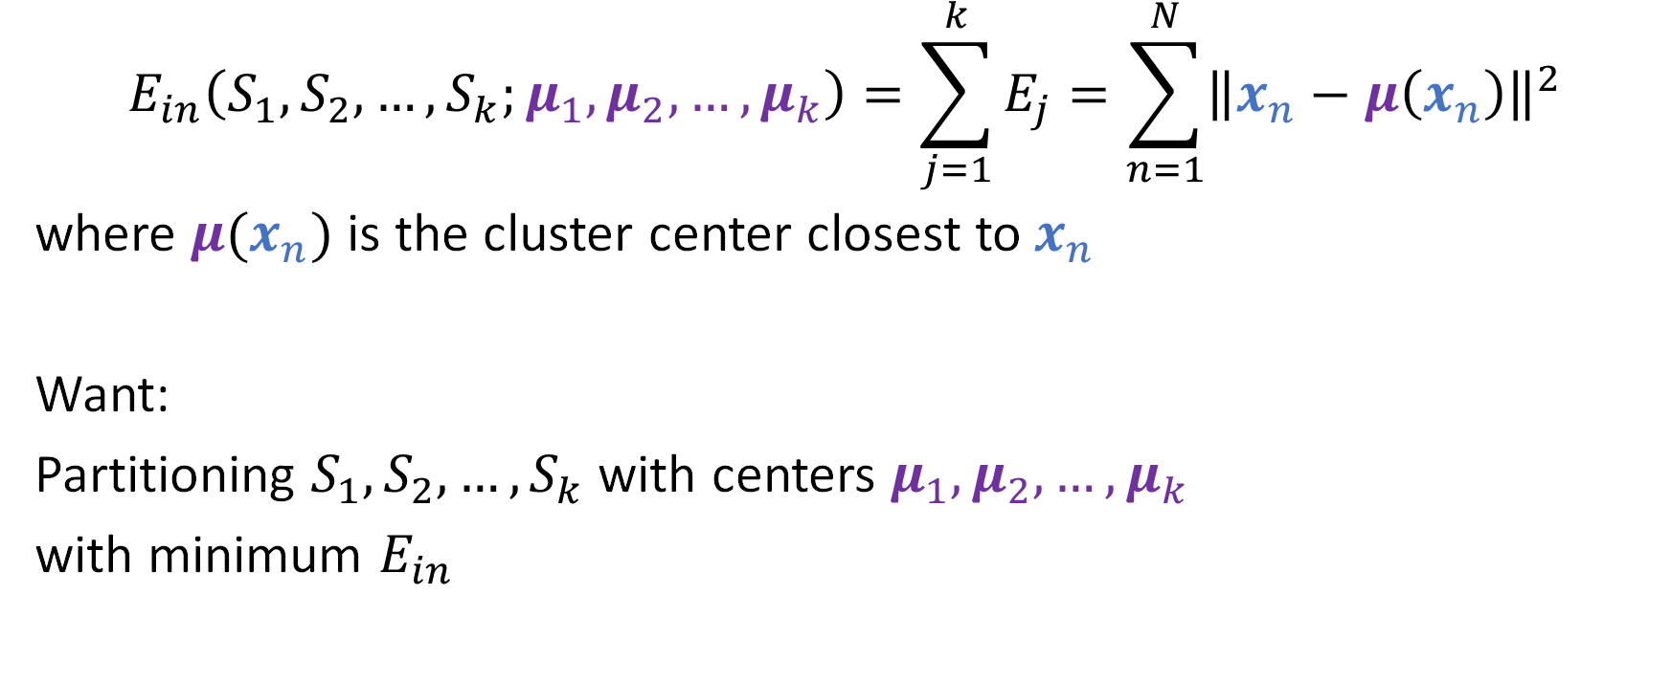

The $k$-means Error Function
$$E_{in}\left(S_{1},S_{2},…,S_{k};μ_{1},μ_{2},…,μ_{k}\right)=\sum_{j=1}^{k}{E_{j}}=\sum_{n=1}^{N}{{\left\|x_{n}−μ\left(x_{n}\right)\right\|}^{2}}$$
where $μ(x_{n})$ is the cluster center closest to $x_{n}$
Want:
Partitioning $S_{1},S_{2},…,S_{k}$ with centers $μ_{1},μ_{2},…,μ_{k}$
with minimum $E_{in}$

Slide 35
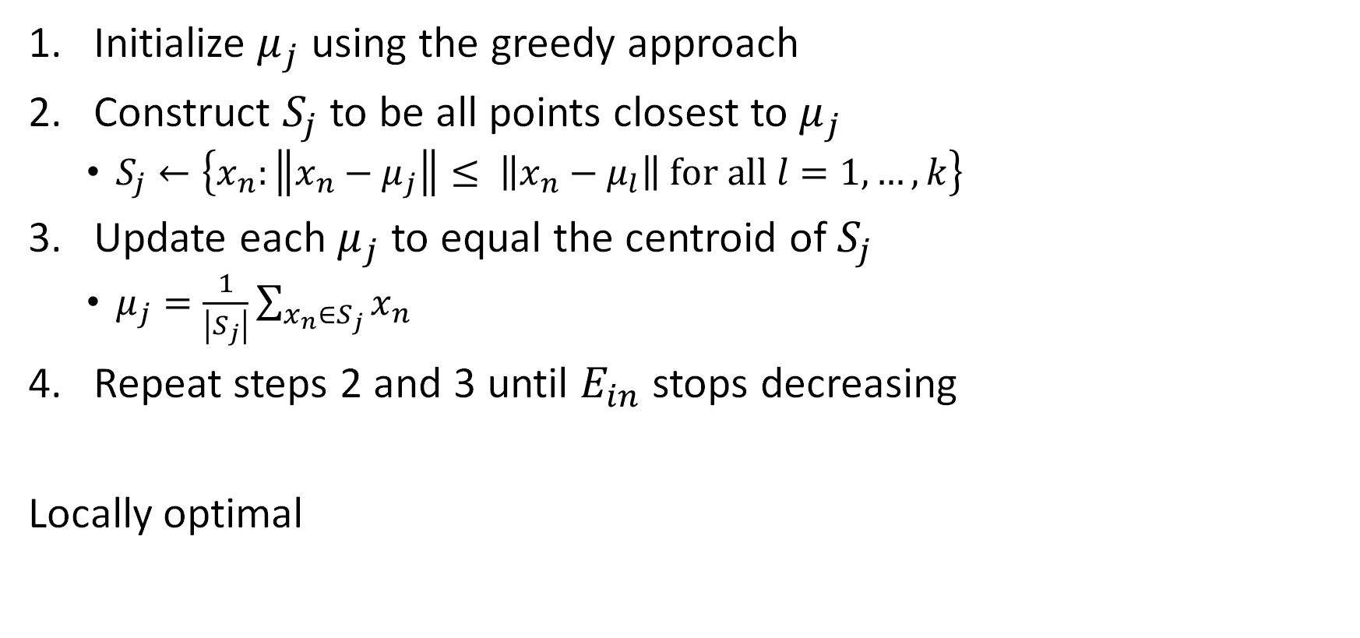
Lloyd’s Algorithm
Initialize $μ_{j}$ using the greedy approach
Construct $S_{j}$ to be all points closest to $μ_{j}$
$S_{j}←\left\{x_{n}:\left\|x_{n}−μ_{j}\right\|≤ \left\|x_{n}−μ_{l}\right\| for all l=1,…,k\right\}$
Update each $μ_{j}$ to equal the centroid of $S_{j}$
$μ_{j}=\frac{1}{\left|S_{j}\right|}\sum_{x_{n}∈S_{j}}{x_{n}}$
Repeat steps 2 and 3 until $E_{in}$ stops decreasing
Locally optimal

