Slide 1
Lectures 7
CS436/536: Introduction to
Machine Learning
Zhaohan Xi
Binghamton University
^{zxi1@binghamton.edu}

Slide 2
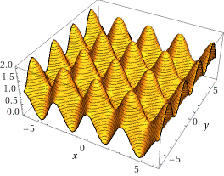

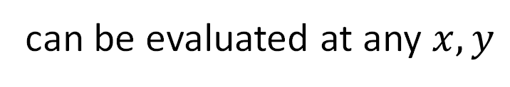
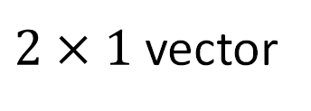
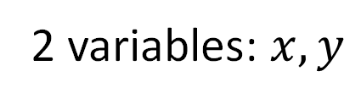
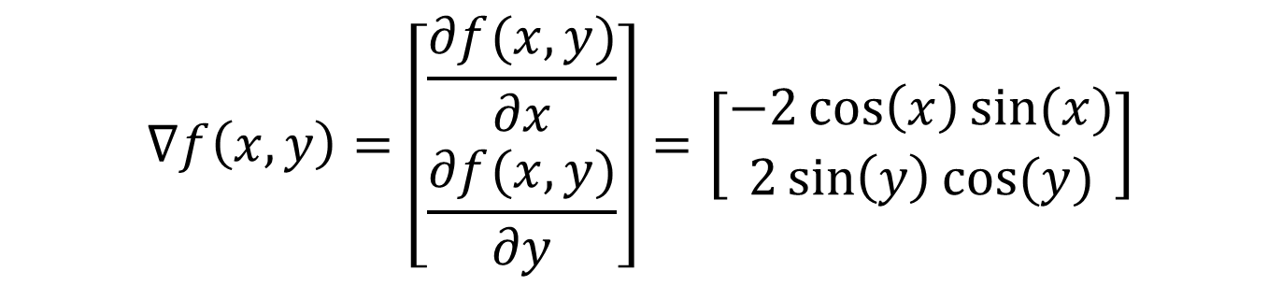
Preliminaries: Gradient
$$f\left(x,y\right)=cos^2(x)+sin^2(y)$$
2 variables: $x, y$
$$∇f\left(x,y\right)=\left[\begin{aligned}\frac{∂f(x,y)}{∂x} \\ \frac{∂f(x,y)}{∂y}\end{aligned}\right]=\left[\begin{aligned}−2\cos\left(x\right)\sin{(x)} \\ 2\sin\left(y\right)\cos{(y)}\end{aligned}\right]$$
can be evaluated at any $x, y$
$2×1$ vector

Slide 3


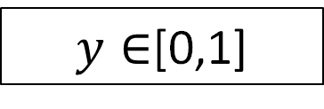
Linear Models for Three Learning Problems
Approve
or Deny
Classification
$$y∈\{−1,+1\}$$
Credit
Analysis
Amount
of Credit
Regression
$$y∈ℝ$$
Probability
of Default
Logistic Regression
$y∈$[0,1]
Fundamental: Building block for more complex models
First model to try!

Slide 4


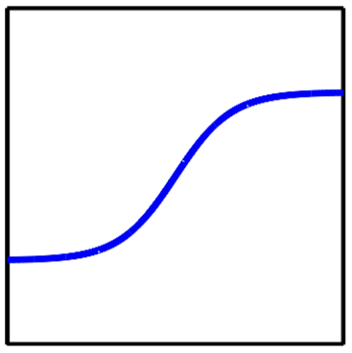







Linear Models: The Linear Signal
$$sign(w^{T}x)$$
$$\{−1,+1\}$$
Classification
$$w^{T}x$$
$$w^{T}x$$
$$ℝ$$
Regression
$$θ(w^{T}x)$$
$$[0,1]$$
Logistic Regression

Slide 5





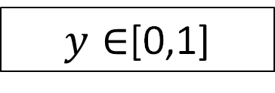
Linear Models for Three Learning Problems
Approve
or Deny
Classification
$$y∈\{−1,+1\}$$
Credit
Analysis
Amount
of Credit
Regression
$$y∈ℝ$$
Probability
of Default
Logistic Regression
$y∈$[0,1]
$$w^{T}x$$
$$θ(w^{T}x)$$
$$[0,1]$$

Slide 6
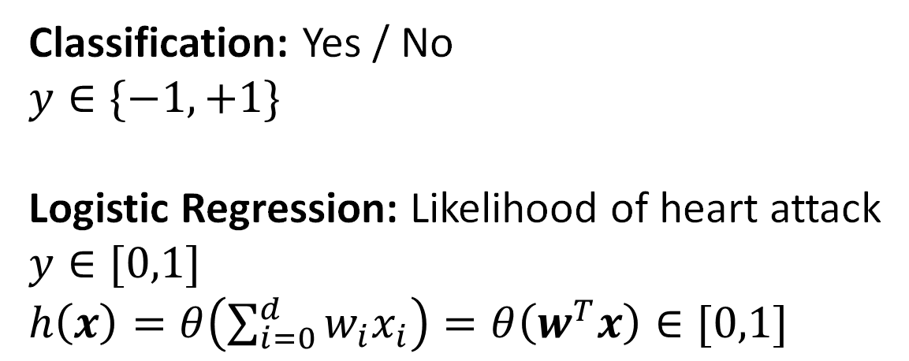
Predicting a Probability: Logistic Regression
Will the subject have a heart attack over the next year?
Patient Record
age | 33 years
gender | male
blood pressure | 137/91 mm Hg
HDL | 50
LDL | 120
BMI | 23.7
… | …
Classification: Yes / No
$y∈\{−1,+1\}$
Logistic Regression: Likelihood of heart attack
$y∈[0,1]$
$h\left(x\right)=θ\left(\sum_{i=0}^{d}{w_{i}x_{i}}\right)=θ\left(w^{T}x\right)∈[0,1]$

Slide 7
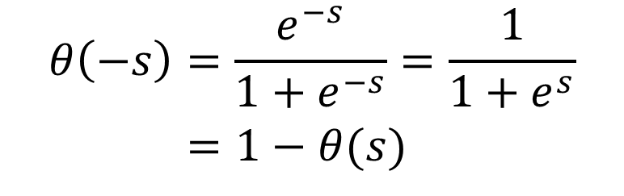

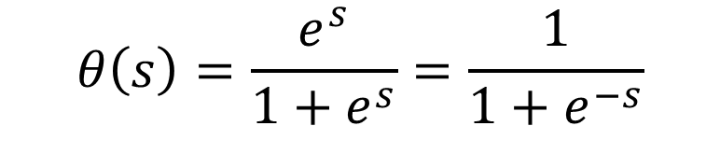


Predicting a Probability Using the Linear Signal
$$w^{T}x$$
$$θ(w^{T}x)$$
$$[0,1]$$
$$θ\left(s\right)=\frac{e^{s}}{1+e^{s}}=\frac{1}{1+e^{−s}}$$
$$θ\left(−s\right)=\frac{e^{−s}}{1+e^{−s}}=\frac{1}{1+e^{s}}$$
$=1−θ(s)$

Slide 8
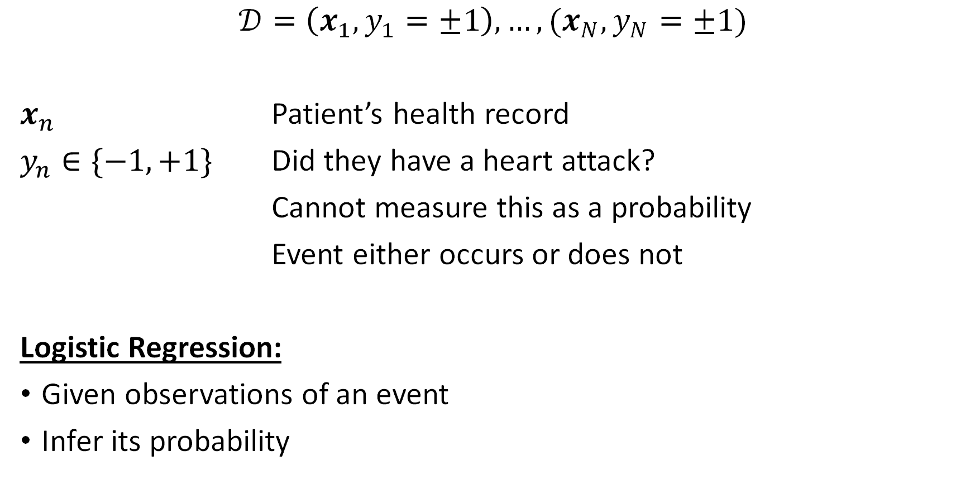
The Logistic Regression Setting: Data is Still Binary
$$𝒟=\left(x_{1},y_{1}=±1\right),…,(x_{N},y_{N}=±1)$$
$x_{n}$ Patient’s health record
$y_{n}∈\{−1,+1\}$ Did they have a heart attack?
Cannot measure this as a probability
Event either occurs or does not
Logistic Regression:
Given observations of an event
Infer its probability

Slide 9

The Target Function is Inherently Noisy
$$f\left(x\right)=ℙ\left[y=+1|x\right]$$
Data generated from noisy target function
$$P\left(y | x\right)=\left\{\begin{aligned}f\left(x\right), for y=+1 \\ 1−f\left(x\right), for y=−1\end{aligned}\right.$$

Slide 10

Measuring Error
A hypothesis is a function $h\left(x\right)=θ(w^{T}x)$
$f\left(x\right)=ℙ\left[y=+1|x\right]$
Want: $h(x)≈f(x)$, i.e.
$P\left(+1 | x\right)≈h\left(x\right)$
$P\left(−1 | x\right)≈1−h\left(x\right)$

Slide 11
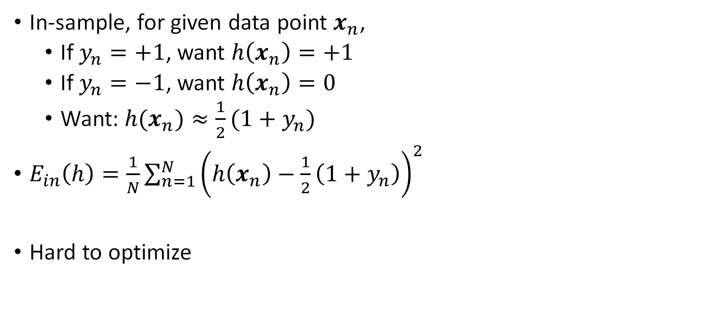

Measuring Error $E_{in}(h)$
In-sample, for given data point $x_{n}$,
If $y_{n}=+1$, want $h\left(x_{n}\right)=+1$
If $y_{n}=−1$, want $h\left(x_{n}\right)=0$
Want: $h(x_{n})≈\frac{1}{2}(1+y_{n})$
$E_{in}\left(h\right)=\frac{1}{N}\sum_{n=1}^{N}{{\left(h\left(x_{n}\right)−\frac{1}{2}\left(1+y_{n}\right)\right)}^{2}}$
Hard to optimize

Slide 12
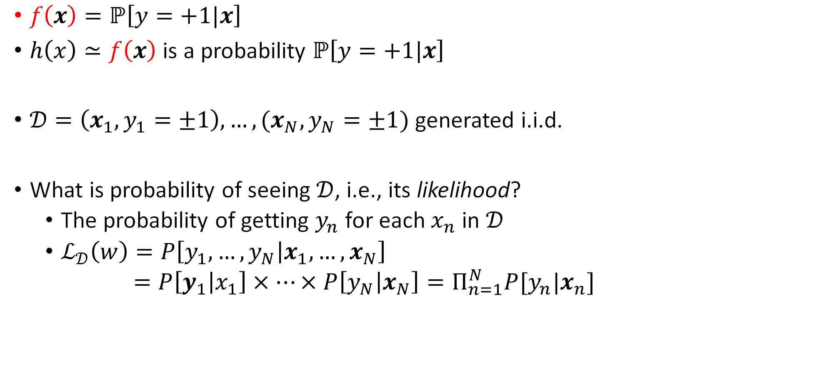
Cross Entropy Error Measure
$f\left(x\right)=ℙ\left[y=+1|x\right]$
$h\left(x\right)≃f\left(x\right)$ is a probability $ℙ\left[y=+1|x\right]$
$𝒟=\left(x_{1},y_{1}=±1\right),…,(x_{N},y_{N}=±1)$ generated i.i.d.
What is probability of seeing $𝒟$, i.e., its likelihood?
The probability of getting $y_{n}$ for each $x_{n}$ in $𝒟$
$ℒ_{𝒟}\left(w\right)=P\left[y_{1},…,y_{N} | x_{1},…,x_{N}\right]$
$=P\left[y_{1} | x_{1}\right]×…×P\left[y_{N} | x_{N}\right]=Π_{n=1}^{N}P[y_{n}|x_{n}]$

Slide 13
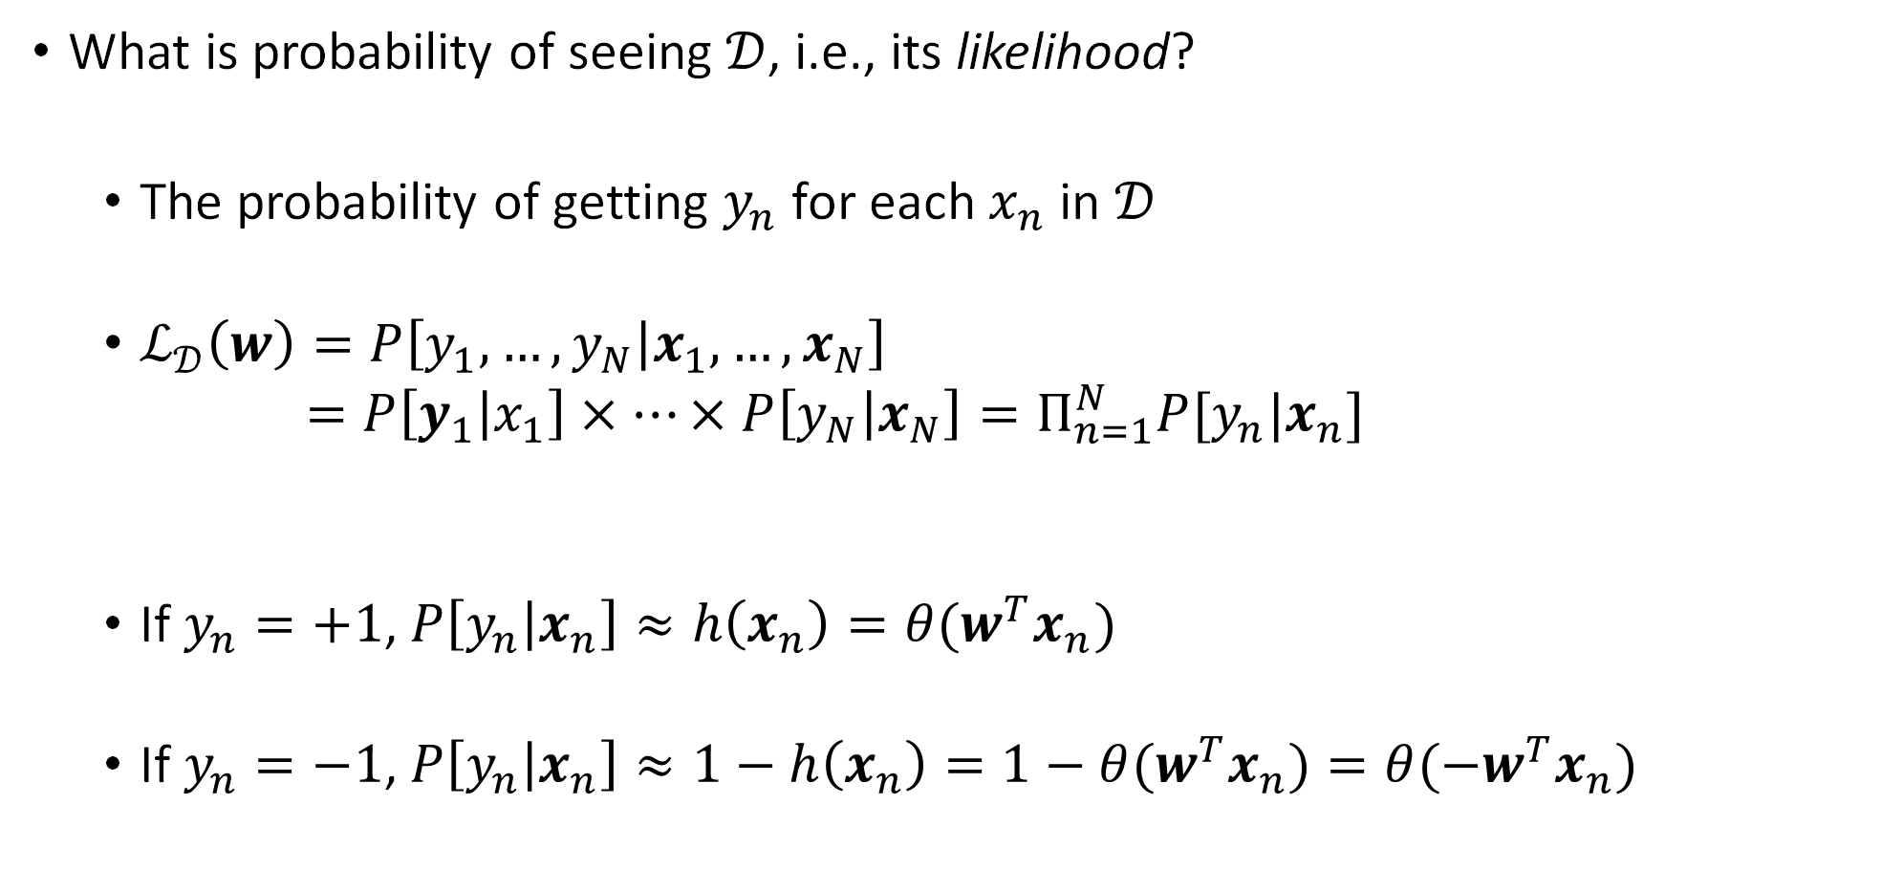
Cross Entropy Error Measure
What is probability of seeing $𝒟$, i.e., its likelihood?
The probability of getting $y_{n}$ for each $x_{n}$ in $𝒟$
$ℒ_{𝒟}\left(w\right)=P\left[y_{1},…,y_{N} | x_{1},…,x_{N}\right]$
$=P\left[y_{1} | x_{1}\right]×…×P\left[y_{N} | x_{N}\right]=Π_{n=1}^{N}P[y_{n}|x_{n}]$
If $y_{n}=+1$, $P\left[y_{n} | x_{n}\right]≈h\left(x_{n}\right)={θ(w}^{T}x_{n})$
If $y_{n}=−1$, $P\left[y_{n} | x_{n}\right]≈1−h\left(x_{n}\right)=1−{θ(w}^{T}x_{n})={θ(−w}^{T}x_{n})$

Slide 14
Recall: Probabilities from the Linear Signal
$$w^{T}x$$
$$θ(w^{T}x)$$
$$[0,1]$$
$$θ\left(s\right)=\frac{e^{s}}{1+e^{s}}=\frac{1}{1+e^{−s}}$$
$$θ\left(−s\right)=\frac{e^{−s}}{1+e^{−s}}=\frac{1}{1+e^{s}}$$
$=1−θ(s)$

Slide 15
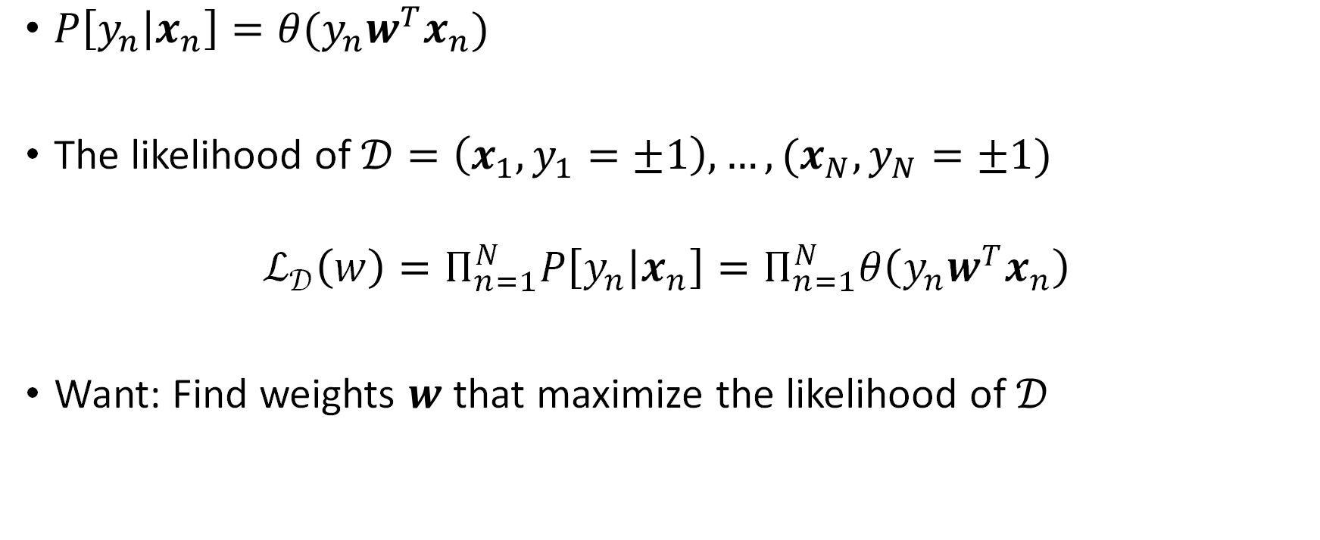
Cross Entropy Error Measure
$P\left[y_{n} | x_{n}\right]=θ(y_{n}w^{T}x_{n})$
The likelihood of $𝒟=\left(x_{1},y_{1}=±1\right),…,(x_{N},y_{N}=±1)$
$$ℒ_{𝒟}\left(w\right)=Π_{n=1}^{N}P\left[y_{n} | x_{n}\right]=Π_{n=1}^{N}θ\left(y_{n}w^{T}x_{n}\right)$$
Want: Find weights $w$ that maximize the likelihood of $𝒟$

Slide 16
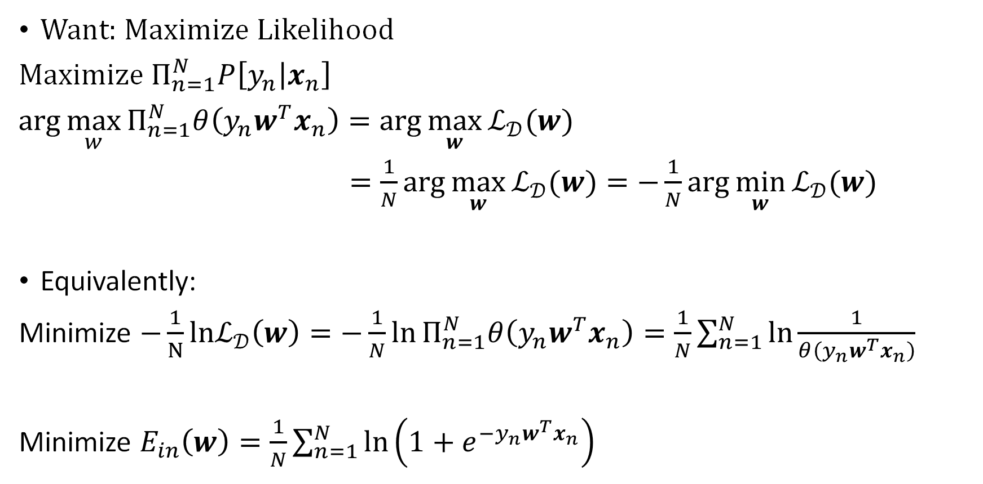
Cross Entropy Error Measure
Want: Maximize Likelihood
Maximize $Π_{n=1}^{N}P\left[y_{n} | x_{n}\right]$
$\arg{\max_{w}{Π_{n=1}^{N}θ\left(y_{n}w^{T}x_{n}\right)}}=\arg{\max_{w}{ℒ_{𝒟}(w)}}$
$=\frac{1}{N}\arg{\max_{w}{ℒ_{𝒟}(w)}}=−\frac{1}{N}\arg{\min_{w}{ℒ_{𝒟}(w)}}$
Equivalently:
Minimize $−\frac{1}{N}lnℒ_{𝒟}\left(w\right)=−\frac{1}{N}\ln{Π_{n=1}^{N}θ\left(y_{n}w^{T}x_{n}\right)}=\frac{1}{N}\sum_{n=1}^{N}{\ln{\frac{1}{θ\left(y_{n}w^{T}x_{n}\right)}}}$
Minimize $E_{in}\left(w\right)=\frac{1}{N}\sum_{n=1}^{N}{\ln\left(1+e^{−y_{n}w^{T}x_{n}}\right)}$

Slide 17
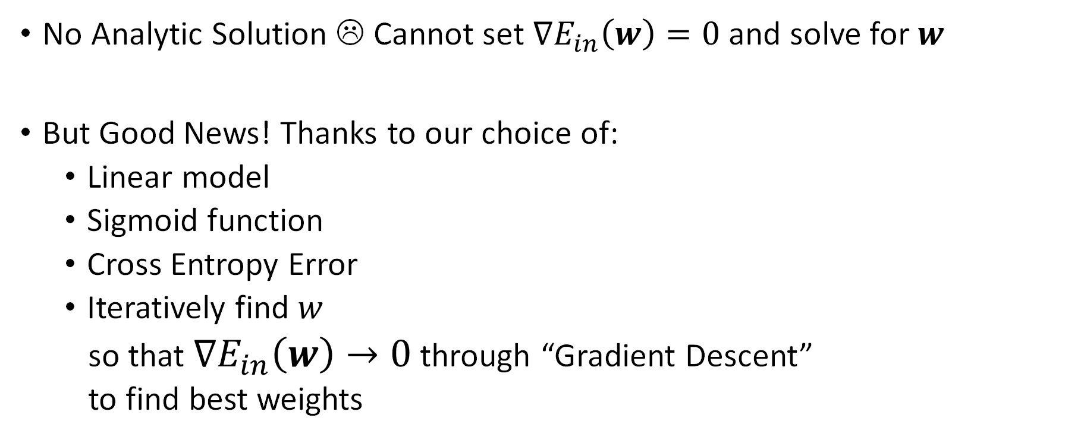
Method of Maximum Likelihood: Minimize Cross Entropy Error
No Analytic Solution ☹ Cannot set $∇E_{in}\left(w\right)=0$ and solve for $w$
But Good News! Thanks to our choice of:
Linear model
Sigmoid function
Cross Entropy Error
Iteratively find $w$
so that $∇E_{in}\left(w\right)→0$ through “Gradient Descent”
to find best weights

Slide 18
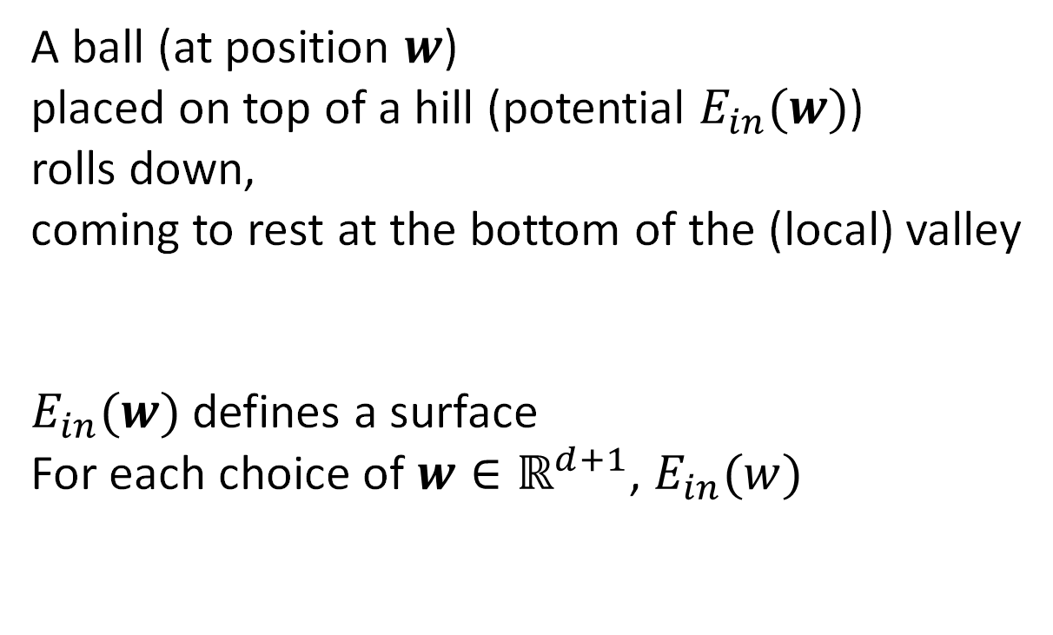


Hill Descent
$$E_{in}(w)$$
A ball (at position $w$)
placed on top of a hill (potential $E_{in}(w)$)
rolls down,
coming to rest at the bottom of the (local) valley
$E_{in}(w)$ defines a surface
For each choice of $w∈ℝ^{d+1}$, $E_{in}(w)$
$$w$$

Slide 19
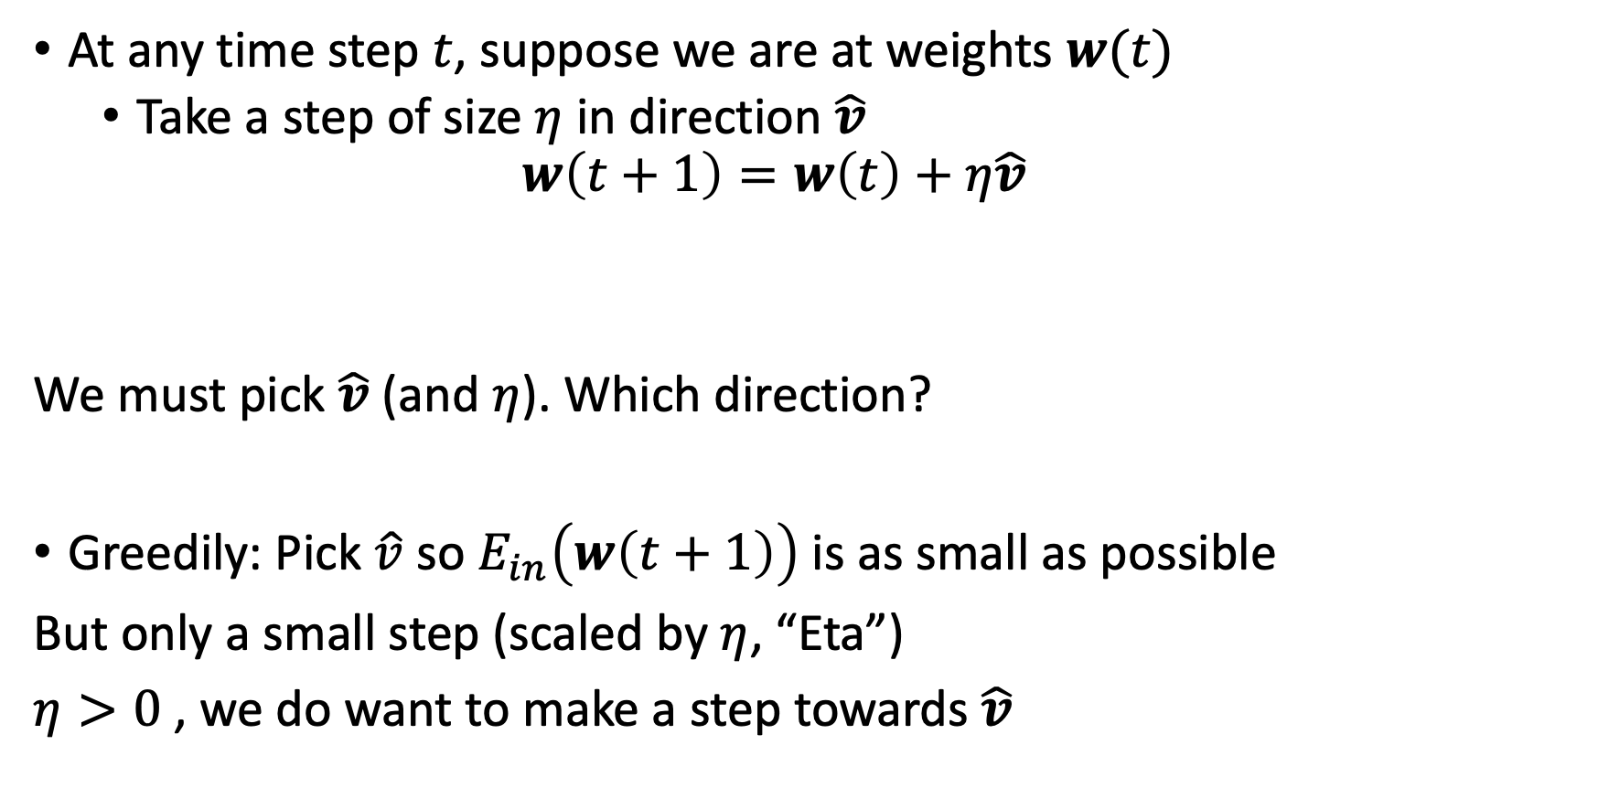




How to Roll Down the Hill?
At any time step $t$, suppose we are at weights $w(t)$
Take a step of size $η$ in direction $\hat{v}$
$$w\left(t+1\right)=w\left(t\right)+η\hat{v}$$
We must pick $\hat{v}$ (and $η$). Which direction?
Greedily: Pick $\hat{v}$ so $E_{in}\left(w\left(t+1\right)\right)$ is as small as possible
But only a small step (scaled by $η$, “Eta”)
$η>0$ , we do want to make a step towards $\hat{v}$
$$w(t+1)$$
$$w(t)$$
$$η\hat{v}$$
$$\hat{v}$$

Slide 20


Rolling Down $≡$ Iterating the Negative Gradient
$w\left(t+1\right)=w\left(t\right)−η∇E_{in}(w(t))$
$w(0)$
negative gradient
$w(1)$
negative gradient
$w(2)$
negative gradient
$w(3)$
negative gradient
$…$

Slide 21

Picking the “Learning Rate” $η$

Slide 22

Good News! There is Only One Valley
With our choice of
$E_{in}(w)$ for Logistic Regression,
$E_{in}(w)$ is a convex function of $w$

Slide 23
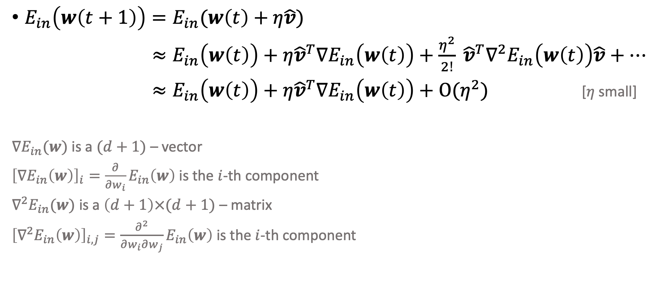
Rolling Down
$E_{in}\left(w\left(t+1\right)\right)=E_{in}(w\left(t\right)+η\hat{v})$
$≈{E_{in}\left(w\left(t\right)\right)+η{\hat{v}}^{T}∇E}_{in}\left(w\left(t\right)\right)+\frac{η^{2}}{2!} {\hat{v}}^{T}∇^{2}E_{in}\left(w\left(t\right)\right)\hat{v}+…$
$≈{E_{in}\left(w\left(t\right)\right)+η{\hat{v}}^{T}∇E}_{in}\left(w\left(t\right)\right)+O(η^{2})$ [$η$ small]
$∇E_{in}(w)$ is a $(d+1)$ – vector
${\left[∇E_{in}\left(w\right)\right]}_{i}=\frac{∂}{∂w_{i}}E_{in}\left(w\right)$ is the $i$-th component
$∇^{2}E_{in}(w)$ is a $\left(d+1\right)×(d+1)$ – matrix
${\left[∇^{2}E_{in}\left(w\right)\right]}_{i,j}=\frac{∂^{2}}{∂w_{i}∂w_{j}}E_{in}\left(w\right)$ is the $i$-th component
[Taylor approximation]

Slide 24

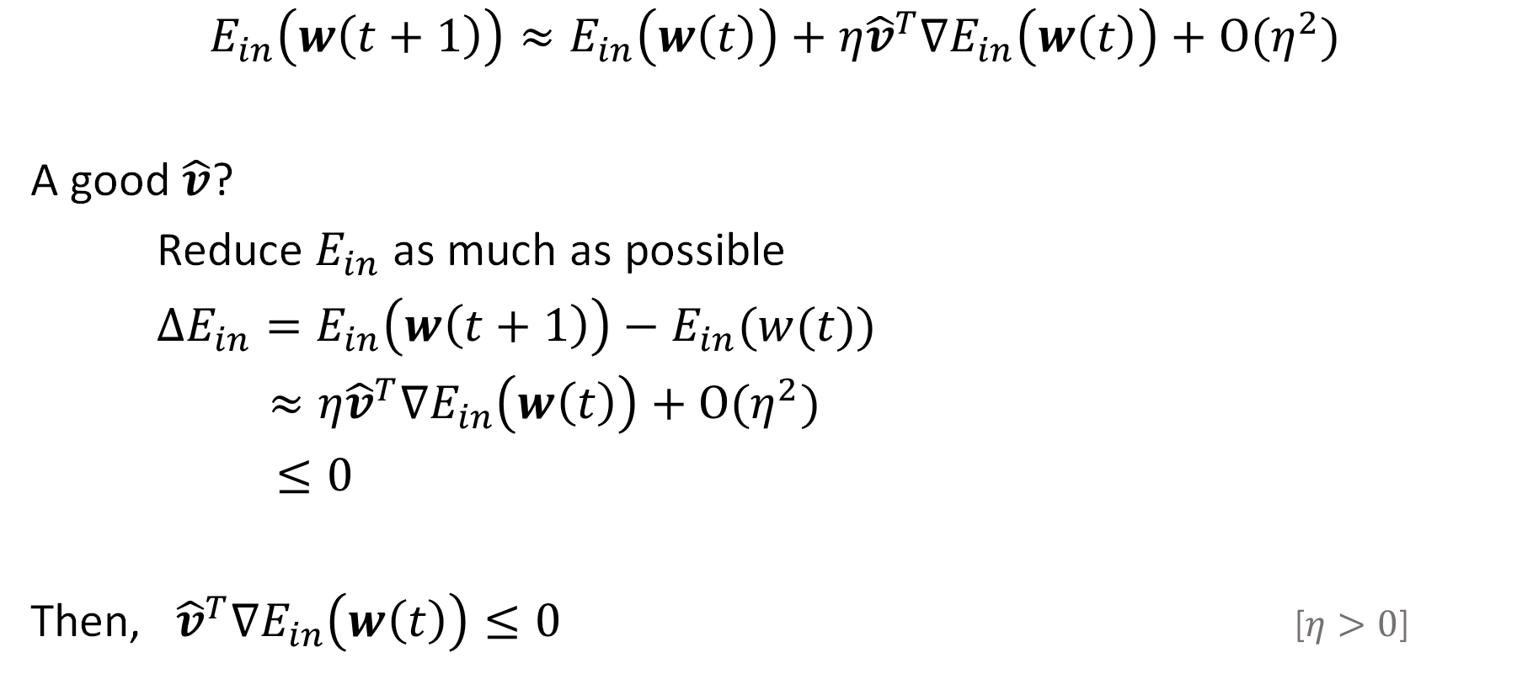

Rolling Down
$$E_{in}\left(w\left(t+1\right)\right)≈{E_{in}\left(w\left(t\right)\right)+η{\hat{v}}^{T}∇E}_{in}\left(w\left(t\right)\right)+O(η^{2})$$
A good $\hat{v}$?
Reduce $E_{in}$ as much as possible
$ΔE_{in}=E_{in}\left(w\left(t+1\right)\right)−E_{in}(w(t))$
$≈{η{\hat{v}}^{T}∇E}_{in}\left(w\left(t\right)\right)+O(η^{2})$
$≤0$
Then, ${{\hat{v}}^{T}∇E}_{in}\left(w\left(t\right)\right)≤0$ [$η>0$]
[change in $E_{in}$]
[want: reduce $E_{in}$]

Slide 25
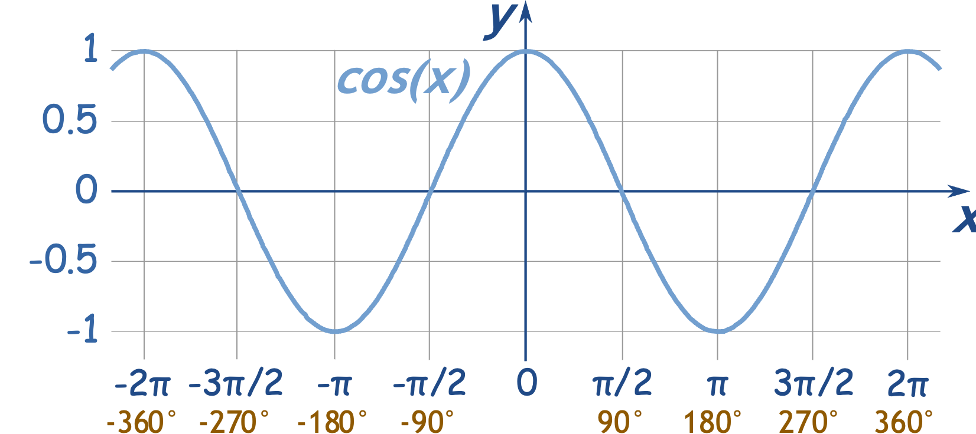

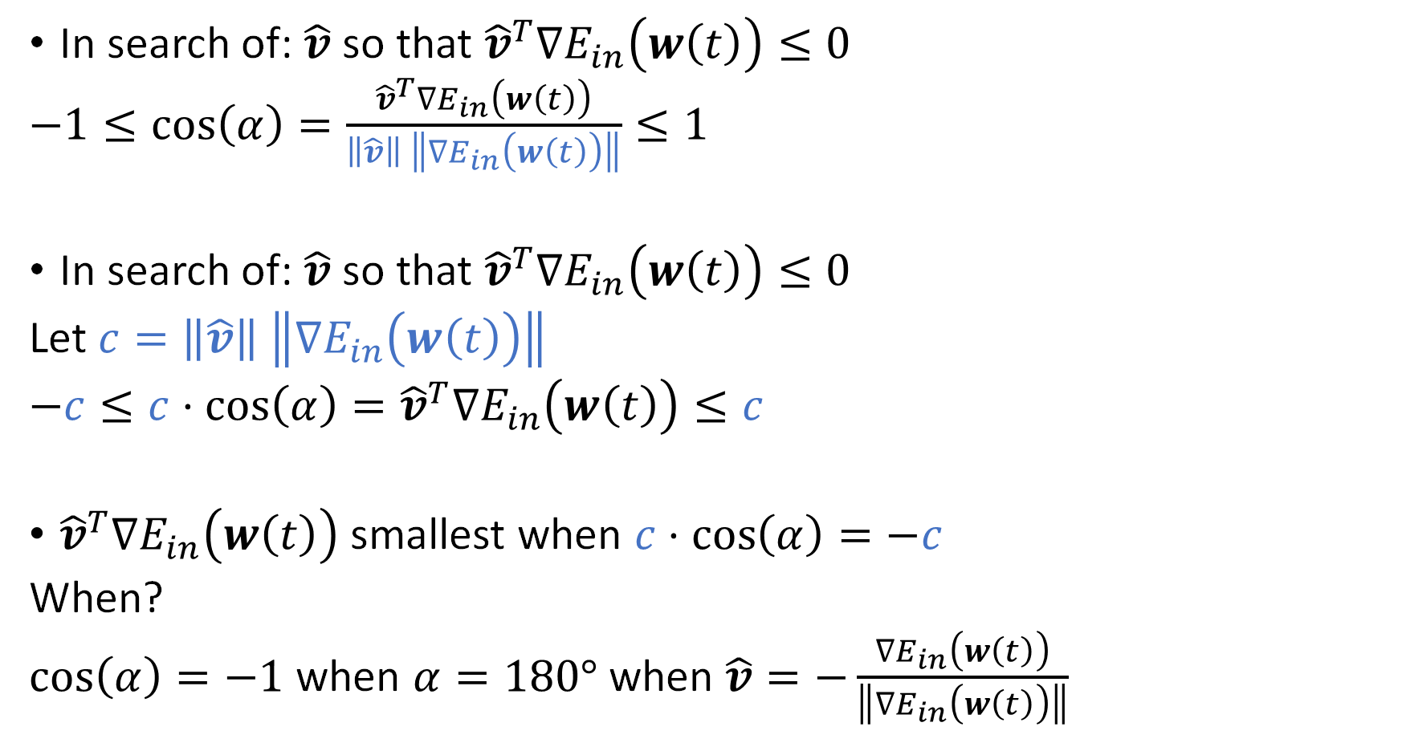


(Is the Gradient)
Fastest Way to Roll Down
$${∇E}_{in}\left(w\left(t\right)\right)$$
In search of: $\hat{v}$ so that ${{\hat{v}}^{T}∇E}_{in}\left(w\left(t\right)\right)≤0$
$−1≤\cos\left(α\right)=\frac{{{\hat{v}}^{T}∇E}_{in}\left(w\left(t\right)\right)}{\left\|\hat{v}\right\| \left\|{∇E}_{in}\left(w\left(t\right)\right)\right\|}≤1$
In search of: $\hat{v}$ so that ${{\hat{v}}^{T}∇E}_{in}\left(w\left(t\right)\right)≤0$
Let $c=\left\|\hat{v}\right\| \left\|{∇E}_{in}\left(w\left(t\right)\right)\right\|$
$−c≤c⋅\cos\left(α\right)={{\hat{v}}^{T}∇E}_{in}\left(w\left(t\right)\right)≤c$
${{\hat{v}}^{T}∇E}_{in}\left(w\left(t\right)\right)$ smallest when $c⋅\cos\left(α\right)=−c$
When?
$\cos\left(α\right)=−1$ when $α=180°$ when $\hat{v}=−\frac{{∇E}_{in}\left(w\left(t\right)\right)}{\left\|{∇E}_{in}\left(w\left(t\right)\right)\right\|}$
$$α$$
$$\hat{v}$$

Slide 26
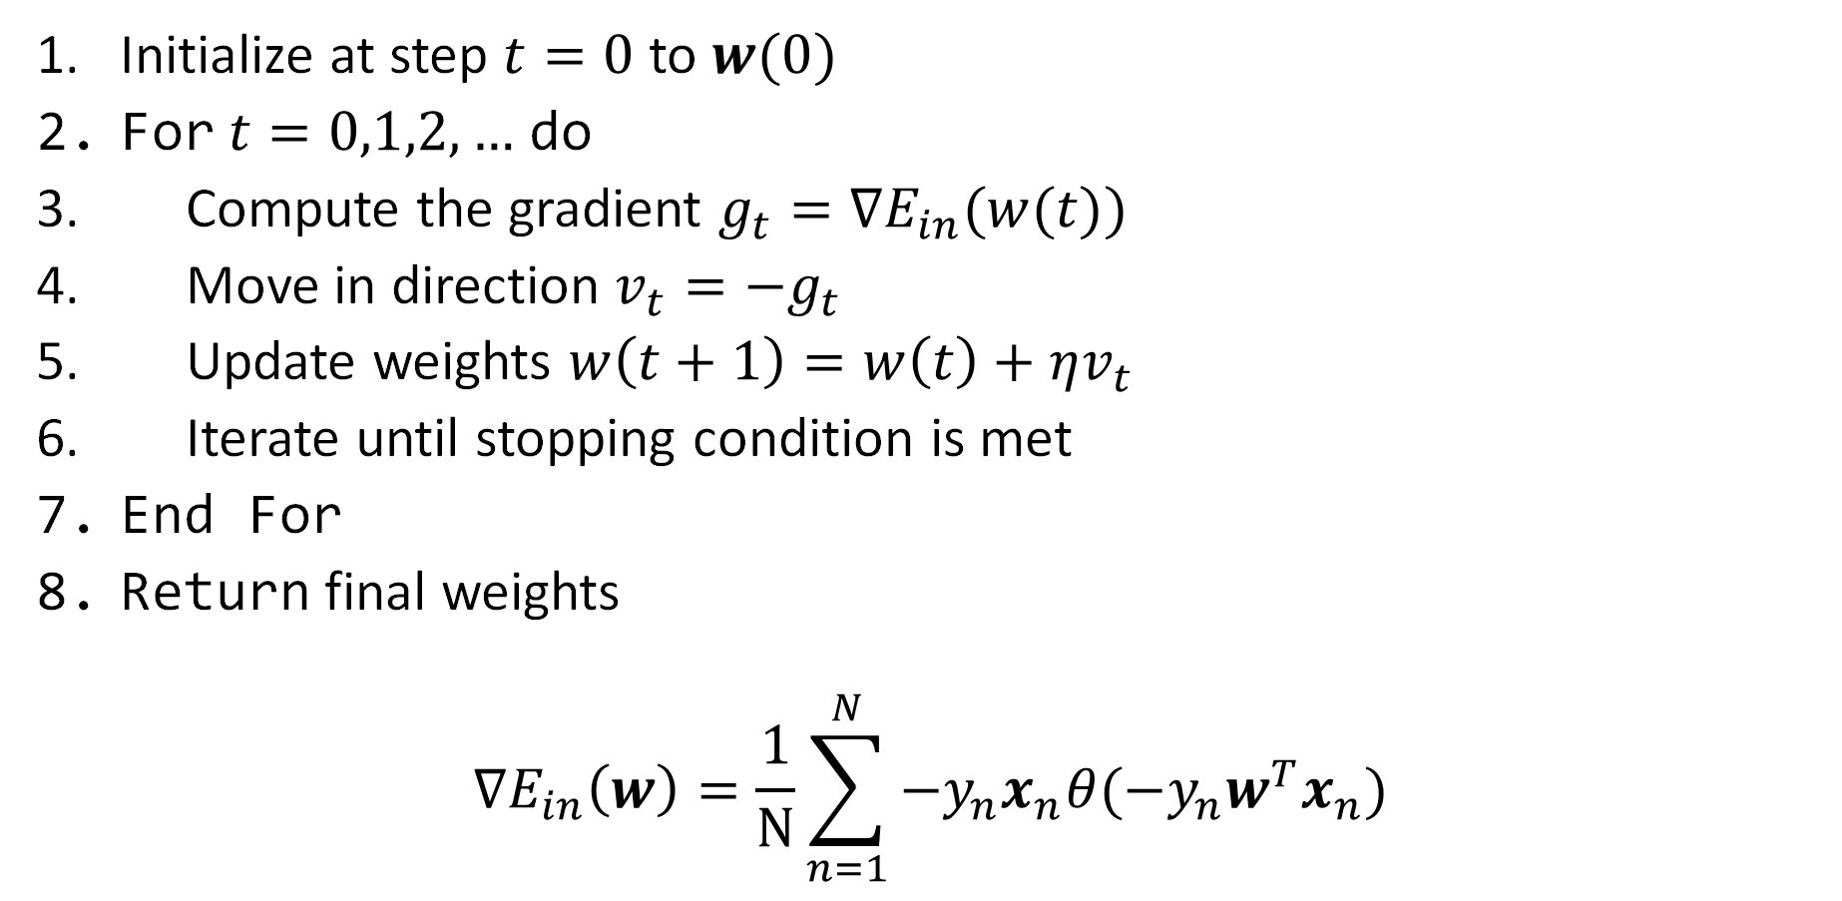
The (fixed learning rate) Gradient Descent Algorithm
Initialize at step $t=0$ to $w(0)$
For $t=0,1,2,…$ do
Compute the gradient $g_{t}=∇E_{in}(w(t))$
Move in direction $v_{t}=−g_{t}$
Update weights $w\left(t+1\right)=w\left(t\right)+ηv_{t}$
Iterate until stopping condition is met
End For
Return final weights
$$∇E_{in}\left(w\right)=\frac{1}{N}\sum_{n=1}^{N}{−y_{n}x_{n}θ(−y_{n}w^{T}x_{n})}$$

Slide 27
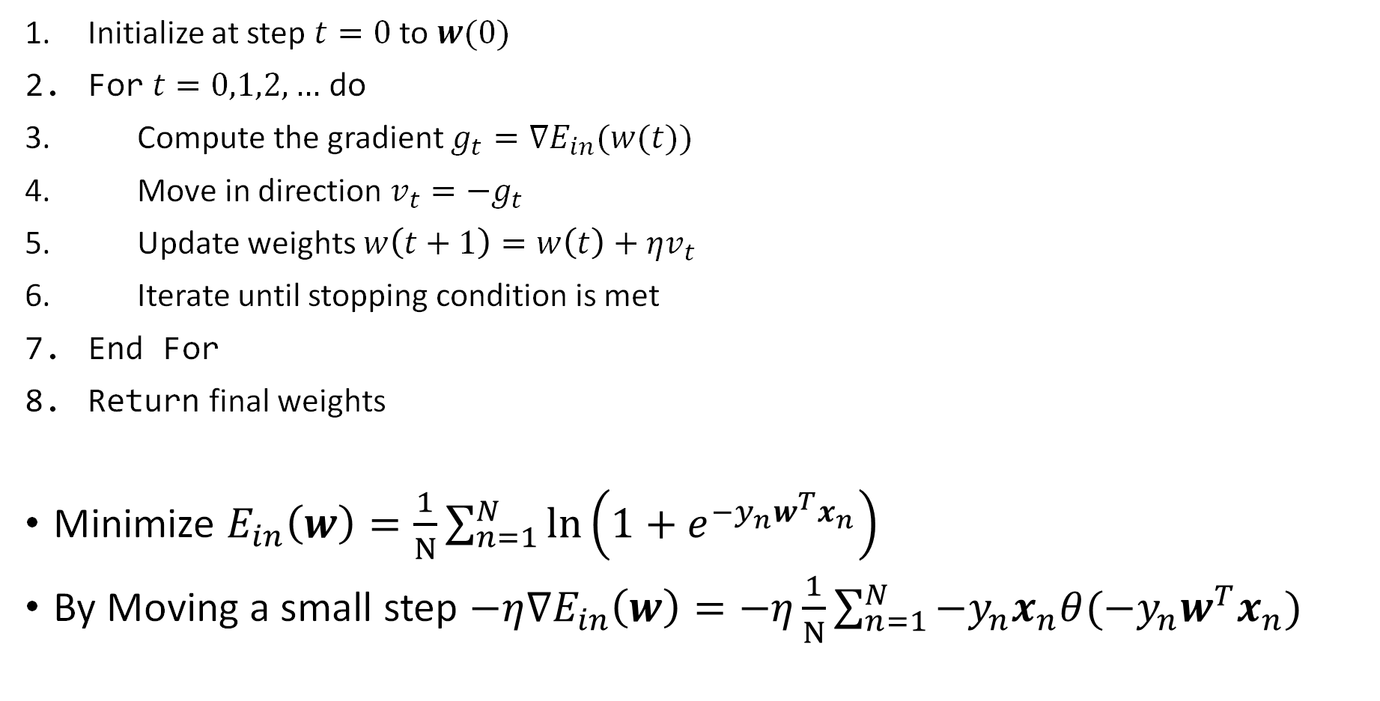
The Gradient Descent (GD) Algorithm
Initialize at step $t=0$ to $w(0)$
For $t=0,1,2,…$ do
Compute the gradient $g_{t}=∇E_{in}(w(t))$
Move in direction $v_{t}=−g_{t}$
Update weights $w\left(t+1\right)=w\left(t\right)+ηv_{t}$
Iterate until stopping condition is met
End For
Return final weights
Minimize $E_{in}\left(w\right)=\frac{1}{N}\sum_{n=1}^{N}{\ln\left(1+e^{−y_{n}w^{T}x_{n}}\right)}$
By Moving a small step $−η∇E_{in}\left(w\right)=−η\frac{1}{N}\sum_{n=1}^{N}{−y_{n}x_{n}θ(−y_{n}w^{T}x_{n})}$

Slide 28
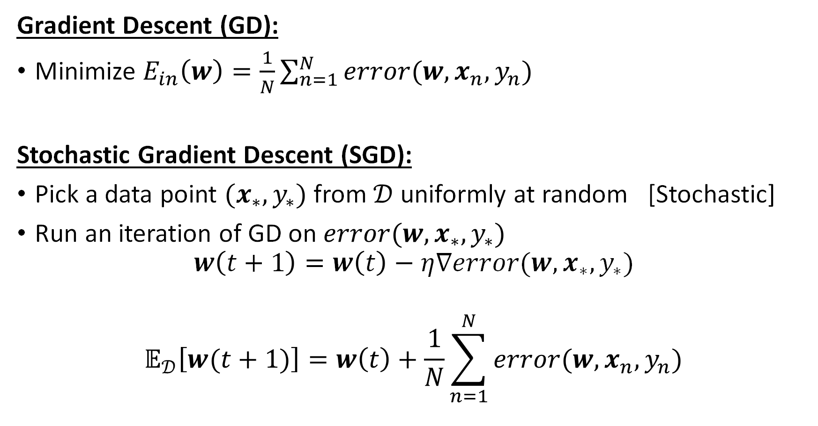
Stochastic Gradient Descent (SGD)
Gradient Descent (GD):
Minimize $E_{in}\left(w\right)=\frac{1}{N}\sum_{n=1}^{N}{error(w,x_{n},y_{n})}$
Stochastic Gradient Descent (SGD):
Pick a data point $(x_{∗},y_{∗})$ from $𝒟$ uniformly at random [Stochastic]
Run an iteration of GD on $error(w,x_{∗},y_{∗})$
$$w\left(t+1\right)=w\left(t\right)−η∇error(w,x_{∗},y_{∗})$$
$$𝔼_{𝒟}\left[w(t+1)\right]=w\left(t\right)+\frac{1}{N}\sum_{n=1}^{N}{error(w,x_{n},y_{n})}$$

Slide 29
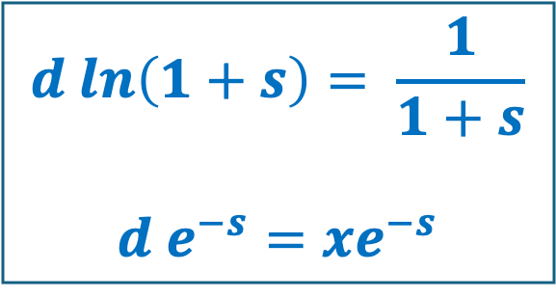
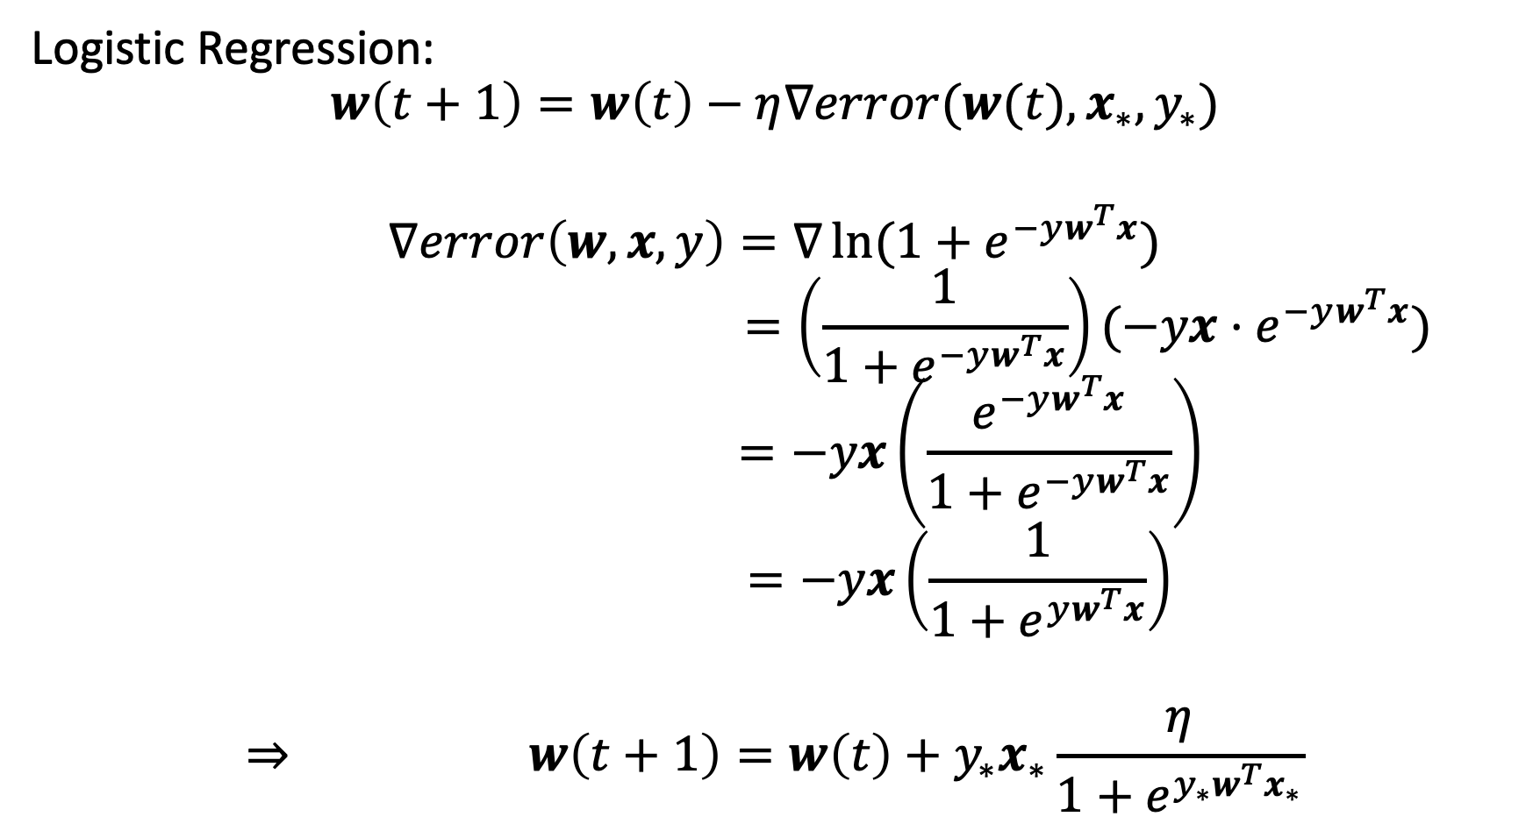
Stochastic Gradient Descent for Logistic Regression
Logistic Regression:
$$w\left(t+1\right)=w\left(t\right)−η∇error(w(t),x_{∗},y_{∗})$$
$$∇error\left(w,x,y\right)=∇\ln{(1+e^{−yw^{T}x})}$$
$$=\left(\frac{1}{1+e^{−yw^{T}x}}\right)(−yx⋅e^{−yw^{T}x})$$
$$=−yx\left(\frac{e^{−yw^{T}x}}{1+e^{−yw^{T}x}}\right)$$
$$=−yx\left(\frac{1}{1+e^{yw^{T}x}}\right)$$
$$⇒ w\left(t+1\right)=w\left(t\right)+y_{∗}x_{∗}\frac{η}{1+e^{y_{∗}w^{T}x_{∗}}}$$
$$d ln\left(1+s\right)= \frac{1}{1+s}$$
$$d e^{−s}=xe^{−s}$$

Slide 30

SGD for Logistic Regression
$w\left(t\right)+η\frac{1}{N}\sum_{n=1}^{N}{y_{n}x_{n}θ(−y_{n}w^{T}x_{n})}$ $w\left(t\right)+η⋅y_{∗}x_{∗}θ(−y_{∗}w^{T}x_{∗})$

Slide 31
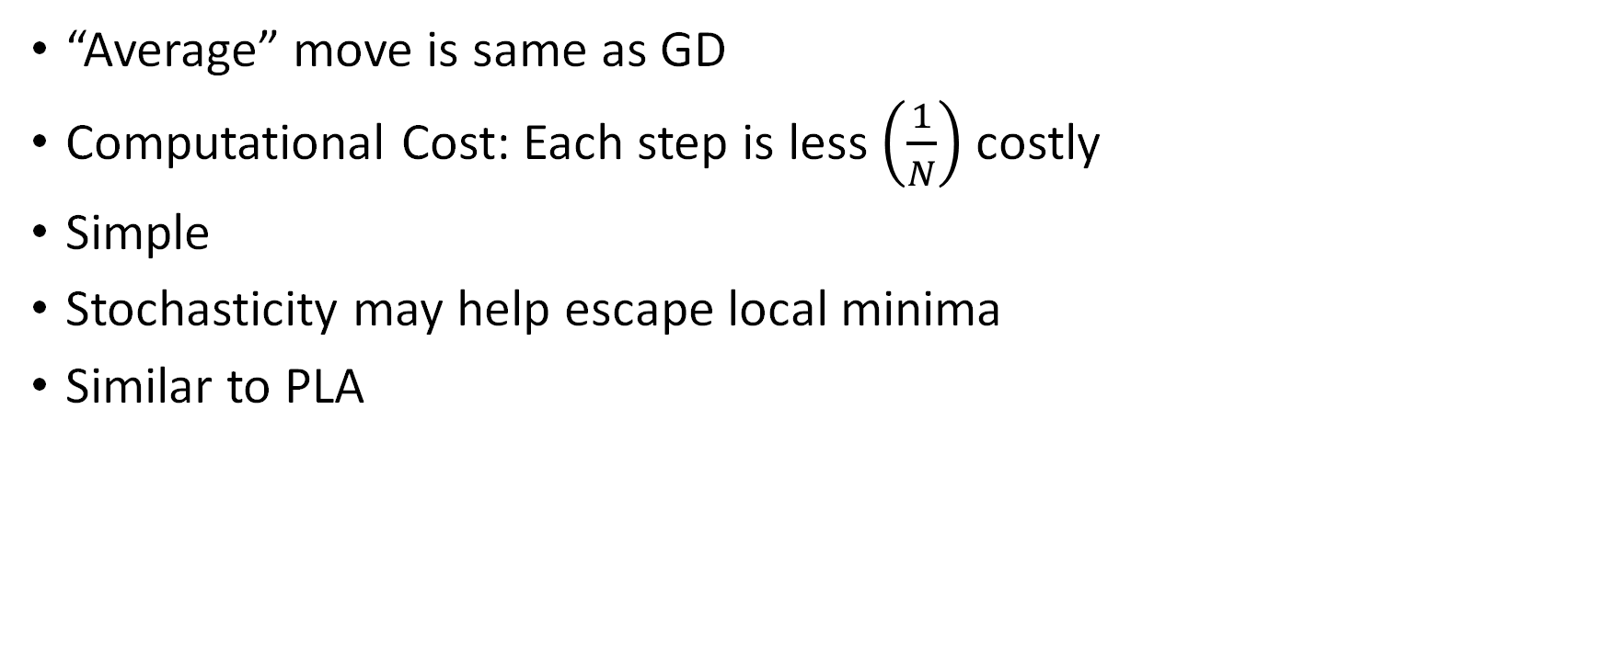
Why Stochastic Gradient Descent?
“Average” move is same as GD
Computational Cost: Each step is less $\left(\frac{1}{N}\right)$ costly
Simple
Stochasticity may help escape local minima
Similar to PLA

