Slide 1
SELF-RAG:LEARNING TO RETRIEVE, GENERATE, AND CRITIQUE THROUGH SELF-REFLECTION
Name : Ankita Patra
B-number : B01101280

Slide 2
Introduction
Modern LLMs still make factual mistakes even with large training data.
Traditional RAG is not always reliable because it often retrieves irrelevant or unhelpful documents.
SELF-RAG improves this by deciding when to retrieve information instead of always retrieving.
It uses reflection tokens to check relevance, support, and the correctness of its own answers.
By retrieving only when needed and choosing the best-supported answer, SELF-RAG achieves higher accuracy than ChatGPT, Llama2-chat, and Alpaca on reasoning, fact-checking, and long-form tasks.code and trained models are available at https://selfrag.github.io/.
Notes:
“Modern large language models are powerful, but they still make factual mistakes because they rely only on what they learned during training. Traditional RAG tries to fix this by retrieving documents, but it often retrieves irrelevant or unnecessary information. SELF-RAG solves this by letting the model decide when to retrieve information and by using special reflection tokens to check whether the retrieved passages are relevant and whether the model’s own answer is correct. This helps SELF-RAG achieve higher factual accuracy than other models like ChatGPT, Llama2-chat, and Alpaca.”

Slide 3
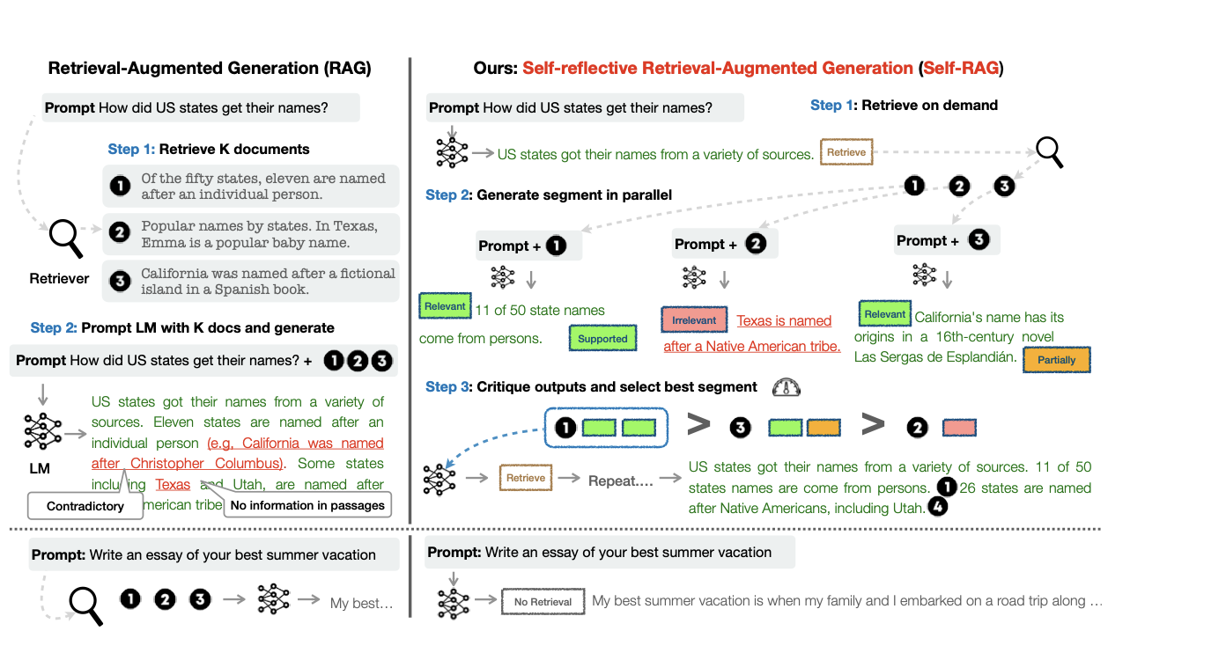
Figure 1: Overview of SELF-RAG. SELF-RAG learns to retrieve, critique, and generate text passages
to enhance overall generation quality, factuality, and verifiability.
Notes:
“This figure shows the difference between traditional RAG and SELF-RAG. Traditional RAG always retrieves a fixed number of documents and forces the model to use them—even if they’re irrelevant. SELF-RAG is more intelligent. It retrieves only when needed, evaluates each document for relevance and support, generates multiple answer options, and critiques them to choose the best one. This leads to much more accurate and reliable responses.”

Slide 4
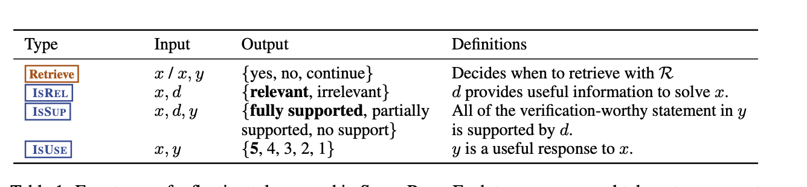
Retrieval-Augmented Generation (RAG)
-> RAG enhances LLMs by adding retrieved text passages to their input.
-> Helps improve performance on knowledge-heavy tasks.
-> Early RAG methods retrieved a fixed number of documents before generation.
-> Some models jointly train the retriever + LLM or add retrieved passages during instruction tuning.
-> Newer methods attempt adaptive retrieval, but often suffer from:
slower run-time,
sensitivity to irrelevant documents,
missing or incorrect citations.
Table 1: Four types of reflection tokens used in SELF-RAG. Each type uses several tokens to represent its output values. The bottom three rows are three types of Critique tokens, and the bold text indicates the most desirable critique tokens. x,y,dindicate input, output, and a relevant passage, respectively.
Notes:
“RAG enhances language models by supplying retrieved documents as extra context. This helps with knowledge-intensive tasks, but it has limitations—such as retrieving irrelevant passages, not updating retrieval during generation, and producing answers without clear attribution. These problems reduce both accuracy and trust.”

Slide 5
Challenges in Existing RAG Methods(Limitations of Previous RAG Approaches)
How SELF-RAG Improves RAG?
Trains any LLM to retrieve only when necessary.
Uses reflection tokens to:
decide when to retrieve,
judge relevance,
evaluate factual support.
Produces controlled, evidence-aligned generations.
More robust to irrelevant context and gives better attributions.
Keypoint : SELF-RAG makes retrieval smarter, selective, and evidence-aware.
Retrieval happens once, not throughout generation.
Often retrieves information even when it isn’t needed.
Sometimes includes off-topic or irrelevant documents → lowers answer quality.
Struggles with attribution hard to know which fact came from which passage.
Adaptive retrieval methods exist but require proprietary LMs or are computationally expensive.
Key point : Traditional RAG lacks control, adaptiveness, and trustworthy citations.
Training SELF-RAG with Critique Signals ?
Instead of expensive RLHF, SELF-RAG uses a critic model trained offline.
Critic generates reflection tokens that label:
relevance,
support,
usefulness,
retrieval need.
These labels are inserted into training data.
The final LLM learns to self-evaluate its own outputs during inference.
Note : A low-cost critic model teaches the LLM to think about when and why to retrieve information.
Notes:
“Existing RAG systems retrieve information only once at the beginning, often when retrieval is not needed. They sometimes mix irrelevant documents with relevant ones, lowering answer quality. They also struggle to show which part of the answer came from which source. And adaptive RAG methods require heavy computation or proprietary models.”
-> “SELF-RAG trains any language model to retrieve only when necessary. It uses reflection tokens to decide when to retrieve, to evaluate the relevance of retrieved passages, and to judge if the answer is fully supported. This results in more factual, controlled, and evidence-aligned responses.”
->“Instead of using expensive RLHF, SELF-RAG uses a critic model trained offline to create reflection tokens. These tokens label relevance, support, usefulness, and retrieval need. The model then learns self-evaluation by training on these tokens, making the overall process cheaper and more effective.”

Slide 6
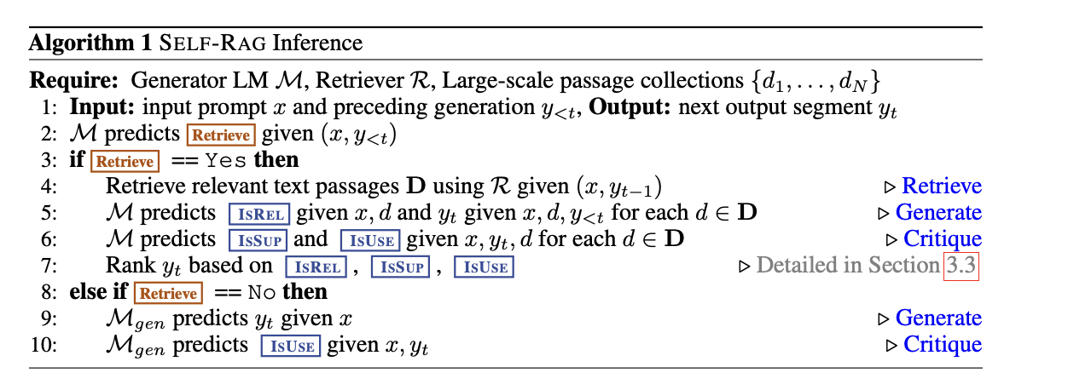
3 SELF-RAG: LEARNING TO RETRIEVE, GENERATE AND CRITIQUE -> PROBLEM FORMALIZATION AND OVERVIEW
SELF-RAG DETAILS
Reflection tokens help the model decide when to retrieve, whether the retrieved text is relevant, how well the answer is supported, and how useful the final response is.
GPT-4 is used to generate training examples for these tokens, and only well-formatted outputs are kept.
Human checks show high agreement with GPT-4’s labels, meaning GPT-4 gives reliable judgments for these fine-grained reflection categories.
SELF-RAG lets the model retrieve information only when needed and check its own answers using special reflection tokens. This makes the model more accurate and reliable than normal RAG, which retrieves documents blindly.
Notes:
“Reflection tokens tell the model four things: whether retrieval is needed, whether a passage is relevant, whether the answer is supported by evidence, and how useful the overall answer is. These fine-grained labels help SELF-RAG judge the quality of each segment during generation.”

Slide 7
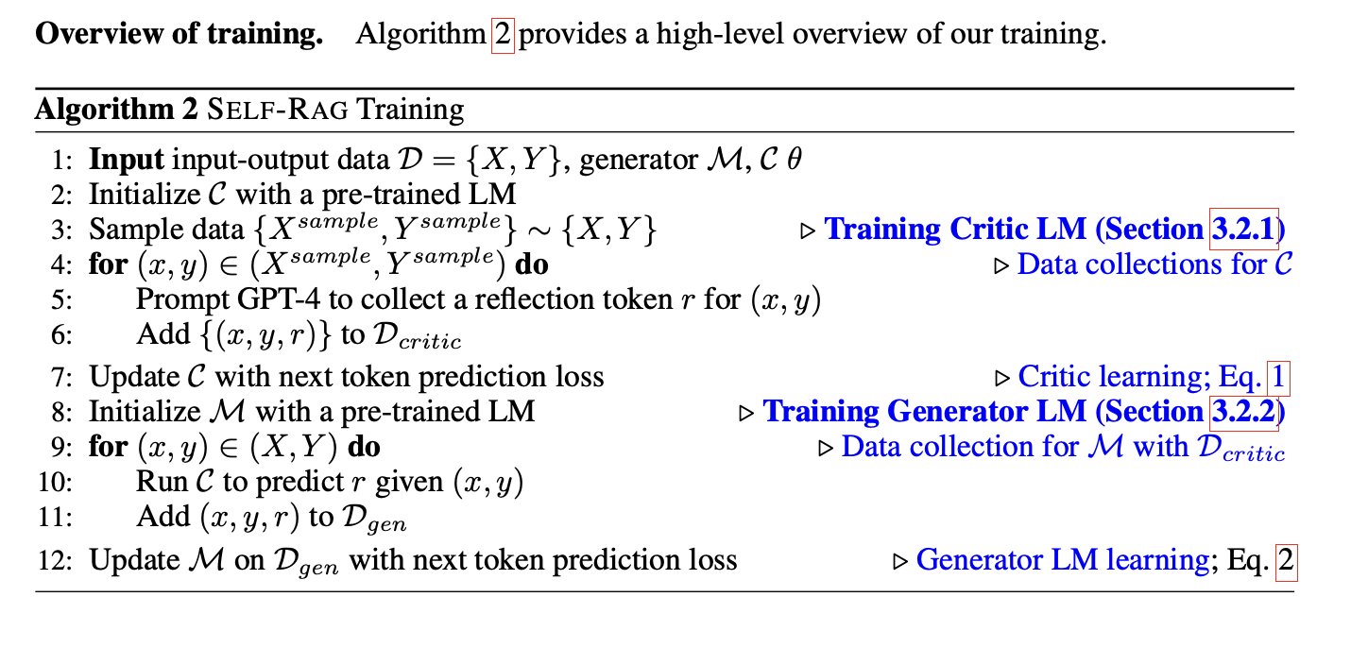
Inference overview
Training overview
SELF-RAG expands a model’s vocabulary by adding reflection tokens, which the model learns to generate just like regular tokens.
The generator model M is trained on data that includes retrieved passages and reflection tokens produced by a separate critic model C.
The critic model evaluates passages and outputs, then inserts the correct reflection tokens into the training data.
After this offline preparation, the generator model is trained normally so it can produce reflection tokens on its own during inference without needing the critic anymore.
SELF-RAG first checks if it needs to retrieve information by generating a special retrieval token.
If retrieval is not needed, it simply continues generating the answer like a normal language model.
If retrieval is needed, it evaluates each retrieved passage for relevance and factual support using critique tokens.
It then generates the next part of the answer based on the best-supported passage.
In Figure 1, passage d1 is chosen because d2 is irrelevant and d3 only partially supports the answer.
Since d1 is fully supported, Algorithm 1 selects it as the best choice.
Notes:
-> “During inference, SELF-RAG decides whether retrieval is needed using a retrieval token. If retrieval is not needed, it continues generating. If it is, SELF-RAG checks each passage for relevance and support, generates multiple answers, and selects the best one. For example, in Figure 1, passage d1 is chosen because it is fully supported while d2 is irrelevant and d3 is only partially supported.”
-> “SELF-RAG expands the model’s vocabulary by adding reflection tokens. The critic first labels each example with these tokens, and then the generator model is trained to produce both the main answer and the reflection tokens. After training, the generator no longer needs the critic—it can critique itself.”

Slide 8
3.2 SELF-RAG TRAINING
Here, we describe the supervised data collection and training of two models, the critic C(Section 3.2.1) and the generator M(Section 3.2.2).
3.2.1 TRAINING THE CRITIC MODEL :
Manually labeling reflection tokens for every segment is expensive and time-consuming.
Instead, the authors use GPT-4 to automatically generate reflection tokens as feedback.
But relying directly on GPT-4 is costly and reduces reproducibility, so they only use it once to create training data.
They prompt GPT-4 with special instructions for each type of reflection token (e.g., whether retrieval is needed).
GPT-4’s judgments closely match human evaluations, so they are reliable.
They generate 4k–20k examples for each reflection token type and combine them into the training dataset.
This dataset is then used to train the critic model C, which learns to produce reflection tokens on its own
Prompting-based retrieval methods are not suitable because SELF-RAG needs detailed, fine-grained self-reflection, which makes prompts very long, costly, and slow. In early tests, models like GPT-3 and Llama2-chat struggled to follow complex reflection instructions, producing wrong formats and inaccurate reflections. SELF-RAG relies on token-level probability scores for reflection tokens, which many black-box APIs (like ChatGPT/GPT-4) don’t provide, making prompting-based methods impractical.
Notes:
“Manually labeling reflection tokens is expensive, so GPT-4 is used to create high-quality labels. These labels are then used to train the critic model. The critic achieves over 90% agreement with GPT-4, showing strong reliability.”

Slide 9
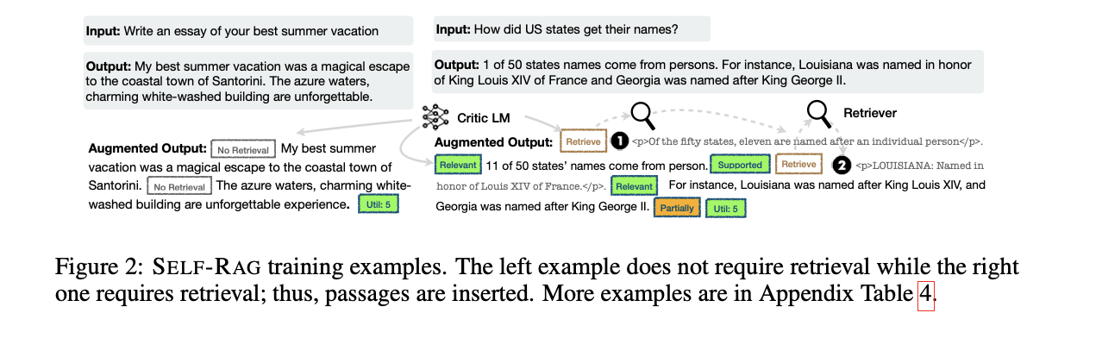
Critic learning :
The collected dataset (Dcritic) is used to train the critic model using standard language-model training.
They initialize the critic with a pre-trained Llama-2 7B model, the same base model used for the generator.
After training, the critic matches GPT-4’s reflection-token predictions with over 90% accuracy.

Slide 10
3.2.2 TRAINING THE GENERATOR MODEL :
Data collection for generator :
For each input–output pair, the system uses the critic model to check every sentence and decide whether retrieval is needed. If retrieval is required, the retriever pulls the top passages, and the critic labels each one for relevance (ISrel) and factual support (ISsup). These reflection tokens are added to the output, and at the end of the answer the critic also adds a usefulness score (ISUSE). This creates training data that closely matches how SELF-RAG behaves during inference.
Generator learning :
We train the generator model Mby training on the curated corpus augmented with reflection tokens Dgen using the standard next token objective:
The generator model is then trained on this augmented dataset using a standard next-token prediction objective. It learns not only to generate the answer but also to produce the reflection tokens. Retrieved passage text is masked out during training, and the model’s vocabulary is expanded to include the new reflection tokens.
Connections to prior work on learning with critique :
Unlike RLHF methods that require expensive reward models and PPO, SELF-RAG adds critique signals offline and trains the model with a simple language modeling objective. This makes training cheaper and more efficient. By learning to generate reflection tokens after each segment, SELF-RAG can later enforce soft or hard constraints to improve factuality during inference.
Notes:
“For each dataset example, the critic decides when retrieval is needed and labels each passage for relevance, support, and usefulness. These reflection tokens are added to the data. The generator then learns to predict both the answer and the tokens. This teaches it to critique itself during inference.”

Slide 11
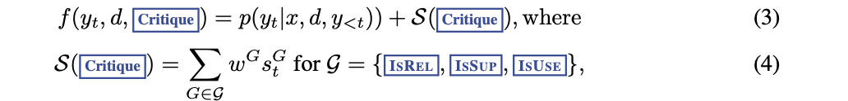

3.3 SELF-RAG INFERENCE
Why Reflection Tokens Matter ?
SELF-RAG creates reflection tokens to judge its own answers, which gives you control during inference. If the task needs strong factual accuracy, the model retrieves more passages. If the task is creative (like writing a story), it retrieves less. This allows SELF-RAG to flexibly adjust its behavior depending on what the task needs.
Adaptive retrieval with threshold : SELF-RAG dynamically decides when to retrieve text passages by predicting Retrieve . Alternatively, our framework allows a threshold to be set. Specifically, if the probability of generating the Retrieve =Yes token normalized over all output tokens in Retrieve designated threshold, we trigger retrieval (details in Appendix Section A.4). Tree-decoding with critique tokens : At each segment step t, when retrieval is required, based either on hard or soft conditions, Rretrieves Kpassages, and the generator Mprocesses each passage in parallel and outputs Kdifferent continuation candidates. We conduct a segment-level beam search (with the beam size=B) to obtain the top-Bsegment continuations at each timestamp t, and return the best sequence at the end of generation. The score of each segment yt with respect to passage dis updated with a critic score Sthat is the linear weighted sum of the normalized probability of each Critique token type. For each critique token group G(e.g., ISREL ), we denote its score at timestamp tas sG t , and we compute a segment score as follows:
Where ,
stands for the generation probability of the most desirable reflection token
The weights wG in Eq. 4 are hyperparameters that can be adjusted at inference time to enable customized behaviors at test time. For instance, to ensure that result y is mostly supported by evidence, we can set a weight term for the ISSUP score higher, while relatively lowering weights for other aspects. Alternatively, we could further enforce hard constraints during decoding using Critique e.g., filtering out a segment continuation when the model generates anundesirable token (e.g., ISSUP =No support).
Notes:
“SELF-RAG allows dynamic control at inference. You can adjust how strictly the model checks evidence or how often it retrieves. The model evaluates continuation segments using a weighted combination of reflection token scores. This lets users choose between higher factual precision or more fluency.”

Slide 12
4 EXPERIMENTS
4.1 TASKS AND DATASETS
4.2 BASELINES
We tested SELF-RAG and other models on many tasks to measure correctness, factual accuracy, and fluency.
All evaluations were zero-shot, meaning models only got instructions and no example answers.
Closed-set tasks included PubHealth (fact-checking) and ARC-Challenge (multiple-choice reasoning), measured using accuracy.
Short-form QA tasks included PopQA and TriviaQA, where the model must answer open-domain factual questions.
For PopQA, we used the long-tail subset with rare entities; for TriviaQA, we used a standard test split.
We evaluated short-form QA by checking whether the model’s output contains the correct answer.
Long-form tasks included biography generation and ASQA, which require paragraph-level answers.
Biographies were scored using FactScore, and ASQA was evaluated using correctness, fluency (MAUVE), and citation precision/recall.
Baselines without retrieval: The authors first compare SELF-RAG to models that do not use retrieval. These include popular open-source models like Llama 2 (7B and 13B), Alpaca (7B and 13B), and also proprietary models like ChatGPT and Llama2-chat. They also compare with CoVE-65B, a method that uses advanced prompting to improve factual accuracy.
Baselines with retrieval: Next, they compare SELF-RAG to models that do use retrieval. This includes standard RAG setups where models like Llama2 or Alpaca receive retrieved documents before generating an answer. They also include versions fine-tuned without reflection tokens (Llama2-FT), plus retrieval-augmented ChatGPT and Llama2-chat. Other advanced retrieval training methods like SAIL and Toolformer are also included.
https://github.com/princeton-nlp/ALCE
4.3 EXPERIMENTAL SETTINGS
Training data and settings :
The model is trained on 150k diverse instruction–output examples taken from Open-Instruct and several knowledge-heavy datasets. Llama-2 (7B/13B) is used as the generator model, Llama-2-7B as the critic, and Contriever-MS MARCO is used to retrieve up to 10 documents per query.
Inference settings:
During inference, the reflection token weights are set to ISREL = 1.0, ISSUP = 1.0, and ISUSE = 0.5. The retrieval threshold is 0.2 (and 0 for ALCE). They use vLLM for faster inference, beam width 2 for segment-level search, and greedy decoding for tokens. By default, the top 5 retrieved documents are used, with extra documents added from web search for biographies/QA and GTR-XXL documents for ASQA.
Notes:
“We evaluate SELF-RAG across six tasks, including fact-checking, multiple-choice reasoning, open-domain QA, biography generation, and long-form QA. We use metrics like accuracy, FactScore, MAUVE, and citation precision to measure quality.”
-> “We compare SELF-RAG to strong baselines both with and without retrieval—such as Llama2, Alpaca, ChatGPT, Llama2-chat, RAG setups, Llama2-FT, SAIL, and Toolformer. This gives a fair and comprehensive evaluation.”
-> “The model is trained on 150k diverse instruction-following examples. We use Llama-2 as both the generator and critic base model. During inference, we adjust reflection token weights and set retrieval thresholds to match different task needs.”

Slide 13
RESULTS
ANALYSIS
The analysis shows that every part of SELF RAG is important for its strong performance. When the model is trained without retrieval or without the critic’s reflection tokens, its accuracy drops a lot. Likewise, using only the top retrieved passage or removing the ISSUP support check during inference also hurts results, proving that SELF RAG works because it carefully evaluates relevance and evidence. The framework also allows customization at inference: increasing the weight of ISSUP improves citation precision but slightly reduces fluency, letting users choose between stricter factual accuracy or more natural writing. Finally, adjusting the retrieval threshold δ changes how often the model retrieves information higher thresholds mean fewer retrievals. This affects tasks differently: PopHealth remains stable, while PopQA suffers more when retrieval decreases, showing a clear trade-off between efficiency and accuracy.
SELF-RAG performs much better than models that don’t use retrieval, even beating ChatGPT in tasks like PubHealth, PopQA, biography writing, and ASQA. It also outperforms advanced methods like CoVE, which uses complicated prompting. When compared to models that do use retrieval, SELF-RAG still gives the best results among all open-source models. Other retrieval-based models often fail to improve accuracy or citations, but SELF RAG achieves much higher citation precision sometimes even better than ChatGPT. This shows that SELF RAG works well not just because of the training data, but because its method of retrieval + self-reflection is genuinely more effective.
Notes:
“SELF-RAG consistently outperforms models without retrieval and even beats ChatGPT on several tasks like PubHealth, PopQA, biography generation, and ASQA. It also outperforms sophisticated prompting methods like CoVE.”
“Even compared to RAG-based baselines, SELF-RAG delivers the best performance among open-source models. It significantly improves citation accuracy and in some cases even surpasses ChatGPT in citation precision.”
“Ablation studies show that every component of SELF-RAG is important. Removing retrieval, removing the critic, or ignoring ISSUP hurts performance. The system also allows customization at inference—giving users control over factuality versus fluency.”

Slide 14
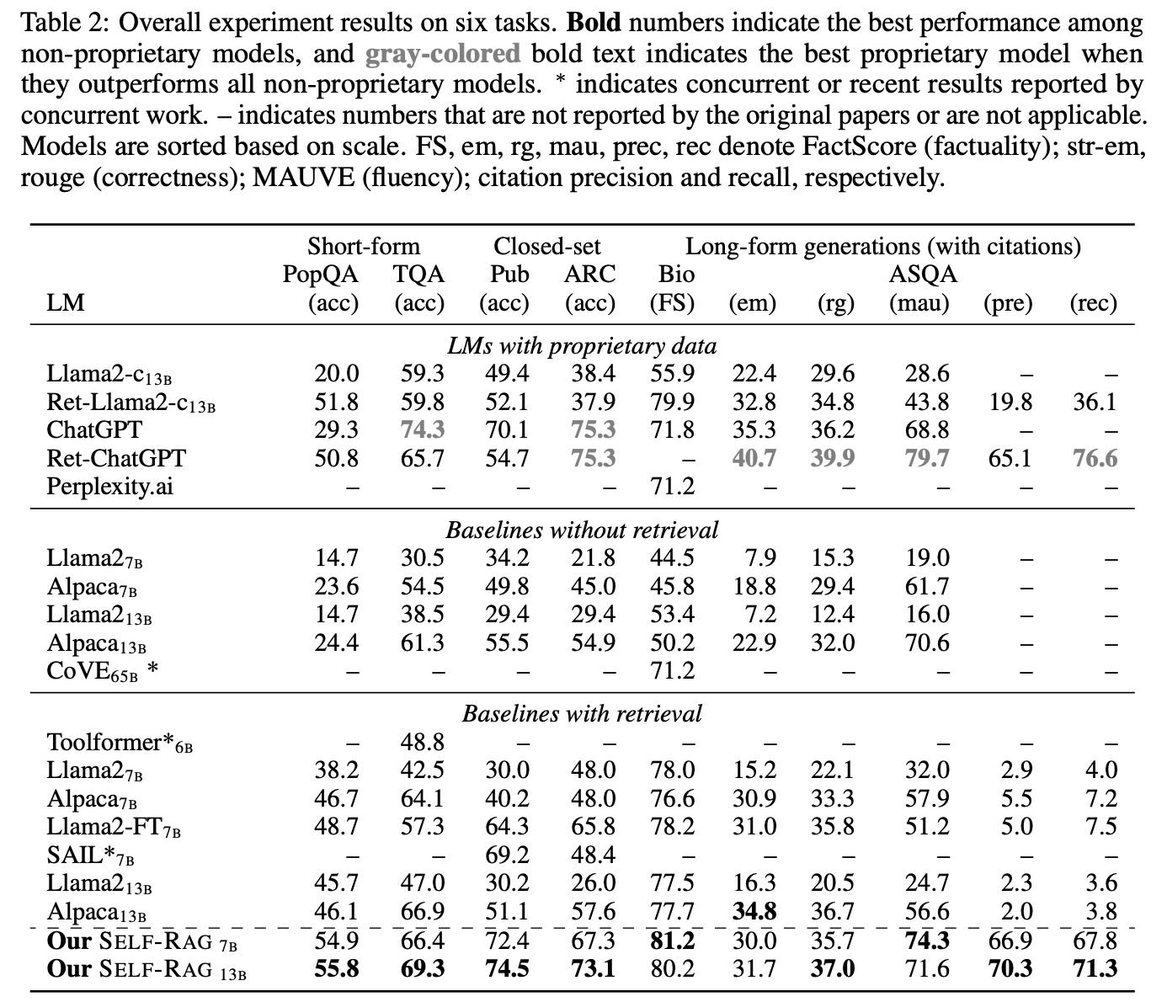

Slide 15
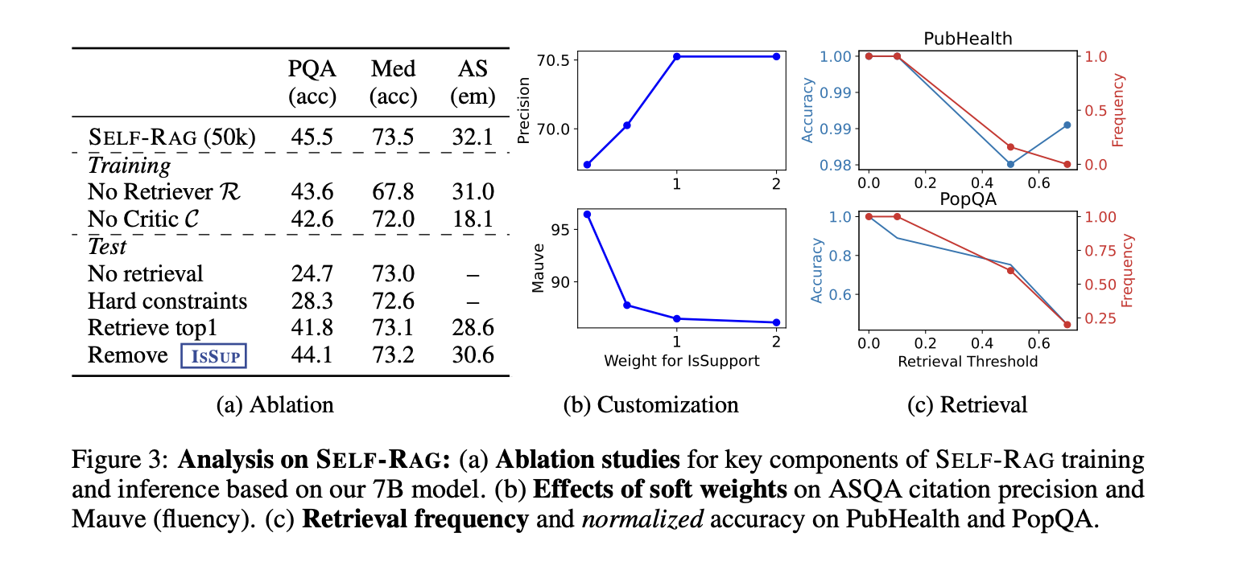

Slide 16
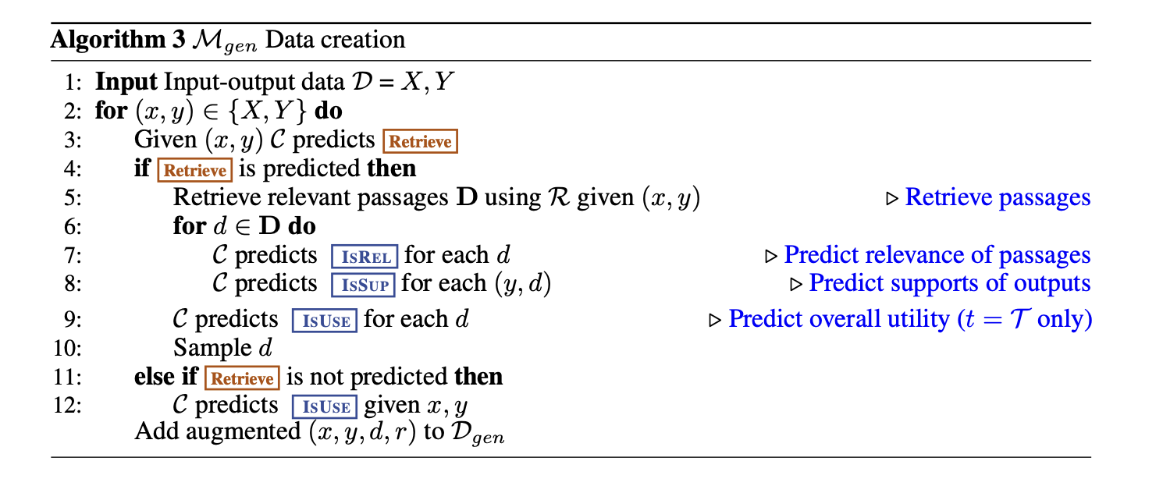
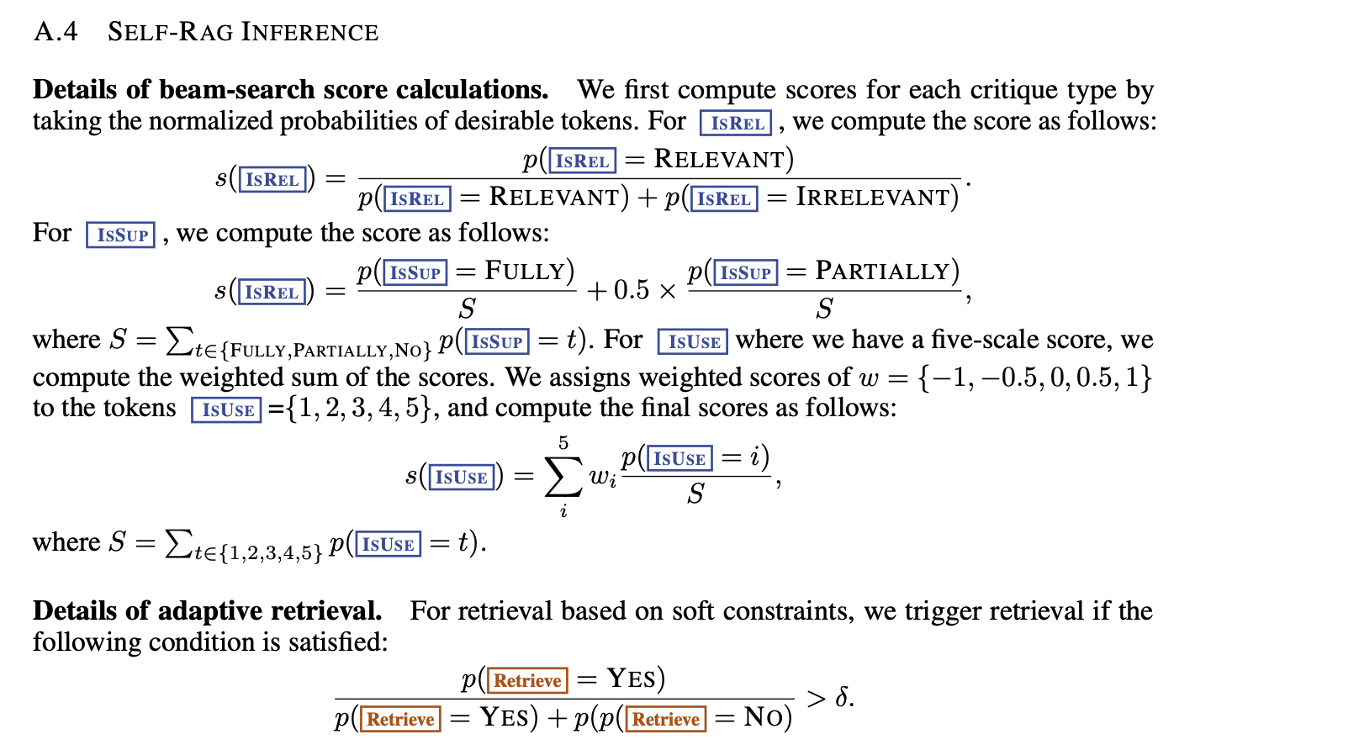
The training data for SELF-RAG is created by using the critic model to decide when retrieval is needed, inserting relevant passages and reflection tokens for each sentence, and balancing the dataset by down-sampling easy cases and up-sampling difficult ones.

Slide 17
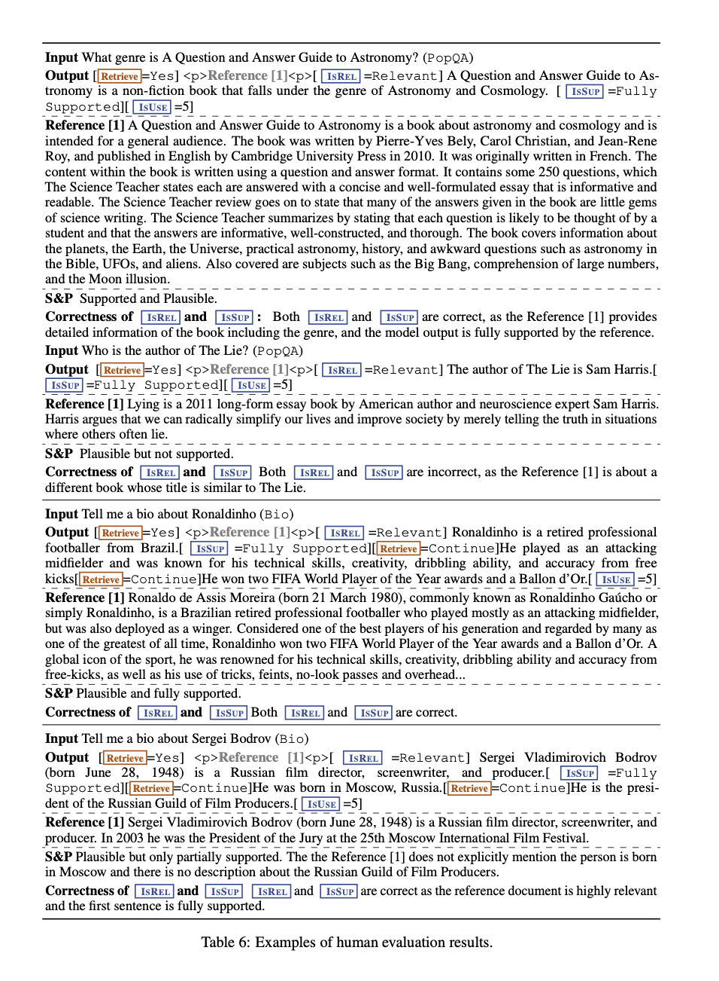
Human evaluation
Human evaluations show that SELF-RAG’s answers are usually plausible and well-supported by evidence, and its reflection tokens (ISREL and ISSUP) mostly match human judgments. Annotators reviewed examples from PopQA and biography tasks and confirmed that SELF-RAG correctly identifies relevant passages, flags contradictions, and marks partially supported claims when evidence is incomplete.
Notes:
“Human evaluators confirm that SELF-RAG’s answers are both plausible and well-supported. They also confirm high agreement with reflection token predictions, proving that SELF-RAG reliably identifies correct evidence.”
“In summary, SELF-RAG is a powerful framework that makes language models more accurate, more factual, and more controllable. By retrieving only when needed and critiquing its own outputs, it achieves better performance than larger models and conventional RAG systems.”

Slide 18
6 CONCLUSION
This work introduces SELF-RAG, a method that improves the accuracy and quality of large language models by letting them retrieve information only when needed and reflect on their own answers. It trains the model to retrieve, generate, and critique text using both normal tokens and new “reflection tokens.” These tokens also allow users to control the model’s behavior during testing. Experiments on six different tasks show that SELF-RAG performs much better than larger models and standard RAG systems.

Slide 19
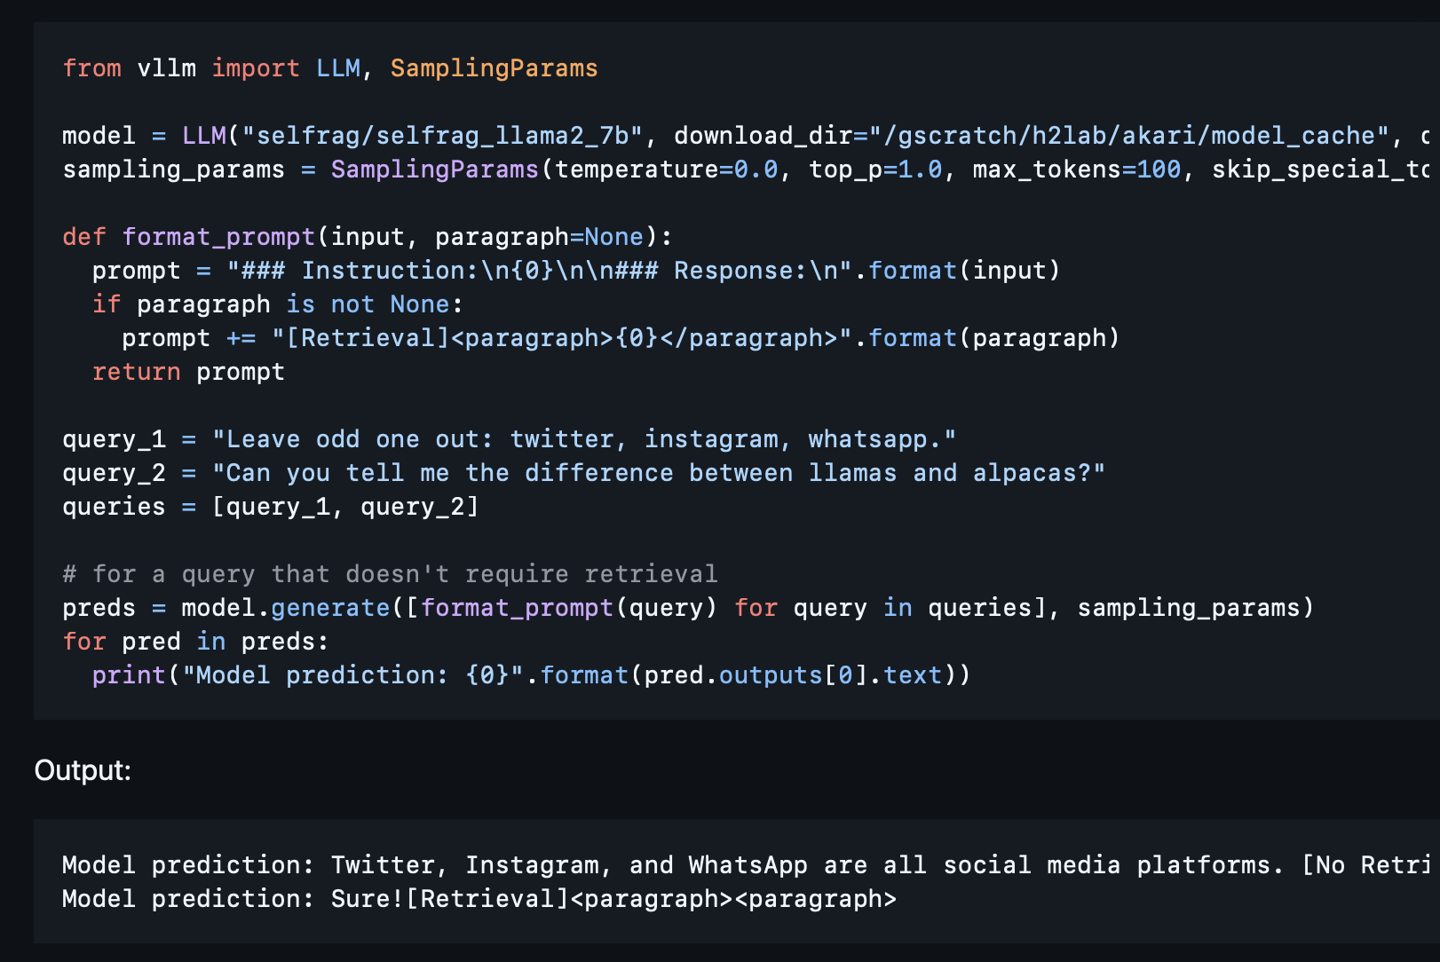
Code :
Retriver setup :
cd retrieval_lm
wget https://dl.fbaipublicfiles.com/dpr/wikipedia_split/psgs_w100.tsv.gz
And run : cd retrieval_lm
python passage_retrieval.py \
--model_name_or_path facebook/contriever-msmarco --passages psgs_w100.tsv \
--passages_embeddings "wikipedia_embeddings/*" \
--data YOUR_INPUT_FILE \
--output_dir YOUR_OUTPUT_FILE \
--n_docs 20
Generate embeddings for your own data:
cd retrieval_lm
for i in {0..3}; do
export CUDA_VISIBLE_DEVICES=${i}
python generate_passage_embeddings.py --model_name_or_path facebook/contriever-msmarco \
--output_dir YOUR_OUTPUT_DIR \
--passages YOUR_PASSAGE_DATA --shard_id ${i} --num_shards 4 > ./log/nohup.my_embeddings.${i} 2>&1 &
-> pip install -r requirements.txt
-> conda env create -f environment.yml

Slide 20
Critic training
Generator Training: cd retrieval_lm
bash script_finetune_7b.sh
Question Answering :
python run_short_form.py \
--model_name selfrag/selfrag_llama2_7b \
--input_file eval_data/popqa_longtail_w_gs.jsonl \
--mode MODE --max_new_tokens 100 \
--threshold 0.2 \
--output_file YOUR_OUTPUT_FILE \
--metric match --ndocs 10 --use_groundness --use_utility --use_seqscore \
--dtype half
mode specifies the inference time mode among ['adaptive_retrieval', 'no_retrieval', 'always_retrieve'].
adaptive_retrieval retrieves given the threshold or Self-RAG prediction
no_retrieval disables retrieval at inference time
always_retrieve always retrieves.
cd data_creation
torchrun --nproc_per_node=2 \
--master_port=2568 train_special_tokens.py \
--model_name_or_path meta-llama/Llama-2-7b-hf \
--data_path PATH_TO_TRAIN_DATA_FILE \
--bf16 True \
--output_dir PATH_TO_CRITIC_MODEL \
--num_train_epochs 3 \
--per_device_train_batch_size 1 --per_device_eval_batch_size 1 \
--gradient_accumulation_steps 8 \
--evaluation_strategy "no" \
--save_strategy "steps" \
--save_steps 300 \
--save_total_limit 1 \
--learning_rate 2e-5 \
--weight_decay 0. \
--warmup_ratio 0.01 \
--lr_scheduler_type "cosine" \
--logging_steps 10 \
--fsdp "full_shard auto_wrap"

Slide 21
Q & A

