Slide 1
CS 551
Spring 2025

Slide 2
Generics
Let’s make a program that finds the largest number in a list.
We’ll start with a vector
E.g., vec![35, 50, 25, 100, 65]
Then we will find the largest number and print it out
Let’s do it with a simple iterator
Give it a try…

Slide 3
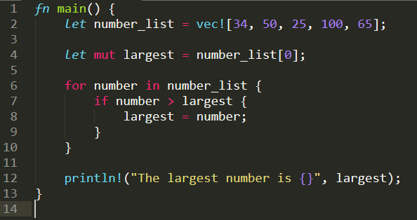

Slide 4
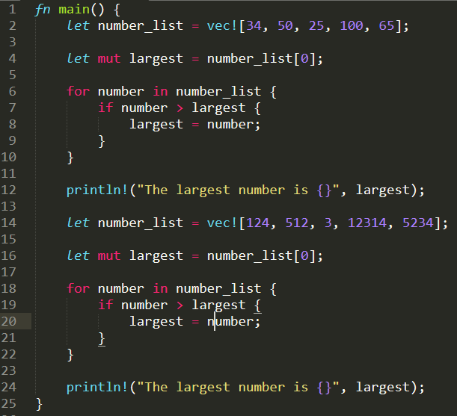
And if we wanted to look through two lists?

Slide 5
Let’s abstract this out to a function…
Give it a try
fn largest(list: &[i32]) -> &i32 { … }
What did we do?
Identify duplicate code
Extract duplicate code into a function
Specifying input and return type
Update two instances of our code to use the new function
We would have to do this for every type of list!

Slide 6
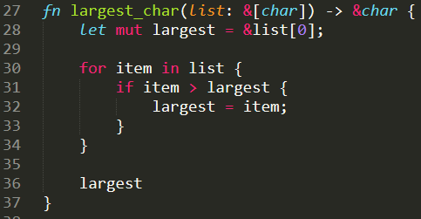
Generic Data Types
What if we want to also be able to find the largest character?
Let’s try it: fn largest_char(list: &[char]) -> &char { … }

Slide 7
Generic Data Types
We’ve already seen the syntax
Vec<u32>, etc.
A signature of a generic function looks like:
fn function_name<T>(param: T) -> T { … }
Let’s try to make our largest function generic…

Slide 8
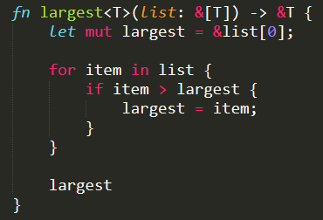

Slide 9
Will it compile?

Slide 10
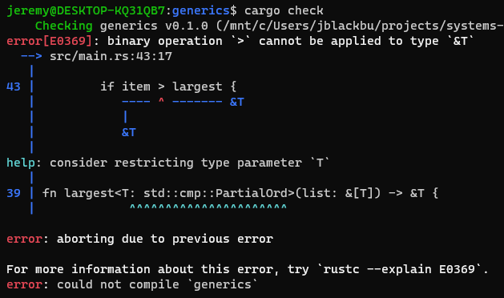

Slide 11
This PartialOrd is a trait

Slide 12
This means that largest won’t work for all possible types because not all possible types have a partial ordering ( > ) on them!

Slide 13

Generics work for structs too

Slide 14
Generics work for structs too
Pint<T> struct is generic over some type T
x and y are both the same type T

Slide 15


Slide 16
Will it compile?

Slide 17
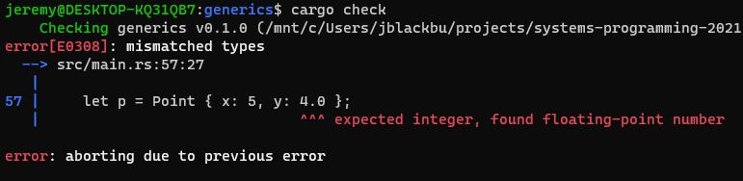

Slide 18
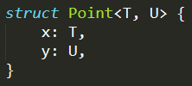
Point<T, U> struct is generic over some type T and U
x is type T and y is type U

Slide 19
Note that T and U can be different but don’t have to be

Slide 20
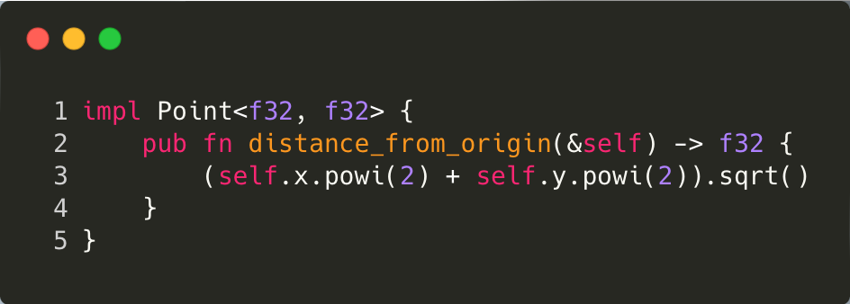

Slide 21
We’re writing an implementation for a Point<T, U> where T is an f32 and U is an f32

Slide 22
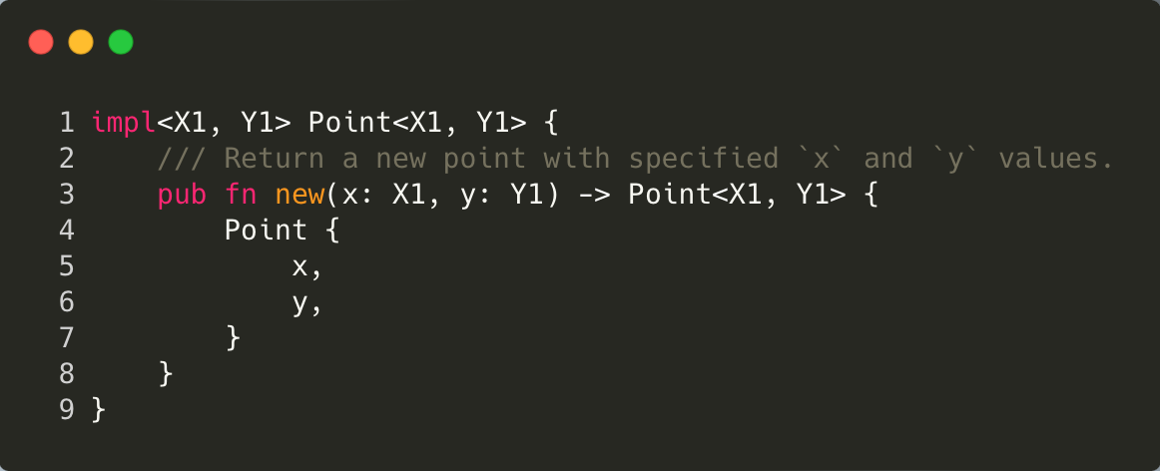

Slide 23
Now let’s write a completely generic implementation.

Slide 24
NB: The names for the generic types here don’t have to be the same as they were in the struct definition!
(but you usually don’t want to make them different unless there is a reason!)

Slide 25
Notice how anytime we are talking about a Point, we are always talking about it in terms of a generic Point with type parameters X1, and Y1.

Slide 26
When we put the <X1, Y1> after “impl” Rust understands that we are treating Point as a generic type instead of a concrete implementation

Slide 27
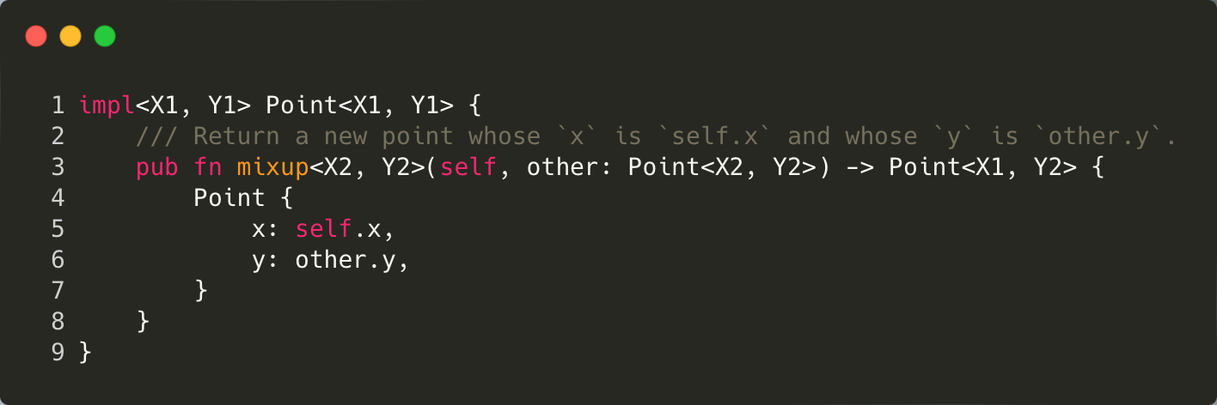

Slide 28
Now, we introduce two new type parameters to the function mixup

Slide 29
We will use those type parameters to make it so that self and other can be totally different concrete Point types!

Slide 30
We will be returning a Point whose x member is of type X1 and whose y member is of type Y2

Slide 31
Awesome! But wait…
Recall our distance_from_origin() function was defined on a concrete type (f32)
Why?!?!

Slide 32
Awesome! But wait…
Recall our distance_from_origin() function was defined on a concrete type (f32)
Is powi() implemented for Strings?

Slide 33
Awesome! But wait…
Recall our distance_from_origin() function was defined on a concrete type (f32)
We can’t call methods that aren’t defined for a type!
Duh!
This would be super constraining IRL...

Slide 34
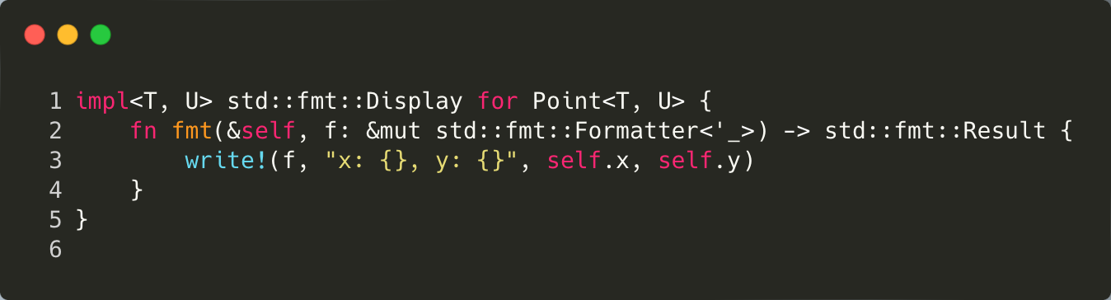
Let’s try to implement the Display trait
Will it compile?
Traits are shared, common functionality
we’ll talk about them more later
We’ve already seen stuff related to the Display trait
E.g., println!(”{}”, x) will fail unless x implements the Display trait

Slide 35
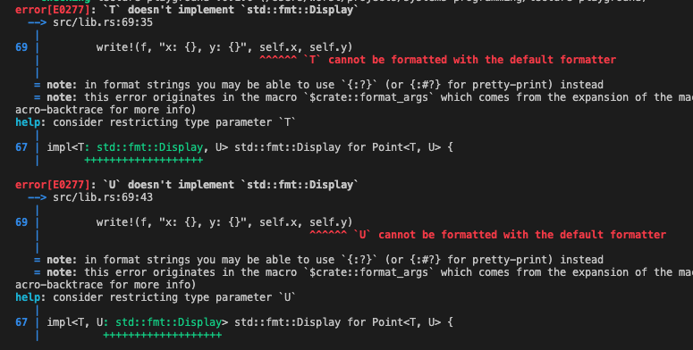

Slide 36
Generic Type Constraints
Display is what allows us to use all the string interpolation stuff
If we want to use self.x and self.y in a string interpolation, they both have to implement Display too!
But, we have only specified that they are of type T and U!
We want to say “this implementation of Display will only work for Point<T, U> such that both T and U also implement Display
We want to put a constraint on the generic types T and U!

Slide 37
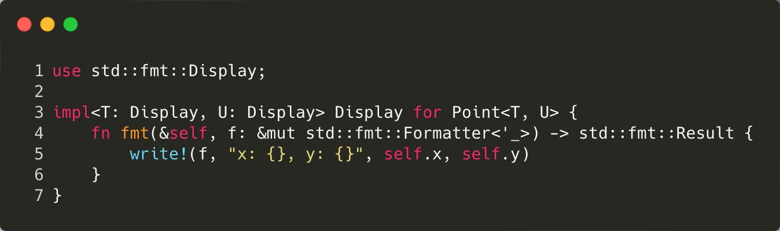

Slide 38
I’m importing std::fmt::Display to make it so we can just type Display so stuff will fit on the slides better, but you could use fully qualified type name

Slide 39
T: Display and U: Display when we declare the type parameters means that T and U are constrainted to types that implement Display

Slide 40
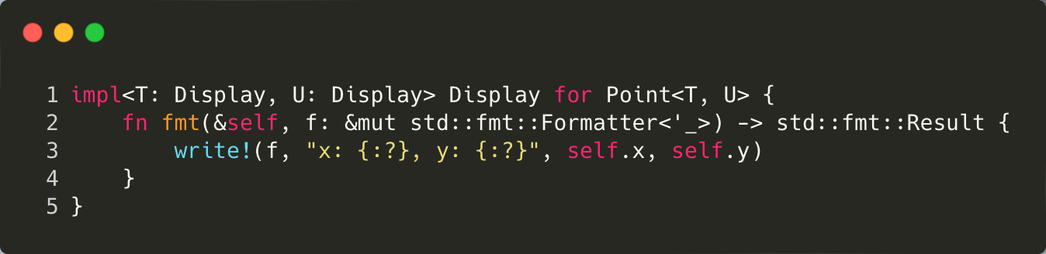

Slide 41
We are going to use the debug formatter (:?) now.

Slide 42
Will it compile?

Slide 43
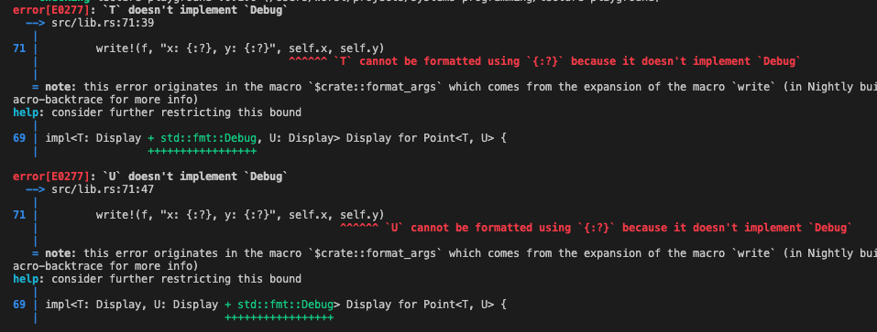
Will it compile?

Slide 44
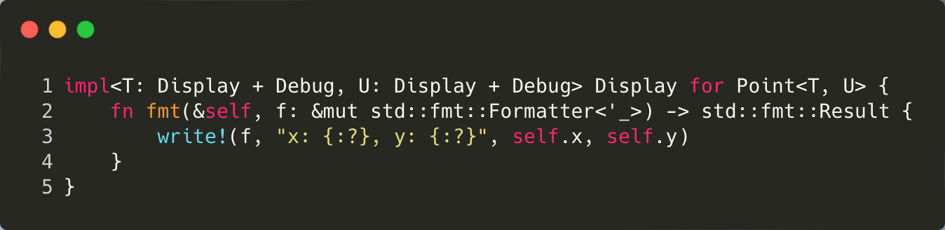
T has to implement both Display AND Debug

Slide 45
Performance?
Do you think there is a performance hit?
Is there some runtime cost?
For Rust, no!
Uses monomorphization
Fills in concrete types at compile time
This is different than Java which uses type erasure
Kinda different at least ☺
For type erasure, the compiler learns the concrete type at compile time, but then replaces it with a generic Object and typecasts
You can do this for run time dynamic dispatch in rust too (kinda)

Slide 46
Performance?
Rust actually inlines special functions.
This makes your executable bigger, but way more efficient in terms of executable speed
Do you think there is a performance hit?
Is there some runtime cost?
For Rust, no!
Uses monomorphization
Fills in concrete types at compile time
This is different than Java which uses type erasure
For type erasure, the compiler learns the concrete type at compile time, but then replaces it with a generic Object and typecasts
Additional overhead!

