Slide 1
CS 451/551
Spring 2025

Slide 2
Password cracking
Back in the day, when hacking a website, you would get a bunch of hashes
We want to hax0r the Gibson.
How do we recover passwords from the hashes?
Maybe we can brute force and store a list of passwords → hashes?
Then just look up whatever hash we want in a lookup tables
Easy!
Any problems?

Slide 3
How much storage would this need?
Assume 8 character, lowercase only passwords.
How many possible password?
26^8 = 208,827,064,576
Assume md5 is the hash (128 bits → 16 bytes)
Assume no compression
How much storage does this take?
208,827,064,576 * (16 + 8) = 5.0118495e+12 bytes = 5TB!
That’s a pretty big chunk of data even today.

Slide 4
How can we deal with this?
What if we could trade off storage (space) for compute (time)
We could use a lossless compression algorithm
Something like a zip file?
Any issues you can see?
Hashes are basically random numbers; not much for a compression algorithm to work with
Maybe we could use a specialized compression algorithm?
One that is aware of both our data and what we want to do with it

Slide 5
Precomputed hash chains
We want to precompute a data structure that
Given a hash function H, some set of passwords P, and an output of H called h
Can either find some password p such that H(p) = h or say that there is no such p.
How might we do this?
What if we create some reduction function R such that
R(h) = p
NB: R(h) = p does NOT imply that H(p) = h
I.e., we are not trying to invert H (we can’t really)
Wut?

Slide 6
Example (fake hash and reduction functions)
aaaa → H(aaaa) = 1234, R(1234) = a234 → H(a234) = 5481 → R(5481) = abcd
We can store only the first and last password.
Recompute the rest of the chain when needed
Example:
Given h = 5481
Apply R(5481) → abcd
abcd is one of our endpoints → our chain contains h
Now, walk the chain, and find the password that hashes to 5481
We can do this for any hash, just keep applying H() and R() until hit endpoint

Slide 7
Problems?
Are all our chains unique?
No!
Pigeon whole principle if |H(p)| > |p|!
We can have multiple chains that end up having the same endpoint, but different starting points!
Ideas on how to fix?

Slide 8
Idea
Our goal is to ensure that each chain is completely unique
What if our reduction function could make use of which link in the chain it’s working on?
I.e., R(h, k) != R(h, k + 1) where k is the link number.
This means that the only way our chains can merge is if the reduction function was used in exactly the same order.
I.e., the two chains are identical
This is a rainbow table!

Slide 9
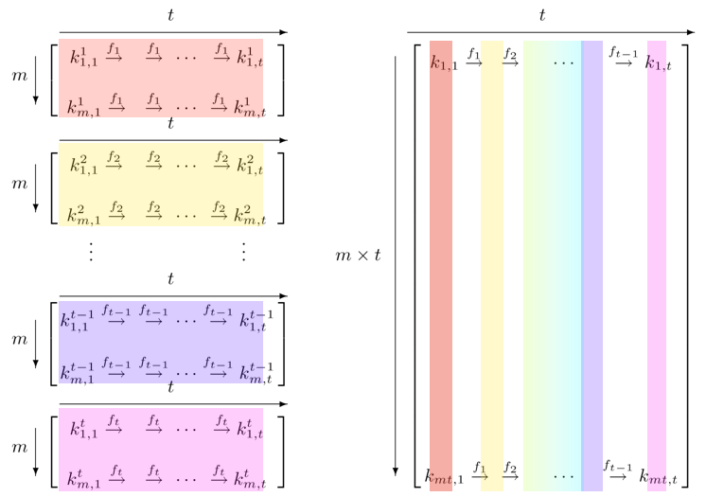
Rainbow Tables
Came from cryptography community
Called a rainbow table because this pic was used in the conference presentation
They are pretty much useless these days
Why are they useless?

Slide 10
Reduction functions
How do we find a good reduction function?
The goal is to do some mapping from a hash to a valid password
We are assuming that number of unique passwords can fit within the number the representation of the hash value.
For md5, this means number of unique passwords can fit in 128 bits (16 bytes)
Ideas?
What if we take the h and mod it by |P|
I.e., we mod it by the the total number of passwords possible
This gives us a number p_{i} that tells us which p the hash reduces to
E.g., for all lowercase passwords of length 3, p₀ = “aaa”, p₁ = “aab”, …, “zzz"

Slide 11
Making chains unique
We have a basic reduction function, but it can (and will) have chains that merge
How can we ensure they are unique?
Recall: We want to find some R(h, k) where k is the link number in the chain
What if we just do (h + k) mod |P| ?
Does this work? If so, why?
It works because the only way we get duplicates in our chains is if the reduction function was applied at the same link!
It had to start from the same starting password as the ”collision”

Slide 12
Let’s write some code

Slide 13
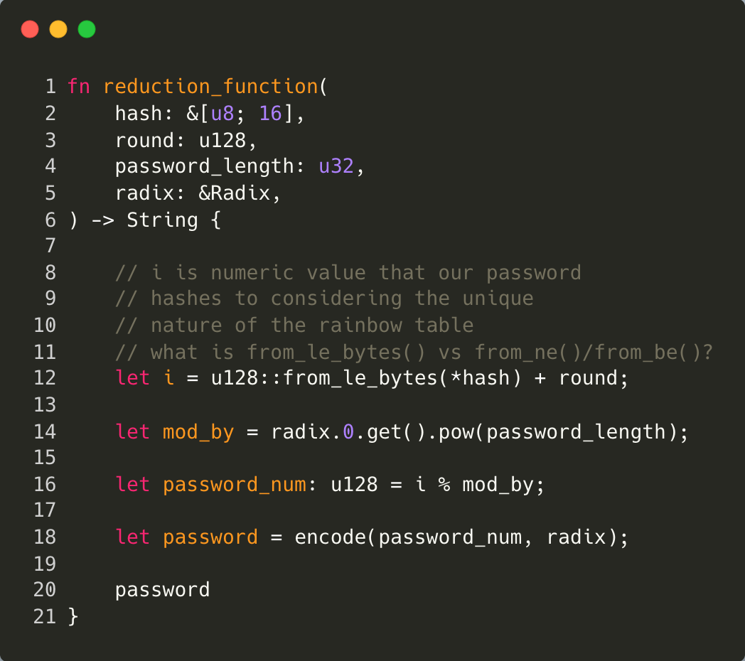

Slide 14
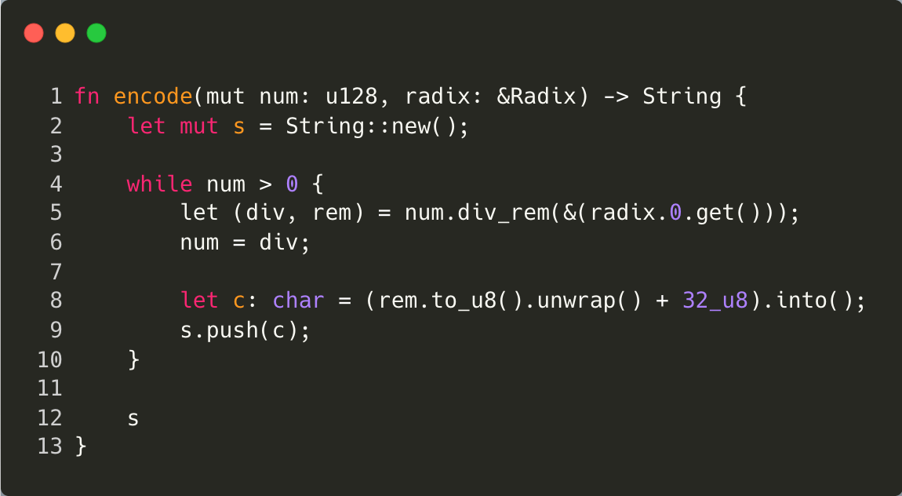

Slide 15
Is a hash in the chain?!
We know how to construct/encode a given chain
How do we crack a hash?
We look to see if the hash exists in our chain
We start by assuming the the hash was the last link in the chain
If we find a hit, then we know the password for that hash (it’s the tail of the chain)
If we don’t find a hit, then we assume the hash was the next to last link in the chain
If we end up at the tail, then we know our password is in our chain
Etc.
If we don’t find the hash after reaching the head of the link, then our chain didn’t contain the password for the hash

Slide 16
Recover password
We know our hash is at position i
Now we need to walk the chain up to position i
Our password is right before position i

