Slide 1
CS 551
Spring 2025

Slide 2
Networking
Networking is a big topic
There are classes here specifically on networking
We are going to do a real quick overview
TCP/IP
Protocols to move data cross a network
Pretty much all networking is built on TCP/IP
Reliable and unreliable protocols
TCP → a reliable, packet based, connection stream of data
UDP → a non-reliable, datagram based, connectionless “stream” of data

Slide 3
TCP vs UDP
TCP
Ordering guaranteed
Error correction (including retransmission of dropped packets) built in
Higher set up cost
Higher latency
UDP
No ordering guarantees
Dropped packets are dropped
Setup costs mostly deferred to the application
Low latency

Slide 4
Sockets
The general abstraction around networking is a socket
For the most part, a socket behaves like a file
You read and write to it
Instead of having file names, sockets have addresses
A socket address is a combination of
IP address
port number
Protocol type

Slide 5
Typical Program
Bind a listener to a given address
Wait for the listener to get a new connection
Receive messages on that connection

Slide 6
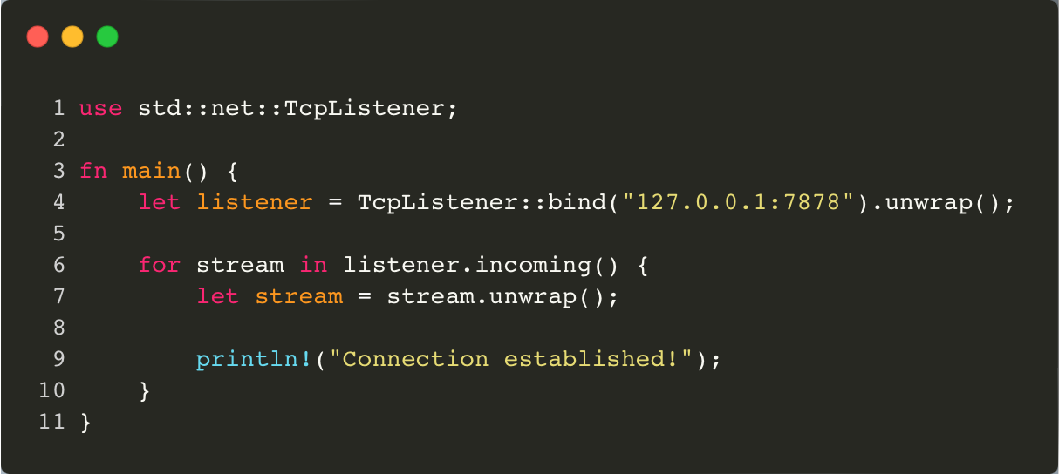
127.0.0.1 is “localhost” (only accessible from the machine you are running it on)
0.0.0.0 is “any available IP address this machine can listen on”

Slide 7
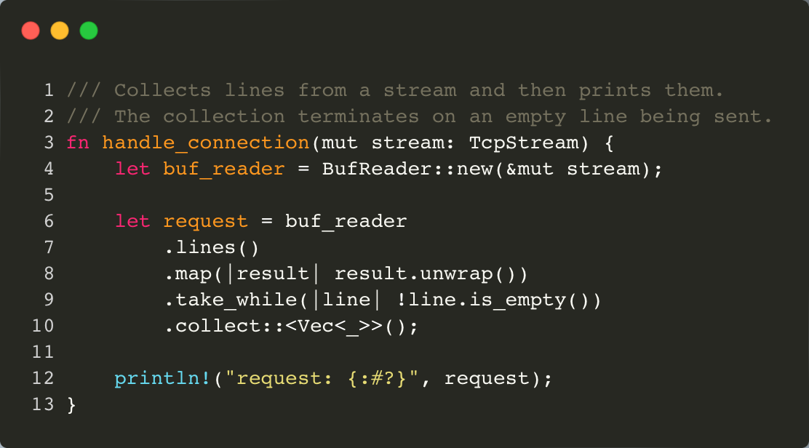
A TcpStream is a lot like an iterator, or a channel if you prefer.

Slide 8
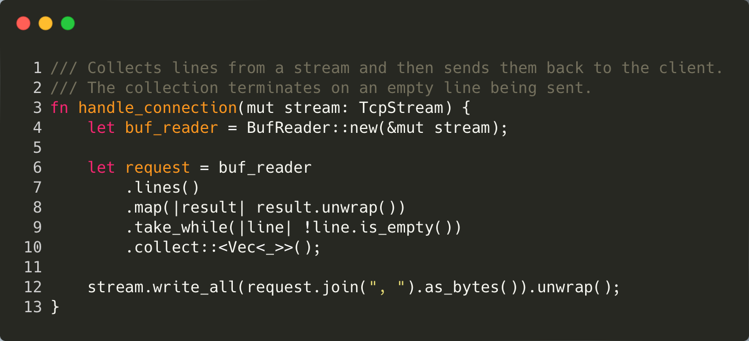
We can also write data back out to a TcpStream!

Slide 9
Multiple connections
What happens when we have multiple connections?
Let’s try!
We need to do multithreading!

Slide 10
