Slide 1
CS 551
Spring 2025

Slide 2
Concurrency and Parallelism
We’ve covered concurrency/parallelism primitives so far
Threads, channels, Arc, Mutex, etc.
Parallelism (kinda) means that you are doing many things at once
Concurrency means that many tasks can be running at the same time
Subtle difference!!!!

Slide 3
Tl;dr:
Concurrency is more about managing tasks to maximize resource usage
Parallelism is about splitting a problem into parts and finding the solution of each part at the same time
You can have concurrency on a single thread!

Slide 4
Asynchronous Programming
In a nutshell: you have a special construct that says:
When I execute this operation, it is ok to suspend the current task until it finishes and run another task
Note that there is nothing about threads here, just tasks!!!
How does this help with performance?!

Slide 5
Asynchronous Rust
Rust has a feature called async/await
At compile time, async functions are transformed into a task
A task is somewhat similar to a green thread
I.e., it’s sort of a “virtual” thread if you will
NB: Rust uses lazy evaluation for its async/await stuff
This means some different semantics
Also means performance ☺

Slide 6
Tokio
Async/await is a part of Rust the language
It was only recently stabilized, and it’s probably not finished evolving
The semantics of async/await are in the language
Managing how things are actually executed is not part of Rust
Instead, there are various runtimes, tokio is the most popular
Runtimes use the semantics of async/await to
Schedule tasks
Build a larger async API

Slide 7
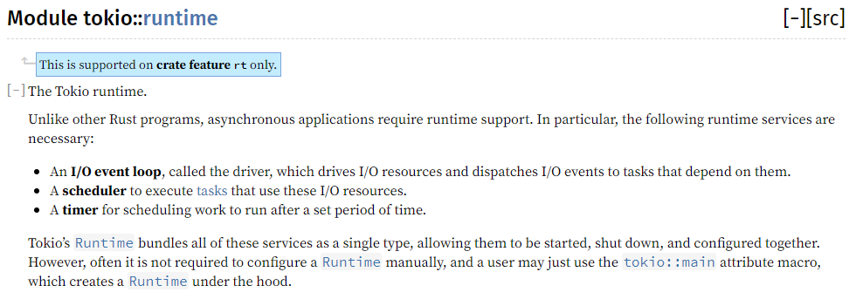

Slide 8
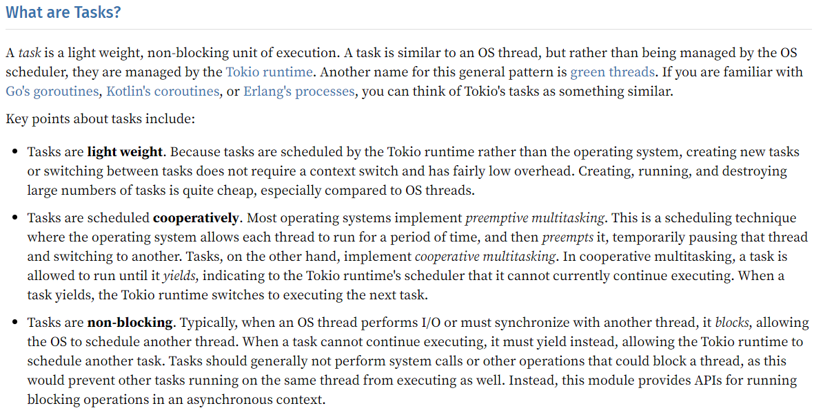

Slide 9
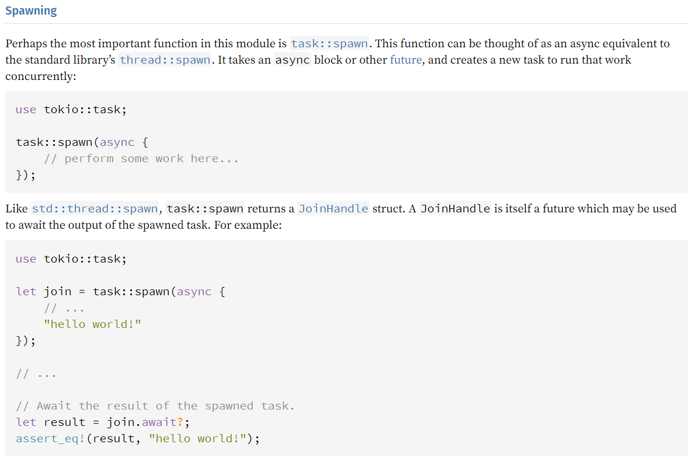

Slide 10
Major Points to Remember!
async fn function() { … } → function() is asynchronous
function().await → the current task will yield until function() finishes
Async gives you concurrency not parallelism
With Rust, you need to use an async run time to do anything serious
Yielding is not blocking
There are some subtleties here that we will run in to…
You should read the docs!
Or at least skim them
I know it’s a lot, but, it is incredibly rewarding

Slide 11
Major Points to Remember!
It is incredibly difficult (borderline impossible) to write straight up broken code
The compiler will not allow it!
Be fearless!!!
async fn function() { … } → function() is asynchronous
function().await → the current task will yield until function() finishes
Async gives you concurrency not parallelism
With Rust, you need to use an async run time to do anything serious
Yielding is not blocking
There are some subtleties here that we will run in to…
You should read the docs!
Or at least skim them
I know it’s a lot, but, it is incredibly rewarding

Slide 12
Super Quick Network Programming Refresh
A Socket is similar to a file in general (read/write)
Just like when you read a file, the socket has to exist when you try to connect to it
The way this is done is to create a new socket and listen on it
Just like with files, sockets have an approximate “name”
SockAddr
Ip address + port
To create a new socket, you bind it to a socket address

Slide 13
Accepting connections
Client connects to socket you are listening on
You accept that connection
You can get a SockAddr for the client connection
This will be the client’s IP address + port (note that their port is probably randomized)
Now we can read/write from/to the client socket!

